Slide 1
Chapter 2
Teacher Background and Beliefs
Computer Science

Slide 2
Teacher Characteristics

Slide 3
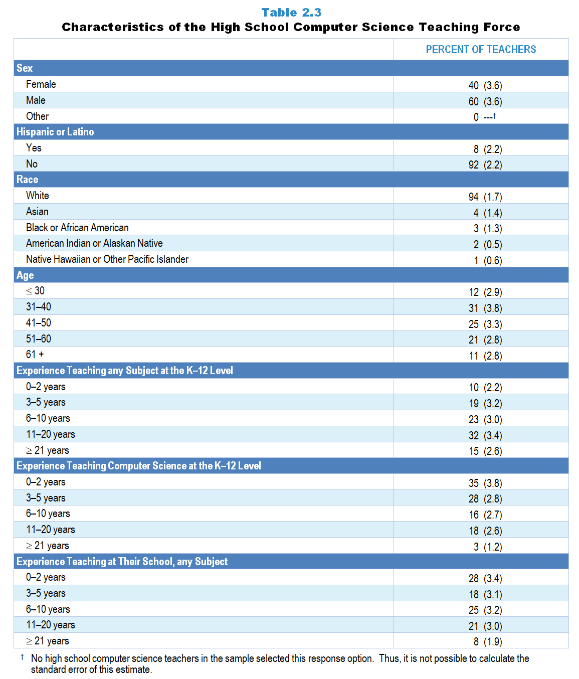
Original Data for Slides 4–7
(not for presentation)
Notes:
Table 2.3, p. 11 in Technical Report
This slide shows data from individual items.
Computer Science Teacher Questionnaire
Q1. How many years have you taught prior to this school year:
any subject at the K–12 level? _____
computer science at the K–12 level? _____
at this school, any subject? _____
Q53. Indicate your sex:
Female
Male
Other
Q54. Are you of Hispanic or Latino origin?
Yes
No
Q55. What is your race? (Select all that apply.)
American Indian or Alaskan Native
Asian
Black or African American
Native Hawaiian or Other Pacific Islander
White
Q56. In what year were you born? _____
The numbers in parentheses are standard errors.
Findings Highlighted in Technical Report
“The characteristics of high school computer science teachers, shown in Table 2.3, are similar to those of high school science and mathematics teachers in some areas and markedly different in others. Similar to science and mathematics teachers, nearly all high school computer science teachers characterize themselves as White, and most are older than 40. In contrast, the majority are male. In addition, although nearly half have more than 10 years of experience teaching at the K–12 level, many are novice teachers of computer science, with 35 percent having 0–2 years of experience teaching the subject.”

Slide 4
High School Computer Science Teacher Characteristics

Slide 5
High School Computer Science Teacher Race/Ethnicity
Percent of Teachers

Slide 6
High School Computer Science Teacher Age

Slide 7
Experience Teaching at K–12 Level
Percent of Teachers

Slide 8
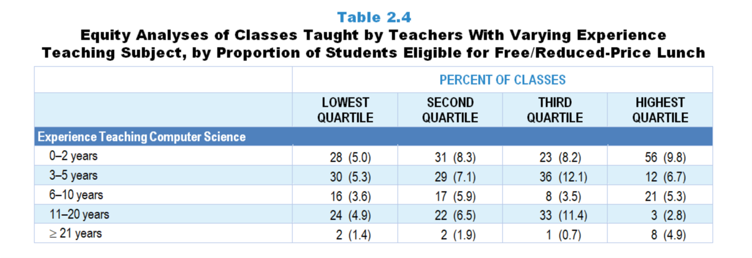
Original Data for Slide 9
(not for presentation)
Notes:
The computer science portion of Table 2.4, p. 12 in Technical Report
This slide shows data from an individual item.
Computer Science Teacher Questionnaire
Q1. How many years have you taught prior to this school year:
any subject at the K–12 level? _____
computer science at the K–12 level? _____
at this school, any subject? _____
The numbers in parentheses are standard errors.
Chapters 2–7 in the technical report provide data on several key indicators, disaggregated by one or more equity factors: the prior achievement level of students in the class, the percentage of students from race/ethnicity groups historically underrepresented in STEM in the class, the percentage of students in the school eligible for free/reduced-price lunch (FRL), school size, community type, and region. For FRL, each school was classified into one of four categories (defined as quartiles) based on the proportion of students eligible for FRL. Similarly, each randomly selected class was classified into one of the four categories based on the proportion of students from race/ethnicity groups historically underrepresented in STEM in the class.
Findings Highlighted in Technical Report
“Analyses were conducted to examine how teachers are distributed among schools—for example, whether teachers with the least experience are concentrated in high-poverty schools (i.e., schools with high proportions of students eligible for free/‌reduced-price lunch). As can be seen in Table 2.4, science classes in high-poverty schools are more likely than those in low-poverty schools to be taught by teachers with five or fewer years of experience. In addition, a majority of computer science classes in high-poverty schools are taught by those with only 0–2 years of experience teaching the subject.”

Slide 9
High School Computer Science Classes Taught by Teachers With 5 or Fewer Years Experience Teaching Computer Science

Slide 10
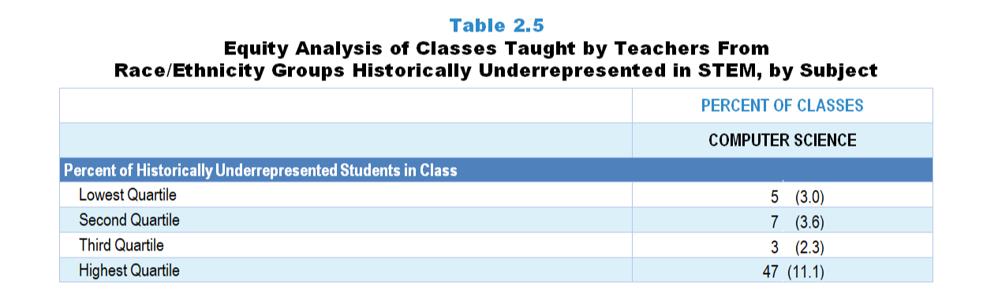
Original Data for Slide 11
(not for presentation)
Notes:
The computer science portion of Table 2.5, p. 12 in Technical Report
This slide shows data derived from:
Computer Science Teacher Questionnaire
Q26. For the students in this class, indicate the number of males and females in this class in each of the following categories of race/ethnicity.
American Indian or Alaskan Native _____ _____
Asian _____ _____
Black or African American _____ _____
Hispanic/Latino _____ _____
Native Hawaiian or Other Pacific Islander _____ _____
White _____ _____
Two or more races _____ _____
Q54. Are you of Hispanic or Latino origin?
Yes
No
Q55. What is your race? (Select all that apply.)
American Indian or Alaska Native
Asian
Black or African American
Native Hawaiian or Other Pacific Islander
White
The numbers in parentheses are standard errors.
Chapters 2–7 in the technical report provide data on several key indicators, disaggregated by one or more equity factors: the prior achievement level of students in the class, the percentage of students from race/ethnicity groups historically underrepresented in STEM in the class, the percentage of students in the school eligible for free/reduced-price lunch (FRL), school size, community type, and region. For FRL, each school was classified into one of four categories (defined as quartiles) based on the proportion of students eligible for FRL. Similarly, each randomly selected class was classified into one of the four categories based on the proportion of students from race/ethnicity groups historically underrepresented in STEM in the class.
Findings Highlighted in Technical Report
“Table 2.5 shows the percentage of classes taught by teachers from race/‌ethnicity groups historically underrepresented in STEM by the proportion of students from these groups in the class. Note that across all three subjects, classes in the highest quartile in terms of students from these groups are more likely than those in the lowest quartile to be taught by teachers from these groups.”

Slide 11
High School Computer Science Classes Taught by Teachers From Race/Ethnicity Groups Historically Underrepresented in Science
Notes:
Historically Underrepresented Students/Teachers includes American Indian or Alaskan Native, Black or African American, Hispanic or Latino, or Native Hawaiian or Other Pacific Islander teachers/students.
Slide shows the composite scores by quartile of percentage of historically underrepresented students in the randomly selected class.

Slide 12
Teacher Preparation

Slide 13
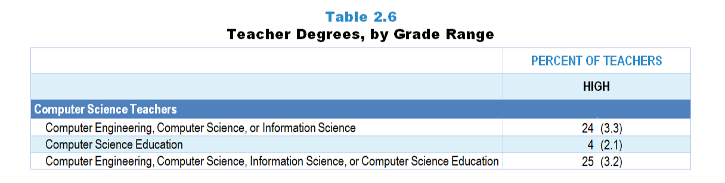
Original Data for Slide 14
(not for presentation)
Notes:
The computer science portion of Table 2.6, p. 13 in Technical Report
This slide shows data derived from:
Computer Science Teacher Questionnaire
Q7. Have you been awarded one or more bachelor’s and/or graduate degrees in the following fields? (With regard to bachelor’s degrees, count only areas in which you majored. Do not include endorsements or certificates.) [Select one on each row.] (Response Options: Yes, No)
Business
Computer science
Education (general or subject specific such as computer science education)
Information science
Mathematics
Natural sciences (for example: Biology, Chemistry, Physics, Earth Sciences)
Computer engineering
Electrical engineering
Other engineering
Other, please specify.____________
Q8. What type of education degree do you have? (With regard to bachelor’s degrees, count only areas in which you majored.) (Select all that apply.)
Computer Science Education
Elementary Education
Mathematics Education
Science Education
Other Education, please specify _____
The numbers in parentheses are standard errors.
Findings Highlighted in Technical Report
“As can be seen in Table 2.6, very few elementary teachers have college or graduate degrees in science or mathematics. The percentage of teachers with one or more degrees in science or mathematics increases with increasing grade range, with 79 percent of high school science teachers and 55 percent of high school mathematics teachers having a major in their discipline. If the definition of degree in discipline is expanded to include degrees in science/‌mathematics education, these figures increase to 91 percent of high school science teachers and 79 percent of high school mathematics teachers. Only about 1 in 4 computer science teachers have a degree in computer engineering, computer science, or information science, and very few have a degree in computer science education.”

Slide 14
High School Computer Science Teacher Degrees

Slide 15
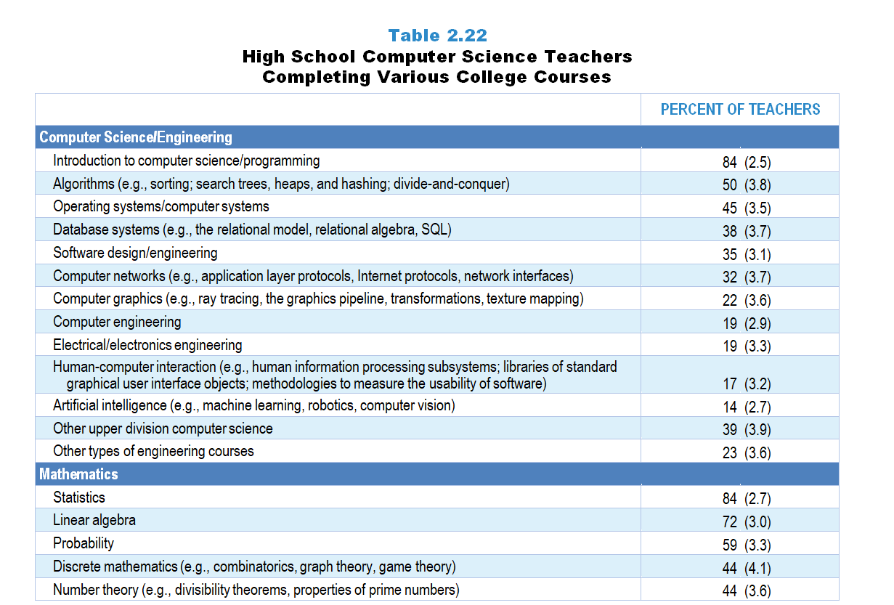
Original Data for Slides 16–17
(not for presentation)
Notes:
Table 2.22, p. 23 in Technical Report
This slide shows from individual items.
Computer Science Teacher Questionnaire
Q9. Did you complete one or more computer science courses in each of the following areas at the undergraduate or graduate level? [Select one on each row.] (Response options: Yes, No)
Introduction to computer science
Introduction to programming
Algorithms (for example: sorting; search trees, heaps, and hashing; divide-and-conquer)
Artificial intelligence (for example: machine learning, robotics, computer vision)
Computer graphics (for example: ray tracing, the graphics pipeline, transformations, texture mapping)
Computer networks (for example: application layer protocols, Internet protocols, network interfaces)
Database systems (for example: the relational model, relational algebra, SQL)
Human-computer interaction (for example: human information processing subsystems; libraries of standard graphical user interface objects; methodologies to measure the usability of software)
Operating systems/computer systems
Software design/engineering
Other upper division computer science
Q10. Did you complete the following mathematics courses at the undergraduate or graduate level? [Select one on each row.] (Response options: Yes, No)
Linear algebra
Probability
Statistics
Number theory (for example: divisibility theorems, properties of prime numbers)
Discrete mathematics (for example: combinatorics, graph theory, game theory)
Q11. Did you complete courses in each of the following areas at the undergraduate or graduate level? [Select one on each row.] (Response options: Yes, No)
Computer engineering
Electrical/Electronics engineering
Other types of engineering courses
The numbers in parentheses are standard errors.
Findings Highlighted in Technical Report
“Table 2.22 shows the percentage of high school computer science teachers with coursework in each of a number of areas. A large majority of computer science teachers have taken an introduction to programming or an introduction to computer science course. Substantially fewer have taken other, more specific, courses related to computer science such as algorithms, computer networks, or artificial intelligence. However, a large majority of computer science teachers also have taken mathematics coursework often used in computer science, either in statistics or linear algebra.”

Slide 16
High School Computer Science Teachers Completing Various Computer Science/
Engineering College Courses
Notes:
CS is short for computer science.

Slide 17
High School Computer Science Teachers Completing Various Mathematics College Courses

Slide 18
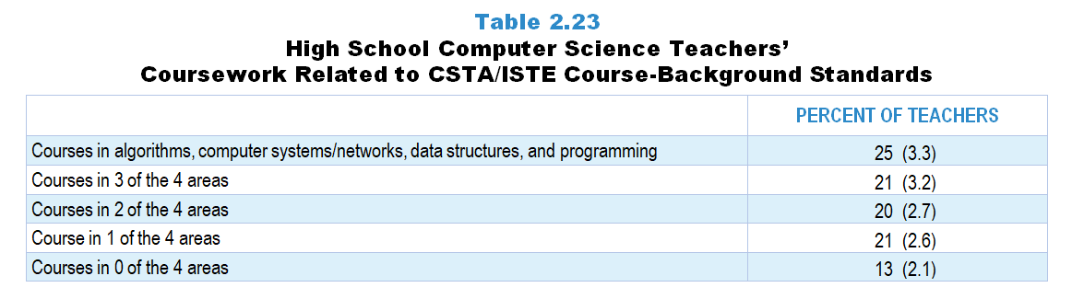
Original Data for Slide 19
(not for presentation)
Notes:
Table 2.23, p. 24 in Technical Report
This slide shows data derived from:
Computer Science Teacher Questionnaire
Q9. Did you complete one or more computer science courses in each of the following areas at the undergraduate or graduate level? [Select one on each row.] (Response options: Yes, No)
Introduction to computer science
Introduction to programming
Algorithms (for example: sorting; search trees, heaps, and hashing; divide-and-conquer)
Artificial intelligence (for example: machine learning, robotics, computer vision)
Computer graphics (for example: ray tracing, the graphics pipeline, transformations, texture mapping)
Computer networks (for example: application layer protocols, Internet protocols, network interfaces)
Database systems (for example: the relational model, relational algebra, SQL)
Human-computer interaction (for example: human information processing subsystems; libraries of standard graphical user interface objects; methodologies to measure the usability of software)
Operating systems/computer systems
Software design/engineering
Other upper division computer science
The numbers in parentheses are standard errors.
Findings Highlighted in Technical Report
“The Computer Science Teachers Association (CSTA) has published recommendations for computer science teacher certification, and the International Society for Technology in Education (ISTE) has published standards for computer science educators. Although there is not perfect agreement between these lists from CSTA and ISTE, they are reasonably consistent. Taken together, they suggest computer science teachers have coursework in the following four areas: programming, algorithms, data structures, and some element of computer systems or networks. As can be seen in Table 2.23, 1 in 4 computer science teachers have taken courses in all four recommended areas. Including those with coursework in at least 3 of the 4 recommended areas increases the percentage of teachers to nearly half.”

Slide 19
High School CS Teacher Coursework Related to CSTA/ISTE Course-Background Standards

Slide 20
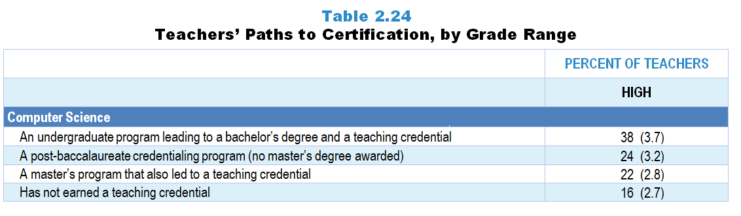
Original Data for Slide 21
(not for presentation)
Notes:
The computer science portion of Table 2.24, p. 24 of Technical Report
This slide shows data from an individual item.
Computer Science Teacher Questionnaire
Q12. Which of the following best describes the program you completed to earn your teaching credential (sometimes called certification or license)?
An undergraduate program leading to a bachelor’s degree and a teaching credential
A post-baccalaureate credentialing program (no master’s degree awarded)
A master’s program that also awarded a teaching credential
I have not completed a program to earn a teaching credential.
The numbers in parentheses are standard errors.
Findings Highlighted in Technical Report
“Teachers were also asked about their path to certification. As can be seen in Table 2.24, elementary science teachers are more likely than those at the high school level to have had an undergraduate program leading to a bachelor’s degree and a teaching credential, and high school science teachers are more likely than their elementary school counterparts to have completed a post-baccalaureate credentialing program that did not include a master’s degree. Similar patterns are seen among mathematics teachers’ paths to certification across grade ranges, though the differences are not as striking. Seven percent of high school mathematics teachers and the same proportion of high school science teachers have not earned a teaching credential. Thirty-eight percent of high school computer science teachers have earned a teaching credential through an undergraduate program leading to a bachelor’s degree, and 24 percent through a post-baccalaureate credentialing program that did not include a master’s degree. Sixteen percent of computer science teachers have not earned a teaching credential.”

Slide 21
High School Computer Science Teachers’ Path to Certification

Slide 22
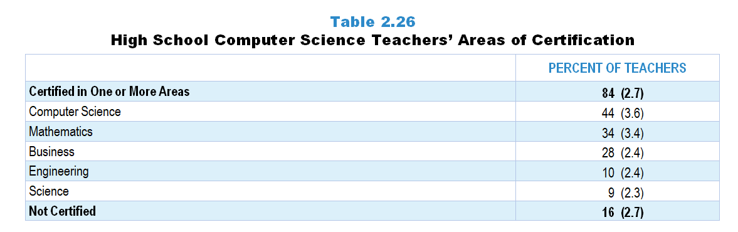
Original Data for Slide 23
(not for presentation)
Notes:
Table 2.26, p. 25 of Technical Report
This slide shows data derived from:
Computer Science Teacher Questionnaire
Q13. In which of the following areas are you certified (have a credential or endorsement) to teach at the high school level? [Select all that apply.]
Business
Computer science
Engineering
Mathematics
Science (any area)
Other
The numbers in parentheses are standard errors.
Findings Highlighted in Technical Report
“High school computer science teachers were asked a similar item about their areas of certification (see Table 2.26). Forty-four percent have a certification in computer science, and 34 percent are certified to teach mathematics. About one-quarter are certified to teach business. “

Slide 23
High School Computer Science Teachers’ Areas of Certification
Certified in One or More Areas

Slide 24
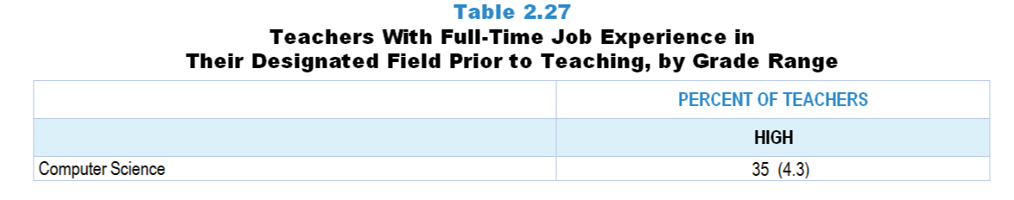
Original Data for Slide 25
(not for presentation)
Notes:
The computer science portion of Table 2.27, p. 26 in Technical Report
This slide shows data from an individual item.
Computer Science Teacher Questionnaire
Q14. After completing your undergraduate degree and prior to becoming a teacher, did you have a full-time job that included computer programming or computer/software engineering?
Yes
No
The numbers in parentheses are standard errors.
Findings Highlighted in Technical Report
“Recognizing that teaching is not always an individual’s first career, the survey also included an item asking whether teachers had a full-time job in their designated field after completing their undergraduate degree and prior to teaching. Science teachers were asked whether they had full-time job experience in a science- or engineering-related field. Mathematics and computer science teachers were asked about experience in a mathematics-related field (e.g., accounting, engineering, computer programming) and computer programming or computer/‌software engineering, respectively. As can be seen in Table 2.27, the likelihood of science and mathematics teachers having prior career experience in their field substantially increases with increasing grade range. In addition, high school science and computer science teachers are more likely than their mathematics colleagues to have prior job experience in their respective fields (about one-third vs. one-fifth).”

Slide 25
High School Computer Science Teachers With Full-Time Job Experience in a Computer Science-Related Field Prior to Teaching

Slide 26
Teacher Pedagogical Beliefs

Slide 27
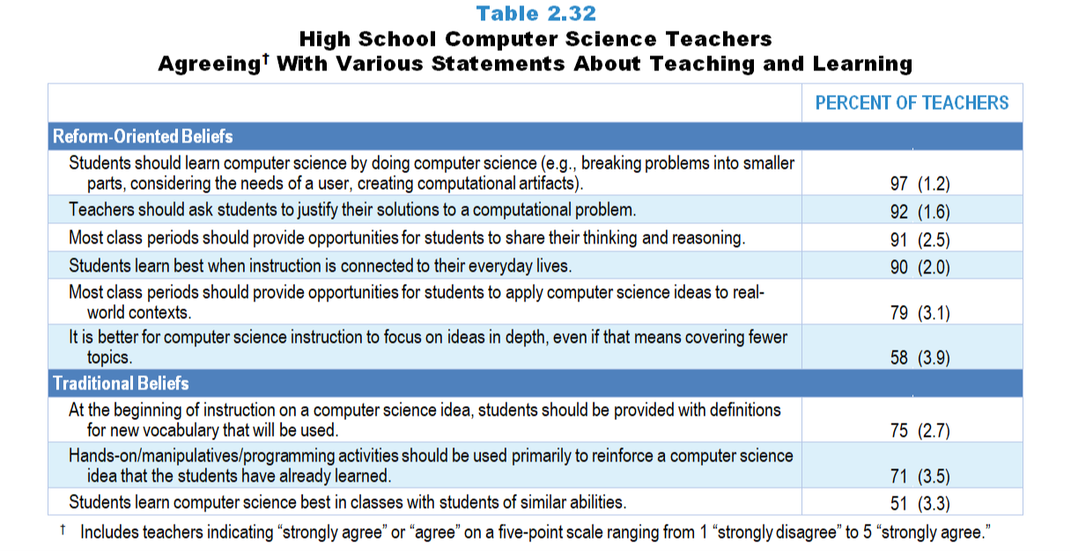
Original Data for Slides 28–29
(not for presentation)
Notes:
Table 2.32, p. 29 in Technical Report
This slide shows data from an individual item.
Computer Science Teacher Questionnaire
Q22. Please provide your opinion about each of the following statements. [Select one on each row.] (Response Options: [1] Strongly Disagree, [2] Disagree, [3] No Opinion, [4] Agree, [5] Strongly Agree)
Students learn computer science best in classes with students of similar abilities.
It is better for computer science instruction to focus on ideas in depth, even if that means covering fewer topics.
At the beginning of instruction on a computer science idea, students should be provided with definitions for new vocabulary that will be used.
Most class periods should provide opportunities for students to share their thinking and reasoning.
Hands-on/manipulatives/programming activities should be used primarily to reinforce a computer science idea that the students have already learned.
Teachers should ask students to justify their solutions to a computational problem.
Students learn best when instruction is connected to their everyday lives.
Most class periods should provide opportunities for students to apply computer science ideas to real-world contexts.
Students should learn computer science by doing computer science (for example: breaking problems into smaller parts, considering the needs of a user, creating computational artifacts).
The numbers in parentheses are standard errors.
Findings Highlighted in Technical Report
“Computer science teachers’ views also echo those of science and mathematics teachers, as at least 90 percent agree that students should learn computer science by doing computer science and learn best when instruction is connected to their everyday lives, that teachers should ask students to justify their solutions, and that most class periods should provide opportunities for students to share their thinking and reasoning (see Table 2.32).
Although most computer science teachers agree with statements characteristic of reform-oriented instruction, a majority still hold beliefs aligned with more traditional instruction. For example, 71 percent agree that hands-on/‌manipulatives/‌programming activities should be used primarily to reinforce a computer science idea that the students have already learned. Similar to their mathematics counterparts, 3 out of 4 high school computer science teachers agree that at the beginning of instruction on a computer science idea, students should be provided with definitions for new vocabulary that will be used.”

Slide 28
High School Computer Science Teachers Agreeing With Various Statements About Teaching and Learning
Notes:
Includes high school computer science teachers indicating “strongly agree” or “agree” on a five-point scale ranging from 1 “strongly disagree” to 5 “strongly agree.”
CS is short for computer science.

Slide 29
High School Computer Science Teachers Agreeing With Various Statements About Teaching and Learning
Notes:
Includes high school computer science teachers indicating “strongly agree” or “agree” on a five-point scale ranging from 1 “strongly disagree” to 5 “strongly agree.”
CS is short for computer science.

Slide 30
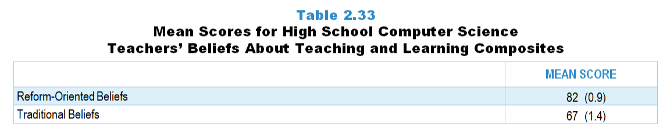
Original Data for Slide 31
(not for presentation)
Notes:
Table 2.33, p. 30 in Technical Report
This slide shows data from composites.
Sets of related questionnaire items were combined to create several composite variables related to key constructs. Composite variables, which are more reliable than individual survey items, were computed to have a minimum possible value of 0 and a maximum possible value of 100. Higher composite scores indicate more of the construct being measure by the composite. Each composite is calculated by summing the responses to the items associated with that composite and then dividing by the total points possible. In order for the composites to be on a 100-point scale, the lowest response option on each scale was set to 0 and the others were adjusted accordingly; so for example, an item with a scale ranging from 1 to 4 was re-coded to have a scale of 0 to 3. By doing this, someone who marks the lowest point on every item in a composite receives a composite score of 0 rather than some positive number. It also assures that 50 is the true mid-point. The denominator for each composite is determined by computing the maximum possible sum of responses for a series of items and dividing by 100; e.g., a 9-item composite where each item is on a scale of 0–3 would have a denominator of 0.27. Composites values were not computed for participants who respond to fewer than two-thirds of the items that form the composite.
Traditional Teaching Beliefs Composite Items
Q22a. Students learn computer science best in classes with students of similar abilities.
Q22c. At the beginning of instruction on a computer science idea, students should be provided with definitions for new vocabulary that will be used.
Q22e. Hands-on/manipulatives/programming activities should be used primarily to reinforce a computer science idea that the students have already learned.
Reform-Oriented Teaching Beliefs Composite Items
Q22d. Most class periods should provide opportunities for students to share their thinking and reasoning.
Q22f.Teachers should ask students to justify their solutions to a computational problem.
Q22g. Students learn best when instruction is connected to their everyday lives.
Q22h. Most class periods should provide opportunities for students to apply computer science ideas to real-world contexts.
Q22i. Students should learn computer science by doing computer science (for example: breaking problems into smaller parts, considering the needs of a user, creating computational artifacts).
Computer Science Teacher Questionnaire
Q22. Please provide your opinion about each of the following statements. [Select one on each row.] (Response Options: [1] Strongly Disagree, [2] Disagree, [3] No Opinion, [4] Agree, [5] Strongly Agree)
Students learn computer science best in classes with students of similar abilities.
It is better for computer science instruction to focus on ideas in depth, even if that means covering fewer topics.
At the beginning of instruction on a computer science idea, students should be provided with definitions for new vocabulary that will be used.
Most class periods should provide opportunities for students to share their thinking and reasoning.
Hands-on/manipulatives/programming activities should be used primarily to reinforce a computer science idea that the students have already learned.
Teachers should ask students to justify their solutions to a computational problem.
Students learn best when instruction is connected to their everyday lives.
Most class periods should provide opportunities for students to apply computer science ideas to real-world contexts.
Students should learn computer science by doing computer science (for example: breaking problems into smaller parts, considering the needs of a user, creating computational artifacts).
The numbers in parentheses are standard errors.
Findings Highlighted in Technical Report
“As can be seen in Table 2.33, high school computer science teachers have relatively strong reform-oriented beliefs. In addition, computer science teachers hold relatively strong traditional beliefs about instruction, even more so than their science and mathematics counterparts.”

Slide 31
High School Computer Science Teachers’ Beliefs About Teaching and Learning Composites
Teacher Mean Score

Slide 32
High School Computer Science Teachers’ Beliefs About Teaching and Learning Composites
(not for presentation)
There are no significant differences in high school computer science teachers’ beliefs about teaching and learning composites by equity factors. Thus, no tables or charts are shown.

Slide 33
Teachers' Perceptions of Preparedness

Slide 34
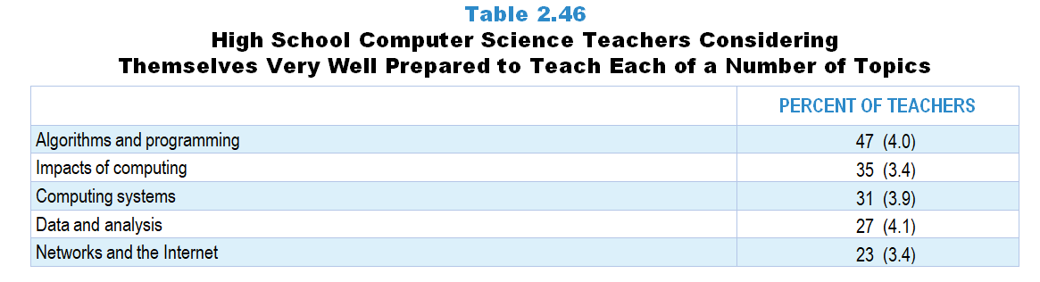
Original Data for Slide 35
(not for presentation)
Notes:
Table 2.46, p. 36 in Technical Report
This slide shows data from an individual item.
Computer Science Teacher Questionnaire
Q20. Within computer science, many teachers feel better prepared to teach some topics than others. How prepared do you feel to teach each of the following topics at the grade level(s) you teach, whether or not they are currently included in your teaching responsibilities? [Select one on each row.] (Response Options: [1] Not adequately prepared, [2] Somewhat prepared, [3] Fairly well prepared, [4] Very well prepared)
Computing systems
Networks and the Internet
Data and analysis
Algorithms and programming
Impacts of computing
The numbers in parentheses are standard errors.
Findings Highlighted in Technical Report
“High school computer science teachers were also asked about their preparedness to teach each of a number of topics related to computing and programming. As can be seen in Table 2.46, fewer than half consider themselves very well prepared in any of the topics, though they are more likely to feel well prepared to teach about algorithms and programming than about networks and the Internet (47 vs. 23 percent, respectively).”

Slide 35
High School Computer Science Teachers Considering Themselves Very Well Prepared to Teach Various Topics

Slide 36
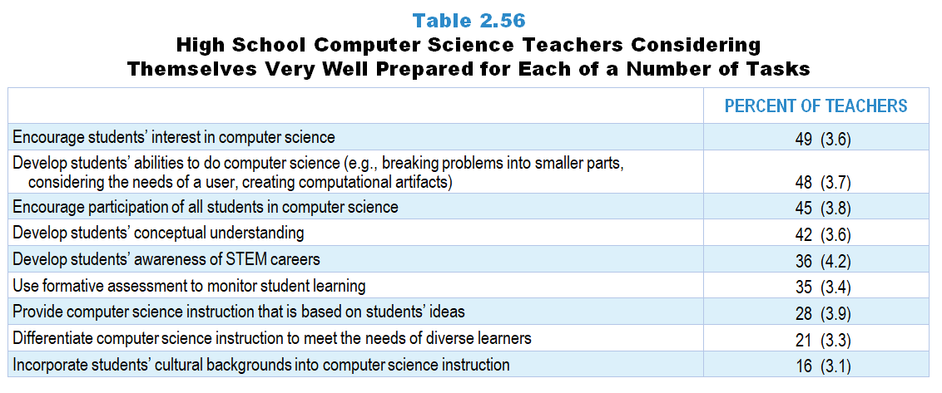
Original Data for Slides 37–38
(not for presentation)
Notes:
Table 2.56, p. 40 in Technical Report
This slide shows data from an individual item.
Computer Science Teacher Questionnaire
Q21. How well prepared do you feel to do each of the following in your computer science instruction? [Select one on each row.] (Response Options: [1] Not adequately prepared, [2] Somewhat prepared, [3] Fairly well prepared, [4] Very well prepared)
Develop students’ conceptual understanding of the computer science ideas you teach
Develop students’ abilities to do computer science (for example: breaking problems into smaller parts, considering the needs of a user, creating computational artifacts)
Develop students’ awareness of STEM careers
Provide computer science instruction that is based on students’ ideas (whether completely correct or not) about the topics you teach
Use formative assessment to monitor student learning
Differentiate computer science instruction to meet the needs of diverse learners
Incorporate students’ cultural backgrounds into computer science instruction
Encourage students’ interest in computer science
Encourage participation of all students in computer science
The numbers in parentheses are standard errors.
Findings Highlighted in Technical Report
“In high school computer science, roughly half of teachers feel very well prepared to encourage students’ interest in computer science, develop students’ ability to do computer science, and encourage participation of all students in computer science (see Table 2.56). Fewer than one-quarter feel very well prepared to differentiate computer science instruction to meet the needs of diverse learners or to incorporate students’ cultural backgrounds into computer science instruction.”

Slide 37
High School Computer Science Teachers Considering Themselves Very Well Prepared for Various Tasks

Slide 38
High School Computer Science Teachers Considering Themselves Very Well Prepared for Various Tasks

Slide 39
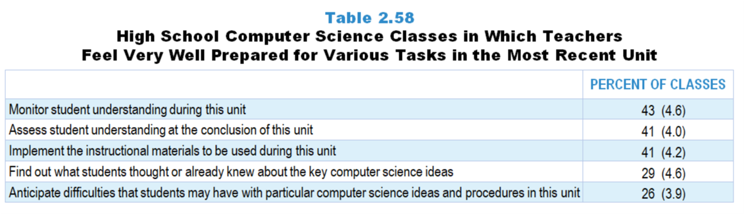
Original Data for Slide 40
(not for presentation)
Notes:
Table 2.58, p. 41 in Technical Report
This slide shows data from an individual item.
Computer Science Teacher Questionnaire
Q49. How well prepared did you feel to do each of the following as part of your instruction on this particular unit? [Select one on each row.] (Response Options: [1] Not adequately prepared, [2] Somewhat prepared, [3] Fairly well prepared, [4] Very well prepared)
Anticipate difficulties that students may have with particular computer science ideas and procedures in this unit
Find out what students thought or already knew about the key computer science ideas
Implement the instructional materials (for example: textbook, online course) to be used during this unit
Monitor student understanding during this unit
Assess student understanding at the conclusion of this unit
The numbers in parentheses are standard errors.
Findings Highlighted in Technical Report
“High school computer science teachers were also asked about their preparedness for unit-related tasks. As can be seen in Table 2.58, computer science teachers tend to feel less well prepared for (1) finding out what students thought or already knew about the key ideas to be addressed in the unit and (2) anticipating what difficulties students may have in the unit than they do for monitoring understanding during or assessing understanding at the end of the unit.”

Slide 40
High School Computer Science Classes in Which Teachers Feel Very Well Prepared for Various Tasks in the Most Recent Unit

Slide 41
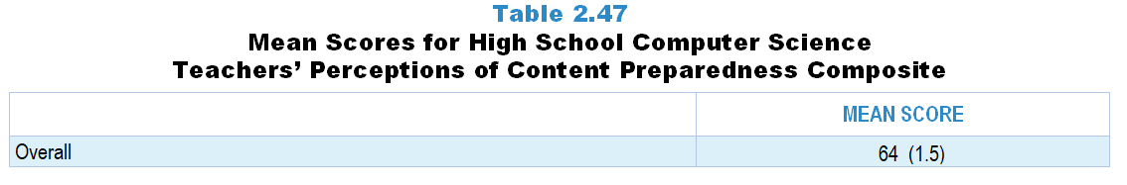
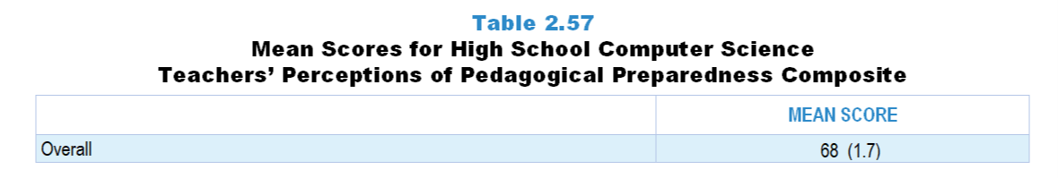
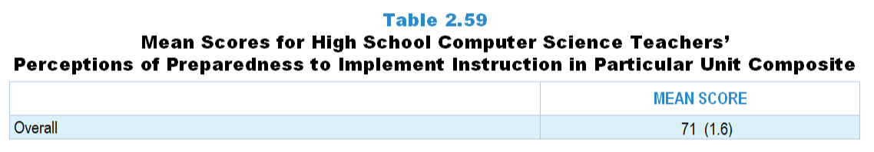
Original Data for Slide 42
(not for presentation)
Notes:
Table 2.47, p. 37 in Technical Report
This slide shows data from composites.
Sets of related questionnaire items were combined to create several composite variables related to key constructs. Composite variables, which are more reliable than individual survey items, were computed to have a minimum possible value of 0 and a maximum possible value of 100. Higher composite scores indicate more of the construct being measure by the composite. Each composite is calculated by summing the responses to the items associated with that composite and then dividing by the total points possible. In order for the composites to be on a 100-point scale, the lowest response option on each scale was set to 0 and the others were adjusted accordingly; so for example, an item with a scale ranging from 1 to 4 was re-coded to have a scale of 0 to 3. By doing this, someone who marks the lowest point on every item in a composite receives a composite score of 0 rather than some positive number. It also assures that 50 is the true mid-point. The denominator for each composite is determined by computing the maximum possible sum of responses for a series of items and dividing by 100; e.g., a 9-item composite where each item is on a scale of 0–3 would have a denominator of 0.27. Composites values were not computed for participants who respond to fewer than two-thirds of the items that form the composite.
Perceptions of Content Preparedness: Computer Science
Q20a. Computing systems
Q20b. Networks and the Internet
Q20c. Data and analysis
Q20d. Algorithms and programming
Q20e. Impacts of computing
Computer Science Teacher Questionnaire
Q20. Within computer science, many teachers feel better prepared to teach some topics than others. How prepared do you feel to teach each of the following topics at the grade level(s) you teach, whether or not they are currently included in your teaching responsibilities? [Select one on each row.] (Response Options: [1] Not adequately prepared, [2] Somewhat prepared, [3] Fairly well prepared, [4] Very well prepared)
Computing systems
Networks and the Internet
Data and analysis
Algorithms and programming
Impacts of computing
The numbers in parentheses are standard errors.
Findings Highlighted in Technical Report
“These items were combined into a composite variable measuring high school computer science teachers’ perceptions of content preparedness (see Table 2.47). Compared to high school science and mathematics teachers, high school computer science teachers perceive themselves to be far less prepared to teach their respective content. “
Table 2.57, p. 41 in Technical Report
Perceptions of Pedagogical Preparedness Composite Items
Q21a. Develop students’ conceptual understanding of the computer science ideas you teach
Q21b. Develop students’ abilities to do computer science (for example: breaking problems into smaller parts, considering the needs of a user, creating computational artifacts)
Q21c. Develop students’ awareness of STEM careers
Q21d. Provide computer science instruction that is based on students’ ideas (whether completely correct or not) about the topics you teach
Q21e. Use formative assessment to monitor student learning
Q21f. Differentiate computer science instruction to meet the needs of diverse learners
Q21g. Incorporate students’ cultural backgrounds into computer science instruction
Q21h. Encourage students’ interest in computer science
Q21i. Encourage participation of all students in computer science
Computer Science Teacher Questionnaire
Q21. How well prepared do you feel to do each of the following in your computer science instruction? [Select one on each row.] (Response Options: [1] Not adequately prepared, [2] Somewhat prepared, [3] Fairly well prepared, [4] Very well prepared)
Develop students’ conceptual understanding of the computer science ideas you teach
Develop students’ abilities to do computer science (for example: breaking problems into smaller parts, considering the needs of a user, creating computational artifacts)
Develop students’ awareness of STEM careers
Provide computer science instruction that is based on students’ ideas (whether completely correct or not) about the topics you teach
Use formative assessment to monitor student learning
Differentiate computer science instruction to meet the needs of diverse learners
Incorporate students’ cultural backgrounds into computer science instruction
Encourage students’ interest in computer science
Encourage participation of all students in computer science
The numbers in parentheses are standard errors.
Findings Highlighted in Technical Report
“Table 2.57 shows the mean composite score for high school computer science teachers’ perceptions of pedagogical preparedness. The mean score of 68 is quite similar to the mean score for high school science and mathematics teachers.”
Table 2.59, p. 41 in Technical Report
This slide shows data from composites.
Perceptions of Preparedness to Implement Instruction in Particular Unit Composite Items
Q49a. Anticipate difficulties that students may have with particular computer science ideas and procedures in this unit
Q49b. Find out what students thought or already knew about the key computer science ideas
Q49c. Implement the instructional materials (for example: textbook, online course) to be used during this unit
Q49d. Monitor student understanding during this unit
Q49e. Assess student understanding at the conclusion of this unit
Computer Science Teacher Questionnaire
Q49. How well prepared did you feel to do each of the following as part of your instruction on this particular unit? [Select one on each row.] (Response Options: [1] Not adequately prepared, [2] Somewhat prepared, [3] Fairly well prepared, [4] Very well prepared)
Anticipate difficulties that students may have with particular computer science ideas and procedures in this unit
Find out what students thought or already knew about the key computer science ideas
Implement the instructional materials (for example: textbook, online course) to be used during this unit
Monitor student understanding during this unit
Assess student understanding at the conclusion of this unit
The numbers in parentheses are standard errors.
Findings Highlighted in Technical Report
“High school computer science teachers’ perceptions of preparedness to implement instruction in a particular unit are shown in Table 2.59. Their feelings of preparedness in this area are consistent with their perceptions of pedagogical preparedness more broadly (see Table 2.57).”

Slide 42
High School Computer Science Teachers’ Perceptions of Preparedness Composites

Slide 43
High School Computer Science Teachers’ Perceptions of Preparedness Composites
(not for presentation)
There are no significant differences in high school computer science teachers’ perceptions of preparedness composites by equity factors. Thus, no tables or charts are shown.

Slide 44
Teacher Leadership Roles and Responsibilities

Slide 45
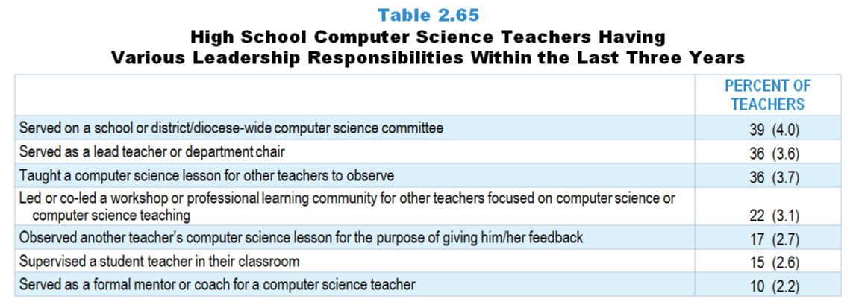
Original Data for Slide 46
(not for presentation)
Notes:
Table 2.65, p. 45 in Technical Report
This slide shows data from an individual item.
Computer Science Teacher Questionnaire
23. In the last 3 years have you… [Select one on each row.] (Response Options: Yes, No)
Served as a lead teacher or department chair?
Served as a formal mentor or coach for a computer science teacher? (Do not include supervision of student teachers.)
Supervised a student teacher in your classroom?
Served on a school or district/diocese-wide computer science committee (for example: developing curriculum, developing pacing guides, selecting instructional materials)?
Led or co-led a workshop or professional learning community (for example: teacher study group, lesson study) for other teachers focused on computer science or computer science teaching?
Taught a computer science lesson for other teachers to observe?
Observed another teacher’s computer science lesson for the purpose of giving him/her feedback?
The numbers in parentheses are standard errors.
Findings Highlighted in Technical Report
“Table 2.65 shows results in this area for high school computer science teachers. Over a third have (1) served on a school computer science committee, (2) been a lead teacher or department chair, and (3) taught a computer science lesson for other teachers to observe. Results in this area may be lower for computer science than the other subjects because, in high schools that offer computer science, many have only one computer science teacher. “

Slide 46
High School Computer Science Teachers Having Various Leadership Responsibilities Within the Last Three Years

