Slide 1
Chapter 2 Teacher Background and Beliefs
Mathematics

Slide 2
Teacher Characteristics

Slide 3
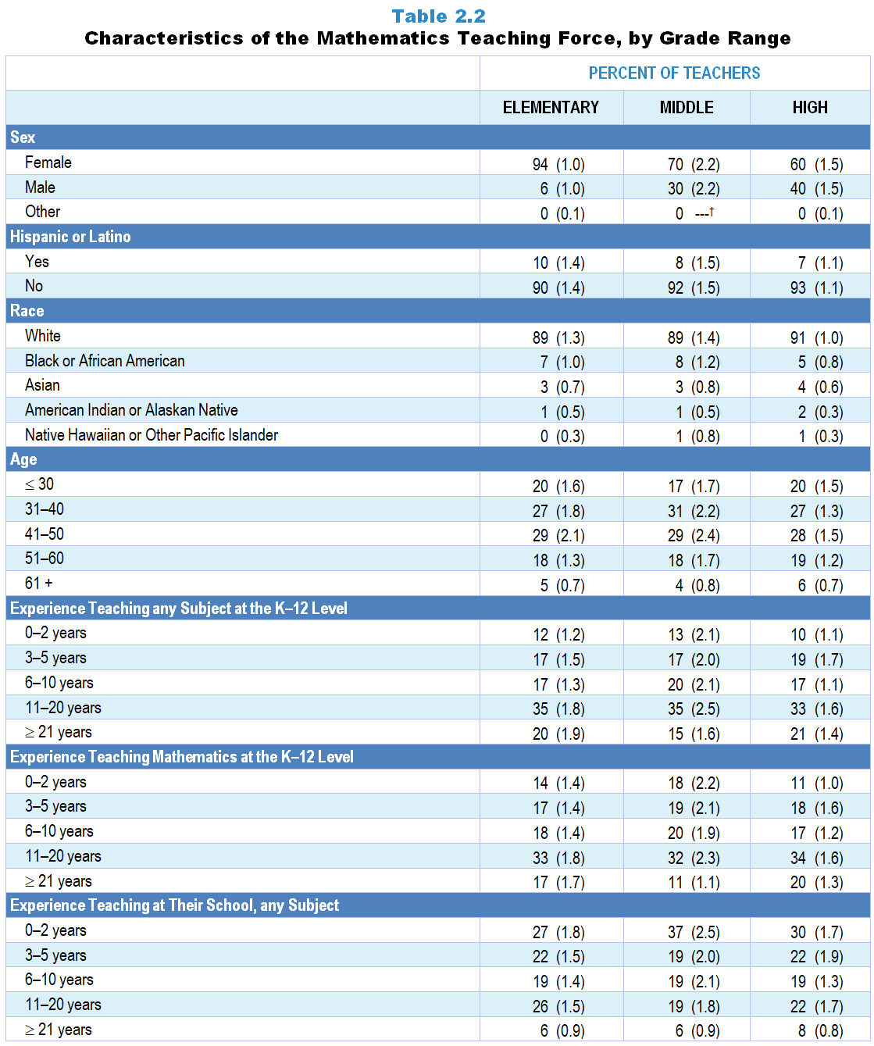
Original Data for Slides 4–7
(not for presentation)
Notes:
Table 2.2, p. 9 in Technical Report
This slide shows data from individual items.
Mathematics Teacher Questionnaire
Q1. How many years have you taught prior to this school year:
any subject at the K–12 level? _____
science at the K–12 level? _____
at this school, any subject? _____
Q57. Indicate your sex:
Female
Male
Other
Q58. Are you of Hispanic or Latino origin?
Yes
No
Q59. What is your race? (Select all that apply.)
American Indian or Alaskan Native
Asian
Black or African American
Native Hawaiian or Other Pacific Islander
White
Q60. In what year were you born? _____
The numbers in parentheses are standard errors.
Findings Highlighted in Technical Report
“Table 2.2 shows characteristics of the mathematics teaching force, which overall, are quite similar to those of the science teaching force. For example, elementary mathematics teachers are also predominantly female, and the proportion who are female decreases as grade level increases. Mathematics teacher experience data are also strikingly similar to those of science teachers. As is the case in science, the typical mathematics teacher in each grade range is White, non-Hispanic, and older than 40.”

Slide 4
Mathematics Teacher Characteristics

Slide 5
Mathematics Teacher Race/Ethnicity

Slide 6
Mathematics Teacher Age

Slide 7
Experience Teaching Mathematics at K–12 Level

Slide 8
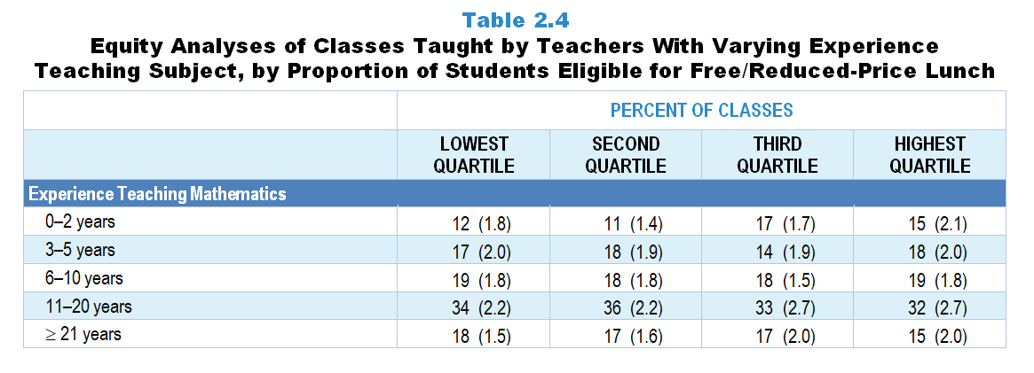
Original Data for Slide 9
(not for presentation)
Notes:
The mathematics portion of Table 2.4, p. 12 in Technical Report
This slide shows data from an individual item.
Mathematics Teacher Questionnaire
Q1. How many years have you taught prior to this school year:
any subject at the K–12 level? _____
mathematics at the K–12 level? _____
at this school, any subject? _____
The numbers in parentheses are standard errors.
Chapters 2–7 in the technical report provide data on several key indicators, disaggregated by one or more equity factors: the prior achievement level of students in the class, the percentage of students from race/ethnicity groups historically underrepresented in STEM in the class, the percentage of students in the school eligible for free/reduced-price lunch (FRL), school size, community type, and region. For FRL, each school was classified into one of four categories (defined as quartiles) based on the proportion of students eligible for FRL. Similarly, each randomly selected class was classified into one of the four categories based on the proportion of students from race/ethnicity groups historically underrepresented in STEM in the class.
Findings Highlighted in Technical Report
“Analyses were conducted to examine how teachers are distributed among schools—for example, whether teachers with the least experience are concentrated in high-poverty schools (i.e., schools with high proportions of students eligible for free/‌reduced-price lunch). As can be seen in Table 2.4, science classes in high-poverty schools are more likely than those in low-poverty schools to be taught by teachers with five or fewer years of experience. In addition, a majority of computer science classes in high-poverty schools are taught by those with only 0–2 years of experience teaching the subject.”

Slide 9
Mathematics Classes Taught by Teachers With 5 or Fewer Years Experience Teaching Mathematics
Notes:
Slide shows the composite scores by quartile of percent of students eligible for free or reduced-price lunch in the school.

Slide 10
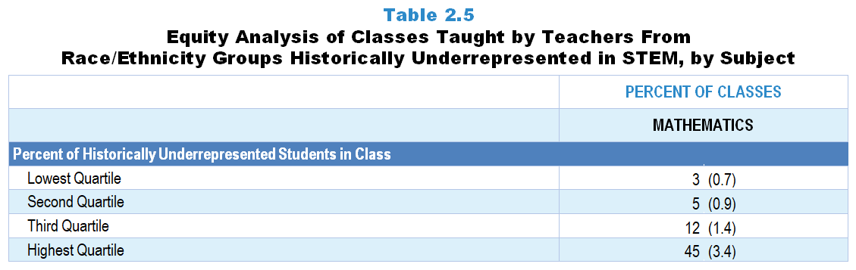
Original Data for Slide 11
(not for presentation)
Notes:
The mathematics portion of Table 2.5, p. 12 in Technical Report
This slide shows data derived from:
Mathematics Teacher Questionnaire
Q30. For the students in this class, indicate the number of males and females in each of the following categories of race/ethnicity.
American Indian or Alaska Native _____ _____
Asian _____ _____
Black or African American _____ _____
Hispanic/Latino _____ _____
Native Hawaiian or Other Pacific Islander _____ _____
White _____ _____
Two or more races _____ _____
Q58. Are you of Hispanic or Latino origin?
Yes
No
Q59. What is your race? (Select all that apply.)
American Indian or Alaska Native
Asian
Black or African American
Native Hawaiian or Other Pacific Islander
White
The numbers in parentheses are standard errors.
Chapters 2–7 in the technical report provide data on several key indicators, disaggregated by one or more equity factors: the prior achievement level of students in the class, the percentage of students from race/ethnicity groups historically underrepresented in STEM in the class, the percentage of students in the school eligible for free/reduced-price lunch (FRL), school size, community type, and region. For FRL, each school was classified into one of four categories (defined as quartiles) based on the proportion of students eligible for FRL. Similarly, each randomly selected class was classified into one of the four categories based on the proportion of students from race/ethnicity groups historically underrepresented in STEM in the class.
Findings Highlighted in Technical Report
“Table 2.5 shows the percentage of classes taught by teachers from race/ethnicity groups historically underrepresented in STEM by the proportion of students from these groups in the class. Note that across all three subjects, classes in the highest quartile in terms of students from these groups are more likely than those in the lowest quartile to be taught by teachers from these groups.”

Slide 11
Mathematics Classes Taught by Teachers From Race/Ethnicity Groups Historically Underrepresented in Mathematics
Notes:
Historically Underrepresented Students/Teachers includes American Indian or Alaskan Native, Black or African American, Hispanic or Latino, or Native Hawaiian or Other Pacific Islander students/teachers.
Slide shows the composite scores by quartile of percent historically underrepresented students in the randomly selected class.

Slide 12
Teacher Preparation

Slide 13
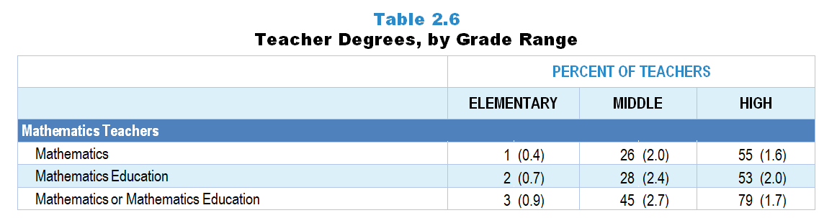
Original Data for Slide 14
(not for presentation)
Notes:
The mathematics portion of Table 2.6, p. 13 in Technical Report
This slide shows data derived from:
Mathematics Teacher Questionnaire
Q12. Have you been awarded one or more bachelor’s and/or graduate degrees in the following fields? (With regard to bachelor’s degrees, count only areas in which you majored.) (Response Options: Yes, No)
Education, including mathematics education
Mathematics
Statistics
Computer Science
Engineering
Other, please specify. _____
Q13. What type of education degree do you have? (With regard to bachelor’s degrees, count only areas in which you majored.) (Select all that apply.)
Elementary Education
Mathematics Education
Science Education
Other Education, please specify. _____
The numbers in parentheses are standard errors.
Findings Highlighted in Technical Report
“As can be seen in Table 2.6, very few elementary teachers have college or graduate degrees in science or mathematics. The percentage of teachers with one or more degrees in science or mathematics increases with increasing grade range, with 79 percent of high school science teachers and 55 percent of high school mathematics teachers having a major in their discipline. If the definition of degree in discipline is expanded to include degrees in science/‌mathematics education, these figures increase to 91 percent of high school science teachers and 79 percent of high school mathematics teachers. Only about 1 in 4 computer science teachers have a degree in computer engineering, computer science, or information science, and very few have a degree in computer science education.”

Slide 14
Mathematics Teacher Degrees

Slide 15
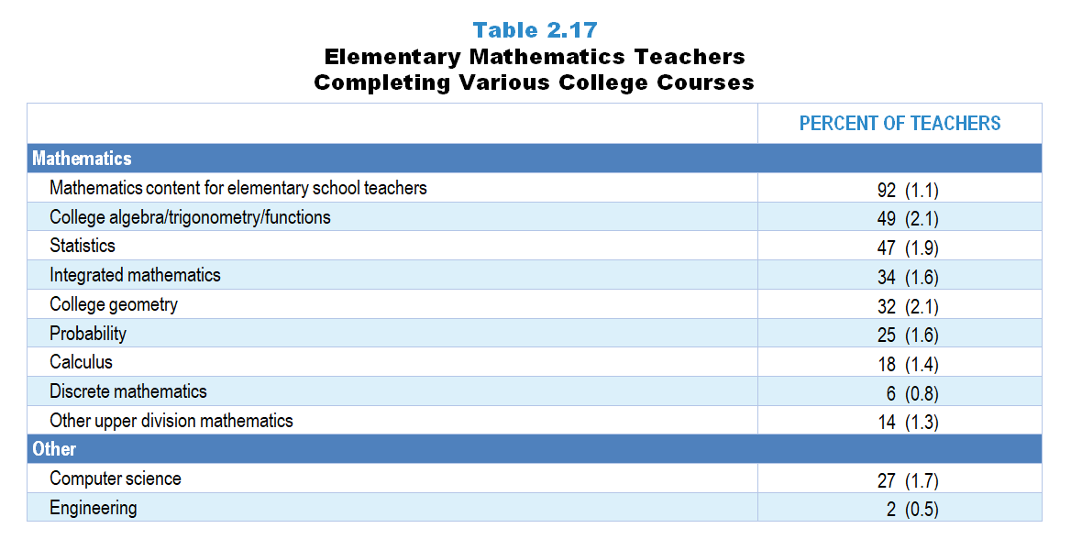
Original Data for Slide 16
(not for presentation)
Notes:
Table 2.17, p. 19 in Technical Report
This slide shows data from individual items.
Q14. Did you complete any of the following mathematics courses at the undergraduate or graduate level? [Select one on each row.] (Response Options: Yes, No)
Mathematics content for elementary school teachers
Mathematics content for middle school teachers
Mathematics content for high school teachers
Integrated mathematics (a single course that addresses content across multiple mathematics subjects, such as algebra and geometry)
College algebra/trigonometry/functions
Abstract algebra (for example: groups, rings, ideals, fields) [Presented to grades 6–12 teachers only]
Linear algebra (for example: vectors, matrices, eigenvalues) [Presented to grades 6–12 teachers only]
Calculus
Advanced calculus [Presented to grades 6–12 teachers only]
Real analysis [Presented to grades 6–12 teachers only]
Differential equations [Presented to grades 6–12 teachers only]
Analytic/Coordinate Geometry (for example: transformations or isometries, conic sections) [Presented to grades 6–12 teachers only]
Axiomatic Geometry (Euclidean or non-Euclidean) [Presented to grades 6–12 teachers only]
College geometry [Presented to grades K–5 teachers only]
Probability
Statistics
Number theory (for example: divisibility theorems, properties of prime numbers) [Presented to grades 6–12 teachers only]
Discrete mathematics (for example: combinatorics, graph theory, game theory)
Other upper division mathematics
Q15. Did you complete one or more courses in each of the following areas at the undergraduate or graduate level? [Select one on each row.]
Computer science
Engineering
The numbers in parentheses are standard errors.
Findings Highlighted in Technical Report
“Turning to elementary grades mathematics, as can be seen in Table 2.17, nearly all teachers have completed college coursework in mathematics for elementary school teachers. Roughly half of elementary mathematics teachers have had college courses in each of a number of areas of mathematics, including algebra and statistics. About 1 in 4 elementary mathematics teachers have had a course in computer science, though very few have taken a course in engineering.”

Slide 16
Elementary Mathematics Teachers Completing Various College Courses

Slide 17
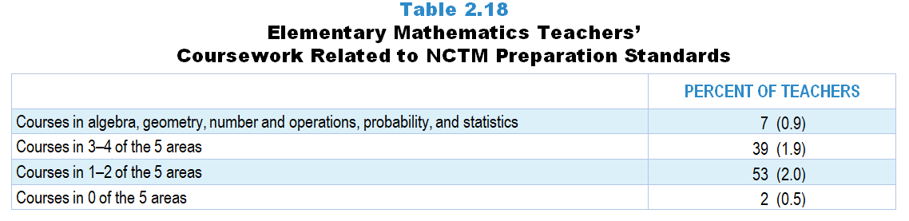
Original Data for Slide 18
(not for presentation)
Notes:
Table 2.18, p. 20 in Technical Report
This slide shows data derived from:
Mathematics Teacher Questionnaire
Q14. Did you complete any of the following mathematics courses at the undergraduate or graduate level? [Select one on each row.] (Response Options: Yes, No)
Mathematics content for elementary school teachers
Mathematics content for middle school teachers
Mathematics content for high school teachers
Integrated mathematics (a single course that addresses content across multiple mathematics subjects, such as algebra and geometry)
College algebra/trigonometry/functions
Abstract algebra (for example: groups, rings, ideals, fields) [Presented to grades 6–12 teachers only]
Linear algebra (for example: vectors, matrices, eigenvalues) [Presented to grades 6–12 teachers only]
Calculus
Advanced calculus [Presented to grades 6–12 teachers only]
Real analysis [Presented to grades 6–12 teachers only]
Differential equations [Presented to grades 6–12 teachers only]
Analytic/Coordinate Geometry (for example: transformations or isometries, conic sections) [Presented to grades 6–12 teachers only]
Axiomatic Geometry (Euclidean or non-Euclidean) [Presented to grades 6–12 teachers only]
College geometry [Presented to grades K–5 teachers only]
Probability
Statistics
Number theory (for example: divisibility theorems, properties of prime numbers) [Presented to grades 6–12 teachers only]
Discrete mathematics (for example: combinatorics, graph theory, game theory)
Other upper division mathematics
The numbers in parentheses are standard errors.
Findings Highlighted in Technical Report
The National Council of Teachers of Mathematics (NCTM) has recommended that elementary mathematics teachers take college coursework in a number of different areas, including number and operations (for which “mathematics content for elementary teachers” can serve as a proxy), algebra, geometry, probability, and statistics. As can be seen in Table 2.18, only 7 percent of elementary mathematics teachers have had courses in each of these areas; the typical elementary teacher has had coursework in only 1 or 2 of these 5 areas.
National Council of Teachers of Mathematics. (2012). NCTM CAEP mathematics content for elementary mathematics specialist. Reston, VA: NCTM.

Slide 18
Elementary Mathematics Teachers’ Coursework Related to NCTM Preparations Standards
Notes:
The five course areas include: algebra, geometry, number and operations, probability, and statistics.

Slide 19
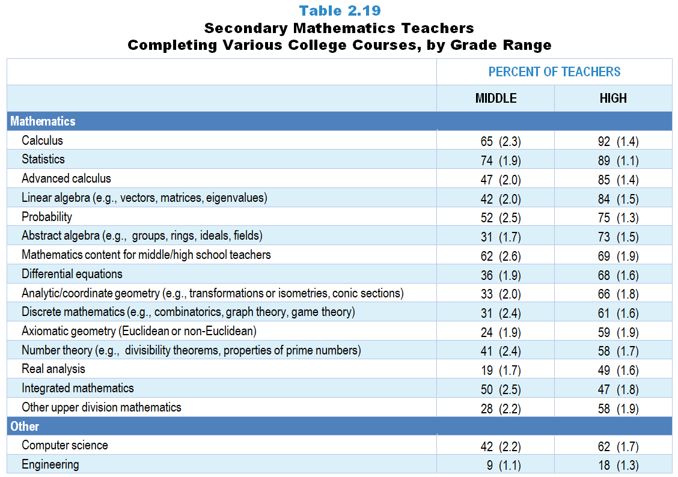
Original Data for Slides 20–23
(not for presentation)
Notes:
Table 2.19, p. 21 in Technical Report
This slide shows data from individual items.
Mathematics Teacher Questionnaire
Q14. Did you complete any of the following mathematics courses at the undergraduate or graduate level? [Select one on each row.] (Response Options: Yes, No)
Mathematics content for elementary school teachers
Mathematics content for middle school teachers
Mathematics content for high school teachers
Integrated mathematics (a single course that addresses content across multiple mathematics subjects, such as algebra and geometry)
College algebra/trigonometry/functions
Abstract algebra (for example: groups, rings, ideals, fields) [Presented to grades 6–12 teachers only]
Linear algebra (for example: vectors, matrices, eigenvalues) [Presented to grades 6–12 teachers only]
Calculus
Advanced calculus [Presented to grades 6–12 teachers only]
Real analysis [Presented to grades 6–12 teachers only]
Differential equations [Presented to grades 6–12 teachers only]
Analytic/Coordinate Geometry (for example: transformations or isometries, conic sections) [Presented to grades 6–12 teachers only]
Axiomatic Geometry (Euclidean or non-Euclidean) [Presented to grades 6–12 teachers only]
College geometry [Presented to grades K–5 teachers only]
Probability
Statistics
Number theory (for example: divisibility theorems, properties of prime numbers) [Presented to grades 6–12 teachers only]
Discrete mathematics (for example: combinatorics, graph theory, game theory)
Other upper division mathematics
Q15. Did you complete one or more courses in each of the following areas at the undergraduate or graduate level? [Select one on each row.]
Computer science
Engineering
The numbers in parentheses are standard errors.
Findings Highlighted in Technical Report
“Table 2.19 shows the percentage of middle and high school mathematics teachers with coursework in each of a number of areas. Nearly all high school mathematics teachers have completed a calculus course, and 85 percent have taken a course in advanced calculus. Similar proportions have had college coursework in linear algebra and in statistics. Other college courses completed by a majority of high school mathematics teachers include abstract algebra, differential equations, axiomatic geometry, analytic geometry, probability, number theory, and discrete mathematics. Substantially fewer teachers at the middle grades have had college coursework in each of these areas though about three-quarters have had a course in statistics and two-thirds in calculus.”

Slide 20
Middle School Mathematics Teachers Completing Various College Courses
Notes:
Note: Each grade-level chart is sorted independently; consequently items may appear in different orders.

Slide 21
Middle School Mathematics Teachers Completing Various College Courses
Notes:
Note: Each grade-level chart is sorted independently; consequently items may appear in different orders.

Slide 22
High School Mathematics Teachers Completing Various College Courses
Notes:
Note: Each grade-level chart is sorted independently; consequently items may appear in different orders.

Slide 23
High School Mathematics Teachers Completing Various College Courses
Notes:
Note: Each grade-level chart is sorted independently; consequently items may appear in different orders.

Slide 24
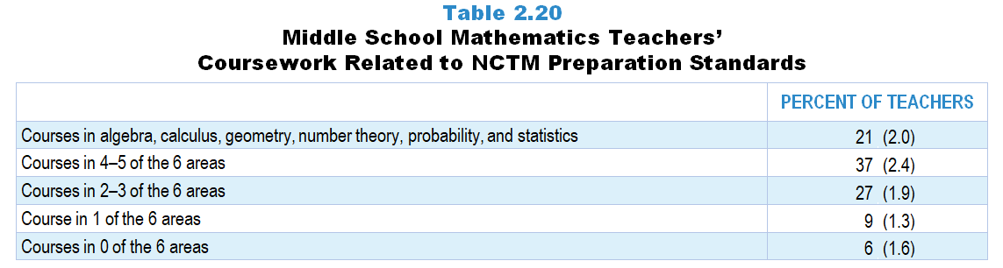
Original Data for Slide 25
(not for presentation)
Notes:
Table 2.20, p. 21 in Technical Report
This slide shows data derived from:
Mathematics Teacher Questionnaire
Q14. Did you complete any of the following mathematics courses at the undergraduate or graduate level? [Select one on each row.] (Response Options: Yes, No)
Mathematics content for elementary school teachers
Mathematics content for middle school teachers
Mathematics content for high school teachers
Integrated mathematics (a single course that addresses content across multiple mathematics subjects, such as algebra and geometry)
College algebra/trigonometry/functions
Abstract algebra (for example: groups, rings, ideals, fields) [Presented to grades 6–12 teachers only]
Linear algebra (for example: vectors, matrices, eigenvalues) [Presented to grades 6–12 teachers only]
Calculus
Advanced calculus [Presented to grades 6–12 teachers only]
Real analysis [Presented to grades 6–12 teachers only]
Differential equations [Presented to grades 6–12 teachers only]
Analytic/Coordinate Geometry (for example: transformations or isometries, conic sections) [Presented to grades 6–12 teachers only]
Axiomatic Geometry (Euclidean or non-Euclidean) [Presented to grades 6–12 teachers only]
College geometry [Presented to grades K–5 teachers only]
Probability
Statistics
Number theory (for example: divisibility theorems, properties of prime numbers) [Presented to grades 6–12 teachers only]
Discrete mathematics (for example: combinatorics, graph theory, game theory)
Other upper division mathematics
The numbers in parentheses are standard errors.
Findings Highlighted in Technical Report
“At the middle grades level, NCTM recommends that teachers have more extensive college coursework, including courses in number theory (for which “mathematics for middle school teachers” can serve as a proxy), algebra, geometry, probability, statistics, and calculus. As can be seen in Table 2.20, more than half of middle grades mathematics teachers have had college courses in all or nearly all of these areas, having completed at least 4 of the 6 recommended courses.”
National Council of Teachers of Mathematics. (2012). NCTM CAEP mathematics content for middle grades. Reston, VA: NCTM.

Slide 25
Middle School Mathematics Teacher Coursework Related to NCTM Preparation Standards
Notes:
The six course areas include: algebra, calculus, geometry, number theory, probability, and statistics.

Slide 26
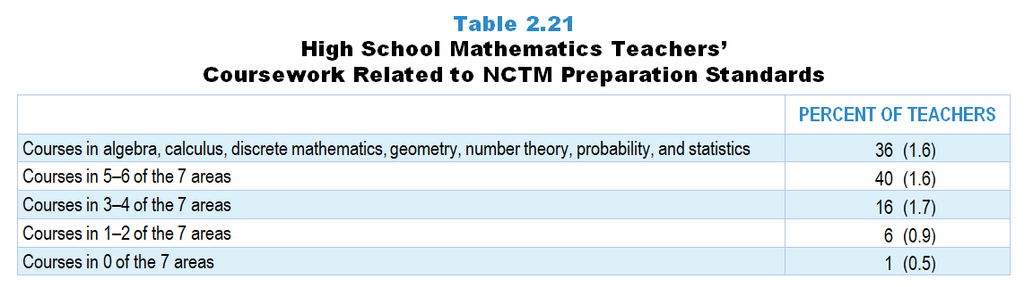
Original Data for Slide 27
(not for presentation)
Notes:
Table 2.21, p. 22 in Technical Report
This slide shows data derived from:
Mathematics Teacher Questionnaire
Q14. Did you complete any of the following mathematics courses at the undergraduate or graduate level? [Select one on each row.] (Response Options: Yes, No)
Mathematics content for elementary school teachers
Mathematics content for middle school teachers
Mathematics content for high school teachers
Integrated mathematics (a single course that addresses content across multiple mathematics subjects, such as algebra and geometry)
College algebra/trigonometry/functions
Abstract algebra (for example: groups, rings, ideals, fields) [Presented to grades 6–12 teachers only]
Linear algebra (for example: vectors, matrices, eigenvalues) [Presented to grades 6–12 teachers only]
Calculus
Advanced calculus [Presented to grades 6–12 teachers only]
Real analysis [Presented to grades 6–12 teachers only]
Differential equations [Presented to grades 6–12 teachers only]
Analytic/Coordinate Geometry (for example: transformations or isometries, conic sections) [Presented to grades 6–12 teachers only]
Axiomatic Geometry (Euclidean or non-Euclidean) [Presented to grades 6–12 teachers only]
College geometry [Presented to grades K–5 teachers only]
Probability
Statistics
Number theory (for example: divisibility theorems, properties of prime numbers) [Presented to grades 6–12 teachers only]
Discrete mathematics (for example: combinatorics, graph theory, game theory)
Other upper division mathematics
The numbers in parentheses are standard errors.
Findings Highlighted in Technical Report
“Table 2.21 provides analogous data for high school mathematics teachers, in this case based on a total of seven courses, including number theory and discrete mathematics and omitting mathematics coursework specifically aimed at teachers. Approximately three-quarters of high school teachers meet or come close to having taken courses in all seven areas, completing at least five.”
National Council of Teachers of Mathematics. (2012). NCTM CAEP mathematics content for secondary. Reston, VA: NCTM.

Slide 27
High School Mathematics Teacher Coursework Related to NCTM Preparation Standards
Notes:
The seven course areas include: algebra, calculus, discrete mathematics, geometry, number theory, probability, and statistics.

Slide 28
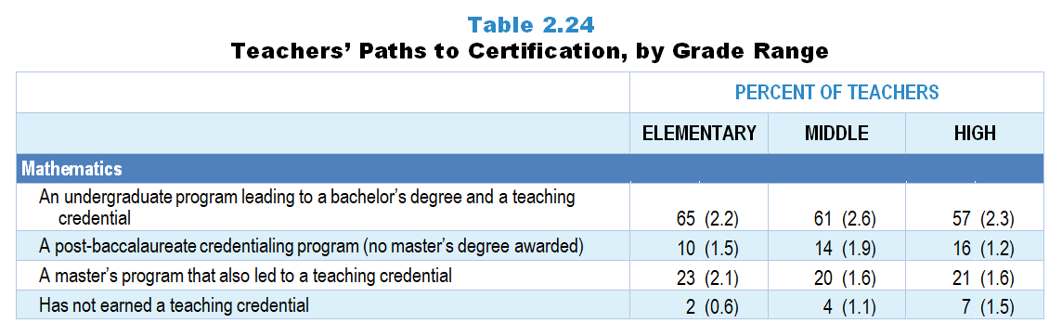
Original Data for Slide 29
(not for presentation)
Notes:
The mathematics portion of Table 2.24, p. 24 in Technical Report
This slide shows data from an individual item.
Mathematics Teacher Questionnaire
Q16. Which of the following best describes your teacher certification program?
An undergraduate program leading to a bachelor’s degree and a teaching credential
A post-baccalaureate credentialing program (no master’s degree awarded)
A master’s program that also awarded a teaching credential
I have not completed a program to earn a teaching credential.
The numbers in parentheses are standard errors.
Findings Highlighted in Technical Report
“Teachers were also asked about their path to certification. As can be seen in Table 2.24, elementary science teachers are more likely than those at the high school level to have had an undergraduate program leading to a bachelor’s degree and a teaching credential, and high school science teachers are more likely than their elementary school counterparts to have completed a post-baccalaureate credentialing program that did not include a master’s degree. Similar patterns are seen among mathematics teachers’ paths to certification across grade ranges, though the differences are not as striking. Seven percent of high school mathematics teachers and the same proportion of high school science teachers have not earned a teaching credential. Thirty-eight percent of high school computer science teachers have earned a teaching credential through an undergraduate program leading to a bachelor’s degree, and 24 percent through a post-baccalaureate credentialing program that did not include a master’s degree. Sixteen percent of computer science teachers have not earned a teaching credential.”

Slide 29
Mathematics Teachers’ Paths to Certification

Slide 30
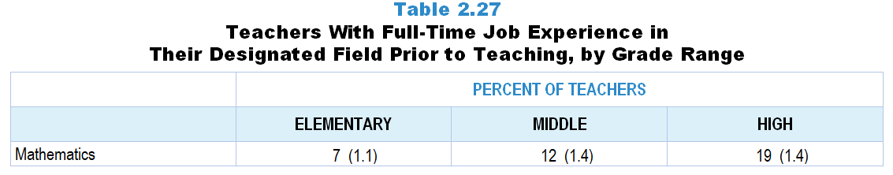
Original Data for Slide 31
(not for presentation)
Notes:
The mathematics portion of table 2.27, p. 26 in Technical Report
This slide shows data from an individual item.
Mathematics Teacher Questionnaire
Q17. After completing your undergraduate degree and prior to becoming a teacher, did you have a full-time job in a mathematics-related field (for example: accounting, engineering, computer programming)?
Yes
No
The numbers in parentheses are standard errors.
Findings Highlighted in Technical Report
“Recognizing that teaching is not always an individual’s first career, the survey also included an item asking whether teachers had a full-time job in their designated field after completing their undergraduate degree and prior to teaching. Science teachers were asked whether they had full-time job experience in a science- or engineering-related field. Mathematics and computer science teachers were asked about experience in a mathematics-related field (e.g., accounting, engineering, computer programming) and computer programming or computer/‌software engineering, respectively. As can be seen in Table 2.27, the likelihood of science and mathematics teachers having prior career experience in their field substantially increases with increasing grade range. In addition, high school science and computer science teachers are more likely than their mathematics colleagues to have prior job experience in their respective fields (about one-third vs. one-fifth). “

Slide 31
Mathematics Teachers With Full-Time Job Experience in Mathematics Prior to Teaching

Slide 32
Teacher Pedagogical Beliefs

Slide 33
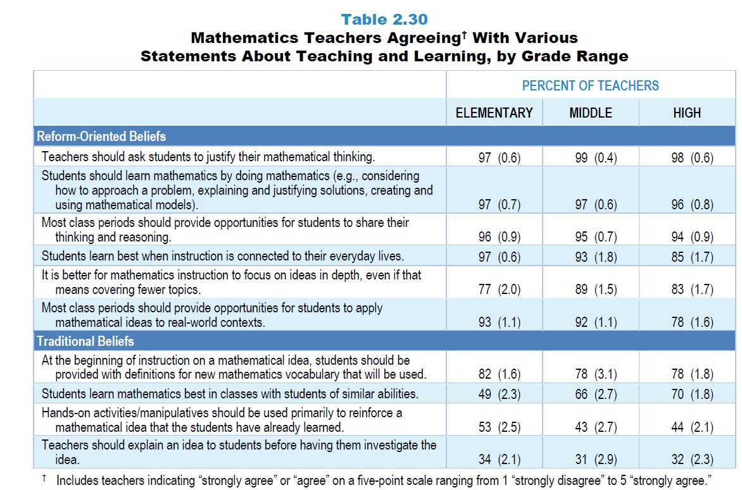
Original Data for Slides 34–39
(not for presentation)
Notes:
Table 2.30, p. 28 in Technical Report
This slide shows data from an individual item.
Mathematics Teacher Questionnaire
Q26. Please provide your opinion about each of the following statements. (Response Options: [1] Strongly Disagree, [2] Disagree, [3] No Opinion, [4] Agree, [5] Strongly Agree)
Students learn mathematics best in classes with students of similar abilities.
Inadequacies in students’ mathematics background can be overcome by effective teaching.
It is better for mathematics instruction to focus on ideas in depth, even if that means covering fewer topics.
Students should be provided with the purpose for a lesson as it begins.
At the beginning of instruction on a mathematical idea, students should be provided with definitions for new vocabulary that will be used.
Teachers should explain an idea to students before having them investigate the idea.
Most class periods should include some review of previously covered ideas and skills.
Most class periods should provide opportunities for students to share their thinking and reasoning.
Hands-on activities/manipulatives should be used primarily to reinforce a mathematical idea that the students have already learned.
Students should be assigned homework most days.
Most class periods should conclude with a summary of the key ideas addressed.
The numbers in parentheses are standard errors.
Findings Highlighted in Technical Report
“As can be seen in Table 2.30, mathematics teachers share many of the reform-oriented beliefs of science teachers, with at least 85 percent of teachers in each grade range agreeing that (1) teachers should ask students to justify their mathematical thinking, (2) students should learn mathematics by doing mathematics, (3) most class periods should provide students opportunities to share their thinking and reasoning, and (4) students learn best when instruction is connected to their everyday lives. At the same time, 49 percent of elementary mathematics teachers, increasing to 66 percent in the middle grades and 70 percent at the high school level, believe that students learn mathematics best in classes with students of similar abilities.
As is the case in science, most mathematics teachers agree with the notion of covering fewer ideas in greater depth, but sizeable proportions do not agree with other recommendations for improving mathematics teaching and learning. For example, 43–53 percent of mathematics teachers, depending on grade range, believe that hands-on activities/‌manipulatives should be used primarily to reinforce ideas the students have already learned, despite recommendations that these be used to help students develop their initial understanding of key concepts. And even larger proportions of mathematics teachers, from 78 percent at the high school level to 82 percent at the elementary level, believe that students should be given definitions of new vocabulary at the beginning of instruction on a mathematical idea.”

Slide 34
Elementary Mathematics Teachers Agreeing With Various Statements About Teaching and Learning
Notes:
Includes teachers indicating “strongly agree” or “agree” on a 5-point response scale with the options “strongly disagree,” “disagree,” “no opinion,” “agree,” and “strongly agree.”
Note: Each grade-level chart is sorted independently; consequently items may appear in different orders.

Slide 35
Elementary Mathematics Teachers Agreeing With Various Statements About Teaching and Learning
Notes:
Includes teachers indicating “strongly agree” or “agree” on a 5-point response scale with the options “strongly disagree,” “disagree,” “no opinion,” “agree,” and “strongly agree.”
Note: Each grade-level chart is sorted independently; consequently items may appear in different orders.

Slide 36
Middle School Mathematics Teachers Agreeing With Various Statements About Teaching and Learning
Notes:
Includes teachers indicating “strongly agree” or “agree” on a 5-point response scale with the options “strongly disagree,” “disagree,” “no opinion,” “agree,” and “strongly agree.”
Note: Each grade-level chart is sorted independently; consequently items may appear in different orders.

Slide 37
Middle School Mathematics Teachers Agreeing with Various Statements about Teaching and Learning
Notes:
Includes teachers indicating “strongly agree” or “agree” on a 5-point response scale with the options “strongly disagree,” “disagree,” “no opinion,” “agree,” and “strongly agree.”
Note: Each grade-level chart is sorted independently; consequently items may appear in different orders.

Slide 38
High School Mathematics Teachers Agreeing With Various Statements About Teaching and Learning
Notes:
Includes teachers indicating “strongly agree” or “agree” on a 5-point response scale with the options “strongly disagree,” “disagree,” “no opinion,” “agree,” and “strongly agree.”
Note: Each grade-level chart is sorted independently; consequently items may appear in different orders.

Slide 39
High School Mathematics Teachers Agreeing With Various Statements About Teaching and Learning
Notes:
Includes teachers indicating “strongly agree” or “agree” on a 5-point response scale with the options “strongly disagree,” “disagree,” “no opinion,” “agree,” and “strongly agree.”
Note: Each grade-level chart is sorted independently; consequently items may appear in different orders.

Slide 40
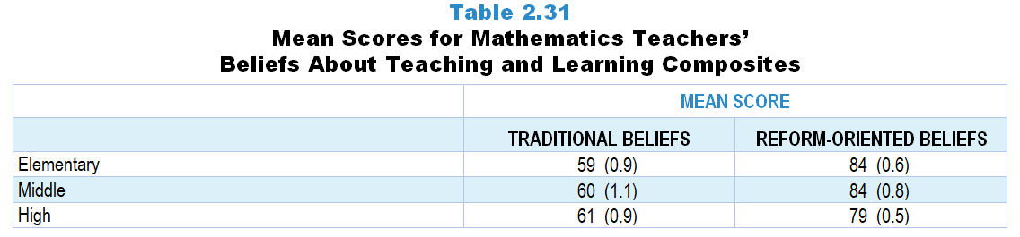
Original Data for Slide 41
(not for presentation)
Notes:
Table 2.31, p. 29 in Technical Report
This slide shows data from composites:
Sets of related questionnaire items were combined to create several composite variables related to key constructs. Composite variables, which are more reliable than individual survey items, were computed to have a minimum possible value of 0 and a maximum possible value of 100. Higher composite scores indicate more of the construct being measure by the composite. Each composite is calculated by summing the responses to the items associated with that composite and then dividing by the total points possible. In order for the composites to be on a 100-point scale, the lowest response option on each scale was set to 0 and the others were adjusted accordingly; so for example, an item with a scale ranging from 1 to 4 was re-coded to have a scale of 0 to 3. By doing this, someone who marks the lowest point on every item in a composite receives a composite score of 0 rather than some positive number. It also assures that 50 is the true mid-point. The denominator for each composite is determined by computing the maximum possible sum of responses for a series of items and dividing by 100; e.g., a 9-item composite where each item is on a scale of 0–3 would have a denominator of 0.27. Composites values were not computed for participants who respond to fewer than two-thirds of the items that form the composite.
Traditional Teaching Beliefs Composite Items
Q26a. Students learn mathematics best in classes with students of similar abilities.
Q26c. At the beginning of instruction on a mathematical idea, students should be provided with definitions for new mathematics vocabulary that will be used.
Q26d. Teachers should explain an idea to students before having them investigate the idea.
Q26f. Hands-on activities/manipulatives should be used primarily to reinforce a mathematical idea that the students have already learned.
Reform-Oriented Teaching Beliefs Composite Items
Q26e. Most class periods should provide opportunities for students to share their thinking and reasoning.
Q26g. Teachers should ask students to justify their mathematical thinking.
Q26h. Students learn best when instruction is connected to their everyday lives.
Q26i. Most class periods should provide opportunities for students to apply mathematical ideas to real-world contexts.
Q26j. Students should learn mathematics by doing mathematics (for example: considering how to approach a problem, explaining and justifying solutions, creating and using mathematical models).
Math Teacher Questionnaire
Q26. Please provide your opinion about each of the following statements. (Response Options: [1] Strongly Disagree, [2] Disagree, [3] No Opinion, [4] Agree, [5] Strongly Agree)
Students learn mathematics best in classes with students of similar abilities.
It is better for mathematics instruction to focus on ideas in depth, even if that means covering fewer topics.
At the beginning of instruction on a mathematical idea, students should be provided with definitions for new mathematics vocabulary that will be used.
Teachers should explain an idea to students before having them investigate the idea.
Most class periods should provide opportunities for students to share their thinking and reasoning.
Hands-on activities/manipulatives should be used primarily to reinforce a mathematical idea that the students have already learned.
Teachers should ask students to justify their mathematical thinking.
Students learn best when instruction is connected to their everyday lives.
Most class periods should provide opportunities for students to apply mathematical ideas to real-world contexts.
Students should learn mathematics by doing mathematics (for example: considering how to approach a problem, explaining and justifying solutions, creating and using mathematical models).
The numbers in parentheses are standard errors.
Findings Highlighted in Technical Report
“Similar to science teachers, mathematics teachers also have relatively strong reform-oriented beliefs (see Table 2.31). Traditional beliefs are also fairly common among mathematics teachers at all grade levels.“

Slide 41
Mathematics Teachers’ Beliefs About Teaching and Learning Composites

Slide 42
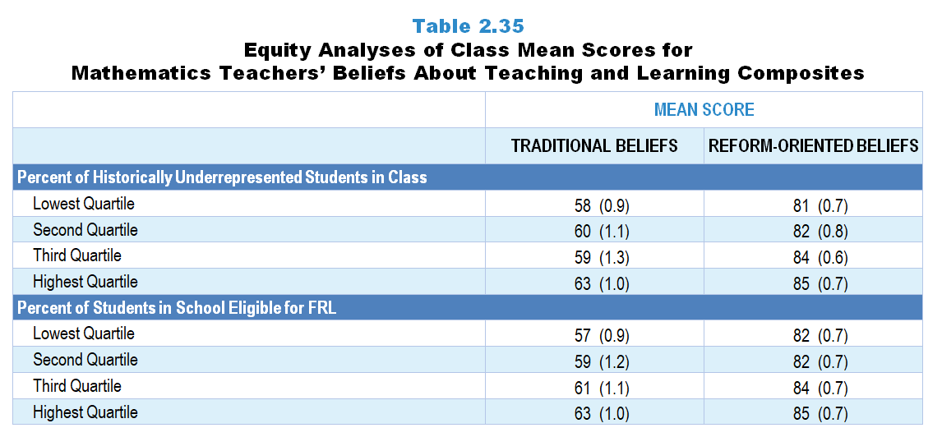
Original Data for Slides 43–44
(not for presentation)
Notes:
Table 2.35, p. 31 in Technical Report
This slide shows data from composites:
Sets of related questionnaire items were combined to create several composite variables related to key constructs. Composite variables, which are more reliable than individual survey items, were computed to have a minimum possible value of 0 and a maximum possible value of 100. Higher composite scores indicate more of the construct being measure by the composite. Each composite is calculated by summing the responses to the items associated with that composite and then dividing by the total points possible. In order for the composites to be on a 100-point scale, the lowest response option on each scale was set to 0 and the others were adjusted accordingly; so for example, an item with a scale ranging from 1 to 4 was re-coded to have a scale of 0 to 3. By doing this, someone who marks the lowest point on every item in a composite receives a composite score of 0 rather than some positive number. It also assures that 50 is the true mid-point. The denominator for each composite is determined by computing the maximum possible sum of responses for a series of items and dividing by 100; e.g., a 9-item composite where each item is on a scale of 0–3 would have a denominator of 0.27. Composites values were not computed for participants who respond to fewer than two-thirds of the items that form the composite.
Traditional Teaching Beliefs Composite Items
Q26a. Students learn mathematics best in classes with students of similar abilities.
Q26c. At the beginning of instruction on a mathematical idea, students should be provided with definitions for new mathematics vocabulary that will be used.
Q26d. Teachers should explain an idea to students before having them investigate the idea.
Q26f. Hands-on activities/manipulatives should be used primarily to reinforce a mathematical idea that the students have already learned.
Reform-Oriented Teaching Beliefs Composite Items
Q26e. Most class periods should provide opportunities for students to share their thinking and reasoning.
Q26g. Teachers should ask students to justify their mathematical thinking.
Q26h. Students learn best when instruction is connected to their everyday lives.
Q26i. Most class periods should provide opportunities for students to apply mathematical ideas to real-world contexts.
Q26j. Students should learn mathematics by doing mathematics (for example: considering how to approach a problem, explaining and Q26justifying solutions, creating and using mathematical models).
Math Teacher Questionnaire
Q26. Please provide your opinion about each of the following statements. (Response Options: [1] Strongly Disagree, [2] Disagree, [3] No Opinion, [4] Agree, [5] Strongly Agree)
Students learn mathematics best in classes with students of similar abilities.
It is better for mathematics instruction to focus on ideas in depth, even if that means covering fewer topics.
At the beginning of instruction on a mathematical idea, students should be provided with definitions for new mathematics vocabulary that will be used.
Teachers should explain an idea to students before having them investigate the idea.
Most class periods should provide opportunities for students to share their thinking and reasoning.
Hands-on activities/manipulatives should be used primarily to reinforce a mathematical idea that the students have already learned.
Teachers should ask students to justify their mathematical thinking.
Students learn best when instruction is connected to their everyday lives.
Most class periods should provide opportunities for students to apply mathematical ideas to real-world contexts.
Students should learn mathematics by doing mathematics (for example: considering how to approach a problem, explaining and justifying solutions, creating and using mathematical models).
Q31. Which of the following best describes the prior mathematics achievement levels of the students in this class relative to other students in this school?
Mostly low achievers
Mostly average achievers
Mostly high achievers
A mixture of levels
The numbers in parentheses are standard errors.
Chapters 2–7 in the technical report provide data on several key indicators, disaggregated by one or more equity factors: the prior achievement level of students in the class, the percentage of students from race/ethnicity groups historically underrepresented in STEM in the class, the percentage of students in the school eligible for free/reduced-price lunch (FRL), school size, community type, and region. For FRL, each school was classified into one of four categories (defined as quartiles) based on the proportion of students eligible for FRL. Similarly, each randomly selected class was classified into one of the four categories based on the proportion of students from race/ethnicity groups historically underrepresented in STEM in the class.
Findings Highlighted in Technical Report
“Data in Table 2.35 suggest weak relationships between mathematics teachers’ beliefs and the proportion of students in the class from race/‌ethnicity groups historically underrepresented in STEM and the proportion of students in the school who are eligible for free/‌reduced-price lunch. Interestingly, the two factors share the same pattern, with traditional beliefs and reform-oriented beliefs being strongest among teachers of classes with the greatest percentage of students from race/‌ethnicity groups historically underrepresented in STEM and students eligible for free/‌reduced-price lunch.“

Slide 43
Mathematics Teachers’ Beliefs About Teaching and Learning Composites, by Percentage of Historically Underrepresented Students in Class
Notes:
Historically Underrepresented Students/Teachers includes American Indian or Alaskan Native, Black or African American, Hispanic or Latino, or Native Hawaiian or Other Pacific Islander students/teachers.
Slide shows the composite scores by quartile of percent historically underrepresented students in the randomly selected class.

Slide 44
Mathematics Teachers’ Beliefs About Teaching and Learning Composites, by Percentage of Students in School Eligible for FRL
Notes:
Slide shows the composite scores by quartile of percent of students eligible for free or reduced-price lunch in the school.

Slide 45
Teachers’ Perception of Preparedness

Slide 46
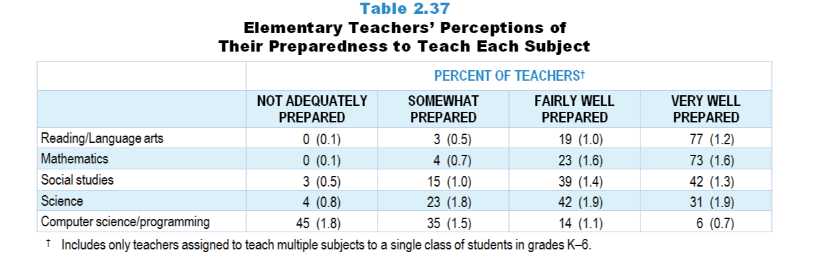
Original Data for Slide 47
(not for presentation)
Notes:
Table 2.37, p. 32 in Technical Report
This slide shows data from individual items found on both the Science Teacher Questionnaire and Mathematics Teacher Questionnaire.
Science Teacher Questionnaire
Q35. Many teachers feel better prepared to teach some subject areas than others. How well prepared do you feel to teach each of the following subjects at the grade level(s) you teach, whether or not they are currently included in your teaching responsibilities? [Select one on each row.] (Response Options: [1] Not adequately prepared, [2] Somewhat prepared, [3] Fairly well prepared, [4] Very well prepared)
Life Science
Earth/Space Science
Physical Science
Engineering
Mathematics
Reading/Language Arts
Social Studies
Computer Science/Programming
Mathematics Teacher Questionnaire
Q23. Many teachers feel better prepared to teach some subjects/topics than others. How well prepared do you feel to teach each of the following at the grade level(s) you teach, whether or not they are currently included in your teaching responsibilities? [Select one on each row.] (Response Options: [1] Not adequately prepared, [2] Somewhat prepared, [3] Fairly well prepared, [4] Very well prepared)
Number and Operations
Early Algebra
Geometry
Measurement and Data Representation
Science
Computer Science/Programming
Reading/Language Arts
Social Studies
The numbers in parentheses are standard errors.
Findings Highlighted in Technical Report
“Elementary teachers are typically assigned to teach multiple subjects to a single group of students, including not only science and mathematics, but other areas as well. However, as can be seen in Table 2.37, these teachers do not feel equally well prepared to teach the various subjects. Although 73 percent of elementary teachers of self-contained classes feel very well prepared to teach mathematics—slightly lower than the 77 percent for reading/‌language arts—only 31 percent feel very well prepared to teach science, and only 6 percent feel very well prepared to teach computer science or programming.”

Slide 47
Elementary Teachers Considering Themselves Very Well Prepared to Teach Each Subject
Notes:
Includes only teachers assigned to teach multiple subjects to a single class of students in grades K–6.

Slide 48
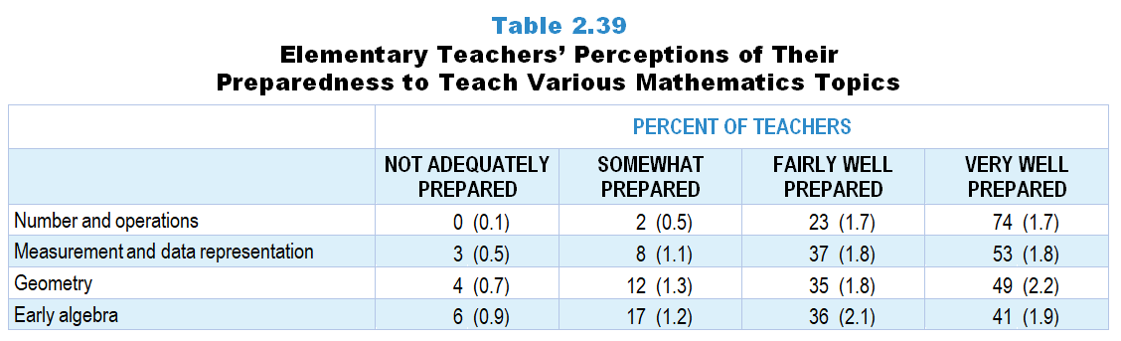
Original Data for Slide 49
(not for presentation)
Notes:
Table 2.39, p. 33 in Technical Report
This slide shows data from an individual item.
Mathematics Teacher Questionnaire
Q23. Many teachers feel better prepared to teach some subjects/topics than others. How well prepared do you feel to teach each of the following at the grade level(s) you teach, whether or not they are currently included in your teaching responsibilities? (Response Options: [1] Not adequately prepared, [2] Somewhat prepared, [3] Fairly well prepared, [4] Very well prepared)
Number and Operations
Early Algebra
Geometry
Measurement and Data Representation
Science
Computer Science
Reading/Language Arts
Social Studies
The numbers in parentheses are standard errors.
Findings Highlighted in Technical Report
“Table 2.39 provides data on elementary teachers’ perceptions of their preparedness to teach each of a number of mathematics topics at their assigned grade level. Interestingly, 74 percent of elementary teachers feel very well prepared to teach number and operations, which is about the same proportion that feel very well prepared to teach mathematics in general. The fact that markedly fewer teachers feel very well prepared to teach measurement and data representation, geometry, and early algebra suggests that elementary teachers equate teaching mathematics with teaching number and operations.”

Slide 49
Elementary Teachers Considering Themselves Very Well Prepared to Teach Various Mathematics Topics

Slide 50
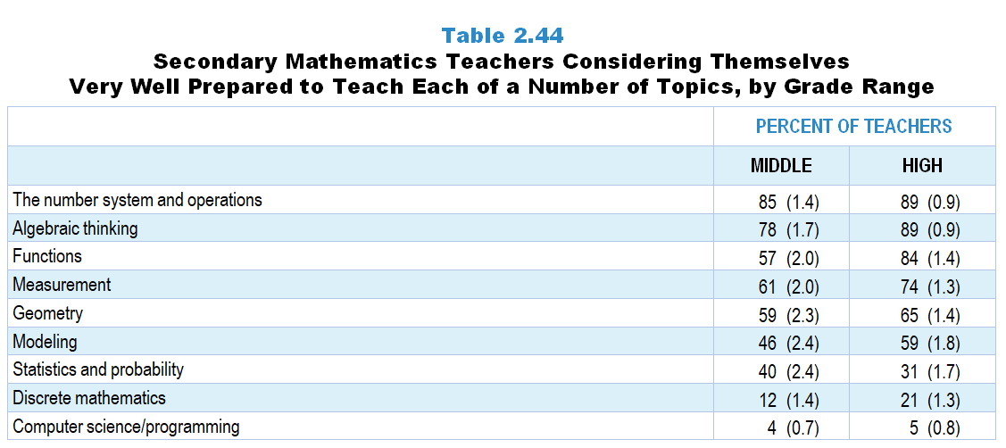
Original Data for Slides 51–52
(not for presentation)
Notes:
Table 2.44, p. 36 in Technical Report
This slide shows data from an individual item.
Mathematics Teacher Questionnaire
Q24. Within mathematics many teachers feel better prepared to teach some topics than others. How prepared do you feel to teach each of the following topics at the grade level(s) you teach, whether or not they are currently included in your curriculum? (Response Options: [1] Not adequately prepared, [2] Somewhat prepared, [3] Fairly well prepared, [4] Very well prepared)
The number system and operations
Algebraic thinking
Functions
Modeling
Measurement
Geometry
Statistics and probability
Discrete mathematics
Computer science/programming
The numbers in parentheses are standard errors.
Findings Highlighted in Technical Report
“Table 2.44 provides data on secondary mathematics teachers’ perceptions of preparedness to teach each of a number of mathematics topics. At each grade level, teachers are most likely to feel very well prepared to teach the number system and operations and algebraic thinking, and far less likely to feel that level of preparedness for discrete mathematics. High school mathematics teachers are substantially more likely than middle school teachers to feel very well prepared to teach many of the listed topics. However, in the case of statistics and probability, middle grades teachers are more likely than high school teachers to feel very well prepared. In addition, very few secondary mathematics teachers consider themselves very well prepared to teach computer science/‌programming ideas.”

Slide 51
Middle School Mathematics Teachers Considering Themselves Very Well Prepared to Teach Each of a Number of Topics
Notes:
Note: Each grade-level chart is sorted independently; consequently items may appear in different orders.

Slide 52
High School Mathematics Teachers Considering Themselves Very Well Prepared to Teach Each of a Number of Topics
Notes:
Note: Each grade-level chart is sorted independently; consequently items may appear in different orders.

Slide 53
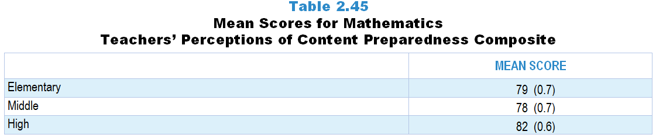
Original Data for Slide 54
(not for presentation)
Notes:
Table 2.45, p. 36 in Technical Report
This slide shows data from composites:
Sets of related questionnaire items were combined to create several composite variables related to key constructs. Composite variables, which are more reliable than individual survey items, were computed to have a minimum possible value of 0 and a maximum possible value of 100. Higher composite scores indicate more of the construct being measure by the composite. Each composite is calculated by summing the responses to the items associated with that composite and then dividing by the total points possible. In order for the composites to be on a 100-point scale, the lowest response option on each scale was set to 0 and the others were adjusted accordingly; so for example, an item with a scale ranging from 1 to 4 was re-coded to have a scale of 0 to 3. By doing this, someone who marks the lowest point on every item in a composite receives a composite score of 0 rather than some positive number. It also assures that 50 is the true mid-point. The denominator for each composite is determined by computing the maximum possible sum of responses for a series of items and dividing by 100; e.g., a 9-item composite where each item is on a scale of 0–3 would have a denominator of 0.27. Composites values were not computed for participants who respond to fewer than two-thirds of the items that form the composite.
Perceptions of Content Preparedness (Self-Contained Teachers)
Q23a. Number and Operations
Q23b. Early Algebra
Q23c. Geometry
Q23d. Measurement and Data Representation
Perceptions of Content Preparedness (Non Self-Contained Teachers)
Q24a. The number system and operations
Q24b. Algebraic thinking
Q24c. Functions
Q24d. Modeling
Q24e. Measurement
Q24f. Geometry
Q24g. Statistics and probability
Q24h. Discrete mathematics
Mathematics Teacher Questionnaire
Q23. Many teachers feel better prepared to teach some subjects/topics than others. How well prepared do you feel to teach each of the following at the grade level(s) you teach, whether or not they are currently included in your teaching responsibilities? (Response Options: [1] Not adequately prepared, [2] Somewhat prepared, [3] Fairly well prepared, [4] Very well prepared)
Number and Operations
Early Algebra
Geometry
Measurement and Data Representation
Science
Computer Science
Reading/Language Arts
Social Studies
Q24. Within mathematics many teachers feel better prepared to teach some topics than others. How prepared do you feel to teach each of the following topics at the grade level(s) you teach, whether or not they are currently included in your curriculum? (Response Options: [1] Not adequately prepared, [2] Somewhat prepared, [3] Fairly well prepared, [4] Very well prepared)
The number system and operations
Algebraic thinking
Functions
Modeling
Measurement
Geometry
Statistics and probability
Discrete mathematics
Computer science/programming
The numbers in parentheses are standard errors.
Findings Highlighted in Technical Report
“Table 2.45 shows mathematics teachers’ scores on the Perceptions of Content Preparedness composite. Similar to science teachers, high school mathematics teachers feel better prepared than middle school mathematics teachers. Elementary teachers feel as prepared to teach mathematics as do middle school mathematics teachers, and substantively more prepared in mathematics than they do in science.”

Slide 54
Mathematics Teachers’ Perceptions of Content Preparedness Composite

Slide 55
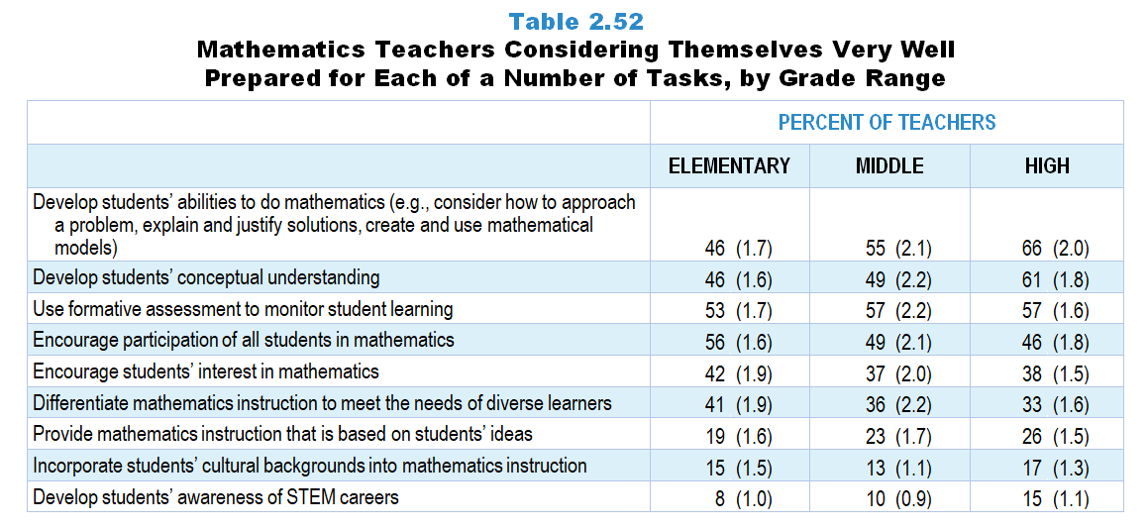
Original Data for Slides 56–61
Notes:
Table 2.52, p. 39 in Technical Report
Table shows data from individual items.
Mathematics Teacher Questionnaire
Q25. How well prepared do you feel to do each of the following in your mathematics instruction? [Select one on each row.] (Response Options: [1] Not adequately prepared, [2] Somewhat prepared, [3] Fairly well prepared, [4] Very well prepared)
Develop students’ conceptual understanding of the mathematical ideas you teach
Develop students’ abilities to do mathematics (for example: consider how to approach a problem, explain and justify solutions, create and use mathematical models)
Develop students’ awareness of STEM careers
Provide mathematics instruction that is based on students’ ideas (whether completely correct or not) about the topics you teach
Use formative assessment to monitor student learning
Differentiate mathematics instruction to meet the needs of diverse learners
Incorporate students’ cultural backgrounds into mathematics instruction
Encourage students' interest in mathematics
Encourage participation of all students in mathematics
The numbers in parentheses are standard errors.
Findings Highlighted in Technical Report
“As can be seen in Table 2.52, mathematics teachers’ feelings of pedagogical preparedness differ by grade range. High school teachers tend to feel more prepared than those at the elementary level to carry out tasks related to deepening students’ understanding. For example, about two-thirds of high school mathematics teachers feel very well prepared to develop students’ abilities to do mathematics and develop students’ conceptual understanding, compared to 46 percent of elementary teachers. In contrast, elementary teachers are more likely than their secondary counterparts to feel very well prepared to encourage students’ interest and participation in mathematics. As in science, few mathematics teachers at any grade level feel very well prepared to incorporate students’ cultural backgrounds into instruction and develop students’ awareness of STEM careers.”

Slide 56
Elementary Mathematics Teachers Considering Themselves Very Well Prepared for Each of a Number of Tasks
Notes:
Note: Each grade-level chart is sorted independently; consequently items may appear in different orders.

Slide 57
Elementary Mathematics Teachers Considering Themselves Very Well Prepared for Each of a Number of Tasks
Notes:
Note: Each grade-level chart is sorted independently; consequently items may appear in different orders.

Slide 58
Middle School Mathematics Teachers Considering Themselves Very Well Prepared for Each of a Number of Tasks
Notes:
Note: Each grade-level chart is sorted independently; consequently items may appear in different orders.

Slide 59
Middle School Mathematics Teachers Considering Themselves Very Well Prepared for Each of a Number of Tasks
Notes:
Note: Each grade-level chart is sorted independently; consequently items may appear in different orders.

Slide 60
High School Mathematics Teachers Considering Themselves Very Well Prepared for Each of a Number of Tasks
Notes:
Note: Each grade-level chart is sorted independently; consequently items may appear in different orders.

Slide 61
High School Mathematics Teachers Considering Themselves Very Well Prepared for Each of a Number of Tasks
Notes:
Note: Each grade-level chart is sorted independently; consequently items may appear in different orders.

Slide 62
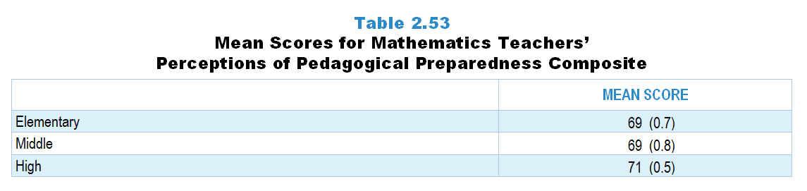
Original Data for Slide 63
(not for presentation)
Notes:
Table 2.53, p. 39 in Technical Report
This slide shows data from composites.
Sets of related questionnaire items were combined to create several composite variables related to key constructs. Composite variables, which are more reliable than individual survey items, were computed to have a minimum possible value of 0 and a maximum possible value of 100. Higher composite scores indicate more of the construct being measure by the composite. Each composite is calculated by summing the responses to the items associated with that composite and then dividing by the total points possible. In order for the composites to be on a 100-point scale, the lowest response option on each scale was set to 0 and the others were adjusted accordingly; so for example, an item with a scale ranging from 1 to 4 was re-coded to have a scale of 0 to 3. By doing this, someone who marks the lowest point on every item in a composite receives a composite score of 0 rather than some positive number. It also assures that 50 is the true mid-point. The denominator for each composite is determined by computing the maximum possible sum of responses for a series of items and dividing by 100; e.g., a 9-item composite where each item is on a scale of 0–3 would have a denominator of 0.27. Composites values were not computed for participants who respond to fewer than two-thirds of the items that form the composite.
Perceptions of Pedagogical Preparedness Composite Items
Q25a. Develop students’ conceptual understanding of the mathematical ideas you teach
Q25b. Develop students’ abilities to do mathematics (for example: consider how to approach a problem, explain and justify solutions, create and use mathematical models)
Q25c. Develop students’ awareness of STEM careers
Q25d. Provide mathematics instruction that is based on students’ ideas (whether completely correct or not) about the topics you teach
Q25e. Use formative assessment to monitor student learning
Q25f. Differentiate mathematics instruction to meet the needs of diverse learners
Q25g. Incorporate students’ cultural backgrounds into mathematics instruction
Q25h. Encourage students' interest in mathematics
Q25i. Encourage participation of all students in mathematics
Mathematics Teacher Questionnaire
Q25. How well prepared do you feel to do each of the following in your mathematics instruction? [Select one on each row.] (Response Options: [1] Not adequately prepared, [2] Somewhat prepared, [3] Fairly well prepared, [4] Very well prepared)
Develop students’ conceptual understanding of the mathematical ideas you teach
Develop students’ abilities to do mathematics (for example: consider how to approach a problem, explain and justify solutions, create and use mathematical models)
Develop students’ awareness of STEM careers
Provide mathematics instruction that is based on students’ ideas (whether completely correct or not) about the topics you teach
Use formative assessment to monitor student learning
Differentiate mathematics instruction to meet the needs of diverse learners
Incorporate students’ cultural backgrounds into mathematics instruction
Encourage students' interest in mathematics
Encourage participation of all students in mathematics
The numbers in parentheses are standard errors.
Findings Highlighted in Technical Report
“In contrast to the pattern in science teachers’ perceptions of pedagogical preparedness, mathematics perceptions are fairly consistent across all grade bands (see Table 2.53). In addition, elementary mathematics teachers feel more pedagogically prepared than elementary science teachers, which is not surprising given that self-contained elementary teachers consider themselves far more prepared to teach mathematics than science. Middle and high school teachers’ perceptions of pedagogical preparedness are very similar across the two subjects.”

Slide 63
Mathematics Teachers’ Perceptions of Pedagogical Preparedness Composite

Slide 64
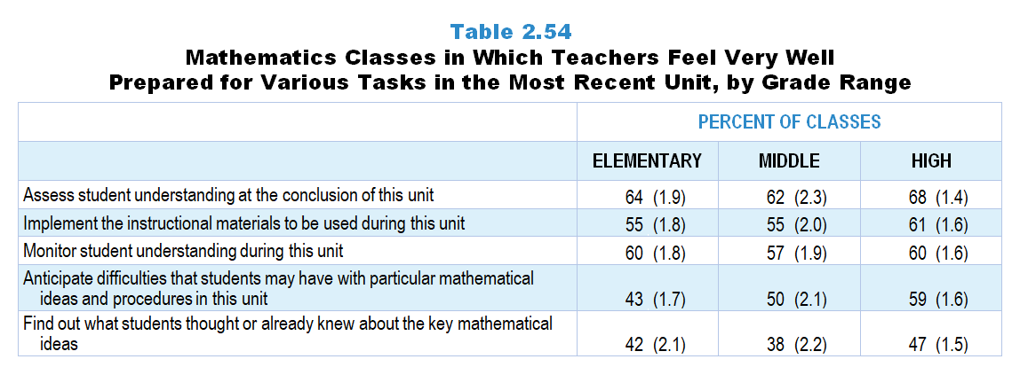
Original Data for Slides 65–67
(not for presentation)
Notes:
Table 2.54, p. 40 in Technical Report
Table shows data from individual items.
Mathematics Teacher Questionnaire
Q53. How well prepared do you feel to do each of the following as part of your instruction on this particular unit? [Select one on each row.]
(Response Options: [1] Not adequately prepared, [2] Somewhat prepared, [3] Fairly well prepared, [4] Very well prepared)
Anticipate difficulties that students may have with particular mathematical ideas and procedures in this unit
Find out what students thought or already knew about the key mathematical ideas
Implement the instructional materials (for example: mathematics textbook) to be used during this unit
Monitor student understanding during this unit
Assess student understanding at the conclusion of this unit
The numbers in parentheses are standard errors.
Findings Highlighted in Technical Report
“Table 2.54 shows the percentage of elementary, middle, and high school mathematics classes taught by teachers who feel very well prepared for each of a number of instructional tasks. As is the case in science, mathematics teachers tend to feel less well prepared to find out what students thought or already knew about the key ideas to be addressed in the unit.”

Slide 65
Elementary Mathematics Classes in Which Teachers Feel Very Well Prepared for Various Tasks in the Most Recent Unit
Notes:
Note: Each grade-level chart is sorted independently; consequently items may appear in different orders.

Slide 66
Middle School Mathematics Classes in Which Teachers Feel Very Well Prepared for Various Tasks in the Most Recent Unit
Notes:
Note: Each grade-level chart is sorted independently; consequently items may appear in different orders.

Slide 67
High School Mathematics Classes in Which Teachers Feel Very Well Prepared for Various Tasks in the Most Recent Unit
Notes:
Note: Each grade-level chart is sorted independently; consequently items may appear in different orders.

Slide 68
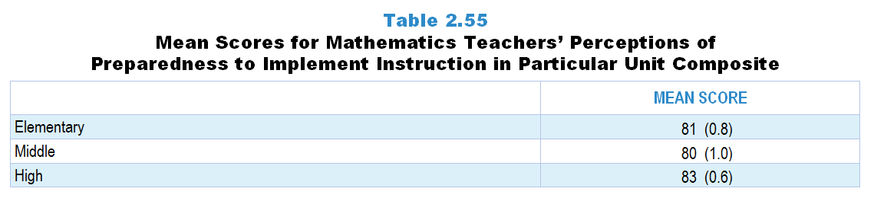
Original Data for Slide 69
(not for presentation)
Notes:
Table 2.55, p. 40 in Technical Report
This slide shows data from composites.
Sets of related questionnaire items were combined to create several composite variables related to key constructs. Composite variables, which are more reliable than individual survey items, were computed to have a minimum possible value of 0 and a maximum possible value of 100. Higher composite scores indicate more of the construct being measure by the composite. Each composite is calculated by summing the responses to the items associated with that composite and then dividing by the total points possible. In order for the composites to be on a 100-point scale, the lowest response option on each scale was set to 0 and the others were adjusted accordingly; so for example, an item with a scale ranging from 1 to 4 was re-coded to have a scale of 0 to 3. By doing this, someone who marks the lowest point on every item in a composite receives a composite score of 0 rather than some positive number. It also assures that 50 is the true mid-point. The denominator for each composite is determined by computing the maximum possible sum of responses for a series of items and dividing by 100; e.g., a 9-item composite where each item is on a scale of 0–3 would have a denominator of 0.27. Composites values were not computed for participants who respond to fewer than two-thirds of the items that form the composite.
Perceptions of Preparedness to Implement Instruction in Particular Unit Composite Items
Q53a. Anticipate difficulties that students may have with particular mathematical ideas and procedures in this unit
Q53b. Find out what students thought or already knew about the key mathematical ideas
Q53c. Implement the instructional materials (for example: mathematics textbook) to be used during this unit
Q53d. Monitor student understanding during this unit
Q53e. Assess student understanding at the conclusion of this unit
Mathematics Teacher Questionnaire
Q53. How well prepared do you feel to do each of the following as part of your instruction on this particular unit? [Select one on each row.] (Response Options: [1] Not adequately prepared, [2] Somewhat prepared, [3] Fairly well prepared, [4] Very well prepared)
Anticipate difficulties that students may have with particular mathematical ideas and procedures in this unit
Find out what students thought or already knew about the key mathematical ideas
Implement the instructional materials (for example: mathematics textbook) to be used during this unit
Monitor student understanding during this unit
Assess student understanding at the conclusion of this unit
The numbers in parentheses are standard errors.
Findings Highlighted in Technical Report
“As can be seen in Table 2.55, mathematics teachers feel relatively well prepared to implement instruction in a particular unit. Among the three grade bands, high school teachers feel slightly more prepared than elementary and middle grades teachers.”

Slide 69
Mathematics Teachers’ Perceptions of Preparedness to Implement Instruction in Particular Unit Composite

Slide 70
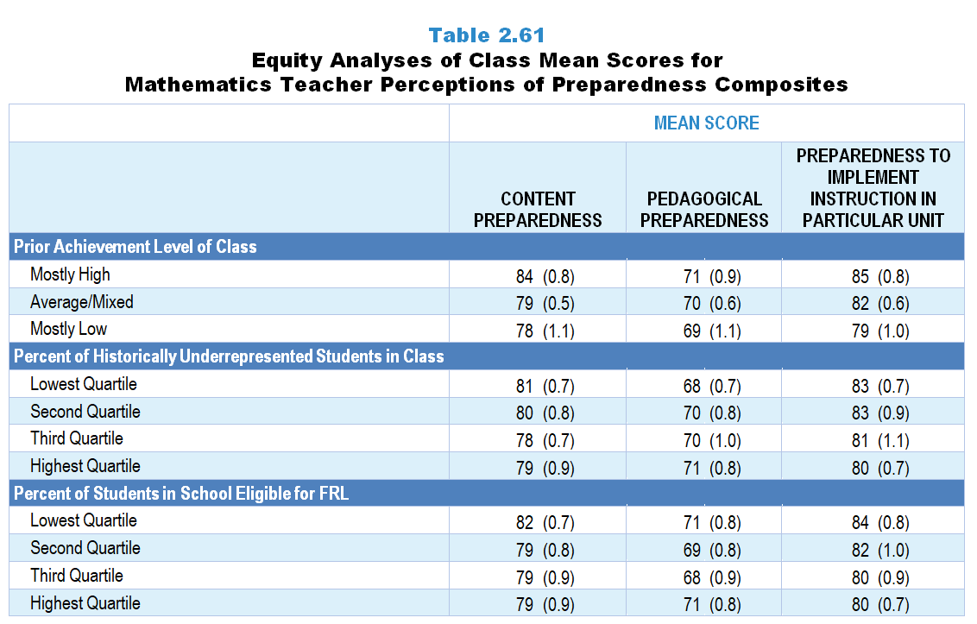
Original Data for Slides 71–73
(not for presentation)
Notes:
Table 2.61, p. 43 in Technical Report
This slide shows data from composites.
Sets of related questionnaire items were combined to create several composite variables related to key constructs. Composite variables, which are more reliable than individual survey items, were computed to have a minimum possible value of 0 and a maximum possible value of 100. Higher composite scores indicate more of the construct being measure by the composite. Each composite is calculated by summing the responses to the items associated with that composite and then dividing by the total points possible. In order for the composites to be on a 100-point scale, the lowest response option on each scale was set to 0 and the others were adjusted accordingly; so for example, an item with a scale ranging from 1 to 4 was re-coded to have a scale of 0 to 3. By doing this, someone who marks the lowest point on every item in a composite receives a composite score of 0 rather than some positive number. It also assures that 50 is the true mid-point. The denominator for each composite is determined by computing the maximum possible sum of responses for a series of items and dividing by 100; e.g., a 9-item composite where each item is on a scale of 0–3 would have a denominator of 0.27. Composites values were not computed for participants who respond to fewer than two-thirds of the items that form the composite.
Perceptions of Content Preparedness (Self-Contained Teachers)
Q23a. Number and Operations
Q23b. Early Algebra
Q23c. Geometry
Q23d. Measurement and Data Representation
Perceptions of Content Preparedness (Non Self-Contained Teachers)
Q24a. The number system and operations
Q24b. Algebraic thinking
Q24c. Functions
Q24d. Modeling
Q24e. Measurement
Q24f. Geometry
Q24g. Statistics and probability
Q24h. Discrete mathematics
Perceptions of Pedagogical Preparedness Composite Items
Q25a. Develop students’ conceptual understanding of the mathematical ideas you teach
Q25b. Develop students’ abilities to do mathematics (for example: consider how to approach a problem, explain and justify solutions, create and use mathematical models)
Q25c. Develop students’ awareness of STEM careers
Q25d. Provide mathematics instruction that is based on students’ ideas (whether completely correct or not) about the topics you teach
Q25e. Use formative assessment to monitor student learning
Q25f. Differentiate mathematics instruction to meet the needs of diverse learners
Q25g. Incorporate students’ cultural backgrounds into mathematics instruction
Q25h. Encourage students' interest in mathematics
Q25i. Encourage participation of all students in mathematics
Perceptions of Preparedness to Implement Instruction in Particular Unit Composite Items
Q53a. Anticipate difficulties that students may have with particular mathematical ideas and procedures in this unit
Q53b. Find out what students thought or already knew about the key mathematical ideas
Q53c. Implement the instructional materials (for example: mathematics textbook) to be used during this unit
Q53d. Monitor student understanding during this unit
Q53e. Assess student understanding at the conclusion of this unit
Mathematics Teacher Questionnaire
Q23. Many teachers feel better prepared to teach some subjects/topics than others. How well prepared do you feel to teach each of the following at the grade level(s) you teach, whether or not they are currently included in your teaching responsibilities? (Response Options: [1] Not adequately prepared, [2] Somewhat prepared, [3] Fairly well prepared, [4] Very well prepared)
Number and Operations
Early Algebra
Geometry
Measurement and Data Representation
Science
Computer Science
Reading/Language Arts
Social Studies
Q24. Within mathematics many teachers feel better prepared to teach some topics than others. How prepared do you feel to teach each of the following topics at the grade level(s) you teach, whether or not they are currently included in your curriculum? (Response Options: [1] Not adequately prepared, [2] Somewhat prepared, [3] Fairly well prepared, [4] Very well prepared)
The number system and operations
Algebraic thinking
Functions
Modeling
Measurement
Geometry
Statistics and probability
Discrete mathematics
Computer science/programming
Q25. How well prepared do you feel to do each of the following in your mathematics instruction? [Select one on each row.]
Develop students’ conceptual understanding of the mathematical ideas you teach
Develop students’ abilities to do mathematics (for example: consider how to approach a problem, explain and justify solutions, create and use mathematical models)
Develop students’ awareness of STEM careers
Provide mathematics instruction that is based on students’ ideas (whether completely correct or not) about the topics you teach
Use formative assessment to monitor student learning
Differentiate mathematics instruction to meet the needs of diverse learners
Incorporate students’ cultural backgrounds into mathematics instruction
Encourage students' interest in mathematics
Encourage participation of all students in mathematics
Q53. How well prepared do you feel to do each of the following as part of your instruction on this particular unit? [Select one on each row.]
Anticipate difficulties that students may have with particular mathematical ideas and procedures in this unit
Find out what students thought or already knew about the key mathematical ideas
Implement the instructional materials (for example: mathematics textbook) to be used during this unit
Monitor student understanding during this unit
Assess student understanding at the conclusion of this unit
Q31. Which of the following best describes the prior mathematics achievement levels of the students in this class relative to other students in this school?
Mostly low achievers
Mostly average achievers
Mostly high achievers
A mixture of levels
Q30. For the number of students in this class, indicate the number of males and females in each of the following categories of race/ethnicity.
American Indian or Alaskan Native _____ _____
Asian _____ _____
Black or African American _____ _____
Hispanic/Latino _____ _____
Native Hawaiian or Other Pacific Islander _____ _____
White _____ _____
Two or more races _____ _____
The numbers in parentheses are standard errors.
Chapters 2–7 in the technical report provide data on several key indicators, disaggregated by one or more equity factors: the prior achievement level of students in the class, the percentage of students from race/ethnicity groups historically underrepresented in STEM in the class, the percentage of students in the school eligible for free/reduced-price lunch (FRL), school size, community type, and region. For FRL, each school was classified into one of four categories (defined as quartiles) based on the proportion of students eligible for FRL. Similarly, each randomly selected class was classified into one of the four categories based on the proportion of students from race/ethnicity groups historically underrepresented in STEM in the class.
Findings Highlighted in Technical Report
“Table 2.61 shows the mean scores on each of the teacher preparedness composites for mathematics classes by the same three equity variables. As is the case in science, classes of mostly high prior achievers are significantly more likely than those that include mostly low prior achievers to be taught by teachers who feel well prepared in mathematics content and to implement instruction in a particular unit. Also similar to science, classes containing a higher proportion of students from race/‌ethnicity groups historically underrepresented in STEM and classes in higher poverty schools are somewhat less likely to be taught by teachers who feel well prepared to implement instruction in a particular unit.”

Slide 71
Mathematics Teacher Perceptions of Preparedness Composites, by Prior Achievement Level

Slide 72
Mathematics Teacher Perceptions of Preparedness Composites, by Percentage of Historically Underrepresented Students
Notes:
Historically Underrepresented Students includes American Indian or Alaskan Native, Black or African American, Hispanic or Latino, or Native Hawaiian or Other Pacific Islander students.
Slide shows the composite scores by quartile of percentage of historically underrepresented students in the randomly selected class.

Slide 73
Mathematics Teacher Perceptions of Preparedness Composites, by Percentage Students Eligible for FRL
Notes:
Slide shows the composite scores by quartile of percent eligible for free/reduced-price lunch in the school.
Slide shows the composite scores by quartile of percentage of students in school eligible for free and reduced lunch.

Slide 74
Teacher Leadership Roles and Responsibilities

Slide 75
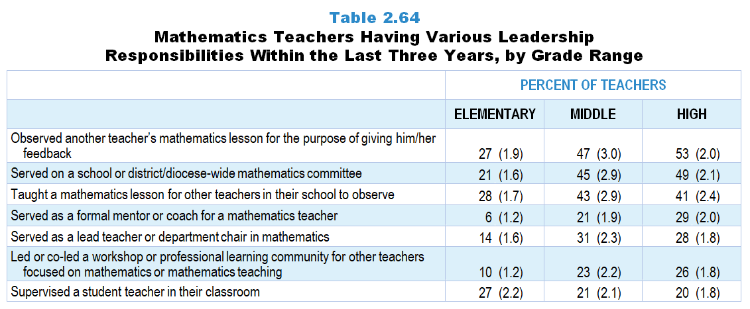
Original Data for Slides 76–78
Notes:
Table 2.64, p. 45 in Technical Report
Table shows data from individual items.
Mathematics Teacher Questionnaire
Q27. In the last 3 years have you… [Select one on each row.]
Served as a lead teacher or department chair in mathematics?
Served as a formal mentor or coach for a mathematics teacher? (Do not include supervision of student teachers.)
Supervised a student teacher in your classroom?
Served on a school or district/diocese-wide mathematics committee (for example: developing curriculum, developing pacing guides, selecting instructional materials)?
Led or co-led a workshop or professional learning community (for example: teacher study group, lesson study) for other teachers focused on mathematics or mathematics teaching?
Taught a mathematics lesson for other teachers in your school to observe?
Observed another teacher’s mathematics lesson for the purpose of giving him/her feedback?
The numbers in parentheses are standard errors.
Findings Highlighted in Technical Report
“Roles and responsibilities held by mathematics teachers within the past three years are quite similar to those held by science teachers and vary by grade range in similar ways (see Table 2.64). Secondary mathematics teachers, like secondary science teachers, are more likely than their elementary counterparts to have served as a formal mentor but less likely to have supervised student teachers. Elementary teachers are much more likely to have taught a mathematics lesson for other teachers in their school to observe than a science lesson.”

Slide 76
Elementary Mathematics Teachers Having Various Leadership Responsibilities Within the Last Three Years
Notes:
Note: Each grade-level chart is sorted independently; consequently items may appear in different orders.

Slide 77
Middle School Mathematics Teachers Having Various Leadership Responsibilities Within the Last Three Years
Notes:
Note: Each grade-level chart is sorted independently; consequently items may appear in different orders.

Slide 78
High School Mathematics Teachers Having Various Leadership Responsibilities Within the Last Three Years
Notes:
Note: Each grade-level chart is sorted independently; consequently items may appear in different orders.

