Slide 1
Chapter 2
Teacher Background and Beliefs
Science

Slide 2
Teacher Characteristics

Slide 3
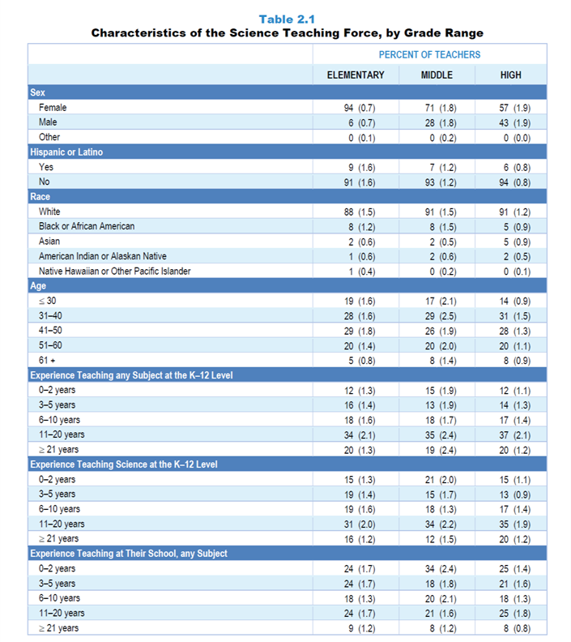
Original Data for Slides 4–7
(not for presentation)
Notes:
Table 2.1, p. 8 in Technical Report
This slide shows data from individual items.
Science Teacher Questionnaire
Q1. How many years have you taught prior to this school year:
any subject at the K–12 level? _____
science at the K–12 level? _____
at this school, any subject? _____
Q71. Indicate your sex:
Female
Male
Other
Q72. Are you of Hispanic or Latino origin?
Yes
No
Q73. What is your race? [Select all that apply.]
American Indian or Alaskan Native
Asian
Black or African American
Native Hawaiian or Other Pacific Islander
White
Q74. In what year were you born? _____
The numbers in parentheses are standard errors.
Findings Highlighted in Technical Report
“As can be seen in Table 2.1, the vast majority of science teachers at the elementary level are female. The proportion of science teachers who are female decreases as grade level increases, to about 60 percent at the high school level. Science teachers’ experience teaching any subject at the K–12 level is similar across grade ranges, though middle school science teachers tend to be less experienced teaching science and more likely to be new to their school. In addition, the majority of the science teaching force is older than 40, with roughly 25 percent of science teachers in each grade range being older than 50. Fewer than 20 percent are age 30 or younger.
Black, Hispanic, and Asian teachers continue to be underrepresented in the science teaching force. At a time when only about half the K–12 student enrollment is White and non-Hispanic, the vast majority of science teachers in each grade range characterize themselves that way.”

Slide 4
Science Teacher Characteristics

Slide 5
Science Teacher Race/Ethnicity
Percent of Teachers

Slide 6
Science Teacher Age

Slide 7
Experience Teaching Science at
K–12 Level
Percent of Teachers

Slide 8
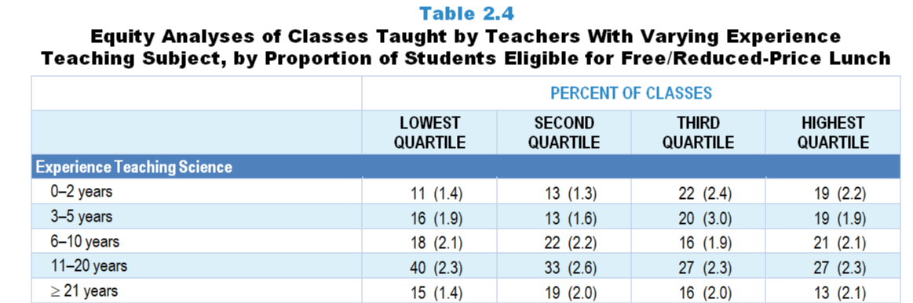
Original Data for Slide 9
(not for presentation)
Notes:
The science portion of Table 2.4, p. 12 in Technical Report
This slide shows data from an individual item.
Science Teacher Questionnaire
Q1. How many years have you taught prior to this school year:
any subject at the K–12 level? _____
science at the K–12 level? _____
at this school, any subject? _____
The numbers in parentheses are standard errors.
Chapters 2–7 in the technical report provide data on several key indicators, disaggregated by one or more equity factors: the prior achievement level of students in the class, the percentage of students from race/ethnicity groups historically underrepresented in STEM in the class, the percentage of students in the school eligible for free/reduced-price lunch (FRL), school size, community type, and region. For FRL, each school was classified into one of four categories (defined as quartiles) based on the proportion of students eligible for FRL. Similarly, each randomly selected class was classified into one of the four categories based on the proportion of students from race/ethnicity groups historically underrepresented in STEM in the class.
Findings Highlighted in Technical Report
“Analyses were conducted to examine how teachers are distributed among schools—for example, whether teachers with the least experience are concentrated in high-poverty schools (i.e., schools with high proportions of students eligible for free/‌reduced-price lunch). As can be seen in Table 2.4, science classes in high-poverty schools are more likely than those in low-poverty schools to be taught by teachers with five or fewer years of experience. In addition, a majority of computer science classes in high-poverty schools are taught by those with only 0–2 years of experience teaching the subject.”

Slide 9
Classes Taught by Science Teachers With 5 or Fewer Years Experience Teaching Science
Notes:
Slide shows the composite scores by quartile of percentage of students in school eligible for free and reduced lunch.

Slide 10
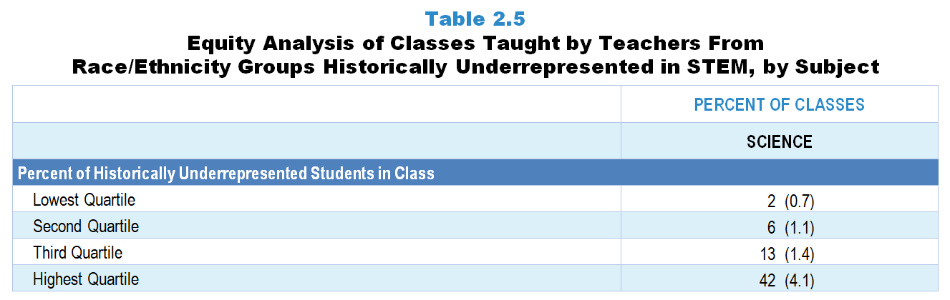
Original Data for Slide 11
(not for presentation)
Notes:
The science portion of Table 2.5, p. 12 in Technical Report
This slide shows data derived from:
Science Teacher Questionnaire
Q42. For the students in this class, indicate the number of males and females in this class in each of the following categories of race/ethnicity.
American Indian or Alaskan Native _____ _____
Asian _____ _____
Black or African American _____ _____
Hispanic/Latino _____ _____
Native Hawaiian or Other Pacific Islander _____ _____
White _____ _____
Two or more races _____ _____
Q72. Are you of Hispanic or Latino origin?
Yes
No
Q73. What is your race? [Select all that apply.]
American Indian or Alaska Native
Asian
Black or African American
Native Hawaiian or Other Pacific Islander
White
The numbers in parentheses are standard errors.
Chapters 2–7 in the technical report provide data on several key indicators, disaggregated by one or more equity factors: the prior achievement level of students in the class, the percentage of students from race/ethnicity groups historically underrepresented in STEM in the class, the percentage of students in the school eligible for free/reduced-price lunch (FRL), school size, community type, and region. For FRL, each school was classified into one of four categories (defined as quartiles) based on the proportion of students eligible for FRL. Similarly, each randomly selected class was classified into one of the four categories based on the proportion of students from race/ethnicity groups historically underrepresented in STEM in the class.
Findings Highlighted in Technical Report
“Table 2.5 shows the percentage of classes taught by teachers from race/‌ethnicity groups historically underrepresented in STEM by the proportion of students from these groups in the class. Note that across all three subjects, classes in the highest quartile in terms of students from these groups are more likely than those in the lowest quartile to be taught by teachers from these groups.”

Slide 11
Science Classes Taught by Teachers From Race/Ethnicity Groups Historically Underrepresented in Science
Notes:
Historically Underrepresented Students/Teachers includes American Indian or Alaskan Native, Black or African American, Hispanic or Latino, or Native Hawaiian or Other Pacific Islander teachers/students.
Slide shows the composite scores by quartile of percentage of historically underrepresented students in the randomly selected class.

Slide 12
Teacher Preparation

Slide 13
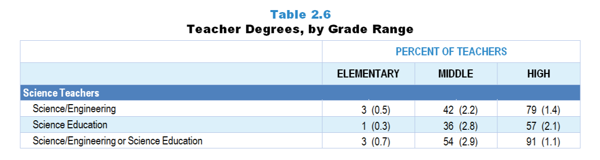
Original Data for Slide 13
(not for presentation)
Notes:
The science portion of Table 2.6, p. 13 in Technical Report
This slide shows data derived from:
Science Teacher Questionnaire
Q12. Have you been awarded one or more bachelor’s and/or graduate degrees in the following fields? (With regard to bachelor’s degrees, count only areas in which you majored.) (Response Options: Yes, No)
Education, including science education
Engineering
Natural Sciences
Other, please specify _____
Q13. What type of education degree do you have? (With regard to bachelor’s degrees, count only areas in which you majored.) [Select all that apply.]
Elementary Education
Mathematics Education
Science Education
Other Education, please specify _____
The numbers in parentheses are standard errors.
Findings Highlighted in Technical Report
“As can be seen in Table 2.6, very few elementary teachers have college or graduate degrees in science or mathematics. The percentage of teachers with one or more degrees in science or mathematics increases with increasing grade range, with 79 percent of high school science teachers and 55 percent of high school mathematics teachers having a major in their discipline. If the definition of degree in discipline is expanded to include degrees in science/‌mathematics education, these figures increase to 91 percent of high school science teachers and 79 percent of high school mathematics teachers. Only about 1 in 4 computer science teachers have a degree in computer engineering, computer science, or information science, and very few have a degree in computer science education.”

Slide 14
Science Teacher Degrees

Slide 15
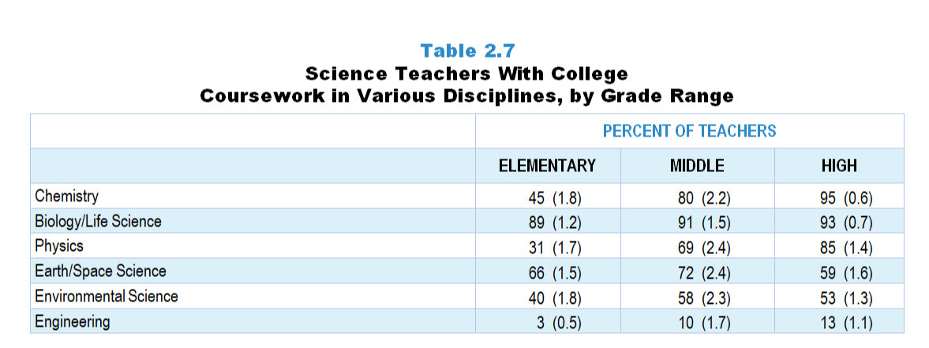
Original Data for Slides 16–18
(not for presentation)
Notes:
Table 2.7, p. 14 in Technical Report
This slide shows data derived from:
Science Teacher Questionnaire
16. Did you complete any of the following types of biology/life science courses at the undergraduate or graduate level? [Select one on each row.] (Response Options: Yes, No)
General/introductory biology/life science courses (for example: Biology I, Introduction to Biology, Biology for Teachers)
Biology/life science courses beyond the general/introductory level
Biology/life science teaching methods courses
18. Did you complete any of the following types of chemistry courses at the undergraduate or graduate level? [Select one on each row.] (Response Options: Yes, No)
General/introductory chemistry courses (for example: Chemistry I, Introduction to Chemistry)
Chemistry courses beyond the general/introductory level
Chemistry teaching methods courses
20. Did you complete any of the following types of physics courses at the undergraduate or graduate level? [Select one on each row.] (Response Options: Yes, No)
General/introductory physics courses (for example: Physics I, Introduction to Physics)
Physics courses beyond the general/introductory level
Physics teaching methods courses
22. Did you complete any of the following types of Earth/space science courses at the undergraduate or graduate level? [Select one on each row.] (Response Options: Yes, No)
General/introductory Earth/space science courses (for example: Earth Science I, Introduction to Earth Science, Introductory Astronomy)
Earth/space science courses beyond the general/introductory level
Earth/space science teaching methods courses
24. Did you complete any of the following types of environmental science courses at the undergraduate or graduate level? [Select one on each row.] (Response Options: Yes, No)
General/introductory environmental science courses (for example: Environmental Science I, Introduction to Environmental Science)
Environmental science courses beyond the general/introductory level
Environmental science teaching methods courses
26. Did you complete one or more engineering courses at the undergraduate or graduate level? (Response Options: Yes, No)
The numbers in parentheses are standard errors.
Findings Highlighted in Technical Report
“Table 2.7 shows the percentage of science teachers in each grade range with at least one college course in each of a number of science disciplines. Note that the vast majority of science teachers at each level have had coursework in the life sciences, and 59–72 percent have had coursework in Earth/‌space science. In contrast, in chemistry and physics, the percentage of teachers with at least one college course in the discipline increases substantially with increasing grade range. Few teachers at any grade level have had coursework in engineering.”

Slide 16
Elementary Science Teachers With at Least One College Course in Various Science Disciplines
Notes:
Note: Each grade-level chart is sorted independently; consequently items may appear in different orders.

Slide 17
Middle School Science Teachers With at Least One College Course in Various Science Disciplines
Notes:
Note: Each grade-level chart is sorted independently; consequently items may appear in different orders.

Slide 18
High School Science Teachers With at Least One College Course in Various Science Disciplines
Notes:
Note: Each grade-level chart is sorted independently; consequently items may appear in different orders.

Slide 19
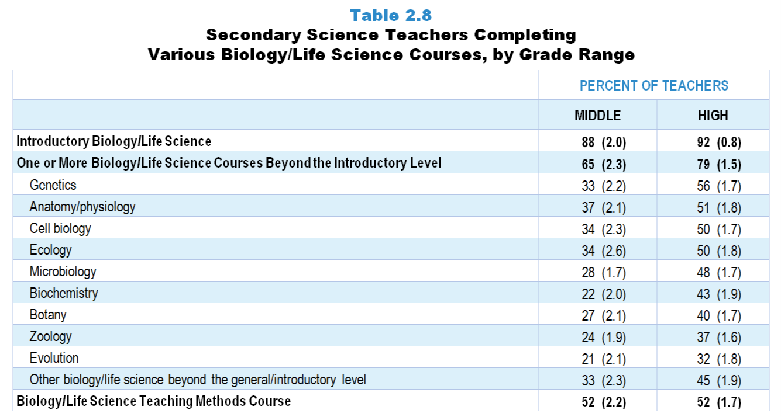
Original Data for Slides 20–21
(not for presentation)
Notes:
Table 2.8, p. 14 in Technical Report
This slide shows data from individual items:
Science Teacher Questionnaire
16. Did you complete any of the following types of biology/life science courses at the undergraduate or graduate level? [Select one on each row.] (Response Options: Yes, No)
General/introductory biology/life science courses (for example: Biology I, Introduction to Biology, Biology for Teachers)
Biology/life science courses beyond the general/introductory level
Biology/life science teaching methods courses
17. [Presented only to teachers that selected “Yes” for Q16b]
Please indicate which of the following biology/life science courses you completed (beyond a general/introductory course) at the undergraduate or graduate level. [Select all that apply.]
Anatomy/Physiology
Biochemistry
Botany
Cell Biology
Ecology
Evolution
Genetics
Microbiology
Zoology
Other biology/life science beyond the general/introductory level
The numbers in parentheses are standard errors.
Findings Highlighted in Technical Report
“Tables 2.8–2.12 provide additional information about secondary science teacher coursework in biology, chemistry, physics, Earth/‌space science, and environmental science, respectively, in each case showing the percentage of middle and high school teachers who have had one or more courses beyond the introductory level, as well as the percentage who have completed each of a number of individual courses. Typically, high school teachers are substantially more likely than their middle grades counterparts to have taken coursework beyond the introductory level in a given discipline. Teachers were also asked whether they have had one or more teaching methods courses in a given discipline. About half of teachers at each level have had a methods course focused on biology/‌life science. Far fewer (14–22 percent of middle school teachers and 7–23 percent of high school teachers) have had methods courses in the other disciplines. “

Slide 20
Middle School Science Teachers Completing Various Biology/‌Life Science Courses
Notes:
Note: Each grade-level chart is sorted independently; consequently items may appear in different orders.

Slide 21
High School Science Teachers Completing Various Biology/‌Life Science Courses
Notes:
Note: Each grade-level chart is sorted independently; consequently items may appear in different orders.

Slide 22
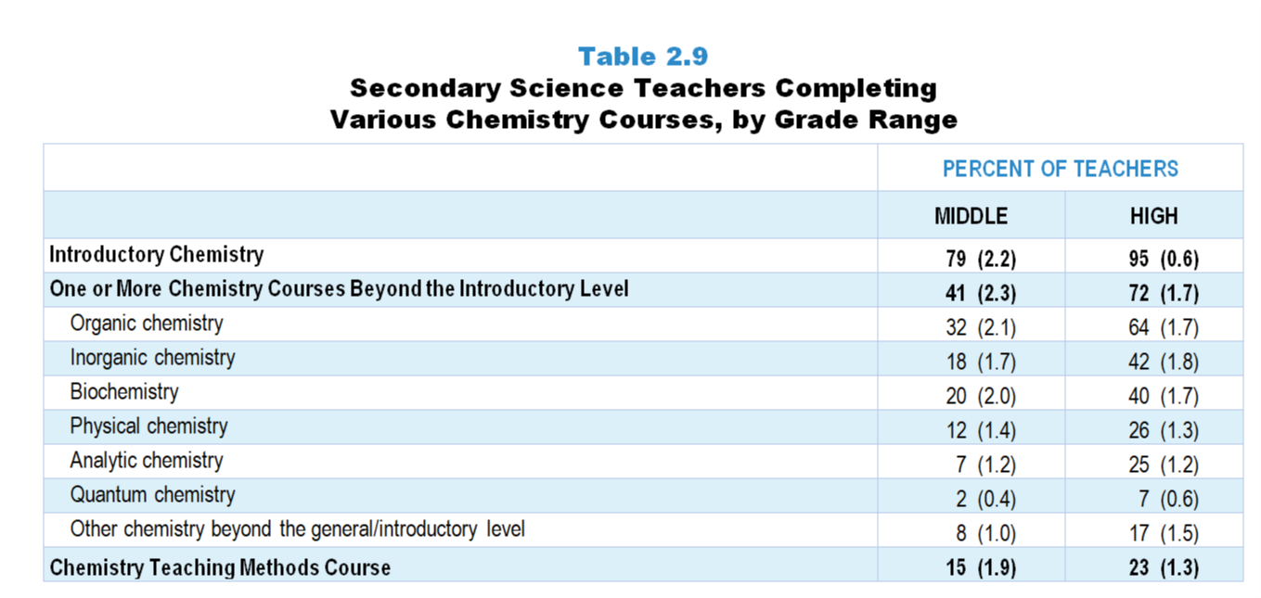
Original Data for Slides 23–24
(not for presentation)
Notes:
Table 2.9, p. 15 in Technical Report
This slide shows data from individual items:
18. Did you complete any of the following types of chemistry courses at the undergraduate or graduate level? [Select one on each row.] (Response Options: Yes, No)
General/introductory chemistry courses (for example: Chemistry I, Introduction to Chemistry)
Chemistry courses beyond the general/introductory level
Chemistry teaching methods courses
19. [Presented only to teachers that selected “Yes” for Q18b]
Please indicate which of the following chemistry courses you completed (beyond a general/introductory course) at the undergraduate or graduate level. [Select all that apply.]
Analytic Chemistry
Biochemistry
Inorganic Chemistry
Organic Chemistry
Physical Chemistry
Quantum Chemistry
Other chemistry beyond the general/introductory level
The numbers in parentheses are standard errors.
Findings Highlighted in Technical Report
“Tables 2.8–2.12 provide additional information about secondary science teacher coursework in biology, chemistry, physics, Earth/‌space science, and environmental science, respectively, in each case showing the percentage of middle and high school teachers who have had one or more courses beyond the introductory level, as well as the percentage who have completed each of a number of individual courses. Typically, high school teachers are substantially more likely than their middle grades counterparts to have taken coursework beyond the introductory level in a given discipline. Teachers were also asked whether they have had one or more teaching methods courses in a given discipline. About half of teachers at each level have had a methods course focused on biology/‌life science. Far fewer (14–22 percent of middle school teachers and 7–23 percent of high school teachers) have had methods courses in the other disciplines. “

Slide 23
Middle School Science Teachers Completing Various Chemistry Courses
Notes:
Note: Each grade-level chart is sorted independently; consequently items may appear in different orders.

Slide 24
High School Science Teachers Completing Various Chemistry Courses
Notes:
Note: Each grade-level chart is sorted independently; consequently items may appear in different orders.

Slide 25
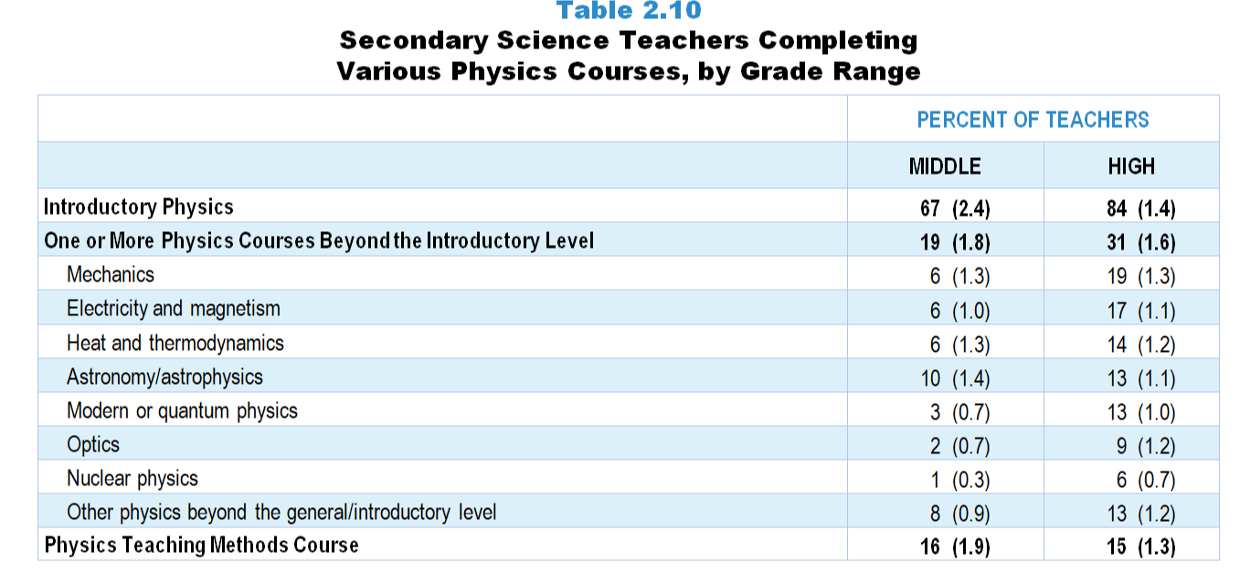
Original Data for Slides 26–27
(not for presentation)
Notes:
Table 2.10, p. 15 in Technical Report
This slide shows data from individual items:
20. Did you complete any of the following types of physics courses at the undergraduate or graduate level? [Select one on each row.] (Response Options: Yes, No)
General/introductory physics courses (for example: Physics I, Introduction to Physics)
Physics courses beyond the general/introductory level
Physics teaching methods courses
21. [Presented only to teachers that selected “Yes” for Q20b]
Please indicate which of the following physics courses you completed (beyond a general/introductory course) at the undergraduate or graduate level. [Select all that apply.]
Astronomy/Astrophysics
Electricity and Magnetism
Heat and Thermodynamics
Mechanics
Modern or Quantum Physics
Nuclear Physics
Optics
Other physics beyond the general/introductory level
The numbers in parentheses are standard errors.
Findings Highlighted in Technical Report
“Tables 2.8–2.12 provide additional information about secondary science teacher coursework in biology, chemistry, physics, Earth/‌space science, and environmental science, respectively, in each case showing the percentage of middle and high school teachers who have had one or more courses beyond the introductory level, as well as the percentage who have completed each of a number of individual courses. Typically, high school teachers are substantially more likely than their middle grades counterparts to have taken coursework beyond the introductory level in a given discipline. Teachers were also asked whether they have had one or more teaching methods courses in a given discipline. About half of teachers at each level have had a methods course focused on biology/‌life science. Far fewer (14–22 percent of middle school teachers and 7–23 percent of high school teachers) have had methods courses in the other disciplines. “

Slide 26
Middle School Science Teachers Completing Various Physics Courses
Notes:
Note: Each grade-level chart is sorted independently; consequently items may appear in different orders.

Slide 27
High School Science Teachers Completing Various Physics Courses
Notes:
Note: Each grade-level chart is sorted independently; consequently items may appear in different orders.

Slide 28
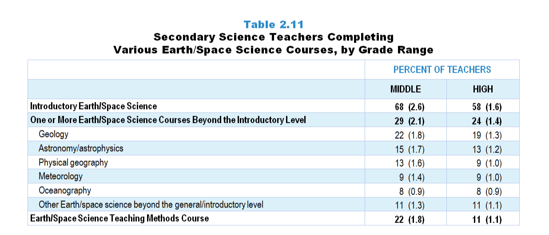
Original Data for Slides 29–30
(not for presentation)
Notes:
Table 2.11, p. 16 in Technical Report
This slide shows data from individual items:
22. Did you complete any of the following types of Earth/space science courses at the undergraduate or graduate level? [Select one on each row.] (Response Options: Yes, No)
General/introductory Earth/space science courses (for example: Earth Science I, Introduction to Earth Science, Introductory Astronomy)
Earth/space science courses beyond the general/introductory level
Earth/space science teaching methods courses
23. [Presented only to teachers that selected “Yes” for Q22b]
Please indicate which of the following Earth/space science courses you completed (beyond a general/introductory course) at the undergraduate or graduate level. [Select all that apply.]
Astronomy/Astrophysics
Geology
Meteorology
Oceanography
Physical Geography
Other Earth/space science beyond the general/introductory level
The numbers in parentheses are standard errors.
Findings Highlighted in Technical Report
“Tables 2.8–2.12 provide additional information about secondary science teacher coursework in biology, chemistry, physics, Earth/‌space science, and environmental science, respectively, in each case showing the percentage of middle and high school teachers who have had one or more courses beyond the introductory level, as well as the percentage who have completed each of a number of individual courses. Typically, high school teachers are substantially more likely than their middle grades counterparts to have taken coursework beyond the introductory level in a given discipline. Teachers were also asked whether they have had one or more teaching methods courses in a given discipline. About half of teachers at each level have had a methods course focused on biology/‌life science. Far fewer (14–22 percent of middle school teachers and 7–23 percent of high school teachers) have had methods courses in the other disciplines. “

Slide 29
Middle School Science Teachers Completing Various Earth/Space Science Courses
Notes:
Note: Each grade-level chart is sorted independently; consequently items may appear in different orders.

Slide 30
High School Science Teachers Completing Various Earth/Space Science Courses
Notes:
Note: Each grade-level chart is sorted independently; consequently items may appear in different orders.

Slide 31
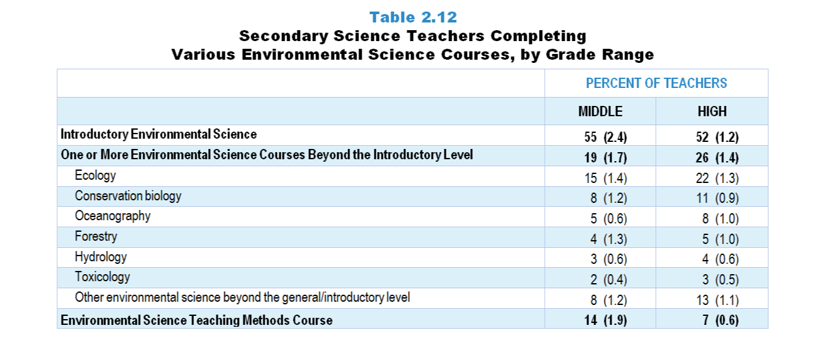
Original Data for Slides 32–33
(not for presentation)
Notes:
Table 2.12, p. 16 in Technical Report
This slide shows data from individual items:
24. Did you complete any of the following types of environmental science courses at the undergraduate or graduate level? [Select one on each row.] (Response Options: Yes, No)
General/introductory environmental science courses (for example: Environmental Science I, Introduction to Environmental Science)
Environmental science courses beyond the general/introductory level
Environmental science teaching methods courses
25. [Presented only to teachers that selected “Yes” for Q24b]
Please indicate which of the following environmental science courses you completed (beyond a general/introductory course) at the undergraduate or graduate level. [Select all that apply.]
Conservation Biology
Ecology
Forestry
Hydrology
Oceanography
Toxicology
Other environmental science beyond the general/introductory level
The numbers in parentheses are standard errors.
Findings Highlighted in Technical Report
“Tables 2.8–2.12 provide additional information about secondary science teacher coursework in biology, chemistry, physics, Earth/‌space science, and environmental science, respectively, in each case showing the percentage of middle and high school teachers who have had one or more courses beyond the introductory level, as well as the percentage who have completed each of a number of individual courses. Typically, high school teachers are substantially more likely than their middle grades counterparts to have taken coursework beyond the introductory level in a given discipline. Teachers were also asked whether they have had one or more teaching methods courses in a given discipline. About half of teachers at each level have had a methods course focused on biology/‌life science. Far fewer (14–22 percent of middle school teachers and 7–23 percent of high school teachers) have had methods courses in the other disciplines. “

Slide 32
Middle School Science Teachers Completing Various Environmental Science Courses
Notes:
Note: Each grade-level chart is sorted independently; consequently items may appear in different orders.

Slide 33
High School Science Teachers Completing Various Environmental Science Courses
Notes:
Note: Each grade-level chart is sorted independently; consequently items may appear in different orders.

Slide 34
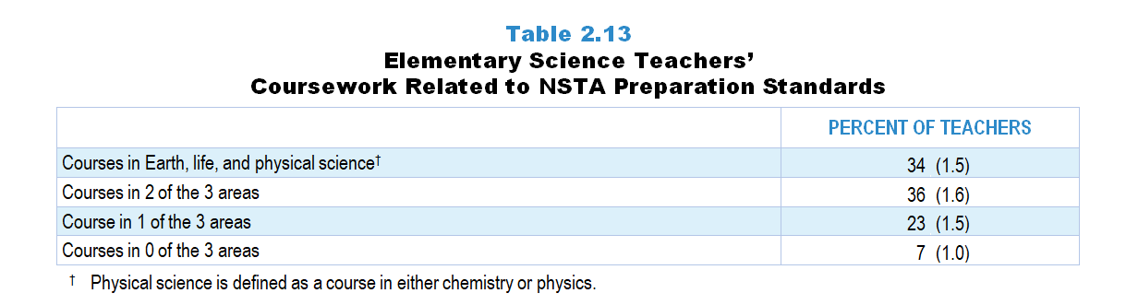
Original Data for Slide 35
(not for presentation)
Notes:
Table 2.13, p. 17 in Technical Report
This slide shows data derived from:
Science Teacher Questionnaire
16. Did you complete any of the following types of biology/life science courses at the undergraduate or graduate level? [Select one on each row.] (Response Options: Yes, No)
General/introductory biology/life science courses (for example: Biology I, Introduction to Biology, Biology for Teachers)
Biology/life science courses beyond the general/introductory level
Biology/life science teaching methods courses
18. Did you complete any of the following types of chemistry courses at the undergraduate or graduate level? [Select one on each row.] (Response Options: Yes, No)
General/introductory chemistry courses (for example: Chemistry I, Introduction to Chemistry)
Chemistry courses beyond the general/introductory level
Chemistry teaching methods courses
20. Did you complete any of the following types of physics courses at the undergraduate or graduate level? [Select one on each row.] (Response Options: Yes, No)
General/introductory physics courses (for example: Physics I, Introduction to Physics)
Physics courses beyond the general/introductory level
Physics teaching methods courses
22. Did you complete any of the following types of Earth/space science courses at the undergraduate or graduate level? [Select one on each row.] (Response Options: Yes, No)
General/introductory Earth/space science courses (for example: Earth Science I, Introduction to Earth Science, Introductory Astronomy)
Earth/space science courses beyond the general/introductory level
Earth/space science teaching methods courses
The numbers in parentheses are standard errors.
Findings Highlighted in Technical Report
“Teachers of science in the elementary grades are typically responsible for instruction across science disciplines. Accordingly, the National Science Teachers Association (NSTA) has recommended that rather than studying a single science discipline in depth, elementary science teachers be prepared to teach life science, Earth science, and physical science. As a proxy for the competencies outlined by NSTA in these different areas, teachers were asked about their coursework in each. As can be seen in Table 2.13, 34 percent of elementary science teachers have had courses in all three of those areas, and another 36 percent have had coursework in 2 of the 3 areas. At the other end of the spectrum, 7 percent of elementary science teachers have not had any college science courses in these areas.”

Slide 35
Elementary Science Teacher Coursework Related to NSTA Preparation Standards
Notes:
Physical science is defined as a course in either chemistry or physics.

Slide 36
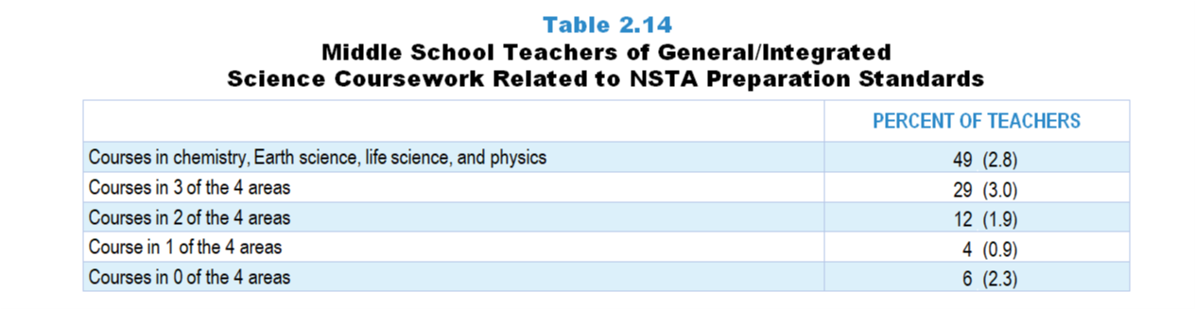
Original Data for Slide 37
(not for presentation)
Notes:
Table 2.14, p. 17 in Technical Report
This slide shows data derived from:
Science Teacher Questionnaire
16. Did you complete any of the following types of biology/life science courses at the undergraduate or graduate level? [Select one on each row.] (Response Options: Yes, No)
General/introductory biology/life science courses (for example: Biology I, Introduction to Biology, Biology for Teachers)
Biology/life science courses beyond the general/introductory level
Biology/life science teaching methods courses
18. Did you complete any of the following types of chemistry courses at the undergraduate or graduate level? [Select one on each row.] (Response Options: Yes, No)
General/introductory chemistry courses (for example: Chemistry I, Introduction to Chemistry)
Chemistry courses beyond the general/introductory level
Chemistry teaching methods courses
20. Did you complete any of the following types of physics courses at the undergraduate or graduate level? [Select one on each row.] (Response Options: Yes, No)
General/introductory physics courses (for example: Physics I, Introduction to Physics)
Physics courses beyond the general/introductory level
Physics teaching methods courses
22. Did you complete any of the following types of Earth/space science courses at the undergraduate or graduate level? [Select one on each row.] (Response Options: Yes, No)
General/introductory Earth/space science courses (for example: Earth Science I, Introduction to Earth Science, Introductory Astronomy)
Earth/space science courses beyond the general/introductory level
Earth/space science teaching methods courses
The numbers in parentheses are standard errors.
Findings Highlighted in Technical Report
“Forty-nine percent of middle grades teachers of general or integrated science have had at least one college course in chemistry, Earth science, life science, and physics. An additional 29 percent have had coursework in 3 of the 4 areas (see Table 2.14).”

Slide 37
Middle School General/Integrated Science Teacher Coursework Related to NSTA Preparation Standards

Slide 38
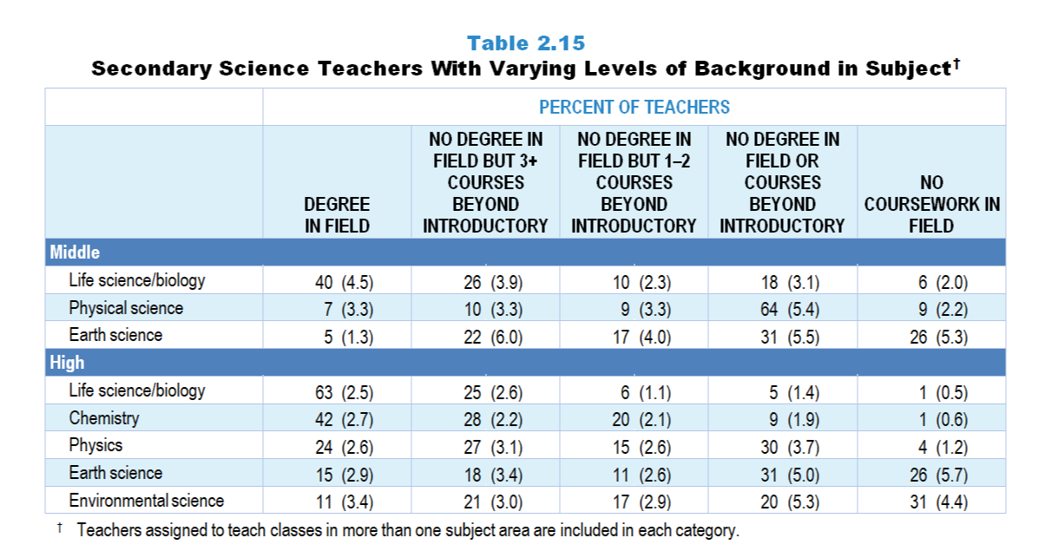
Original Data for Slides 39–48
(not for presentation)
Notes:
Table 2.15, p. 18 in Technical Report
This slide shows data from individual items.
Science Teacher Questionnaire
Q12. Have you been awarded one or more bachelor’s and/or graduate degrees in the following fields? (With regard to bachelor’s degrees, count only areas in which you majored.) (Response Options: Yes, No)
Education, including science education
Engineering
Natural Sciences
Other, please specify _____
Q15. What type of natural science degree do you have? (With regard to bachelor’s degrees, count only areas in which you majored.) (Select all that apply.)
Biology/Life Science
Chemistry
Earth/Space Science
Environmental Science/Ecology
Physics
Other natural science, please specify _____
Science Teacher Questionnaire
16. Did you complete any of the following types of biology/life science courses at the undergraduate or graduate level? [Select one on each row.] (Response Options: Yes, No)
General/introductory biology/life science courses (for example: Biology I, Introduction to Biology, Biology for Teachers)
Biology/life science courses beyond the general/introductory level
Biology/life science teaching methods courses
17. [Presented only to teachers that selected “Yes” for Q16b]
Please indicate which of the following biology/life science courses you completed (beyond a general/introductory course) at the undergraduate or graduate level. [Select all that apply.]
Anatomy/Physiology
Biochemistry
Botany
Cell Biology
Ecology
Evolution
Genetics
Microbiology
Zoology
Other biology/life science beyond the general/introductory level
18. Did you complete any of the following types of chemistry courses at the undergraduate or graduate level? [Select one on each row.] (Response Options: Yes, No)
General/introductory chemistry courses (for example: Chemistry I, Introduction to Chemistry)
Chemistry courses beyond the general/introductory level
Chemistry teaching methods courses
19. [Presented only to teachers that selected “Yes” for Q18b]
Please indicate which of the following chemistry courses you completed (beyond a general/introductory course) at the undergraduate or graduate level. [Select all that apply.]
Analytic Chemistry
Biochemistry
Inorganic Chemistry
Organic Chemistry
Physical Chemistry
Quantum Chemistry
Other chemistry beyond the general/introductory level
20. Did you complete any of the following types of physics courses at the undergraduate or graduate level? [Select one on each row.] (Response Options: Yes, No)
General/introductory physics courses (for example: Physics I, Introduction to Physics)
Physics courses beyond the general/introductory level
Physics teaching methods courses
21. [Presented only to teachers that selected “Yes” for Q20b]
Please indicate which of the following physics courses you completed (beyond a general/introductory course) at the undergraduate or graduate level. [Select all that apply.]
Astronomy/Astrophysics
Electricity and Magnetism
Heat and Thermodynamics
Mechanics
Modern or Quantum Physics
Nuclear Physics
Optics
Other physics beyond the general/introductory level
22. Did you complete any of the following types of Earth/space science courses at the undergraduate or graduate level? [Select one on each row.] (Response Options: Yes, No)
General/introductory Earth/space science courses (for example: Earth Science I, Introduction to Earth Science, Introductory Astronomy)
Earth/space science courses beyond the general/introductory level
Earth/space science teaching methods courses
23. [Presented only to teachers that selected “Yes” for Q22b]
Please indicate which of the following Earth/space science courses you completed (beyond a general/introductory course) at the undergraduate or graduate level. [Select all that apply.]
Astronomy/Astrophysics
Geology
Meteorology
Oceanography
Physical Geography
Other Earth/space science beyond the general/introductory level
24. Did you complete any of the following types of environmental science courses at the undergraduate or graduate level? [Select one on each row.] (Response Options: Yes, No)
General/introductory environmental science courses (for example: Environmental Science I, Introduction to Environmental Science)
Environmental science courses beyond the general/introductory level
Environmental science teaching methods courses
25. [Presented only to teachers that selected “Yes” for Q24b]
Please indicate which of the following environmental science courses you completed (beyond a general/introductory course) at the undergraduate or graduate level. [Select all that apply.]
Conservation Biology
Ecology
Forestry
Hydrology
Oceanography
Toxicology
Other environmental science beyond the general/introductory level
The numbers in parentheses are standard errors.
Findings Highlighted in Technical Report
“Many secondary science classes, especially at the high school level, focus on a single area of science, such as biology or chemistry. Table 2.15 provides information about the course background of those teaching these courses. Middle school life science/‌biology teachers are far more likely to have a degree in their discipline (40 percent) than those teaching Earth science (5 percent) or physical science (7 percent). In addition, a majority of middle school Earth science and physical science teachers have had either no coursework in the field or only an introductory course. High school biology teachers also tend to have particularly strong backgrounds in their discipline, with 63 percent having a degree in biology, and another 25 percent with at least three college courses beyond introductory biology. In contrast, about one-third of high school environmental science teachers and roughly one-quarter of Earth science teachers in each grade range have not had any college coursework in their field.“

Slide 39
Middle School Science Teachers With Degree in Field or 3+ Courses Beyond Introductory

Slide 40
Middle School Life Science/Biology Teachers’ Course Background

Slide 41
Middle School Earth Science Teachers’ Course Background

Slide 42
Middle School Physical Science Teachers’ Course Background
Notes:
A physical science degree is defined as a degree in physics and/or chemistry.

Slide 43
High School Science Teachers With Degree in Field or 3+ Courses Beyond Introductory
Notes:
A physical science degree is defined as a degree in physics and/or chemistry.

Slide 44
High School Biology Teachers’ Course Background

Slide 45
High School Chemistry Teachers’ Course Background

Slide 46
High School Physics Teachers’ Course Background

Slide 47
High School Earth Science Teachers’ Course Background

Slide 48
High School Environmental Science Teachers’ Course Background

Slide 49
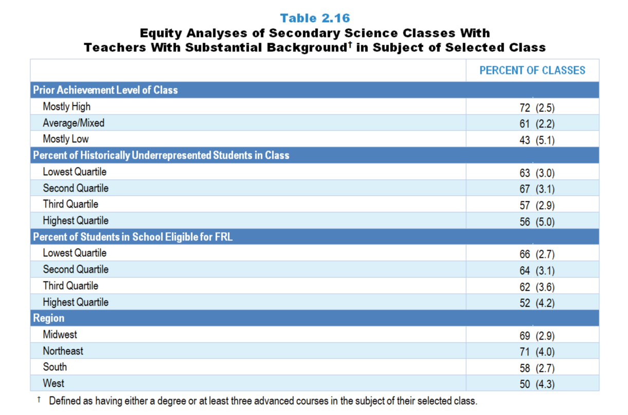
Original Data for Slide 50–52
(not for presentation)
Notes:
Table 2.16, p. 19 in Technical Report
This slide shows data derived from:
Science Teacher Questionnaire
Q12. Have you been awarded one or more bachelor’s and/or graduate degrees in the following fields? (With regard to bachelor’s degrees, count only areas in which you majored.) (Response Options: Yes, No)
Education, including science education
Engineering
Natural Sciences
Other, please specify _____
Q15. What type of natural science degree do you have? (With regard to bachelor’s degrees, count only areas in which you majored.) (Select all that apply.)
Biology/Life Science
Chemistry
Earth/Space Science
Environmental Science/Ecology
Physics
Other natural science, please specify _____
Science Teacher Questionnaire
16. Did you complete any of the following types of biology/life science courses at the undergraduate or graduate level? [Select one on each row.] (Response Options: Yes, No)
General/introductory biology/life science courses (for example: Biology I, Introduction to Biology, Biology for Teachers)
Biology/life science courses beyond the general/introductory level
Biology/life science teaching methods courses
17. [Presented only to teachers that selected “Yes” for Q16b]
Please indicate which of the following biology/life science courses you completed (beyond a general/introductory course) at the undergraduate or graduate level. [Select all that apply.]
Anatomy/Physiology
Biochemistry
Botany
Cell Biology
Ecology
Evolution
Genetics
Microbiology
Zoology
Other biology/life science beyond the general/introductory level
18. Did you complete any of the following types of chemistry courses at the undergraduate or graduate level? [Select one on each row.] (Response Options: Yes, No)
General/introductory chemistry courses (for example: Chemistry I, Introduction to Chemistry)
Chemistry courses beyond the general/introductory level
Chemistry teaching methods courses
19. [Presented only to teachers that selected “Yes” for Q18b]
Please indicate which of the following chemistry courses you completed (beyond a general/introductory course) at the undergraduate or graduate level. [Select all that apply.]
Analytic Chemistry
Biochemistry
Inorganic Chemistry
Organic Chemistry
Physical Chemistry
Quantum Chemistry
Other chemistry beyond the general/introductory level
20. Did you complete any of the following types of physics courses at the undergraduate or graduate level? [Select one on each row.] (Response Options: Yes, No)
General/introductory physics courses (for example: Physics I, Introduction to Physics)
Physics courses beyond the general/introductory level
Physics teaching methods courses
21. [Presented only to teachers that selected “Yes” for Q20b]
Please indicate which of the following physics courses you completed (beyond a general/introductory course) at the undergraduate or graduate level. [Select all that apply.]
Astronomy/Astrophysics
Electricity and Magnetism
Heat and Thermodynamics
Mechanics
Modern or Quantum Physics
Nuclear Physics
Optics
Other physics beyond the general/introductory level
22. Did you complete any of the following types of Earth/space science courses at the undergraduate or graduate level? [Select one on each row.] (Response Options: Yes, No)
General/introductory Earth/space science courses (for example: Earth Science I, Introduction to Earth Science, Introductory Astronomy)
Earth/space science courses beyond the general/introductory level
Earth/space science teaching methods courses
23. [Presented only to teachers that selected “Yes” for Q22b]
Please indicate which of the following Earth/space science courses you completed (beyond a general/introductory course) at the undergraduate or graduate level. [Select all that apply.]
Astronomy/Astrophysics
Geology
Meteorology
Oceanography
Physical Geography
Other Earth/space science beyond the general/introductory level
24. Did you complete any of the following types of environmental science courses at the undergraduate or graduate level? [Select one on each row.] (Response Options: Yes, No)
General/introductory environmental science courses (for example: Environmental Science I, Introduction to Environmental Science)
Environmental science courses beyond the general/introductory level
Environmental science teaching methods courses
25. [Presented only to teachers that selected “Yes” for Q24b]
Please indicate which of the following environmental science courses you completed (beyond a general/introductory course) at the undergraduate or graduate level. [Select all that apply.]
Conservation Biology
Ecology
Forestry
Hydrology
Oceanography
Toxicology
Other environmental science beyond the general/introductory level
Q42. For the students in this class, indicate the number of males and females in this class in each of the following categories of race/ethnicity.
American Indian or Alaska Native _____ _____
Asian _____ _____
Black or African American _____ _____
Hispanic/Latino _____ _____
Native Hawaiian or Other Pacific Islander _____ _____
White _____ _____
Two or more races _____ _____
Q43. Which of the following best describes the prior science achievement levels of the students in this class relative to other students in this school?
Mostly low achievers
Mostly average achievers
Mostly high achievers
A mixture of levels
The numbers in parentheses are standard errors.
Chapters 2–7 in the technical report provide data on several key indicators, disaggregated by one or more equity factors: the prior achievement level of students in the class, the percentage of students from race/ethnicity groups historically underrepresented in STEM in the class, the percentage of students in the school eligible for free/reduced-price lunch (FRL), school size, community type, and region. For FRL, each school was classified into one of four categories (defined as quartiles) based on the proportion of students eligible for FRL. Similarly, each randomly selected class was classified into one of the four categories based on the proportion of students from race/ethnicity groups historically underrepresented in STEM in the class.
Findings Highlighted in Technical Report
“Additional analyses were conducted to examine the extent to which teachers with the strongest background in their field are equitably distributed; results are shown in Table 2.16. Secondary science classes with different proportions of students from race/‌ethnicity groups historically underrepresented in STEM are about equally likely to be taught by teachers who have had at least three courses in the subject beyond the introductory level. In contrast, classes composed of high-achieving students are significantly more likely to be taught by teachers with strong content background than those with low levels of prior achievement. In addition, classes in schools with the highest proportion of students eligible for free/‌reduced-price lunch are less likely to be taught by teachers with substantial background in the subject than classes in schools in the lowest quartile. There also appear to be regional differences, as classes in the Northeast and Midwest are more likely to be taught by teachers who have a degree or at least three advanced courses in the subject.”

Slide 50
Secondary Science Classes Taught by Teachers With Substantial Background in Subject of Selected Class
Notes:
Substantial Background is defined as having either a degree or at least three advanced courses in the subject of their selected class.
Secondary Teachers include middle and high school teachers.

Slide 51
Secondary Science Classes Taught by Teachers With Substantial Background in Subject of Selected Class
Notes:
Substantial Background is defined as having either a degree or at least three advanced courses in the subject of their selected class.
Secondary Teachers include middle and high school teachers.
Slide shows the composite scores by quartile of percentage of students in school eligible for free and reduced lunch.

Slide 52
Secondary Science Classes Taught by Teachers With Substantial Background in Subject of Selected Class
Notes:
Substantial Background is defined as having either a degree or at least three advanced courses in the subject of their selected class.
Secondary Teachers include middle and high school teachers.

Slide 53
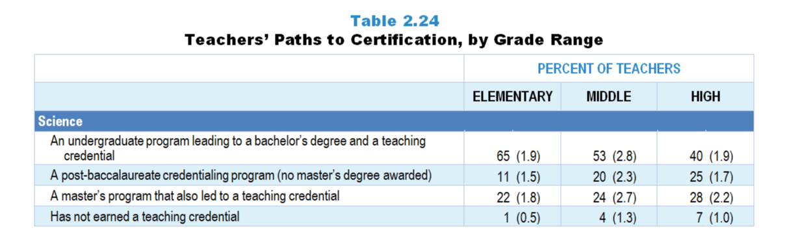
Original Data for Slide 54
(not for presentation)
Notes:
The science portion of Table 2.24, p. 24 of Technical Report
This slide shows data from an individual item.
Science Teacher Questionnaire
Q27. Which of the following best describes the program you completed to earn your teaching credential (sometimes called certification or license)?
An undergraduate program leading to a bachelor’s degree and a teaching credential
A post-baccalaureate credentialing program (no master’s degree awarded)
A master’s program that also awarded a teaching credential
I have not completed a program to earn a teaching credential.
The numbers in parentheses are standard errors.
Findings Highlighted in Technical Report
“Teachers were also asked about their path to certification. As can be seen in Table 2.24, elementary science teachers are more likely than those at the high school level to have had an undergraduate program leading to a bachelor’s degree and a teaching credential, and high school science teachers are more likely than their elementary school counterparts to have completed a post-baccalaureate credentialing program that did not include a master’s degree. Similar patterns are seen among mathematics teachers’ paths to certification across grade ranges, though the differences are not as striking. Seven percent of high school mathematics teachers and the same proportion of high school science teachers have not earned a teaching credential. Thirty-eight percent of high school computer science teachers have earned a teaching credential through an undergraduate program leading to a bachelor’s degree, and 24 percent through a post-baccalaureate credentialing program that did not include a master’s degree. Sixteen percent of computer science teachers have not earned a teaching credential.”

Slide 54
Science Teachers’ Path to Certification

Slide 55
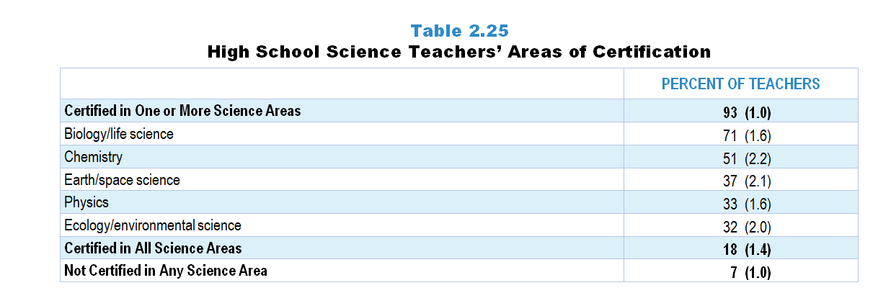
Original Data for Slide 56
(not for presentation)
Notes:
Table 2.25, p. 25 of Technical Report
This slide shows data derived from:
Science Teacher Questionnaire
28 . [Presented only to high school teachers]
In which of the following areas are you certified (have a credential, endorsement, or license) to teach at the high school level? [Select all that apply.]
Biology/life science
Chemistry
Earth/space science
Ecology/environmental science
Engineering
Physics
The numbers in parentheses are standard errors.
Findings Highlighted in Technical Report
“Table 2.25 shows the content areas high school science teachers are certified to teach (i.e., have a credential, endorsement, or license in that area). Nearly all are certified in at least one science area, with the most common areas being biology/life science (71 percent) and chemistry (51 percent). About one-third are certified to teach Earth/space science, physics, or ecology/‌environmental science. About 1 in 6 are certified to teach all science content areas.”

Slide 56
High School Science Teachers’ Areas of Certification
Notes:
Chapter 2 – Science - 57

Slide 57
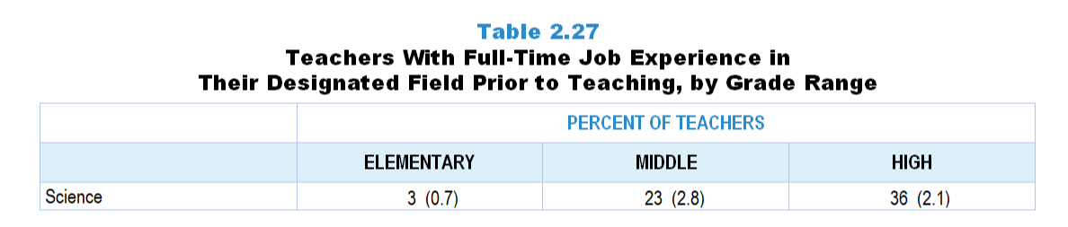
Original Data for Slide 58
(not for presentation)
Notes:
The science portion of Table 2.27, p. 26 in Technical Report
This slide shows data from an individual item.
Science Teacher Questionnaire
29. After completing your undergraduate degree and prior to becoming a teacher, did you have a full-time job in a science- or engineering-related field?
Yes
No
The numbers in parentheses are standard errors.
Findings Highlighted in Technical Report
“Recognizing that teaching is not always an individual’s first career, the survey also included an item asking whether teachers had a full-time job in their designated field after completing their undergraduate degree and prior to teaching. Science teachers were asked whether they had full-time job experience in a science- or engineering-related field. Mathematics and computer science teachers were asked about experience in a mathematics-related field (e.g., accounting, engineering, computer programming) and computer programming or computer/‌software engineering, respectively. As can be seen in Table 2.27, the likelihood of science and mathematics teachers having prior career experience in their field substantially increases with increasing grade range. In addition, high school science and computer science teachers are more likely than their mathematics colleagues to have prior job experience in their respective fields (about one-third vs. one-fifth).”

Slide 58
Science Teachers With Full-Time Job Experience in a Science/Engineering-Related Field Prior to Teaching

Slide 59
Teacher Pedagogical Beliefs

Slide 60
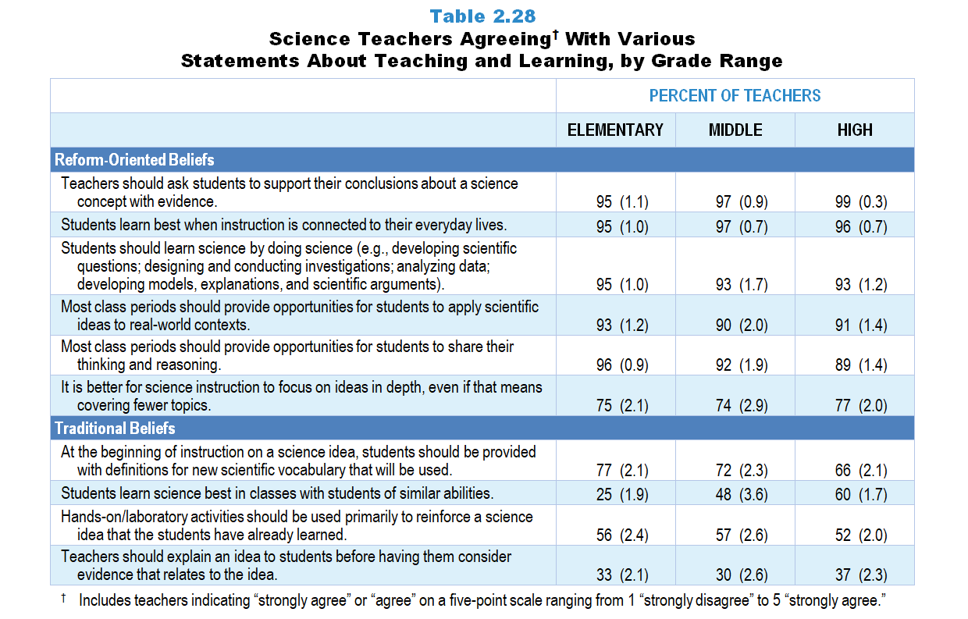
Original Data for Slides 61–66
(not for presentation)
Notes:
Table 2.28, p. 27 in Technical Report
This slide shows data from an individual item.
Science Teacher Questionnaire
Q38. Please provide your opinion about each of the following statements. (Response Options: [1] Strongly Disagree, [2] Disagree, [3] No Opinion, [4] Agree, [5] Strongly Agree)
Students learn science best in classes with students of similar abilities.
It is better for science instruction to focus on ideas in depth, even if that means covering fewer topics.
At the beginning of instruction on a science idea, students should be provided with definitions for new scientific vocabulary that will be used.
Teachers should explain an idea to students before having them consider evidence that relates to the idea.
Most class periods should provide opportunities for students to share their thinking and reasoning.
Hands-on/laboratory activities should be used primarily to reinforce a science idea that the students have already learned.
Teachers should ask students to support their conclusions about a science concept with evidence.
Students learn best when instruction is connected to their everyday lives.
Most class periods should provide opportunities for students to apply scientific ideas to real-world contexts.
Students should learn science by doing science (for example: developing scientific questions; designing and conducting investigations; analyzing data; developing models, explanations, and scientific arguments).
The numbers in parentheses are standard errors.
Findings Highlighted in Technical Report
“Teachers were asked about their beliefs regarding effective teaching and learning. Table 2.28 shows the percentage of science teachers in each grade range agreeing with each of the statements; data for mathematics teachers and computer science teachers are shown in Table 2.30 and Table 2.32, respectively.
It is interesting to note that elementary, middle, and high school science teachers have similar views about a number of elements of science instruction. At least 90 percent of teachers in each grade range agree that: (1) teachers should ask students to support their conclusions about a science concept with evidence; (2) students learn best when instruction is connected to their everyday lives; (3) students should learn science by doing science; and (4) most class periods should provide opportunities for students to apply scientific ideas to real-world contexts. A similarly large proportion of science teachers in each grade range believe that most class periods should provide opportunities for students to share their thinking and reasoning. In contrast, teacher opinions about ability grouping vary considerably by grade range, with 60 percent of high school science teachers, 48 percent of those in the middle grades, and 25 percent at the elementary level believing that students learn science best in classes with students of similar abilities.
There are also inconsistent views in relation to a number of elements of effective science instruction, with teachers agreeing with statements associated with both traditional and reform-oriented beliefs. Approximately three-fourths of teachers at each grade range agree that it is better to focus on ideas in depth, even if it means covering fewer topics, one of the central tenets of calls for reform in science instruction. At the same time, despite research on learning that suggests otherwise, roughly one-third of science teachers at each grade level agree that teachers should explain an idea to students before having them consider evidence for that idea, and more than half that laboratory activities should be used primarily to reinforce ideas that the students have already learned. And despite recommendations that students develop understanding of concepts first and learn the scientific language later, 66–77 percent of science teachers at the various grade ranges think that students should be given definitions for new vocabulary at the beginning of instruction on a science idea.”

Slide 61
Elementary Science Teachers Agreeing With Various Statements About Teaching and Learning
Notes:
Includes teachers indicating “strongly agree” or “agree” on a 5-point response scale with the options “strongly disagree,” “disagree,” “no opinion,” “agree,” and “strongly agree.”
Note: Each grade-level chart is sorted independently; consequently items may appear in different orders.

Slide 62
Elementary Science Teachers Agreeing With Various Statements About Teaching and Learning
Notes:
Includes teachers indicating “strongly agree” or “agree” on a 5-point response scale with the options “strongly disagree,” “disagree,” “no opinion,” “agree,” and “strongly agree.”
Note: Each grade-level chart is sorted independently; consequently items may appear in different orders.

Slide 63
Middle School Science Teachers Agreeing With Various Statements About Teaching and Learning
Notes:
Includes teachers indicating “strongly agree” or “agree” on a 5-point response scale with the options “strongly disagree,” “disagree,” “no opinion,” “agree,” and “strongly agree.”
Note: Each grade-level chart is sorted independently; consequently items may appear in different orders.

Slide 64
Middle School Science Teachers Agreeing With Various Statements About Teaching and Learning
Notes:
Includes teachers indicating “strongly agree” or “agree” on a 5-point response scale with the options “strongly disagree,” “disagree,” “no opinion,” “agree,” and “strongly agree.”
Note: Each grade-level chart is sorted independently; consequently items may appear in different orders.

Slide 65
High School Science Teachers Agreeing With Various Statements About Teaching and Learning
Notes:
Includes teachers indicating “strongly agree” or “agree” on a 5-point response scale with the options “strongly disagree,” “disagree,” “no opinion,” “agree,” and “strongly agree.”
Note: Each grade-level chart is sorted independently; consequently items may appear in different orders.

Slide 66
High School Science Teachers Agreeing With Various Statements About Teaching and Learning
Notes:
Includes teachers indicating “strongly agree” or “agree” on a 5-point response scale with the options “strongly disagree,” “disagree,” “no opinion,” “agree,” and “strongly agree.”
Note: Each grade-level chart is sorted independently; consequently items may appear in different orders.

Slide 67
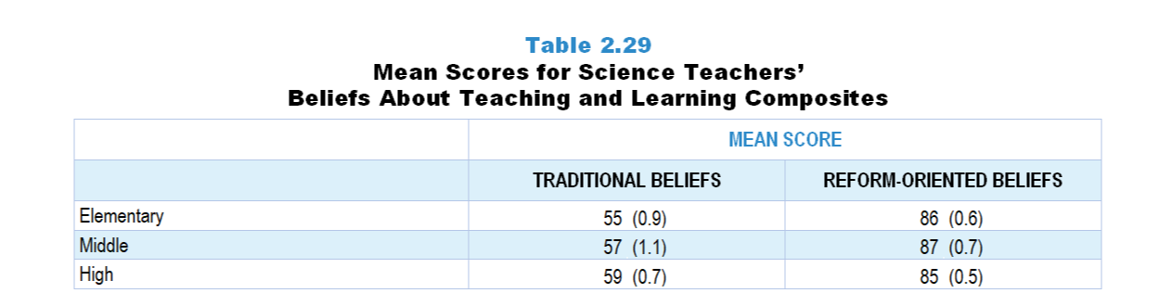
Original Data for Slide 68
(not for presentation)
Notes:
Table 2.29, p. 27 in Technical Report
This slide shows data from composites.
Sets of related questionnaire items were combined to create several composite variables related to key constructs. Composite variables, which are more reliable than individual survey items, were computed to have a minimum possible value of 0 and a maximum possible value of 100. Higher composite scores indicate more of the construct being measure by the composite. Each composite is calculated by summing the responses to the items associated with that composite and then dividing by the total points possible. In order for the composites to be on a 100-point scale, the lowest response option on each scale was set to 0 and the others were adjusted accordingly; so for example, an item with a scale ranging from 1 to 4 was re-coded to have a scale of 0 to 3. By doing this, someone who marks the lowest point on every item in a composite receives a composite score of 0 rather than some positive number. It also assures that 50 is the true mid-point. The denominator for each composite is determined by computing the maximum possible sum of responses for a series of items and dividing by 100; e.g., a 9-item composite where each item is on a scale of 0–3 would have a denominator of 0.27. Composites values were not computed for participants who respond to fewer than two-thirds of the items that form the composite.
Traditional Teaching Beliefs Composite Items
Q38a. Students learn science best in classes with students of similar abilities.
Q38c. At the beginning of instruction on a science idea, students should be provided with definitions for new scientific vocabulary that will be used.
Q38d. Teachers should explain an idea to students before having them consider evidence that relates to the idea.
Q38f. Hands-on/laboratory activities should be used primarily to reinforce a science idea that the students have already learned.
Reform-Oriented Teaching Beliefs Composite Items
Q38e. Most class periods should provide opportunities for students to share their thinking and reasoning.
Q38g. Teachers should ask students to support their conclusions about a science concept with evidence.
Q38h. Students learn best when instruction is connected to their everyday lives.
Q38i. Most class periods should provide opportunities for students to apply scientific ideas to real-world contexts.
Q38j. Students should learn science by doing science (for example: developing scientific questions; designing and conducting investigations; analyzing data; developing models, explanations, and scientific arguments).
Science Teacher Questionnaire
Q38. Please provide your opinion about each of the following statements. (Response Options: [1] Strongly Disagree, [2] Disagree, [3] No Opinion, [4] Agree, [5] Strongly Agree)
Students learn science best in classes with students of similar abilities.
It is better for science instruction to focus on ideas in depth, even if that means covering fewer topics.
At the beginning of instruction on a science idea, students should be provided with definitions for new scientific vocabulary that will be used.
Teachers should explain an idea to students before having them consider evidence that relates to the idea.
Most class periods should provide opportunities for students to share their thinking and reasoning.
Hands-on/laboratory activities should be used primarily to reinforce a science idea that the students have already learned.
Teachers should ask students to support their conclusions about a science concept with evidence.
Students learn best when instruction is connected to their everyday lives.
Most class periods should provide opportunities for students to apply scientific ideas to real-world contexts.
Students should learn science by doing science (for example: developing scientific questions; designing and conducting investigations; analyzing data; developing models, explanations, and scientific arguments).
The numbers in parentheses are standard errors.
Findings Highlighted in Technical Report
“These items (and the analogous items for mathematics and computer science) were combined into two composite variables: Traditional Teaching Beliefs and Reform-Oriented Teaching Beliefs. The composite scores shown in Table 2.29 suggest that elementary, middle, and high school science teachers have relatively strong reform-oriented beliefs. However, traditional beliefs are also fairly prevalent across all grades.”

Slide 68
Science Teachers’ Beliefs About Teaching and Learning Composites
Teacher Mean Score

Slide 69
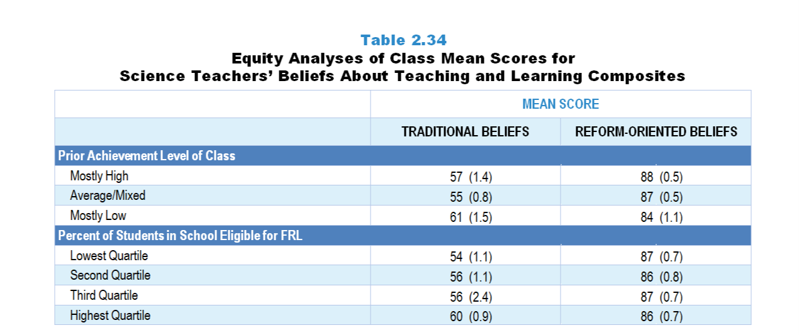
Original Data for Slides 70–71
(not for presentation)
Notes:
Table 2.34, p. 30 in Technical Report
This slide shows data from composites.
Sets of related questionnaire items were combined to create several composite variables related to key constructs. Composite variables, which are more reliable than individual survey items, were computed to have a minimum possible value of 0 and a maximum possible value of 100. Higher composite scores indicate more of the construct being measure by the composite. Each composite is calculated by summing the responses to the items associated with that composite and then dividing by the total points possible. In order for the composites to be on a 100-point scale, the lowest response option on each scale was set to 0 and the others were adjusted accordingly; so for example, an item with a scale ranging from 1 to 4 was re-coded to have a scale of 0 to 3. By doing this, someone who marks the lowest point on every item in a composite receives a composite score of 0 rather than some positive number. It also assures that 50 is the true mid-point. The denominator for each composite is determined by computing the maximum possible sum of responses for a series of items and dividing by 100; e.g., a 9-item composite where each item is on a scale of 0–3 would have a denominator of 0.27. Composites values were not computed for participants who respond to fewer than two-thirds of the items that form the composite.
Traditional Teaching Beliefs Composite Items
Q38a. Students learn science best in classes with students of similar abilities.
Q38c. At the beginning of instruction on a science idea, students should be provided with definitions for new scientific vocabulary that will be used.
Q38d. Teachers should explain an idea to students before having them consider evidence that relates to the idea.
Q38f. Hands-on/laboratory activities should be used primarily to reinforce a science idea that the students have already learned.
Reform-Oriented Teaching Beliefs Composite Items
Q38e. Most class periods should provide opportunities for students to share their thinking and reasoning.
Q38g. Teachers should ask students to support their conclusions about a science concept with evidence.
Q38h. Students learn best when instruction is connected to their everyday lives.
Q38i. Most class periods should provide opportunities for students to apply scientific ideas to real-world contexts.
Q38j. Students should learn science by doing science (for example: developing scientific questions; designing and conducting investigations; analyzing data; developing models, explanations, and scientific arguments).
Science Teacher Questionnaire
Q38. Please provide your opinion about each of the following statements. (Response Options: [1] Strongly Disagree, [2] Disagree, [3] No Opinion, [4] Agree, [5] Strongly Agree)
Students learn science best in classes with students of similar abilities.
It is better for science instruction to focus on ideas in depth, even if that means covering fewer topics.
At the beginning of instruction on a science idea, students should be provided with definitions for new scientific vocabulary that will be used.
Teachers should explain an idea to students before having them consider evidence that relates to the idea.
Most class periods should provide opportunities for students to share their thinking and reasoning.
Hands-on/laboratory activities should be used primarily to reinforce a science idea that the students have already learned.
Teachers should ask students to support their conclusions about a science concept with evidence.
Students learn best when instruction is connected to their everyday lives.
Most class periods should provide opportunities for students to apply scientific ideas to real-world contexts.
Students should learn science by doing science (for example: developing scientific questions; designing and conducting investigations; analyzing data; developing models, explanations, and scientific arguments).
Q43. Which of the following best describes the prior science achievement levels of the students in this class relative to other students in this school?
Mostly low achievers
Mostly average achievers
Mostly high achievers
A mixture of levels
The numbers in parentheses are standard errors.
Chapters 2–7 in the technical report provide data on several key indicators, disaggregated by one or more equity factors: the prior achievement level of students in the class, the percentage of students from race/ethnicity groups historically underrepresented in STEM in the class, the percentage of students in the school eligible for free/reduced-price lunch (FRL), school size, community type, and region. For FRL, each school was classified into one of four categories (defined as quartiles) based on the proportion of students eligible for FRL. Similarly, each randomly selected class was classified into one of the four categories based on the proportion of students from race/ethnicity groups historically underrepresented in STEM in the class.
Findings Highlighted in Technical Report
“Because beliefs are important mediators of behaviors, it is worth examining whether teachers’ beliefs vary by the context in which they teach or the students they serve. Tables 2.34–2.36 display class mean scores for the teacher belief composites by a number of equity factors.
Table 2.34 presents composite scores for science teachers’ beliefs about teaching and learning by two equity factors: the prior achievement level of the class and the proportion of students in the school who are eligible for free/‌reduced-price lunch. Teachers of classes composed of students characterized as mostly low prior achievers are somewhat more likely to hold traditional beliefs and slightly less likely to hold reform-oriented beliefs about science instruction. Science classes in schools with the highest proportions of students eligible for free/‌reduced-price lunch are more likely to be taught by teachers with more traditional beliefs than those in low-poverty schools, though the difference is small.”

Slide 70
Science Teachers’ Beliefs About Teaching and Learning Composites, by Prior Achievement Level

Slide 71
Science Teachers’ Beliefs About Teaching and Learning Composites, by Percentage of Students in School Eligible for FRL
Notes:
Slide shows the composite scores by quartile of percentage of students in school eligible for free and reduced lunch.

Slide 72
Teachers' Perceptions of Preparedness

Slide 73
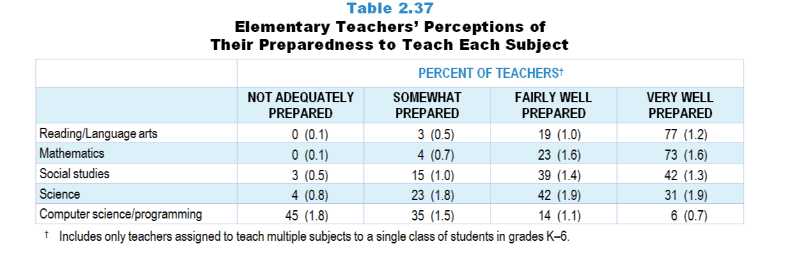
Original Data for Slide 74
(not for presentation)
Notes:
Table 2.37, p. 32 in Technical Report
This slide shows data from individual items found on both the Science Teacher Questionnaire and Mathematics Teacher Questionnaire.
Science Teacher Questionnaire
Q35. Many teachers feel better prepared to teach some subject areas than others. How well prepared do you feel to teach each of the following subjects at the grade level(s) you teach, whether or not they are currently included in your teaching responsibilities? [Select one on each row.] (Response Options: [1] Not adequately prepared, [2] Somewhat prepared, [3] Fairly well prepared, [4] Very well prepared)
Life Science
Earth/Space Science
Physical Science
Engineering
Mathematics
Reading/Language Arts
Social Studies
Computer Science/Programming
Mathematics Teacher Questionnaire
Q23. Many teachers feel better prepared to teach some subjects/topics than others. How well prepared do you feel to teach each of the following at the grade level(s) you teach, whether or not they are currently included in your teaching responsibilities? [Select one on each row.] (Response Options: [1] Not adequately prepared, [2] Somewhat prepared, [3] Fairly well prepared, [4] Very well prepared)
Number and Operations
Early Algebra
Geometry
Measurement and Data Representation
Science
Computer Science/Programming
Reading/Language Arts
Social Studies
The numbers in parentheses are standard errors.
Findings Highlighted in Technical Report
“Elementary teachers are typically assigned to teach multiple subjects to a single group of students, including not only science and mathematics, but other areas as well. However, as can be seen in Table 2.37, these teachers do not feel equally well prepared to teach the various subjects. Although 73 percent of elementary teachers of self-contained classes feel very well prepared to teach mathematics—slightly lower than the 77 percent for reading/‌language arts—only 31 percent feel very well prepared to teach science, and only 6 percent feel very well prepared to teach computer science or programming.”

Slide 74
Self-Contained Elementary Teachers Considering Themselves Very Well Prepared to Teach Each Subject

Slide 75
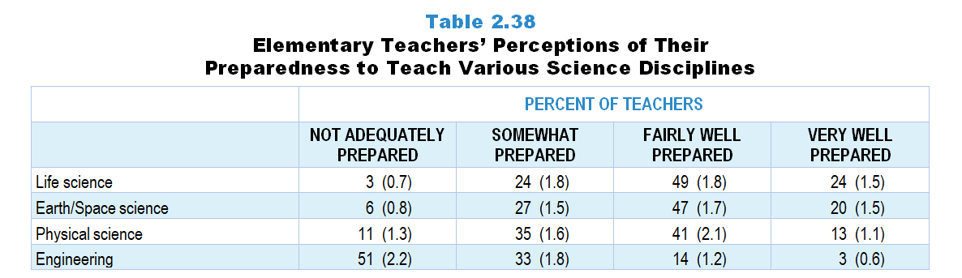
Original Data for Slide 76
(not for presentation)
Notes:
Table 2.38, p. 32 in Technical Report
This slide shows data from an individual item.
Science Teacher Questionnaire
Q35. Many teachers feel better prepared to teach some subject areas than others. How well prepared do you feel to teach each of the following subjects at the grade level(s) you teach, whether or not they are currently included in your teaching responsibilities? [Select one on each row.] (Response Options: [1] Not adequately prepared, [2] Somewhat prepared, [3] Fairly well prepared, [4] Very well prepared)
Life Science
Earth Science
Physical Science
Engineering
Mathematics
Reading/Language Arts
Social Studies
The numbers in parentheses are standard errors.
Findings Highlighted in Technical Report
“As noted earlier, teachers of self-contained classes were randomly assigned to respond to either the science or mathematics teacher questionnaire. Those who received the science questionnaire were asked about their preparedness to teach each of the major science disciplines to that class, and those receiving the mathematics questionnaire were asked about a number of mathematics areas.
As can be seen in Table 2.38, elementary teachers are more likely to feel very well prepared to teach life science and Earth science than they are to teach physical science. Engineering stands out as the area where elementary teachers feel least prepared, with only 3 percent feeling very well prepared to teach it at their grade level, and 51 percent noting that they are not adequately prepared.”

Slide 76
Elementary Teachers Considering Themselves Very Well Prepared to Teach Various Science Disciplines

Slide 77
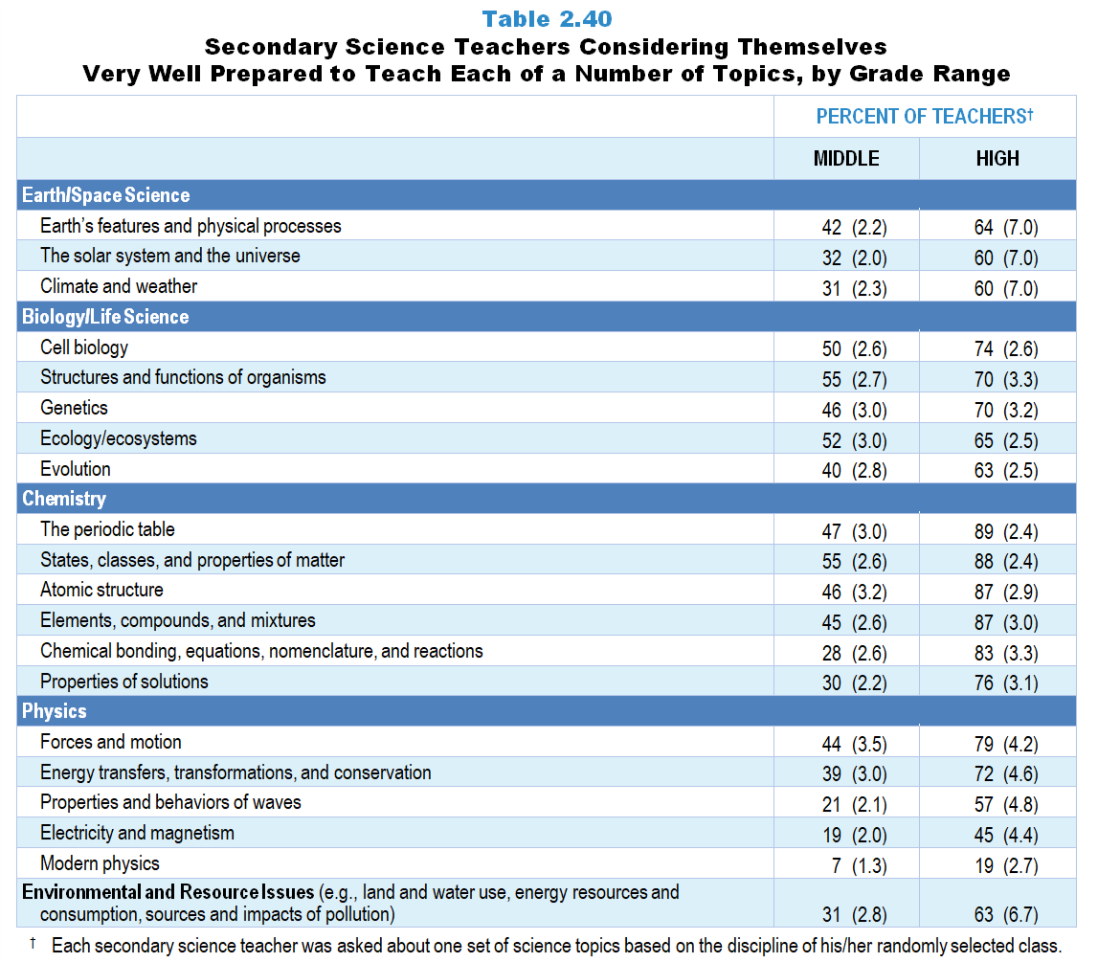
Original Data for Slides 78–86
(not for presentation)
Notes:
Table 2.40, p. 34 in Technical Report
This slide shows data from an individual item.
Science Teacher Questionnaire
Q36. Within science, many teachers feel better prepared to teach some topics than others. How well prepared do you feel to teach each of the following topics at the grade level(s) you teach, whether or not they are currently included in your teaching responsibilities? [Select one on each row.] (Response Options: [1] Not adequately prepared, [2] Somewhat prepared, [3] Fairly well prepared, [4] Very well prepared)
Earth/Space Science
Earth’s features and physical processes
The solar system and the universe
Climate and weather
Biology/Life Science
Cell biology
Structures and functions of organisms
Ecology/ecosystems
Genetics
Evolution
Chemistry
Atomic structure
Chemical bonding, equations, nomenclature, and reactions
Elements, compounds, and mixtures
The Periodic Table
Properties of solutions
States, classes, and properties of matter
Physics
Forces and motion
Energy transfers, transformations, and conservation
Properties and behaviors of waves
Electricity and magnetism
Modern physics (for example: special relativity)
Engineering
Defining engineering problems
Developing possible solutions
Optimizing a design solution
Environmental and resource issues (for example: land and water use, energy resources and consumption, sources and impacts of pollution)
The numbers in parentheses are standard errors.
Findings Highlighted in Technical Report
“As noted earlier, the teacher questionnaires included a series of items about a single, randomly selected class. Middle and high school science teachers were shown a list of topics based on the subject of that class and asked how well prepared they felt to teach each of those topics at the grade levels they teach. As can be seen in Table 2.40, high school science teachers are more likely than their middle grades counterparts to feel very well prepared to teach topics within each discipline. In addition, high school chemistry teachers are more likely to feel well prepared than teachers in any other subject/‌grade level group, with 76–89 percent considering themselves very well prepared to teach the various topics. It is interesting to note the variation among topics within physics, with only 19 percent of high school physics teachers feeling very well prepared to teach modern physics (e.g., relativity) compared to 45–79 percent for the other topics in the list.”

Slide 78
Middle School Science Teachers Considering Themselves Very Well Prepared to Teach Earth/Space Science Topics
Notes:
Note: Each grade-level chart is sorted independently; consequently items may appear in different orders.

Slide 79
High School Science Teachers Considering Themselves Very Well Prepared to Teach Earth/Space Science Topics
Notes:
Note: Each grade-level chart is sorted independently; consequently items may appear in different orders.

Slide 80
Middle School Science Teachers Considering Themselves Very Well Prepared to Teach Biology/Life Science Topics
Notes:
Note: Each grade-level chart is sorted independently; consequently items may appear in different orders.

Slide 81
High School Science Teachers Considering Themselves Very Well Prepared to Teach Biology/Life Science Topics
Notes:
Note: Each grade-level chart is sorted independently; consequently items may appear in different orders.

Slide 82
Middle School Science Teachers Considering Themselves Very Well Prepared to Teach Chemistry Topics
Notes:
Note: Each grade-level chart is sorted independently; consequently items may appear in different orders.

Slide 83
High School Science Teachers Considering Themselves Very Well Prepared to Teach Chemistry Topics
Notes:
Note: Each grade-level chart is sorted independently; consequently items may appear in different orders.

Slide 84
Middle School Science Teachers Considering Themselves Very Well Prepared to Teach Physics Topics
Notes:
Note: Each grade-level chart is sorted independently; consequently items may appear in different orders.

Slide 85
High School Science Teachers Considering Themselves Very Well Prepared to Teach Physics Topics
Notes:
Note: Each grade-level chart is sorted independently; consequently items may appear in different orders.

Slide 86
Secondary School Science Teachers Considering Themselves Very Well Prepared to Teach Environmental Science
Notes:
Note: Secondary Teachers include middle and high school teachers.

Slide 87
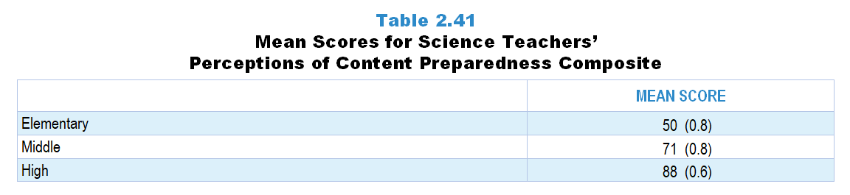
Original Data for Slide 88
(not for presentation)
Notes:
Table 2.41, p. 34 in Technical Report
This slide shows data from composites.
Sets of related questionnaire items were combined to create several composite variables related to key constructs. Composite variables, which are more reliable than individual survey items, were computed to have a minimum possible value of 0 and a maximum possible value of 100. Higher composite scores indicate more of the construct being measure by the composite. Each composite is calculated by summing the responses to the items associated with that composite and then dividing by the total points possible. In order for the composites to be on a 100-point scale, the lowest response option on each scale was set to 0 and the others were adjusted accordingly; so for example, an item with a scale ranging from 1 to 4 was re-coded to have a scale of 0 to 3. By doing this, someone who marks the lowest point on every item in a composite receives a composite score of 0 rather than some positive number. It also assures that 50 is the true mid-point. The denominator for each composite is determined by computing the maximum possible sum of responses for a series of items and dividing by 100; e.g., a 9-item composite where each item is on a scale of 0–3 would have a denominator of 0.27. Composites values were not computed for participants who respond to fewer than two-thirds of the items that form the composite.
The Perceptions of Content Preparedness composite was calculated based on the topics taught in the targeted class. Thus, it is defined differently across the subjects and grade ranges included in this study.
Perceptions of Content Preparedness: Elementary Science Composite Items
Q35a. Life Science
Q35b. Earth Science
Q35c. Physical Science
Q35d. Engineering
Perceptions of Content Preparedness: Biology/Life Science Composite Items
Q36b. Biology/Life Science
Cell biology
Structures and functions of organisms
Ecology/ecosystems
Genetics
Evolution
Perceptions of Content Preparedness: Chemistry Composite Items
Q36c. Chemistry
Atomic structure
Chemical bonding, equations, nomenclature, and reactions
Elements, compounds, and mixtures
The Periodic Table
Properties of solutions
States, classes, and properties of matter
Perceptions of Content Preparedness: Earth Science Composite Items
Q36a. Earth/Space Science
Earth’s features and physical processes
The solar system and the universe
Climate and weather
Perceptions of Content Preparedness: Integrated/General Science Composite Items
Q36a. Earth/Space Science
Earth’s features and physical processes
The solar system and the universe
Climate and weather
Q36b. Biology/Life Science
Cell biology
Structures and functions of organisms
Ecology/ecosystems
Genetics
Evolution
Q36c. Chemistry
Atomic structure
Chemical bonding, equations, nomenclature, and reactions
Elements, compounds, and mixtures
The Periodic Table
Properties of solutions
States, classes, and properties of matter
Q36d. Physics
Forces and motion
Energy transfers, transformations, and conservation
Properties and behaviors of waves
Electricity and magnetism
Modern physics (for example: special relativity)
Q36e. Engineering
Defining engineering problems
Developing possible solutions
Optimizing a design solution
Q36f. Environmental and resource issues (for example: land and water use, energy resources and consumption, sources and impacts of pollution)
Perceptions of Content Preparedness: Physical Science Composite Items
Q36c. Chemistry
Atomic structure
Chemical bonding, equations, nomenclature, and reactions
Elements, compounds, and mixtures
The Periodic Table
Properties of solutions
States, classes, and properties of matter
Q36d. Physics
Forces and motion
Energy transfers, transformations, and conservation
Properties and behaviors of waves
Electricity and magnetism
Modern physics (for example: special relativity)
Perceptions of Content Preparedness: Physics Composite Items
Q36d. Physics
Forces and motion
Energy transfers, transformations, and conservation
Properties and behaviors of waves
Electricity and magnetism
Modern physics (for example: special relativity)
Science Teacher Questionnaire
Q35. Many teachers feel better prepared to teach some subject areas than others. How well prepared do you feel to teach each of the following subjects at the grade level(s) you teach, whether or not they are currently included in your teaching responsibilities? [Select one on each row.] (Response Options: [1] Not adequately prepared, [2] Somewhat prepared, [3] Fairly well prepared, [4] Very well prepared)
Life Science
Earth Science
Physical Science
Engineering
Mathematics
Reading/Language Arts
Social Studies
Q36. Within science, many teachers feel better prepared to teach some topics than others. How well prepared do you feel to teach each of the following topics at the grade level(s) you teach, whether or not they are currently included in your teaching responsibilities? [Select one on each row.] (Response Options: [1] Not adequately prepared, [2] Somewhat prepared, [3] Fairly well prepared, [4] Very well prepared)
Earth/Space Science
Earth’s features and physical processes
The solar system and the universe
Climate and weather
Biology/Life Science
Cell biology
Structures and functions of organisms
Ecology/ecosystems
Genetics
Evolution
Chemistry
Atomic structure
Chemical bonding, equations, nomenclature, and reactions
Elements, compounds, and mixtures
The Periodic Table
Properties of solutions
States, classes, and properties of matter
Physics
Forces and motion
Energy transfers, transformations, and conservation
Properties and behaviors of waves
Electricity and magnetism
Modern physics (for example: special relativity)
Engineering
Defining engineering problems
Developing possible solutions
Optimizing a design solution
Environmental and resource issues (for example: land and water use, energy resources and consumption, sources and impacts of pollution)
The numbers in parentheses are standard errors.
Findings Highlighted in Technical Report
“Table 2.41 displays mean scores for the composite variable Perceptions of Content Preparedness, which was defined based on the content of the targeted class. The mean scores indicate that elementary teachers generally do not feel well prepared to teach science. In addition, high school science teachers feel better prepared to teach science than their middle school counterparts.”

Slide 88
Science Teachers’ Perceptions of Content Preparedness Composite

Slide 89
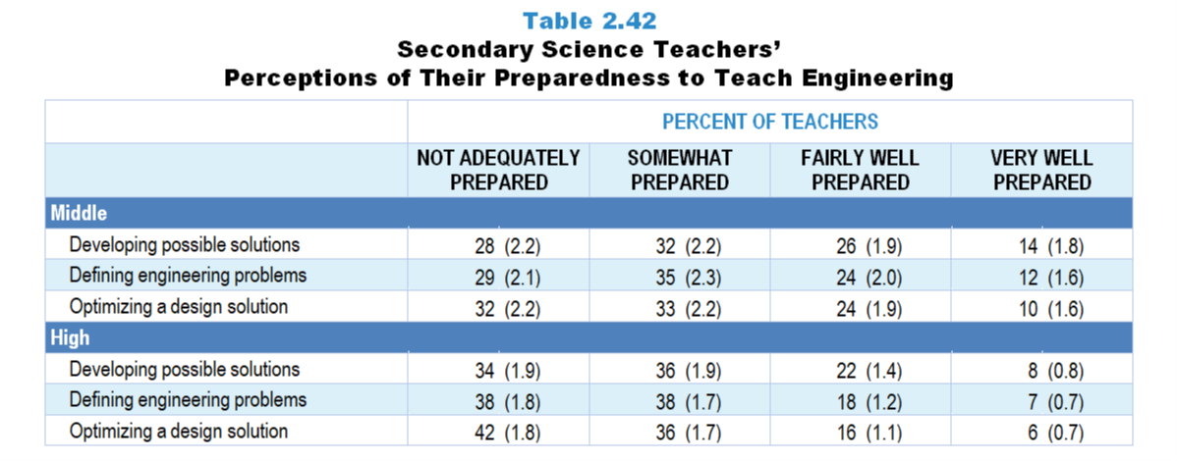
Original Data for Slide 91
(not for presentation)
Notes:
Table 2.42, p. 35 in Technical Report
This slide shows data from an individual item.
Science Teacher Questionnaire
Q36. Within science, many teachers feel better prepared to teach some topics than others. How well prepared do you feel to teach each of the following topics at the grade level(s) you teach, whether or not they are currently included in your teaching responsibilities? [Select one on each row.] (Response Options: [1] Not adequately prepared, [2] Somewhat prepared, [3] Fairly well prepared, [4] Very well prepared)
Earth/Space Science
Earth’s features and physical processes
The solar system and the universe
Climate and weather
Biology/Life Science
Cell biology
Structures and functions of organisms
Ecology/ecosystems
Genetics
Evolution
Chemistry
Atomic structure
Chemical bonding, equations, nomenclature, and reactions
Elements, compounds, and mixtures
The Periodic Table
Properties of solutions
States, classes, and properties of matter
Physics
Forces and motion
Energy transfers, transformations, and conservation
Properties and behaviors of waves
Electricity and magnetism
Modern physics (for example: special relativity)
Engineering
Defining engineering problems
Developing possible solutions
Optimizing a design solution
Environmental and resource issues (for example: land and water use, energy resources and consumption, sources and impacts of pollution)
The numbers in parentheses are standard errors.
Findings Highlighted in Technical Report
“Secondary science teachers were also asked about their preparedness to teach engineering, regardless of the discipline of their designated class. As can be seen in Table 2.42, very few middle and high school science teachers feel very well prepared to teach engineering concepts, and sizeable proportions indicate being not adequately prepared. This finding is not surprising given that few teachers have had college coursework in engineering and engineering has not historically been part of the school curriculum. K–12 teachers will likely need both high-quality curriculum and substantive professional development to be successful at integrating engineering into their science teaching.”

Slide 90
Middle School Science Teachers’
Considering Themselves Very Well Prepared to Teach Engineering Topics

Slide 91
High School Science Teachers’
Considering Themselves Very Well Prepared to Teach Engineering Topics

Slide 92
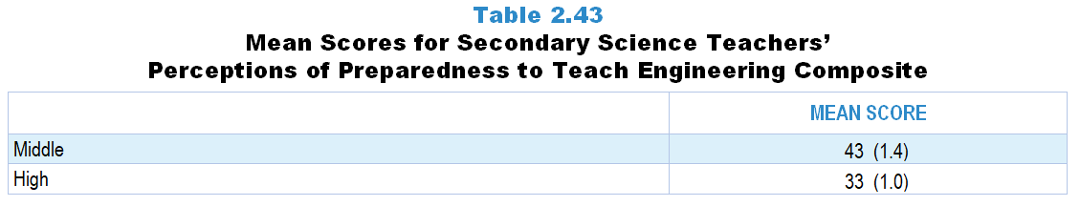
Original Data for Slide 93
(not for presentation)
Notes:
Table 2.43, p. 35 in Technical Report
This slide shows data from composites.
Sets of related questionnaire items were combined to create several composite variables related to key constructs. Composite variables, which are more reliable than individual survey items, were computed to have a minimum possible value of 0 and a maximum possible value of 100. Higher composite scores indicate more of the construct being measure by the composite. Each composite is calculated by summing the responses to the items associated with that composite and then dividing by the total points possible. In order for the composites to be on a 100-point scale, the lowest response option on each scale was set to 0 and the others were adjusted accordingly; so for example, an item with a scale ranging from 1 to 4 was re-coded to have a scale of 0 to 3. By doing this, someone who marks the lowest point on every item in a composite receives a composite score of 0 rather than some positive number. It also assures that 50 is the true mid-point. The denominator for each composite is determined by computing the maximum possible sum of responses for a series of items and dividing by 100; e.g., a 9-item composite where each item is on a scale of 0–3 would have a denominator of 0.27. Composites values were not computed for participants who respond to fewer than two-thirds of the items that form the composite.
Perceptions of Preparedness to Teach Engineering Composite Items
Q36e. Engineering
Defining engineering problems
Developing possible solutions
Optimizing a design solution
Science Teacher Questionnaire
Q36. Within science, many teachers feel better prepared to teach some topics than others. How well prepared do you feel to teach each of the following topics at the grade level(s) you teach, whether or not they are currently included in your teaching responsibilities? [Select one on each row.] (Response Options: [1] Not adequately prepared, [2] Somewhat prepared, [3] Fairly well prepared, [4] Very well prepared)
Earth/Space Science
Earth’s features and physical processes
The solar system and the universe
Climate and weather
Biology/Life Science
Cell biology
Structures and functions of organisms
Ecology/ecosystems
Genetics
Evolution
Chemistry
Atomic structure
Chemical bonding, equations, nomenclature, and reactions
Elements, compounds, and mixtures
The Periodic Table
Properties of solutions
States, classes, and properties of matter
Physics
Forces and motion
Energy transfers, transformations, and conservation
Properties and behaviors of waves
Electricity and magnetism
Modern physics (for example: special relativity)
Engineering
Defining engineering problems
Developing possible solutions
Optimizing a design solution
Environmental and resource issues (for example: land and water use, energy resources and consumption, sources and impacts of pollution)
The numbers in parentheses are standard errors.
Findings Highlighted in Technical Report
“The relatively low scores on the Perceptions of Preparedness to Teach Engineering composite, shown in Table 2.43, indicate that middle and high school science teachers do not feel adequately prepared to teach engineering. Interestingly, middle school science teachers feel significantly more prepared in this area than high school science teachers.”

Slide 93
Secondary Science Teachers’ Perceptions of Preparedness to Teach Engineering Composite

Slide 94
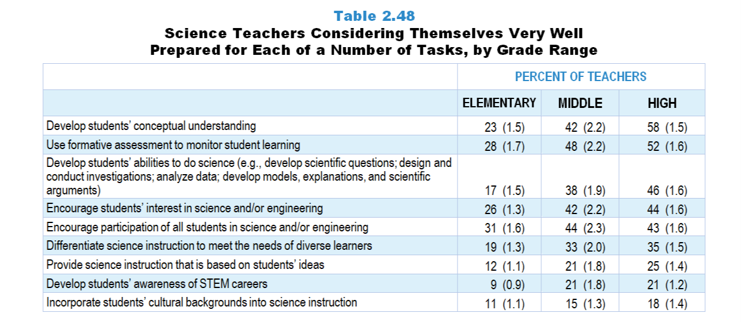
Original Data for Slides 95–100
(not for presentation)
Notes:
Table 2.48, p. 37 in Technical Report
This slide shows data from an individual item.
Science Teacher Questionnaire
Q37. How well prepared do you feel to do each of the following in your science instruction? [Select one on each row.] (Response Options: [1] Not adequately prepared, [2] Somewhat prepared, [3] Fairly well prepared, [4] Very well prepared)
Develop students’ conceptual understanding of the science ideas you teach
Develop students’ abilities to do science (for example: develop scientific questions; design and conduct investigations; analyze data; develop models, explanations, and scientific arguments)
Develop students’ awareness of STEM careers
Provide science instruction that is based on students’ ideas (whether completely correct or not) about the topics you teach
Use formative assessment to monitor student learning
Differentiate science instruction to meet the needs of diverse learners
Incorporate students’ cultural backgrounds into science instruction
Encourage students' interest in science and/or engineering
Encourage participation of all students in science and/or engineering
The numbers in parentheses are standard errors.
Findings Highlighted in Technical Report
“As can be seen in Table 2.48, science teacher preparedness tends to increase with increasing grade range. For example, only 23 percent of elementary teachers feel very well prepared to develop students’ conceptual understanding of science ideas, compared to 42 percent of middle grades teachers and 58 percent of high school teachers. A majority of high school teachers also feel very well prepared to use formative assessment to monitor student learning; the proportion of teachers feeling very well prepared increases with increasing grade level. Fewer teachers at all grade levels feel very well prepared to provide science instruction that is based on students’ ideas, develop students’ awareness of STEM careers, and incorporate students’ cultural backgrounds into science instruction.”

Slide 95
Elementary Science Teachers Considering Themselves Very Well Prepared for Each of a Number of Tasks
Notes:
Note: Each grade-level chart is sorted independently; consequently items may appear in different orders.

Slide 96
Elementary Science Teachers Considering Themselves Very Well Prepared for Various Tasks
Notes:
Note: Each grade-level chart is sorted independently; consequently items may appear in different orders.

Slide 97
Middle School Science Teachers Considering Themselves Very Well Prepared for Various Tasks
Notes:
Note: Each grade-level chart is sorted independently; consequently items may appear in different orders.

Slide 98
Middle School Science Teachers Considering Themselves Very Well Prepared for Various Tasks
Notes:
Note: Each grade-level chart is sorted independently; consequently items may appear in different orders.

Slide 99
High School Science Teachers Considering Themselves Very Well Prepared for Various Tasks
Notes:
Note: Each grade-level chart is sorted independently; consequently items may appear in different orders.

Slide 100
High School Science Teachers Considering Themselves Very Well Prepared for Various Tasks
Notes:
Note: Each grade-level chart is sorted independently; consequently items may appear in different orders.

Slide 101
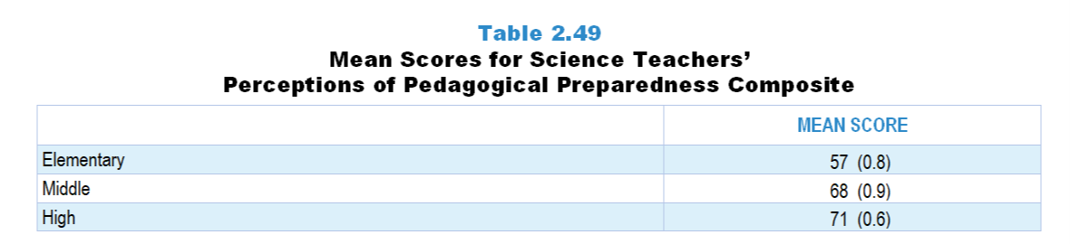
Original Data for Slide 102
(not for presentation)
Notes:
Table 2.49, p. 38 in Technical Report
This slide shows data from composites.
Sets of related questionnaire items were combined to create several composite variables related to key constructs. Composite variables, which are more reliable than individual survey items, were computed to have a minimum possible value of 0 and a maximum possible value of 100. Higher composite scores indicate more of the construct being measure by the composite. Each composite is calculated by summing the responses to the items associated with that composite and then dividing by the total points possible. In order for the composites to be on a 100-point scale, the lowest response option on each scale was set to 0 and the others were adjusted accordingly; so for example, an item with a scale ranging from 1 to 4 was re-coded to have a scale of 0 to 3. By doing this, someone who marks the lowest point on every item in a composite receives a composite score of 0 rather than some positive number. It also assures that 50 is the true mid-point. The denominator for each composite is determined by computing the maximum possible sum of responses for a series of items and dividing by 100; e.g., a 9-item composite where each item is on a scale of 0–3 would have a denominator of 0.27. Composites values were not computed for participants who respond to fewer than two-thirds of the items that form the composite.
Perceptions of Pedagogical Preparedness Composite Items
Q37a. Develop students’ conceptual understanding of the science ideas you teach
Q37b. Develop students’ abilities to do science (for example: develop scientific questions; design and conduct investigations; analyze data; develop models, explanations, and scientific arguments)
Q37c. Develop students’ awareness of STEM careers
Q37d. Provide science instruction that is based on students’ ideas (whether completely correct or not) about the topics you teach
Q37e. Use formative assessment to monitor student learning
Q37f. Differentiate science instruction to meet the needs of diverse learners
Q37g. Incorporate students’ cultural backgrounds into science instruction
Q37h. Encourage students' interest in science and/or engineering
Q37i. Encourage participation of all students in science and/or engineering
Science Teacher Questionnaire
Q37. How well prepared do you feel to do each of the following in your science instruction? [Select one on each row.] (Response Options: [1] Not adequately prepared, [2] Somewhat prepared, [3] Fairly well prepared, [4] Very well prepared)
Develop students’ conceptual understanding of the science ideas you teach
Develop students’ abilities to do science (for example: develop scientific questions; design and conduct investigations; analyze data; develop models, explanations, and scientific arguments)
Develop students’ awareness of STEM careers
Provide science instruction that is based on students’ ideas (whether completely correct or not) about the topics you teach
Use formative assessment to monitor student learning
Differentiate science instruction to meet the needs of diverse learners
Incorporate students’ cultural backgrounds into science instruction
Encourage students' interest in science and/or engineering
Encourage participation of all students in science and/or engineering
The numbers in parentheses are standard errors.
Findings Highlighted in Technical Report
“The items in Table 2.48 were combined into a composite variable to examine science teachers’ overall perceptions of pedagogical preparedness. As can be seen in Table 2.49, secondary science teachers feel more prepared in this area than elementary science teachers.”

Slide 102
Secondary Science Teachers’ Perceptions of Pedagogical Preparedness Composite

Slide 103
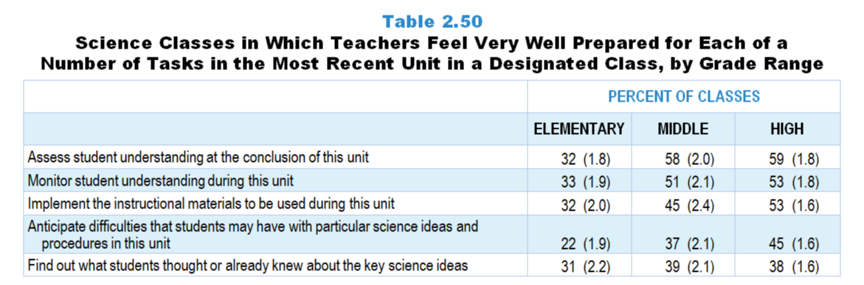
Original Data for Slides 104–106
(not for presentation)
Notes:
Table 2.50, p. 38 in Technical Report
This slide shows data from an individual item.
Science Teacher Questionnaire
Q67. How well prepared did you feel to do each of the following as part of your instruction on this particular unit? [Select one on each row.] (Response Options: [1] Not adequately prepared, [2] Somewhat prepared, [3] Fairly well prepared, [4] Very well prepared)
Anticipate difficulties that students may have with particular science ideas and procedures in this unit
Find out what students thought or already knew about the key science ideas
Implement the instructional materials (for example: textbook, module) to be used during this unit
Monitor student understanding during this unit
Assess student understanding at the conclusion of this unit
The numbers in parentheses are standard errors.
Findings Highlighted in Technical Report
“Table 2.50 shows the percentage of science classes at each grade level taught by teachers who feel very well prepared for each of a number of tasks related to instruction within a particular unit in a designated class. Two findings are notable. First, secondary teachers feel better prepared for these tasks than elementary teachers. Second, science teachers, regardless of grade level, tend to feel less well prepared for finding out what students already know or think about the key science ideas to be addressed, and anticipating what students might find difficult in the unit.”

Slide 104
Elementary Science Classes in Which Teachers Feel Very Well Prepared for Various Tasks in the Most Recent Unit
Notes:
Note: Each grade-level chart is sorted independently; consequently items may appear in different orders.

Slide 105
Middle School Science Classes in Which Teachers Feel Very Well Prepared for Various Tasks in the Most Recent Unit
Notes:
Note: Each grade-level chart is sorted independently; consequently items may appear in different orders.

Slide 106
High School Science Classes in Which Teachers Feel Very Well Prepared for Various Tasks in the Most Recent Unit
Notes:
Note: Each grade-level chart is sorted independently; consequently items may appear in different orders.

Slide 107
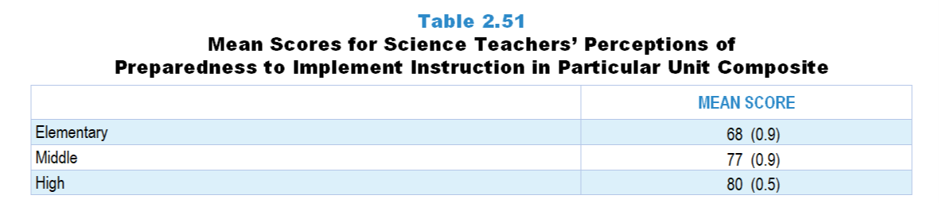
Original Data for Slide 108
(not for presentation)
Notes:
Table 2.51, p. 38 in Technical Report
This slide shows data from composites.
Sets of related questionnaire items were combined to create several composite variables related to key constructs. Composite variables, which are more reliable than individual survey items, were computed to have a minimum possible value of 0 and a maximum possible value of 100. Higher composite scores indicate more of the construct being measure by the composite. Each composite is calculated by summing the responses to the items associated with that composite and then dividing by the total points possible. In order for the composites to be on a 100-point scale, the lowest response option on each scale was set to 0 and the others were adjusted accordingly; so for example, an item with a scale ranging from 1 to 4 was re-coded to have a scale of 0 to 3. By doing this, someone who marks the lowest point on every item in a composite receives a composite score of 0 rather than some positive number. It also assures that 50 is the true mid-point. The denominator for each composite is determined by computing the maximum possible sum of responses for a series of items and dividing by 100; e.g., a 9-item composite where each item is on a scale of 0–3 would have a denominator of 0.27. Composites values were not computed for participants who respond to fewer than two-thirds of the items that form the composite.
Perceptions of Preparedness to Implement Instruction in Particular Unit Composite Items
Q67a. Anticipate difficulties that students may have with particular science ideas and procedures in this unit
Q67b. Find out what students thought or already knew about the key science ideas
Q67c. Implement the instructional materials (for example: textbook, module) to be used during this unit
Q67d. Monitor student understanding during this unit
Q67e. Assess student understanding at the conclusion of this unit
Science Teacher Questionnaire
Q67. How well prepared did you feel to do each of the following as part of your instruction on this particular unit? [Select one on each row.] (Response Options: [1] Not adequately prepared, [2] Somewhat prepared, [3] Fairly well prepared, [4] Very well prepared)
Anticipate difficulties that students may have with particular science ideas and procedures in this unit
Find out what students thought or already knew about the key science ideas
Implement the instructional materials (for example: textbook, module) to be used during this unit
Monitor student understanding during this unit
Assess student understanding at the conclusion of this unit
The numbers in parentheses are standard errors.
Findings Highlighted in Technical Report
“The items in Table 2.50 were combined to create a composite variable named Perceptions of Preparedness to Implement Instruction in Particular Unit. As can be seen in Table 2.51, feelings of preparedness increase with increasing grade range.”

Slide 108
Science Teachers’ Perceptions of Preparedness to Implement Instruction in Particular Unit Composite

Slide 109
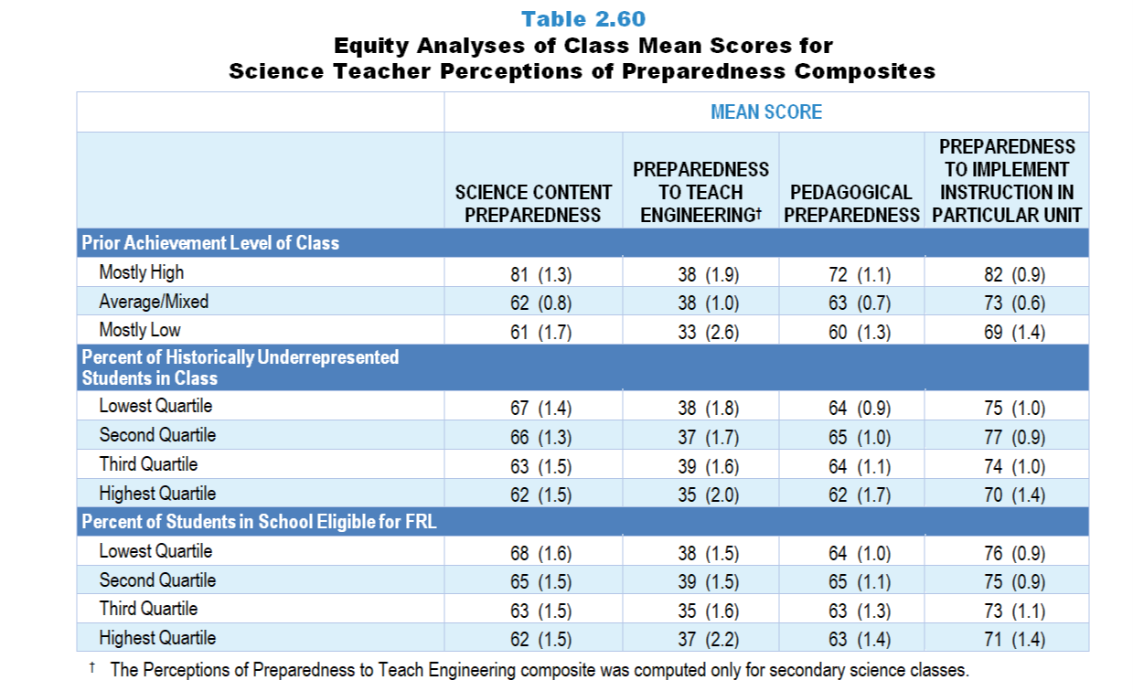
Original Data for Slides 110–112
(not for presentation)
Notes:
Table 2.60, p. 42 in Technical Report
This slide shows data from Composites.
Sets of related questionnaire items were combined to create several composite variables related to key constructs. Composite variables, which are more reliable than individual survey items, were computed to have a minimum possible value of 0 and a maximum possible value of 100. Higher composite scores indicate more of the construct being measured by the composite. Each composite is calculated by summing the responses to the items associated with that composite and then dividing by the total points possible. In order for the composites to be on a 100-point scale, the lowest response option on each scale was set to 0 and the others were adjusted accordingly; so for example, an item with a scale ranging from 1 to 4 was re-coded to have a scale of 0 to 3. By doing this, someone who marks the lowest point on every item in a composite receives a composite score of 0 rather than some positive number. It also assures that 50 is the true mid-point. The denominator for each composite is determined by computing the maximum possible sum of responses for a series of items and dividing by 100; e.g., a 9-item composite where each item is on a scale of 0–3 would have a denominator of 0.27. Composite values were not computed for participants who responded to fewer than two-thirds of the items that form the composite.
The Perceptions of Content Preparedness composite was calculated based on the topics taught in the targeted class. Thus, it is defined differently across the subjects and grade ranges included in this study.
Perceptions of Science Content Preparedness Composite Items
Q35a. Life Science
Q35b. Earth Science
Q35c. Physical Science
Q35d. Engineering
Q36a. Earth/Space Science
Earth’s features and physical processes
The solar system and the universe
Climate and weather
Q36b. Biology/Life Science
Cell biology
Structures and functions of organisms
Ecology/ecosystems
Genetics
Evolution
Q36c. Chemistry
Atomic structure
Chemical bonding, equations, nomenclature, and reactions
Elements, compounds, and mixtures
The Periodic Table
Properties of solutions
States, classes, and properties of matter
Q36d. Physics
Forces and motion
Energy transfers, transformations, and conservation
Properties and behaviors of waves
Electricity and magnetism
Modern physics (for example: special relativity)
Q36f. Environmental and resource issues (for example: land and water use, energy resources and consumption, sources and impacts of pollution)
Perceptions of Preparedness to Teach Engineering Composite Items
Q36e. Engineering
Defining engineering problems
Developing possible solutions
Optimizing a design solution
Perceptions of Pedagogical Preparedness Composite Items
Q37a. Develop students’ conceptual understanding of the science ideas you teach
Q37b. Develop students’ abilities to do science (for example: develop scientific questions; design and conduct investigations; analyze data; develop models, explanations, and scientific arguments)
Q37c. Develop students’ awareness of STEM careers
Q37d. Provide science instruction that is based on students’ ideas (whether completely correct or not) about the topics you teach
Q37e. Use formative assessment to monitor student learning
Q37f. Differentiate science instruction to meet the needs of diverse learners
Q37g. Incorporate students’ cultural backgrounds into science instruction
Q37h. Encourage students' interest in science and/or engineering
Q37i. Encourage participation of all students in science and/or engineering
Perceptions of Preparedness to Implement Instruction in Particular Unit Composite Items
Q67a. Anticipate difficulties that students may have with particular science ideas and procedures in this unit
Q67b. Find out what students thought or already knew about the key science ideas
Q67c. Implement the instructional materials (for example: textbook, module) to be used during this unit
Q67d. Monitor student understanding during this unit
Q67e. Assess student understanding at the conclusion of this unit
Science Teacher Questionnaire
Q35. Many teachers feel better prepared to teach some subject areas than others. How well prepared do you feel to teach each of the following subjects at the grade level(s) you teach, whether or not they are currently included in your teaching responsibilities? [Select one on each row.] (Response Options: [1] Not adequately prepared, [2] Somewhat prepared, [3] Fairly well prepared, [4] Very well prepared)
Life Science
Earth Science
Physical Science
Engineering
Mathematics
Reading/Language Arts
Social Studies
Q36. Within science, many teachers feel better prepared to teach some topics than others. How well prepared do you feel to teach each of the following topics at the grade level(s) you teach, whether or not they are currently included in your teaching responsibilities? [Select one on each row.] (Response Options: [1] Not adequately prepared, [2] Somewhat prepared, [3] Fairly well prepared, [4] Very well prepared)
Earth/Space Science
Earth’s features and physical processes
The solar system and the universe
Climate and weather
Biology/Life Science
Cell biology
Structures and functions of organisms
Ecology/ecosystems
Genetics
Evolution
Chemistry
Atomic structure
Chemical bonding, equations, nomenclature, and reactions
Elements, compounds, and mixtures
The Periodic Table
Properties of solutions
States, classes, and properties of matter
Physics
Forces and motion
Energy transfers, transformations, and conservation
Properties and behaviors of waves
Electricity and magnetism
Modern physics (for example: special relativity)
Engineering
Defining engineering problems
Developing possible solutions
Optimizing a design solution
Environmental and resource issues (for example: land and water use, energy resources and consumption, sources and impacts of pollution)
Q37. How well prepared do you feel to do each of the following in your science instruction? [Select one on each row.] (Response Options: [1] Not adequately prepared, [2] Somewhat prepared, [3] Fairly well prepared, [4] Very well prepared)
Develop students’ conceptual understanding of the science ideas you teach
Develop students’ abilities to do science (for example: develop scientific questions; design and conduct investigations; analyze data; develop models, explanations, and scientific arguments)
Develop students’ awareness of STEM careers
Provide science instruction that is based on students’ ideas (whether completely correct or not) about the topics you teach
Use formative assessment to monitor student learning
Differentiate science instruction to meet the needs of diverse learners
Incorporate students’ cultural backgrounds into science instruction
Encourage students' interest in science and/or engineering
Encourage participation of all students in science and/or engineering
Q67. How well prepared did you feel to do each of the following as part of your instruction on this particular unit? [Select one on each row.] (Response Options: [1] Not adequately prepared, [2] Somewhat prepared, [3] Fairly well prepared, [4] Very well prepared)
Anticipate difficulties that students may have with particular science ideas and procedures in this unit
Find out what students thought or already knew about the key science ideas
Implement the instructional materials (for example: textbook, module) to be used during this unit
Monitor student understanding during this unit
Assess student understanding at the conclusion of this unit
The numbers in parentheses are standard errors.
Chapters 2–7 in the technical report provide data on several key indicators, disaggregated by one or more equity factors: the prior achievement level of students in the class, the percentage of students from race/ethnicity groups historically underrepresented in STEM in the class, the percentage of students in the school eligible for free/reduced-price lunch (FRL), school size, community type, and region. For FRL, each school was classified into one of four categories (defined as quartiles) based on the proportion of students eligible for FRL. Similarly, each randomly selected class was classified into one of the four categories based on the proportion of students from race/ethnicity groups historically underrepresented in STEM in the class.
Findings Highlighted in Technical Report
“Scores on the teacher perceptions of preparedness composites were analyzed by a number of equity variables. In science, the most striking differences are among classes of students with different levels of prior achievement (see Table 2.60). Compared to classes of mostly low prior achievers, teachers of classes with mostly high prior achievers are more likely to feel well prepared to teach science content, implement pedagogies (e.g., develop students’ abilities to do science, encourage students’ interest in science and/‌or engineering), and implement instruction in a particular unit. Although the same pattern appears in teachers’ perceptions of preparedness to teach engineering, the difference between classes of mostly high prior achievers and mostly low prior achievers is not statistically significant. In addition, classes containing a higher proportion of students from race/‌ethnicity groups historically underrepresented in STEM and classes in higher-poverty schools are less likely to be taught by teachers who feel well prepared to teach science content and implement instruction in a particular unit.”

Slide 110
Science Teacher Perceptions of Preparedness Composites, by Prior Achievement Level
Notes:
The Perceptions of Content Preparedness composite was calculated based on the topics taught in the targeted class. Thus, it is defined differently across the subjects and grade ranges included in this study.
The Perceptions of Preparedness to Teach Engineering composite was computed only for secondary science classes.

Slide 111
Science Teacher Perceptions of Preparedness Composites, by Percentage of Historically Underrepresented Students
Notes:
Historically Underrepresented Students includes American Indian or Alaskan Native, Black or African American, Hispanic or Latino, or Native Hawaiian or Other Pacific Islander students.
The Perceptions of Content Preparedness composite was calculated based on the topics taught in the targeted class. Thus, it is defined differently across the subjects and grade ranges included in this study.
The Perceptions of Preparedness to Teach Engineering composite was computed only for secondary science classes.
Slide shows the composite scores by quartile of percentage of historically underrepresented students in the randomly selected class.

Slide 112
Science Teacher Perceptions of Preparedness Composites, by Percentage of Students Eligible for FRL
Notes:
The Perceptions of Content Preparedness composite was calculated based on the topics taught in the targeted class. Thus, it is defined differently across the subjects and grade ranges included in this study.
The Perceptions of Preparedness to Teach Engineering composite was computed only for secondary science classes.
Slide shows the composite scores by quartile of percentage of students in school eligible for free and reduced lunch.

Slide 113
Teacher Leadership Roles and Responsibilities

Slide 114
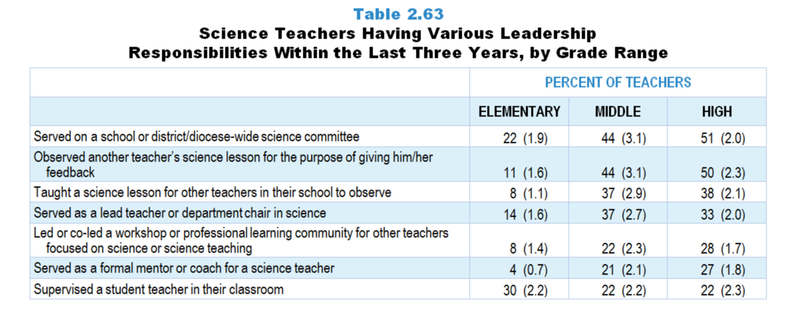
Original Data for Slides 115–117
(not for presentation)
Notes:
Table 2.63, p. 44 in Technical Report
This slide shows data from an individual item.
Science Teacher Questionnaire
39. In the last 3 years have you… [Select one on each row.]
Served as a lead teacher or department chair in science?
Served as a formal mentor or coach for a science teacher? (Do not include supervision of student teachers.)
Supervised a student teacher in your classroom?
Served on a school or district/diocese-wide science committee (for example: developing curriculum, developing pacing guides, selecting instructional materials)?
Led or co-led a workshop or professional learning community (for example: teacher study group, lesson study) for other teachers focused on science or science teaching?
Taught a science lesson for other teachers in your school to observe?
Observed another teacher’s science lesson for the purpose of giving him/her feedback?
The numbers in parentheses are standard errors.
Findings Highlighted in Technical Report
“As can be seen in Table 2.63, elementary science teachers are far less likely than secondary teachers to have had many of these responsibilities. For example, 44–51 percent of secondary science teachers have: (1) served on a school- or district-wide committee specific to their subject or (2) observed another teachers’ science lesson in order to provide feedback. Relatively few elementary science teachers have served in these roles. Elementary teachers may have fewer opportunities to serve on subject-specific committees or as an observer, as many are responsible for teaching all subjects in a self-contained setting on the same schedule as their colleagues. Secondary science teachers are also more likely than elementary teachers to have served as a formal mentor or coach for a science teacher. In contrast, elementary teachers are more likely to have supervised student teachers in the last three years.”

Slide 115
Elementary Science Teachers Having Various Leadership Responsibilities Within the Last 3 Years
Notes:
Note: Each grade-level chart is sorted independently; consequently items may appear in different orders.

Slide 116
Middle School Science Teachers Having Various Leadership Responsibilities Within the Last 3 Years
Notes:
Note: Each grade-level chart is sorted independently; consequently items may appear in different orders.

Slide 117
High School Science Teachers Having Various Leadership Responsibilities Within the Last 3 Years
Notes:
Note: Each grade-level chart is sorted independently; consequently items may appear in different orders.

