Slide 1
Chapter 3
Professional Development
Computer Science

Slide 2
Teacher Professional Development

Slide 3
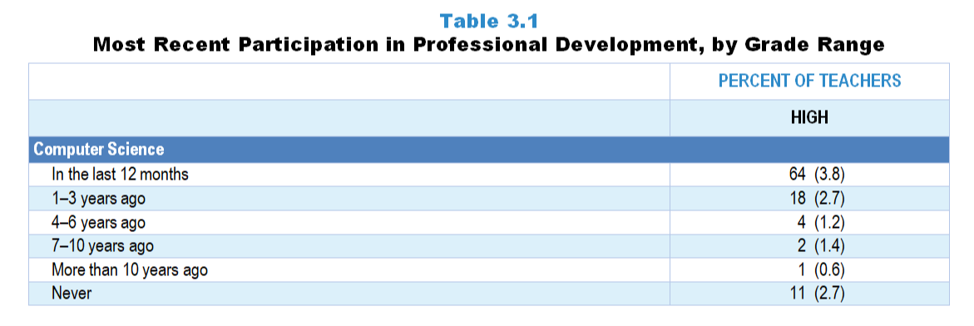
Original Data for Slide 4
(not for presentation)
Notes:
The computer science portion of Table 3.1, p. 48 in Technical Report
This slide shows data from an individual item.
Computer Science Teacher Questionnaire
Q15. When did you last participate in professional development focused on computer science or computer science teaching?
In the last 12 months
1- 3 years ago
4–6 years ago
7–10 years ago
More than 10 years ago
Never
The numbers in parentheses are standard errors.
Findings Highlighted in Technical Report
“One important measure of teachers’ continuing education is how long it has been since they participated in professional development. As can be seen in Table 3.1, with the exception of elementary science teachers, roughly 80 percent or more of science, ‌mathematics, and ‌computer science teachers have participated in discipline-focused professional development (i.e., focused on science, mathematics, computer science content or the teaching of science, mathematics, computer science) within the last three years. Elementary science teachers stand out for the relative paucity of professional development in science or science teaching, with fewer than about 60 percent having participated in the last three years.”

Slide 4
High School Computer Science Teachers Participating in Computer Science-Focused Professional Development
Notes:
Computer science-focused professional development includes professional development focused on computer science content or the teaching of computer science.

Slide 5
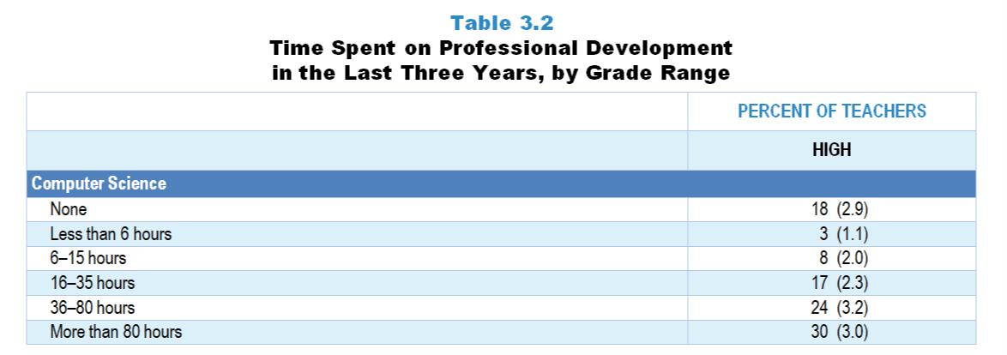
Original Data for Slide 6
(not for presentation)
Notes:
The computer science portion of Table 3.2, p. 49 of Technical Report
This slide shows data from an individual item.
Computer Science Teacher Questionnaire
Q17. What is the total amount of time you have spent on professional development related to computer science or computer science teaching in the last 3 years?
Less than 6 hours
6–15 hours
16–35 hours
36-80 hours
More than 80 hours
The numbers in parentheses are standard errors.
Findings Highlighted in Technical Report
“Although some involvement in professional development may be better than none, a brief exposure of a few hours over several years is not likely to be sufficient to enhance teachers’ knowledge and skills in meaningful ways. Accordingly, teachers across all subject areas were asked about the total amount of time they have spent on discipline-focused professional development in the last three years. As can be seen in Table 3.2, about a quarter of middle school and about a third of high school science teachers have participated in 36 hours or more of science professional development in the last three years; very few elementary teachers have had this amount of professional development in science. A similar pattern exists in mathematics, with about 2 in 5 secondary teachers having participated in at least 36 hours of mathematics-focused professional development in the last three years compared to fewer than 1 in 6 elementary teachers. In contrast, over half of high school computer science teachers have participated in this amount of professional development related to computer science or computer science teaching. This finding most likely reflects the recent national emphasis on computer science in STEM education and the push to develop students’ computational thinking skills.”

Slide 6
High School Computer Science Teachers’ Time Spent on Computer Science-Focused PD in Last 3 Years
Percent of Teachers
Notes:
Computer science-focused professional development includes professional development focused on computer science content or the teaching of computer science.
PD is short for professional development.

Slide 7
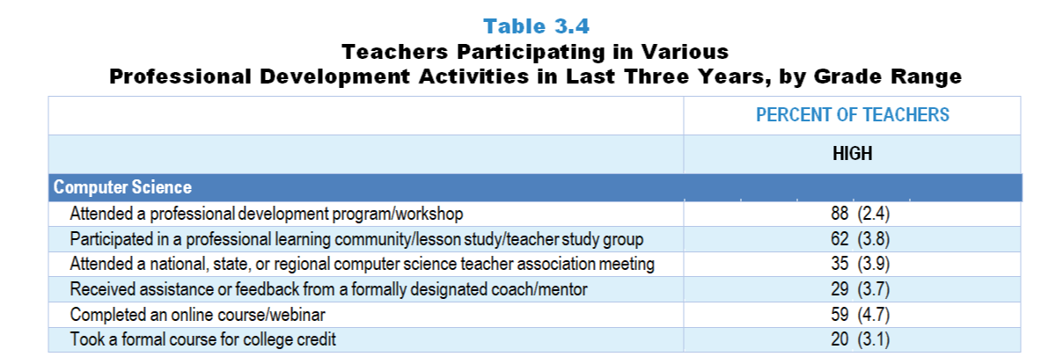
Original Data for Slide 8
(not for presentation)
Notes:
The computer science portion of Table 3.4, p. 51 in Technical Report
This slide shows data from individual items.
Computer Science Teacher Questionnaire
Q16. In the last 3 years, which of the following types of professional development related to science/engineering or science/engineering teaching have you had? [Select one on each row.]
I attended a professional development program/workshop.
I attended a national, state, or regional computer science teacher association meeting.
I completed an online course/webinar.
I participated in a professional learning community/lesson study/teacher study group
I received assistance or feedback from a formally designated coach/mentor.
I took a formal course for college credit.
The numbers in parentheses are standard errors.
Findings Highlighted in Technical Report
“Teachers who indicated they had recently participated in professional development were asked about the nature of those activities. Data for science teachers are shown in Table 3.5, and for mathematics teachers in Table 3.6. For each subject/grade-range combination, workshops are the most prevalent activity, with 84–92 percent of teachers who had participated in professional development activities in the last three years indicating they had attended a workshop. Roughly three-fourths of middle and high school mathematics and science teachers, but fewer of their elementary school colleagues, report participating in professional learning communities or other types of teacher study groups. Middle and high school teachers also attend science/mathematics teacher association meetings at a higher rate than do elementary teachers, likely a reflection of the fact that elementary teachers are responsible for teaching, and keeping up with, multiple disciplines. Finally, not only are elementary science teachers less likely to have participated recently in professional development, they are far less likely to have received feedback on their teaching from a mentor/coach than any other group.”

Slide 8
High School Computer Science Teachers Participating in Various PD Activities in the Last 3 Years
Notes:
Only high school computer science teachers indicating that they participated in computer science-focused professional development in the last three years are included in these analyses.
Computer science-focused professional development includes professional development focused on computer science content or the teaching of computer science.
PD is short for professional development.

Slide 9
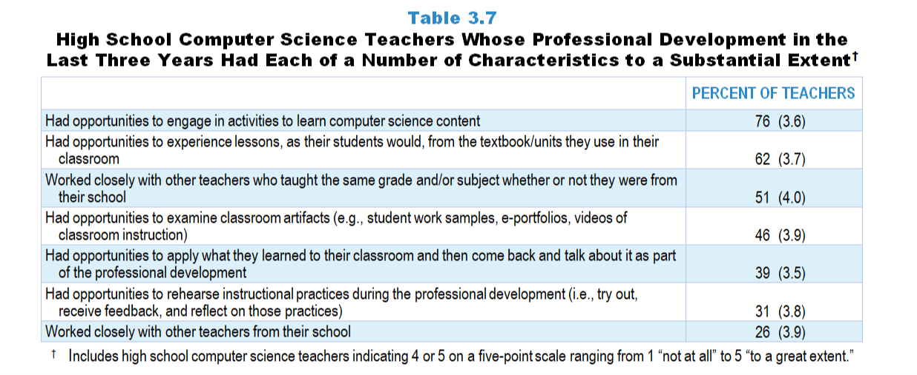
Original Data for Slides 10
(not for presentation)
Notes:
Table 3.7, p. 53 in Technical Report
This slide shows data from an individual item.
Computer Science Teacher Questionnaire
Q18. Considering all of your computer science-related professional development in the last 3 years, to what extent does each of the following describe your experiences? [Select one on each row.] (Response Options: [1] Not at all, [2] 2 of 5, [3] Somewhat, [4] 4 of 5, [5] To a great extent)
I had opportunities to engage in activities to learn computer science content.
I had opportunities to experience lessons, as my students would, from the textbook/units I use in my classroom.
I had opportunities to examine classroom artifacts (for example: student work samples, e-portfolios, videos of classroom instruction).
I had opportunities to rehearse instructional practices during the professional development (meaning: try out, receive feedback, and reflect on those practices).
I had opportunities to apply what I learned to my classroom and then come back and talk about it as part of the professional development.
I worked closely with other teachers from my school.
I worked closely with other teachers who taught the same grade and/or subject whether or not they were from my school.
The numbers in parentheses are standard errors.
Findings Highlighted in Technical Report
“Table 3.7 shows the data for high school computer science teachers. About three-fourths have had opportunities to engage in activities to learn computer science in the last three years. Another common characteristic is experiencing lessons as students would from the textbooks/‌units used in the classroom (62 percent). Further, about half of computer science teachers have had substantial opportunities to work closely with other computer science teachers who taught the same grade and/‌or subject, whether or not they were from their school, and to examine classroom artifacts. As is the case with science and mathematics teachers, high school computer science teachers rarely have had substantial opportunities to rehearse instructional practices during professional development.”

Slide 10
High School Computer Science Teachers Whose PD in the Last 3 Years Had Various Characteristics to a Substantial Extent
Notes:
Includes high school computer science teachers indicating 4 or 5 on a five-point scale ranging from 1 “not at all” to 5 “to a great extent.”
Only high school computer science teachers indicating that they participated in computer science-focused professional development in the last three years are included in these analyses.
PD is short for professional development.

Slide 11
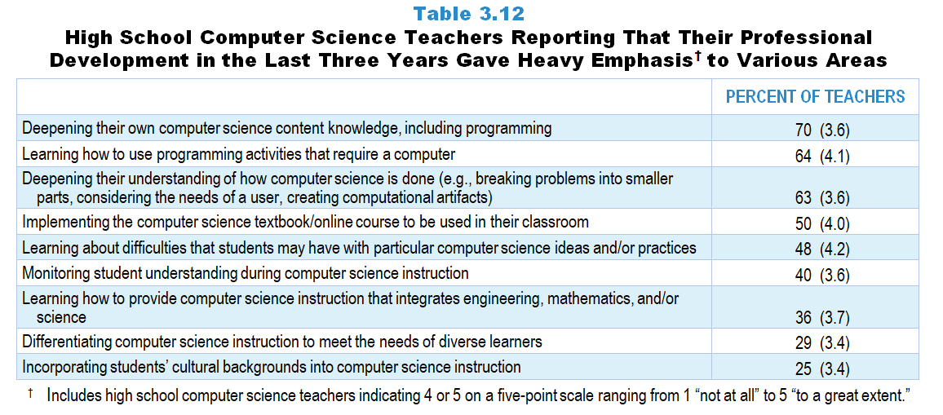
Original Data for Slides 12–13
(not for presentation)
Notes:
Table 3.12, p. 57 in Technical Report
This slide shows data from an individual item.
Computer Science Teacher Questionnaire
Q19. Thinking about all of your computer science-related professional development in the last 3 years, to what extent was each of the following emphasized? [Select one on each row.] (Response Options: [1] Not at all, [2] 2 of 5, [3] Somewhat, [4] 4 of 5, [5] To a great extent)
Deepening your own computer science content knowledge, including programming
Deepening your understanding of how computer science is done (for example: breaking problems into smaller parts, considering the needs of a user, creating computational artifacts)
Implementing the computer science textbook/online course to be used in your classroom
Learning how to use programming activities that require a computer
Learning about difficulties that students may have with particular computer science ideas and/or practices
Monitoring student understanding during computer science instruction
Differentiating computer science instruction to meet the needs of diverse learners
Incorporating students’ cultural backgrounds into computer science instruction
Learning how to provide computer science instruction that integrates engineering, mathematics, and/or science
The numbers in parentheses are standard errors.
Findings Highlighted in Technical Report
“High school computer science teacher data are shown in Table 3.12. The most common emphases related to understanding and doing computer science: deepening their computer science content knowledge, including programming (70 percent); learning how to use programming activities that require a computer (64 percent); and deepening understanding of how computer science is done (63 percent). Half of computer science teachers’ professional development has had a substantial focus on implementing the computer science textbook/‌online course to be used in their classroom. Only about a quarter have attended professional development that emphasized differentiating computer science instruction to meet the needs of diverse learners or incorporating students’ cultural backgrounds into computer science instruction, two areas that likely will need greater emphasis to help ensure students from all backgrounds have opportunities in this field.”

Slide 12
High School Computer Science Teachers Reporting PD in the Last 3 Years With Heavy Emphasis on Various Areas
Notes:
Includes high school computer science teachers indicating 4 or 5 on a five-point scale ranging from 1 “not at all” to 5 “to a great extent.”
Only high school computer science teachers indicating that they participated in computer science-focused professional development in the last three years are included in these analyses.
PD is short for professional development.

Slide 13
High School Computer Science Teachers Reporting PD in the Last 3 Years With Heavy Emphasis on Various Areas
Notes:
Includes high school computer science teachers indicating 4 or 5 on a five-point scale ranging from 1 “not at all” to 5 “to a great extent.”
Only high school computer science teachers indicating that they participated in computer science-focused professional development in the last three years are included in these analyses.
PD is short for professional development.

Slide 14
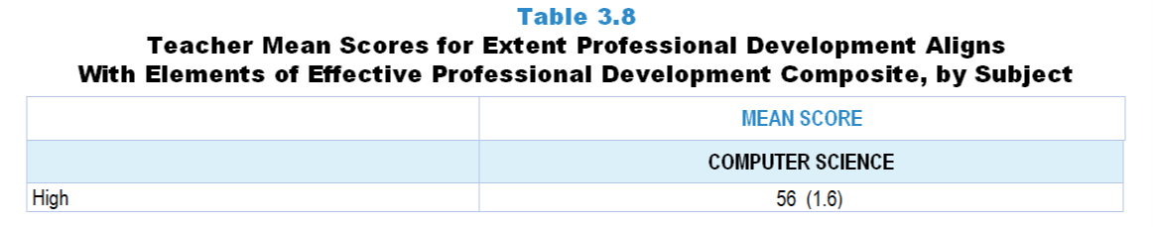
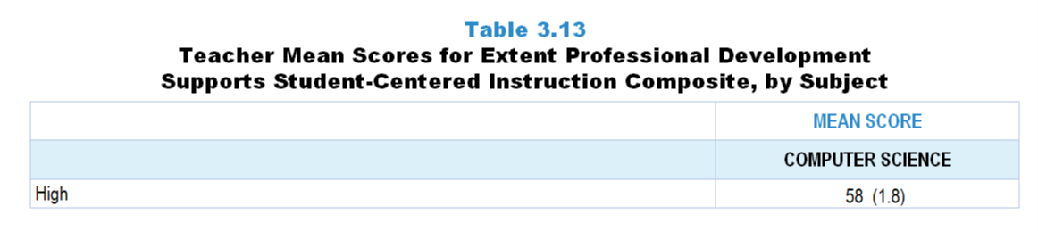
Original Data for Slide 15
(not for presentation)
Notes:
The computer science portion of Table 3.8, p. 54 in Technical Report
This slide shows data from composites.
Sets of related questionnaire items were combined to create several composite variables related to key constructs. Composite variables, which are more reliable than individual survey items, were computed to have a minimum possible value of 0 and a maximum possible value of 100. Higher composite scores indicate more of the construct being measure by the composite. Each composite is calculated by summing the responses to the items associated with that composite and then dividing by the total points possible. In order for the composites to be on a 100-point scale, the lowest response option on each scale was set to 0 and the others were adjusted accordingly; so for example, an item with a scale ranging from 1 to 4 was re-coded to have a scale of 0 to 3. By doing this, someone who marks the lowest point on every item in a composite receives a composite score of 0 rather than some positive number. It also assures that 50 is the true mid-point. The denominator for each composite is determined by computing the maximum possible sum of responses for a series of items and dividing by 100; e.g., a 9-item composite where each item is on a scale of 0–3 would have a denominator of 0.27. Composites values were not computed for participants who respond to fewer than two-thirds of the items that form the composite.
Extent Professional Development Aligns With Elements of Effective Professional Development Composite Items
Q18a. I had opportunities to engage in activities to learn computer science content.
Q18b. I had opportunities to experience lessons, as my students would, from the textbook/units I use in my classroom.
Q18c. I had opportunities to examine classroom artifacts (for example: student work samples, e-portfolios, videos of classroom instruction).
Q18d. I had opportunities to rehearse instructional practices during the professional development (meaning: try out, receive feedback, and reflect on those practices).
Q18e. I had opportunities to apply what I learned to my classroom and then come back and talk about it as part of the professional development.
Q18f. I worked closely with other teachers from my school.
Q18g. I worked closely with other teachers who taught the same grade and/or subject whether or not they were from my school.
Computer Science Teacher Questionnaire
Q18. Considering all of your computer science-related professional development in the last 3 years, to what extent does each of the following describe your experiences? [Select one on each row.] (Response Options: [1] Not at all, [2] 2 of 5, [3] Somewhat, [4] 4 of 5, [5] To a great extent)
I had opportunities to engage in activities to learn computer science content.
I had opportunities to experience lessons, as my students would, from the textbook/units I use in my classroom.
I had opportunities to examine classroom artifacts (for example: student work samples, e-portfolios, videos of classroom instruction).
I had opportunities to rehearse instructional practices during the professional development (meaning: try out, receive feedback, and reflect on those practices).
I had opportunities to apply what I learned to my classroom and then come back and talk about it as part of the professional development.
I worked closely with other teachers from my school.
I worked closely with other teachers who taught the same grade and/or subject whether or not they were from my school.
The numbers in parentheses are standard errors.
Findings Highlighted in Technical Report
“As can be seen in Table 3.8, the mean scores on this composite are similar across subject/‌grade-range categories, except for elementary science, where scores are lower than the other subject/‌grade-range combinations.”
The computer science portion of Table 3.13, p. 58 in Technical Report
This slide shows data from composites.
Sets of related questionnaire items were combined to create several composite variables related to key constructs. Composite variables, which are more reliable than individual survey items, were computed to have a minimum possible value of 0 and a maximum possible value of 100. Higher composite scores indicate more of the construct being measure by the composite. Each composite is calculated by summing the responses to the items associated with that composite and then dividing by the total points possible. In order for the composites to be on a 100-point scale, the lowest response option on each scale was set to 0 and the others were adjusted accordingly; so for example, an item with a scale ranging from 1 to 4 was re-coded to have a scale of 0 to 3. By doing this, someone who marks the lowest point on every item in a composite receives a composite score of 0 rather than some positive number. It also assures that 50 is the true mid-point. The denominator for each composite is determined by computing the maximum possible sum of responses for a series of items and dividing by 100; e.g., a 9-item composite where each item is on a scale of 0–3 would have a denominator of 0.27. Composites values were not computed for participants who respond to fewer than two-thirds of the items that form the composite.
Extent Professional Development Supports Student-Centered Instruction Composite Items
Q19a. Deepening your own computer science content knowledge, including programming
Q19b. Deepening your understanding of how computer science is done (for example: breaking problems into smaller parts, considering the needs of a user, creating computational artifacts)
Q19c. Implementing the computer science textbook/online course to be used in your classroom
Q19d. Learning how to use programming activities that require a computer
Q19e. Learning about difficulties that students may have with particular computer science ideas and/or practices
Q19f. Monitoring student understanding during computer science instruction
Q19g. Differentiating computer science instruction to meet the needs of diverse learners
Q19h. Incorporating students’ cultural backgrounds into computer science instruction
Q19i. Learning how to provide computer science instruction that integrates engineering, mathematics, and/or science
Computer Science Teacher Questionnaire
Q19. Thinking about all of your computer science-related professional development in the last 3 years, to what extent was each of the following emphasized? [Select one on each row.] (Response Options: [1] Not at all, [2] 2 of 5, [3] Somewhat, [4] 4 of 5, [5] To a great extent)
Deepening your own computer science content knowledge, including programming
Deepening your understanding of how computer science is done (for example: breaking problems into smaller parts, considering the needs of a user, creating computational artifacts)
Implementing the computer science textbook/online course to be used in your classroom
Learning how to use programming activities that require a computer
Learning about difficulties that students may have with particular computer science ideas and/or practices
Monitoring student understanding during computer science instruction
Differentiating computer science instruction to meet the needs of diverse learners
Incorporating students’ cultural backgrounds into computer science instruction
Learning how to provide computer science instruction that integrates engineering, mathematics, and/or science
The numbers in parentheses are standard errors.
Findings Highlighted in Technical Report
“Several items related to a focus on student-centered instruction in recent teacher professional development were combined into a composite variable. As can be seen in Table 3.13, professional development for elementary mathematics is more likely than professional development for elementary science to support student-centered instruction (mean scores of 61 and 48, respectively). Interestingly, in science, professional development for middle and high school teachers gives more emphasis to student-centered instruction than elementary teachers, but in mathematics, professional development for elementary teachers is more likely to have this focus compared to what high school mathematics teachers experience. Lastly, the mean score for high school computer science teachers is significantly higher than the mean scores for both science and mathematics high school teachers.”

Slide 15
High School Computer Science Teacher Professional Development Composites

Slide 16
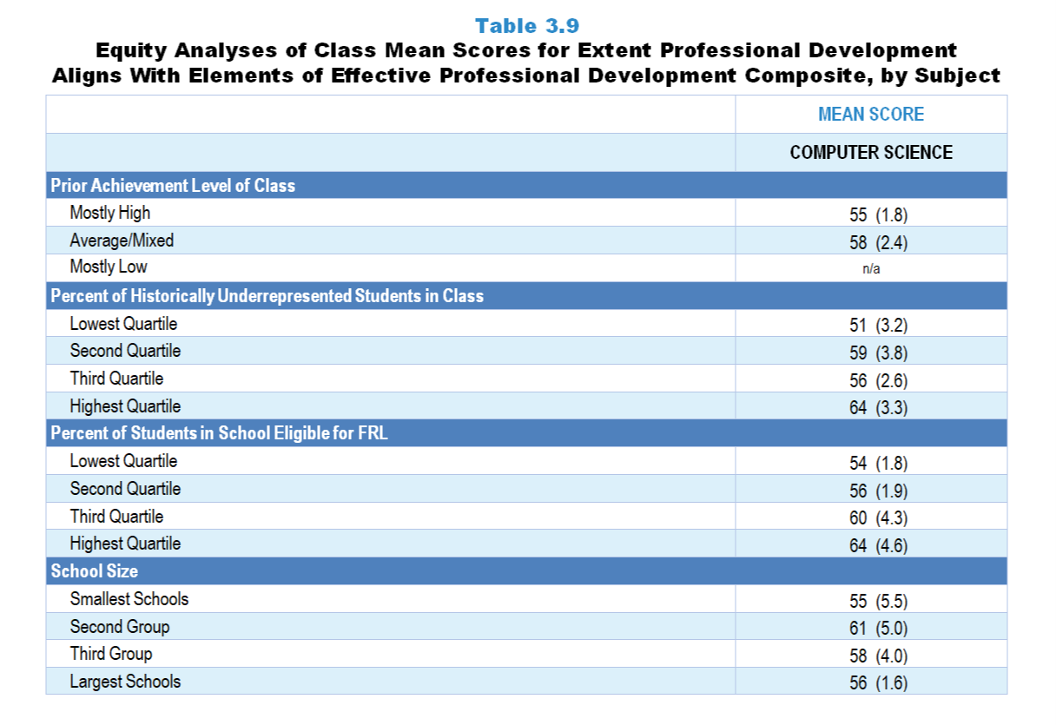
Original Data for Slide 17
(not for presentation)
Notes:
The computer science portion of Table 3.9, p. 55 in Technical Report
This slide shows data from composites.
Sets of related questionnaire items were combined to create several composite variables related to key constructs. Composite variables, which are more reliable than individual survey items, were computed to have a minimum possible value of 0 and a maximum possible value of 100. Higher composite scores indicate more of the construct being measure by the composite. Each composite is calculated by summing the responses to the items associated with that composite and then dividing by the total points possible. In order for the composites to be on a 100-point scale, the lowest response option on each scale was set to 0 and the others were adjusted accordingly; so for example, an item with a scale ranging from 1 to 4 was re-coded to have a scale of 0 to 3. By doing this, someone who marks the lowest point on every item in a composite receives a composite score of 0 rather than some positive number. It also assures that 50 is the true mid-point. The denominator for each composite is determined by computing the maximum possible sum of responses for a series of items and dividing by 100; e.g., a 9-item composite where each item is on a scale of 0–3 would have a denominator of 0.27. Composites values were not computed for participants who respond to fewer than two-thirds of the items that form the composite.
Extent Professional Development Aligns With Elements of Effective Professional Development Composite Items
Q18a. I had opportunities to engage in activities to learn computer science content.
Q18b. I had opportunities to experience lessons, as my students would, from the textbook/units I use in my classroom.
Q18c. I had opportunities to examine classroom artifacts (for example: student work samples, e-portfolios, videos of classroom instruction).
Q18d. I had opportunities to rehearse instructional practices during the professional development (meaning: try out, receive feedback, and reflect on those practices).
Q18e. I had opportunities to apply what I learned to my classroom and then come back and talk about it as part of the professional development.
Q18f. I worked closely with other teachers from my school.
Q18g. I worked closely with other teachers who taught the same grade and/or subject whether or not they were from my school.
Computer Science Teacher Questionnaire
Q18. Considering all of your computer science-related professional development in the last 3 years, to what extent does each of the following describe your experiences? [Select one on each row.] (Response Options: [1] Not at all, [2] 2 of 5, [3] Somewhat, [4] 4 of 5, [5] To a great extent)
I had opportunities to engage in activities to learn computer science content.
I had opportunities to experience lessons, as my students would, from the textbook/units I use in my classroom.
I had opportunities to examine classroom artifacts (for example: student work samples, e-portfolios, videos of classroom instruction).
I had opportunities to rehearse instructional practices during the professional development (meaning: try out, receive feedback, and reflect on those practices).
I had opportunities to apply what I learned to my classroom and then come back and talk about it as part of the professional development.
I worked closely with other teachers from my school.
I worked closely with other teachers who taught the same grade and/or subject whether or not they were from my school.
Q26. For the students in this class, indicate the number of males and females in this class in each of the following categories of race/ethnicity.
American Indian or Alaskan Native _____ _____
Asian _____ _____
Black or African American _____ _____
Hispanic/Latino _____ _____
Native Hawaiian or Other Pacific Islander _____ _____
White _____ _____
Two or more races _____ _____
Q27. Which of the following best describes the prior achievement levels of the students in this class relative to other students in this school?
Mostly low achievers
Mostly average achievers
Mostly high achievers
A mixture of levels
The numbers in parentheses are standard errors.
Chapters 2–7 in the technical report provide data on several key indicators, disaggregated by one or more equity factors: the prior achievement level of students in the class, the percentage of students from race/ethnicity groups historically underrepresented in STEM in the class, the percentage of students in the school eligible for free/reduced-price lunch (FRL), school size, community type, and region. For FRL, each school was classified into one of four categories (defined as quartiles) based on the proportion of students eligible for FRL. Similarly, each randomly selected class was classified into one of the four categories based on the proportion of students from race/ethnicity groups historically underrepresented in STEM in the class.
Findings Highlighted in Technical Report
“When looking at the composite scores by equity factors, a number of differences are apparent by both class and school factors (see Table 3.9). Science classes consisting mostly of high-achieving students are more likely than classes of mostly low-achieving students to be taught by teachers who attended high-quality professional development (mean scores of 57 and 48, respectively). A similar pattern exists in terms of school size. Science classes in the largest schools have an advantage over those in the smallest schools when it comes to having access to teachers with effective professional learning experiences (mean scores of 54 and 47, respectively).
In contrast, mathematics classes composed of mostly low-achieving students tend to be taught by teachers with more high-quality professional development experiences than classes with mostly high-achieving students (mean score 61 and 56, respectively). Also, high school computer science classes with the largest proportion of students from race/‌ethnicity groups historically underrepresented in STEM are more likely to be taught by teachers who have experienced aspects of effective professional development than classes with the smallest proportion of students from these groups (mean score of 64 and 51, respectively). However, it is important to note that for computer science, the highest quartile contains relatively few students from these groups.”

Slide 17
Extent High School Computer Science Professional Development Aligns With Elements of Effective Professional Development Composite
Notes:
Historically Underrepresented Students includes American Indian or Alaskan Native, Black or African American, Hispanic or Latino, or Native Hawaiian or Other Pacific Islander students.

Slide 18
Professional Development
Offerings at the School Level

Slide 19
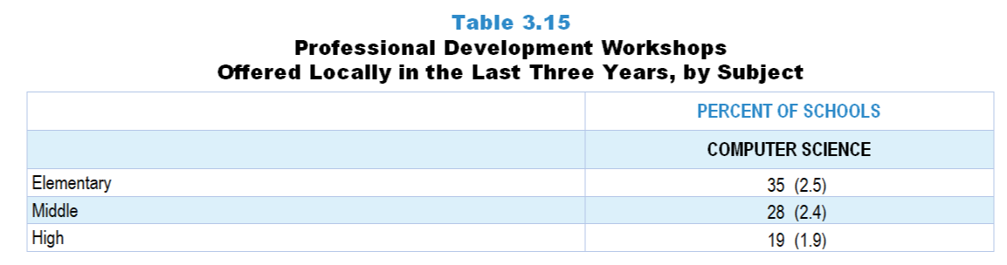
Original Data for Slide 20
(not for presentation)
Notes:
The computer science portion of Table 3.15, p. 60 in Technical Report
This slide shows data from an individual item.
School Coordinator Questionnaire
Q30. In the last 3 years, has your school and/or district/diocese offered workshops specifically focused on computer science or computer science teaching, possibly in conjunction with other organizations (for example: other school districts/dioceses, colleges or universities, museums, professional associations, commercial vendors)?
Yes
No
The numbers in parentheses are standard errors.
Findings Highlighted in Technical Report
“School representatives were asked whether professional development workshops in the respective discipline have been offered by their school and/‌or district, possibly in conjunction with other school systems, colleges or universities, museums, professional associations, or commercial vendors. As can be seen in Table 3.15, both elementary schools and middle schools are more likely to have locally offered workshops in mathematics than in science in the last three years. Schools across the grade levels are least likely to have local workshops in computer science.”

Slide 20
Computer Science PD Workshops Offered Locally in the Last 3 Years
Notes:
PD is short for professional development.

Slide 21
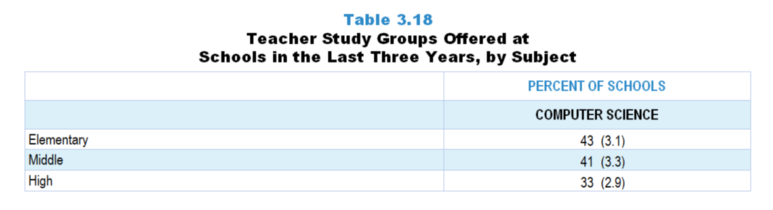
Original Data for Slide 22
(not for presentation)
Notes:
The computer science portion of Table 3.18, p. 61 in Technical Report
This slide shows data from an individual item.
School Coordinator Questionnaire
Q31. In the last 3 years, has your school and/or district and/or diocese offered teacher study groups where teachers meet on a regular basis to discuss teaching and learning of computer science, and possibly other content areas as well (sometimes referred to as Professional Learning Communities, PLCs, or lesson study)?
Yes
No
The numbers in parentheses are standard errors.
Findings Highlighted in Technical Report
“One concern about professional development workshops is that teachers may not be given adequate assistance in applying what they are learning to their own instruction. Teacher study groups (professional learning communities, lesson study, etc.) have the potential to help teachers focus on instruction. School science, mathematics, and computer science program representatives were asked whether their school has offered teacher study groups where teachers meet on a regular basis to discuss science, mathematics, or computer science teaching and learning in the last three years. As can be seen in Table 3.18, study groups are more likely to be offered in mathematics than in science or computer science. For example, 55 percent of elementary schools offer teacher study groups in mathematics compared to only 28 percent offering them in science.”

Slide 22
Computer Science Teacher Study Groups Offered at Schools in the Last 3 Years

Slide 23
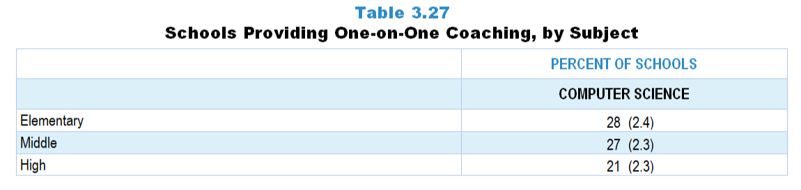
Original Data for Slide 24
(not for presentation)
Notes:
The computer science portion of Table 3.27, p. 67 in Technical Report
This slide shows data from an individual item.
School Coordinator Questionnaire
Q33. Do any teachers in your school have access to one-on-one coaching focused on improving their computer science instruction (include voluntary and required coaching)?
Yes
No
The numbers in parentheses are standard errors.
Findings Highlighted in Technical Report
“As noted earlier, professional development workshops and teacher study groups can provide important opportunities for teachers to deepen their disciplinary and pedagogical content knowledge, and to develop skill in using that knowledge for key tasks of teaching, such as analyzing student work to determine what a student does and does not understand. When resources allow, one-on-one coaching to help teachers improve their practice can be a powerful tool.
School program representatives were asked whether any teachers in their school have access to one-on-one coaching focused on improving their science, mathematics, and ‌computer science instruction; these data are shown in Table 3.27. Across subject areas and grade ranges, one-on-one coaching is relatively rare except in elementary school mathematics, where over 4 in 10 schools offer coaching.”

Slide 24
Schools Providing One-on-One Computer Science Coaching

Slide 25
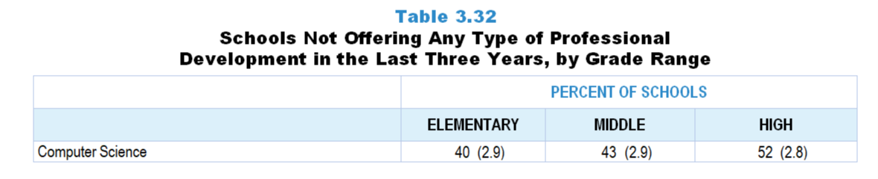
Original Data for Slide 26
(not for presentation)
Notes:
The computer science portion of Table 3.32, p. 69 in Technical Report
This slide shows data derived from:
School Coordinator Questionnaire
Q30. In the last 3 years, has your school and/or district/diocese offered workshops specifically focused on computer science or computer science teaching, possibly in conjunction with other organizations (for example: other school districts/dioceses, colleges or universities, museums, professional associations, commercial vendors)?
Yes
No
Q31. In the last 3 years, has your school and/or district and/or diocese offered teacher study groups where teachers meet on a regular basis to discuss teaching and learning of computer science, and possibly other content areas as well (sometimes referred to as Professional Learning Communities, PLCs, or lesson study)?
Yes
No
Q32. Do any teachers in your school have access to one-on-one coaching focused on improving their computer science instruction (include voluntary and required coaching)?
Yes
No
The numbers in parentheses are standard errors.
Findings Highlighted in Technical Report
“Responses to whether schools/‌districts provide science, mathematics, and ‌computer science workshops, teacher study groups, and one-on-one coaching were combined to look at the proportion of schools that have not offered any of these types of professional development. As can be seen in Table 3.32, about a third of schools have not offered some form of professional development in science in the last three years; 16–28 percent of schools, depending on grade level, have not offered any type of professional development in mathematics. In contrast, about 40–50 percent of schools have not offered computer science professional development at all in the last three years.”

Slide 26
Schools Not Offering Any Type of Computer Science PD in the Last 3 Years
Notes:
PD is short for professional development.

Slide 27
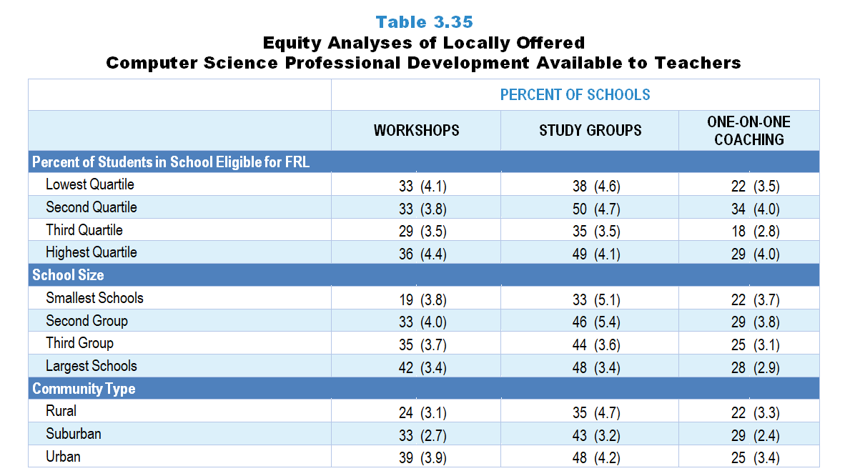
Original Data for Slides 28–30
(not for presentation)
Notes:
Table 3.35, p. 71 in Technical Report
This slide shows data from individual items.
School Coordinator Questionnaire
Q30. In the last 3 years, has your school and/or district/diocese offered workshops specifically focused on computer science or computer science teaching, possibly in conjunction with other organizations (for example: other school districts/dioceses, colleges or universities, museums, professional associations, commercial vendors)?
Yes
No
Q31. In the last 3 years, has your school and/or district and/or diocese offered teacher study groups where teachers meet on a regular basis to discuss teaching and learning of computer science, and possibly other content areas as well (sometimes referred to as Professional Learning Communities, PLCs, or lesson study)?
Yes
No
Q32. Do any teachers in your school have access to one-on-one coaching focused on improving their computer science instruction (include voluntary and required coaching)?
Yes
No
The numbers in parentheses are standard errors.
Chapters 2–7 in the technical report provide data on several key indicators, disaggregated by one or more equity factors: the prior achievement level of students in the class, the percentage of students from race/ethnicity groups historically underrepresented in STEM in the class, the percentage of students in the school eligible for free/reduced-price lunch (FRL), school size, community type, and region. For FRL, each school was classified into one of four categories (defined as quartiles) based on the proportion of students eligible for FRL. Similarly, each randomly selected class was classified into one of the four categories based on the proportion of students from race/ethnicity groups historically underrepresented in STEM in the class.
Findings Highlighted in Technical Report
“A somewhat similar pattern is seen in computer science. As can be seen in Table 3.35, the largest schools are significantly more likely than the smallest schools to offer computer science-focused workshops (42 vs. 19 percent, respectively) and teacher study groups (48 vs. 33 percent, respectively). There are also disparities by community type, with rural schools being less likely to provide workshops and study groups than their urban counterparts. The distribution of schools offering one-on-one coaching in computer science is relatively equal when analyzed by each of the different equity factors. “

Slide 28
Locally Offered Computer Science Professional Development Available to Teachers, by Percentage of Students in School Eligible for FRL

Slide 29
Locally Offered Computer Science Professional Development Available to Teachers, by School Size

Slide 30
Locally Offered Computer Science Professional Development Available to Teachers, by Community Type

