Slide 1
Chapter 3 Professional Development

Slide 2
Teacher Induction Programs

Slide 3
Original Data for Slide 4
(not for presentation)
Notes:
Table 3.36, p. 71 in Technical Report
This slide shows data from individual items.
School Coordinator Questionnaire
Q12. Does your school/district/diocese have a formal induction program for teachers new to the profession (support that is not offered to other teachers in the school)?
Yes
No
Q13. How long does a teacher typically receive support from the induction program?
One year or less
2 years
3 or more years
The numbers in parentheses are standard errors.
Findings Highlighted in Technical Report
“Formal induction programs provide critical support and guidance for beginning teachers and show promise for having a positive impact on teacher retention, instructional practices, and student achievement in schools. However, the effectiveness of these programs greatly depends on their length and the nature of the supports offered to teachers. Accordingly, school coordinators were asked a series of questions about formal induction programs at the schools.
Table 3.36 shows that roughly 70 percent of schools across the grade bands offer formal teacher induction programs. About a third of schools have programs that last one year or less, and about a fourth of schools have programs that last two years. It is rare for schools to have an induction program of three years or more. Of schools that do offer induction programs, a majority of them are developed and implemented by either the district or the school (see Table 3.37).”

Slide 4
Typical Duration of Formal Induction Programs

Slide 5
Original Data for Slide 6
(not for presentation)
Notes:
Table 3.37, p. 72 in Technical Report
This slide shows original and derived data from an individual item.
School Coordinator Questionnaire
Q14. Which of the following organizations are involved in developing and implementing the induction program? [Select all that apply.]
School
District/Diocese (if applicable)
Regional or county educational service
Local university
Other; please specify __________
The numbers in parentheses are standard errors.
Findings Highlighted in Technical Report
“Table 3.36 shows that roughly 70 percent of schools across the grade bands offer formal teacher induction programs. About a third of schools have programs that last one year or less, and about a fourth of schools have programs that last two years. It is rare for schools to have an induction program of three years or more. Of schools that do offer induction programs, a majority of them are developed and implemented by either the district or the school (see Table 3.37).”

Slide 6
Organization Developing and Implementing Formal Induction Programs

Slide 7
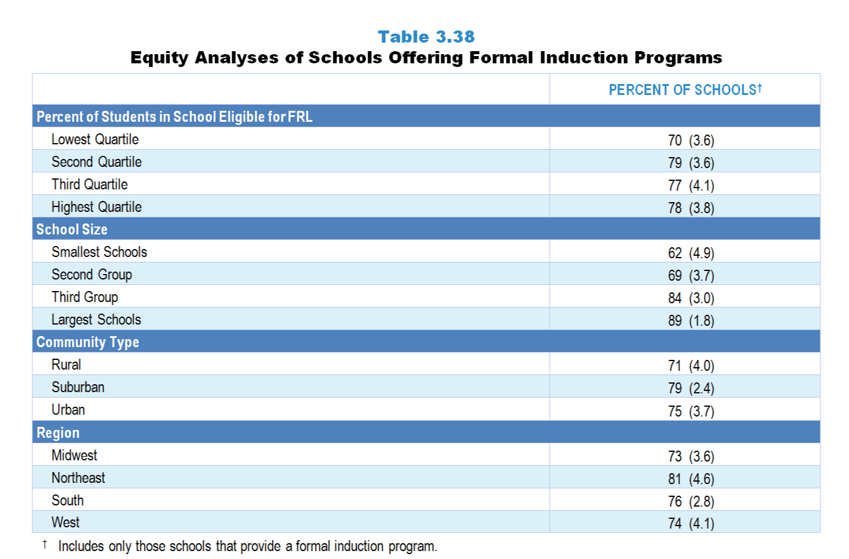
Original Data for Slide 8
(not for presentation)
Notes:
Table 3.38, p. 72 in Technical Report
This slide shows data derived from an individual item.
School Coordinator Questionnaire
Q12. Does your school/district/diocese have a formal induction program for teachers new to the profession (support that is not offered to other teachers in the school)?
Yes
No
The numbers in parentheses are standard errors.
Chapters 2–7 in the technical report provide data on several key indicators, disaggregated by one or more equity factors: the prior achievement level of students in the class, the percentage of students from race/ethnicity groups historically underrepresented in STEM in the class, the percentage of students in the school eligible for free/reduced-price lunch (FRL), school size, community type, and region. For FRL, each school was classified into one of four categories (defined as quartiles) based on the proportion of students eligible for FRL. Similarly, each randomly selected class was classified into one of the four categories based on the proportion of students from race/ethnicity groups historically underrepresented in STEM in the class.
Findings Highlighted in Technical Report
“The percentages of schools offering a formal teacher induction program are relatively equally distributed when analyzed by various school-based equity factors, including poverty level, community type, and region (see Table 3.38). In contrast, it is not surprising that the largest schools are more likely than the smallest schools to have induction programs for beginning teachers.”

Slide 8
Schools Offering Formal Induction Programs
Notes:
Includes only those schools that provide a formal induction program.

Slide 9
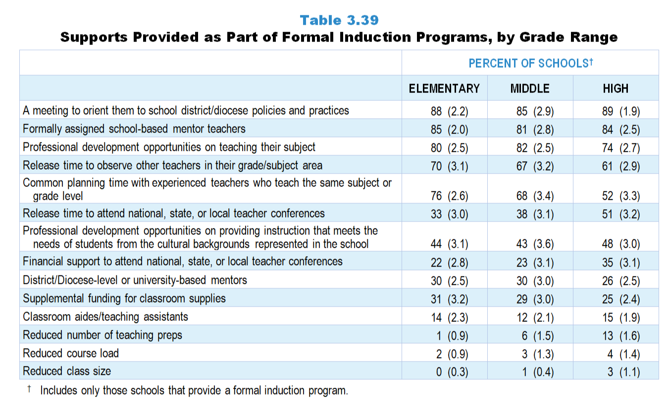
Original Data for Slides 10–18
(not for presentation)
Notes:
Table 3.39, p. 73 in Technical Report
This slide shows data from an individual item.
School Coordinator Questionnaire
Q17. Which of the following supports are provided as part of the formal induction program? [Select all that apply.]
Release time to attend national, state, or local teacher conferences
Financial support to attend national, state, or local teacher conferences
Common planning time with experienced teachers who teach the same subject or grade level
Release time to observe other teachers in their grade/subject area
Formally assigned school-based mentor teachers
District/diocese-based or university-based mentors
Reduced course load
Reduced class size
Reduced number of teaching preps
A meeting to orient them to school/district/diocese policies and practices
Professional development opportunities on teaching their subject
Professional development opportunities on providing instruction that meets the needs of students from the cultural backgrounds represented in your school
Classroom aides/teaching assistants
Supplemental funding for classroom supplies
The numbers in parentheses are standard errors.
Findings Highlighted in Technical Report
“As can be seen in Table 3.39, many schools at all grade levels have formal induction programs that include a number of these best practices. For example, the most predominant supports provided to beginning teachers include a meeting to orient them to school policies and practices (85–89 percent), formally assigned school-based mentors (81–85 percent), and professional development opportunities on teaching their subject (74–82 percent). In addition, 61–70 percent of schools give release time to observe other teachers in their grade/‌subject area. Schools at the elementary and middle grades level are more likely than schools at the high school level to offer common planning time with experienced teachers who teach the same subject or grade level (76, 68, and 52 percent, respectively). In contrast, high schools are more likely than their middle or elementary counterparts to provide release time for beginning teachers to attend national, state, or local conferences (51, 38, and 33 percent, respectively).”

Slide 10
Supports Provided as Part of Formal Induction Programs in Elementary Schools
Notes:
Note: Each grade level chart is sorted independently; consequently items may appear in different orders.

Slide 11
Supports Provided as Part of Formal Induction Programs in Elementary Schools
Notes:
Note: Each grade level chart is sorted independently; consequently items may appear in different orders.
PD is short for professional development.

Slide 12
Supports Provided as Part of Formal Induction Programs in Elementary Schools
Notes:
Note: Each grade level chart is sorted independently; consequently items may appear in different orders.

Slide 13
Supports Provided as Part of Formal Induction Programs in Middle Schools
Notes:
Note: Each grade level chart is sorted independently; consequently items may appear in different orders.

Slide 14
Supports Provided as Part of Formal Induction Programs in Middle Schools
Notes:
Note: Each grade level chart is sorted independently; consequently items may appear in different orders.
PD is short for professional development.

Slide 15
Supports Provided as Part of Formal Induction Programs in Middle Schools
Notes:
Note: Each grade level chart is sorted independently; consequently items may appear in different orders.

Slide 16
Supports Provided as Part of Formal Induction Programs in High Schools
Notes:
Note: Each grade level chart is sorted independently; consequently items may appear in different orders.

Slide 17
Supports Provided as Part of Formal Induction Programs in High Schools
Notes:
Note: Each grade level chart is sorted independently; consequently items may appear in different orders.
PD is short for professional development.

Slide 18
Supports Provided as Part of Formal Induction Programs in High Schools
Notes:
Note: Each grade level chart is sorted independently; consequently items may appear in different orders.

Slide 19
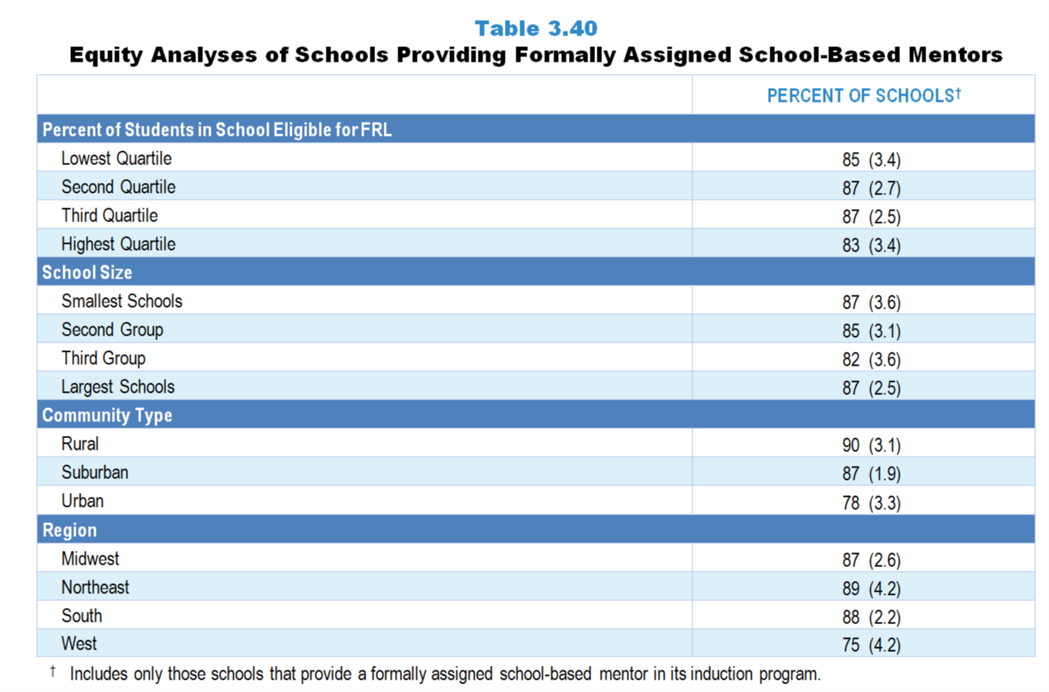
Original Data for Slides 20–21
(not for presentation)
Notes:
Table 3.40, p. 74 in Technical Report
This slide shows data derived from an individual item.
School Coordinator Questionnaire
Q17. Which of the following supports are provided as part of the formal induction program? [Select all that apply.]
Release time to attend national, state, or local teacher conferences
Financial support to attend national, state, or local teacher conferences
Common planning time with experienced teachers who teach the same subject or grade level
Release time to observe other teachers in their grade/subject area
Formally assigned school-based mentor teachers
District/diocese-based or university-based mentors
Reduced course load
Reduced class size
Reduced number of teaching preps
A meeting to orient them to school/district/diocese policies and practices
Professional development opportunities on teaching their subject
Professional development opportunities on providing instruction that meets the needs of students from the cultural backgrounds represented in your school
Classroom aides/teaching assistants
Supplemental funding for classroom supplies
The numbers in parentheses are standard errors.
Chapters 2–7 in the technical report provide data on several key indicators, disaggregated by one or more equity factors: the prior achievement level of students in the class, the percentage of students from race/ethnicity groups historically underrepresented in STEM in the class, the percentage of students in the school eligible for free/reduced-price lunch (FRL), school size, community type, and region. For FRL, each school was classified into one of four categories (defined as quartiles) based on the proportion of students eligible for FRL. Similarly, each randomly selected class was classified into one of the four categories based on the proportion of students from race/ethnicity groups historically underrepresented in STEM in the class.
Findings Highlighted in Technical Report
“Given that mentoring plays an important role in effective induction programs, the percentage of schools that formally assign school-based mentor teachers was examined by different school characteristics. As can be seen in Table 3.40, urban schools are significantly less likely than their suburban or rural counterparts to assign mentors (78, 87, and 90 percent, respectively). Schools in the West are also less likely to formally assign school-based mentors than schools in the Northeast (75 and 89 percent, respectively). No disparities exist in terms of proportion of students in the school eligible for free/‌reduced-price lunch or school size.”

Slide 20
Schools Offering Formal Induction Programs
Notes:
Includes only those schools that provide a formal induction program.

Slide 21
Schools Offering Formal Induction Programs
Notes:
Includes only those schools that provide a formal induction program.

Slide 22
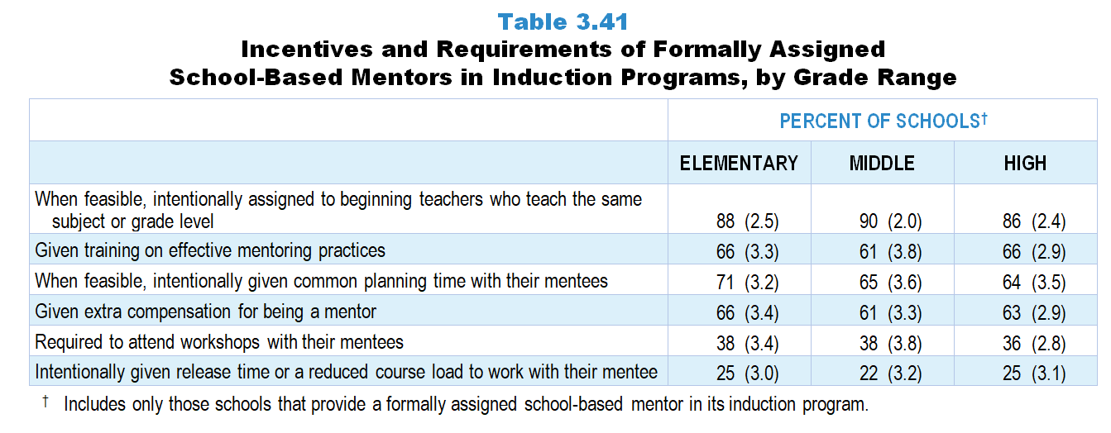
Original Data for Slides 23–25
(not for presentation)
Notes:
Table 3.41, p. 74 in Technical Report
This slide shows data from an individual item.
School Coordinator Questionnaire
Q17. [For schools that select Question 15e only]
Are formally assigned school-based mentor teachers in your school’s induction program… [Select one on each row.] (Response options: Yes. No)
given extra compensation for being a mentor?
intentionally given release time or a reduced course load to work with their mentee?
given training on effective mentoring practices?
required to attend workshops with their mentees?
when feasible, intentionally assigned to beginning teachers who teach the same subject or grade level?
when feasible, intentionally given common planning time with their mentees?
The numbers in parentheses are standard errors.
Findings Highlighted in Technical Report
“School coordinators who indicated having formally assigned school-based mentors as part of the school induction program were asked to describe the schools’ incentives and requirements of these mentors. About 90 percent of schools, when feasible, intentionally assign a school-based mentor who teaches the same subject or grade level as the beginning teacher (see Table 3.41). Also, roughly two-thirds of schools give school-based mentors training on effective mentoring practices, common planning time with their mentees when feasible, and extra compensation for their service. Still, only a quarter of schools intentionally give mentors release time or a reduced course load to work with their mentee.”

Slide 23
Incentives and Requirements of Formally Assigned School-Based Mentors in Induction Programs in Elementary Schools
Notes:
Includes only those schools that provide a formally assigned school-based mentor in its induction program.
Note: Each grade level chart is sorted independently; consequently items may appear in different orders.

Slide 24
Incentives and Requirements of Formally Assigned School-Based Mentors in Induction Programs in Middle Schools
Notes:
Includes only those schools that provide a formally assigned school-based mentor in its induction program.
Note: Each grade level chart is sorted independently; consequently items may appear in different orders.

Slide 25
Incentives and Requirements of Formally Assigned School-Based Mentors in Induction Programs in High Schools
Notes:
Includes only those schools that provide a formally assigned school-based mentor in its induction program.
Note: Each grade level chart is sorted independently; consequently items may appear in different orders.

