Slide 1
Chapter 3 Professional Development
Science

Slide 2
Teacher Professional Development

Slide 3
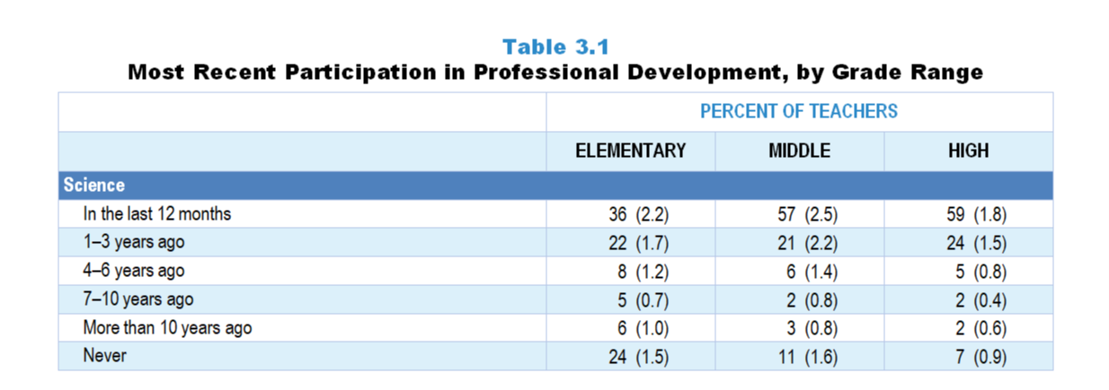
Original Data for Slide 4
(not for presentation)
Notes:
The science portion of Table 3.1, p. 48 in Technical Report
This slide shows data from an individual item.
Science Teacher Questionnaire
Q30. When did you last participate in professional development focused on science/engineering or science/engineering teaching?
In the last 12 months
1- 3 years ago
4–6 years ago
7–10 years ago
More than 10 years ago
Never
The numbers in parentheses are standard errors.
Findings Highlighted in Technical Report
“One important measure of teachers’ continuing education is how long it has been since they participated in professional development. As can be seen in Table 3.1, with the exception of elementary science teachers, roughly 80 percent or more of science, ‌mathematics, and ‌computer science teachers have participated in discipline-focused professional development (i.e., focused on science, mathematics, computer science content or the teaching of science, mathematics, computer science) within the last three years. Elementary science teachers stand out for the relative paucity of professional development in science or science teaching, with fewer than about 60 percent having participated in the last three years.”

Slide 4
Science Teachers Participating in Science-Focused PD in the Last 3 Years
Notes:
Science-focused professional development includes professional development focused on science/engineering content or the teaching of science/engineering.
PD is short for professional development.

Slide 5
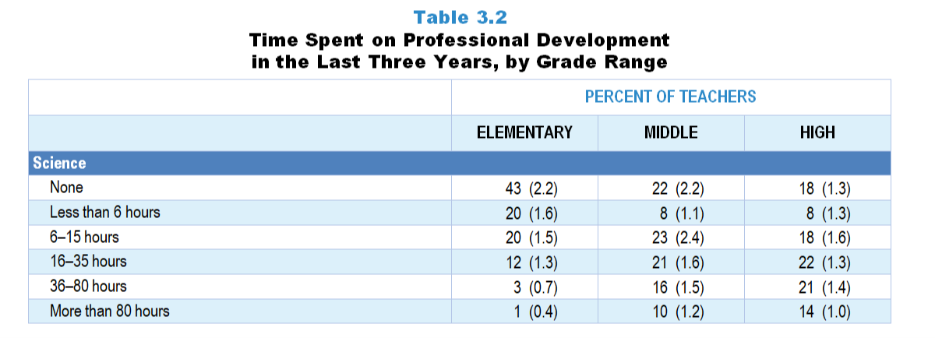
Original Data for Slide 6
(not for presentation)
Notes:
The science portion of Table 3.2, p. 49 of Technical Report
This slide shows data from an individual item.
Science Teacher Questionnaire
Q32. What is the total amount of time you have spent on professional development related to science/engineering or science/engineering teaching in the last 3 years?
Less than 6 hours
6–15 hours
16–35 hours
36-80 hours
More than 80 hours
The numbers in parentheses are standard errors.
Findings Highlighted in Technical Report
“Although some involvement in professional development may be better than none, a brief exposure of a few hours over several years is not likely to be sufficient to enhance teachers’ knowledge and skills in meaningful ways. Accordingly, teachers across all subject areas were asked about the total amount of time they have spent on discipline-focused professional development in the last three years. As can be seen in Table 3.2, about a quarter of middle school and about a third of high school science teachers have participated in 36 hours or more of science professional development in the last three years; very few elementary teachers have had this amount of professional development in science. A similar pattern exists in mathematics, with about 2 in 5 secondary teachers having participated in at least 36 hours of mathematics-focused professional development in the last three years compared to fewer than 1 in 6 elementary teachers. In contrast, over half of high school computer science teachers have participated in this amount of professional development related to computer science or computer science teaching. This finding most likely reflects the recent national emphasis on computer science in STEM education and the push to develop students’ computational thinking skills.”

Slide 6
Science Teachers’ Time Spent on Science-Focused PD in Last 3 Years
Percent of Teachers
Notes:
Science-focused professional development includes professional development focused on science/engineering content or the teaching of science/engineering.
PD is short for professional development.

Slide 7
Original Data for Slides 8–10 (not for presentation)
Notes:
The science portion of Table 3.3, p. 50 of Technical Report
This slide shows data from individual items.
Science Teacher Questionnaire
Q32. What is the total amount of time you have spent on professional development related to science/engineering or science/engineering teaching in the last 3 years?
Less than 6 hours
6–15 hours
16–35 hours
36-80 hours
More than 80 hours
Q42. For the students in this class, indicate the number of males and females in this class in each of the following categories of race/ethnicity.
American Indian or Alaskan Native _____ _____
Asian _____ _____
Black or African American _____ _____
Hispanic/Latino _____ _____
Native Hawaiian or Other Pacific Islander _____ _____
White _____ _____
Two or more races _____ _____
Q43. Which of the following best describes the prior science achievement levels of the students in this class relative to other students in this school?
Mostly low achievers
Mostly average achievers
Mostly high achievers
A mixture of levels
The numbers in parentheses are standard errors.
Chapters 2–7 in the technical report provide data on several key indicators, disaggregated by one or more equity factors: the prior achievement level of students in the class, the percentage of students from race/ethnicity groups historically underrepresented in STEM in the class, the percentage of students in the school eligible for free/reduced-price lunch (FRL), school size, community type, and region. For FRL, each school was classified into one of four categories (defined as quartiles) based on the proportion of students eligible for FRL. Similarly, each randomly selected class was classified into one of the four categories based on the proportion of students from race/ethnicity groups historically underrepresented in STEM in the class.
Findings Highlighted in Technical Report
“The data were also analyzed by a number of class and school equity factors. Table 3.3 suggests some interesting differences in the extent to which science and mathematics classes with different demographic characteristics have access to teachers who have had a substantial amount of professional development. In science, classes composed of mostly low prior achievers and classes with the highest proportion of students from race/‌ethnicity groups historically underrepresented in STEM are significantly less likely than classes of high prior achievers and few students from these race/‌ethnicity groups to be taught by teachers who have participated in more than 35 hours of professional development in the last three years. A similar disparity exists by school size. Only about half as many science classes in the smallest schools compared to classes in the largest schools have access to teachers who have participated in a substantial amount of professional development. In contrast, mathematics classes with the highest proportion of students from race/‌ethnicity groups historically underrepresented in STEM are more likely than their counterparts to be taught by teachers who have participated in more than 35 hours of professional development in the last three years.”

Slide 8
Science Classes Taught by Teachers With More Than 35 Hours of PD in the Last 3 Years
Notes:
PD is short for professional development.

Slide 9
Science Classes Taught by Teachers With More Than 35 Hours of PD in the Last 3 Years
Notes:
Historically Underrepresented Students/Teachers includes American Indian or Alaskan Native, Black or African American, Hispanic or Latino, or Native Hawaiian or Other Pacific Islander teachers/students.
PD is short for professional development.

Slide 10
Science Classes Taught by Teachers With More Than 35 Hours of PD in the Last 3 Years
Notes:
PD is short for professional development.

Slide 11
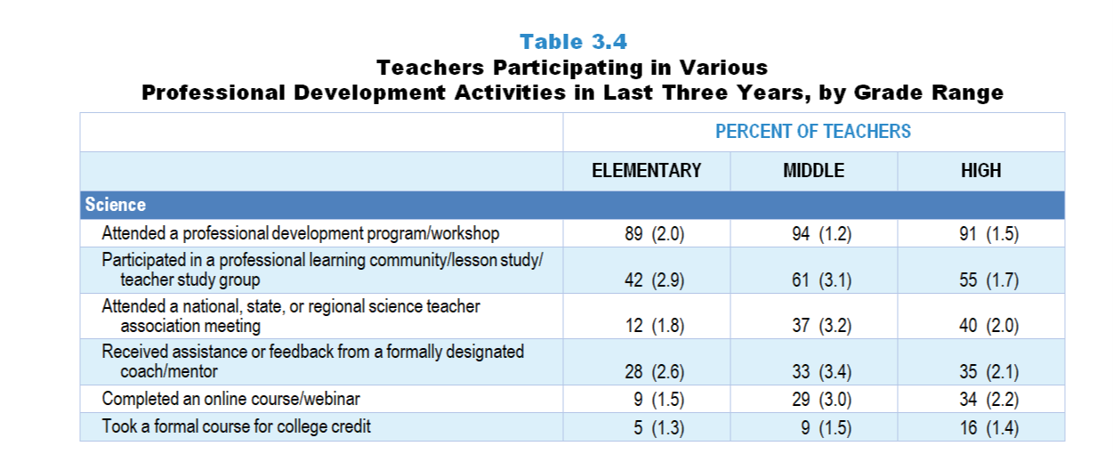
Original Data for Slides 12–14
(not for presentation)
Notes:
The science portion of Table 3.4, p. 51 in Technical Report
This slide shows data from individual items.
Science Teacher Questionnaire
Q31. In the last 3 years, which of the following types of professional development related to science/engineering or science/engineering teaching have you had? [Select one on each row.]
I attended a professional development program/workshop.
I attended a national, state, or regional science teacher association meeting.
I completed an online course/webinar.
I participated in a professional learning community/lesson study/teacher study group
I received assistance or feedback from a formally designated coach/mentor.
I took a formal course for college credit.
The numbers in parentheses are standard errors.
Findings Highlighted in Technical Report
“Teachers who indicated they had recently participated in professional development were asked about the nature of those activities. Data for science teachers are shown in Table 3.5, and for mathematics teachers in Table 3.6. For each subject/grade-range combination, workshops are the most prevalent activity, with 84–92 percent of teachers who had participated in professional development activities in the last three years indicating they had attended a workshop. Roughly three-fourths of middle and high school mathematics and science teachers, but fewer of their elementary school colleagues, report participating in professional learning communities or other types of teacher study groups. Middle and high school teachers also attend science/mathematics teacher association meetings at a higher rate than do elementary teachers, likely a reflection of the fact that elementary teachers are responsible for teaching, and keeping up with, multiple disciplines. Finally, not only are elementary science teachers less likely to have participated recently in professional development, they are far less likely to have received feedback on their teaching from a mentor/coach than any other group.”

Slide 12
Elementary Science Teachers Participating in Various PD Activities in the Last 3 Years
Notes:
Only science teachers indicating that they participated in science-focused professional development in the last three years are included in these analyses.
Note: Each grade-level chart is sorted independently; consequently items may appear in different orders.
PD is short for professional development.

Slide 13
Middle School Science Teachers Participating in Various PD Activities in the Last 3 Years
Notes:
Only science teachers indicating that they participated in science-focused professional development in the last three years are included in these analyses.
Note: Each grade-level chart is sorted independently; consequently items may appear in different orders.
PD is short for professional development.

Slide 14
High School Science Teachers Participating in Various PD Activities in the Last 3 Years
Notes:
Only science teachers indicating that they participated in science-focused professional development in the last three years are included in these analyses.
Note: Each grade-level chart is sorted independently; consequently items may appear in different orders.
PD is short for professional development.

Slide 15
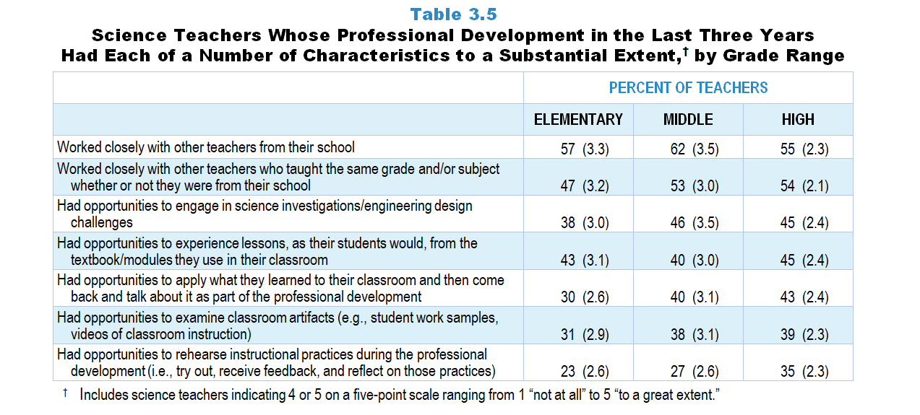
Original Data for Slides 16–18
(not for presentation)
Notes:
Table 3.5, p. 52 in Technical Report
This slide shows data from an individual item.
Science Teacher Questionnaire
Q33. Considering all of your science- and engineering-related professional development in the last 3 years, to what extent does each of the following describe your experiences? [Select one on each row.] (Response Options: [1] Not at all, [2] 2 of 5, [3] Somewhat, [4] 4 of 5, [5] To a great extent)
I had opportunities to engage in science investigations/engineering design challenges.
I had opportunities to experience lessons, as my students would, from the textbook/modules I use in my classroom.
I had opportunities to examine classroom artifacts (for example: student work samples, videos of classroom instruction).
I had opportunities to rehearse instructional practices during the professional development (meaning: try out, receive feedback, and reflect on those practices).
I had opportunities to apply what I learned to my classroom and then come back and talk about it as part of the professional development.
I worked closely with other teachers from my school.
I worked closely with other teachers who taught the same grade and/or subject whether or not they were from my school.
The numbers in parentheses are standard errors.
Findings Highlighted in Technical Report
“As can be seen in Table 3.5, 47–62 percent of science teachers, depending on grade range, have worked closely during the professional development with other science colleagues from their school or science teachers in their grade level and/‌or subject, whether or not they were from the same school. Other relatively common characteristics of their professional development are having opportunities to experience lessons as students would from the textbook/‌modules used in the classroom (43–45 percent) and engaging in science investigations/‌engineering design challenges (38–45 percent). Only about a quarter to a third of teachers, depending on grade range, have had substantial opportunities to rehearse instructional practices during professional development.”

Slide 16
Elementary Science Teachers Whose PD in the Last 3 Years Had Various Characteristics to a Substantial Extent
Notes:
Substantial Extent includes teachers that selected “4 of 5” or “to a great extent” on a 5-point scale with the options of “not at all,” “2 of 5,” “somewhat,” “4 of 5,” and “to a great extent.”
Only science teachers indicating that they participated in science-focused professional development in the last three years are included in these analyses.
Note: Each grade-level chart is sorted independently; consequently items may appear in different orders.
PD is short for professional development.

Slide 17
Middle School Science Teachers Whose PD in the Last 3 Years Had Various Characteristics to a Substantial Extent
Notes:
Substantial Extent includes teachers that selected “4 of 5” or “to a great extent” on a 5-point scale with the options of “not at all,” “2 of 5,” “somewhat,” “4 of 5,” and “to a great extent.”
Only science teachers indicating that they participated in science-focused professional development in the last three years are included in these analyses.
Note: Each grade-level chart is sorted independently; consequently items may appear in different orders.
PD is short for professional development.

Slide 18
High School Science Teachers Whose PD in the Last 3 Years Had Various Characteristics to a Substantial Extent
Notes:
Substantial Extent includes teachers that selected “4 of 5” or “to a great extent” on a 5-point scale with the options of “not at all,” “2 of 5,” “somewhat,” “4 of 5,” and “to a great extent.”
Only science teachers indicating that they participated in science-focused professional development in the last three years are included in these analyses.
Note: Each grade-level chart is sorted independently; consequently items may appear in different orders.
PD is short for professional development.

Slide 19
Original Data for Slide 20
(not for presentation)
Notes:
The science portion of Table 3.8, p. 54 in Technical Report
This slide shows data from composites.
Sets of related questionnaire items were combined to create several composite variables related to key constructs. Composite variables, which are more reliable than individual survey items, were computed to have a minimum possible value of 0 and a maximum possible value of 100. Higher composite scores indicate more of the construct being measure by the composite. Each composite is calculated by summing the responses to the items associated with that composite and then dividing by the total points possible. In order for the composites to be on a 100-point scale, the lowest response option on each scale was set to 0 and the others were adjusted accordingly; so for example, an item with a scale ranging from 1 to 4 was re-coded to have a scale of 0 to 3. By doing this, someone who marks the lowest point on every item in a composite receives a composite score of 0 rather than some positive number. It also assures that 50 is the true mid-point. The denominator for each composite is determined by computing the maximum possible sum of responses for a series of items and dividing by 100; e.g., a 9-item composite where each item is on a scale of 0–3 would have a denominator of 0.27. Composites values were not computed for participants who respond to fewer than two-thirds of the items that form the composite.
Extent Professional Development Aligns With Elements of Effective Professional Development Composite Items
Q33a. I had opportunities to engage in science investigations/engineering design challenges.
Q33b. I had opportunities to experience lessons, as my students would, from the textbook/modules I use in my classroom.
Q33c. I had opportunities to examine classroom artifacts (for example: student work samples, videos of classroom instruction).
Q33d. I had opportunities to rehearse instructional practices during the professional development (meaning: try out, receive feedback, and reflect on those practices).
Q33e. I had opportunities to apply what I learned to my classroom and then come back and talk about it as part of the professional development.
Q33f. I worked closely with other teachers from my school.
Q33g. I worked closely with other teachers who taught the same grade and/or subject whether or not they were from my school.
Science Teacher Questionnaire
Q33. Considering all of your science- and engineering-related professional development in the last 3 years, to what extent does each of the following describe your experiences? [Select one on each row.] (Response Options: [1] Not at all, [2] 2 of 5, [3] Somewhat, [4] 4 of 5, [5] To a great extent)
I had opportunities to engage in science investigations/engineering design challenges.
I had opportunities to experience lessons, as my students would, from the textbook/modules I use in my classroom.
I had opportunities to examine classroom artifacts (for example: student work samples, videos of classroom instruction).
I had opportunities to rehearse instructional practices during the professional development (meaning: try out, receive feedback, and reflect on those practices).
I had opportunities to apply what I learned to my classroom and then come back and talk about it as part of the professional development.
I worked closely with other teachers from my school.
I worked closely with other teachers who taught the same grade and/or subject whether or not they were from my school.
The numbers in parentheses are standard errors.
Findings Highlighted in Technical Report
“As can be seen in Table 3.8, the mean scores on this composite are similar across subject/‌grade-range categories, except for elementary science, where scores are lower than the other subject/‌grade-range combinations.”

Slide 20
Extent Professional Development Aligns With Elements of Effective Professional Development Composite

Slide 21
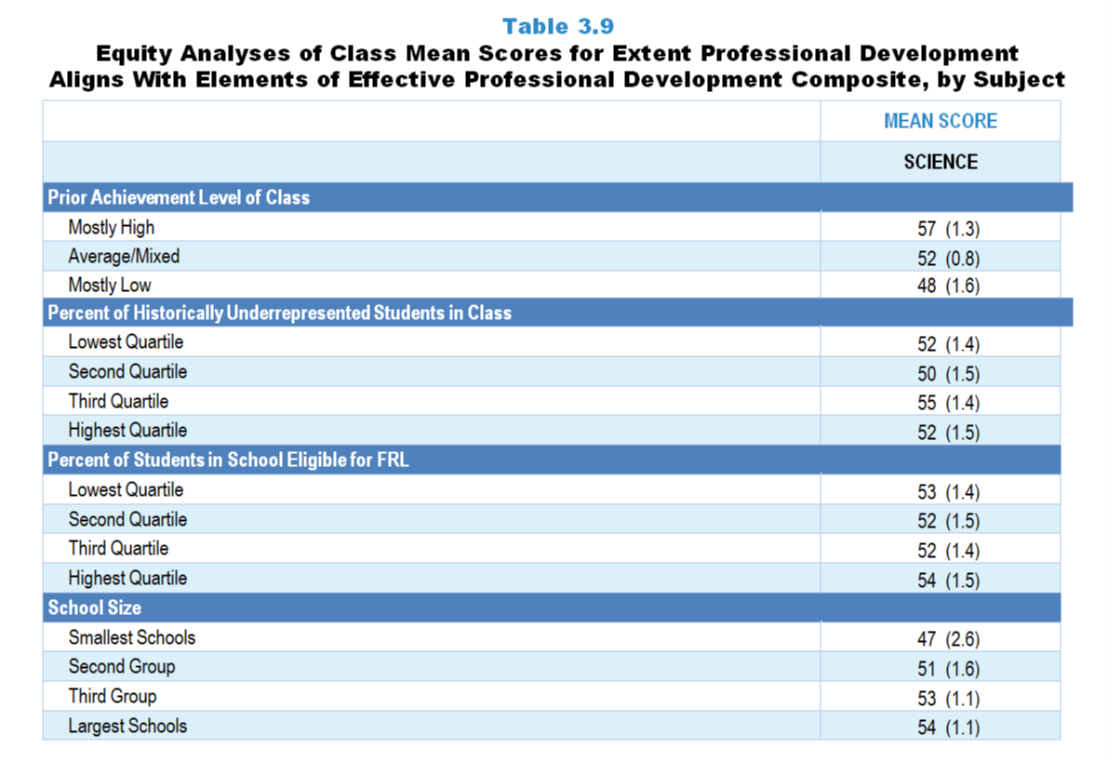
Original Data for Slides 22–23
(not for presentation)
Notes:
The science portion of Table 3.9, p. 55 in Technical Report
This slide shows data from composites.
Sets of related questionnaire items were combined to create several composite variables related to key constructs. Composite variables, which are more reliable than individual survey items, were computed to have a minimum possible value of 0 and a maximum possible value of 100. Higher composite scores indicate more of the construct being measure by the composite. Each composite is calculated by summing the responses to the items associated with that composite and then dividing by the total points possible. In order for the composites to be on a 100-point scale, the lowest response option on each scale was set to 0 and the others were adjusted accordingly; so for example, an item with a scale ranging from 1 to 4 was re-coded to have a scale of 0 to 3. By doing this, someone who marks the lowest point on every item in a composite receives a composite score of 0 rather than some positive number. It also assures that 50 is the true mid-point. The denominator for each composite is determined by computing the maximum possible sum of responses for a series of items and dividing by 100; e.g., a 9-item composite where each item is on a scale of 0–3 would have a denominator of 0.27. Composites values were not computed for participants who respond to fewer than two-thirds of the items that form the composite.
Extent Professional Development Aligns With Elements of Effective Professional Development Composite Items
Q33a. I had opportunities to engage in science investigations/engineering design challenges.
Q33b. I had opportunities to experience lessons, as my students would, from the textbook/modules I use in my classroom.
Q33c. I had opportunities to examine classroom artifacts (for example: student work samples, videos of classroom instruction).
Q33d. I had opportunities to rehearse instructional practices during the professional development (meaning: try out, receive feedback, and reflect on those practices).
Q33e. I had opportunities to apply what I learned to my classroom and then come back and talk about it as part of the professional development.
Q33f. I worked closely with other teachers from my school.
Q33g. I worked closely with other teachers who taught the same grade and/or subject whether or not they were from my school.
Science Teacher Questionnaire
Q33. Considering all of your science- and engineering-related professional development in the last 3 years, to what extent does each of the following describe your experiences? [Select one on each row.] (Response Options: [1] Not at all, [2] 2 of 5, [3] Somewhat, [4] 4 of 5, [5] To a great extent)
I had opportunities to engage in science investigations/engineering design challenges.
I had opportunities to experience lessons, as my students would, from the textbook/modules I use in my classroom.
I had opportunities to examine classroom artifacts (for example: student work samples, videos of classroom instruction).
I had opportunities to rehearse instructional practices during the professional development (meaning: try out, receive feedback, and reflect on those practices).
I had opportunities to apply what I learned to my classroom and then come back and talk about it as part of the professional development.
I worked closely with other teachers from my school.
I worked closely with other teachers who taught the same grade and/or subject whether or not they were from my school.
Q42. For the students in this class, indicate the number of males and females in this class in each of the following categories of race/ethnicity.
American Indian or Alaskan Native _____ _____
Asian _____ _____
Black or African American _____ _____
Hispanic/Latino _____ _____
Native Hawaiian or Other Pacific Islander _____ _____
White _____ _____
Two or more races _____ _____
Q43. Which of the following best describes the prior science achievement levels of the students in this class relative to other students in this school?
Mostly low achievers
Mostly average achievers
Mostly high achievers
A mixture of levels
The numbers in parentheses are standard errors.
Chapters 2–7 in the technical report provide data on several key indicators, disaggregated by one or more equity factors: the prior achievement level of students in the class, the percentage of students from race/ethnicity groups historically underrepresented in STEM in the class, the percentage of students in the school eligible for free/reduced-price lunch (FRL), school size, community type, and region. For FRL, each school was classified into one of four categories (defined as quartiles) based on the proportion of students eligible for FRL. Similarly, each randomly selected class was classified into one of the four categories based on the proportion of students from race/ethnicity groups historically underrepresented in STEM in the class.
Findings Highlighted in Technical Report
“When looking at the composite scores by equity factors, a number of differences are apparent by both class and school factors (see Table 3.9). Science classes consisting mostly of high-achieving students are more likely than classes of mostly low-achieving students to be taught by teachers who attended high-quality professional development (mean scores of 57 and 48, respectively). A similar pattern exists in terms of school size. Science classes in the largest schools have an advantage over those in the smallest schools when it comes to having access to teachers with effective professional learning experiences (mean scores of 54 and 47, respectively).
In contrast, mathematics classes composed of mostly low-achieving students tend to be taught by teachers with more high-quality professional development experiences than classes with mostly high-achieving students (mean score 61 and 56, respectively). Also, high school computer science classes with the largest proportion of students from race/‌ethnicity groups historically underrepresented in STEM are more likely to be taught by teachers who have experienced aspects of effective professional development than classes with the smallest proportion of students from these groups (mean score of 64 and 51, respectively). However, it is important to note that for computer science, the highest quartile contains relatively few students from these groups.”

Slide 22
Extent Professional Development Aligns With Elements of Effective Professional Development Composite

Slide 23
Extent Professional Development Aligns With Elements of Effective Professional Development Composite

Slide 24
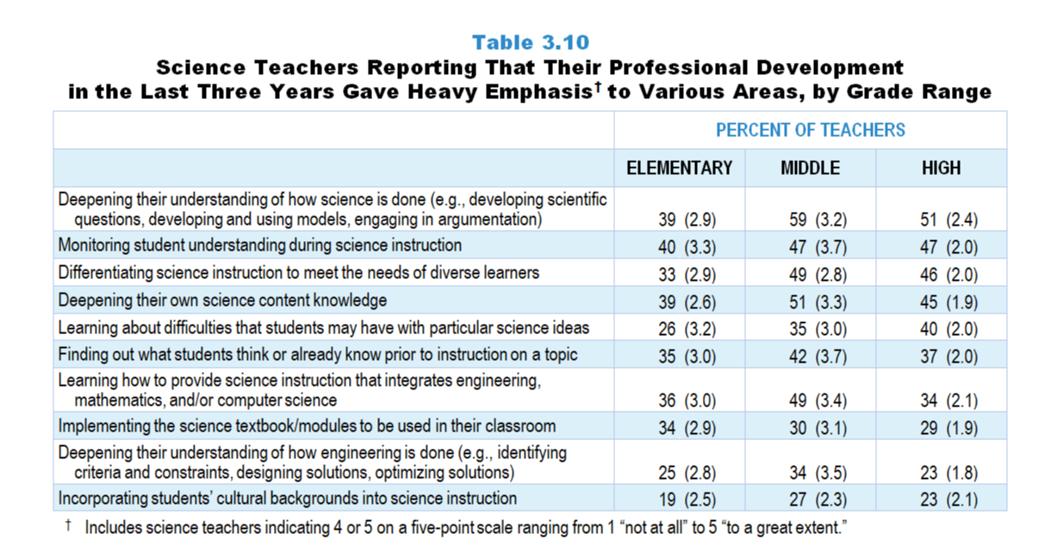
Original Data for Slides 25–30
(not for presentation)
Notes:
Table 3.10, p. 56 in Technical Report
This slide shows data from an individual item.
Science Teacher Questionnaire
Q34. Thinking about all of your science- and engineering-related professional development in the last 3 years, to what extent was each of the following emphasized? [Select one on each row.] (Response Options: [1] Not at all, [2] 2 of 5, [3] Somewhat, [4] 4 of 5, [5] To a great extent)
Deepening your own science content knowledge
Deepening your understanding of how science is done (for example: developing scientific questions, developing and using models, engaging in argumentation)
Deepening your understanding of how engineering is done (for example: identifying criteria and constraints, designing solutions, optimizing solutions)
Implementing the science textbook/modules to be used in your classroom
Learning about difficulties that students may have with particular science ideas
Finding out what students think or already know prior to instruction on a topic
Monitoring student understanding during science instruction
Differentiating science instruction to meet the needs of diverse learners
Incorporating students’ cultural backgrounds into science instruction
Learning how to provide science instruction that integrates engineering, mathematics, and/or computer science
The numbers in parentheses are standard errors.
Findings Highlighted in Technical Report
“Another series of items asked about the focus of professional development opportunities teachers have had in the last three years. As can be seen in Table 3.10, roughly half of secondary science teachers’ recent professional development heavily emphasized deepening understanding of how science is done; monitoring student understanding during science instruction; differentiating science instruction to meet the needs of diverse learners; and deepening science content knowledge. As elementary teachers tend to be less well prepared in science, it is somewhat surprising that they have been less likely to attend professional development that emphasizes deepening their science content knowledge and their understanding of how science is done.
Given the inclusion of engineering in the NGSS and many states’ standards, as well as teachers’ self-report of lack of preparation to teach engineering, it is somewhat surprising that fewer than a third of K­–12 science teachers have attended professional development that focused heavily on deepening their understanding of how engineering is done. Further, only about a quarter of science teachers across the grade-range categories have attended professional development with a heavy emphasis on incorporating students’ cultural backgrounds into science instruction despite the push for culturally responsive teaching.”

Slide 25
Elementary Science Teachers Reporting PD in the Last 3 Years With Heavy Emphasis on Various Areas
Notes:
Heavy emphasis includes teachers that selected “4 of 5” or “to a great extent” on a 5-point scale with the options of “not at all,” “2 of 5,” “somewhat,” “4 of 5,” and “to a great extent.”
Only science teachers indicating that they participated in science-focused professional development in the last three years are included in these analyses.
Note: Each grade-level chart is sorted independently; consequently items may appear in different orders.
PD is short for professional development.

Slide 26
Elementary Science Teachers Reporting PD in the Last 3 Years With Heavy Emphasis on Various Areas
Notes:
Heavy emphasis includes teachers that selected “4 of 5” or “to a great extent” on a 5-point scale with the options of “not at all,” “2 of 5,” “somewhat,” “4 of 5,” and “to a great extent.”
Note: Each grade-level chart is sorted independently; consequently items may appear in different orders.
PD is short for professional development.

Slide 27
Middle School Science Teachers Reporting PD in the Last 3 Years With Heavy Emphasis on Various Areas
Notes:
Heavy emphasis includes teachers that selected “4 of 5” or “to a great extent” on a 5-point scale with the options of “not at all,” “2 of 5,” “somewhat,” “4 of 5,” and “to a great extent.”
Only science teachers indicating that they participated in science-focused professional development in the last three years are included in these analyses.
Note: Each grade-level chart is sorted independently; consequently items may appear in different orders.
PD is short for professional development.

Slide 28
Middle School Science Teachers Reporting PD in the Last 3 Years With Heavy Emphasis on Various Areas
Notes:
Heavy emphasis includes teachers that selected “4 of 5” or “to a great extent” on a 5-point scale with the options of “not at all,” “2 of 5,” “somewhat,” “4 of 5,” and “to a great extent.”
Only science teachers indicating that they participated in science-focused professional development in the last three years are included in these analyses.
Note: Each grade-level chart is sorted independently; consequently items may appear in different orders.
PD is short for professional development.

Slide 29
High School Science Teachers Reporting PD in the Last 3 Years With Heavy Emphasis on Various Areas
Notes:
Heavy emphasis includes teachers that selected “4 of 5” or “to a great extent” on a 5-point scale with the options of “not at all,” “2 of 5,” “somewhat,” “4 of 5,” and “to a great extent.”
Only science teachers indicating that they participated in science-focused professional development in the last three years are included in these analyses.
Note: Each grade-level chart is sorted independently; consequently items may appear in different orders.
PD is short for professional development.

Slide 30
High School Science Teachers Reporting PD in the Last 3 Years With Heavy Emphasis on Various Areas
Notes:
Heavy emphasis includes teachers that selected “4 of 5” or “to a great extent” on a 5-point scale with the options of “not at all,” “2 of 5,” “somewhat,” “4 of 5,” and “to a great extent.”
Only science teachers indicating that they participated in science-focused professional development in the last three years are included in these analyses.
Note: Each grade-level chart is sorted independently; consequently items may appear in different orders.
PD is short for professional development.

Slide 31
Original Data for Slide 32
(not for presentation)
Notes:
The science portion of Table 3.13, p. 58 in Technical Report
This slide shows data from composites.
Sets of related questionnaire items were combined to create several composite variables related to key constructs. Composite variables, which are more reliable than individual survey items, were computed to have a minimum possible value of 0 and a maximum possible value of 100. Higher composite scores indicate more of the construct being measure by the composite. Each composite is calculated by summing the responses to the items associated with that composite and then dividing by the total points possible. In order for the composites to be on a 100-point scale, the lowest response option on each scale was set to 0 and the others were adjusted accordingly; so for example, an item with a scale ranging from 1 to 4 was re-coded to have a scale of 0 to 3. By doing this, someone who marks the lowest point on every item in a composite receives a composite score of 0 rather than some positive number. It also assures that 50 is the true mid-point. The denominator for each composite is determined by computing the maximum possible sum of responses for a series of items and dividing by 100; e.g., a 9-item composite where each item is on a scale of 0–3 would have a denominator of 0.27. Composites values were not computed for participants who respond to fewer than two-thirds of the items that form the composite.
Extent Professional Development Supports Student-Centered Instruction Composite Items
Q34a. Deepening your own science content knowledge
Q34b. Deepening your understanding of how science is done (for example: developing scientific questions, developing and using models, engaging in argumentation)
Q34c. Deepening your understanding of how engineering is done (for example: identifying criteria and constraints, designing solutions, optimizing solutions)
Q34d. Implementing the science textbook/modules to be used in your classroom
Q34e. Learning about difficulties that students may have with particular science ideas
Q34f. Finding out what students think or already know prior to instruction on a topic
Q34g. Monitoring student understanding during science instruction
Q34h. Differentiating science instruction to meet the needs of diverse learners
Science Teacher Questionnaire
Q34. Thinking about all of your science- and engineering-related professional development in the last 3 years, to what extent was each of the following emphasized? [Select one on each row.] (Response Options: [1] Not at all, [2] 2 of 5, [3] Somewhat, [4] 4 of 5, [5] To a great extent)
Deepening your own science content knowledge
Deepening your understanding of how science is done (for example: developing scientific questions, developing and using models, engaging in argumentation)
Deepening your understanding of how engineering is done (for example: identifying criteria and constraints, designing solutions, optimizing solutions)
Implementing the science textbook/modules to be used in your classroom
Learning about difficulties that students may have with particular science ideas
Finding out what students think or already know prior to instruction on a topic
Monitoring student understanding during science instruction
Differentiating science instruction to meet the needs of diverse learners
Incorporating students’ cultural backgrounds into science instruction
Learning how to provide science instruction that integrates engineering, mathematics, and/or computer science
The numbers in parentheses are standard errors.
Findings Highlighted in Technical Report
“Several items related to a focus on student-centered instruction in recent teacher professional development were combined into a composite variable. As can be seen in Table 3.13, professional development for elementary mathematics is more likely than professional development for elementary science to support student-centered instruction (mean scores of 61 and 48, respectively). Interestingly, in science, professional development for middle and high school teachers gives more emphasis to student-centered instruction than elementary teachers, but in mathematics, professional development for elementary teachers is more likely to have this focus compared to what high school mathematics teachers experience. Lastly, the mean score for high school computer science teachers is significantly higher than the mean scores for both science and mathematics high school teachers.”

Slide 32
Extent Professional Development Supports Student-Centered Instruction Composite

Slide 33
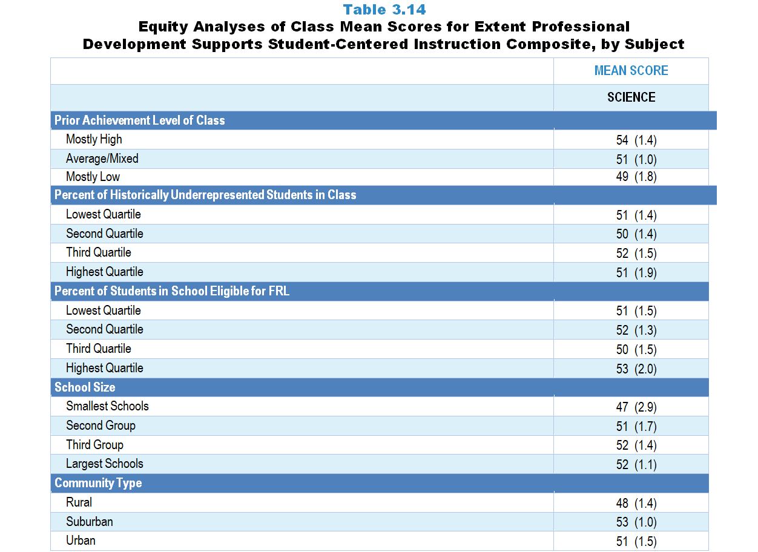
Original Data for Slides 34–35
(not for presentation)
Notes:
The science portion of Table 3.14, p. 59 in Technical Report
This slide shows data from composites.
Sets of related questionnaire items were combined to create several composite variables related to key constructs. Composite variables, which are more reliable than individual survey items, were computed to have a minimum possible value of 0 and a maximum possible value of 100. Higher composite scores indicate more of the construct being measure by the composite. Each composite is calculated by summing the responses to the items associated with that composite and then dividing by the total points possible. In order for the composites to be on a 100-point scale, the lowest response option on each scale was set to 0 and the others were adjusted accordingly; so for example, an item with a scale ranging from 1 to 4 was re-coded to have a scale of 0 to 3. By doing this, someone who marks the lowest point on every item in a composite receives a composite score of 0 rather than some positive number. It also assures that 50 is the true mid-point. The denominator for each composite is determined by computing the maximum possible sum of responses for a series of items and dividing by 100; e.g., a 9-item composite where each item is on a scale of 0–3 would have a denominator of 0.27. Composites values were not computed for participants who respond to fewer than two-thirds of the items that form the composite.
Extent Professional Development Supports Student-Centered Instruction Composite Items
Q34a. Deepening your own science content knowledge
Q34b. Deepening your understanding of how science is done (for example: developing scientific questions, developing and using models, engaging in argumentation)
Q34c. Deepening your understanding of how engineering is done (for example: identifying criteria and constraints, designing solutions, optimizing solutions)
Q34d. Implementing the science textbook/modules to be used in your classroom
Q34e. Learning about difficulties that students may have with particular science ideas
Q34f. Finding out what students think or already know prior to instruction on a topic
Q34g. Monitoring student understanding during science instruction
Q34h. Differentiating science instruction to meet the needs of diverse learners
Science Teacher Questionnaire
Q34. Thinking about all of your science- and engineering-related professional development in the last 3 years, to what extent was each of the following emphasized? [Select one on each row.] (Response Options: [1] Not at all, [2] 2 of 5, [3] Somewhat, [4] 4 of 5, [5] To a great extent)
Deepening your own science content knowledge
Deepening your understanding of how science is done (for example: developing scientific questions, developing and using models, engaging in argumentation)
Deepening your understanding of how engineering is done (for example: identifying criteria and constraints, designing solutions, optimizing solutions)
Implementing the science textbook/modules to be used in your classroom
Learning about difficulties that students may have with particular science ideas
Finding out what students think or already know prior to instruction on a topic
Monitoring student understanding during science instruction
Differentiating science instruction to meet the needs of diverse learners
Incorporating students’ cultural backgrounds into science instruction
Learning how to provide science instruction that integrates engineering, mathematics, and/or computer science
Q42. For the students in this class, indicate the number of males and females in this class in each of the following categories of race/ethnicity.
American Indian or Alaskan Native _____ _____
Asian _____ _____
Black or African American _____ _____
Hispanic/Latino _____ _____
Native Hawaiian or Other Pacific Islander _____ _____
White _____ _____
Two or more races _____ _____
Q43. Which of the following best describes the prior science achievement levels of the students in this class relative to other students in this school?
Mostly low achievers
Mostly average achievers
Mostly high achievers
A mixture of levels
The numbers in parentheses are standard errors.
Chapters 2–7 in the technical report provide data on several key indicators, disaggregated by one or more equity factors: the prior achievement level of students in the class, the percentage of students from race/ethnicity groups historically underrepresented in STEM in the class, the percentage of students in the school eligible for free/reduced-price lunch (FRL), school size, community type, and region. For FRL, each school was classified into one of four categories (defined as quartiles) based on the proportion of students eligible for FRL. Similarly, each randomly selected class was classified into one of the four categories based on the proportion of students from race/ethnicity groups historically underrepresented in STEM in the class.
Findings Highlighted in Technical Report
“Table 3.14 provides information about the extent to which science, mathematics, and computer science classes with different demographic characteristics have access to teachers who have had recent opportunities to learn about student-centered instruction. Science classes in suburban schools and those consisting of mostly high prior achievers are more likely to be taught by teachers with higher scores on this composite than classes in rural schools or those consisting of mostly low prior achievers. In mathematics, the opposite pattern is evident for prior achievement level of the class. The mean score for mathematics classes with mostly low-achieving students is 60, compared to 55 for classes with mostly high-achieving students. Surprisingly, disparities in science, mathematics, or computer science classes do not exist when the data are examined by school size, poverty level, and the percentage of students in the class from race/‌ethnicity groups historically underrepresented in STEM.”

Slide 34
Extent Professional Development Supports Student-Centered Instruction Composite

Slide 35
Extent Professional Development Supports Student-Centered Instruction Composite

Slide 36
Professional Development Offerings at the School Level

Slide 37
Original Data for Slide 38 (not for presentation)
Notes:
The science portion of Table 3.15, p. 60 in Technical Report
This slide shows data from an individual item.
Science Program Questionnaire
Q18. In the last 3 years, has your school and/or district/diocese offered workshops specifically focused on science/engineering or science/engineering teaching, possibly in conjunction with other organizations (for example: other schools/districts/dioceses, colleges or universities, museums, professional associations, commercial vendors)?
Yes
No
The numbers in parentheses are standard errors.
Findings Highlighted in Technical Report
“School representatives were asked whether professional development workshops in the respective discipline have been offered by their school and/‌or district, possibly in conjunction with other school systems, colleges or universities, museums, professional associations, or commercial vendors. As can be seen in Table 3.15, both elementary schools and middle schools are more likely to have locally offered workshops in mathematics than in science in the last three years. Schools across the grade levels are least likely to have local workshops in computer science.”

Slide 38
Science Professional Development Workshops Offered Locally in the Last 3 Years

Slide 39
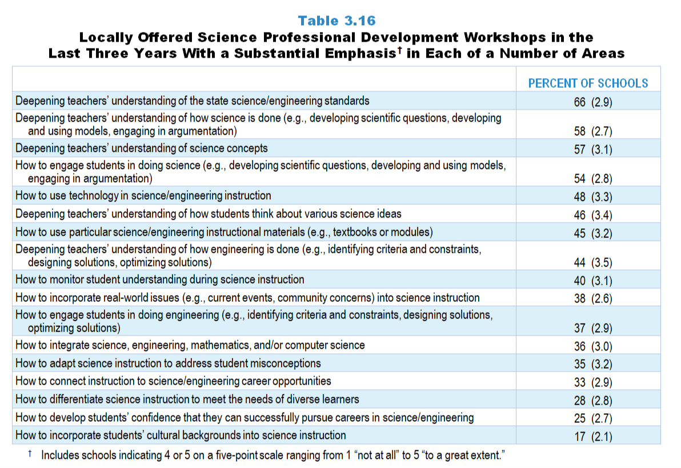
Original Data for Slides 40–42
(not for presentation)
Notes:
Table 3.16, p. 60 in Technical Report
This slide shows data from an individual item.
Science Program Questionnaire
Q19. Please indicate the extent to which workshops offered by your school and/or district/diocese in the last 3 years emphasized each of the following: [Select one on each row.] (Response Options: [1] Not at all, [2] 2 of 5, [3] Somewhat, [4] 4 of 5, [5] To a great extent)
Deepening teachers’ understanding of science concepts
Deepening teachers’ understanding of how science is done (for example: developing scientific questions, developing and using models, engaging in argumentation)
Deepening teachers’ understanding of how engineering is done (for example: identifying criteria and constraints, designing solutions, optimizing solutions)
Deepening teachers’ understanding of the state science standards
Deepening teachers’ understanding of how students think about various science ideas
How to use particular science/engineering instructional materials (for example: textbooks or modules)
How to monitor student understanding during science instruction
How to adapt science instruction to address student misconceptions
How to use technology in science instruction
How to develop students’ confidence that they can successfully pursue careers in science/engineering
How to incorporate real-world issues (for example: current events, community concerns) into science instruction
How to connect instruction to science/engineering career opportunities
How to integrate science, engineering, mathematics, and/or computer science
How to engage students in doing science (for example: developing scientific questions, developing and using models, engaging in argumentation)
How to engage students in doing engineering (for example: identifying criteria and constraints, designing solutions, optimizing solutions)
How to incorporate students’ cultural backgrounds into science instruction
How to differentiate science instruction to meet the needs of diverse learners
The numbers in parentheses are standard errors.
Findings Highlighted in Technical Report
“Science and mathematics program representatives who indicated that workshops have been offered locally in the last three years were asked about the extent to which that professional development emphasized each of a number of areas. In both science and mathematics, about 60 percent of schools indicated that locally offered workshops have emphasized deepening teachers’ understanding of: (1) state standards, (2) how science/‌mathematics is done, and (3) science/‌mathematics concepts (see Table 3.16 and Table 3.17). Learning how to engage students in doing science/‌mathematics, how to use particular instructional materials, and how to use technology in instruction are also relatively common emphases (45–54 percent of schools depending on subject). Relatively few locally offered workshops have focused on how to develop students’ confidence that they can successfully pursue careers in the discipline, how to connect instruction to career opportunities, and how to incorporate students’ cultural backgrounds into instruction.”

Slide 40
Locally Offered Science PD Workshops in the Last 3 Years With Substantial Focus in Various Areas
Notes:
Substantial Focus includes schools that selected “4 of 5” or “to a great extent” on a 5-point scale with the options of “not at all,” “2 of 5,” “somewhat,” “4 of 5,” and “to a great extent.”
PD is short for professional development.

Slide 41
Locally Offered Science PD Workshops in the Last 3 Years With Substantial Focus in Various Areas
Notes:
Substantial Focus includes schools that selected “4 of 5” or “to a great extent” on a 5-point scale with the options of “not at all,” “2 of 5,” “somewhat,” “4 of 5,” and “to a great extent.”
PD is short for professional development.

Slide 42
Locally Offered Science PD Workshops in the Last 3 Years With Substantial Focus in Various Areas
Notes:
Substantial Focus includes schools that selected “4 of 5” or “to a great extent” on a 5-point scale with the options of “not at all,” “2 of 5,” “somewhat,” “4 of 5,” and “to a great extent.”
PD is short for professional development.

Slide 43
Original Data for Slide 44
(not for presentation)
Notes:
The science portion of Table 3.18, p. 61 in Technical Report
This slide shows data from an individual item.
Science Program Questionnaire
Q20. In the last 3 years, has your school offered teacher study groups where teachers meet on a regular basis to discuss teaching and learning of science/engineering, and possibly other content areas as well (sometimes referred to as Professional Learning Communities, PLCs, or lesson study)?
Yes
No
The numbers in parentheses are standard errors.
Findings Highlighted in Technical Report
“One concern about professional development workshops is that teachers may not be given adequate assistance in applying what they are learning to their own instruction. Teacher study groups (professional learning communities, lesson study, etc.) have the potential to help teachers focus on instruction. School science, mathematics, and computer science program representatives were asked whether their school has offered teacher study groups where teachers meet on a regular basis to discuss science, mathematics, or computer science teaching and learning in the last three years. As can be seen in Table 3.18, study groups are more likely to be offered in mathematics than in science or computer science. For example, 55 percent of elementary schools offer teacher study groups in mathematics compared to only 28 percent offering them in science.”

Slide 44
Science Teacher Study Groups Offered at Schools in the Last 3 Years

Slide 45
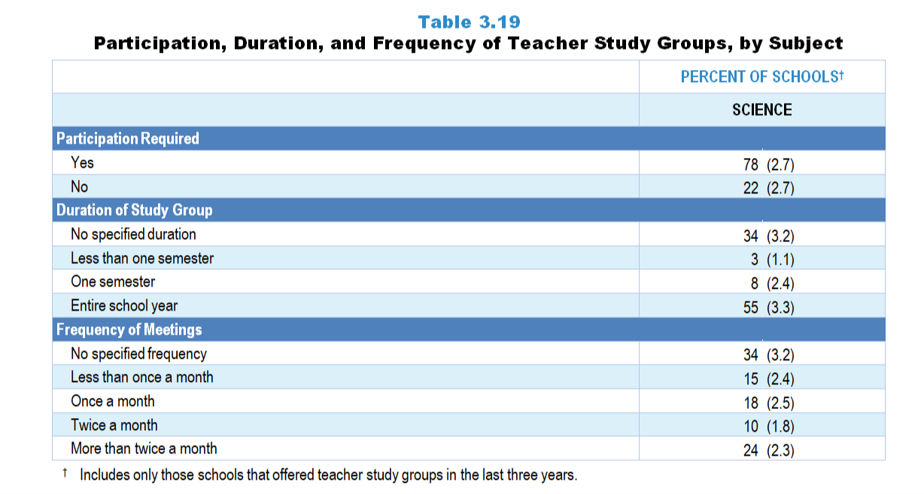
Original Data for Slides 46–48
(not for presentation)
Notes:
The science portion of Table 3.19, p. 62 in Technical Report
This slide shows data from individual items.
Science Program Questionnaire
21. [Presented only to schools that include any grades K–5]
Typically, are teachers of grades K–5 science required to participate in these science/engineering-focused teacher study groups?
Yes, all teachers of grades K–5 science
Yes, but only science/STEM specialists
No
22. [Presented only to schools that include any grades 6–8]
Typically, are teachers of grades 6–8 science classes required to participate in these science/engineering-focused teacher study groups?
Yes
No
23. [Presented only to schools that include any grades 9–12]
Typically, are teachers of grades 9–12 science classes required to participate in these science/engineering-focused teacher study groups?
Yes
No
24. Has your school specified a schedule for when these science/engineering-focused teacher study groups are expected to meet?
Yes
No
25. Over what period of time have these science/engineering-focused teacher study groups typically been expected to meet?
The entire school year
One semester
Less than one semester
26. How often have these science/engineering-focused teacher study groups typically been expected to meet?
Less than once a month
Once a month
Twice a month
More than twice a month
The numbers in parentheses are standard errors.
Findings Highlighted in Technical Report
“As can be seen in Table 3.19, study groups in these two subjects are relatively similar in terms of whether teachers have been required to participate (78 and 81 percent). If schools do have a specified duration for the science and mathematics study groups, they tend to meet for the entire school year (55 and 72 percent, respectively), but there is considerable variation in the frequency of these study group meetings. About a quarter of schools have science and mathematics teacher study groups that meet more than twice a month.”

Slide 46
Required Participation in Science Teacher Study Groups
Notes:
Includes only those schools that offered teacher study groups in the last three years.

Slide 47
Duration of Science Teacher Study Groups
Notes:
Includes only those schools that offered teacher study groups in the last three years.

Slide 48
Frequency of Science Teacher Study Groups
Notes:
Includes only those schools that offered teacher study groups in the last three years.

Slide 49
Original Data for Slide 50
(not for presentation)
Notes:
The science portion of Table 3.20, p. 62 in Technical Report
This slide shows data from an individual item.
Science Program Questionnaire
Q31. The designated leaders of these science/engineering-focused teacher study groups were from: [Select all that apply.]
This school
Elsewhere in this district/diocese [Not presented to non-Catholic private schools]
College or University
External consultants
Other (please specify: _____)
The numbers in parentheses are standard errors.
Findings Highlighted in Technical Report
“Data about whether schools have had designated leaders for the teacher study groups and where those leaders come from are presented in Table 3.20. Roughly two-thirds of schools have had designated leaders for science and mathematics study groups, who most often come from within the school (50 and 55 percent, respectively.)”

Slide 50
Origin of Designated Leaders of Science Teacher Study Groups
Notes:
Includes only those schools that offered teacher study groups in the last three years.

Slide 51
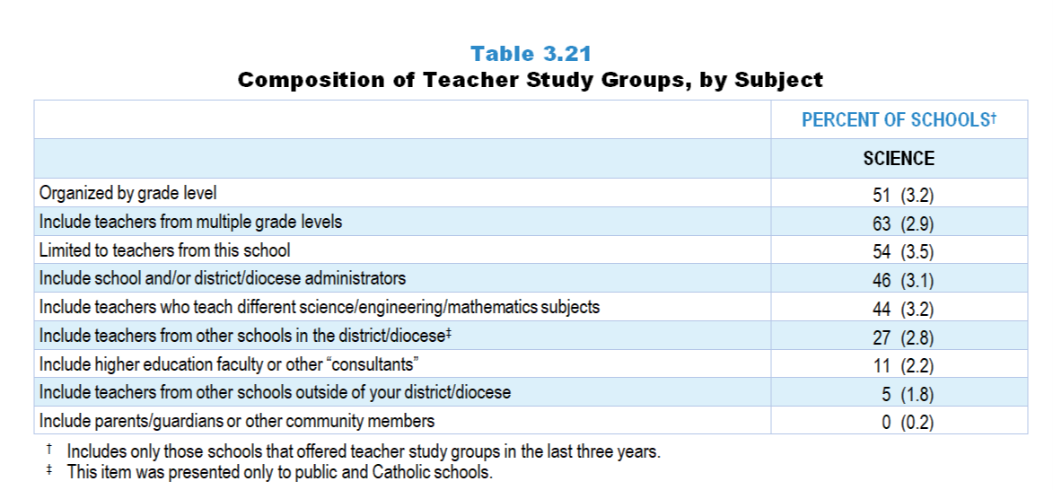
Original Data for Slide 52
(not for presentation)
Notes:
The science portion of Table 3.21, p. 63 in Technical Report
This slide shows data from an individual item.
Science Program Questionnaire
Q27. Which of the following describe the typical science-focused teacher study groups in this school? [Select all that apply.]
Organized by grade level
Include teachers from multiple grade levels
Include teachers who teach different science/engineering subjects
Include parents/guardians or other community members
Include higher education faculty or other “consultants”
Include school and/or district/diocese administrators
Limited to teachers from this school
Include teachers from other schools in the district/diocese [Not presented to non-Catholic private schools]
Include teachers from other schools outside of your district/diocese
The numbers in parentheses are standard errors.
Findings Highlighted in Technical Report
“Information about the composition of teacher study groups is shown in Table 3.21. Most schools organize their science- and mathematics-focused teacher study groups by grade level (51 and 66 percent, respectively), include teachers from multiple grade levels (63 and 59 percent), and limit participation in the study groups to teachers from their school (54 and 58 percent). Many study groups also include school and/‌or district administrators. It is rare for schools to include higher education faculty or other consultants, parents/‌guardians or other community members, or teachers from other schools outside the district in the study groups.”

Slide 52
Composition of Science Teacher Study Groups
Notes:
Includes only those schools that offered teacher study groups in the last three years.

Slide 53
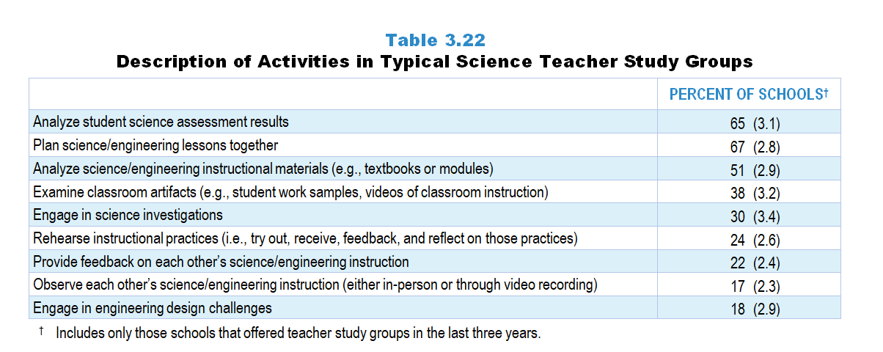
Original Data for Slides 54–55
(not for presentation)
Notes:
Table 3.22, p. 63 in Technical Report
This slide shows data from an individual item.
Science Program Questionnaire
Q28. Which of the following describe the typical science/engineering-focused teacher study groups in this school? [Select all that apply.]
Teachers engage in science investigations.
Teachers engage in engineering design challenges.
Teachers analyze student science assessment results.
Teachers analyze science/engineering instructional materials (for example: textbooks or modules).
Teachers plan science/engineering lessons together.
Teachers rehearse instructional practices (meaning: try out, receive feedback, and reflect on those practices).
Teachers observe each other’s science/engineering instruction (either in-person or through video recording).
Teachers provide feedback on each other’s science/engineering instruction.
Teachers examine classroom artifacts (for example: student work samples, videos of classroom instruction).
The numbers in parentheses are standard errors.
Findings Highlighted in Technical Report
“School science and mathematics program representatives were also asked about the activities typically included in teacher study groups focused on their subject. As can be seen in Table 3.22 and Table 3.23, 65 percent of study groups in science and 81 percent in mathematics have involved teachers in analyzing student assessment results. Roughly one-half to two-thirds of study groups in each subject have had teachers plan lessons together and analyze student instructional materials. Considerably fewer study groups have had teachers provide feedback on each other’s instruction, rehearse instructional practices, and observe each other’s instruction.”

Slide 54
Description of Activities in Typical Science Teacher Study Groups
Notes:
Includes only those schools that offered teacher study groups in the last three years.

Slide 55
Description of Activities in Typical Science Teacher Study Groups
Notes:
Includes only those schools that offered teacher study groups in the last three years.

Slide 56
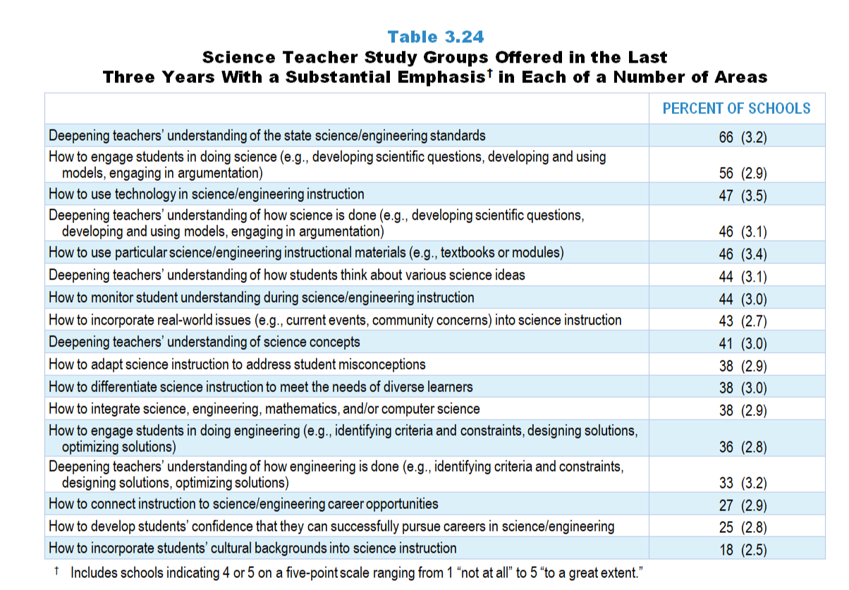
Original Data for Slide 57–59
(not for presentation)
Notes:
Table 3.24, p. 65 in Technical Report
This slide shows data from an individual item.
Science Program Questionnaire
29. To what extent have these science/engineering-focused teacher study groups emphasized each of the following? [Select one on each row.] (Response Options: [1] Not at all, [2] 2 of 5, [3] Somewhat, [4] 4 of 5, [5] To a great extent)
Deepening teachers’ understanding of science concepts
Deepening teachers’ understanding of how science is done (for example: developing scientific questions, developing and using models, engaging in argumentation)
Deepening teachers’ understanding of how engineering is done (for example: identifying criteria and constraints, designing solutions, optimizing solutions)
Deepening teachers’ understanding of the state science standards
Deepening teachers’ understanding of how students think about various science ideas
How to use particular science/engineering instructional materials (for example: textbooks or modules)
How to monitor student understanding during science/engineering instruction
How to adapt science instruction to address student misconceptions
How to use technology in science instruction
How to develop students’ confidence that they can successfully pursue careers in science/engineering
How to incorporate real-world issues (for example: current events, community concerns) into science instruction
How to connect instruction to science/engineering career opportunities
How to integrate science, engineering, mathematics, and/or computer science
How to engage students in doing science (for example: developing scientific questions, developing and using models, engaging in argumentation)
How to engage students in doing engineering (for example: identifying criteria and constraints, designing solutions, optimizing solutions)
How to incorporate students’ cultural backgrounds into science instruction
How to differentiate science instruction to meet the needs of diverse learners
The numbers in parentheses are standard errors.
Findings Highlighted in Technical Report
“Further, school program representatives were asked about the extent to which the teacher study groups have addressed each of a number of topics. These data are presented in Table 3.24 and Table 3.25. Similar to the pattern seen with locally offered professional development workshops, in many schools, both science and mathematics teacher study groups in the last three years have focused heavily on deepening teachers’ understanding of the state standards (66 and 61 percent, respectively). Other areas with a substantial emphasis are learning how to engage students in doing science/‌mathematics (56 and 59 percent); deepening teachers’ understanding of how science/‌mathematics is done (46 and 53 percent); deepening teachers’ understanding of how students think about various ideas (44 and 53 percent); and monitoring student understanding during instruction (44 and 52 percent). Only about a third of schools indicated that science-focused study groups have had a large emphasis on how to engage students in doing engineering and deepening teachers’ understanding of how engineering is done.
In addition, study groups in mathematics are more likely than those in science to focus on how to differentiate instruction to meet the needs of diverse learners and how to adapt instruction to address student misconceptions. In contrast, science study groups are more likely than mathematics study groups to emphasize how to incorporate real-world issues into instruction.”

Slide 57
Emphases of Typical Science Teacher Study Groups
Notes:
Includes only those schools that offered teacher study groups in the last three years.

Slide 58
Emphases of Typical Science Teacher Study Groups
Notes:
Includes only those schools that offered teacher study groups in the last three years.

Slide 59
Emphases of Typical Science Teacher Study Groups
Notes:
Includes only those schools that offered teacher study groups in the last three years.

Slide 60
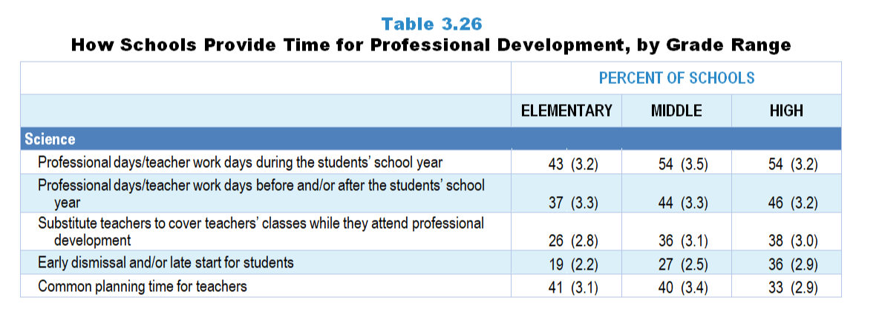
Original Data for Slides 61–63
(not for presentation)
Notes:
The science portion of Table 3.26, p. 66 in Technical Report
This slide shows data from an individual item.
Science Program Questionnaire
Q53. Thinking about last school year, which of the following were used to provide teachers in this school with time for professional development workshops/teacher study groups that included a focus on science/engineering and/or science/engineering teaching, regardless of whether they were offered by your school and/or district/diocese? [Select all that apply.]
Early dismissal and/or late start for students
Professional days/teacher work days during the students' school year
Professional days/teacher work days before and/or after the students' school year
Common planning time for teachers
Substitute teachers to cover teachers' classes while they attend professional development
None of the above
The numbers in parentheses are standard errors.
Findings Highlighted in Technical Report
“Although there is general agreement that teachers can benefit from participating in professional development workshops and study groups, it is often difficult to find time for them to do so. In schools that offered in-service workshops and/or teacher study groups within the last three years, school representatives were given a list of ways in which time might be provided for teachers to participate, and asked to indicate which were used in their school. As can be seen in Table 3.27, teacher work days during the school year have been the most likely to be used, including 63 percent of schools for mathematics and 55 percent for science. Somewhat fewer schools have used common planning time, teacher work days outside the regular school year, substitute teachers, and early dismissal or late start for students to provide time for professional development.”

Slide 61
How Elementary Schools Provide Time for Science Professional Development
Notes:
Note: Each grade-level chart is sorted independently; consequently items may appear in different orders.
PD is short for professional development.

Slide 62
How Middle Schools Provide Time for Science Professional Development
Notes:
Note: Each grade-level chart is sorted independently; consequently items may appear in different orders.

Slide 63
How High Schools Provide Time for Science Professional Development
Notes:
Note: Each grade-level chart is sorted independently; consequently items may appear in different orders.

Slide 64
Original Data for Slide 65
(not for presentation)
Notes:
The science portion of Table 3.27, p. 67 in Technical Report
This slide shows data from an individual item.
Science Program Questionnaire
Q33. Do any teachers in your school have access to one-on-one coaching focused on improving their science instruction (include voluntary and required coaching)?
Yes
No
The numbers in parentheses are standard errors.
Findings Highlighted in Technical Report
“As noted earlier, professional development workshops and teacher study groups can provide important opportunities for teachers to deepen their disciplinary and pedagogical content knowledge, and to develop skill in using that knowledge for key tasks of teaching, such as analyzing student work to determine what a student does and does not understand. When resources allow, one-on-one coaching to help teachers improve their practice can be a powerful tool.
School program representatives were asked whether any teachers in their school have access to one-on-one coaching focused on improving their science, mathematics, and ‌computer science instruction; these data are shown in Table 3.27. Across subject areas and grade ranges, one-on-one coaching is relatively rare except in elementary school mathematics, where over 4 in 10 schools offer coaching.”

Slide 65
Schools Providing One-on-One Science Coaching

Slide 66
Original Data for Slide 67
(not for presentation)
Notes:
The science portion of Table 3.28, p. 67 in Technical Report
This slide shows data derived from:
Science Program Questionnaire
Q34. This school year, how many teachers in this school have received one-on-one coaching focused on improving their science instruction (include voluntary and required coaching)? _____
The numbers in parentheses are standard errors.
Findings Highlighted in Technical Report
“Not only is one-on-one coaching a somewhat uncommon practice, but the proportion of teachers who are coached is small. In science, roughly 10 percent of teachers in schools are provided with one-on-one coaching (see Table 3.28). The proportion of teachers receiving coaching in mathematics ranges from 13–18 percent depending on grade range.”

Slide 67
Average Percentage of Teachers in Schools Receiving One-on-One Science Coaching

Slide 68
Original Data for Slide 69
(not for presentation)
Notes:
The science portion of Table 3.29, p. 67 in Technical Report
This slide shows data derived from:
Science Program Questionnaire
Q35. To what extent is one-on-one coaching focused on improving science instruction provided by each of the following? [Select one on each row.] (Response Options: [1] Not at all, [2] 2 of 5, [3] Somewhat, [4] 4 of 5, [5] To a great extent)
The principal of your school
An assistant principal at your school
District/Diocese administrators including science supervisors/coordinators [Not presented to non-Catholic private schools]
Teachers/coaches who do not have classroom teaching responsibilities
Teachers/coaches who have part-time classroom teaching responsibilities
Teachers/coaches who have full-time classroom teaching responsibilities
The numbers in parentheses are standard errors.
Findings Highlighted in Technical Report
“In schools where science/‌mathematics teachers have access to one-on-one coaching, program representatives were asked who provides the coaching services. Roughly three-quarters of schools that offer coaching use a combination of administrators and teachers/‌coaches (see Table 3.29).”

Slide 69
Teaching Professionals Providing Science-Focused One-on-One Coaching
Notes:
Includes only those schools that provide science-/‌mathematics-focused coaching.
Includes teachers/‌coaches of all levels of teaching responsibility: full-time, part-time, and not teaching.

Slide 70
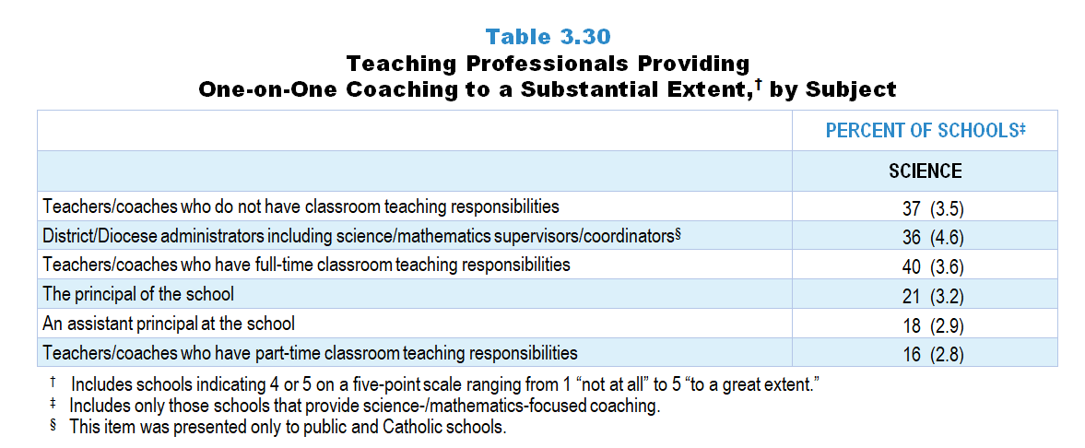
Original Data for Slide 71
(not for presentation)
Notes:
The science portion of Table 3.30, p. 68 in Technical Report
This slide shows data from an individual item.
Science Program Questionnaire
Q35. To what extent is one-on-one coaching focused on improving science instruction provided by each of the following? [Select one on each row.] (Response Options: [1] Not at all, [2] 2 of 5, [3] Somewhat, [4] 4 of 5, [5] To a great extent)
The principal of your school
An assistant principal at your school
District/Diocese administrators including science supervisors/coordinators [Not presented to non-Catholic private schools]
Teachers/coaches who do not have classroom teaching responsibilities
Teachers/coaches who have part-time classroom teaching responsibilities
Teachers/coaches who have full-time classroom teaching responsibilities
The numbers in parentheses are standard errors.
Findings Highlighted in Technical Report
“Although most schools have both teachers/‌coaches and administrators provide coaching, it appears that teachers/‌coaches are responsible for the bulk of it. Table 3.30 shows the percentage of schools with coaching provided by different professionals to a substantial extent. In science, 40 percent of schools have teachers/‌coaches who have full-time teaching loads provide one-on-one coaching to a substantial extent; 37 percent use teachers/‌coaches who do not have classroom teaching responsibilities. Fifty-six percent of schools have one-on-one mathematics coaching provided to a substantial extent by teachers/‌coaches who do not have classroom teaching responsibilities; 28 percent use teachers/‌coaches with full class loads to a substantial extent.”

Slide 71
Professionals Providing Science-Focused One-on-One Coaching to a Substantial Extent
Notes:
Includes schools indicating 4 or 5 on a five-point scale ranging from 1 “not at all” to 5 “to a great extent.”
Includes only those schools that provide science-/‌mathematics-focused coaching.

Slide 72
Original Data for Slide 73
(not for presentation)
Notes:
Table 3.31, p. 68 in Technical Report
This slide shows data from an individual item.
Science Program Questionnaire
Q36. Which of the following are provided to teachers considered in need of special assistance in science teaching? [Select all that apply.]
Seminars, classes, and/or study groups
Guidance from a formally designated mentor or coach
A higher level of supervision than for other teachers
None of the above
The numbers in parentheses are standard errors.
Findings Highlighted in Technical Report
“In addition, school science and mathematics program representatives were asked about the services provided to teachers in need of special assistance. In science, 33–44 percent of schools, depending on grades served, provide guidance from a formally designated mentor or coach (see Table 3.31). The likelihood of schools providing a higher level of supervision for these teachers increases as grade level increases. In mathematics, about half of the schools at each grade range have mentors or coaches who provide guidance to teachers in particular need of help. Schools that include elementary grades are more likely than schools at the high school level to provide seminars, classes, and/‌or study groups for these teachers (40 vs. 22 percent, respectively).”

Slide 73
Services Provided to Science Teachers in Need of Special Assistance in Teaching

Slide 74
Original Data for Slide 75
(not for presentation)
Notes:
The science portion of Table 3.32, p. 69 in Technical Report
This slide shows data derived from:
Science Program Questionnaire
Q18. In the last 3 years, has your school and/or district/diocese offered workshops specifically focused on science/engineering or science/engineering teaching, possibly in conjunction with other organizations (for example: other schools/districts/dioceses, colleges or universities, museums, professional associations, commercial vendors)?
Yes
No
Q20. In the last 3 years, has your school offered teacher study groups where teachers meet on a regular basis to discuss teaching and learning of science/engineering, and possibly other content areas as well (sometimes referred to as Professional Learning Communities, PLCs, or lesson study)?
Yes
No
Q33. Do any teachers in your school have access to one-on-one coaching focused on improving their science instruction (include voluntary and required coaching)?
Yes
No
The numbers in parentheses are standard errors.
Findings Highlighted in Technical Report
“Responses to whether schools/‌districts provide science, mathematics, and ‌computer science workshops, teacher study groups, and one-on-one coaching were combined to look at the proportion of schools that have not offered any of these types of professional development. As can be seen in Table 3.32, about a third of schools have not offered some form of professional development in science in the last three years; 16–28 percent of schools, depending on grade level, have not offered any type of professional development in mathematics. In contrast, about 40–50 percent of schools have not offered computer science professional development at all in the last three years.”

Slide 75
Schools Not Offering Any Type of Science Professional Development in the Last 3 Years

Slide 76
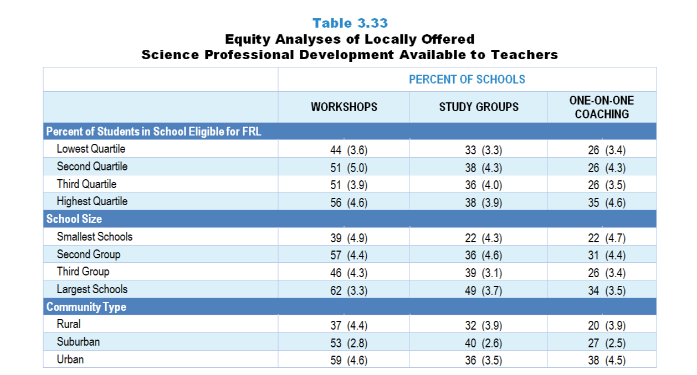
Original Data for Slides 77–79
(not for presentation)
Notes:
The science portion of Table 3.33, p. 69 in Technical Report
This slide shows data from individual items.
Science Program Questionnaire
Q18. In the last 3 years, has your school and/or district/diocese offered workshops specifically focused on science/engineering or science/engineering teaching, possibly in conjunction with other organizations (for example: other schools/districts/dioceses, colleges or universities, museums, professional associations, commercial vendors)?
Yes
No
Q20. In the last 3 years, has your school offered teacher study groups where teachers meet on a regular basis to discuss teaching and learning of science/engineering, and possibly other content areas as well (sometimes referred to as Professional Learning Communities, PLCs, or lesson study)?
Yes
No
Q33. Do any teachers in your school have access to one-on-one coaching focused on improving their science instruction (include voluntary and required coaching)?
Yes
No
The numbers in parentheses are standard errors.
Chapters 2–7 in the technical report provide data on several key indicators, disaggregated by one or more equity factors: the prior achievement level of students in the class, the percentage of students from race/ethnicity groups historically underrepresented in STEM in the class, the percentage of students in the school eligible for free/reduced-price lunch (FRL), school size, community type, and region. For FRL, each school was classified into one of four categories (defined as quartiles) based on the proportion of students eligible for FRL. Similarly, each randomly selected class was classified into one of the four categories based on the proportion of students from race/ethnicity groups historically underrepresented in STEM in the class.
Findings Highlighted in Technical Report
“Additional analyses were conducted to see if these three types of professional development offerings are equitably distributed across schools. In science, schools with the largest proportion of students eligible for free/‌reduced-price lunch are more likely to provide workshops than schools with the lowest proportion of students in this category (see Table 3.33). Not surprisingly, the largest schools are significantly more likely than the smallest schools to offer science-focused workshops and teacher study groups. In addition, schools in rural areas are less likely than urban schools to offer workshops and one-on-one coaching.”

Slide 77
Locally Offered Science Professional Development Available to Teachers, by Percentage of Students in School Eligible for FRL
Notes:
Slide shows the composite scores by quartile of percentage of students in school eligible for free and reduced lunch.

Slide 78
Locally Offered Science Professional Development Available to Teachers, by School Size

Slide 79
Locally Offered Science Professional Development Available to Teachers, by Community Type

