Slide 1
Chapter 4
Science, Mathematics, and Computer Science Courses
Computer Science

Slide 2
Computer Science Course Offerings

Slide 3
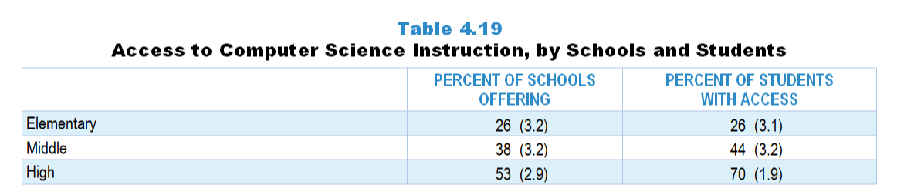
Original Data for Slide 4
(not for presentation)
Notes:
Table 4.19, p. 86 in Technical Report
This slide shows data derived from:
School Coordinator Questionnaire
Q18. [Elementary and middle schools only]
Does your school provide computer programming (for example: LOGO, Python, Scratch, Snap!) instruction to any or all students during the regular school day?
Yes
No
Q26. [High schools only]
Is your school offering any computer science courses in the following categories this school year for students in any grades 9–12? [Select one on each row.] (Response options: Yes, No)
Computer technology courses that do not include programming (e.g., Computer literacy, Keyboarding, Media technology (digital video/audio, multimedia presentations, digital arts), Desktop publishing, Computer applications (word processing, spreadsheets, slide presentations), Computer repair and computer networking, Web design, Computer-aided design (architectural drawing, fashion design), Other technology courses that do not teach or require programming)
Introductory high school computer science courses that include programming but do not qualify for college credit (e.g., Computer Science Discoveries on code.org, Exploring computer science, PLTW’s Computer Science Essentials, introductory programming course, IB Computer Science–Standard Level, Computer science elective that includes introductory programming)
Specialized/elective computer science courses with programming as a prerequisite that do not qualify for college credit (e.g., Advanced Computer science electives such as Robotics, Game or mobile app development, or other advanced computer science elective with programming as a prerequisite)
The numbers in parentheses are standard errors.
Findings Highlighted in Technical Report
“Computer science instruction is offered at only some schools, unlike science and mathematics (see Table 4.19). About 1 in 4 elementary schools and 1 in 3 middle schools offer computer programming instruction as part of the regular school day. About half of high schools offer one or more computer courses. In high schools, the proportion of students with access to computer science instruction is higher than the proportion of schools offering it, indicating that larger high schools are more likely to offer computer science courses.”

Slide 4
Access to Computer Science Courses

Slide 5
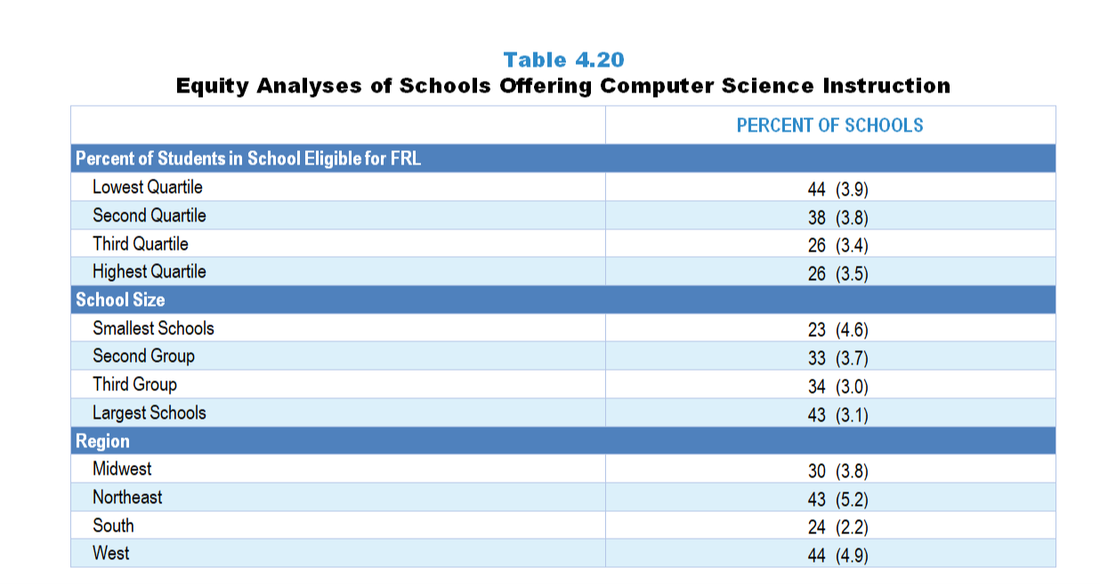
Original Data for Slides 6–8
(not for presentation)
Notes:
Table 4.20, p. 87 in Technical Report
This slide shows data derived from:
School Coordinator Questionnaire
Q18. [Elementary and middle schools only]
Does your school provide computer programming (for example: LOGO, Python, Scratch, Snap!) instruction to any or all students during the regular school day?
Yes
No
Q26. [High schools only]
Is your school offering any computer science courses in the following categories this school year for students in any grades 9–12? [Select one on each row.] (Response options: Yes, No)
Computer technology courses that do not include programming (e.g., Computer literacy, Keyboarding, Media technology (digital video/audio, multimedia presentations, digital arts), Desktop publishing, Computer applications (word processing, spreadsheets, slide presentations), Computer repair and computer networking, Web design, Computer-aided design (architectural drawing, fashion design), Other technology courses that do not teach or require programming)
Introductory high school computer science courses that include programming but do not qualify for college credit (e.g., Computer Science Discoveries on code.org, Exploring computer science, PLTW’s Computer Science Essentials, introductory programming course, IB Computer Science–Standard Level, Computer science elective that includes introductory programming)
Specialized/elective computer science courses with programming as a prerequisite that do not qualify for college credit (e.g., Advanced Computer science electives such as Robotics, Game or mobile app development, or other advanced computer science elective with programming as a prerequisite)
The numbers in parentheses are standard errors.
Chapters 2–7 in the technical report provide data on several key indicators, disaggregated by one or more equity factors: the prior achievement level of students in the class, the percentage of students from race/ethnicity groups historically underrepresented in STEM in the class, the percentage of students in the school eligible for free/reduced-price lunch (FRL), school size, community type, and region. For FRL, each school was classified into one of four categories (defined as quartiles) based on the proportion of students eligible for FRL. Similarly, each randomly selected class was classified into one of the four categories based on the proportion of students from race/ethnicity groups historically underrepresented in STEM in the class.
Findings Highlighted in Technical Report
“Table 4.20 shows the percentage of schools that offer computer science instruction by equity factors. Unsurprisingly, high-poverty schools are less likely to offer computer science than low-poverty schools, and larger schools are more likely to offer computer science than smaller schools. There are also regional differences, with schools in the West more likely to offer computer science than schools in the Midwest and South, and schools in the Northeast more likely to offer it than schools in the South.”

Slide 6
Schools Offering Computer Science Instruction
Notes:
Slide shows the composite scores by quartile of percentage of students in school eligible for free and reduced lunch.

Slide 7
Schools Offering Computer Science Instruction

Slide 8
Schools Offering Computer Science Instruction

Slide 9
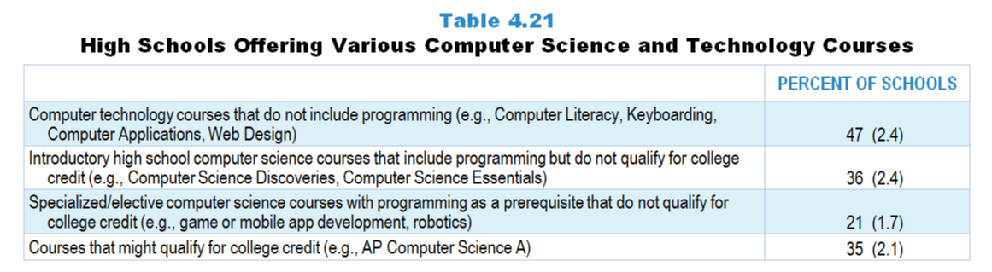
Original Data for Slide 10
(not for presentation)
Notes:
Table 4.21, p. 87 in Technical Report
This slide shows data derived from:
School Coordinator Questionnaire
Q23. [High schools only]
Does your school offer each of the following types of computer science courses that might qualify for college credit? Include both courses that are offered every year and those offered in alternating years. [Select one on each row.] (Response options: Yes, No)
Advanced Placement (AP) computer science courses
International Baccalaureate (IB) computer science courses
Concurrent college and high school credit/‌dual enrollment computer science courses
Q26. [High schools only]
Is your school offering any computer science courses in the following categories this school year for students in any grades 9–12? [Select one on each row.] (Response options: Yes, No)
Computer technology courses that do not include programming (e.g., Computer literacy, Keyboarding, Media technology (digital video/audio, multimedia presentations, digital arts), Desktop publishing, Computer applications (word processing, spreadsheets, slide presentations), Computer repair and computer networking, Web design, Computer-aided design (architectural drawing, fashion design), Other technology courses that do not teach or require programming)
Introductory high school computer science courses that include programming but do not qualify for college credit (e.g., Computer Science Discoveries on code.org, Exploring computer science, PLTW’s Computer Science Essentials, introductory programming course, IB Computer Science–Standard Level, Computer science elective that includes introductory programming)
Specialized/elective computer science courses with programming as a prerequisite that do not qualify for college credit (e.g., Advanced Computer science electives such as Robotics, Game or mobile app development, or other advanced computer science elective with programming as a prerequisite)
The numbers in parentheses are standard errors.
Findings Highlighted in Technical Report
“The percentages of schools offering different types of computer science and computer technology courses are shown in Table 4.21. Almost half of high schools offer computer technology courses that do not include programming. Introductory high school computer science courses and computer science courses that might qualify for college credit are each offered at about a third of high schools. Specialized computer science courses that require programming are offered at only about 1 in 5 high schools.”

Slide 10
High Schools Offering Various Computer Science and Technology Courses

Slide 11
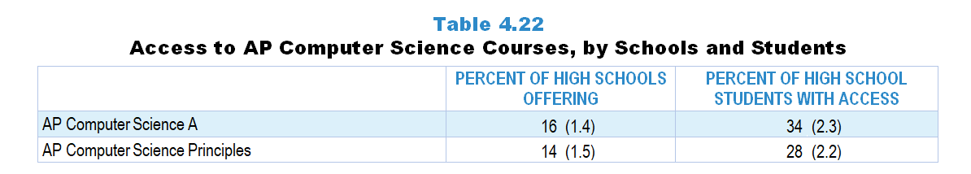
Original Data for Slide 12
(not for presentation)
Notes:
Table 4.22, p. 87 in Technical Report
This slide shows data derived from:
School Coordinator Questionnaire
Q25. [High schools only]
Which of the following computer science courses are available to students in this school? For each course that is available, indicate where and when it is offered. [Select one on each row in each section, if applicable.]
(Response Options: [1] Available (Response Options: Yes, No) ;
[2] Where Offered (Response Options: At this school, Elsewhere (offsite or online)) ;
[3] When Offered (Response Options: This year, Not this year, but in alternating years)
AP Computer Science A
AP Computer Science Principles
IB Computer science standard level
IB Computer science higher level
Other IB computer science course
The numbers in parentheses are standard errors.
Findings Highlighted in Technical Report
“As can be seen in Table 4.22, AP Computer Science A and AP Computer Science Principles are offered in about 1 in 6 high schools. Similar to science and mathematics, the percentage of grades 9–12 students with access to each course is substantially greater than the percentage of schools offering it.”

Slide 12
Access to AP Computer Science Courses

Slide 13
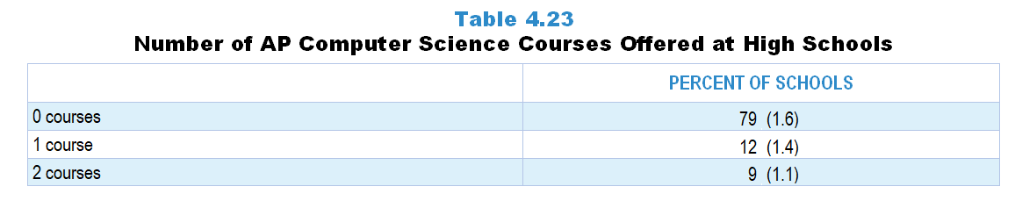
Original Data for Slide 14
(not for presentation)
Notes:
Table 4.23, p. 88 in Technical Report
This slide shows data derived from:
School Coordinator Questionnaire
Q25. [High schools only]
Which of the following computer science courses are available to students in this school? For each course that is available, indicate where and when it is offered. [Select one on each row in each section, if applicable.]
(Response Options: [1] Available (Response Options: Yes, No) ;
[2] Where Offered (Response Options: At this school, Elsewhere (offsite or online)) ;
[3] When Offered (Response Options: This year, Not this year, but in alternating years)
AP Computer Science A
AP Computer Science Principles
IB Computer science standard level
IB Computer science higher level
Other IB computer science course
The numbers in parentheses are standard errors.
Findings Highlighted in Technical Report
“Almost four-fifths of high schools do not offer any AP computer science course (see Table 4.23). Twelve percent offer one AP computer science course, and 9 percent offer both AP courses.”

Slide 14
Number of AP Computer Science Courses Offered at High Schools

Slide 15
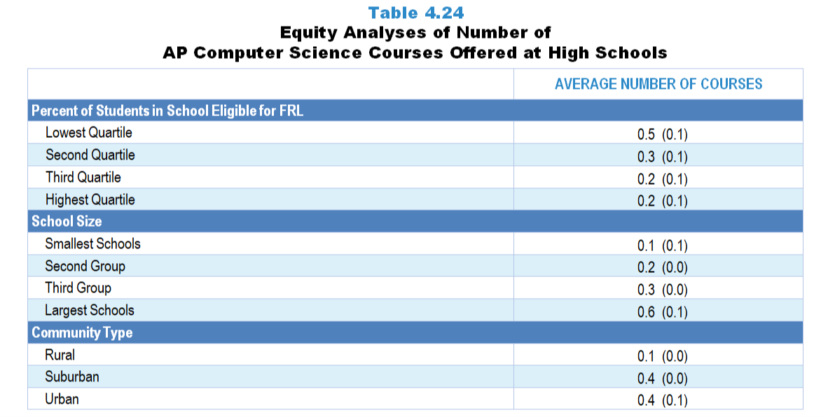
Original Data for Slides 16–18
(not for presentation)
Notes:
Table 4.24, p. 88 in Technical Report
This slide shows data derived from:
School Coordinator Questionnaire
Q25. [High schools only]
Which of the following computer science courses are available to students in this school? For each course that is available, indicate where and when it is offered. [Select one on each row in each section, if applicable.]
(Response Options: [1] Available (Response Options: Yes, No) ;
[2] Where Offered (Response Options: At this school, Elsewhere (offsite or online)) ;
[3] When Offered (Response Options: This year, Not this year, but in alternating years)
AP Computer Science A
AP Computer Science Principles
IB Computer science standard level
IB Computer science higher level
Other IB computer science course
Chapters 2–7 in the technical report provide data on several key indicators, disaggregated by one or more equity factors: the prior achievement level of students in the class, the percentage of students from race/ethnicity groups historically underrepresented in STEM in the class, the percentage of students in the school eligible for free/reduced-price lunch (FRL), school size, community type, and region. For FRL, each school was classified into one of four categories (defined as quartiles) based on the proportion of students eligible for FRL. Similarly, each randomly selected class was classified into one of the four categories based on the proportion of students from race/ethnicity groups historically underrepresented in STEM in the class.
The numbers in parentheses are standard errors.
Findings Highlighted in Technical Report
“Patterns in the number of AP computer science courses offered by equity factors are similar to those in science and mathematics. Large schools are more likely to offer AP computer science courses than small schools. Rural schools are less likely than suburban or urban schools, and high-poverty schools less likely than low-poverty schools, to offer AP computer science (see Table 4.24).”

Slide 16
Average Number of AP Computer Science Courses Offered at High Schools
Notes:
Slide shows the composite scores by quartile of percentage of students in school eligible for free and reduced lunch.

Slide 17
Average Number of AP Computer Science Courses Offered at High Schools

Slide 18
Average Number of AP Computer Science Courses Offered at High Schools

Slide 19
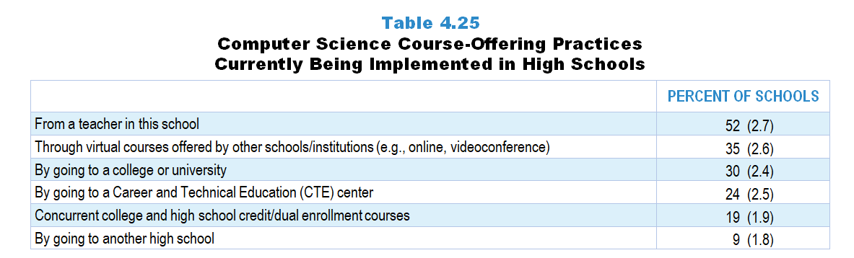
Original Data for Slide 20
(not for presentation)
Notes:
Table 4.25, p. 89 in Technical Report
This slide shows data from individual items.
School Coordinator Questionnaire
Q22. [High Schools Only]
In which of the following ways can grades 9–12 students in this school take a computer science course that teaches programming or requires programming as a prerequisite? [Select all that apply.]
From a teacher in this school
Through virtual courses offered by other schools/institutions (for example: online, videoconference)
By going to a Career and Technical Education (CTE) center
By going to another high school
By going to a college or university
Grades 9-12 students in this school cannot take a computer science course that teaches programming or requires programming as a prerequisite
Q23. [High schools only]
Does your school offer each of the following types of computer science courses that might qualify for college credit? Include both courses that are offered every year and those offered in alternating years. [Select one on each row.] (Response Options: Yes, No)
Advanced Placement (AP) computer science courses
International Baccalaureate (IB) computer science courses
Concurrent college and high school credit/‌dual enrollment computer science courses
The numbers in parentheses are standard errors.
Findings Highlighted in Technical Report
“Students can take computer science courses from a teacher in their school at about half of high schools (see Table 4.25). Fewer high schools offer virtual computer science courses (35 percent of high schools) than virtual mathematics courses (59 percent of high schools), and students earning college credit through dual enrollment or by going to a college or university are less common practices in computer science (19 and 30 percent of high schools, respectively) than in science or mathematics (46–68 percent of high schools).”

Slide 20
Computer Science Course-Offering Practices Currently Being Implemented in High Schools

Slide 21
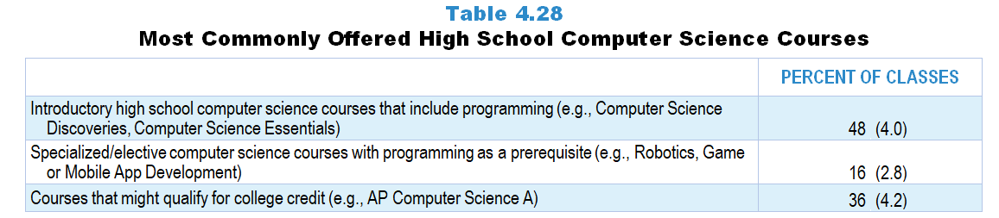
Original Data for Slide 22
(not for presentation)
Notes:
Table 4.28, p. 90 in Technical Report
This slide shows data derived from:
Computer Science Teacher Questionnaire
Q5. For each computer science class you currently teach, select the course type and enter the number of students enrolled. Enter the classes in the order that you teach them. For teachers on an alternating day block schedule, please order your classes starting with the first class you teach this week.
Course Type List
Computer technology courses that do not include programming
Introductory high school computer science courses that include programming
Computer science courses that might qualify for college credit
Specialized/elective computer science courses with programming as a prerequisite
The numbers in parentheses are standard errors.
Findings Highlighted in Technical Report
“In computer science, introductory courses account for almost half of all computer science courses that include programming or have programming as a prerequisite (see Table 4.28). Just over a third of classes might qualify for college credit; only 16 percent of classes are specialized or elective computer science courses.”

Slide 22
Most Commonly Offered High School Computer Science Courses

Slide 23
Other Characteristics of Computer Science Classes

Slide 24
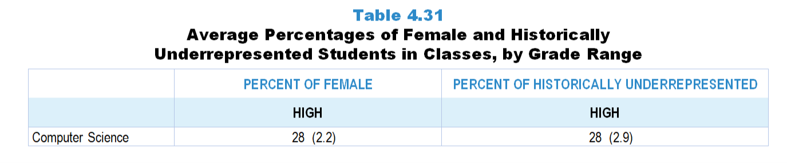
Original Data for Slide 25
(not for presentation)
Notes:
The computer science portion of Table 4.31, p. 93 in Technical Report
This slide shows data from an individual item.
Computer Science Teacher Questionnaire
Q26. For the students in this class, indicate the number of males and females in this class in each of the following categories of race/ethnicity.
American Indian or Alaskan Native _____ _____
Asian _____ _____
Black or African American _____ _____
Hispanic/Latino _____ _____
Native Hawaiian or Other Pacific Islander _____ _____
White _____ _____
Two or more races _____ _____
The numbers in parentheses are standard errors.
Findings Highlighted in Technical Report
“Table 4.31 shows the percentages of female students and students from race/‌ethnicity groups historically underrepresented in STEM in classes in the different grade bands. Elementary and middle school data mirror those of students in the nation, as students typically are required to take science and mathematics at each grade level. In high school, where students are generally not required to take each subject every year, the data show that historically underrepresented students are less likely to take science and mathematics classes. In high school computer science classes, only about a quarter of students are female or from a historically underrepresented race/‌ethnicity group.”

Slide 25
Average Percentages of Female and Historically Underrepresented Students in High School Computer Science Classes

Slide 26
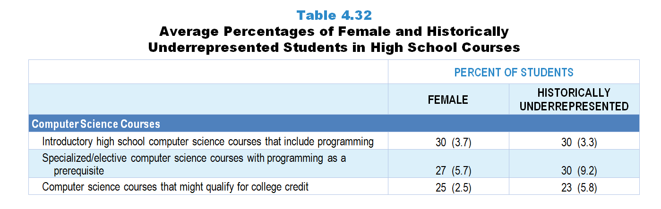
Original Data for Slides 27–28
(not for presentation)
Notes:
The computer science portion of Table 4.32, p. 94 in Technical Report
This slide shows data derived from:
Computer Science Teacher Questionnaire
Q5. For each computer science class you currently teach, select the course type and enter the number of students enrolled. Enter the classes in the order that you teach them. For teachers on an alternating day block schedule, please order your classes starting with the first class you teach this week.
Course Type List
Computer technology courses that do not include programming
Introductory high school computer science courses that include programming
Computer science courses that might qualify for college credit
Specialized/elective computer science courses with programming as a prerequisite
Q26. For the students in this class, indicate the number of males and females in this class in each of the following categories of race/ethnicity.
American Indian or Alaskan Native _____ _____
Asian _____ _____
Black or African American _____ _____
Hispanic/Latino _____ _____
Native Hawaiian or Other Pacific Islander _____ _____
White _____ _____
Two or more races _____ _____
The numbers in parentheses are standard errors.
Findings Highlighted in Technical Report
“A pattern of decreasing enrollment of students from race/‌ethnicity groups historically underrepresented in STEM is seen in the class composition data across the progression of high school science and mathematics courses (see Table 4.32). For example, students from these groups make up 43 percent of students in non-college prep science classes and 35 percent of students in 1st year biology classes, compared to only 27 percent in advanced science classes. In mathematics, 38 percent of students in formal/college prep level 1 classes are from race/‌ethnicity groups historically underrepresented in STEM, compared to only 22 percent of students in classes that might qualify for college credit. In computer science, students from these groups make up 30 percent of students in introductory classes and 23 percent of students in courses that might qualify for college credit. In terms of gender, high school science and mathematics courses tend to have classes that are evenly split between male and female students on average. Exceptions are non-college prep science and mathematics classes and 1st year physics classes, which have smaller percentages of female students.”

Slide 27
Average Percentage of Female Students in High School Computer Science Courses, by Course Type
Notes:
Historically Underrepresented Students includes American Indian or Alaskan Native, Black or African American, Hispanic or Latino, or Native Hawaiian or Other Pacific Islander students.

Slide 28
Average Percentage of Historically Underrepresented Students in High School Computer Science Courses, by Course Type
Notes:
Historically Underrepresented Students includes American Indian or Alaskan Native, Black or African American, Hispanic or Latino, or Native Hawaiian or Other Pacific Islander students.

Slide 29
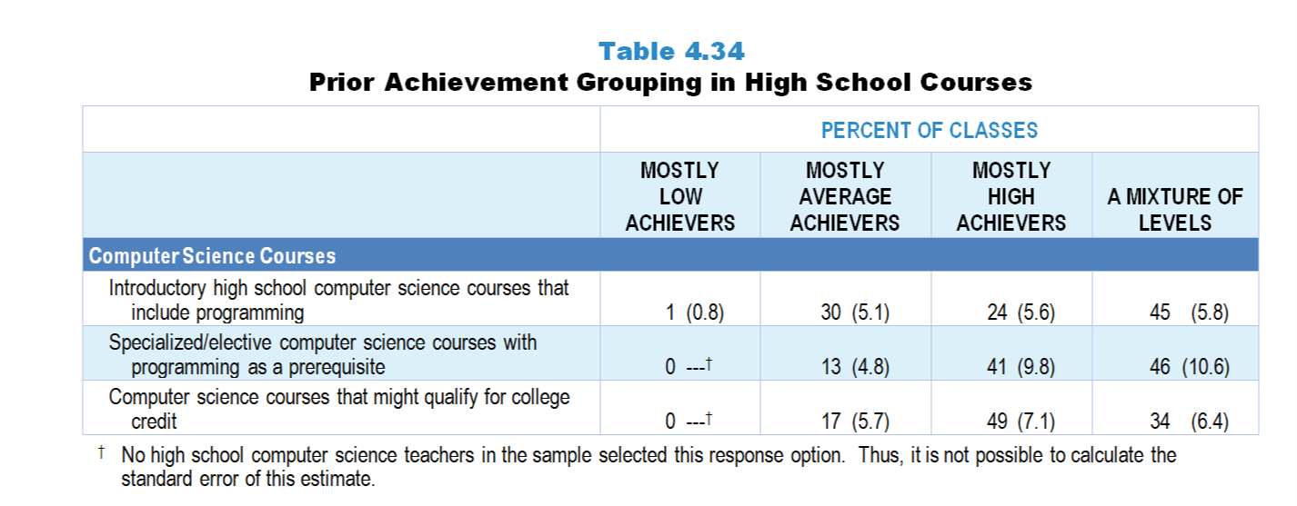
Original Data for Slide 30
(not for presentation)
Notes:
The computer science portion of Table 4.34, p. 96 in Technical Report
This slide shows data from individual items.
Computer Science Teacher Questionnaire
Q5. For each computer science class you currently teach, select the course type and enter the number of students enrolled. Enter the classes in the order that you teach them. For teachers on an alternating day block schedule, please order your classes starting with the first class you teach this week.
Course Type List
Computer technology courses that do not include programming
Introductory high school computer science courses that include programming
Computer science courses that might qualify for college credit
Specialized/elective computer science courses with programming as a prerequisite
Q27. Which of the following best describes the prior achievement levels of the students in this class relative to other students in this school?
Mostly low achievers
Mostly average achievers
Mostly high achievers
A mixture of levels
The numbers in parentheses are standard errors.
Findings Highlighted in Technical Report
“The percentage of science classes composed mostly of high prior achievers tends to increase across the traditional course sequence; for example, about 30 percent of 1st year biology and chemistry classes consist mostly of high prior achievers, compared to 42 percent of 1st year physics classes and 65 percent of advanced science classes (see Table 4.34). A similar trend occurs in mathematics, where few level 1, a quarter of level 2 and level 3, half of level 4, and a large majority of classes that might qualify for college credit are composed of mostly high prior achievers. In computer science, 24 percent of introductory computer science classes, 41 percent of specialized/‌elective classes, and 49 percent of classes that might qualify for college credit consist of mostly high prior achievers.”

Slide 30
Prior Achievement Grouping in High School Computer Science Classes, by Course Type

Slide 31
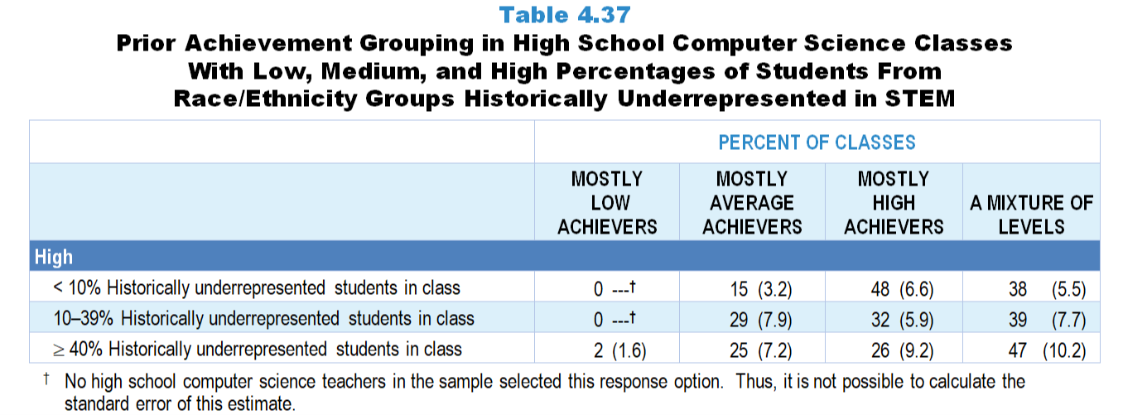
Original Data for Slide 32
(not for presentation)
Notes:
The computer science portion of Table 4.37, p. 98 in Technical Report
This slide shows data from individual items.
Computer Science Teacher Questionnaire
Q26. For the students in this class, indicate the number of males and females in this class in each of the following categories of race/ethnicity.
American Indian or Alaskan Native _____ _____
Asian _____ _____
Black or African American _____ _____
Hispanic/Latino _____ _____
Native Hawaiian or Other Pacific Islander _____ _____
White _____ _____
Two or more races _____ _____
Q27. Which of the following best describes the prior achievement levels of the students in this class relative to other students in this school?
Mostly low achievers
Mostly average achievers
Mostly high achievers
A mixture of levels
The numbers in parentheses are standard errors.
Findings Highlighted in Technical Report
“Prior achievement grouping also varies by the percentage of students from race/‌ethnicity groups historically underrepresented in STEM in classes. Across all grade levels in both science (see Table 4.35) and mathematics (see Table 4.36), classes composed of 40 percent or more of students from race/‌ethnicity groups historically underrepresented in STEM are more likely to be classified as consisting of mostly low prior achievers than classes with smaller proportions of students from these groups. For example, 32 percent of high school mathematics classes with a high percentage of students from race/‌ethnicity groups historically underrepresented in STEM are classified as being composed mostly of low prior achievers, compared to 16 percent of classes with a low percentage of students from these groups. In high school computer science, classes composed of fewer than 10 percent of students from these groups are more likely to be classified as consisting of mostly high prior achievers than classes in which 40 percent or more of students are from these groups (see Table 4.37).”

Slide 32
Prior Achievement Grouping in High School Computer Science Classes
Notes:
Historically Underrepresented Students includes American Indian or Alaskan Native, Black or African American, Hispanic or Latino, or Native Hawaiian or Other Pacific Islander students.

