Slide 1
Chapter 4
Science, Mathematics, and Computer Science Courses
Science

Slide 2
Time Spent on Science Instruction in Elementary Grades

Slide 3
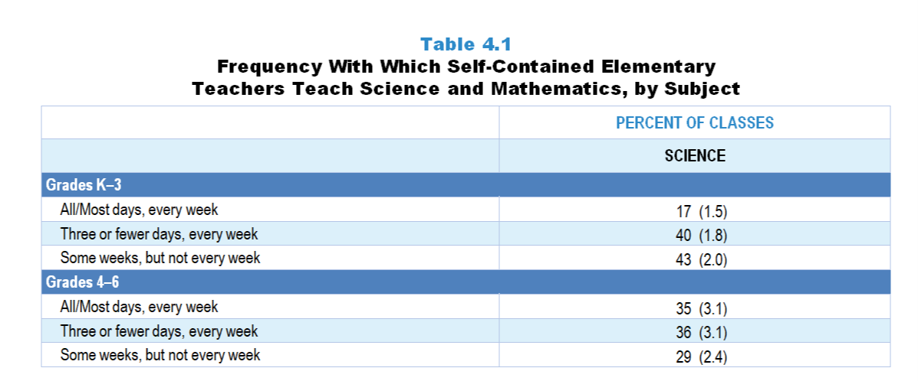
Original Data for Slide 4
(not for presentation)
Notes:
The science portion of Table 4.1, p. 77 in Technical Report
This slide shows data from individual items.
Science Teacher Questionnaire
Q5. Which best describes your science teaching?
I teach science all or most days, every week of the year.
I teach science every week, but typically not every day of the week.
I teach science some weeks, but typically not every week.
Mathematics Teacher Questionnaire
Q6. Which best describes your science teaching?
I teach science all or most days, every week of the year.
I teach science every week, but typically three or fewer days each week.
I teach science some weeks, but typically not every week.
I do not teach science.
The numbers in parentheses are standard errors.
Findings Highlighted in Technical Report
“Self-contained elementary teachers were asked how often they teach mathematics and/‌or science. As can be seen in Table 4.1, mathematics is taught in virtually all classes on most or all school days in both grades K–3 and 4–6. In contrast, science is taught less frequently, with only 17 percent of grades K–3 classes and 35 percent of grades 4–6 classes receiving science instruction all or most days, every week of the school year. Many elementary classes receive science instruction only a few days a week or during some weeks of the year.”

Slide 4
Frequency With Which Self-Contained Elementary Classes Receive Science Instruction
Notes:
Includes only teachers assigned to teach multiple subjects to a single class of students grades K–6.

Slide 5
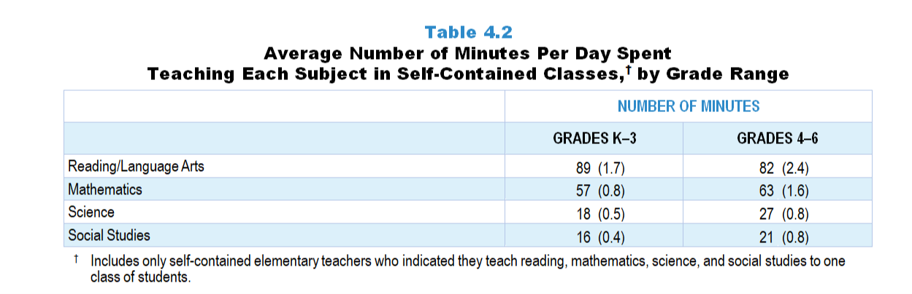
Original Data for Slide 6
(not for presentation)
Notes:
Table 4.2, p. 78 in Technical Report
This slide shows data from individual items found on both the Science Teacher Questionnaire and Mathematics Teacher Questionnaire.
Science Teacher Questionnaire
Q6. In a typical week, how many days do you teach lessons on each of the following subjects and how many minutes per week are spent on each subject?
Mathematics _____ _____
Science _____ _____
Social Studies _____ _____
Reading/Language Arts _____ _____
Q7. In a typical year, how many weeks do you teach lessons on each of the following subjects and how many minutes per week are spent on each subject?
Mathematics _____ _____
Science _____ _____
Social Studies _____ _____
Reading/Language Arts _____ _____
Mathematics Teacher Questionnaire
Q7. In a typical week, how many days do you teach lessons on each of the following subjects and how many minutes per week are spent on each subject?
Mathematics _____ _____
Science _____ _____
Social Studies _____ _____
Reading/Language Arts _____ _____
Q8. In a typical year, how many weeks do you teach lessons on each of the following subjects and how many minutes per week are spent on each subject?
Mathematics _____ _____
Science _____ _____
Social Studies _____ _____
Reading/Language Arts _____ _____
The numbers in parentheses are standard errors.
Findings Highlighted in Technical Report
“The survey also asked the approximate number of minutes typically spent teaching mathematics, science, social studies, and reading/‌language arts in self-contained classes. The average number of minutes per day typically spent on instruction in each subject in grades K–3 and 4–6 is shown in Table 4.2; to facilitate comparisons among the subject areas, only teachers who teach all four of these subjects to one class of students were included in this analysis. In 2018, grades K–3 self-contained classes spent an average of 89 minutes per day on reading instruction and 57 minutes on mathematics instruction, compared to only 18 minutes on science and 16 minutes on social studies instruction. The pattern in grades 4–6 is similar, with 82 minutes per day devoted to reading, 63 minutes to mathematics, 27 minutes to science, and 21 minutes to social studies instruction.”

Slide 6
Average Number of Minutes Spent Teaching Subjects in Self-Contained Classes
Notes:
Includes only self-contained elementary teachers who indicated they teach reading, mathematics, science, and social studies to one class of students.

Slide 7
Science Course Offerings

Slide 8
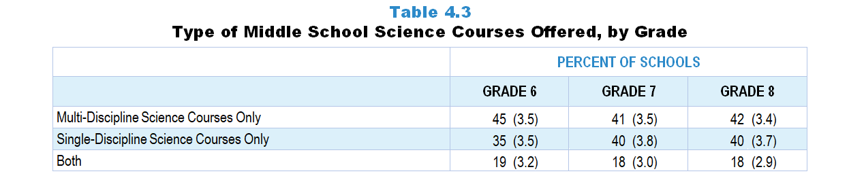
Original Data for Slide 9
(not for presentation)
Notes:
Table 4.3, p. 78 in Technical Report
This slide shows data from individual items.
Science Program Questionnaire
Q7. [Presented only to schools that include any grades 6-8]
What types of science courses are offered to students in the following grades? [Select one on each row.]
6th grade:
Single-discipline science courses (for example: life science)
Multi-discipline science courses (for example: general science, integrated science)
Both single-discipline and multi-discipline science courses
7th grade:
Single-discipline science courses (for example: life science)
Multi-discipline science courses (for example: general science, integrated science)
Both single-discipline and multi-discipline science courses
8th grade:
Single-discipline science courses (for example: life science)
Multi-discipline science courses (for example: general science, integrated science)
Both single-discipline and multi-discipline science courses
The numbers in parentheses are standard errors.
Findings Highlighted in Technical Report
“For science, middle schools were asked whether they offer single-discipline courses (e.g., life science, physical science), coordinated/‌integrated science courses, or both in each grade 6–8 contained in the school. As can be seen in Table 4.3, 45 percent of schools containing 6th grade offer only coordinated/‌integrated science, and 35 percent offer only single-discipline courses; in grades 7 and 8, the percentage of schools offering only coordinated/‌integrated science is approximately the same as the those offering only single-discipline courses (about 40 percent). Fewer than 1 in 5 schools containing these grades offer both types of courses.”

Slide 9
Type of Middle School Science Courses Offered

Slide 10
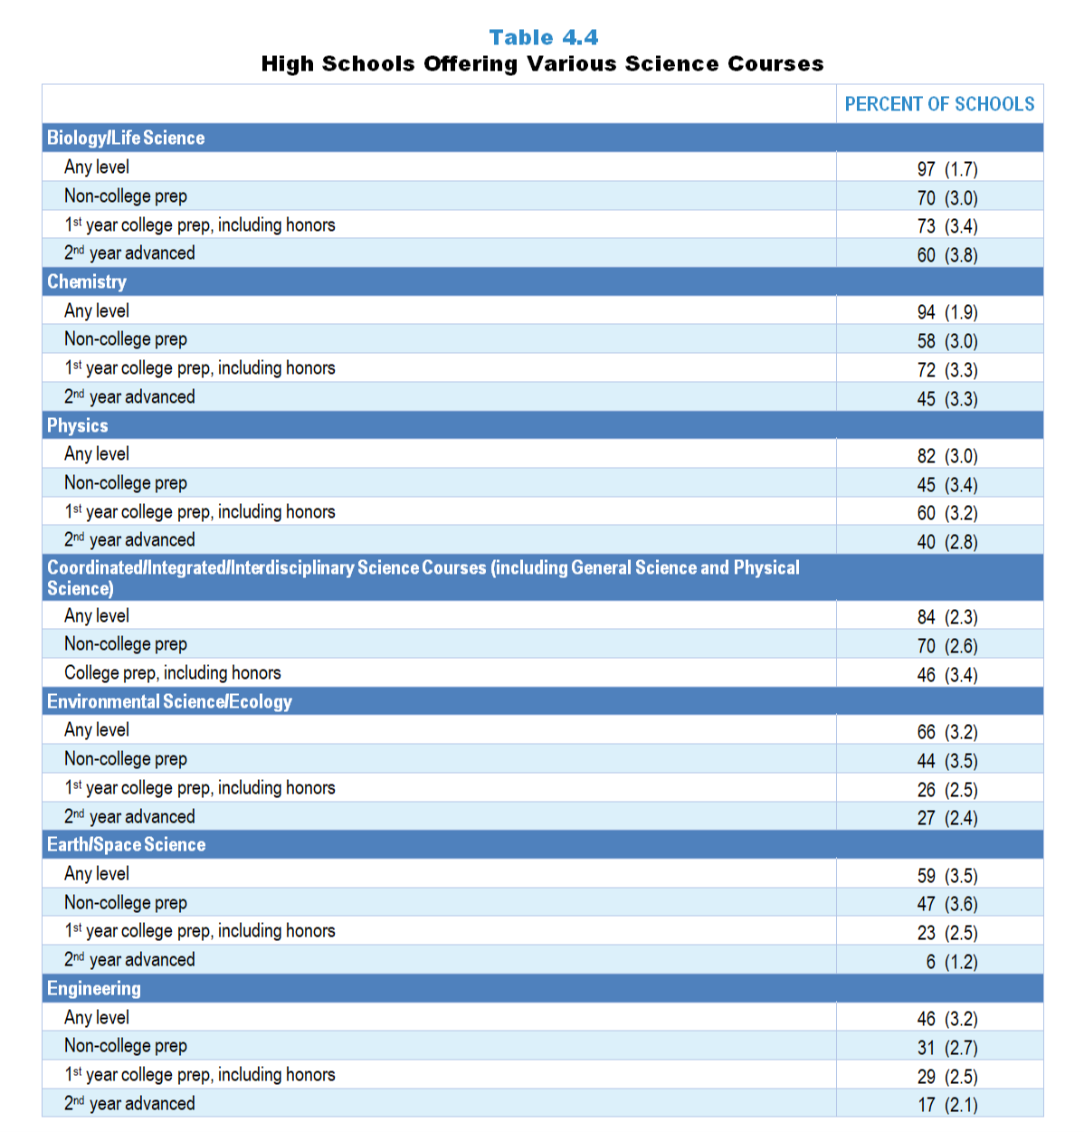
Original Data for Slides 11–17
(not for presentation)
Notes:
Table 4.4, p. 79 in Technical Report
This slide shows data from an individual item.
Science Program Questionnaire
Q8. Is your school offering any courses in each of the following categories this year for students in grades 9–12? [Select one on each row.] (Response Options: Yes, No)
a. Coordinated/Integrated/Interdisciplinary science (including General Science and Physical Science)
i. Non-college prep
ii. College prep, including honors
b. Earth/Space Science
i. Non-college prep
ii. 1st year college prep, including honors
iii. 2nd year advanced, including concurrent college and high school credit/dual enrollment courses
c. Life Science/Biology
i. Non-college prep
ii. 1st year college prep, including honors
iii. 2nd year advanced, including Advanced Placement, International Baccalaureate, and concurrent college and high school credit/dual enrollment courses
d. Environmental Science/Ecology
i. Non-college prep
ii. 1st year college prep, including honors
iii. 2nd year advanced, including Advanced Placement, International Baccalaureate, and concurrent college and high school credit/dual enrollment courses
e. Chemistry
i. Non-college prep
ii. 1st year college prep, including honors
iii. 2nd year advanced, including Advanced Placement, International Baccalaureate, and concurrent college and high school credit/dual enrollment courses
f. Physics
i. Non-college prep
ii. 1st year college prep, including honors
iii. 2nd year advanced, including Advanced Placement, International Baccalaureate, and concurrent college and high school credit/dual enrollment courses
g. Engineering—Include courses that address the nature of engineering, engineering design processes, technological systems, or technology and society. Do not include career-technical education (CTE) courses that cover such things as automotive repair, audio/video production, etc.
i. Non-college prep
ii. 1st year college prep, including honors
iii. 2nd year advanced, including concurrent college and high school credit/dual enrollment courses
The numbers in parentheses are standard errors.
Findings Highlighted in Technical Report
Table 4.4 shows science courses offered in high schools. Almost all schools (97 percent) with grades 9–12 offer courses in biology/‌life science, with 70 percent offering non-college prep courses, 73 percent offering 1st year college preparatory courses, and 60 percent offering at least one 2nd year biology/‌life science course. Overall, 94 percent of high schools offer some form of chemistry course. First-year college prep chemistry courses are offered in 72 percent and 2nd year chemistry in 45 percent of high schools. Most high schools (82 percent) offer physics courses. Three-fifths offer 1st year physics, and two-fifths offer 2nd year physics. Most high schools (84 percent) offer coursework in coordinated/‌integrated science (including physical science). Fewer high schools offer courses in environmental science (66 percent) or Earth/‌space science (59 percent) than in the other science disciplines. Only 27 percent offer a second course in environmental science; 6 percent of schools offer 2nd year Earth/space science courses. Nearly one-half of high schools offer at least one engineering course; 31 percent offer non-college prep, and 29 percent offer 1st year college prep engineering courses. Only 17 percent of high schools offer a 2nd year engineering course.”

Slide 11
High Schools Offering Various Biology/Life Science Courses

Slide 12
High Schools Offering Various Chemistry Courses

Slide 13
High Schools Offering Various Physics Courses

Slide 14
High Schools Offering Various Integrated Science Courses

Slide 15
High Schools Offering Various Environmental Science/Ecology Courses

Slide 16
High Schools Offering Various Earth/Space Science Courses

Slide 17
High Schools Offering Various Engineering Courses

Slide 18
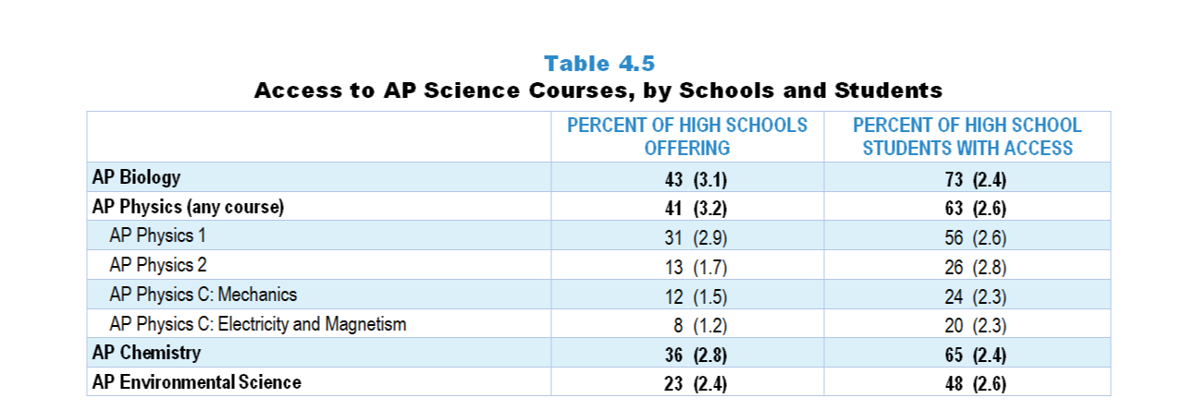
Original Data for Slides 19–20
(not for presentation)
Notes:
Table 4.5, p. 80 in Technical Report
This slide shows data derived from:
Science Program Questionnaire
Q11. Which of the following science courses are available to students in this school, either on site, at other locations, or online? [Select one on each row.]
(Response Options: [1] Available (Response Options: Yes, No) ;
[2] Where Offered (Response Options: At this school, Elsewhere (offsite or online)) ;
[3] When Offered (Response Options: This year, Not this year, but in alternating years)
AP Biology
AP Chemistry
AP Physics 1
AP Physics 2
AP Physics C: Electricity and Magnetism
AP Physics C: Mechanics
AP Environmental Science
IB Biology
IB Chemistry
IB Physics
IB Environmental Systems and Societies
The numbers in parentheses are standard errors.
Findings Highlighted in Technical Report
“Table 4.5 shows the percentage of high schools offering each of the Advanced Placement (AP) science courses and the percentage of grades 9–12 students in the nation at those schools. Biology is the most commonly offered AP course, available in about 4 in 10 high schools. About the same proportion offer some form of AP Physics, with AP Physics 1 being the most common type. AP Chemistry is offered in roughly 1 in 3 schools and AP Environmental Science in about 1 in 4 high schools. That the percentage of high school students with access to each course is much larger than the percentage of schools offering it indicates that larger schools are more likely than smaller schools to offer AP science courses. However, 27–80 percent of students do not have access to the various AP science courses.”

Slide 19
Access to AP Science Courses

Slide 20
Access to AP Physics Courses

Slide 21
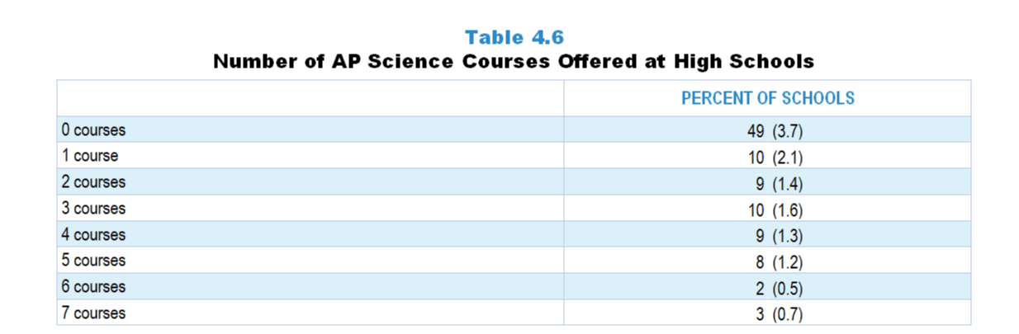
Original Data for Slide 22
(not for presentation)
Notes:
Table 4.6, p. 80 in Technical Report
This slide shows data derived from:
Science Program Questionnaire
Q11. Which of the following science courses are available to students in this school, either on site, at other locations, or online? [Select one on each row.]
(Response Options: [1] Available (Response Options: Yes, No) ;
[2] Where Offered (Response Options: At this school, Elsewhere (offsite or online)) ;
[3] When Offered (Response Options: This year, Not this year, but in alternating years)
AP Biology
AP Chemistry
AP Physics 1
AP Physics 2
AP Physics C: Electricity and Magnetism
AP Physics C: Mechanics
AP Environmental Science
IB Biology
IB Chemistry
IB Physics
IB Environmental Systems and Societies
The numbers in parentheses are standard errors.
Findings Highlighted in Technical Report
“Across the disciplines, 51 percent of high schools offer at least one AP science course, either this year or in alternating years (see Table 4.6). Approximately the same percentage of schools offer 1–5 AP science courses, with about 10 percent of schools in each category. Only 3 percent of schools offer all of the currently available AP science courses.”

Slide 22
Number of AP Science Courses Offered at High Schools

Slide 23
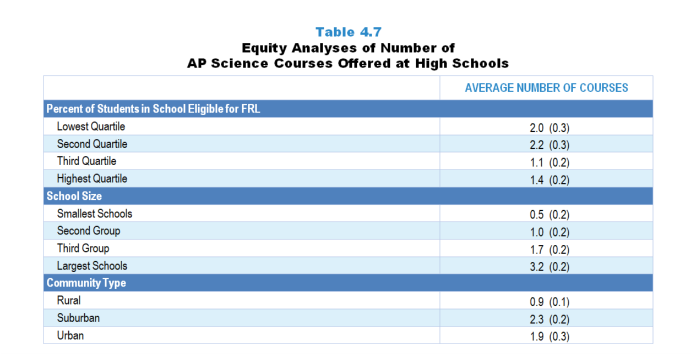
Original Data for Slides 24–26
(not for presentation)
Notes:
Table 4.7, p. 81 in Technical Report
This slide shows data derived from:
Science Program Questionnaire
Science Program Questionnaire
Q11. Which of the following science courses are available to students in this school, either on site, at other locations, or online? [Select one on each row.]
(Response Options: [1] Available (Response Options: Yes, No) ;
[2] Where Offered (Response Options: At this school, Elsewhere (offsite or online)) ;
[3] When Offered (Response Options: This year, Not this year, but in alternating years)
AP Biology
AP Chemistry
AP Physics 1
AP Physics 2
AP Physics C: Electricity and Magnetism
AP Physics C: Mechanics
AP Environmental Science
IB Biology
IB Chemistry
IB Physics
IB Environmental Systems and Societies
Chapters 2–7 in the technical report provide data on several key indicators, disaggregated by one or more equity factors: the prior achievement level of students in the class, the percentage of students from race/ethnicity groups historically underrepresented in STEM in the class, the percentage of students in the school eligible for free/reduced-price lunch (FRL), school size, community type, and region. For FRL, each school was classified into one of four categories (defined as quartiles) based on the proportion of students eligible for FRL. Similarly, each randomly selected class was classified into one of the four categories based on the proportion of students from race/ethnicity groups historically underrepresented in STEM in the class.
The numbers in parentheses are standard errors.
Findings Highlighted in Technical Report
“Table 4.7 shows the average number of AP science courses offered by various equity factors. Not surprisingly, small schools tend to offer fewer AP science courses than large schools. On average, suburban and urban schools offer more AP science courses than rural schools. In addition, schools in the top two quartiles in terms of the percentage of students eligible for free/‌reduced-price lunch offer fewer AP science courses than schools with lower proportions of such students.”

Slide 24
Average Number of AP Science Courses Offered at High Schools

Slide 25
Average Number of AP Science Courses Offered at High Schools

Slide 26
Average Number of AP Science Courses Offered at High Schools

Slide 27
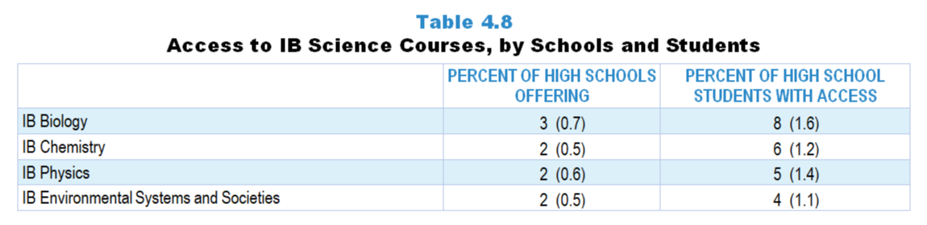
Original Data for Slide 28
(not for presentation)
Notes:
Table 4.8, p. 81 in Technical Report
This slide shows data derived from:
Science Program Questionnaire
Q11. Which of the following science courses are available to students in this school, either on site, at other locations, or online? [Select one on each row.]
(Response Options: [1] Available (Response Options: Yes, No) ;
[2] Where Offered (Response Options: At this school, Elsewhere (offsite or online)) ;
[3] When Offered (Response Options: This year, Not this year, but in alternating years)
AP Biology
AP Chemistry
AP Physics 1
AP Physics 2
AP Physics C: Electricity and Magnetism
AP Physics C: Mechanics
AP Environmental Science
IB Biology
IB Chemistry
IB Physics
IB Environmental Systems and Societies
The numbers in parentheses are standard errors.
Findings Highlighted in Technical Report
“The survey also asked if high schools offer International Baccalaureate (IB) courses. As can be seen in Table 4.8, very few schools offer the IB program and fewer than 1 in 10 high school students have access to any of these science courses.”

Slide 28
Access to IB Science Courses

Slide 29
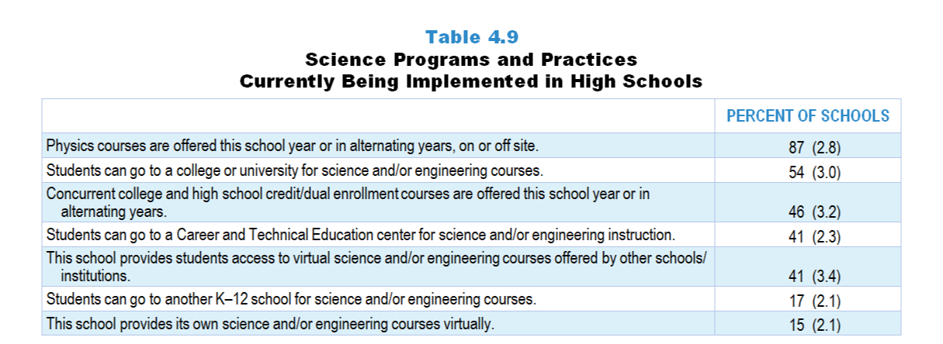
Original Data for Slide 30
(not for presentation)
Notes:
Table 4.9, p. 82 in Technical Report
This slide shows data from individual items.
Science Program Questionnaire
Q3. [Presented only to schools that include any grades 9–12]
Indicate whether each of the following programs and/or practices is currently being implemented in your school. [Select one on each row.] (Response Options: Yes, No)
Physics courses offered this school year or in alternating years, on or off site.
Students can go to a Career and Technical Education (CTE) Center for science and/or engineering instruction.
This school provides students access to virtual science and/or engineering courses offered by other schools/institutions (for example: online, videoconference).
This school provides its own science and/or engineering courses virtually (for example: online, videoconference).
Students can go to another K–12 school for science and/or engineering courses.
Students can go to a college or university for science and/or engineering courses.
Q9. Does your school offer each of the following types of science courses that might qualify for college credit? (Include both courses that are offered every year and those offered in alternating years.) [Select one on each row.] (Response Options: Yes, No)
Advanced Placement (AP) science courses
International Baccalaureate (IB) science courses
Concurrent college and high school credit/dual enrollment science courses
The numbers in parentheses are standard errors.
Findings Highlighted in Technical Report
“The survey asked high schools about opportunities provided to students to take science and engineering courses not offered on-site. As previously described, 82 percent of high schools offer at least one physics course; a small additional percentage of schools provide students with access to physics either by offering it in alternative years or by allowing students to take the course off campus (see Table 4.9). Over half of high schools have students take science and/‌or engineering courses at a college/‌university, and almost half provide access to concurrent credit/‌dual enrollment courses—courses that count for high school and college credit. About 2 in 5 high schools allow students to take science and/‌or engineering courses at a Career and Technical Education center or virtually through other schools/‌institutions. Fewer than 1 in 5 high schools have students take science/‌engineering courses at another high school or provide their own science and/‌or engineering courses virtually.”

Slide 30
Science Programs and Practices Currently Being Implemented in High Schools

Slide 31
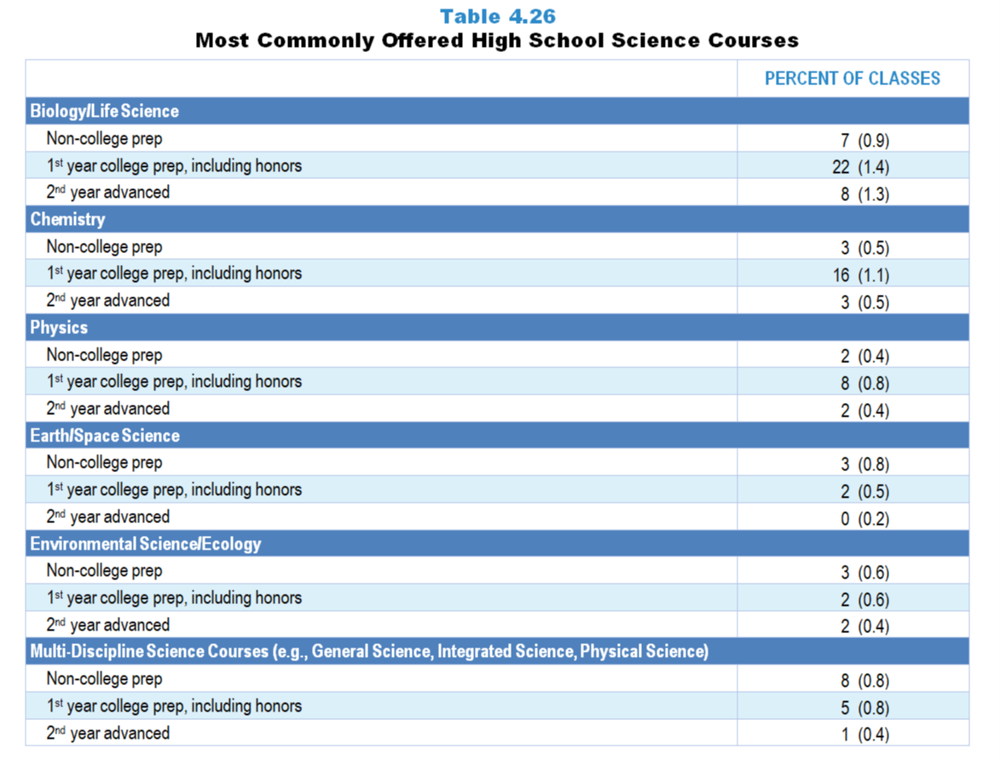
Original Data for Slides 32–33
(not for presentation)
Notes:
Table 4.26, p. 89 in Technical Report
This slide shows data derived from:
Science Teacher Questionnaire
Q9. [Presented to non-self-contained teachers only]
For each science class you teach, select the course type and enter the number of students enrolled. Enter the classes in the order that you teach them. For teachers on an alternating day block schedule, please order your classes starting with the first class you teach this week.
Course Type List
Science (Grades K–5)
Life Science (Grades 6–8)
Earth Science (Grades 6–8)
Physical Science (Grades 6–8)
General or Integrated Science (Grades 6–8)
Coordinated or Integrated Science including General Science and Physical Science (Grades 9–12)
Earth/Space Science (Grades 9–12)
Life Science/Biology (Grades 9–12)
Environmental Science/Ecology (Grades 9–12)
Chemistry (Grades 9–12)
Physics (Grades 9–12)
Q10. [Presented to non-self-contained grades 9–12 teachers only]
For each grades 9–12 science class you teach, select the level that best describes the content addressed in that class.
Non-college Prep: A course that does not count towards the entrance requirements of a 4-year college. For example: Life Science.
1st Year College Prep, Including Honors: The first course in a discipline that counts towards the entrance requirements of a 4-year college. For example: Biology, Chemistry I.
2nd Year Advanced: A course typically taken after a 1st year college prep course. For example: Anatomy and Physiology, Advanced Chemistry, Physics II. Include Advanced Placement, International Baccalaureate, and concurrent college and high school credit/dual enrollment.
The numbers in parentheses are standard errors.
Findings Highlighted in Technical Report
“In addition to gathering school-level information about course offerings, the survey asked each teacher for the course type of a randomly selected class, which allows for an estimate of the percentage of courses of each type in schools. As can be seen in Table 4.26, 1st year college prep biology accounts for 22 percent of high school science classes; 16 percent of the classes are 1st year chemistry, and 8 percent are 1st year physics.”

Slide 32
Most Commonly Offered 1st Year College Prep High School Science Courses
Notes:
Note: Each chart is sorted independently; consequently items may appear in different orders.

Slide 33
Most Commonly Offered 2nd Year Advanced High School Science Courses
Notes:
Note: Each chart is sorted independently; consequently items may appear in different orders.

Slide 34
Other Characteristics
of Science Classes

Slide 35
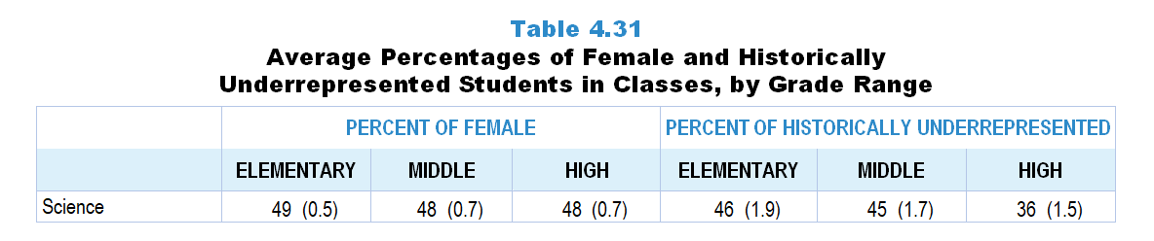
Original Data for Slide 36
(not for presentation)
Notes:
The science portion of Table 4.31, p. 93 in Technical Report
This slide shows data from an individual item.
Science Teacher Questionnaire
Q42. For the students in this class, indicate the number of males and females in this class in each of the following categories of race/ethnicity.
American Indian or Alaskan Native _____ _____
Asian _____ _____
Black or African American _____ _____
Hispanic/Latino _____ _____
Native Hawaiian or Other Pacific Islander _____ _____
White _____ _____
Two or more races _____ _____
The numbers in parentheses are standard errors.
Findings Highlighted in Technical Report
“Table 4.31 shows the percentages of female students and students from race/‌ethnicity groups historically underrepresented in STEM in classes in the different grade bands. Elementary and middle school data mirror those of students in the nation, as students typically are required to take science and mathematics at each grade level. In high school, where students are generally not required to take each subject every year, the data show that historically underrepresented students are less likely to take science and mathematics classes. In high school computer science classes, only about a quarter of students are female or from a historically underrepresented race/‌ethnicity group.”

Slide 36
Average Percentages of Female and Historically Underrepresented Students in Classes

Slide 37
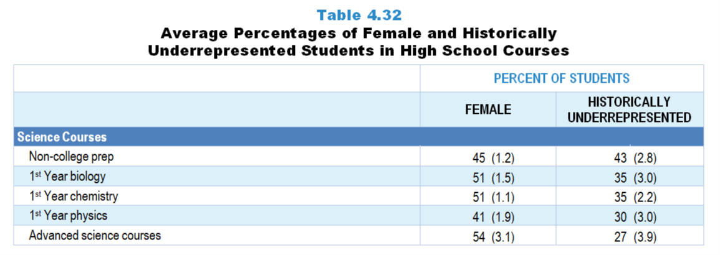
Original Data for Slides 38–39
(not for presentation)
Notes:
The science portion of Table 4.32, p. 94 in Technical Report
This slide shows data derived from:
Science Teacher Questionnaire
Q8. [Presented to non-self-contained teachers only] For each science class you teach, select the course type and enter the number of students enrolled. Enter the classes in the order that you teach them. For teachers on an alternating day block schedule, please order your classes starting with the first class you teach this week.
Course Type List
Science (Grades K–5)
Life Science (Grades 6–8)
Earth Science (Grades 6–8)
Physical Science (Grades 6–8)
General or Integrated Science (Grades 6–8)
Coordinated or Integrated Science including General Science and Physical Science (Grades 9–12)
Earth/Space Science (Grades 9–12)
Life Science/Biology (Grades 9–12)
Environmental Science/Ecology (Grades 9–12)
Chemistry (Grades 9–12)
Physics (Grades 9–12)
Q9. [Presented to non-self-contained grades 9–12 teachers only] For each grades 9–12 science class you teach, select the level that best describes the content addressed in that class.
Non-college Prep: A course that does not count towards the entrance requirements of a 4-year college. For example: Life Science.
1st Year College Prep, Including Honors: The first course in a discipline that counts towards the entrance requirements of a 4-year college. For example: Biology, Chemistry I.
2nd Year Advanced: A course typically taken after a 1st year college prep course. For example: Anatomy and Physiology, Advanced Chemistry, Physics II. Include Advanced Placement, International Baccalaureate, and concurrent college and high school credit/dual enrollment.
Q42. For the students in this class, indicate the number of males and females in this class in each of the following categories of race/ethnicity.
American Indian or Alaskan Native _____ _____
Asian _____ _____
Black or African American _____ _____
Hispanic/Latino _____ _____
Native Hawaiian or Other Pacific Islander _____ _____
White _____ _____
Two or more races _____ _____
The numbers in parentheses are standard errors.
Findings Highlighted in Technical Report
“A pattern of decreasing enrollment of students from race/‌ethnicity groups historically underrepresented in STEM is seen in the class composition data across the progression of high school science and mathematics courses (see Table 4.32). For example, students from these groups make up 43 percent of students in non-college prep science classes and 35 percent of students in 1st year biology classes, compared to only 27 percent in advanced science classes. In mathematics, 38 percent of students in formal/college prep level 1 classes are from race/‌ethnicity groups historically underrepresented in STEM, compared to only 22 percent of students in classes that might qualify for college credit. In computer science, students from these groups make up 30 percent of students in introductory classes and 23 percent of students in courses that might qualify for college credit. In terms of gender, high school science and mathematics courses tend to have classes that are evenly split between male and female students on average. Exceptions are non-college prep science and mathematics classes and 1st year physics classes, which have smaller percentages of female students.”

Slide 38
Average Percentage of Female Students in High School Science Courses

Slide 39
Average Percentage of Historically Underrepresented Students in High School Science Courses
Notes:
Historically Underrepresented Students includes American Indian or Alaskan Native, Black or African American, Hispanic or Latino, or Native Hawaiian or Other Pacific Islander students.

Slide 40
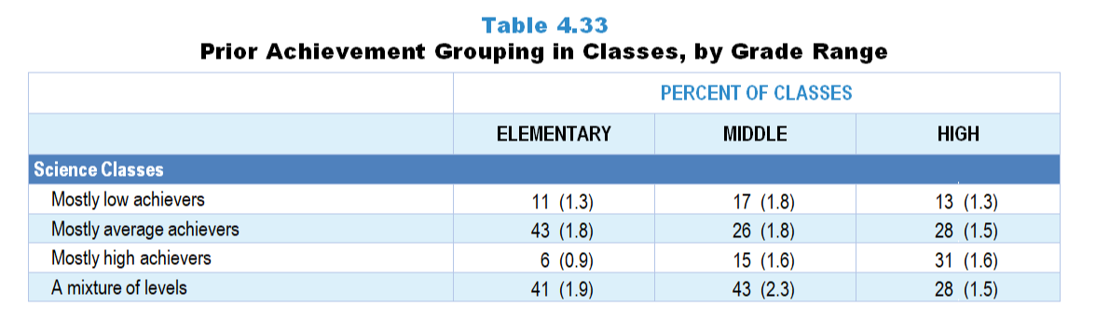
Original Data for Slide 41
(not for presentation)
Notes:
The science portion of Table 4.33, p. 95 in Technical Report
This slide shows data from an individual item.
Science Teacher Questionnaire
Q43. Which of the following best describes the prior science achievement levels of the students in this class relative to other students in this school?
Mostly low achievers
Mostly average achievers
Mostly high achievers
A mixture of levels
The numbers in parentheses are standard errors.
Findings Highlighted in Technical Report
“Teachers were asked to indicate the prior achievement level of students in the selected class relative to other students in the school. At the elementary level, 41 percent of science and 51 percent of mathematics classes are heterogeneous in terms of prior achievement; most of the remaining classes are composed primarily of average-achieving students (see Table 4.33). Heterogeneous grouping is less common in middle school mathematics and in high school science and mathematics. However, 41 percent of high school computer science classes include students with a mixture of prior achievement levels. In contrast to science and mathematics, almost no computer science classes are composed of mostly low prior achievers.”

Slide 41
Prior Achievement Grouping in Science Classes

Slide 42
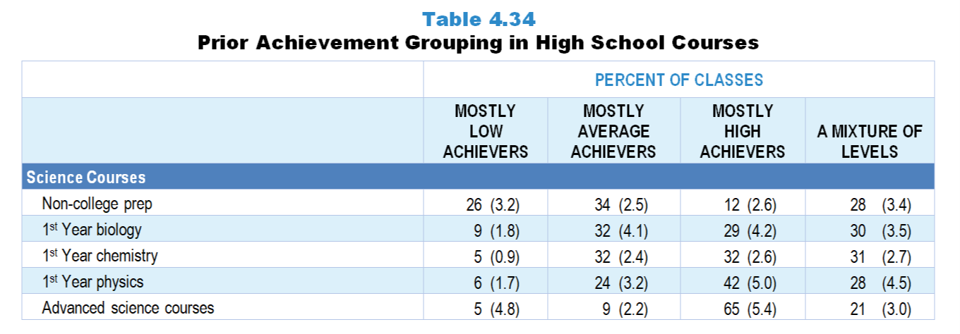
Original Data for Slide 43
(not for presentation)
Notes:
The science portion of Table 4.34, p. 96 in Technical Report
This slide shows data from an individual item.
Science Teacher Questionnaire
Q43. Which of the following best describes the prior science achievement levels of the students in this class relative to other students in this school?
Mostly low achievers
Mostly average achievers
Mostly high achievers
A mixture of levels
The numbers in parentheses are standard errors.
Findings Highlighted in Technical Report
“The percentage of science classes composed mostly of high prior achievers tends to increase across the traditional course sequence; for example, about 30 percent of 1st year biology and chemistry classes consist mostly of high prior achievers, compared to 42 percent of 1st year physics classes and 65 percent of advanced science classes (see Table 4.34). A similar trend occurs in mathematics, where few level 1, a quarter of level 2 and level 3, half of level 4, and a large majority of classes that might qualify for college credit are composed of mostly high prior achievers. In computer science, 24 percent of introductory computer science classes, 41 percent of specialized/‌elective classes, and 49 percent of classes that might qualify for college credit consist of mostly high prior achievers.”

Slide 43
Prior Achievement Grouping in High School Science Classes

Slide 44
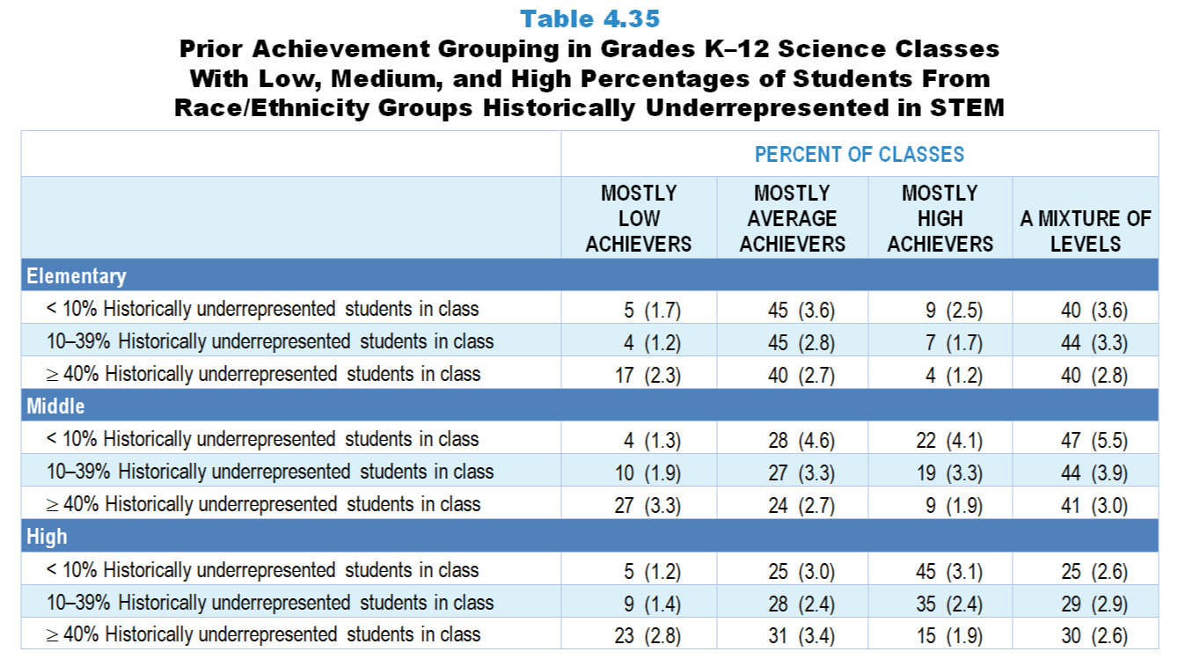
Original Data for Slides 45–47
(not for presentation)
Notes:
The science portion of Table 4.35, p. 97 in Technical Report
This slide shows data from an individual item.
Science Teacher Questionnaire
Q43. Which of the following best describes the prior science achievement levels of the students in this class relative to other students in this school?
Mostly low achievers
Mostly average achievers
Mostly high achievers
A mixture of levels
The numbers in parentheses are standard errors.
Findings Highlighted in Technical Report
“Prior achievement grouping also varies by the percentage of students from race/‌ethnicity groups historically underrepresented in STEM in classes. Across all grade levels in both science (see Table 4.35) and mathematics (see Table 4.36), classes composed of 40 percent or more of students from race/‌ethnicity groups historically underrepresented in STEM are more likely to be classified as consisting of mostly low prior achievers than classes with smaller proportions of students from these groups. For example, 32 percent of high school mathematics classes with a high percentage of students from race/‌ethnicity groups historically underrepresented in STEM are classified as being composed mostly of low prior achievers, compared to 16 percent of classes with a low percentage of students from these groups. In high school computer science, classes composed of fewer than 10 percent of students from these groups are more likely to be classified as consisting of mostly high prior achievers than classes in which 40 percent or more of students are from these groups (see Table 4.37).”

Slide 45
Prior Achievement Grouping in Elementary Science Classes

Slide 46
Prior Achievement Grouping in Middle School Science Classes

Slide 47
Prior Achievement Grouping in High School Science Classes

