Slide 1
Chapter 5 Instructional Decision-Making, Objectives, and Activities
Computer Science

Slide 2
Teachers’ Perceptions of Their Decision-Making Autonomy

Slide 3
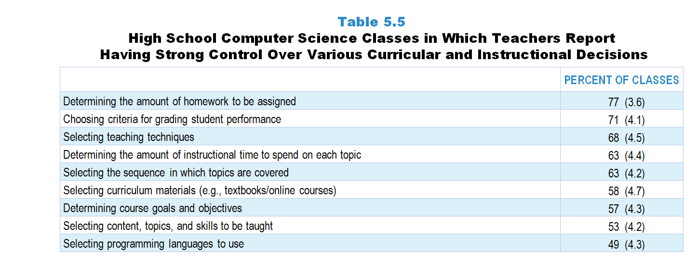
Original Data for Slide 4
(not for presentation)
Notes:
Table 5.5, p. 103 in Technical Report
This slide shows data from an individual item.
Computer Science Teacher Questionnaire
Q28. How much control do you have over each of the following for computer science instruction in this class? [Select one on each row.]
(Response Options: [1] No control, [2] 2 of 5, [3] Moderate control, [4] 4 of 5, [5] Strong control)
Determining course goals and objectives
Selecting curriculum materials (for example: textbooks/online courses)
Selecting content, topics, and skills to be taught
Selecting programming languages to use
Selecting the sequence in which topics are covered
Determining the amount of instructional time to spend on each topic
Selecting teaching techniques
Determining the amount of homework to be assigned
Choosing criteria for grading student performance
The numbers in parentheses are standard errors.
Findings Highlighted in Technical Report
“In high school computer science classes, teachers also tend to report more control over instruction than curriculum, but in general report having more control over curriculum than their science and mathematics counterparts (see Table 5.5). In very few classes, perhaps because of the largely elective nature of computer science, do teachers feel like they have no control over these decisions (see Table 5.6).

Slide 4
High School Computer Science Classes in Which Teachers Report Having Strong Control Over Various Decisions
Notes:
Includes classes for which the teacher selected “strong control” on a 5-point response scale with the options of “no control,” “2 of 5,” “moderate control,” “4 of 5,” and “strong control.”

Slide 5
Original Data for Slide 6
(not for presentation)
Notes:
The computer science portion of Table 5.7, p. 105 in Technical Report
This slide shows data from composites.
Sets of related questionnaire items were combined to create several composite variables related to key constructs. Composite variables, which are more reliable than individual survey items, were computed to have a minimum possible value of 0 and a maximum possible value of 100. Higher composite scores indicate more of the construct being measured by the composite. Each composite is calculated by summing the responses to the items associated with that composite and then dividing by the total points possible. In order for the composites to be on a 100-point scale, the lowest response option on each scale was set to 0 and the others were adjusted accordingly; so for example, an item with a scale ranging from 1 to 4 was re-coded to have a scale of 0 to 3. By doing this, someone who marks the lowest point on every item in a composite receives a composite score of 0 rather than some positive number. It also assures that 50 is the true mid-point. The denominator for each composite is determined by computing the maximum possible sum of responses for a series of items and dividing by 100; e.g., a 9-item composite where each item is on a scale of 0–3 would have a denominator of 0.27. Composite values were not computed for participants who responded to fewer than two-thirds of the items that form the composite.
Curriculum Control Composite Items
Q28a. Determining course goals and objectives
Q28b. Selecting curriculum materials (for example: textbooks/online courses)
Q28c. Selecting content, topics, and skills to be taught
Q28d. Selecting programming languages to use
Q28e. Selecting the sequence in which topics are covered
Pedagogy Control Composite Items
Q28g. Selecting teaching techniques
Q28h. Determining the amount of homework to be assigned
Q28i. Choosing criteria for grading student performance
Computer Science Teacher Questionnaire
Q28. How much control do you have over each of the following for computer science instruction in this class? [Select one on each row.]
(Response Options: [1] No control, [2] 2 of 5, [3] Moderate control, [4] 4 of 5, [5] Strong control)
Determining course goals and objectives
Selecting curriculum materials (for example: textbooks/online courses)
Selecting content, topics, and skills to be taught
Selecting programming languages to use
Selecting the sequence in which topics are covered
Determining the amount of instructional time to spend on each topic
Selecting teaching techniques
Determining the amount of homework to be assigned
Choosing criteria for grading student performance
The numbers in parentheses are standard errors.
Findings Highlighted in Technical Report
“Table 5.7 displays the mean scores on these composite. These scores indicate that teachers perceive more control over decisions related to pedagogy than curriculum, especially in science and mathematics classes. They also show that perceived control for both composite variables is greater in secondary science and mathematics classes than in elementary classes.”

Slide 6
High School Computer Science Class Mean Scores for Curriculum and Pedagogy Control Composites

Slide 7
Instructional Objectives

Slide 8
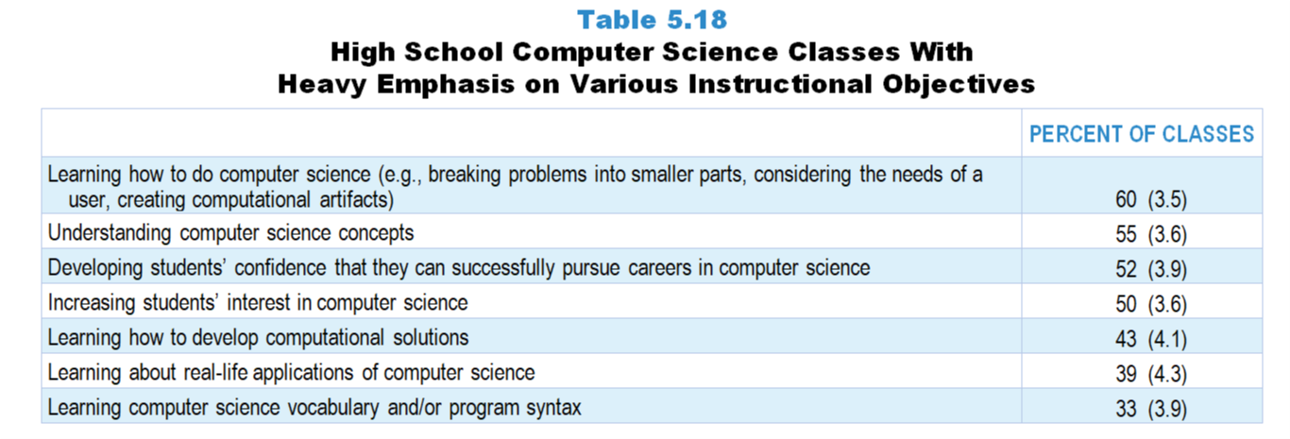
Original Data for Slide 9
(not for presentation)
Notes:
Table 5.18, p. 109 in Technical Report
This slide shows data from an individual item.
Computer Science Teacher Questionnaire
Q29. Think about your plans for this class for the entire course/year. By the end of the course/year, how much emphasis will each of the following student objectives receive? [Select one on each row.] (Response Options: [1] None, [2] Minimal emphasis, [3] Moderate emphasis, [4] Heavy emphasis)
Learning computer science vocabulary and/or program syntax
Understanding computer science concepts
Learning how to do computer science (for example: breaking problems into smaller parts, considering the needs of a user, creating computational artifacts)
Learning how to develop computational solutions
Learning about real-life applications of computer science
Increasing students’ interest in computer science
Developing students’ confidence that they can successfully pursue careers in computer science
The numbers in parentheses are standard errors.
Findings Highlighted in Technical Report
“In high school computer science classes, learning how to do computer science, understanding computer science concepts, developing students’ confidence that they can successfully pursue computer science careers, and increasing student interest receive a heavy emphasis in a majority of classes (see Table 5.18). Learning vocabulary and/‌or the syntax of a particular language receives a heavy emphasis in only a third of classes.”

Slide 9
High School Computer Science Classes With Heavy Emphasis on Various Instructional Objectives
Notes:
Includes classes for which the teacher selected “heavy emphasis” on a 4-point response scale with the options of “none,” “minimal emphasis,” “moderate emphasis,” and “heavy emphasis.”

Slide 10
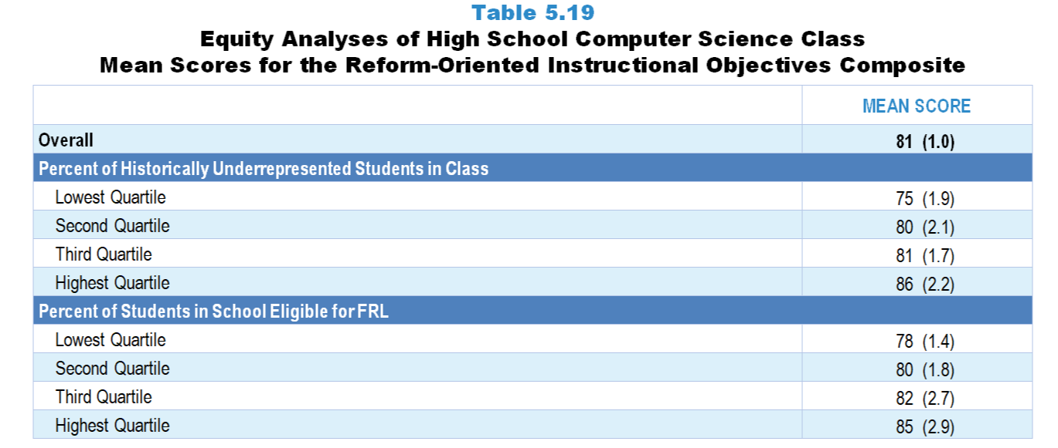
Original Data for Slides 11–13
(not for presentation)
Notes:
Table 5.19, p. 112 in Technical Report
This slide shows data from Composites.
Sets of related questionnaire items were combined to create several composite variables related to key constructs. Composite variables, which are more reliable than individual survey items, were computed to have a minimum possible value of 0 and a maximum possible value of 100. Higher composite scores indicate more of the construct being measured by the composite. Each composite is calculated by summing the responses to the items associated with that composite and then dividing by the total points possible. In order for the composites to be on a 100-point scale, the lowest response option on each scale was set to 0 and the others were adjusted accordingly; so for example, an item with a scale ranging from 1 to 4 was re-coded to have a scale of 0 to 3. By doing this, someone who marks the lowest point on every item in a composite receives a composite score of 0 rather than some positive number. It also assures that 50 is the true mid-point. The denominator for each composite is determined by computing the maximum possible sum of responses for a series of items and dividing by 100; e.g., a 9-item composite where each item is on a scale of 0–3 would have a denominator of 0.27. Composite values were not computed for participants who responded to fewer than two-thirds of the items that form the composite.
Reform-Oriented Instructional Objectives Composite Items
Q29b. Understanding computer science concepts
Q29c. Learning how to do computer science (for example: breaking problems into smaller parts, considering the needs of a user, creating computational artifacts)
Q29d. Learning how to develop computational solutions
Q29e. Learning about real-life applications of computer science
Q29f. Increasing students’ interest in computer science
Q28g. Developing students’ confidence that they can successfully pursue careers in computer science
Computer Science Teacher Questionnaire
Q26. For the students in this class, indicate the number of males and females in this class in each of the following categories of race/ethnicity.
American Indian or Alaskan Native _____ _____
Asian _____ _____
Black or African American _____ _____
Hispanic/Latino _____ _____
Native Hawaiian or Other Pacific Islander _____ _____
White _____ _____
Two or more races _____ _____
Q29. Think about your plans for this class for the entire course/year. By the end of the course/year, how much emphasis will each of the following student objectives receive? [Select one on each row.] (Response Options: [1] None, [2] Minimal emphasis, [3] Moderate emphasis, [4] Heavy emphasis)
Learning computer science vocabulary and/or program syntax
Understanding computer science concepts
Learning how to do computer science (for example: breaking problems into smaller parts, considering the needs of a user, creating computational artifacts)
Learning how to develop computational solutions
Learning about real-life applications of computer science
Increasing students’ interest in computer science
Developing students’ confidence that they can successfully pursue careers in computer science
The numbers in parentheses are standard errors.
Chapters 2–7 in the technical report provide data on several key indicators, disaggregated by one or more equity factors: the prior achievement level of students in the class, the percentage of students from race/ethnicity groups historically underrepresented in STEM in the class, the percentage of students in the school eligible for free/reduced-price lunch (FRL), school size, community type, and region. For FRL, each school was classified into one of four categories (defined as quartiles) based on the proportion of students eligible for FRL. Similarly, each randomly selected class was classified into one of the four categories based on the proportion of students from race/ethnicity groups historically underrepresented in STEM in the class.
Findings Highlighted in Technical Report
“Table 5.19 shows scores on the reform-oriented instructional objectives composite for high school computer science classes overall and by two equity factors. Interestingly, classes with a higher proportion of students from race/‌ethnicity groups historically underrepresented in STEM fields are more likely to emphasize reform-oriented objectives, as are classes in schools with a higher proportion of students eligible for free/‌reduced-price lunch.”

Slide 11
Reform-Oriented Instructional Objectives Composite

Slide 12
Reform-Oriented Instructional Objectives Composite
Notes:
Historically Underrepresented Students includes American Indian or Alaskan Native, Black or African American, Hispanic or Latino, or Native Hawaiian or Other Pacific Islander students.

Slide 13
Reform-Oriented Instructional Objectives Composite

Slide 14
Class Activities

Slide 15
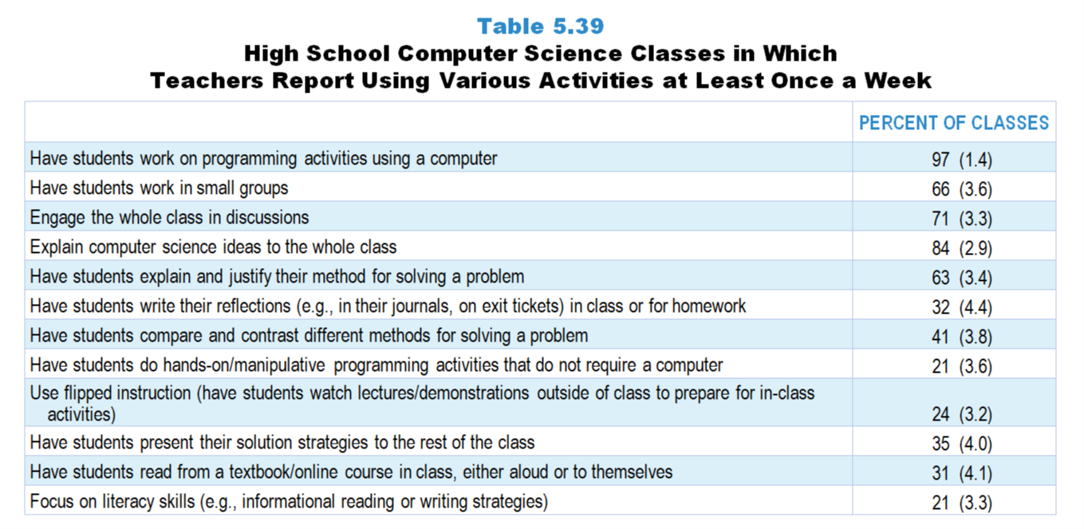
Original Data for Slides 16–17
(not for presentation)
Notes:
Table 5.39 p. 125 in Technical Report
This slide shows data from an individual item.
Computer Science Teacher Questionnaire
Q30. How often do you do each of the following in your computer science instruction in this class? [Select one on each row.] (Response Options: [1] Never, [2] Rarely (for example: A few times a year), [3] Sometimes (for example: Once or twice a month), [4] Often (for example: Once or twice a week), [5] All or almost all computer science lessons)
Explain computer science ideas to the whole class
Engage the whole class in discussions
Have students work in small groups
Have students do hands-on/manipulative programming activities that do not require a computer
Have students work on programming activities using a computer
Use flipped instruction (have students watch lectures/demonstrations outside of class to prepare for in-class activities)
Have students read from a textbook/online course in class, either aloud or to themselves
Have students explain and justify their method for solving a problem
Have students present their solution strategies to the rest of the class
Have students compare and contrast different methods for solving a problem
Have students write their reflections (for example: in their journals, on exit tickets) in class or for homework
Focus on literacy skills (for example: informational reading or writing strategies)
The numbers in parentheses are standard errors.
Findings Highlighted in Technical Report
“On a weekly basis, the same activities are the most common (see Table 5.39). For example, 97 percent of classes have students work on programming activities using a computer, 84 percent include lecture, 71 percent whole class discussions, and 66 percent small group work at least once a week. Although it does not occur daily in many classes, having students explain and justify their method for solving a problem occurs weekly in nearly two-thirds of high school computer science classes.”
Elementary and middle school science classes are much more likely than high school classes to include literacy activities at least once a week. For example, students read from a science textbook, module, or other material on a weekly basis in approximately 4 out of 10 elementary and middle grades classes, compared to a quarter of high school classes. Having students write reflections at least once a week is also more common in elementary and middle school classes than high school classes. In addition, 60 percent of elementary classes focus on literacy skills at least once a week, compared to only one-third of high school classes.”

Slide 16
High School Computer Science Classes Using Various Activities at Least Once a Week
Notes:
Includes classes for which the teacher selected “often (for example: once or twice a week)” or “all or almost all science lessons” on a 5-point response scale with the options of “never,” “rarely (for example: a few times a year),” “sometimes (for example: once or twice a month),” “often (for example: once or twice a week),” and “all or almost all science lessons.”

Slide 17
High School Computer Science Classes Using Various Activities at Least Once a Week
Notes:
Includes classes for which the teacher selected “often (for example: once or twice a week)” or “all or almost all science lessons” on a 5-point response scale with the options of “never,” “rarely (for example: a few times a year),” “sometimes (for example: once or twice a month),” “often (for example: once or twice a week),” and “all or almost all science lessons.”

Slide 18
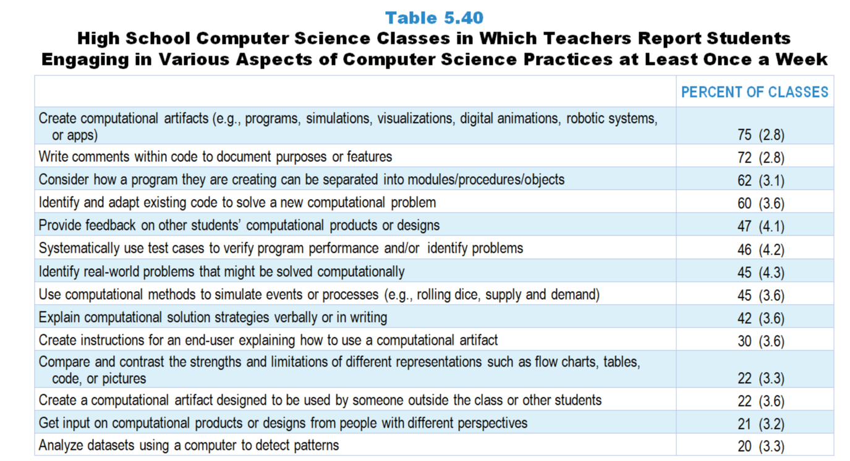
Original Data for Slides 19–21
(not for presentation)
Notes:
Table 5.40, p. 126 in Technical Report
This slide shows data from an individual item.
Computer Science Teacher Questionnaire
Q31. How often do you have students do each of the following in this class? [Select one on each row.] (Response Options: [1] Never, [2] Rarely (for example: A few times a year), [3] Sometimes (for example: Once or twice a month), [4] Often (for example: Once or twice a week), [5] All or almost all computer science lessons)
Create computational artifacts (for example: programs, simulations, visualizations, digital animations, robotic systems, or apps)
Create a computational artifact designed to be used by someone outside the class or other students
Provide feedback on other students’ computational products or designs
Get input on computational products or designs from people with different perspectives (do not include feedback that you give students)
Systematically use test cases to verify program performance and/or identify problems
Identify real-world problems that might be solved computationally
Consider how a program they are creating can be separated into modules/procedures/objects
Identify and adapt existing code to solve a new computational problem
Use computational methods to simulate events or processes (for example: rolling dice, supply and demand)
Analyze datasets using a computer to detect patterns
Write comments within code to document purposes or features
Create instructions for an end-user explaining how to use a computational artifact
Explain computational solution strategies verbally or in writing
Compare and contrast the strengths and limitations of different representations such as flow charts, tables, code, or pictures
The numbers in parentheses are standard errors.
Findings Highlighted in Technical Report
“Teachers were asked how often they engage students in the practices of computer science described in the Computer Science Teachers Association’s K–12 Computer Science Standards. These practices include developing and using abstractions, recognizing and defining computational problems, testing and refining computational artifacts, communicating about computing, and fostering an inclusive computing culture. As can be seen in Table 5.40, activities related to testing and refining computational artifacts occur most frequently. For example, creating computational artifacts, writing comments within code, considering how to break a program into modules/‌procedures/‌objects, and adapting existing code to a new problem occur weekly in 60 percent or more of classes. Aspects of computer science related to end users are less often emphasized. For example, only 30 percent of classes have students create instructions for an end-user explaining a computational artifact on a weekly basis. Similarly, fewer than a quarter of high school computer science classes have students create a computational artifact to be used by someone else or get input on computational products from people with different perspectives at least once a week. “

Slide 19
High School Computer Science Classes in Which Teachers Report Students Engaging in Various Aspects of Computer Science Practices at Least Once a Week
Notes:
Includes classes for which the teacher selected “often (for example: once or twice a week)” or “all or almost all science lessons” on a 5-point response scale with the options of “never,” “rarely (for example: a few times a year),” “sometimes (for example: once or twice a month),” “often (for example: once or twice a week),” and “all or almost all computer science lessons.

Slide 20
High School Computer Science Classes in Which Teachers Report Students Engaging in Various Aspects of Computer Science Practices at Least Once a Week
Notes:
Includes classes for which the teacher selected “often (for example: once or twice a week)” or “all or almost all science lessons” on a 5-point response scale with the options of “never,” “rarely (for example: a few times a year),” “sometimes (for example: once or twice a month),” “often (for example: once or twice a week),” and “all or almost all computer science lessons.

Slide 21
High School Computer Science Classes in Which Teachers Report Students Engaging in Various Aspects of Computer Science Practices at Least Once a Week
Notes:
Includes classes for which the teacher selected “often (for example: once or twice a week)” or “all or almost all science lessons” on a 5-point response scale with the options of “never,” “rarely (for example: a few times a year),” “sometimes (for example: once or twice a month),” “often (for example: once or twice a week),” and “all or almost all computer science lessons.

Slide 22
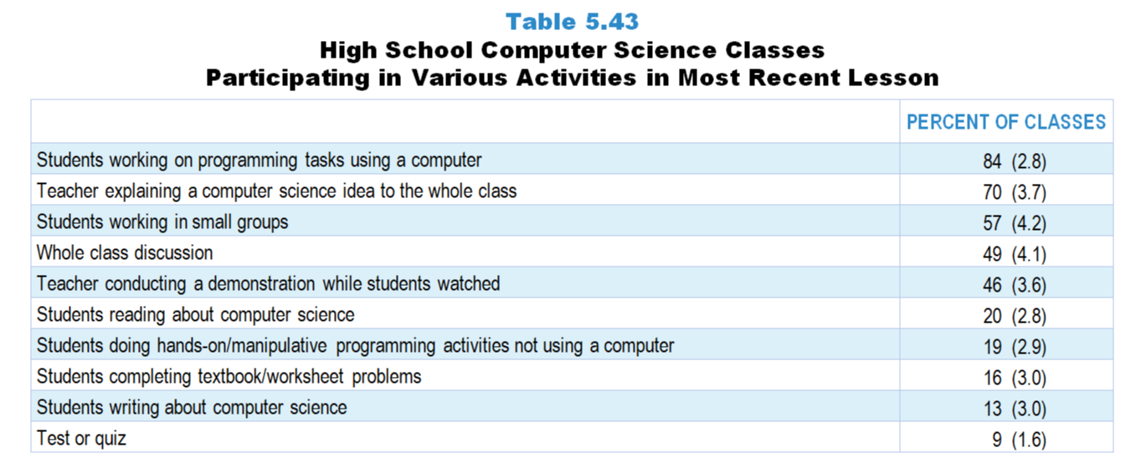
Original Data for Slide 23
(not for presentation)
Notes:
Table 5.43, p. 128 in Technical Report
This slide shows data from an individual item.
Computer Science Teacher Questionnaire
Q52. Which of the following activities took place during that day’s science lesson? [Select all that apply.]
Teacher explaining a computer science idea to the whole class
Teacher conducting a demonstration while students watched
Whole class discussion
Students working in small groups
Students completing textbook/worksheet problems
Students doing hands-on/manipulative programming activities not using a computer
Students reading about computer science
Students writing about computer science (do not include students taking notes)
Test or quiz
None of the above
The numbers in parentheses are standard errors.
Findings Highlighted in Technical Report
“High school computer science teachers were also asked which activities took place in their most recent lesson. As can be seen in Table 5.43, 84 percent of lessons include students working on programming tasks using a computer, and 70 percent include the teacher explaining ideas to the whole class. About half include small group work, whole class discussion, or students watching a demonstration.”

Slide 23
High School Computer Science Classes Participating in Various Activities in the Most Recent Lesson
Notes:
Note: Each grade-level chart is sorted independently; consequently items may appear in different orders.

Slide 24
Original Data for Slide 25
(not for presentation)
Notes:
Table 5.44, p. 128 in Technical Report
This slide shows data derived from:
Computer Science Teacher Questionnaire
Q50. How many minutes was that day’s computer science lesson? Answer for the entire length of the class period, even if there were interruptions. ____
Q51. Of these minutes, how many were spent on the following:
Non-instructional activities (for example: attendance taking, interruptions) ____
Whole class activities (for example: lectures, explanations, discussions) ____
Small group work ____
Students working individually (for example: reading textbooks, programming, taking a test or quiz) ____
The numbers in parentheses are standard errors.
Findings Highlighted in Technical Report
“On average, 40 percent of time in high school computer science classes is spent with students working individually (see Table 5.44). Whole class activities and small group work take up 29 and 22 percent of class time, respectively.”

Slide 25
Percentage of Time Spent on Different Activities in the Most Recent High School Computer Science Lesson

Slide 26
Homework and Assessment Practices

Slide 27
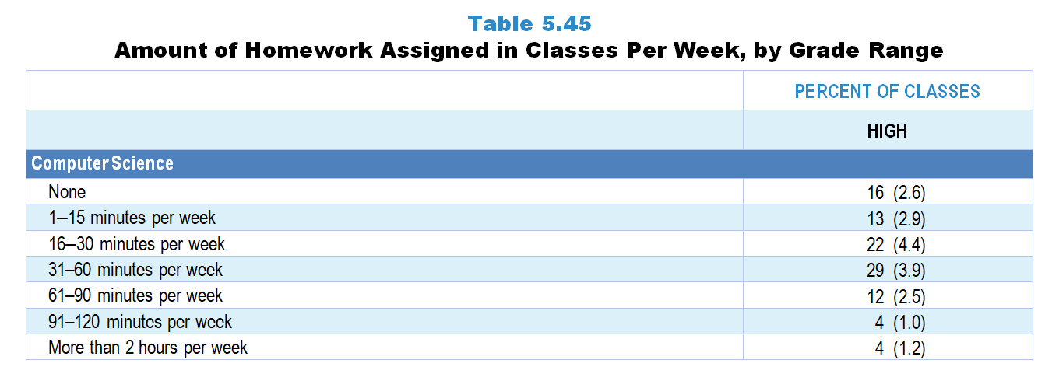
Original Data for Slide 28
(not for presentation)
Notes:
The computer science portion of Table 5.45, p. 129 in Technical Report
This slide shows data from an individual item.
Computer Science Teacher Questionnaire
Q34. In a typical week, how much time outside of this class are students expected to spend on computer science assignments?
None
1–15 minutes per week
16–30 minutes per week
31–60 minutes per week
61–90 minutes per week
91–120 minutes per week
More than 2 hours per week
The numbers in parentheses are standard errors.
Findings Highlighted in Technical Report
“Teachers were asked about the amount of homework assigned per week in the randomly selected class. Across the grade levels, students in mathematics classes are assigned more homework than students in science classes, particularly when looking at the percentage of classes assigned 31 minutes or more per week (see Table 5.45). This pattern is particularly evident in elementary classes, where students in 31 percent of classes are given 31–60 minutes of mathematics homework a week; only 8 percent of elementary classes are assigned this much science homework. Not surprisingly, the amount of time students are asked to spend on science and mathematics homework increases with grade range. For example, over half of high school mathematics classes are assigned one or more hours of homework per week, compared to under one-fifth of elementary classes. Homework expectations in high school computer science classes are similar to those in high school science classes.”

Slide 28
Amount of Homework Assigned in High School Computer Science Classes Per Week

