Slide 1
Chapter 5 Instruction Decision-Making, Objectives, and Activities
Mathematics

Slide 2
Teachers’ Perceptions of Their Decision-Making Autonomy

Slide 3
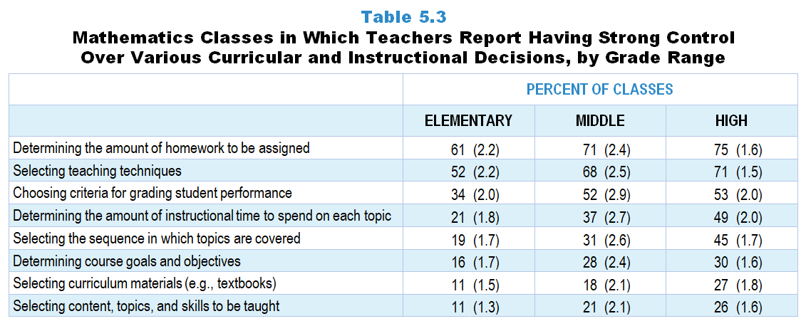
Original Data for Slides 4–6
(not for presentation)
Notes:
Table 5.3, p. 103 in Technical Report
This slide shows data from an individual item.
Mathematics Teacher Questionnaire
Q32. How much control do you have over each of the following for mathematics instruction in this class? [Select one on each row.](Response Options: [1] No control, [2] 2 of 5, [3] Moderate control, [4] 4 of 5, [5] Strong control)
Determining course goals and objectives
Selecting curriculum materials (for example: textbooks)
Selecting content, topics, and skills to be taught
Selecting the sequence in which topics are covered
Determining the amount of instructional time to spend on each topic
Selecting teaching techniques
Determining the amount of homework to be assigned
Choosing criteria for grading student performance
The numbers in parentheses are standard errors.
Findings Highlighted in Technical Report
“A similar pattern appears in mathematics classes (see Tables 5.3 and 5.4). In a majority of mathematics classes, teachers report having strong control over determining the amount of homework to assign (61–75 percent) and selecting teaching techniques (52–71 percent). In relatively few mathematics classes do teachers feel strong control over determining course goals and objectives (16–30 percent); selecting curriculum materials (11–27 percent); and selecting content, topics, and skills to be taught (11–26 percent). In general, teachers of secondary mathematics classes perceive greater control over curriculum and instruction decisions than teachers of elementary mathematics. Further, in a sizeable proportion of classes at each grade band, teachers report having no control over curriculum decisions.”

Slide 4
Elementary Mathematics Classes in Which Teachers Report Having Strong Control Over Various Decisions
Notes:
Includes classes for which the teacher selected “strong control” on a 5-point response scale with the options of “no control,” “2 of 5,” “moderate control,” “4 of 5,” and “strong control.”
Note: Each grade-level chart is sorted independently; consequently items may appear in different orders.

Slide 5
Middle School Mathematics Classes in Which Teachers Report Having Strong Control Over Various Decisions
Notes:
Includes classes for which the teacher selected “strong control” on a 5-point response scale with the options of “no control,” “2 of 5,” “moderate control,” “4 of 5,” and “strong control.”
Note: Each grade-level chart is sorted independently; consequently items may appear in different orders.

Slide 6
High School Mathematics Classes in Which Teachers Report Having Strong Control Over Various Decisions
Notes:
Includes classes for which the teacher selected “strong control” on a 5-point response scale with the options of “no control,” “2 of 5,” “moderate control,” “4 of 5,” and “strong control.”
Note: Each grade-level chart is sorted independently; consequently items may appear in different orders.

Slide 7
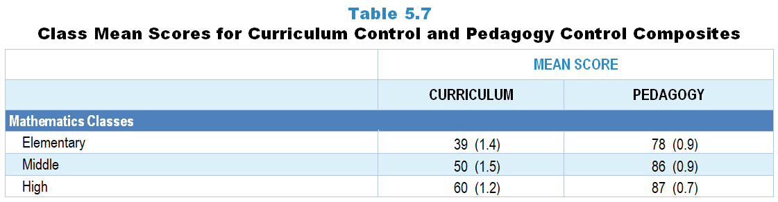
Original Data for Slide 8
(not for presentation)
Notes:
The mathematics portion of Table 5.7, p. 105 in Technical Report
This slide shows data from Composites.
Sets of related questionnaire items were combined to create several composite variables related to key constructs. Composite variables, which are more reliable than individual survey items, were computed to have a minimum possible value of 0 and a maximum possible value of 100. Higher composite scores indicate more of the construct being measured by the composite. Each composite is calculated by summing the responses to the items associated with that composite and then dividing by the total points possible. In order for the composites to be on a 100-point scale, the lowest response option on each scale was set to 0 and the others were adjusted accordingly; so for example, an item with a scale ranging from 1 to 4 was re-coded to have a scale of 0 to 3. By doing this, someone who marks the lowest point on every item in a composite receives a composite score of 0 rather than some positive number. It also assures that 50 is the true mid-point. The denominator for each composite is determined by computing the maximum possible sum of responses for a series of items and dividing by 100; e.g., a 9-item composite where each item is on a scale of 0–3 would have a denominator of 0.27. Composite values were not computed for participants who responded to fewer than two-thirds of the items that form the composite.
Curriculum Control Composite Items
Q32a. Determining course goals and objectives
Q32b. Selecting curriculum materials (for example: textbooks)
Q32c. Selecting content, topics, and skills to be taught
Q32d. Selecting the sequence in which topics are covered
Pedagogical Control Composite Items
Q32e. Selecting teaching techniques
Q32f. Determining the amount of homework to be assigned
Q32g. Choosing criteria for grading student performance
Mathematics Teacher Questionnaire
Q32. How much control do you have over each of the following for mathematics instruction in this class? [Select one on each row.](Response Options: [1] No control, [2] 2 of 5, [3] Moderate control, [4] 4 of 5, [5] Strong control)
Determining course goals and objectives
Selecting curriculum materials (for example: textbooks)
Selecting content, topics, and skills to be taught
Selecting the sequence in which topics are covered
Determining the amount of instructional time to spend on each topic
Selecting teaching techniques
Determining the amount of homework to be assigned
Choosing criteria for grading student performance
The numbers in parentheses are standard errors.
Findings Highlighted in Technical Report
“Table 5.7 displays the mean scores on these composite. These scores indicate that teachers perceive more control over decisions related to pedagogy than curriculum, especially in science and mathematics classes. They also show that perceived control for both composite variables is greater in secondary science and mathematics classes than in elementary classes.”

Slide 8
Curriculum and Pedagogy Control Composites

Slide 9
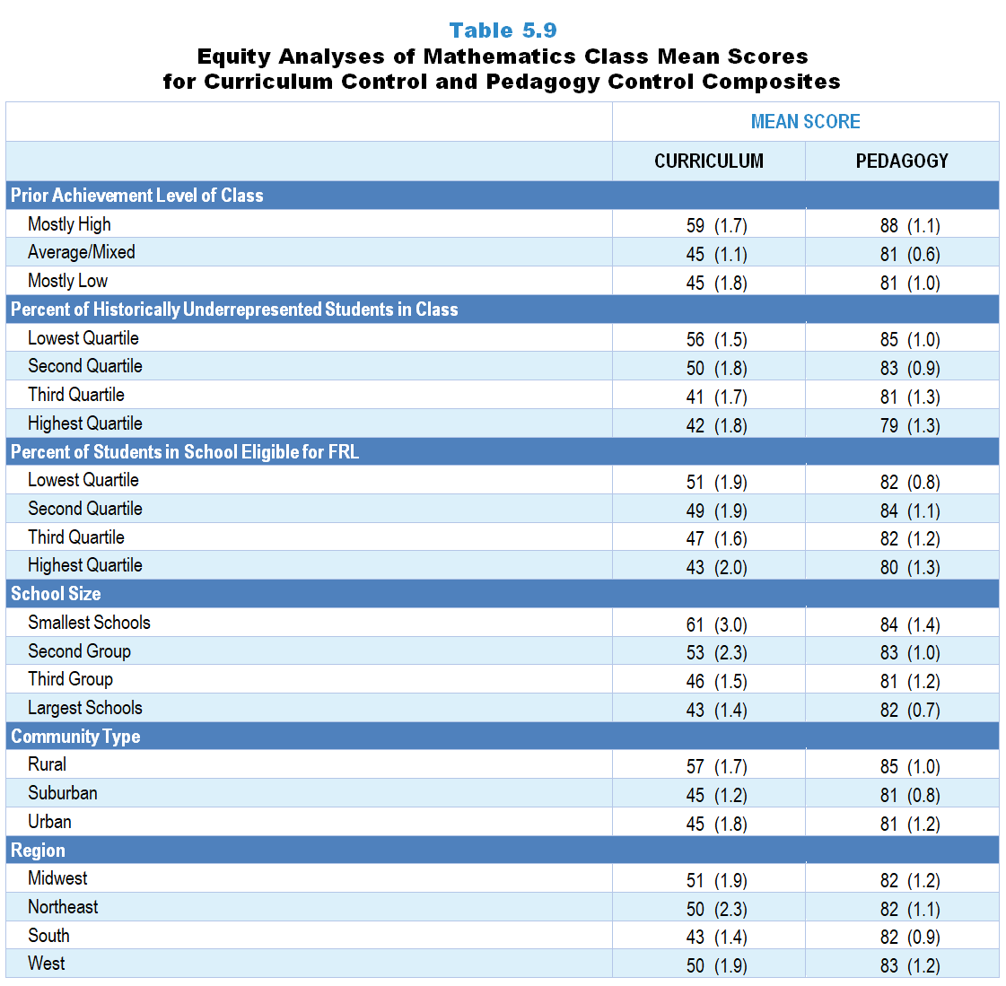
Original Data for Slides 10–13
(not for presentation)
Notes:
The mathematics portion of Table 5.9, p. 107 in Technical Report
This slide shows data from Composites.
Sets of related questionnaire items were combined to create several composite variables related to key constructs. Composite variables, which are more reliable than individual survey items, were computed to have a minimum possible value of 0 and a maximum possible value of 100. Higher composite scores indicate more of the construct being measured by the composite. Each composite is calculated by summing the responses to the items associated with that composite and then dividing by the total points possible. In order for the composites to be on a 100-point scale, the lowest response option on each scale was set to 0 and the others were adjusted accordingly; so for example, an item with a scale ranging from 1 to 4 was re-coded to have a scale of 0 to 3. By doing this, someone who marks the lowest point on every item in a composite receives a composite score of 0 rather than some positive number. It also assures that 50 is the true mid-point. The denominator for each composite is determined by computing the maximum possible sum of responses for a series of items and dividing by 100; e.g., a 9-item composite where each item is on a scale of 0–3 would have a denominator of 0.27. Composite values were not computed for participants who responded to fewer than two-thirds of the items that form the composite.
Curriculum Control Composite Items
Q32a. Determining course goals and objectives
Q32b. Selecting curriculum materials (for example: textbooks)
Q32c. Selecting content, topics, and skills to be taught
Q32d. Selecting the sequence in which topics are covered
Pedagogical Control Composite Items
Q32e. Selecting teaching techniques
Q32f. Determining the amount of homework to be assigned
Q32g. Choosing criteria for grading student performance
Mathematics Teacher Questionnaire
Q30. For the number of students in this class, indicate the number of males and females in each of the following categories of race/ethnicity.
American Indian or Alaskan Native _____ _____
Asian _____ _____
Black or African American _____ _____
Hispanic or Latino _____ _____
Native Hawaiian or Other Pacific Islander _____ _____
White _____ _____
Two or more races _____ _____
Q31. Which of the following best describes the prior mathematics achievement levels of the students in this class relative to other students in this school?
Mostly low achievers
Mostly average achievers
Mostly high achievers
A mixture of levels
Q32. How much control do you have over each of the following for mathematics instruction in this class? [Select one on each row.](Response Options: [1] No control, [2] 2 of 5, [3] Moderate control, [4] 4 of 5, [5] Strong control)
Determining course goals and objectives
Selecting curriculum materials (for example: textbooks)
Selecting content, topics, and skills to be taught
Selecting the sequence in which topics are covered
Determining the amount of instructional time to spend on each topic
Selecting teaching techniques
Determining the amount of homework to be assigned
Choosing criteria for grading student performance
The numbers in parentheses are standard errors.
Chapters 2–7 in the technical report provide data on several key indicators, disaggregated by one or more equity factors: the prior achievement level of students in the class, the percentage of students from race/ethnicity groups historically underrepresented in STEM in the class, the percentage of students in the school eligible for free/reduced-price lunch (FRL), school size, community type, and region. For FRL, each school was classified into one of four categories (defined as quartiles) based on the proportion of students eligible for FRL. Similarly, each randomly selected class was classified into one of the four categories based on the proportion of students from race/ethnicity groups historically underrepresented in STEM in the class.
Findings Highlighted in Technical Report
“When looking at the composite scores by equity factors, a number of differences are apparent by both class and school factors. For example, teachers of science classes composed mostly of low prior achievers report having less control over both curriculum and pedagogy than teachers of classes containing mostly high prior achievers (see Table 5.8). A similar pattern exists in terms of race/‌ethnicity composition—teachers of classes serving a high proportion of students from race/‌ethnicity groups historically underrepresented in STEM report lower instructional control than teachers of classes with relatively few students from these groups. Teachers of classes in higher-poverty schools and in large schools tend to report less control than their counterparts in low-poverty and small schools.
Similar patterns are evident in mathematics classes, though differences tend to be limited to curriculum control (see Table 5.9). Computer science results are shown in Table 5.10. Although there appear to be differences in curriculum control by school size and community type, they are not statistically significant.”

Slide 10
Curriculum Control and Pedagogy Control Composites, by Prior Achievement Level

Slide 11
Curriculum Control and Pedagogy Control Composites, by Percentage of Historically Underrepresented Students in Class
Notes:
Historically Underrepresented Students includes American Indian or Alaskan Native, Black or African American, Hispanic or Latino, or Native Hawaiian or Other Pacific Islander students.
Slide shows the composite scores by quartile of percent historically underrepresented students in the randomly selected class.

Slide 12
Curriculum Control and Pedagogy Control Composites
Notes:
Slide shows the composite scores by quartile of percent of students eligible for free or reduced-price lunch in the school.

Slide 13
Curriculum Control and Pedagogy Control Composites, by School Size

Slide 14
Instructional Objectives

Slide 15
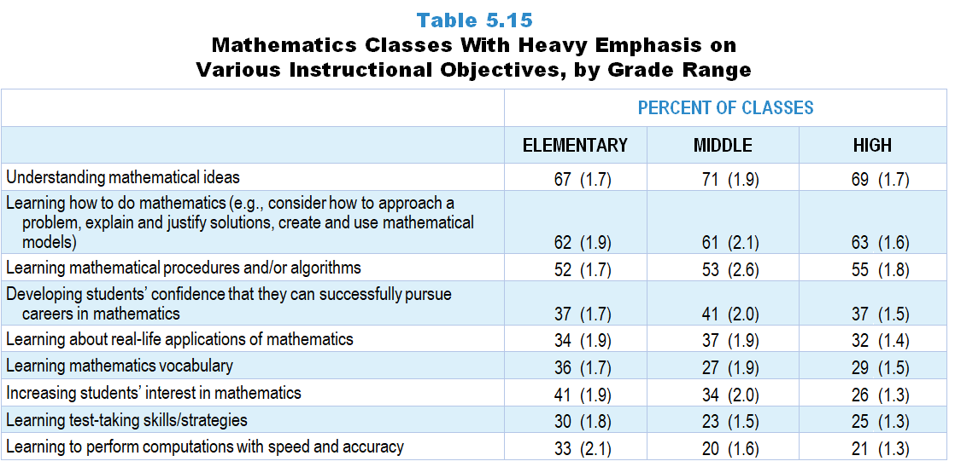
Original Data for Slides 16–21
(not for presentation)
Notes:
Table 5.15, p. 110 in Technical Report
This slide shows data from an individual item.
Mathematics Teacher Questionnaire
Q33. Think about your plans for this class for the entire course/year. By the end of the course/year, how much emphasis will each of the following student objectives receive? [Select one on each row.] (Response Options: [1] None, [2] Minimal emphasis, [3] Moderate emphasis, [4] Heavy emphasis)
Learning mathematics vocabulary
Learning mathematical procedures and/or algorithms
Learning to perform computations with speed and accuracy
Understanding mathematical ideas
Learning how to do mathematics (for example: consider how to approach a problem, explain and justify solutions, create and use mathematical models)
Learning about real-life applications of mathematics
Increasing students’ interest in mathematics
Developing students’ confidence that they can successfully pursue careers in mathematics
Learning test-taking skills/strategies
The numbers in parentheses are standard errors.
Findings Highlighted in Technical Report
“In mathematics, about 7 out of 10 elementary, middle, and high school mathematics classes focus heavily on having students understand mathematical ideas (see Table 5.15). Other objectives heavily emphasized by over half of classes across grade levels are learning how to do mathematics and learning mathematical procedures and/‌or algorithms.
The data also reveal two notable differences in emphasis by grade range. One is that 41 percent of elementary mathematics classes focus heavily on increasing students’ interest in mathematics, compared to 34 percent and 26 percent of middle and high school classes, respectively. The other is that learning to perform computations with speed and accuracy is more likely to be heavily emphasized in elementary classes than in middle and high school classes (33, 20, and 21 percent, respectively).”

Slide 16
Elementary Mathematics Classes With Heavy Emphasis on Various Instructional Objectives
Notes:
Includes classes for which the teacher selected “heavy emphasis” on a 4-point response scale with the options of “none,” “minimal emphasis,” “moderate emphasis,” and “heavy emphasis.”
Note: Each grade-level chart is sorted independently; consequently items may appear in different orders.

Slide 17
Elementary Mathematics Classes With Heavy Emphasis on Various Instructional Objectives

Slide 18
Middle School Mathematics Classes With Heavy Emphasis on Various Instructional Objectives
Notes:
Includes classes for which the teacher selected “heavy emphasis” on a 4-point response scale with the options of “none,” “minimal emphasis,” “moderate emphasis,” and “heavy emphasis.”
Note: Each grade-level chart is sorted independently; consequently items may appear in different orders.

Slide 19
Middle School Mathematics Classes With Heavy Emphasis on Various Instructional Objectives
Notes:
Includes classes for which the teacher selected “heavy emphasis” on a 4-point response scale with the options of “none,” “minimal emphasis,” “moderate emphasis,” and “heavy emphasis.”
Note: Each grade-level chart is sorted independently; consequently items may appear in different orders.

Slide 20
High School Mathematics Classes With Heavy Emphasis on Various Instructional Objectives
Notes:
Includes classes for which the teacher selected “heavy emphasis” on a 4-point response scale with the options of “none,” “minimal emphasis,” “moderate emphasis,” and “heavy emphasis.”
Note: Each grade-level chart is sorted independently; consequently items may appear in different orders.

Slide 21
High School Mathematics Classes With Heavy Emphasis on Various Instructional Objectives
Notes:
Includes classes for which the teacher selected “heavy emphasis” on a 4-point response scale with the options of “none,” “minimal emphasis,” “moderate emphasis,” and “heavy emphasis.”
Note: Each grade-level chart is sorted independently; consequently items may appear in different orders.

Slide 22
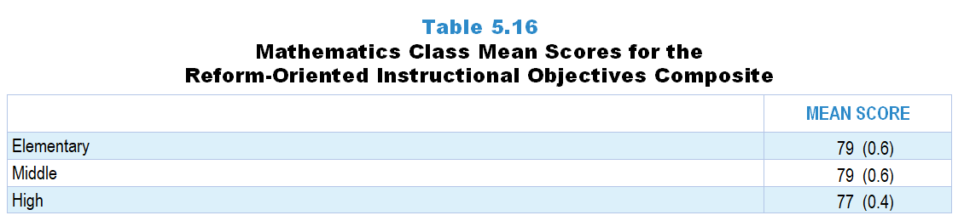
Original Data for Slide 23
(not for presentation)
Notes:
Table 5.16, p. 111 in Technical Report
This slide shows data from composites.
Sets of related questionnaire items were combined to create several composite variables related to key constructs. Composite variables, which are more reliable than individual survey items, were computed to have a minimum possible value of 0 and a maximum possible value of 100. Higher composite scores indicate more of the construct being measure by the composite. Each composite is calculated by summing the responses to the items associated with that composite and then dividing by the total points possible. In order for the composites to be on a 100-point scale, the lowest response option on each scale was set to 0 and the others were adjusted accordingly; so for example, an item with a scale ranging from 1 to 4 was re-coded to have a scale of 0 to 3. By doing this, someone who marks the lowest point on every item in a composite receives a composite score of 0 rather than some positive number. It also assures that 50 is the true mid-point. The denominator for each composite is determined by computing the maximum possible sum of responses for a series of items and dividing by 100; e.g., a 9-item composite where each item is on a scale of 0–3 would have a denominator of 0.27. Composites values were not computed for participants who respond to fewer than two-thirds of the items that form the composite.
Reform Oriented Instructional Objectives
Q33d. Understanding mathematical ideas
Q33e. Learning how to do mathematics (for example: consider how to approach a problem, explain and justify solutions, create and use mathematical models)
Q33f. Learning about real-life applications of mathematics
Q33g. Increasing students’ interest in mathematics
Q33h. Developing students’ confidence that they can successfully pursue careers in mathematics
Mathematics Teacher Questionnaire
Q33. Think about your plans for this class for the entire course/year. By the end of the course/year, how much emphasis will each of the following student objectives receive? [Select one on each row.] (Response Options: [1] None, [2] Minimal emphasis, [3] Moderate emphasis, [4] Heavy emphasis)
Learning mathematics vocabulary
Learning mathematical procedures and/or algorithms
Learning to perform computations with speed and accuracy
Understanding mathematical ideas
Learning how to do mathematics (for example: consider how to approach a problem, explain and justify solutions, create and use mathematical models)
Learning about real-life applications of mathematics
Increasing students’ interest in mathematics
Developing students’ confidence that they can successfully pursue careers in mathematics
Learning test-taking skills/strategies
The numbers in parentheses are standard errors.
Findings Highlighted in Technical Report
“Table 5.16 presents mean scores on the reform-oriented instructional objectives in mathematics composite by grade range. Mathematics classes are, on average, likely to emphasize reform-oriented instructional objectives at all grade levels—more so than science classes do.”

Slide 23
Reform-Oriented Instructional Objectives Composite

Slide 24
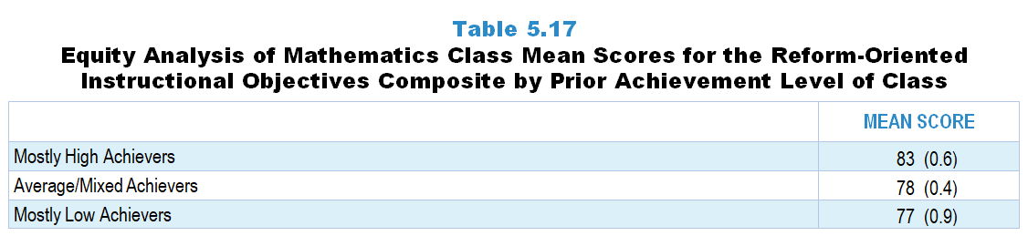
Original Data for Slide 25
(not for presentation)
Notes:
Table 5.17, p. 111 in Technical Report
This slide shows data from composites.
Sets of related questionnaire items were combined to create several composite variables related to key constructs. Composite variables, which are more reliable than individual survey items, were computed to have a minimum possible value of 0 and a maximum possible value of 100. Higher composite scores indicate more of the construct being measure by the composite. Each composite is calculated by summing the responses to the items associated with that composite and then dividing by the total points possible. In order for the composites to be on a 100-point scale, the lowest response option on each scale was set to 0 and the others were adjusted accordingly; so for example, an item with a scale ranging from 1 to 4 was re-coded to have a scale of 0 to 3. By doing this, someone who marks the lowest point on every item in a composite receives a composite score of 0 rather than some positive number. It also assures that 50 is the true mid-point. The denominator for each composite is determined by computing the maximum possible sum of responses for a series of items and dividing by 100; e.g., a 9-item composite where each item is on a scale of 0–3 would have a denominator of 0.27. Composites values were not computed for participants who respond to fewer than two-thirds of the items that form the composite.
Reform Oriented Instructional Objectives
Q33d. Understanding mathematical ideas
Q33e. Learning how to do mathematics (for example: consider how to approach a problem, explain and justify solutions, create and use mathematical models)
Q33f. Learning about real-life applications of mathematics
Q33g. Increasing students’ interest in mathematics
Q33h. Developing students’ confidence that they can successfully pursue careers in mathematics
Mathematics Teacher Questionnaire
Q33. Think about your plans for this class for the entire course/year. By the end of the course/year, how much emphasis will each of the following student objectives receive? [Select one on each row.] (Response Options: [1] None, [2] Minimal emphasis, [3] Moderate emphasis, [4] Heavy emphasis)
Learning mathematics vocabulary
Learning mathematical procedures and/or algorithms
Learning to perform computations with speed and accuracy
Understanding mathematical ideas
Learning how to do mathematics (for example: consider how to approach a problem, explain and justify solutions, create and use mathematical models)
Learning about real-life applications of mathematics
Increasing students’ interest in mathematics
Developing students’ confidence that they can successfully pursue careers in mathematics
Learning test-taking skills/strategies
Q31. Which of the following best describes the prior mathematics achievement levels of the students in this class relative to other students in this school?
Mostly low achievers
Mostly average achievers
Mostly high achievers
A mixture of levels
Chapters 2–7 in the technical report provide data on several key indicators, disaggregated by one or more equity factors: the prior achievement level of students in the class, the percentage of students from race/ethnicity groups historically underrepresented in STEM in the class, the percentage of students in the school eligible for free/reduced-price lunch (FRL), school size, community type, and region. For FRL, each school was classified into one of four categories (defined as quartiles) based on the proportion of students eligible for FRL. Similarly, each randomly selected class was classified into one of the four categories based on the proportion of students from race/ethnicity groups historically underrepresented in STEM in the class.
The numbers in parentheses are standard errors.
Findings Highlighted in Technical Report
“Similar to science, there are differences in composite scores by the prior achievement level of the class in mathematics. Reform-oriented instructional objectives are more heavily emphasized in mathematics classes with mostly high-prior-achieving students than in classes with mostly average/‌mixed or low-prior-achieving students (see Table 5.17).”

Slide 25
Reform-Oriented Instructional Objectives Composite

Slide 26
Class Activities

Slide 27
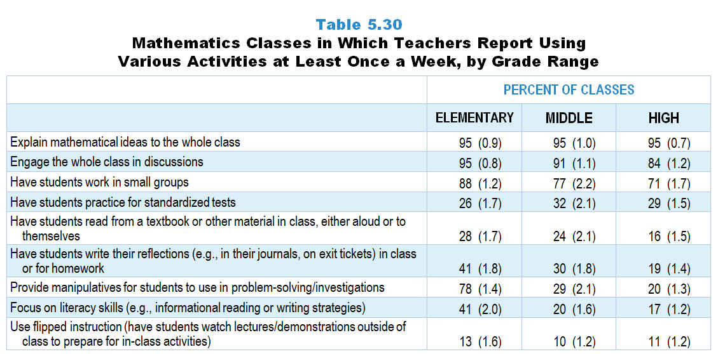
Original Data for Slides 28–33
(not for presentation)
Notes:
Table 5.30, p. 120 in Technical Report
This slide shows data from an individual item.
Mathematics Teacher Questionnaire
Q34. How often do you do each of the following in your mathematics instruction in this class? [Select one on each row.] (Response Options: [1] Never, [2] Rarely (for example: A few times a year), [3] Sometimes (for example: Once or twice a month), [4] Often (for example: Once or twice a week), [5] All or almost all mathematics lessons)
Explain mathematical ideas to the whole class
Engage the whole class in discussions
Have students work in small groups
Provide manipulatives for students to use in problem-solving/investigations
Use flipped instruction (have students watch lectures/demonstrations outside of class to prepare for in-class activities)
Have students read from a textbook or other material in class, either aloud or to themselves
Have students write their reflections (for example: in their journals, on exit tickets) in class or for homework
Focus on literacy skills (for example: informational reading or writing strategies)
Have students practice for standardized tests
The numbers in parentheses are standard errors.
Findings Highlighted in Technical Report
“The percentage of mathematics classes including these same activities at least once a week is displayed in Table 5.30. Not unexpectedly, nearly all classes at each grade level include the teacher explaining mathematical ideas and leading whole class discussions on a weekly basis. Having students work in small groups is also a fairly common weekly occurrence across grade ranges, though its frequency decreases from 88 percent in elementary classes to 71 percent in high school classes. Elementary classes are also much more likely than secondary classes to provide manipulatives for students to use, have students write their reflections, and focus on literacy skills.”

Slide 28
Elementary Mathematics Classes Using Various Activities at Least Once a Week
Notes:
Includes classes for which the teacher selected “often (for example: once or twice a week)” or “all or almost all mathematics lessons” on a 5-point response scale with the options of “never,” “rarely (for example: a few times a year),” “sometimes (for example: once or twice a month),” “often (for example: once or twice a week),” and “all or almost all mathematics lessons.”
Note: Each grade-level chart is sorted independently; consequently items may appear in different orders.

Slide 29
Elementary Mathematics Classes Using Various Activities at Least Once a Week
Notes:
Includes classes for which the teacher selected “often (for example: once or twice a week)” or “all or almost all mathematics lessons” on a 5-point response scale with the options of “never,” “rarely (for example: a few times a year),” “sometimes (for example: once or twice a month),” “often (for example: once or twice a week),” and “all or almost all mathematics lessons.”
Note: Each grade-level chart is sorted independently; consequently items may appear in different orders.

Slide 30
Middle School Mathematics Classes Using Various Activities at Least Once a Week
Notes:
Includes classes for which the teacher selected “often (for example: once or twice a week)” or “all or almost all mathematics lessons” on a 5-point response scale with the options of “never,” “rarely (for example: a few times a year),” “sometimes (for example: once or twice a month),” “often (for example: once or twice a week),” and “all or almost all mathematics lessons.”
Note: Each grade-level chart is sorted independently; consequently items may appear in different orders.

Slide 31
Middle School Mathematics Classes Using Various Activities at Least Once a Week
Notes:
Includes classes for which the teacher selected “often (for example: once or twice a week)” or “all or almost all mathematics lessons” on a 5-point response scale with the options of “never,” “rarely (for example: a few times a year),” “sometimes (for example: once or twice a month),” “often (for example: once or twice a week),” and “all or almost all mathematics lessons.”
Note: Each grade-level chart is sorted independently; consequently items may appear in different orders.

Slide 32
High School Mathematics Classes Using Various Activities at Least Once a Week
Notes:
Includes classes for which the teacher selected “often (for example: once or twice a week)” or “all or almost all mathematics lessons” on a 5-point response scale with the options of “never,” “rarely (for example: a few times a year),” “sometimes (for example: once or twice a month),” “often (for example: once or twice a week),” and “all or almost all mathematics lessons.”
Note: Each grade-level chart is sorted independently; consequently items may appear in different orders.

Slide 33
High School Mathematics Classes Using Various Activities at Least Once a Week
Notes:
Includes classes for which the teacher selected “often (for example: once or twice a week)” or “all or almost all mathematics lessons” on a 5-point response scale with the options of “never,” “rarely (for example: a few times a year),” “sometimes (for example: once or twice a month),” “often (for example: once or twice a week),” and “all or almost all mathematics lessons.”
Note: Each grade-level chart is sorted independently; consequently items may appear in different orders.

Slide 34
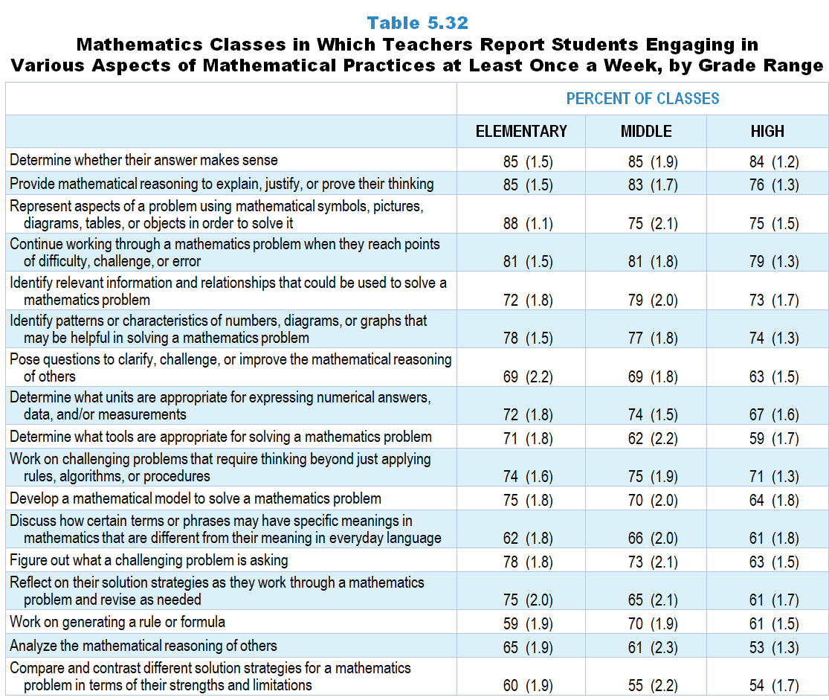
Original Data for Slides 35–43
(not for presentation)
Notes:
Table 5.32, p. 122 in Technical Report
This slide shows data from an individual item.
Mathematics Teacher Questionnaire
Q35. How often do you have students do each of the following during mathematics instruction in this class? [Select one on each row.] (Response Options: [1] Never, [2] Rarely (for example: A few times a year), [3] Sometimes (for example: Once or twice a month), [4] Often (for example: Once or twice a week), [5] All or almost all mathematics lessons)
Work on challenging problems that require thinking beyond just applying rules, algorithms, or procedures
Figure out what a challenging problem is asking (by talking with their classmates and/or using manipulatives, pictures, diagrams, tables, or equations)
Reflect on their solution strategies as they work through a mathematics problem and revise as needed
Continue working through a mathematics problem when they reach points of difficulty, challenge, or error
Determine whether their answer makes sense (for example: the answer has reasonable magnitude or sign, uses appropriate units, fits the context of the problem)
Represent aspects of a problem using mathematical symbols, pictures, diagrams, tables, or objects in order to solve it
Provide mathematical reasoning to explain, justify, or prove their thinking
Compare and contrast different solution strategies for a mathematics problem in terms of their strengths and limitations (for example: their efficiency, generalizability, interpretability by others)
Analyze the mathematical reasoning of others (for example: decide if their reasoning makes sense, identify correct ideas or flaws in their thinking)
Pose questions to clarify, challenge, or improve the mathematical reasoning of others
Identify relevant information and relationships that could be used to solve a mathematics problem (for example: quantities and relationships needed to develop an equation that illustrates a situation or determines an outcome)
Develop a mathematical model (meaning, a representation of relevant information and relationships such as an equation, tape diagram, algorithm, or function) to solve a mathematics problem
Determine what tools (for example: pencil and paper, manipulatives, ruler, protractor, calculator, spreadsheet) are appropriate for solving a mathematics problem
Determine what units are appropriate for expressing numerical answers, data, and/or measurements
Discuss how certain terms or phrases may have specific meanings in mathematics that are different from their meaning in everyday language
Identify patterns or characteristics of numbers, diagrams, or graphs that may be helpful in solving a mathematics problem
Work on generating a rule or formula (for example: based on multiple problems, patterns, or repeated calculations)
The numbers in parentheses are standard errors.
Findings Highlighted in Technical Report
“Although students tend not to be engaged in these activities daily, they are relatively likely to engage with them at least once a week (see Table 5.32). For example, in three-quarters or more of classes across the grade bands, students are asked to determine whether their answer makes sense; provide mathematics reasoning to explain, justify, or prove their thinking; develop representations of aspects of problems; and continue working through mathematics problems when they reach points of difficulty, challenge, or error. In addition, given the emphasis in recent years on the importance of students critiquing different approaches to solving mathematics problems, it is somewhat surprising that only two-thirds or fewer classes have students analyze the mathematical thinking of others or compare and contrast different solution strategies on a weekly basis.”

Slide 35
Elementary Mathematics Classes in Which Teachers Report Students Engaging in Various Aspects of Mathematical Practices at Least Once a Week

Slide 36
Elementary Mathematics Classes in Which Teachers Report Students Engaging in Various Aspects of Mathematical Practices at Least Once a Week

Slide 37
Elementary Mathematics Classes in Which Teachers Report Students Engaging in Various Aspects of Mathematical Practices at Least Once a Week

Slide 38
Middle School Mathematics Classes in Which Teachers Report Students Engaging in Various Aspects of Mathematical Practices at Least Once a Week

Slide 39
Middle School Mathematics Classes in Which Teachers Report Students Engaging in Various Aspects of Mathematical Practices at Least Once a Week

Slide 40
Middle School Mathematics Classes in Which Teachers Report Students Engaging in Various Aspects of Mathematical Practices at Least Once a Week

Slide 41
High School Mathematics Classes in Which Teachers Report Students Engaging in Various Aspects of Mathematical Practices at Least Once a Week

Slide 42
High School Mathematics Classes in Which Teachers Report Students Engaging in Various Aspects of Mathematical Practices at Least Once a Week

Slide 43
High School Mathematics Classes in Which Teachers Report Students Engaging in Various Aspects of Mathematical Practices at Least Once a Week

Slide 44
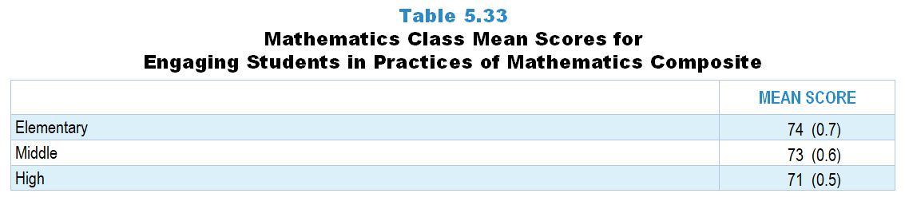
Original Data for Slide 45
(not for presentation)
Notes:
Table 5.33, p. 122 in Technical Report
This slide shows data from Composites.
Sets of related questionnaire items were combined to create several composite variables related to key constructs. Composite variables, which are more reliable than individual survey items, were computed to have a minimum possible value of 0 and a maximum possible value of 100. Higher composite scores indicate more of the construct being measure by the composite. Each composite is calculated by summing the responses to the items associated with that composite and then dividing by the total points possible. In order for the composites to be on a 100-point scale, the lowest response option on each scale was set to 0 and the others were adjusted accordingly; so for example, an item with a scale ranging from 1 to 4 was re-coded to have a scale of 0 to 3. By doing this, someone who marks the lowest point on every item in a composite receives a composite score of 0 rather than some positive number. It also assures that 50 is the true mid-point. The denominator for each composite is determined by computing the maximum possible sum of responses for a series of items and dividing by 100; e.g., a 9-item composite where each item is on a scale of 0–3 would have a denominator of 0.27. Composites values were not computed for participants who respond to fewer than two-thirds of the items that form the composite.
Engaging Students in Practices of Mathematics
Q35a. Work on challenging problems that require thinking beyond just applying rules, algorithms, or procedures
Q35b. Figure out what a challenging problem is asking (by talking with their classmates and/or using manipulatives, pictures, diagrams, tables, or equations)
Q35c. Reflect on their solution strategies as they work through a mathematics problem and revise as needed
Q35d. Continue working through a mathematics problem when they reach points of difficulty, challenge, or error
Q35e. Determine whether their answer makes sense (for example: the answer has reasonable magnitude or sign, uses appropriate units, fits the context of the problem)
Q35f. Represent aspects of a problem using mathematical symbols, pictures, diagrams, tables, or objects in order to solve it
Q35g. Provide mathematical reasoning to explain, justify, or prove their thinking
Q35h. Compare and contrast different solution strategies for a mathematics problem in terms of their strengths and limitations (for example: their efficiency, generalizability, interpretability by others)
Q35i. Analyze the mathematical reasoning of others (for example: decide if their reasoning makes sense, identify correct ideas or flaws in their thinking)
Q35j. Pose questions to clarify, challenge, or improve the mathematical reasoning of others
Q35k. Identify relevant information and relationships that could be used to solve a mathematics problem (for example: quantities and relationships needed to develop an equation that illustrates a situation or determines an outcome)
Q35l. Develop a mathematical model (meaning, a representation of relevant information and relationships such as an equation, tape diagram, algorithm, or function) to solve a mathematics problem
Q35m. Determine what tools (for example: pencil and paper, manipulatives, ruler, protractor, calculator, spreadsheet) are appropriate for solving a mathematics problem
Q35n. Determine what units are appropriate for expressing numerical answers, data, and/or measurements
Q35o. Discuss how certain terms or phrases may have specific meanings in mathematics that are different from their meaning in everyday language
Q35p. Identify patterns or characteristics of numbers, diagrams, or graphs that may be helpful in solving a mathematics problem
Q35q. Work on generating a rule or formula (for example: based on multiple problems, patterns, or repeated calculations)
Mathematics Teacher Questionnaire
Q35. How often do you have students do each of the following during mathematics instruction in this class? [Select one on each row.] (Response Options: [1] Never, [2] Rarely (for example: A few times a year), [3] Sometimes (for example: Once or twice a month), [4] Often (for example: Once or twice a week), [5] All or almost all mathematics lessons)
Work on challenging problems that require thinking beyond just applying rules, algorithms, or procedures
Figure out what a challenging problem is asking (by talking with their classmates and/or using manipulatives, pictures, diagrams, tables, or equations)
Reflect on their solution strategies as they work through a mathematics problem and revise as needed
Continue working through a mathematics problem when they reach points of difficulty, challenge, or error
Determine whether their answer makes sense (for example: the answer has reasonable magnitude or sign, uses appropriate units, fits the context of the problem)
Represent aspects of a problem using mathematical symbols, pictures, diagrams, tables, or objects in order to solve it
Provide mathematical reasoning to explain, justify, or prove their thinking
Compare and contrast different solution strategies for a mathematics problem in terms of their strengths and limitations (for example: their efficiency, generalizability, interpretability by others)
Analyze the mathematical reasoning of others (for example: decide if their reasoning makes sense, identify correct ideas or flaws in their thinking)
Pose questions to clarify, challenge, or improve the mathematical reasoning of others
Identify relevant information and relationships that could be used to solve a mathematics problem (for example: quantities and relationships needed to develop an equation that illustrates a situation or determines an outcome)
Develop a mathematical model (meaning, a representation of relevant information and relationships such as an equation, tape diagram, algorithm, or function) to solve a mathematics problem
Determine what tools (for example: pencil and paper, manipulatives, ruler, protractor, calculator, spreadsheet) are appropriate for solving a mathematics problem
Determine what units are appropriate for expressing numerical answers, data, and/or measurements
Discuss how certain terms or phrases may have specific meanings in mathematics that are different from their meaning in everyday language
Identify patterns or characteristics of numbers, diagrams, or graphs that may be helpful in solving a mathematics problem
Work on generating a rule or formula (for example: based on multiple problems, patterns, or repeated calculations)
The numbers in parentheses are standard errors.
Findings Highlighted in Technical Report
“Although students tend not to be engaged in these activities daily, they are relatively likely to engage with them at least once a week (see Table 5.32). For example, in three-quarters or more of classes across the grade bands, students are asked to determine whether their answer makes sense; provide mathematics reasoning to explain, justify, or prove their thinking; develop representations of aspects of problems; and continue working through mathematics problems when they reach points of difficulty, challenge, or error. In addition, given the emphasis in recent years on the importance of students critiquing different approaches to solving mathematics problems, it is somewhat surprising that only two-thirds or fewer classes have students analyze the mathematical thinking of others or compare and contrast different solution strategies on a weekly basis.”

Slide 45
Engaging Students in Practices of Mathematics Composite

Slide 46
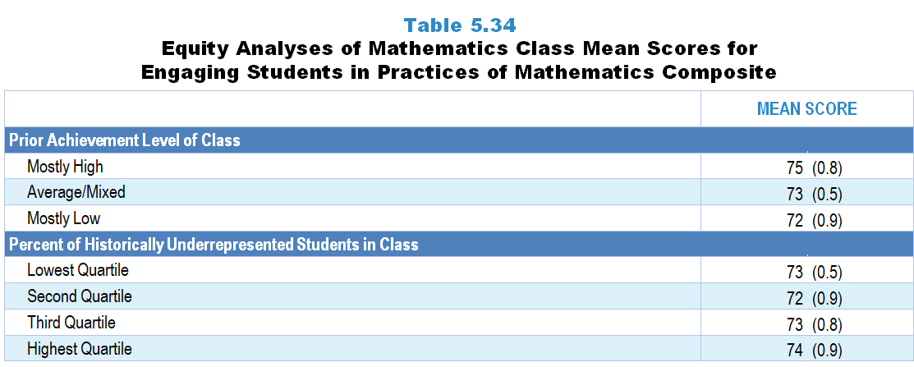
Original Data for Slides 47–48
(not for presentation)
Notes:
Table 5.34, p. 123 in Technical Report
This slide shows data from Composites.
Sets of related questionnaire items were combined to create several composite variables related to key constructs. Composite variables, which are more reliable than individual survey items, were computed to have a minimum possible value of 0 and a maximum possible value of 100. Higher composite scores indicate more of the construct being measure by the composite. Each composite is calculated by summing the responses to the items associated with that composite and then dividing by the total points possible. In order for the composites to be on a 100-point scale, the lowest response option on each scale was set to 0 and the others were adjusted accordingly; so for example, an item with a scale ranging from 1 to 4 was re-coded to have a scale of 0 to 3. By doing this, someone who marks the lowest point on every item in a composite receives a composite score of 0 rather than some positive number. It also assures that 50 is the true mid-point. The denominator for each composite is determined by computing the maximum possible sum of responses for a series of items and dividing by 100; e.g., a 9-item composite where each item is on a scale of 0–3 would have a denominator of 0.27. Composites values were not computed for participants who respond to fewer than two-thirds of the items that form the composite.
Engaging Students in Practices of Mathematics
Q35a. Work on challenging problems that require thinking beyond just applying rules, algorithms, or procedures
Q35b. Figure out what a challenging problem is asking (by talking with their classmates and/or using manipulatives, pictures, diagrams, tables, or equations)
Q35c. Reflect on their solution strategies as they work through a mathematics problem and revise as needed
Q35d. Continue working through a mathematics problem when they reach points of difficulty, challenge, or error
Q35e. Determine whether their answer makes sense (for example: the answer has reasonable magnitude or sign, uses appropriate units, fits the context of the problem)
Q35f. Represent aspects of a problem using mathematical symbols, pictures, diagrams, tables, or objects in order to solve it
Q35g. Provide mathematical reasoning to explain, justify, or prove their thinking
Q35h. Compare and contrast different solution strategies for a mathematics problem in terms of their strengths and limitations (for example: their efficiency, generalizability, interpretability by others)
Q35i. Analyze the mathematical reasoning of others (for example: decide if their reasoning makes sense, identify correct ideas or flaws in their thinking)
Q35j. Pose questions to clarify, challenge, or improve the mathematical reasoning of others
Q35k. Identify relevant information and relationships that could be used to solve a mathematics problem (for example: quantities and relationships needed to develop an equation that illustrates a situation or determines an outcome)
Q35l. Develop a mathematical model (meaning, a representation of relevant information and relationships such as an equation, tape diagram, algorithm, or function) to solve a mathematics problem
Q35m. Determine what tools (for example: pencil and paper, manipulatives, ruler, protractor, calculator, spreadsheet) are appropriate for solving a mathematics problem
Q35n. Determine what units are appropriate for expressing numerical answers, data, and/or measurements
Q35o. Discuss how certain terms or phrases may have specific meanings in mathematics that are different from their meaning in everyday language
Q35p. Identify patterns or characteristics of numbers, diagrams, or graphs that may be helpful in solving a mathematics problem
Q35q. Work on generating a rule or formula (for example: based on multiple problems, patterns, or repeated calculations)
Mathematics Teacher Questionnaire
Q30. For the number of students in this class, indicate the number of males and females in each of the following categories of race/ethnicity.
American Indian or Alaskan Native _____ _____
Asian _____ _____
Black or African American _____ _____
Hispanic or Latino _____ _____
Native Hawaiian or Other Pacific Islander _____ _____
White _____ _____
Two or more races _____ _____
Q31. Which of the following best describes the prior mathematics achievement levels of the students in this class relative to other students in this school?
Mostly low achievers
Mostly average achievers
Mostly high achievers
A mixture of levels
Q35. How often do you have students do each of the following during mathematics instruction in this class? [Select one on each row.] (Response Options: [1] Never, [2] Rarely (for example: A few times a year), [3] Sometimes (for example: Once or twice a month), [4] Often (for example: Once or twice a week), [5] All or almost all mathematics lessons)
Work on challenging problems that require thinking beyond just applying rules, algorithms, or procedures
Figure out what a challenging problem is asking (by talking with their classmates and/or using manipulatives, pictures, diagrams, tables, or equations)
Reflect on their solution strategies as they work through a mathematics problem and revise as needed
Continue working through a mathematics problem when they reach points of difficulty, challenge, or error
Determine whether their answer makes sense (for example: the answer has reasonable magnitude or sign, uses appropriate units, fits the context of the problem)
Represent aspects of a problem using mathematical symbols, pictures, diagrams, tables, or objects in order to solve it
Provide mathematical reasoning to explain, justify, or prove their thinking
Compare and contrast different solution strategies for a mathematics problem in terms of their strengths and limitations (for example: their efficiency, generalizability, interpretability by others)
Analyze the mathematical reasoning of others (for example: decide if their reasoning makes sense, identify correct ideas or flaws in their thinking)
Pose questions to clarify, challenge, or improve the mathematical reasoning of others
Identify relevant information and relationships that could be used to solve a mathematics problem (for example: quantities and relationships needed to develop an equation that illustrates a situation or determines an outcome)
Develop a mathematical model (meaning, a representation of relevant information and relationships such as an equation, tape diagram, algorithm, or function) to solve a mathematics problem
Determine what tools (for example: pencil and paper, manipulatives, ruler, protractor, calculator, spreadsheet) are appropriate for solving a mathematics problem
Determine what units are appropriate for expressing numerical answers, data, and/or measurements
Discuss how certain terms or phrases may have specific meanings in mathematics that are different from their meaning in everyday language
Identify patterns or characteristics of numbers, diagrams, or graphs that may be helpful in solving a mathematics problem
Work on generating a rule or formula (for example: based on multiple problems, patterns, or repeated calculations)
Chapters 2–7 in the technical report provide data on several key indicators, disaggregated by one or more equity factors: the prior achievement level of students in the class, the percentage of students from race/ethnicity groups historically underrepresented in STEM in the class, the percentage of students in the school eligible for free/reduced-price lunch (FRL), school size, community type, and region. For FRL, each school was classified into one of four categories (defined as quartiles) based on the proportion of students eligible for FRL. Similarly, each randomly selected class was classified into one of the four categories based on the proportion of students from race/ethnicity groups historically underrepresented in STEM in the class.
The numbers in parentheses are standard errors.
Findings Highlighted in Technical Report
“Table 5.33 shows the means for the Engaging Students in the Practices of Mathematics composite by grade band, and Table 5.34 shows scores by the prior achievement level of students and percentage of students in the class from race/‌ethnicity groups historically underrepresented in STEM. Overall, scores are similar across grade bands, though a little higher for elementary classes than high school classes. Scores are also slightly higher for classes composed of mostly high prior achievers than for classes of mostly low prior achievers.”

Slide 47
Engaging Students in Practices of Mathematics Composite, by Prior Achievement Level

Slide 48
Engaging Students in Practices of Mathematics Composite, by Percentage of Historically Underrepresented Students
Notes:
Slide shows the composite scores by quartile of percent historically underrepresented students in the randomly selected class.

Slide 49
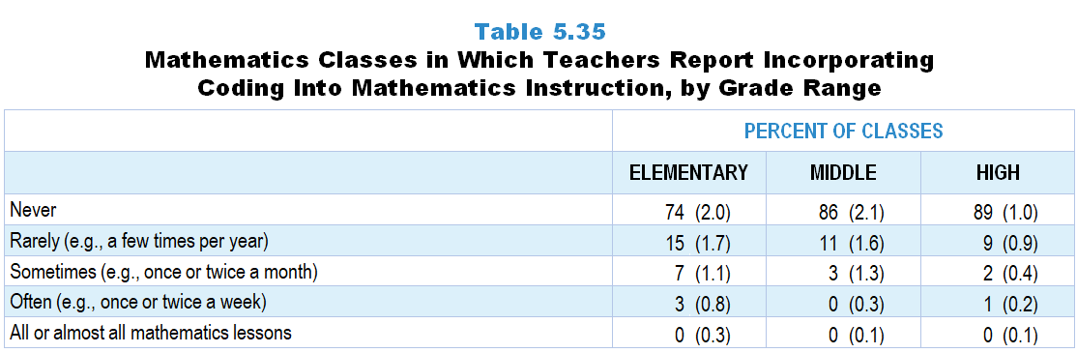
Original Data for Slide 50
(not for presentation)
Notes:
Table 5.35, p. 123 in Technical Report
This slide shows data from an individual item.
Mathematics Teacher Questionnaire
Q36. Thinking about your instruction in this class over the entire year, about how often do you have students use coding to develop or revise computer programs as part of your mathematics instruction (for example: use Scratch or Python as part of doing mathematics)?
Never
Rarely (for example: A few times per year)
Sometimes (for example: Once or twice a month)
Often (for example: Once or twice a week)
All or almost all mathematics lessons
The numbers in parentheses are standard errors.
Findings Highlighted in Technical Report
“Similar to science, very few mathematics classes incorporate coding into instruction (see Table 5.35). The practice is somewhat more common in the elementary grades than secondary grades, but even at the elementary level tends to be done only a few times a year if at all.”

Slide 50
Mathematics Classes in Which Teachers Report Incorporating Coding Into Mathematics Instruction

Slide 51
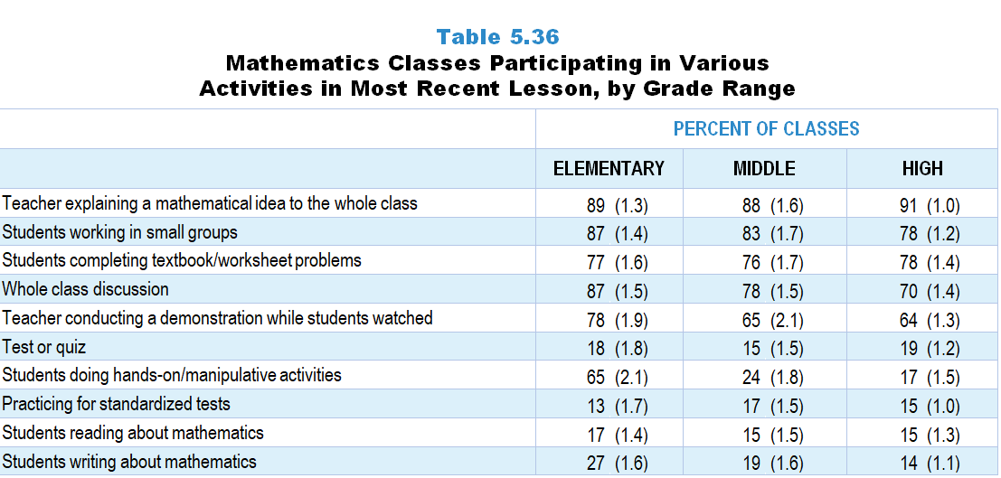
Original Data for Slides 52–54
(not for presentation)
Notes:
Table 5.36, p. 124 in Technical Report
This slide shows data from an individual item.
Mathematics Teacher Questionnaire
Q56. Which of the following activities took place during that day’s mathematics lesson? [Select all that apply.]
Teacher explaining a mathematical idea to the whole class
Teacher conducting a demonstration while students watched
Whole class discussion
Students working in small groups
Students completing textbook/worksheet problems
Students doing hands-on/manipulative activities
Students reading about mathematics
Students writing about mathematics (do not include students taking notes)
Practicing for standardized tests
Test or quiz
None of the above
The numbers in parentheses are standard errors.
Findings Highlighted in Technical Report
“Table 5.36 presents the percentage of most recent lessons in K–12 mathematics classes that include various activities. With only a few exceptions, the frequency of activities in each grade range is fairly similar. For example, most elementary, middle, and high school lessons include the explanation of mathematical ideas (88–91 percent) and students working in small groups (78–87 percent). Having students complete textbook/‌worksheet problems is also prevalent, occurring in roughly 3 out of 4 K–12 mathematics lessons. Lessons vary across the grade ranges in the use of hands-on/‌manipulatives and whole class discussion. At the elementary level, 65 percent of lessons include students doing hands-on/‌manipulative activities compared to only 24 and 17 percent of middle and high school mathematics lessons, respectively. In addition, 87 percent of elementary lessons include whole class discussion compared to 78 and 70 percent of middle and high school mathematics lessons.”

Slide 52
Elementary Mathematics Classes Participating in Various Activities in the Most Recent Lesson
Notes:
Note: Each grade-level chart is sorted independently; consequently items may appear in different orders.

Slide 53
Middle School Mathematics Classes Participating in Various Activities in the Most Recent Lesson
Notes:
Note: Each grade-level chart is sorted independently; consequently items may appear in different orders.

Slide 54
High School Mathematics Classes Participating in Various Activities in the Most Recent Lesson
Notes:
Note: Each grade-level chart is sorted independently; consequently items may appear in different orders.

Slide 55
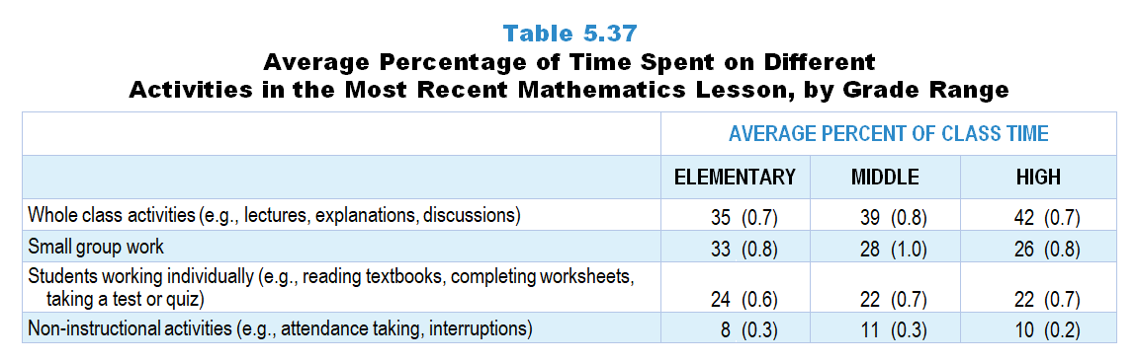
Original Data for Slide 56
(not for presentation)
Notes:
Table 5.37, p. 124 in Technical Report
This slide shows data derived from:
Mathematics Teacher Questionnaire
Q54. How many minutes was that day’s mathematics lesson? Answer for the entire length of the class period, even if there were interruptions. ____
Q55. Of these minutes, how many were spent on the following
Non-instructional activities (for example: attendance taking, interruptions) _____
Whole class activities (for example: lectures, explanations, discussions) _____
Small group work _____
Students working individually (for example: reading textbooks, completing worksheets, taking a test or quiz) _____
The numbers in parentheses are standard errors.
Findings Highlighted in Technical Report
“The proportion of time spent on various instructional arrangements in mathematics lessons is relatively similar across the grade levels (see Table 5.37), though there is some variation. On average, more time is spent in whole class activities in high school mathematics classes than in elementary classes, ranging from 35–42 percent of class time. In contrast, the time spent in small group work decreases with increasing grade range, from 33 percent of time in elementary classes to 26 percent of time in high school mathematics classes.”

Slide 56
Percentage of Time Spent on Different Activities in the Most Recent Mathematics Lesson

Slide 57
Homework and Assessment Practices

Slide 58
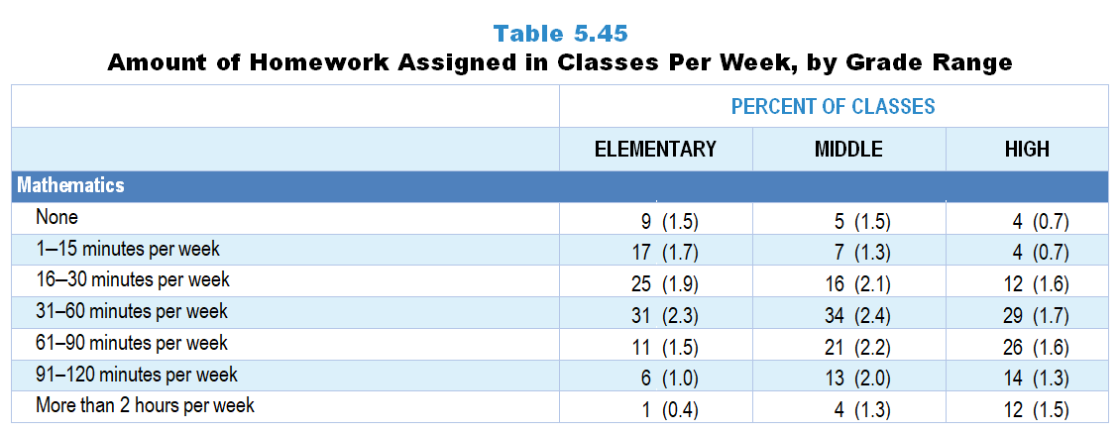
Original Data for Slide 59
(not for presentation)
Notes:
The mathematics portion of Table 5.45, p. 129 in Technical Report
This slide shows data from an individual item.
Mathematics Teacher Questionnaire
Q37. In a typical week, how much time outside of this class are students expected to spend on mathematics assignments?
None
1‒15 minutes per week
16‒30 minutes per week
31‒60 minutes per week
61‒90 minutes per week
91‒120 minutes per week
More than 2 hours per week
The numbers in parentheses are standard errors.
Findings Highlighted in Technical Report
“Teachers were asked about the amount of homework assigned per week in the randomly selected class. Across the grade levels, students in mathematics classes are assigned more homework than students in science classes, particularly when looking at the percentage of classes assigned 31 minutes or more per week (see Table 5.45). This pattern is particularly evident in elementary classes, where students in 31 percent of classes are given 31–60 minutes of mathematics homework a week; only 8 percent of elementary classes are assigned this much science homework. Not surprisingly, the amount of time students are asked to spend on science and mathematics homework increases with grade range. For example, over half of high school mathematics classes are assigned one or more hours of homework per week, compared to under one-fifth of elementary classes. Homework expectations in high school computer science classes are similar to those in high school science classes.”

Slide 59
Amount of Homework Assigned in Mathematics Classes Per Week

Slide 60
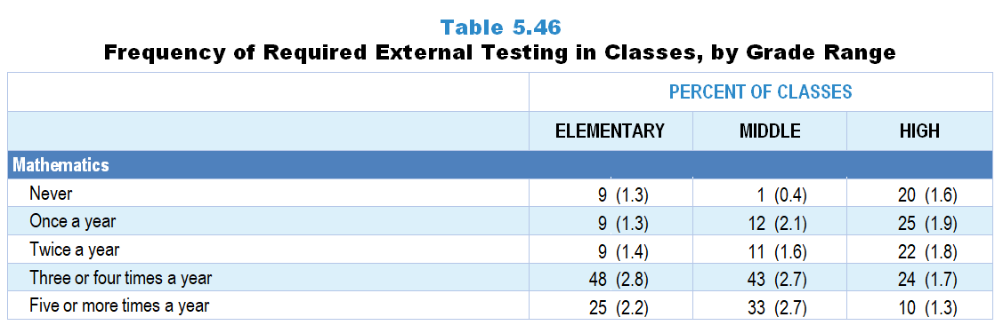
Original Data for Slide 61
(not for presentation)
Notes:
The mathematics portion of Table 5.46, p. 130 in Technical Report
This slide shows data from an individual item.
Mathematics Teacher Questionnaire
Q38. How often are students in this class required to take mathematics tests that you did not choose to administer, for example state assessments or district benchmarks? Do not include Advanced Placement or International Baccalaureate exams or students retaking a test because of failure.
Never
Once a year
Twice a year
Three or four times a year
Five or more times a year
The numbers in parentheses are standard errors.
Findings Highlighted in Technical Report
“In science and mathematics, the survey asked how often students in the randomly selected class are required to take assessments the teachers did not develop, such as state or district benchmark assessments. Given that mathematics tends to be included in the high stakes accountability systems of states at more grades than science, it is not surprising that the frequency of external testing is greater in mathematics classes than in science classes, particularly at the elementary and middle grades levels (see Table 5.46). At the elementary level, 62 percent of classes never administer external science assessments; only 9 percent never administer external mathematics assessments.”

Slide 61
Frequency of Required External Testing in Mathematics Classes

Slide 62
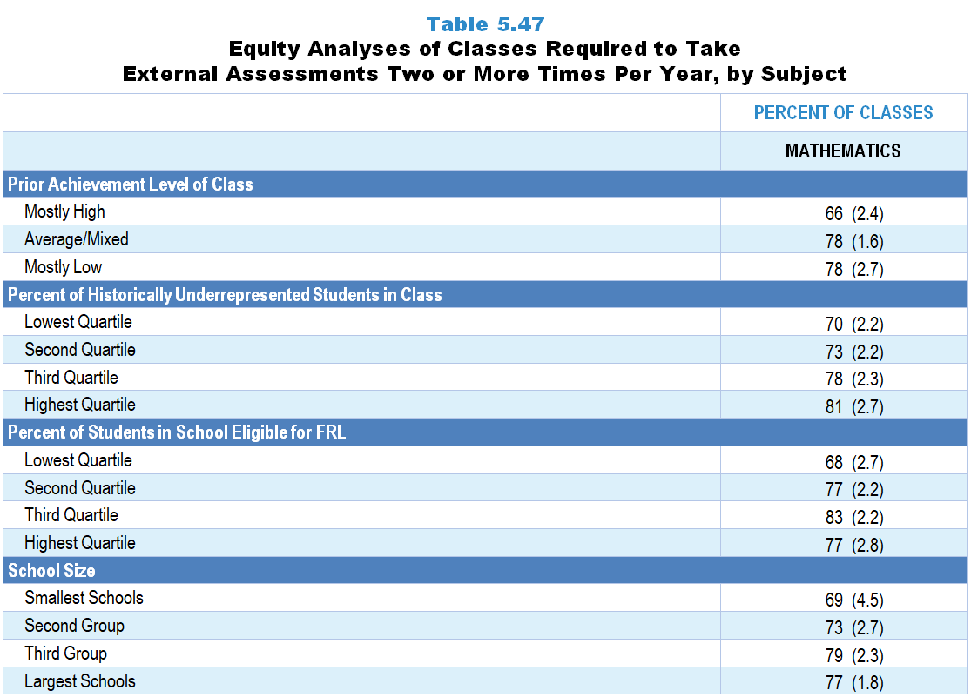
Original Data for Slides 63–66
(not for presentation)
Notes:
The mathematics portion of Table 5.47, p. 131 in Technical Report
This slide shows data from an individual item.
Mathematics Teacher Questionnaire
Q38. How often are students in this class required to take mathematics tests that you did not choose to administer, for example state assessments or district benchmarks? Do not include Advanced Placement or International Baccalaureate exams or students retaking a test because of failure.
Never
Once a year
Twice a year
Three or four times a year
Five or more times a year
Q30. For the students in this class, indicate the number of males and females in each of the following categories of race/ethnicity.
American Indian or Alaska Native _____ _____
Asian _____ _____
Black or African American _____ _____
Hispanic/Latino _____ _____
Native Hawaiian or Other Pacific Islander _____ _____
White _____ _____
Two or more races _____ _____
Q31. Which of the following best describes the prior mathematics achievement levels of the students in this class relative to other students in this school?
Mostly low achievers
Mostly average achievers
Mostly high achievers
A mixture of levels
The numbers in parentheses are standard errors.
Chapters 2–7 in the technical report provide data on several key indicators, disaggregated by one or more equity factors: the prior achievement level of students in the class, the percentage of students from race/ethnicity groups historically underrepresented in STEM in the class, the percentage of students in the school eligible for free/reduced-price lunch (FRL), school size, community type, and region. For FRL, each school was classified into one of four categories (defined as quartiles) based on the proportion of students eligible for FRL. Similarly, each randomly selected class was classified into one of the four categories based on the proportion of students from race/ethnicity groups historically underrepresented in STEM in the class.
Findings Highlighted in Technical Report
“The prior achievement level of the class, percentage of students in the class from race/‌ethnicity groups historically underrepresented in STEM, percentage of students in the school eligible for free/‌reduced-price lunch, and school size are all related to the frequency with which classes are required to take external assessments. As can be seen in Table 5.47, classes with mostly low-achieving students are more likely than classes with mostly high prior achievers to take external mathematics assessments two or more times per year. Similarly, in both science and mathematics, the greater the percentage of students from race/‌ethnicity groups historically underrepresented in STEM in the class and the greater the percentage of students eligible for free/‌reduced-price lunch in the school, the more likely students are to be tested this frequently.”

Slide 63
Mathematics Classes Required to Take External Assessments Two or More Times Per Year

Slide 64
Mathematics Classes Required to Take External Assessments Two or More Times Per Year
Notes:
Historically Underrepresented Students includes American Indian or Alaskan Native, Black or African American, Hispanic or Latino, or Native Hawaiian or Other Pacific Islander students.
Slide shows the composite scores by quartile of percent historically underrepresented students in the randomly selected class.

Slide 65
Mathematics Classes Required to Take External Assessments Two or More Times Per Year
Notes:
Slide shows the composite scores by quartile of percent of students eligible for free or reduced-price lunch in the school.

Slide 66
Mathematics Classes Required to Take External Assessments Two or More Times Per Year

