Slide 1
Chapter 5
Instructional Decision-Making, Objectives, and Activities
Science

Slide 2
Teachers’ Perceptions of Their Decision-Making Autonomy

Slide 3
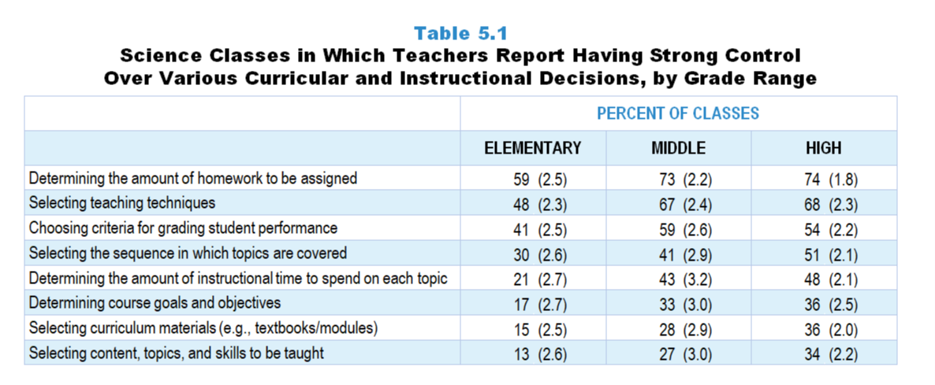
Original Data for Slides 4–6
(not for presentation)
Notes:
Table 5.1, p. 102 in Technical Report
This slide shows data from an individual item.
Science Teacher Questionnaire
Q44. How much control do you have over each of the following for science instruction in this class? [Select one on each row.]
(Response Options: [1] No control, [2] 2 of 5, [3] Moderate control, [4] 4 of 5, [5] Strong control)
Determining course goals and objectives
Selecting curriculum materials (for example: textbooks/modules)
Selecting content, topics, and skills to be taught
Selecting the sequence in which topics are covered
Determining the amount of instructional time to spend on each topic
Selecting teaching techniques
Determining the amount of homework to be assigned
Choosing criteria for grading student performance
The numbers in parentheses are standard errors.
Findings Highlighted in Technical Report
“As can be seen in Table 5.1, in science classes across all grade levels, teachers tend to perceive themselves as having strong control over pedagogical decisions such as determining the amount of homework to be assigned (59–74 percent), selecting teaching techniques (48–68 percent), and choosing criteria for grading student performance (41–59 percent). In contrast, especially in the elementary grades, teachers are less likely to feel strong control in determining course goals and objectives (17–36 percent); selecting textbooks/‌modules/‌programs (15–36 percent); and selecting content, topics, and skills to be taught (13–34 percent). In fact, in about a third of elementary classes, teachers report having no control over these decisions (see Table 5.2). “

Slide 4
Elementary Science Classes in Which Teachers Report Having Strong Control Over Various Decisions
Notes:
Includes classes for which the teacher selected “strong control” on a 5-point response scale with the options of “no control,” “2 of 5,” “moderate control,” “4 of 5,” and “strong control.”
Note: Each grade-level chart is sorted independently; consequently items may appear in different orders.

Slide 5
Middle School Science Classes in Which Teachers Report Having Strong Control Over Various Decisions
Notes:
Includes classes for which the teacher selected “strong control” on a 5-point response scale with the options of “no control,” “2 of 5,” “moderate control,” “4 of 5,” and “strong control.”
Note: Each grade-level chart is sorted independently; consequently items may appear in different orders.

Slide 6
High School Science Classes in Which Teachers Report Having Strong Control Over Various Decisions
Notes:
Includes classes for which the teacher selected “strong control” on a 5-point response scale with the options of “no control,” “2 of 5,” “moderate control,” “4 of 5,” and “strong control.”
Note: Each grade-level chart is sorted independently; consequently items may appear in different orders.

Slide 7
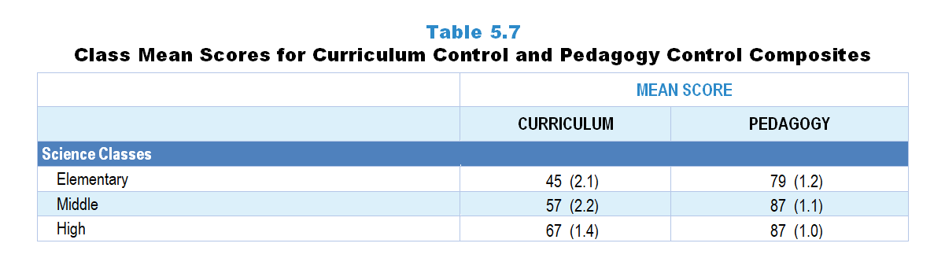
Original Data for Slide 8
(not for presentation)
Notes:
The science portion of Table 5.7, p. 105 in Technical Report
This slide shows data from Composites.
Sets of related questionnaire items were combined to create several composite variables related to key constructs. Composite variables, which are more reliable than individual survey items, were computed to have a minimum possible value of 0 and a maximum possible value of 100. Higher composite scores indicate more of the construct being measured by the composite. Each composite is calculated by summing the responses to the items associated with that composite and then dividing by the total points possible. In order for the composites to be on a 100-point scale, the lowest response option on each scale was set to 0 and the others were adjusted accordingly; so for example, an item with a scale ranging from 1 to 4 was re-coded to have a scale of 0 to 3. By doing this, someone who marks the lowest point on every item in a composite receives a composite score of 0 rather than some positive number. It also assures that 50 is the true mid-point. The denominator for each composite is determined by computing the maximum possible sum of responses for a series of items and dividing by 100; e.g., a 9-item composite where each item is on a scale of 0–3 would have a denominator of 0.27. Composite values were not computed for participants who responded to fewer than two-thirds of the items that form the composite.
Curriculum Control Composite Items
Q44a. Determining course goals and objectives
Q44b. Selecting curriculum materials (for example: textbooks/modules)
Q44c. Selecting content, topics, and skills to be taught
Q44d. Selecting the sequence in which topics are covered
Pedagogy Control Composite Items
Q44f. Selecting teaching techniques
Q44g. Determining the amount of homework to be assigned
Q44h. Choosing criteria for grading student performance
Science Teacher Questionnaire
Q44. How much control do you have over each of the following for science instruction in this class? [Select one on each row.]
(Response Options: [1] No control, [2] 2 of 5, [3] Moderate control, [4] 4 of 5, [5] Strong control)
Determining course goals and objectives
Selecting curriculum materials (for example: textbooks/modules)
Selecting content, topics, and skills to be taught
Selecting the sequence in which topics are covered
Determining the amount of instructional time to spend on each topic
Selecting teaching techniques
Determining the amount of homework to be assigned
Choosing criteria for grading student performance
The numbers in parentheses are standard errors.
Findings Highlighted in Technical Report
“Table 5.7 displays the mean scores on these composite. These scores indicate that teachers perceive more control over decisions related to pedagogy than curriculum, especially in science and mathematics classes. They also show that perceived control for both composite variables is greater in secondary science and mathematics classes than in elementary classes.”

Slide 8
Curriculum and Pedagogy Control Composites

Slide 9
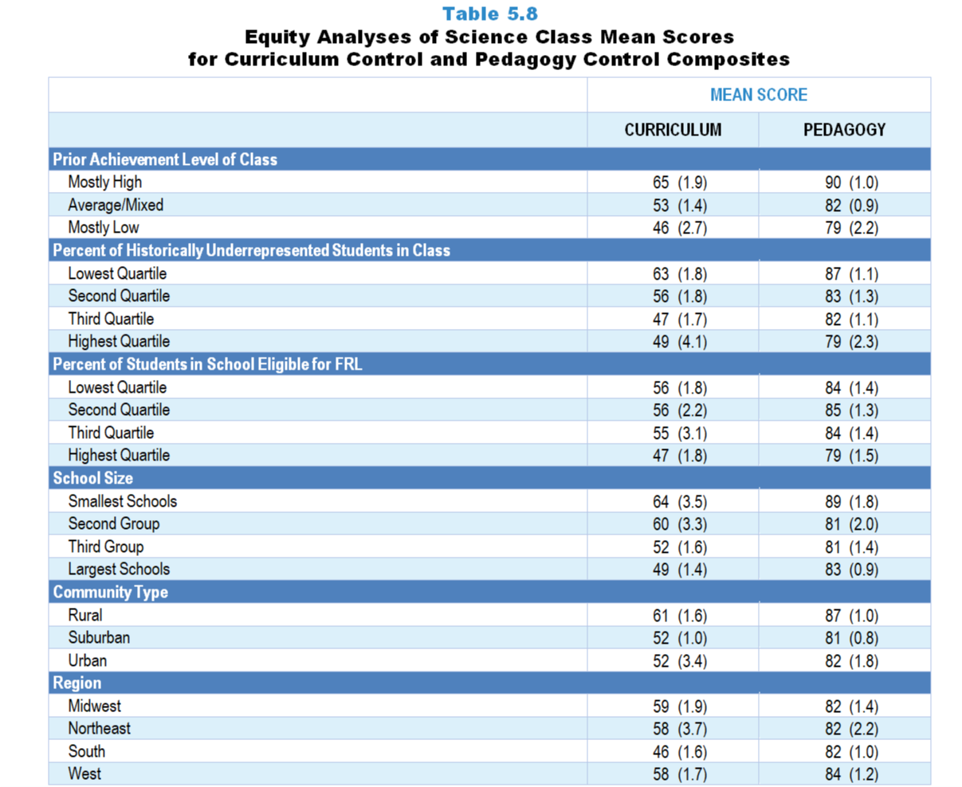
Original Data for Slides 10–13
(not for presentation)
Notes:
Table 5.8, p. 106 in Technical Report
This slide shows data from composites.
Sets of related questionnaire items were combined to create several composite variables related to key constructs. Composite variables, which are more reliable than individual survey items, were computed to have a minimum possible value of 0 and a maximum possible value of 100. Higher composite scores indicate more of the construct being measured by the composite. Each composite is calculated by summing the responses to the items associated with that composite and then dividing by the total points possible. In order for the composites to be on a 100-point scale, the lowest response option on each scale was set to 0 and the others were adjusted accordingly; so for example, an item with a scale ranging from 1 to 4 was re-coded to have a scale of 0 to 3. By doing this, someone who marks the lowest point on every item in a composite receives a composite score of 0 rather than some positive number. It also assures that 50 is the true mid-point. The denominator for each composite is determined by computing the maximum possible sum of responses for a series of items and dividing by 100; e.g., a 9-item composite where each item is on a scale of 0–3 would have a denominator of 0.27. Composite values were not computed for participants who responded to fewer than two-thirds of the items that form the composite.
Curriculum Control Composite Items
Q44a. Determining course goals and objectives
Q44b. Selecting curriculum materials (for example: textbooks/modules)
Q44c. Selecting content, topics, and skills to be taught
Q44d. Selecting the sequence in which topics are covered
Pedagogy Control Composite Items
Q44f. Selecting teaching techniques
Q44g. Determining the amount of homework to be assigned
Q44h. Choosing criteria for grading student performance
Science Teacher Questionnaire
Q44. How much control do you have over each of the following for science instruction in this class? [Select one on each row.]
(Response Options: [1] No control, [2] 2 of 5, [3] Moderate control, [4] 4 of 5, [5] Strong control)
Determining course goals and objectives
Selecting curriculum materials (for example: textbooks/modules)
Selecting content, topics, and skills to be taught
Selecting the sequence in which topics are covered
Determining the amount of instructional time to spend on each topic
Selecting teaching techniques
Determining the amount of homework to be assigned
Choosing criteria for grading student performance
The numbers in parentheses are standard errors.
Chapters 2–7 in the technical report provide data on several key indicators, disaggregated by one or more equity factors: the prior achievement level of students in the class, the percentage of students from race/ethnicity groups historically underrepresented in STEM in the class, the percentage of students in the school eligible for free/reduced-price lunch (FRL), school size, community type, and region. For FRL, each school was classified into one of four categories (defined as quartiles) based on the proportion of students eligible for FRL. Similarly, each randomly selected class was classified into one of the four categories based on the proportion of students from race/ethnicity groups historically underrepresented in STEM in the class.
Findings Highlighted in Technical Report
“When looking at the composite scores by equity factors, a number of differences are apparent by both class and school factors. For example, teachers of science classes composed mostly of low prior achievers report having less control over both curriculum and pedagogy than teachers of classes containing mostly high prior achievers (see Table 5.8). A similar pattern exists in terms of race/‌ethnicity composition—teachers of classes serving a high proportion of students from race/‌ethnicity groups historically underrepresented in STEM report lower instructional control than teachers of classes with relatively few students from these groups. Teachers of classes in higher-poverty schools and in large schools tend to report less control than their counterparts in low-poverty and small schools.”

Slide 10
Curriculum and Pedagogy Control Composites, by Prior Achievement Level

Slide 11
Curriculum and Pedagogy Control Composites, by Percentage of Historically Underrepresented Students in Class
Notes:
Historically Underrepresented Students includes American Indian or Alaskan Native, Black or African American, Hispanic or Latino, or Native Hawaiian or Other Pacific Islander students.

Slide 12
Curriculum and Pedagogy Control Composites, by Percentage of Students in School Eligible for FRL

Slide 13
Curriculum and Pedagogy Control Composites, by School Size

Slide 14
Instructional Objectives

Slide 15
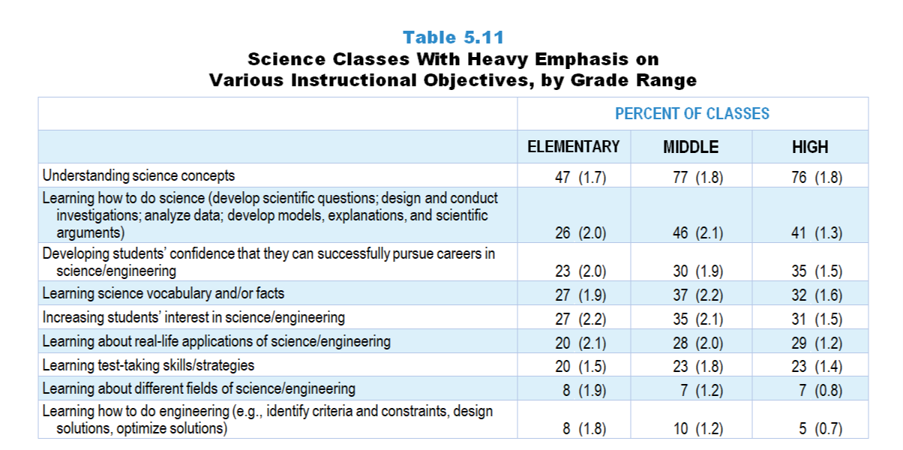
Original Data for Slides 16–21
(not for presentation)
Notes:
Table 5.11, p. 109 in Technical Report
This slide shows data from an individual item.
Science Teacher Questionnaire
Q45. Think about your plans for this class for the entire course/year. By the end of the course/year, how much emphasis will each of the following student objectives receive? [Select one on each row.] (Response Options: [1] None, [2] Minimal emphasis, [3] Moderate emphasis, [4] Heavy emphasis)
Learning science vocabulary and/or facts
Understanding science concepts
Learning about different fields of science/engineering
Learning how to do science (develop scientific questions; design and conduct investigations; analyze data; develop models, explanations, and scientific arguments)
Learning how to do engineering (for example: identify criteria and constraints, design solutions, optimize solutions)
Learning about real-life applications of science/engineering
Increasing students’ interest in science/engineering
Developing students’ confidence that they can successfully pursue careers in science/engineering
Learning test-taking skills/strategies
The numbers in parentheses are standard errors.
Findings Highlighted in Technical Report
“The survey provided a list of possible objectives of instruction and asked teachers how much emphasis each would receive in an entire course of a particular, randomly selected class. Table 5.11 shows the percentage of science classes by grade range with a heavy emphasis for each objective. Understanding science concepts is the most frequently emphasized objective, although more so in secondary classes (about three-quarters of middle and high school classes) than in elementary (fewer than half of classes). Given the adoption in many states of the NGSS or NGSS-like standards, it is somewhat surprising that fewer than half of secondary classes, and only a quarter of elementary classes have a heavy emphasis on students learning how to do science. In addition, about a third of classes have a heavy emphasis on students learning science vocabulary and/‌or facts. Objectives least likely to be emphasized are learning about different fields of science and engineering and learning how to do engineering (10 percent or fewer science classes). In fact, 18–31 percent of science classes, depending on grade range, have no emphasis on learning how to do engineering (see Table 5.12)”

Slide 16
Elementary Science Classes With Heavy Emphasis on Various Instructional Objectives
Notes:
Includes classes for which the teacher selected “heavy emphasis” on a 4-point response scale with the options of “none,” “minimal emphasis,” “moderate emphasis,” and “heavy emphasis.”
Note: Each grade-level chart is sorted independently; consequently items may appear in different orders.

Slide 17
Elementary Science Classes With Heavy Emphasis on Various Instructional Objectives
Notes:
Includes classes for which the teacher selected “heavy emphasis” on a 4-point response scale with the options of “none,” “minimal emphasis,” “moderate emphasis,” and “heavy emphasis.”
Note: Each grade-level chart is sorted independently; consequently items may appear in different orders.

Slide 18
Middle School Science Classes With Heavy Emphasis on Various Instructional Objectives
Notes:
Includes classes for which the teacher selected “heavy emphasis” on a 4-point response scale with the options of “none,” “minimal emphasis,” “moderate emphasis,” and “heavy emphasis.”
Note: Each grade-level chart is sorted independently; consequently items may appear in different orders.

Slide 19
Middle School Science Classes With Heavy Emphasis on Various Instructional Objectives
Notes:
Includes classes for which the teacher selected “heavy emphasis” on a 4-point response scale with the options of “none,” “minimal emphasis,” “moderate emphasis,” and “heavy emphasis.”
Note: Each grade-level chart is sorted independently; consequently items may appear in different orders.

Slide 20
High School Science Classes With Heavy Emphasis on Various Instructional Objectives
Notes:
Includes classes for which the teacher selected “heavy emphasis” on a 4-point response scale with the options of “none,” “minimal emphasis,” “moderate emphasis,” and “heavy emphasis.”
Note: Each grade-level chart is sorted independently; consequently items may appear in different orders.

Slide 21
High School Science Classes With Heavy Emphasis on Various Instructional Objectives
Notes:
Includes classes for which the teacher selected “heavy emphasis” on a 4-point response scale with the options of “none,” “minimal emphasis,” “moderate emphasis,” and “heavy emphasis.”
Note: Each grade-level chart is sorted independently; consequently items may appear in different orders.

Slide 22
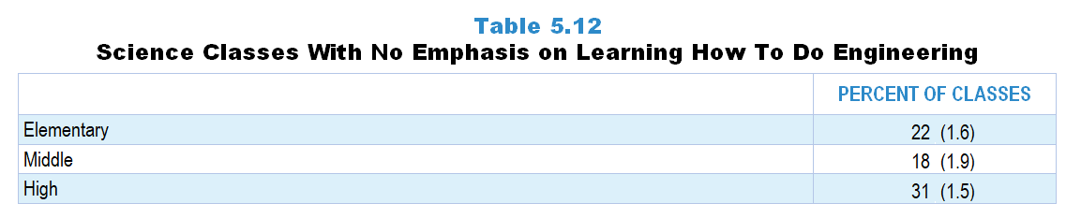
Original Data for Slide 23
(not for presentation)
Notes:
Table 5.12, p. 109 in Technical Report
This slide shows data from an individual item.
Science Teacher Questionnaire
Q45. Think about your plans for this class for the entire course/year. By the end of the course/year, how much emphasis will each of the following student objectives receive? [Select one on each row.] (Response Options: [1] None, [2] Minimal emphasis, [3] Moderate emphasis, [4] Heavy emphasis)
Learning science vocabulary and/or facts
Understanding science concepts
Learning about different fields of science/engineering
Learning how to do science (develop scientific questions; design and conduct investigations; analyze data; develop models, explanations, and scientific arguments)
Learning how to do engineering (for example: identify criteria and constraints, design solutions, optimize solutions)
Learning about real-life applications of science/engineering
Increasing students’ interest in science/engineering
Developing students’ confidence that they can successfully pursue careers in science/engineering
Learning test-taking skills/strategies
The numbers in parentheses are standard errors.
Findings Highlighted in Technical Report
“The survey provided a list of possible objectives of instruction and asked teachers how much emphasis each would receive in an entire course of a particular, randomly selected class. Table 5.11 shows the percentage of science classes by grade range with a heavy emphasis for each objective. Understanding science concepts is the most frequently emphasized objective, although more so in secondary classes (about three-quarters of middle and high school classes) than in elementary (fewer than half of classes). Given the adoption in many states of the NGSS or NGSS-like standards, it is somewhat surprising that fewer than half of secondary classes, and only a quarter of elementary classes have a heavy emphasis on students learning how to do science. In addition, about a third of classes have a heavy emphasis on students learning science vocabulary and/‌or facts. Objectives least likely to be emphasized are learning about different fields of science and engineering and learning how to do engineering (10 percent or fewer science classes). In fact, 18–31 percent of science classes, depending on grade range, have no emphasis on learning how to do engineering (see Table 5.12)”

Slide 23
Science Classes With No Emphasis on Learning How To Do Engineering
Notes:
Includes classes for which the teacher selected “none” on a 4-point response scale with the options of “none,” “minimal emphasis,” “moderate emphasis,” and “heavy emphasis.”

Slide 24
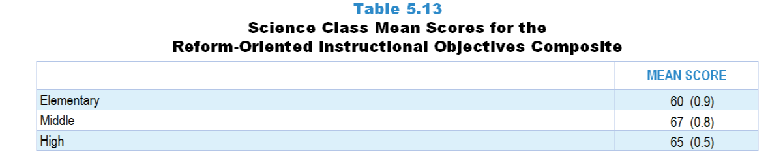
Original Data for Slide 25
(not for presentation)
Notes:
Table 5.13, p. 109 in Technical Report
This slide shows data from Composites.
Sets of related questionnaire items were combined to create several composite variables related to key constructs. Composite variables, which are more reliable than individual survey items, were computed to have a minimum possible value of 0 and a maximum possible value of 100. Higher composite scores indicate more of the construct being measured by the composite. Each composite is calculated by summing the responses to the items associated with that composite and then dividing by the total points possible. In order for the composites to be on a 100-point scale, the lowest response option on each scale was set to 0 and the others were adjusted accordingly; so for example, an item with a scale ranging from 1 to 4 was re-coded to have a scale of 0 to 3. By doing this, someone who marks the lowest point on every item in a composite receives a composite score of 0 rather than some positive number. It also assures that 50 is the true mid-point. The denominator for each composite is determined by computing the maximum possible sum of responses for a series of items and dividing by 100; e.g., a 9-item composite where each item is on a scale of 0–3 would have a denominator of 0.27. Composite values were not computed for participants who responded to fewer than two-thirds of the items that form the composite.
Curriculum Control Composite Items
Q45b. Understanding science concepts
Q45c. Learning about different fields of science/engineering
Q45d. Learning how to do science (develop scientific questions; design and conduct investigations; analyze data; develop models, explanations, and scientific arguments)
Q45e. Learning how to do engineering (for example: identify criteria and constraints, design solutions, optimize solutions)
Q45f. Learning about real-life applications of science/engineering
Q45g. Increasing students’ interest in science/engineering
Q45h. Developing students’ confidence that they can successfully pursue careers in science/engineering
Science Teacher Questionnaire
Q45. Think about your plans for this class for the entire course/year. By the end of the course/year, how much emphasis will each of the following student objectives receive? [Select one on each row.] (Response Options: [1] None, [2] Minimal emphasis, [3] Moderate emphasis, [4] Heavy emphasis)
Learning science vocabulary and/or facts
Understanding science concepts
Learning about different fields of science/engineering
Learning how to do science (develop scientific questions; design and conduct investigations; analyze data; develop models, explanations, and scientific arguments)
Learning how to do engineering (for example: identify criteria and constraints, design solutions, optimize solutions)
Learning about real-life applications of science/engineering
Increasing students’ interest in science/engineering
Developing students’ confidence that they can successfully pursue careers in science/engineering
Learning test-taking skills/strategies
The numbers in parentheses are standard errors.
Findings Highlighted in Technical Report
“The objectives related to reform-oriented instruction (understanding science concepts, learning about different fields of science/‌engineering, learning how to do science, learning how to do engineering, learning about real-life applications of science/‌engineering, increasing students’ interest in science/‌engineering, and developing students’ confidence that they can successfully pursue careers in science/‌engineering) were combined into a composite variable. Overall, scores on this composite are not very high (see Table 5.13), indicating that science classes are only somewhat likely to emphasize reform-oriented instructional objectives. In addition, secondary classes are somewhat more likely than elementary classes to emphasize these objectives.”

Slide 25
Reform-Oriented Instructional Objectives Composite

Slide 26
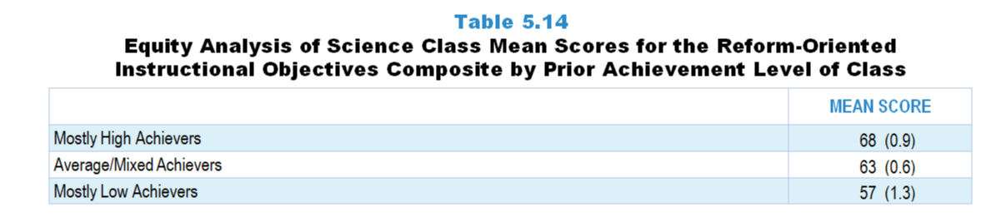
Original Data for Slide 27
(not for presentation)
Notes:
Table 5.14, p. 110 in Technical Report
This slide shows data from composites.
Sets of related questionnaire items were combined to create several composite variables related to key constructs. Composite variables, which are more reliable than individual survey items, were computed to have a minimum possible value of 0 and a maximum possible value of 100. Higher composite scores indicate more of the construct being measured by the composite. Each composite is calculated by summing the responses to the items associated with that composite and then dividing by the total points possible. In order for the composites to be on a 100-point scale, the lowest response option on each scale was set to 0 and the others were adjusted accordingly; so for example, an item with a scale ranging from 1 to 4 was re-coded to have a scale of 0 to 3. By doing this, someone who marks the lowest point on every item in a composite receives a composite score of 0 rather than some positive number. It also assures that 50 is the true mid-point. The denominator for each composite is determined by computing the maximum possible sum of responses for a series of items and dividing by 100; e.g., a 9-item composite where each item is on a scale of 0–3 would have a denominator of 0.27. Composite values were not computed for participants who responded to fewer than two-thirds of the items that form the composite.
Curriculum Control Composite Items
Q45b. Understanding science concepts
Q45c. Learning about different fields of science/engineering
Q45d. Learning how to do science (develop scientific questions; design and conduct investigations; analyze data; develop models, explanations, and scientific arguments)
Q45e. Learning how to do engineering (for example: identify criteria and constraints, design solutions, optimize solutions)
Q45f. Learning about real-life applications of science/engineering
Q45g. Increasing students’ interest in science/engineering
Q45h. Developing students’ confidence that they can successfully pursue careers in science/engineering
Science Teacher Questionnaire
Q45. Think about your plans for this class for the entire course/year. By the end of the course/year, how much emphasis will each of the following student objectives receive? [Select one on each row.] (Response Options: [1] None, [2] Minimal emphasis, [3] Moderate emphasis, [4] Heavy emphasis)
Learning science vocabulary and/or facts
Understanding science concepts
Learning about different fields of science/engineering
Learning how to do science (develop scientific questions; design and conduct investigations; analyze data; develop models, explanations, and scientific arguments)
Learning how to do engineering (for example: identify criteria and constraints, design solutions, optimize solutions)
Learning about real-life applications of science/engineering
Increasing students’ interest in science/engineering
Developing students’ confidence that they can successfully pursue careers in science/engineering
Learning test-taking skills/strategies
Chapters 2–7 in the technical report provide data on several key indicators, disaggregated by one or more equity factors: the prior achievement level of students in the class, the percentage of students from race/ethnicity groups historically underrepresented in STEM in the class, the percentage of students in the school eligible for free/reduced-price lunch (FRL), school size, community type, and region. For FRL, each school was classified into one of four categories (defined as quartiles) based on the proportion of students eligible for FRL. Similarly, each randomly selected class was classified into one of the four categories based on the proportion of students from race/ethnicity groups historically underrepresented in STEM in the class.
The numbers in parentheses are standard errors.
Findings Highlighted in Technical Report
“Scores on this composite were also analyzed by a number of equity factors. The only factor that has a clear relationship with this composite is the prior achievement level of the class. As can be seen in Table 5.14, classes containing mostly high-achieving students are more likely to stress reform-oriented instructional objectives than classes with mostly low-achieving students.”

Slide 27
Reform-Oriented Instructional Objectives Composite

Slide 28
Class Activities

Slide 29
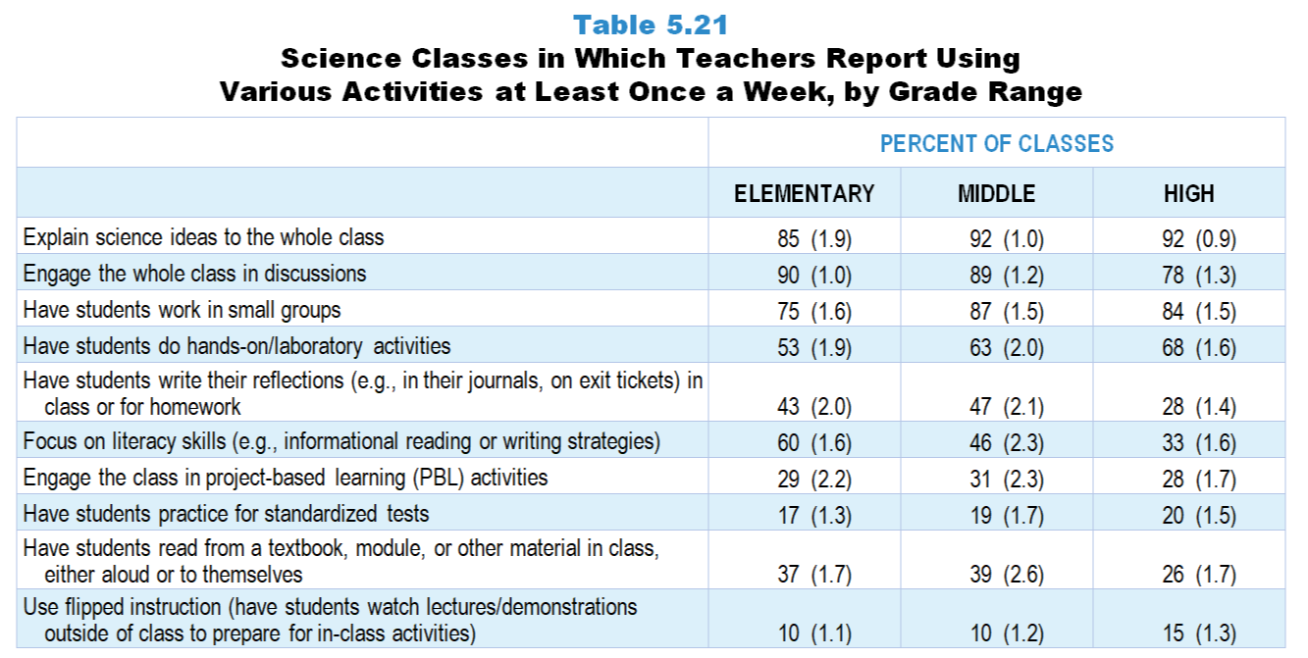
Original Data for Slides 30–35
(not for presentation)
Notes:
Table 5.21 p. 114 in Technical Report
This slide shows data from an individual item.
Science Teacher Questionnaire
Q46. How often do you do each of the following in your science instruction in this class? [Select one on each row.] (Response Options: [1] Never, [2] Rarely (for example: A few times a year), [3] Sometimes (for example: Once or twice a month), [4] Often (for example: Once or twice a week), [5] All or almost all science lessons)
Explain science ideas to the whole class
Engage the whole class in discussions
Have students work in small groups
Have students do hands-on/laboratory activities
Use flipped instruction (have students watch lectures/demonstrations outside of class to prepare for in-class activities)
Have students read from a textbook, module, or other material in class, either aloud or to themselves
Engage the class in project-based learning (PBL) activities
Have students write their reflections (for example: in their journals, on exit tickets) in class or for homework
Focus on literacy skills (for example: informational reading or writing strategies)
Have students practice for standardized tests
The numbers in parentheses are standard errors.
Findings Highlighted in Technical Report
“As can be seen in Table 5.21, three instructional activities occur at least once a week in a large majority of science classes across grade levels: explaining science ideas to the whole class (85–92 percent), engaging the whole class in discussions (78–90 percent), and having students work in small groups (75–87 percent). Over half of elementary and about two-thirds of secondary science classes include hands-on/‌laboratory activities on a weekly basis. In addition, roughly 30 percent of classes engage students in project-based learning activities weekly.
Elementary and middle school science classes are much more likely than high school classes to include literacy activities at least once a week. For example, students read from a science textbook, module, or other material on a weekly basis in approximately 4 out of 10 elementary and middle grades classes, compared to a quarter of high school classes. Having students write reflections at least once a week is also more common in elementary and middle school classes than high school classes. In addition, 60 percent of elementary classes focus on literacy skills at least once a week, compared to only one-third of high school classes.”

Slide 30
Elementary Science Classes Using Various Activities at Least Once a Week
Notes:
Includes classes for which the teacher selected “often (for example: once or twice a week)” or “all or almost all science lessons” on a 5-point response scale with the options of “never,” “rarely (for example: a few times a year),” “sometimes (for example: once or twice a month),” “often (for example: once or twice a week),” and “all or almost all science lessons.”
Note: Each grade-level chart is sorted independently; consequently items may appear in different orders.

Slide 31
Elementary Science Classes Using Various Activities at Least Once a Week
Notes:
Includes classes for which the teacher selected “often (for example: once or twice a week)” or “all or almost all science lessons” on a 5-point response scale with the options of “never,” “rarely (for example: a few times a year),” “sometimes (for example: once or twice a month),” “often (for example: once or twice a week),” and “all or almost all science lessons.”
Note: Each grade-level chart is sorted independently; consequently items may appear in different orders.

Slide 32
Middle School Science Classes Using Various Activities at Least Once a Week
Notes:
Includes classes for which the teacher selected “often (for example: once or twice a week)” or “all or almost all science lessons” on a 5-point response scale with the options of “never,” “rarely (for example: a few times a year),” “sometimes (for example: once or twice a month),” “often (for example: once or twice a week),” and “all or almost all science lessons.”
Note: Each grade-level chart is sorted independently; consequently items may appear in different orders.

Slide 33
Middle School Science Classes Using Various Activities at Least Once a Week
Notes:
Includes classes for which the teacher selected “often (for example: once or twice a week)” or “all or almost all science lessons” on a 5-point response scale with the options of “never,” “rarely (for example: a few times a year),” “sometimes (for example: once or twice a month),” “often (for example: once or twice a week),” and “all or almost all science lessons.”
Note: Each grade-level chart is sorted independently; consequently items may appear in different orders.

Slide 34
High School Science Classes Using Various Activities at Least Once a Week
Notes:
Includes classes for which the teacher selected “often (for example: once or twice a week)” or “all or almost all science lessons” on a 5-point response scale with the options of “never,” “rarely (for example: a few times a year),” “sometimes (for example: once or twice a month),” “often (for example: once or twice a week),” and “all or almost all science lessons.”
Note: Each grade-level chart is sorted independently; consequently items may appear in different orders.

Slide 35
High School Science Classes Using Various Activities at Least Once a Week
Notes:
Includes classes for which the teacher selected “often (for example: once or twice a week)” or “all or almost all science lessons” on a 5-point response scale with the options of “never,” “rarely (for example: a few times a year),” “sometimes (for example: once or twice a month),” “often (for example: once or twice a week),” and “all or almost all science lessons.”
Note: Each grade-level chart is sorted independently; consequently items may appear in different orders.

Slide 36
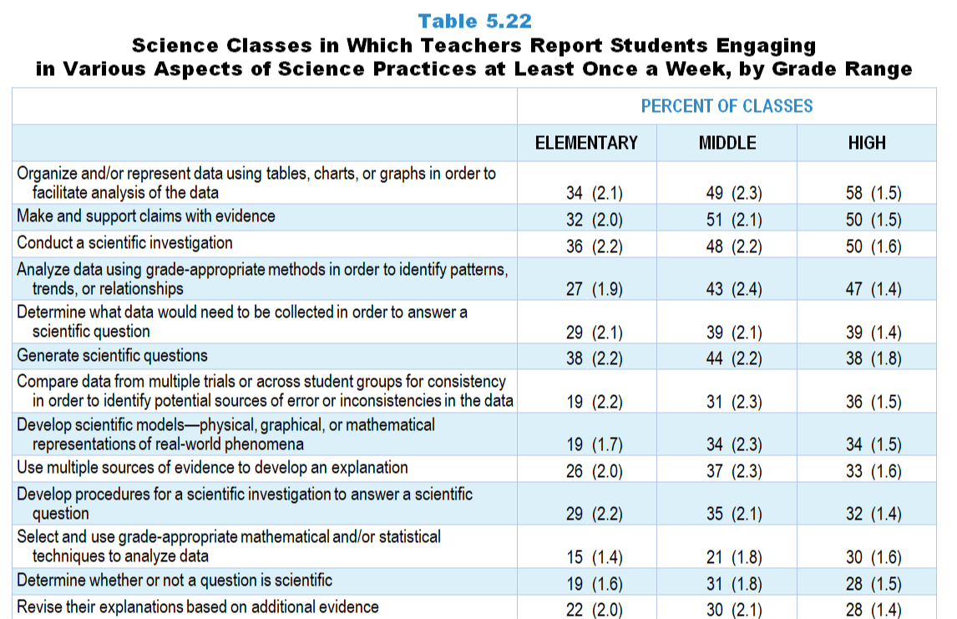
Original Data for Slides 38–49
(not for presentation)
Notes:
Table 5.22, p. 115 in Technical Report
This slide shows data from an individual item.
Science Teacher Questionnaire
Q47. How often do you have students do each of the following during science instruction in this class? [Select one on each row.](Response Options: [1] Never, [2] Rarely (for example: A few times a year), [3] Sometimes (for example: Once or twice a month), [4] Often (for example: Once or twice a week), [5] All or almost all science lessons)
Determine whether or not a question is “scientific” (meaning it requires an answer supported by evidence gathered through systematic investigation)
Generate scientific questions based on their curiosity, prior knowledge, careful observation of real-world phenomena, scientific models, or preliminary data from an investigation
Determine what data would need to be collected in order to answer a scientific question (regardless of who generated the question)
Develop procedures for a scientific investigation to answer a scientific question (regardless of who generated the question)
Conduct a scientific investigation (regardless of who developed the procedures)
Organize and/or represent data using tables, charts, or graphs in order to facilitate analysis of the data
Compare data from multiple trials or across student groups for consistency in order to identify potential sources of error or inconsistencies in the data
Analyze data using grade-appropriate methods in order to identify patterns, trends, or relationships
Consider how missing data or measurement error can affect the interpretation of data
Make and support claims (proposed answers to scientific questions) with evidence
Use multiple sources of evidence (for example: different investigations, scientific literature) to develop an explanation
Revise their explanations (claims supported by evidence and reasoning) for real-world phenomena based on additional evidence
Develop scientific models—physical, graphical, or mathematical representations of real-world phenomena—based on data and reasoning
Identify the strengths and limitations of a scientific model—in terms of accuracy, clarity, generalizability, accessibility to others, strength of evidence supporting it—regardless of who created the model
Select and use grade-appropriate mathematical and/or statistical techniques to analyze data (for example: determining the best measure of central tendency, examining variation in data, or developing a fit line)
Use mathematical and/or computational models to generate data to support a scientific claim
Determine what details about an investigation (for example: its design, implementation, and results) might persuade a targeted audience about a scientific claim (regardless of who made the claim)
Use data and reasoning to defend, verbally or in writing, a claim or refute alternative scientific claims about a real-world phenomenon (regardless of who made the claims)
Evaluate the strengths and weaknesses of competing scientific explanations (claims supported by evidence) for a real-world phenomenon
Construct a persuasive case, verbally or in writing, for the best scientific model or explanation for a real-world phenomenon
Pose questions that elicit relevant details about the important aspects of a scientific argument (for example: the claims/models/explanations, research design, implementation, data analysis)
Evaluate the credibility of scientific information—for example: its reliability, validity, consistency, logical coherence, lack of bias, or methodological strengths and weaknesses (regardless of whether it is from their own or others’ work)
Summarize patterns, similarities, and differences in scientific information obtained from multiple sources (regardless of whether it is from their own or others’ work)
The numbers in parentheses are standard errors.
Findings Highlighted in Technical Report
“The survey also asked how often students in science classes are engaged in doing science as described in documents like A Framework for K–12 Science Education—i.e., the practices of science such as formulating scientific questions, designing and implementing investigations, developing models and explanations, and engaging in argumentation. As can be seen in Table 5.22, students often engage in aspects of science related to conducting investigations and analyzing data. For example, about half of middle and high school classes have students organize and represent data, make and support claims with evidence, conduct scientific investigations, and analyze data at least once a week. At the elementary level, about a third of classes engage students in these activities weekly.
Across all grade bands, students tend to not be engaged very often in aspects of science related to evaluating the strengths/‌limitations of evidence and the practice of argumentation. For example, fewer than a quarter of secondary science classes have students, at least once a week, pose questions about scientific arguments, evaluate the credibility of scientific information, identify strengths and limitations of a scientific model, evaluate the strengths and weaknesses of competing scientific explanations, determine what details about an investigation might persuade a targeted audience about a scientific claim, or construct a persuasive case. Even fewer elementary classes engage students in these activities weekly, and about a third never do so (see Table 5.23).”

Slide 37
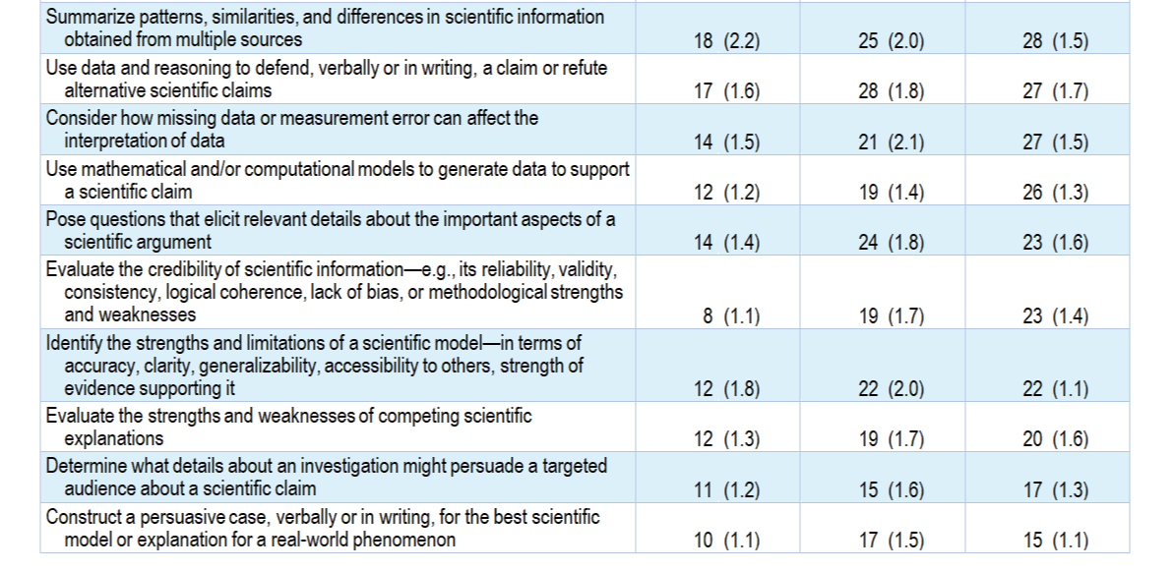
Original Data for Slides 38–49
(not for presentation)
Notes:
Table 5.22, p. 115 in Technical Report
This slide shows data from an individual item.
Science Teacher Questionnaire
Q47. How often do you have students do each of the following during science instruction in this class? [Select one on each row.](Response Options: [1] Never, [2] Rarely (for example: A few times a year), [3] Sometimes (for example: Once or twice a month), [4] Often (for example: Once or twice a week), [5] All or almost all science lessons)
Determine whether or not a question is “scientific” (meaning it requires an answer supported by evidence gathered through systematic investigation)
Generate scientific questions based on their curiosity, prior knowledge, careful observation of real-world phenomena, scientific models, or preliminary data from an investigation
Determine what data would need to be collected in order to answer a scientific question (regardless of who generated the question)
Develop procedures for a scientific investigation to answer a scientific question (regardless of who generated the question)
Conduct a scientific investigation (regardless of who developed the procedures)
Organize and/or represent data using tables, charts, or graphs in order to facilitate analysis of the data
Compare data from multiple trials or across student groups for consistency in order to identify potential sources of error or inconsistencies in the data
Analyze data using grade-appropriate methods in order to identify patterns, trends, or relationships
Consider how missing data or measurement error can affect the interpretation of data
Make and support claims (proposed answers to scientific questions) with evidence
Use multiple sources of evidence (for example: different investigations, scientific literature) to develop an explanation
Revise their explanations (claims supported by evidence and reasoning) for real-world phenomena based on additional evidence
Develop scientific models—physical, graphical, or mathematical representations of real-world phenomena—based on data and reasoning
Identify the strengths and limitations of a scientific model—in terms of accuracy, clarity, generalizability, accessibility to others, strength of evidence supporting it—regardless of who created the model
Select and use grade-appropriate mathematical and/or statistical techniques to analyze data (for example: determining the best measure of central tendency, examining variation in data, or developing a fit line)
Use mathematical and/or computational models to generate data to support a scientific claim
Determine what details about an investigation (for example: its design, implementation, and results) might persuade a targeted audience about a scientific claim (regardless of who made the claim)
Use data and reasoning to defend, verbally or in writing, a claim or refute alternative scientific claims about a real-world phenomenon (regardless of who made the claims)
Evaluate the strengths and weaknesses of competing scientific explanations (claims supported by evidence) for a real-world phenomenon
Construct a persuasive case, verbally or in writing, for the best scientific model or explanation for a real-world phenomenon
Pose questions that elicit relevant details about the important aspects of a scientific argument (for example: the claims/models/explanations, research design, implementation, data analysis)
Evaluate the credibility of scientific information—for example: its reliability, validity, consistency, logical coherence, lack of bias, or methodological strengths and weaknesses (regardless of whether it is from their own or others’ work)
Summarize patterns, similarities, and differences in scientific information obtained from multiple sources (regardless of whether it is from their own or others’ work)
The numbers in parentheses are standard errors.
Findings Highlighted in Technical Report
“The survey also asked how often students in science classes are engaged in doing science as described in documents like A Framework for K–12 Science Education—i.e., the practices of science such as formulating scientific questions, designing and implementing investigations, developing models and explanations, and engaging in argumentation. As can be seen in Table 5.22, students often engage in aspects of science related to conducting investigations and analyzing data. For example, about half of middle and high school classes have students organize and represent data, make and support claims with evidence, conduct scientific investigations, and analyze data at least once a week. At the elementary level, about a third of classes engage students in these activities weekly.
Across all grade bands, students tend to not be engaged very often in aspects of science related to evaluating the strengths/‌limitations of evidence and the practice of argumentation. For example, fewer than a quarter of secondary science classes have students, at least once a week, pose questions about scientific arguments, evaluate the credibility of scientific information, identify strengths and limitations of a scientific model, evaluate the strengths and weaknesses of competing scientific explanations, determine what details about an investigation might persuade a targeted audience about a scientific claim, or construct a persuasive case. Even fewer elementary classes engage students in these activities weekly, and about a third never do so (see Table 5.23).”

Slide 38
Elementary Science Classes in Which Teachers Report Students Engaging in Various Aspects of Science Practices at Least Once a Week
Notes:
Includes classes for which the teacher selected “often (for example: once or twice a week)” or “all or almost all science lessons” on a 5-point response scale with the options of “never,” “rarely (for example: a few times a year),” “sometimes (for example: once or twice a month),” “often (for example: once or twice a week),” and “all or almost all science lessons.”
Note: Each grade-level chart is sorted independently; consequently items may appear in different orders.

Slide 39
Elementary Science Classes in Which Teachers Report Students Engaging in Various Aspects of Science Practices at Least Once a Week
Notes:
Includes classes for which the teacher selected “often (for example: once or twice a week)” or “all or almost all science lessons” on a 5-point response scale with the options of “never,” “rarely (for example: a few times a year),” “sometimes (for example: once or twice a month),” “often (for example: once or twice a week),” and “all or almost all science lessons.”
Note: Each grade-level chart is sorted independently; consequently items may appear in different orders.

Slide 40
Elementary Science Classes in Which Teachers Report Students Engaging in Various Aspects of Science Practices at Least Once a Week
Notes:
Includes classes for which the teacher selected “often (for example: once or twice a week)” or “all or almost all science lessons” on a 5-point response scale with the options of “never,” “rarely (for example: a few times a year),” “sometimes (for example: once or twice a month),” “often (for example: once or twice a week),” and “all or almost all science lessons.”
Note: Each grade-level chart is sorted independently; consequently items may appear in different orders.

Slide 41
Elementary Science Classes in Which Teachers Report Students Engaging in Various Aspects of Science Practices at Least Once a Week
Notes:
Includes classes for which the teacher selected “often (for example: once or twice a week)” or “all or almost all science lessons” on a 5-point response scale with the options of “never,” “rarely (for example: a few times a year),” “sometimes (for example: once or twice a month),” “often (for example: once or twice a week),” and “all or almost all science lessons.”
Note: Each grade-level chart is sorted independently; consequently items may appear in different orders.

Slide 42
Middle School Science Classes in Which Teachers Report Students Engaging in Various Aspects of Science Practices at Least Once a Week
Notes:
Includes classes for which the teacher selected “often (for example: once or twice a week)” or “all or almost all science lessons” on a 5-point response scale with the options of “never,” “rarely (for example: a few times a year),” “sometimes (for example: once or twice a month),” “often (for example: once or twice a week),” and “all or almost all science lessons.”
Note: Each grade-level chart is sorted independently; consequently items may appear in different orders.

Slide 43
Middle School Science Classes in Which Teachers Report Students Engaging in Various Aspects of Science Practices at Least Once a Week
Notes:
Includes classes for which the teacher selected “often (for example: once or twice a week)” or “all or almost all science lessons” on a 5-point response scale with the options of “never,” “rarely (for example: a few times a year),” “sometimes (for example: once or twice a month),” “often (for example: once or twice a week),” and “all or almost all science lessons.”
Note: Each grade-level chart is sorted independently; consequently items may appear in different orders.

Slide 44
Middle School Science Classes in Which Teachers Report Students Engaging in Various Aspects of Science Practices at Least Once a Week
Notes:
Includes classes for which the teacher selected “often (for example: once or twice a week)” or “all or almost all science lessons” on a 5-point response scale with the options of “never,” “rarely (for example: a few times a year),” “sometimes (for example: once or twice a month),” “often (for example: once or twice a week),” and “all or almost all science lessons.”
Note: Each grade-level chart is sorted independently; consequently items may appear in different orders.

Slide 45
Middle School Science Classes in Which Teachers Report Students Engaging in Various Aspects of Science Practices at Least Once a Week
Notes:
Includes classes for which the teacher selected “often (for example: once or twice a week)” or “all or almost all science lessons” on a 5-point response scale with the options of “never,” “rarely (for example: a few times a year),” “sometimes (for example: once or twice a month),” “often (for example: once or twice a week),” and “all or almost all science lessons.”
Note: Each grade-level chart is sorted independently; consequently items may appear in different orders.

Slide 46
High School Science Classes in Which Teachers Report Students Engaging in Various Aspects of Science Practices at Least Once a Week
Notes:
Includes classes for which the teacher selected “often (for example: once or twice a week)” or “all or almost all science lessons” on a 5-point response scale with the options of “never,” “rarely (for example: a few times a year),” “sometimes (for example: once or twice a month),” “often (for example: once or twice a week),” and “all or almost all science lessons.”
Note: Each grade-level chart is sorted independently; consequently items may appear in different orders.

Slide 47
High School Science Classes in Which Teachers Report Students Engaging in Various Aspects of Science Practices at Least Once a Week
Notes:
Includes classes for which the teacher selected “often (for example: once or twice a week)” or “all or almost all science lessons” on a 5-point response scale with the options of “never,” “rarely (for example: a few times a year),” “sometimes (for example: once or twice a month),” “often (for example: once or twice a week),” and “all or almost all science lessons.”
Note: Each grade-level chart is sorted independently; consequently items may appear in different orders.

Slide 48
High School Science Classes in Which Teachers Report Students Engaging in Various Aspects of Science Practices at Least Once a Week
Notes:
Includes classes for which the teacher selected “often (for example: once or twice a week)” or “all or almost all science lessons” on a 5-point response scale with the options of “never,” “rarely (for example: a few times a year),” “sometimes (for example: once or twice a month),” “often (for example: once or twice a week),” and “all or almost all science lessons.”
Note: Each grade-level chart is sorted independently; consequently items may appear in different orders.

Slide 49
High School Science Classes in Which Teachers Report Students Engaging in Various Aspects of Science Practices at Least Once a Week
Notes:
Includes classes for which the teacher selected “often (for example: once or twice a week)” or “all or almost all science lessons” on a 5-point response scale with the options of “never,” “rarely (for example: a few times a year),” “sometimes (for example: once or twice a month),” “often (for example: once or twice a week),” and “all or almost all science lessons.”
Note: Each grade-level chart is sorted independently; consequently items may appear in different orders.

Slide 50
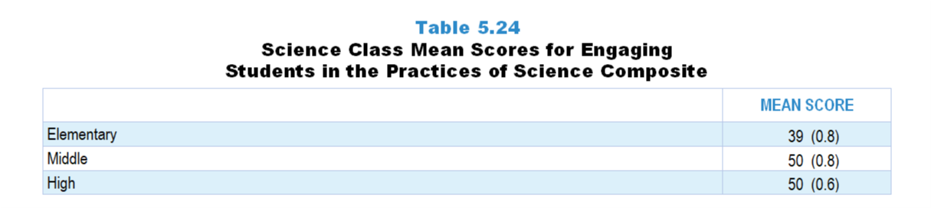
Original Data for Slide 51
(not for presentation)
Notes:
Table 5.24, p. 117 in Technical Report
This slide shows data from composites.
Sets of related questionnaire items were combined to create several composite variables related to key constructs. Composite variables, which are more reliable than individual survey items, were computed to have a minimum possible value of 0 and a maximum possible value of 100. Higher composite scores indicate more of the construct being measure by the composite. Each composite is calculated by summing the responses to the items associated with that composite and then dividing by the total points possible. In order for the composites to be on a 100-point scale, the lowest response option on each scale was set to 0 and the others were adjusted accordingly; so for example, an item with a scale ranging from 1 to 4 was re-coded to have a scale of 0 to 3. By doing this, someone who marks the lowest point on every item in a composite receives a composite score of 0 rather than some positive number. It also assures that 50 is the true mid-point. The denominator for each composite is determined by computing the maximum possible sum of responses for a series of items and dividing by 100; e.g., a 9-item composite where each item is on a scale of 0–3 would have a denominator of 0.27. Composites values were not computed for participants who respond to fewer than two-thirds of the items that form the composite.
Engaging Students in the Practices of Science Composite Items
Q47a. Determine whether or not a question is “scientific” (meaning it requires an answer supported by evidence gathered through systematic investigation)
Q47b. Generate scientific questions based on their curiosity, prior knowledge, careful observation of real-world phenomena, scientific models, or preliminary data from an investigation
Q47c. Determine what data would need to be collected in order to answer a scientific question (regardless of who generated the question)
Q47d. Develop procedures for a scientific investigation to answer a scientific question (regardless of who generated the question)
Q47e. Conduct a scientific investigation (regardless of who developed the procedures)
Q47f. Organize and/or represent data using tables, charts, or graphs in order to facilitate analysis of the data
Q47g. Compare data from multiple trials or across student groups for consistency in order to identify potential sources of error or inconsistencies in the data
Q47h. Analyze data using grade-appropriate methods in order to identify patterns, trends, or relationships
Q47i. Consider how missing data or measurement error can affect the interpretation of data
Q47j. Make and support claims (proposed answers to scientific questions) with evidence
Q47k. Use multiple sources of evidence (for example: different investigations, scientific literature) to develop an explanation
Q47l. Revise their explanations (claims supported by evidence and reasoning) for real-world phenomena based on additional evidence
Q47m. Develop scientific models—physical, graphical, or mathematical representations of real-world phenomena—based on data and reasoning
Q47n. Identify the strengths and limitations of a scientific model—in terms of accuracy, clarity, generalizability, accessibility to others, strength of evidence supporting it—regardless of who created the model
Q47o. Select and use grade-appropriate mathematical and/or statistical techniques to analyze data (for example: determining the best measure of central tendency, examining variation in data, or developing a fit line)
Q47p. Use mathematical and/or computational models to generate data to support a scientific claim
Q47q. Determine what details about an investigation (for example: its design, implementation, and results) might persuade a targeted audience about a scientific claim (regardless of who made the claim)
Q47r. Use data and reasoning to defend, verbally or in writing, a claim or refute alternative scientific claims about a real-world phenomenon (regardless of who made the claims)
Q47s. Evaluate the strengths and weaknesses of competing scientific explanations (claims supported by evidence) for a real-world phenomenon
Q47t. Construct a persuasive case, verbally or in writing, for the best scientific model or explanation for a real-world phenomenon
Q47u. Pose questions that elicit relevant details about the important aspects of a scientific argument (for example: the claims/models/explanations, research design, implementation, data analysis)
Q47v. Evaluate the credibility of scientific information—for example: its reliability, validity, consistency, logical coherence, lack of bias, or methodological strengths and weaknesses (regardless of whether it is from their own or others’ work)
Q47w. Summarize patterns, similarities, and differences in scientific information obtained from multiple sources (regardless of whether it is from their own or others’ work)
Science Teacher Questionnaire
Q47. How often do you have students do each of the following during science instruction in this class? [Select one on each row.](Response Options: [1] Never, [2] Rarely (for example: A few times a year), [3] Sometimes (for example: Once or twice a month), [4] Often (for example: Once or twice a week), [5] All or almost all science lessons)
Determine whether or not a question is “scientific” (meaning it requires an answer supported by evidence gathered through systematic investigation)
Generate scientific questions based on their curiosity, prior knowledge, careful observation of real-world phenomena, scientific models, or preliminary data from an investigation
Determine what data would need to be collected in order to answer a scientific question (regardless of who generated the question)
Develop procedures for a scientific investigation to answer a scientific question (regardless of who generated the question)
Conduct a scientific investigation (regardless of who developed the procedures)
Organize and/or represent data using tables, charts, or graphs in order to facilitate analysis of the data
Compare data from multiple trials or across student groups for consistency in order to identify potential sources of error or inconsistencies in the data
Analyze data using grade-appropriate methods in order to identify patterns, trends, or relationships
Consider how missing data or measurement error can affect the interpretation of data
Make and support claims (proposed answers to scientific questions) with evidence
Use multiple sources of evidence (for example: different investigations, scientific literature) to develop an explanation
Revise their explanations (claims supported by evidence and reasoning) for real-world phenomena based on additional evidence
Develop scientific models—physical, graphical, or mathematical representations of real-world phenomena—based on data and reasoning
Identify the strengths and limitations of a scientific model—in terms of accuracy, clarity, generalizability, accessibility to others, strength of evidence supporting it—regardless of who created the model
Select and use grade-appropriate mathematical and/or statistical techniques to analyze data (for example: determining the best measure of central tendency, examining variation in data, or developing a fit line)
Use mathematical and/or computational models to generate data to support a scientific claim
Determine what details about an investigation (for example: its design, implementation, and results) might persuade a targeted audience about a scientific claim (regardless of who made the claim)
Use data and reasoning to defend, verbally or in writing, a claim or refute alternative scientific claims about a real-world phenomenon (regardless of who made the claims)
Evaluate the strengths and weaknesses of competing scientific explanations (claims supported by evidence) for a real-world phenomenon
Construct a persuasive case, verbally or in writing, for the best scientific model or explanation for a real-world phenomenon
Pose questions that elicit relevant details about the important aspects of a scientific argument (for example: the claims/models/explanations, research design, implementation, data analysis)
Evaluate the credibility of scientific information—for example: its reliability, validity, consistency, logical coherence, lack of bias, or methodological strengths and weaknesses (regardless of whether it is from their own or others’ work)
Summarize patterns, similarities, and differences in scientific information obtained from multiple sources (regardless of whether it is from their own or others’ work)
The numbers in parentheses are standard errors.
Findings Highlighted in Technical Report
“These items were combined into a composite variable titled Engaging Students in the Practices of Science. The scores on this composite indicate that students are more likely to be engaged in doing science in middle and high school classes than they are in elementary classes (see Table 5.24). In addition, the scores indicate that students engage in this set of practices, on average, just once or twice a month or less.”

Slide 51
Engaging Students in Practices of Science Composite

Slide 52
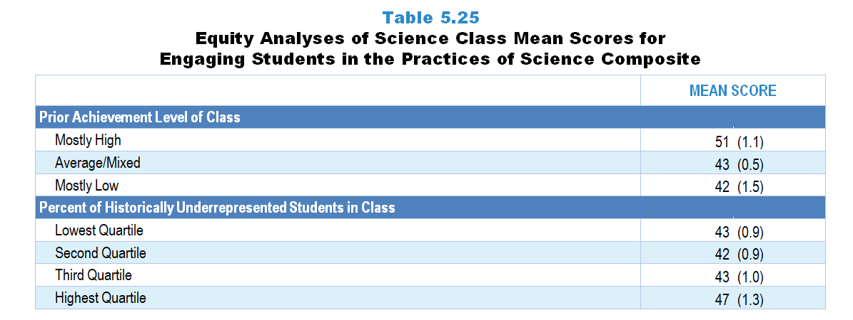
Original Data for Slides 53–54
(not for presentation)
Notes:
Table 5.25, p. 117 in Technical Report
This slide shows data from composites.
Sets of related questionnaire items were combined to create several composite variables related to key constructs. Composite variables, which are more reliable than individual survey items, were computed to have a minimum possible value of 0 and a maximum possible value of 100. Higher composite scores indicate more of the construct being measure by the composite. Each composite is calculated by summing the responses to the items associated with that composite and then dividing by the total points possible. In order for the composites to be on a 100-point scale, the lowest response option on each scale was set to 0 and the others were adjusted accordingly; so for example, an item with a scale ranging from 1 to 4 was re-coded to have a scale of 0 to 3. By doing this, someone who marks the lowest point on every item in a composite receives a composite score of 0 rather than some positive number. It also assures that 50 is the true mid-point. The denominator for each composite is determined by computing the maximum possible sum of responses for a series of items and dividing by 100; e.g., a 9-item composite where each item is on a scale of 0–3 would have a denominator of 0.27. Composites values were not computed for participants who respond to fewer than two-thirds of the items that form the composite.
Engaging Students in the Practices of Science Composite Items
Q47a. Determine whether or not a question is “scientific” (meaning it requires an answer supported by evidence gathered through systematic investigation)
Q47b. Generate scientific questions based on their curiosity, prior knowledge, careful observation of real-world phenomena, scientific models, or preliminary data from an investigation
Q47c. Determine what data would need to be collected in order to answer a scientific question (regardless of who generated the question)
Q47d. Develop procedures for a scientific investigation to answer a scientific question (regardless of who generated the question)
Q47e. Conduct a scientific investigation (regardless of who developed the procedures)
Q47f. Organize and/or represent data using tables, charts, or graphs in order to facilitate analysis of the data
Q47g. Compare data from multiple trials or across student groups for consistency in order to identify potential sources of error or inconsistencies in the data
Q47h. Analyze data using grade-appropriate methods in order to identify patterns, trends, or relationships
Q47i. Consider how missing data or measurement error can affect the interpretation of data
Q47j. Make and support claims (proposed answers to scientific questions) with evidence
Q47k. Use multiple sources of evidence (for example: different investigations, scientific literature) to develop an explanation
Q47l. Revise their explanations (claims supported by evidence and reasoning) for real-world phenomena based on additional evidence
Q47m. Develop scientific models—physical, graphical, or mathematical representations of real-world phenomena—based on data and reasoning
Q47n. Identify the strengths and limitations of a scientific model—in terms of accuracy, clarity, generalizability, accessibility to others, strength of evidence supporting it—regardless of who created the model
Q47o. Select and use grade-appropriate mathematical and/or statistical techniques to analyze data (for example: determining the best measure of central tendency, examining variation in data, or developing a fit line)
Q47p. Use mathematical and/or computational models to generate data to support a scientific claim
Q47q. Determine what details about an investigation (for example: its design, implementation, and results) might persuade a targeted audience about a scientific claim (regardless of who made the claim)
Q47r. Use data and reasoning to defend, verbally or in writing, a claim or refute alternative scientific claims about a real-world phenomenon (regardless of who made the claims)
Q47s. Evaluate the strengths and weaknesses of competing scientific explanations (claims supported by evidence) for a real-world phenomenon
Q47t. Construct a persuasive case, verbally or in writing, for the best scientific model or explanation for a real-world phenomenon
Q47u. Pose questions that elicit relevant details about the important aspects of a scientific argument (for example: the claims/models/explanations, research design, implementation, data analysis)
Q47v. Evaluate the credibility of scientific information—for example: its reliability, validity, consistency, logical coherence, lack of bias, or methodological strengths and weaknesses (regardless of whether it is from their own or others’ work)
Q47w. Summarize patterns, similarities, and differences in scientific information obtained from multiple sources (regardless of whether it is from their own or others’ work)
Science Teacher Questionnaire
Q47. How often do you have students do each of the following during science instruction in this class? [Select one on each row.](Response Options: [1] Never, [2] Rarely (for example: A few times a year), [3] Sometimes (for example: Once or twice a month), [4] Often (for example: Once or twice a week), [5] All or almost all science lessons)
Determine whether or not a question is “scientific” (meaning it requires an answer supported by evidence gathered through systematic investigation)
Generate scientific questions based on their curiosity, prior knowledge, careful observation of real-world phenomena, scientific models, or preliminary data from an investigation
Determine what data would need to be collected in order to answer a scientific question (regardless of who generated the question)
Develop procedures for a scientific investigation to answer a scientific question (regardless of who generated the question)
Conduct a scientific investigation (regardless of who developed the procedures)
Organize and/or represent data using tables, charts, or graphs in order to facilitate analysis of the data
Compare data from multiple trials or across student groups for consistency in order to identify potential sources of error or inconsistencies in the data
Analyze data using grade-appropriate methods in order to identify patterns, trends, or relationships
Consider how missing data or measurement error can affect the interpretation of data
Make and support claims (proposed answers to scientific questions) with evidence
Use multiple sources of evidence (for example: different investigations, scientific literature) to develop an explanation
Revise their explanations (claims supported by evidence and reasoning) for real-world phenomena based on additional evidence
Develop scientific models—physical, graphical, or mathematical representations of real-world phenomena—based on data and reasoning
Identify the strengths and limitations of a scientific model—in terms of accuracy, clarity, generalizability, accessibility to others, strength of evidence supporting it—regardless of who created the model
Select and use grade-appropriate mathematical and/or statistical techniques to analyze data (for example: determining the best measure of central tendency, examining variation in data, or developing a fit line)
Use mathematical and/or computational models to generate data to support a scientific claim
Determine what details about an investigation (for example: its design, implementation, and results) might persuade a targeted audience about a scientific claim (regardless of who made the claim)
Use data and reasoning to defend, verbally or in writing, a claim or refute alternative scientific claims about a real-world phenomenon (regardless of who made the claims)
Evaluate the strengths and weaknesses of competing scientific explanations (claims supported by evidence) for a real-world phenomenon
Construct a persuasive case, verbally or in writing, for the best scientific model or explanation for a real-world phenomenon
Pose questions that elicit relevant details about the important aspects of a scientific argument (for example: the claims/models/explanations, research design, implementation, data analysis)
Evaluate the credibility of scientific information—for example: its reliability, validity, consistency, logical coherence, lack of bias, or methodological strengths and weaknesses (regardless of whether it is from their own or others’ work)
Summarize patterns, similarities, and differences in scientific information obtained from multiple sources (regardless of whether it is from their own or others’ work)
Chapters 2–7 in the technical report provide data on several key indicators, disaggregated by one or more equity factors: the prior achievement level of students in the class, the percentage of students from race/ethnicity groups historically underrepresented in STEM in the class, the percentage of students in the school eligible for free/reduced-price lunch (FRL), school size, community type, and region. For FRL, each school was classified into one of four categories (defined as quartiles) based on the proportion of students eligible for FRL. Similarly, each randomly selected class was classified into one of the four categories based on the proportion of students from race/ethnicity groups historically underrepresented in STEM in the class.
The numbers in parentheses are standard errors.
Findings Highlighted in Technical Report
“Table 5.25 displays scores on this composite by the two class-level equity factors. Students in classes of mostly high prior achievers are more likely to be engaged in these practices than classes of average or low prior achievers. In addition, when considering the percentage of students in classes from race/‌ethnicity groups historically underrepresented in STEM, classes in the highest quartile are more likely to be engaged in these practices than classes in the other three quartiles.”

Slide 53
Engaging Students in the Practices of Science Composite

Slide 54
Engaging Students in the Practices of Science Composite
Notes:
Historically Underrepresented Students includes American Indian or Alaskan Native, Black or African American, Hispanic or Latino, or Native Hawaiian or Other Pacific Islander students.

Slide 55
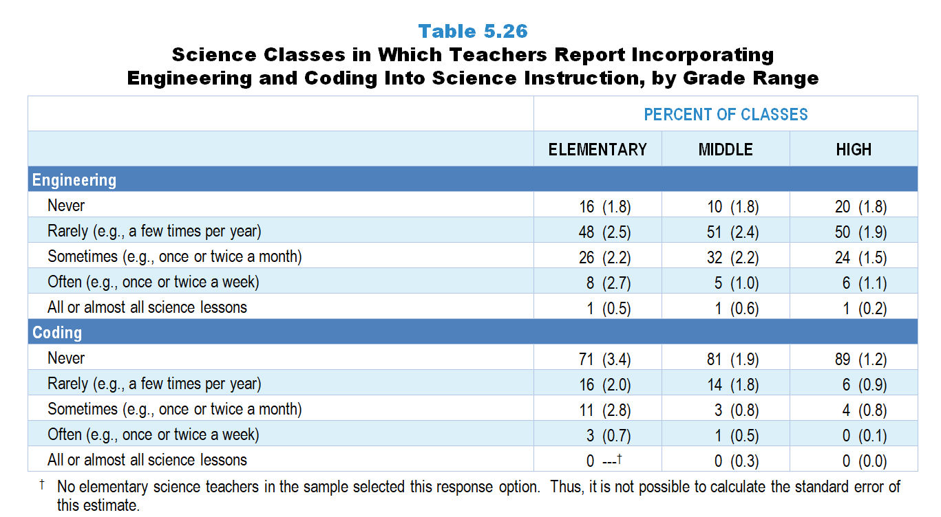
Original Data for Slides 56–57
(not for presentation)
Notes:
Table 5.26, p. 118 in Technical Report
This slide shows data from individual items.
Science Teacher Questionnaire
Q48. Thinking about your instruction in this class over the entire year, about how often do you incorporate engineering into your science instruction?
Never
Rarely (for example: A few times per year)
Sometimes (for example: Once or twice a month)
Often (for example: Once or twice a week)
All or almost all science lessons
Q49. Thinking about your instruction in this class over the entire year, about how often do you have students use coding to develop or revise computer programs as part of your science instruction (for example: use Scratch or Python as part of doing science)?
Never
Rarely (for example: A few times per year)
Sometimes (for example: Once or twice a month)
Often (for example: Once or twice a week)
All or almost all science lessons
The numbers in parentheses are standard errors.
Findings Highlighted in Technical Report
“Given recent trends to incorporate engineering and computer science into science education, the 2018 NSSME+ asked teachers how frequently they do so. As can be seen in Table 5.26, the typical science class experiences engineering a few times per year (48–51 percent of classes depending on grade level). About a third of science classes incorporate engineering at least monthly. In terms of coding, a large majority (71–89 percent) of classes never include coding as part of their science instruction. Interestingly, coding occurs somewhat more often in elementary classes than in middle or high school classes.”

Slide 56
Science Classes in Which Teachers Report Incorporating Engineering Into Science Instruction

Slide 57
Science Classes in Which Teachers Report Incorporating Coding Into Science Instruction

Slide 58
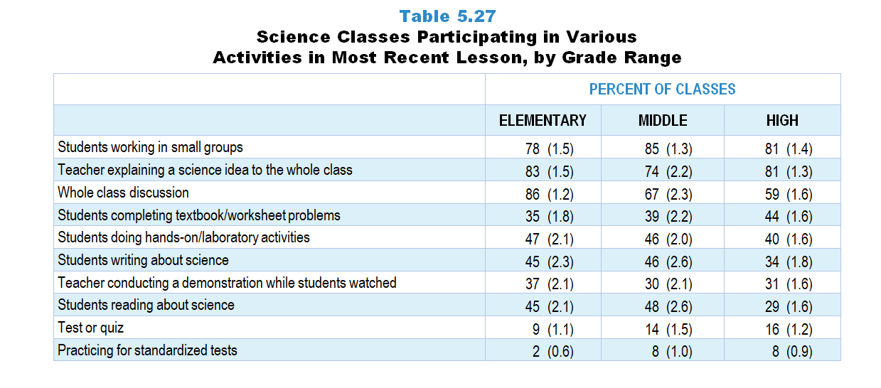
Original Data for Slides 59–61
(not for presentation)
Notes:
Table 5.27, p. 118 in Technical Report
This slide shows data from an individual item.
Science Teacher Questionnaire
Q70. Which of the following activities took place during that day’s science lesson? [Select all that apply.]
Teacher explaining a science idea to the whole class
Teacher conducting a demonstration while students watched
Whole class discussion
Students working in small groups
Students completing textbook/worksheet problems
Students doing hands-on/laboratory activities
Students reading about science
Students writing about science (do not include students taking notes)
Practicing for standardized tests
Test or quiz
None of the above
The numbers in parentheses are standard errors.
Findings Highlighted in Technical Report
“In addition to asking about class activities in the course as a whole, teachers were asked about activities that took place during their most recent science lesson in the randomly selected class. As can be seen in Table 5.27, small group work and the teacher explaining science ideas to the whole class are the most common activities, occurring in three-quarters or more of classes. Whole class discussions are also relatively common, though more so in elementary classes than middle or high school classes (86, 67, and 59 percent of classes, respectively). Almost half of elementary and middle school classes include students doing hands-on/‌laboratory activities and students writing about science in the most recent lesson, compared to 4 in 10 or fewer high school classes.”

Slide 59
Elementary Science Classes Participating in Various Activities in the Most Recent Lesson
Notes:
Note: Each grade-level chart is sorted independently; consequently items may appear in different orders.

Slide 60
Middle School Science Classes Participating in Various Activities in the Most Recent Lesson
Notes:
Note: Each grade-level chart is sorted independently; consequently items may appear in different orders.

Slide 61
High School Science Classes Participating in Various Activities in the Most Recent Lesson
Notes:
Note: Each grade-level chart is sorted independently; consequently items may appear in different orders.

Slide 62
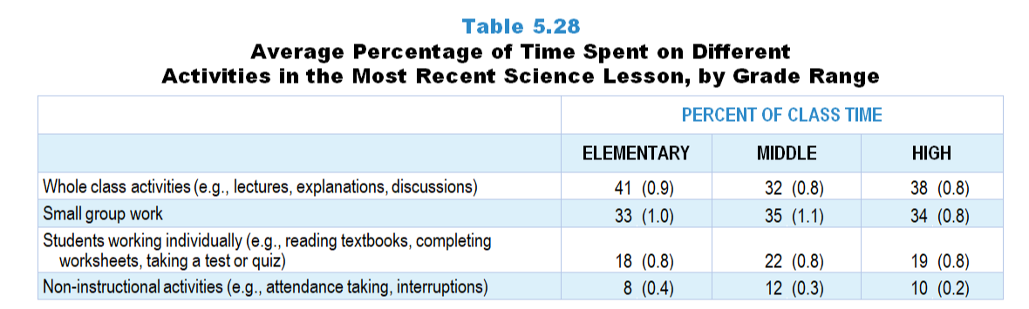
Original Data for Slide 63
(not for presentation)
Notes:
Table 5.28, p. 119 in Technical Report
This slide shows data derived from:
Science Teacher Questionnaire
Q68. How many minutes was that day’s science lesson? Answer for the entire length of the class period, even if there were interruptions. ____
Q69. Of these minutes, how many were spent on the following:
Non-instructional activities (for example: attendance taking, interruptions) ____
Whole class activities (for example: lectures, explanations, discussions) ____
Small group work ____
Students working individually (for example: reading textbooks, completing worksheets, taking a test or quiz) ____
The numbers in parentheses are standard errors.
Findings Highlighted in Technical Report
“The survey also asked teachers to estimate the time spent on each of a number of types of activities in this most recent science lesson. Across the grades, about 40 percent of class time is spent on whole class activities, 30 percent on small group work, and 20 percent on students working individually (see Table 5.28). Non-instructional activities, including attendance taking and interruptions, account for about 10 percent or less of science class time.”

Slide 63
Percentage of Time Spent on Different Activities in the Most Recent Science Lesson

Slide 64
Homework and Assessment Practices

Slide 65
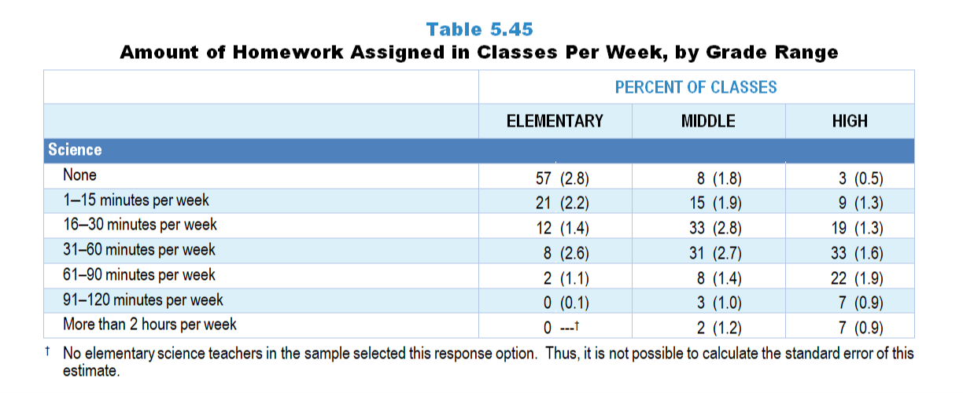
Original Data for Slide 66
(not for presentation)
Notes:
The science portion of Table 5.45, p. 129 in Technical Report
This slide shows data from an individual item.
Science Teacher Questionnaire
Q52. In a typical week, how much time outside of this class are students expected to spend on science assignments?
None
1–15 minutes per week
16–30 minutes per week
31–60 minutes per week
61–90 minutes per week
91–120 minutes per week
More than 2 hours per week
The numbers in parentheses are standard errors.
Findings Highlighted in Technical Report
“Teachers were asked about the amount of homework assigned per week in the randomly selected class. Across the grade levels, students in mathematics classes are assigned more homework than students in science classes, particularly when looking at the percentage of classes assigned 31 minutes or more per week (see Table 5.45). This pattern is particularly evident in elementary classes, where students in 31 percent of classes are given 31–60 minutes of mathematics homework a week; only 8 percent of elementary classes are assigned this much science homework. Not surprisingly, the amount of time students are asked to spend on science and mathematics homework increases with grade range. For example, over half of high school mathematics classes are assigned one or more hours of homework per week, compared to under one-fifth of elementary classes. Homework expectations in high school computer science classes are similar to those in high school science classes.”

Slide 66
Amount of Homework Assigned in Science Classes Per Week

Slide 67
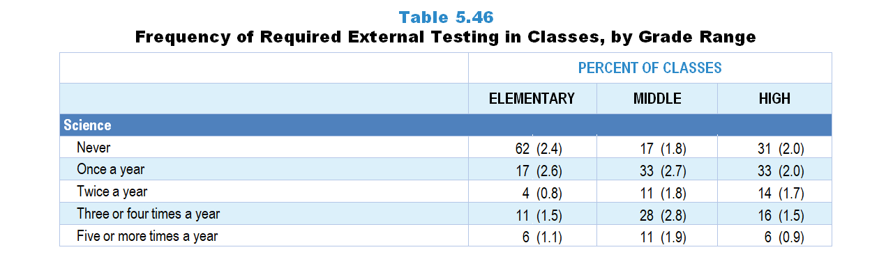
Original Data for Slide 68
(not for presentation)
Notes:
The science portion Table 5.46, p. 130 in Technical Report
This slide shows data from an individual item.
Science Teacher Questionnaire
Q51. How often are students in this class required to take science tests that you did not choose to administer, for example state assessments or district benchmarks? Do not include Advanced Placement or International Baccalaureate exams or students retaking a test because of failure.
Never
Once a year
Twice a year
Three or four times a year
Five or more times a year
The numbers in parentheses are standard errors.
Findings Highlighted in Technical Report
“In science and mathematics, the survey asked how often students in the randomly selected class are required to take assessments the teachers did not develop, such as state or district benchmark assessments. Given that mathematics tends to be included in the high stakes accountability systems of states at more grades than science, it is not surprising that the frequency of external testing is greater in mathematics classes than in science classes, particularly at the elementary and middle grades levels (see Table 5.46). At the elementary level, 62 percent of classes never administer external science assessments; only 9 percent never administer external mathematics assessments.”

Slide 68
Frequency of Required External Testing in Science Classes

Slide 69
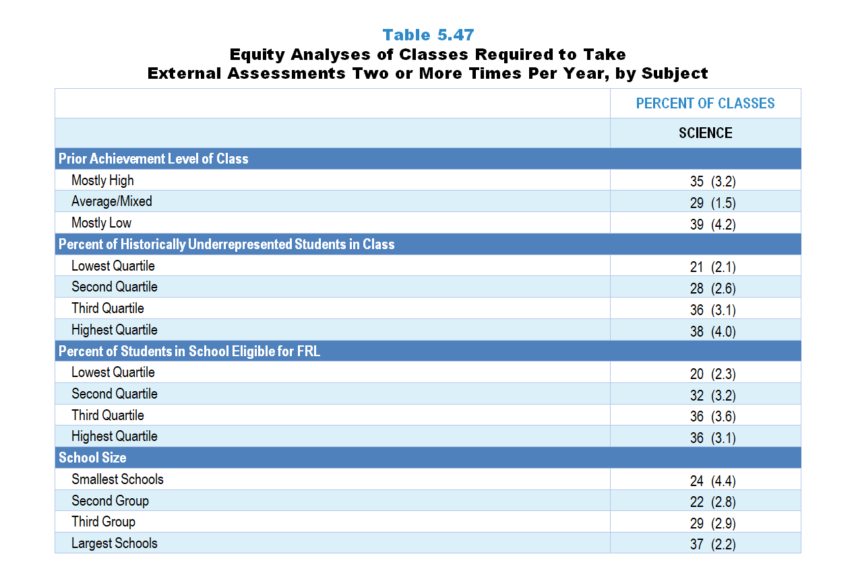
Original Data for Slides 70–73
(not for presentation)
Notes:
The science portion Table 5.47, p. 131 in Technical Report
This slide shows data from an individual item.
Science Teacher Questionnaire
Q51. How often are students in this class required to take science tests that you did not choose to administer, for example state assessments or district benchmarks? Do not include Advanced Placement or International Baccalaureate exams or students retaking a test because of failure.
Never
Once a year
Twice a year
Three or four times a year
Five or more times a year
The numbers in parentheses are standard errors.
Chapters 2–7 in the technical report provide data on several key indicators, disaggregated by one or more equity factors: the prior achievement level of students in the class, the percentage of students from race/ethnicity groups historically underrepresented in STEM in the class, the percentage of students in the school eligible for free/reduced-price lunch (FRL), school size, community type, and region. For FRL, each school was classified into one of four categories (defined as quartiles) based on the proportion of students eligible for FRL. Similarly, each randomly selected class was classified into one of the four categories based on the proportion of students from race/ethnicity groups historically underrepresented in STEM in the class.
Findings Highlighted in Technical Report
“The prior achievement level of the class, percentage of students in the class from race/‌ethnicity groups historically underrepresented in STEM, percentage of students in the school eligible for free/‌reduced-price lunch, and school size are all related to the frequency with which classes are required to take external assessments. As can be seen in Table 5.47, classes with mostly low-achieving students are more likely than classes with mostly high prior achievers to take external mathematics assessments two or more times per year. Similarly, in both science and mathematics, the greater the percentage of students from race/‌ethnicity groups historically underrepresented in STEM in the class and the greater the percentage of students eligible for free/‌reduced-price lunch in the school, the more likely students are to be tested this frequently.”

Slide 70
Science Classes Required to Take External Assessments Two or More Times Per Year

Slide 71
Science Classes Required to Take External Assessments Two or More Times Per Year
Notes:
Historically Underrepresented Students includes American Indian or Alaskan Native, Black or African American, Hispanic or Latino, or Native Hawaiian or Other Pacific Islander students.
Slide shows the composite scores by quartile of percentage of historically underrepresented students in the randomly selected class.

Slide 72
Science Classes Required to Take External Assessments Two or More Times Per Year
Notes:
Slide shows the composite scores by quartile of percentage of students in school eligible for free and reduced lunch.

Slide 73
Science Classes Required to Take External Assessments Two or More Times per Year

