Slide 1
Chapter 6 Instructional Resources
Computer Science

Slide 2
Use of Textbooks and Other Instructional Resources

Slide 3
Original Data for Slide 4
(not for presentation)
Notes:
The computer science portion of Table 6.1, p. 133 in Technical Report
This slide shows data from an individual item.
Computer Science Teacher Questionnaire
Q36. Does your school/district/diocese designate instructional materials (textbooks, units, or lessons) to be used in this class?
Yes
No
The numbers in parentheses are standard errors.
Findings Highlighted in Technical Report
“The 2018 NSSME+ collected data on the use of various instructional resources, including commercially published textbooks or programs, both print and electronic. Of particular interest is how much latitude teachers have in selecting instructional resources. Table 6.1 shows that instructional materials are designated by the district‌ for most science and mathematics classes. The likelihood of having designated materials decreases from elementary school to high school in mathematics. Also, mathematics classes are generally more likely to have designated materials, perhaps due to the greater accountability emphasis in mathematics. High school computer science classes are very unlikely to have designated materials; only about a quarter have materials designated for them.”

Slide 4
High School Computer Science Classes for Which the District Designates Instructional Materials to Be Used

Slide 5
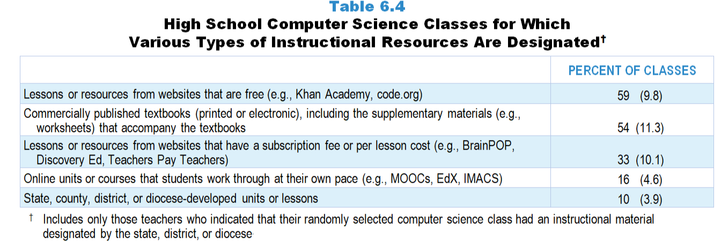
Original Data for Slide 6
(not for presentation)
Notes:
Table 6.4, p. 135 in Technical Report
This slide shows data from an individual item.
Computer Science Teacher Questionnaire
Q37. Which of the following types of instructional materials does your school/district/diocese designate to be used in this class? [Select all that apply.]
Commercially published textbooks (printed or electronic), including the supplementary materials (for example: worksheets, laboratory handouts) that accompany the textbooks
State, county, or district/diocese-developed instructional materials
Online units or courses that students work through at their own pace (for example: MOOCs, EdX, IMACS)
Lessons or resources from websites that have a subscription fee or per lesson cost (for example: BrainPOP, Discovery Ed, Teachers Pay Teachers)
Lessons or resources from websites that are free (for example: Khan Academy, code.org)
The numbers in parentheses are standard errors.
Findings Highlighted in Technical Report
“As reported above, teachers of only about a quarter of high school computer science classes indicate having instructional materials designated. Among these classes, free, web-based resources are just as prominent as the textbook (see Table 6.4).”

Slide 6
High School Computer Science Classes for Which Various Types of Instructional Resources Are Designated
Notes:
Only high school computer science classes for which instructional materials are designated by the state, district, or diocese are included in these analyses.

Slide 7
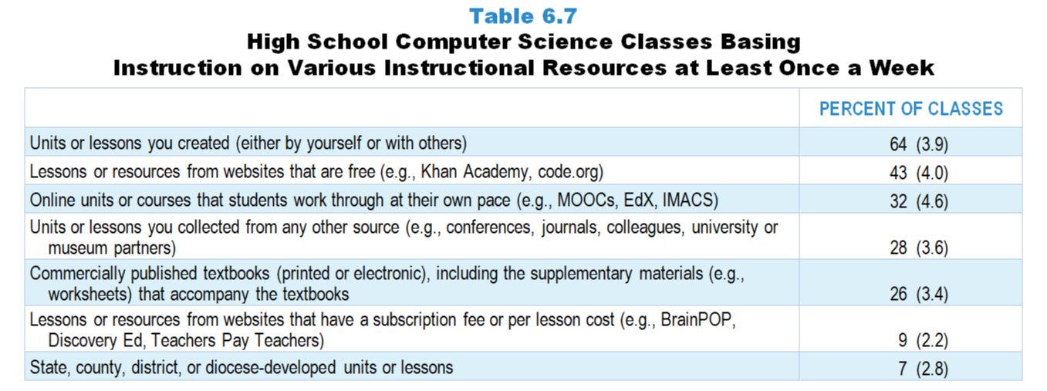
Original Data for Slide 8
(not for presentation)
Notes:
Table 6.7, p. 136 in Technical Report
This slide shows data from an individual item.
Computer Science Teacher Questionnaire
Q35. Thinking about your instruction in this class over the entire year, about how often is instruction based on materials from each of the following sources? [Select one on each row.] (Response Options: [1] Never, [2] Rarely (for example: A few times a year), [3] Sometimes (for example: Once or twice a month), [4] Often (for example: Once or twice a week), [5] All or almost all science lessons)
Commercially published textbooks (printed or electronic), including the supplementary materials (for example: worksheets) that accompany the textbooks
State, county, or district/diocese-developed units or lessons
Online units or courses that students work through at their own pace (for example: MOOCs, EdX, IMACS)
Lessons or resources from websites that have a subscription fee or per lesson cost (for example: BrainPOP, Discovery Ed, Teachers Pay Teachers)
Lessons or resources from websites that are free (for example: Khan Academy, code.org)
Units or lessons you created (either by yourself or with others)
Units or lessons you collected from any other source (for example: conferences, journals, colleagues, university or museum partners)
The numbers in parentheses are standard errors.
Findings Highlighted in Technical Report
“In high school computer science, like science and mathematics, classes are most likely to be based on teacher-created lessons (64 percent at least once a week; see Table 6.7), with lessons from free websites a distant second (43 percent). Compared to high school classes in the other subjects, computer science instruction is much less likely to be based on a commercially published textbook and considerably more likely to be based on free websites and online self-paced materials.”

Slide 8
High School Computer Science Classes Basing Instruction on Various Instructional Resources at Least Once a Week

Slide 9
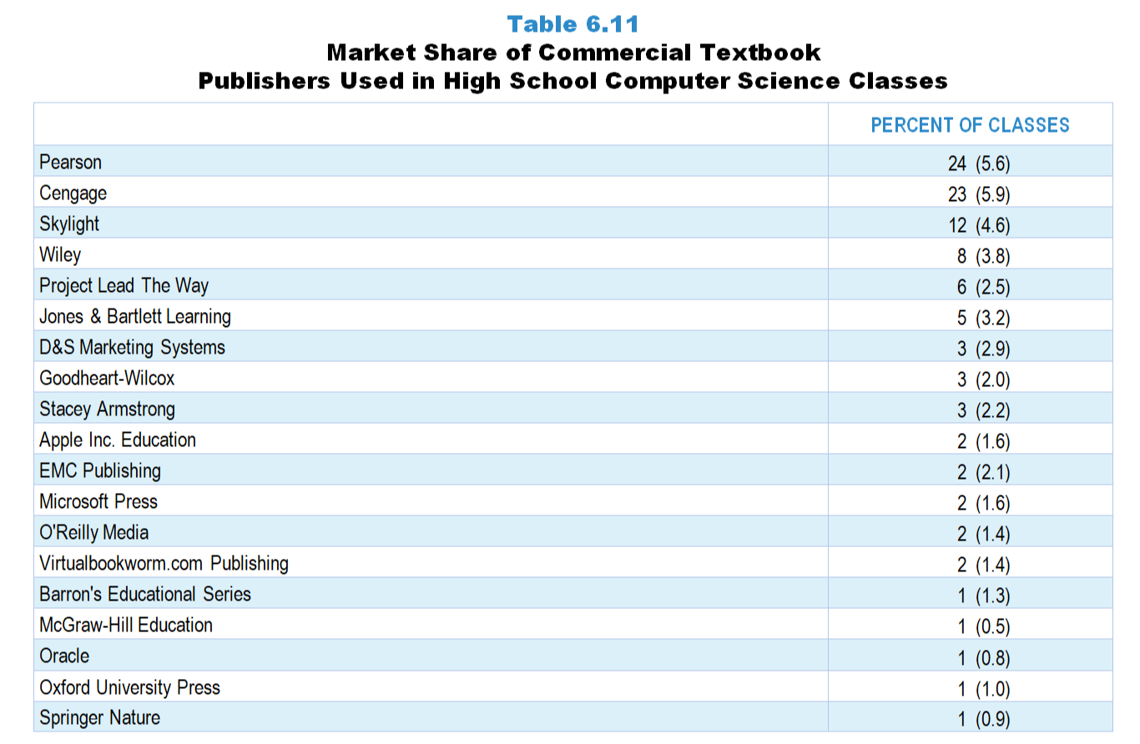
Original Data for Slide 10
(not for presentation)
Notes:
Table 6.11, p. 140 in Technical Report
This slide shows data derived from:
Computer Science Teacher Questionnaire
Q39. [Presented only to teachers who selected “Sometimes” “Often” or “All” for Q35a or c]
[Version for teachers who indicate using a commercial textbook most often]
Please indicate the title, author, most recent copyright year, and ISBN code of the commercially published textbook or kits/modules (printed or electronic) used most often by the students in this class.
If you use multiple kits/modules, select one to enter the information for.
The 10- or 13-character ISBN code can be found on the copyright page and/or the back cover of the textbook/module.
Do not include the dashes when entering the ISBN.
An example of the location of the ISBN is shown to the right.
Title: ____
First Author: ____
Year: ____
ISBN: ____
URL: [for teachers who indicate using an online program most often]
The numbers in parentheses are standard errors.
Findings Highlighted in Technical Report
“Teachers who indicated that instruction in their randomly selected class was based substantially on a commercially published textbook or module were asked to record the title, author, year, and ISBN of the material used most often in the class. Using this information, the publisher of the material was identified. Tables 6.9–6.11 show the market share held by each of the major science, mathematics, and computer science textbook publishers. It is interesting to note that three publishers—Pearson, McGraw-Hill, and Houghton Mifflin Harcourt—account for instructional materials used in more than 75 percent of middle school and high school science classes and more than 70 percent of all mathematics classes. The only other publishers with a substantial share of the market are Delta Education in elementary science and Great Minds in elementary mathematics. In high school computer science, Pearson again has a considerable market share, followed closely by Cengage.”

Slide 10
Market Share of Commercial Textbook Publishers in High School Computer Science Classes

Slide 11
Original Data for Slide 12
(not for presentation)
Notes:
The computer science portion of Table 6.14, p. 143 in Technical Report
This slide shows data from an individual item.
Computer Science Teacher Questionnaire
Q39. [Presented only to teachers who selected “Sometimes” “Often” or “All” for Q35a or c]
[Version for teachers who indicate using a commercial textbook most often]
Please indicate the title, author, most recent copyright year, and ISBN code of the commercially published textbook or kits/modules (printed or electronic) used most often by the students in this class.
If you use multiple kits/modules, select one to enter the information for.
The 10- or 13-character ISBN code can be found on the copyright page and/or the back cover of the textbook/module.
Do not include the dashes when entering the ISBN.
An example of the location of the ISBN is shown to the right.
Title: ____
First Author: ____
Year: ____
ISBN: ____
URL: [for teachers who indicate using an online program most often]
The numbers in parentheses are standard errors.
Findings Highlighted in Technical Report
“Table 6.14 shows the publication year of science, mathematics, and computer science textbooks. In 2018, 43–51 percent of science classes used textbooks published in 2009 or earlier. Science classes are considerably more likely than mathematics classes to use older textbooks. For example, 51 percent of middle grades science classes are using textbooks published in 2009 or earlier, compared to only 15 percent of middle grades mathematics classes. Given the growing presence of computer science classes, it is surprising that a third of them are using textbooks published in 2009 or earlier, but it is important to remember that a relatively small proportion of these classes use published materials at all.”

Slide 12
Publication Year of High School Computer Science Textbooks/Programs
Notes:
Only high school computer science classes using commercially published textbooks/programs are included in these analyses.

Slide 13
Original Data for Slide 14
(not for presentation)
Notes:
The computer science portion of Table 6.15, p. 143 in Technical Report
This slide shows data from an individual item.
Computer Science Teacher Questionnaire
Q62. [Presented only to teachers who selected “Sometimes” “Often” or “All” for Q35a or c]
Was this unit based primarily on a commercially published textbook/kit/module or state, county, or district/diocese-developed materials?
Yes
No
The numbers in parentheses are standard errors.
Findings Highlighted in Technical Report
“Teachers were also asked whether the most recent unit in their randomly selected class was based primarily on either a commercially published textbook or materials developed by the state or district. (Computer science teachers were asked about commercially published online courses in addition.) As shown in Table 6.15, more than half of classes—mathematics classes in particular—are based on such materials.”

Slide 14
High School Computer Science Classes in Which the Most Recent Unit Was Based on a Commercially Published Textbook or a Material Developed by the State or District

Slide 15
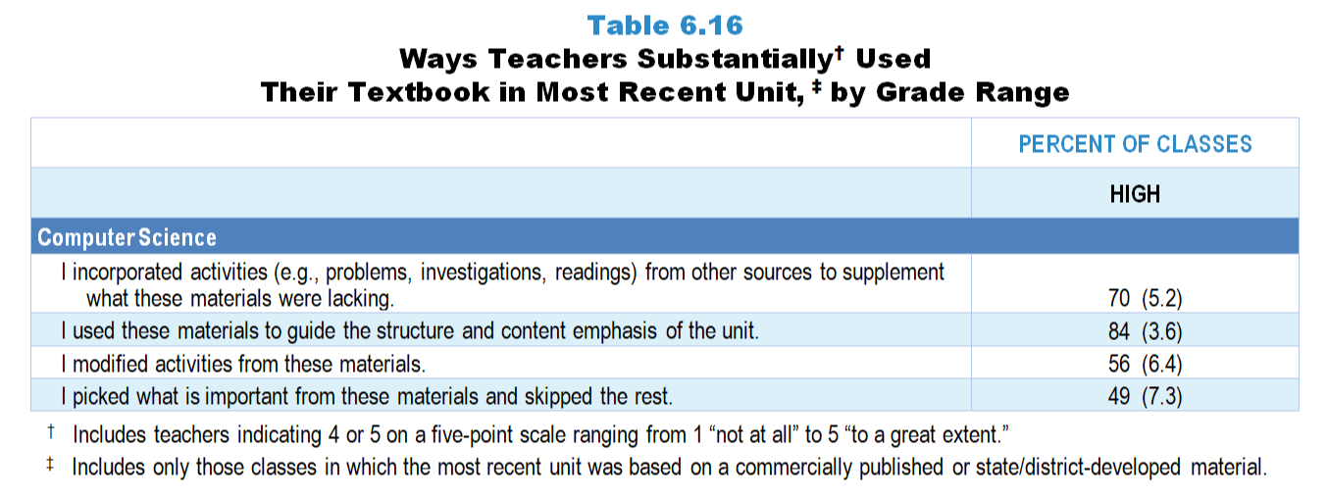
Original Data for Slide 16
(not for presentation)
Notes:
The computer science portion of the Table 6.16, p. 144 in Technical Report
This slide shows data from an individual item.
Computer Science Teacher Questionnaire
Q45. Please indicate the extent to which you did each of the following while teaching this unit. [Select one on each row.] (Response Options: [1] Not at all, [2] 2 of 5, [3] Somewhat, [4] 4 of 5, [5] To a great extent)
I used these materials to guide the structure and content emphasis of the unit.
I picked what is important from these materials and skipped the rest.
I incorporated activities (for example: problems, investigations, readings) from other sources to supplement what these materials were lacking.
I modified activities from these materials.
The numbers in parentheses are standard errors.
Findings Highlighted in Technical Report
“When teachers responded that their most recent unit was based on one of these materials, they were asked how they used the material (see Table 6.16). Two important findings emerge from these data. First, when classes use commercially published and state/‌district-developed materials, the materials heavily influence instruction in all subjects at all grade ranges. Teachers in more than 70 percent of classes in the various subject and grade-level categories use the textbook substantially to guide the overall structure and content emphasis of their units. Second, it is clear that teachers modify their materials substantially when designing instruction. In roughly half or more of classes, teachers incorporate activities from other sources substantially, “pick and choose” from the material, and modify activities from the materials. “

Slide 16
Ways High School Computer Science Teachers Substantially Used Their Textbook in the Most Recent Unit
Notes:
Includes high school computer science teachers indicating 4 or 5 on a 5-point scale ranging from 1 “not at all” to 5 “to a great extent.”
Only high school computer science classes in which the most recent unit was based on commercially published or state/‌district-developed materials are included in these analyses.

Slide 17
Original Data for Slide 18
(not for presentation)
Notes:
The computer science portion of Table 6.17, p. 145 in Technical Report
This slide shows data from an individual item.
Computer Science Teacher Questionnaire
Q46. [Presented only to teachers who did not select “Not at all” for Q45b]
During this unit, when you skipped activities (for example: problems, investigations, readings) in these materials, how much was each of the following a factor in your decisions? [Select one on each row.] (Response Options: [1] Not a factor, [2] A minor factor, [3] A major factor)
The computer science ideas addressed in the activities I skipped are not included in my pacing guide/standards.
I did not have the materials needed to implement the activities I skipped.
I did not have the knowledge needed to implement the activities I skipped.
The activities I skipped were too difficult for my students.
My students already knew the computer science ideas or were able to learn them without the activities I skipped.
I have different activities for those computer science ideas that work better than the ones I skipped.
I did not have enough instructional time for the activities I skipped.
The numbers in parentheses are standard errors.
Findings Highlighted in Technical Report
“Teachers in roughly half of science, mathematics, and computer science classes skip activities in the material substantially. As can be seen in Table 6.17, in all subjects, some of the most frequently selected reasons for skipping parts of the materials are: (1) having another activity that works better than the one skipped, (2) the science ideas addressed not being included in pacing guides or standards, (3) not having enough instructional time, and (4) the activities skipped being too difficult for the students. In more than 40 percent of classes, teachers skip activities that they deem unnecessary (students either already knew the ideas or could learn them without the activities). Differences across grades, however, are also apparent. For example, in mathematics, teachers in 38 percent of elementary classes cite the difficulty of the activity as the reason for skipping it, compared to 55 percent in high school mathematics classes. A similar pattern is evident in science. Also, not having materials for an activity is much more likely to be cited as a reason in science classes (54–62 percent) than in mathematics classes (24–27 percent) or high school computer science classes (28 percent).”

Slide 18
Reasons Why Parts of Materials Are Skipped in High School Computer Science Classes
Notes:
Only high school computer science classes in which (1) the most recent unit was based on commercially published or state/district-developed materials and (2) teachers reported skipping some activities are included in these analyses.

Slide 19
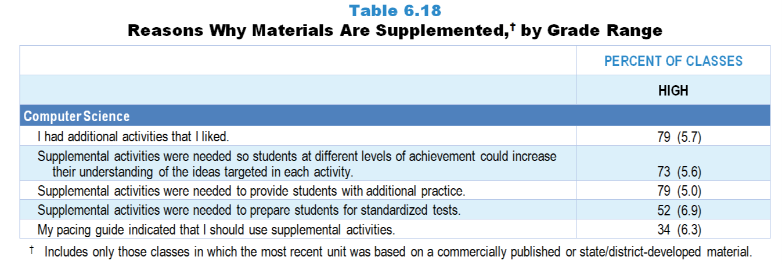
Original Data for Slide 20
(not for presentation)
Notes:
The computer science portion of Table 6.18, p. 146 in Technical Report
This slide shows data from an individual item.
Computer Science Teacher Questionnaire
Q47. [Presented only to teachers who did not select “Not at all” for Q45c]
During this unit, when you supplemented these materials with additional activities, how much was each of the following a factor in your decisions? [Select one on each row.] (Response Options: [1] Not a factor, [2] A minor factor, [3] A major factor)
My pacing guide indicated that I should use supplemental activities.
Supplemental activities were needed to prepare students for standardized tests.
Supplemental activities were needed to provide students with additional practice.
Supplemental activities were needed so students at different levels of achievement could increase their understanding of the ideas targeted in each activity.
I had additional activities that I liked.
The numbers in parentheses are standard errors.
Findings Highlighted in Technical Report
“Given that teachers often skip activities in their materials because they know of better ones, it is perhaps not surprising that teachers in well more than half of science, mathematics, and computer science classes supplement their materials. Of the reasons listed on the questionnaire, three stand out above the rest: (1) teachers having additional activities that they like, (2) providing students with additional practice, and (3) differentiating instruction for students at different achievement levels (see Table 6.18). The influence of standardized testing is also evident, with teachers in anywhere from about half to almost three-fourths of classes across subjects supplementing for test-preparation purposes. Finally, in 34–49 percent of classes, depending on subject and grade level, teachers supplement their published material because their pacing guide indicates that they should. This finding both speaks to the prevalence of pacing guides and suggests that supplementing is at least to some extent sanctioned or prescribed by schools and districts.”

Slide 20
Reasons Why Materials Are Supplemented in High School Computer Science Classes
Notes:
Only high school computer science classes in which (1) the most recent unit was based on commercially published or state/district-developed materials and (2) teachers reported supplementing some activities are included in these analyses.

Slide 21
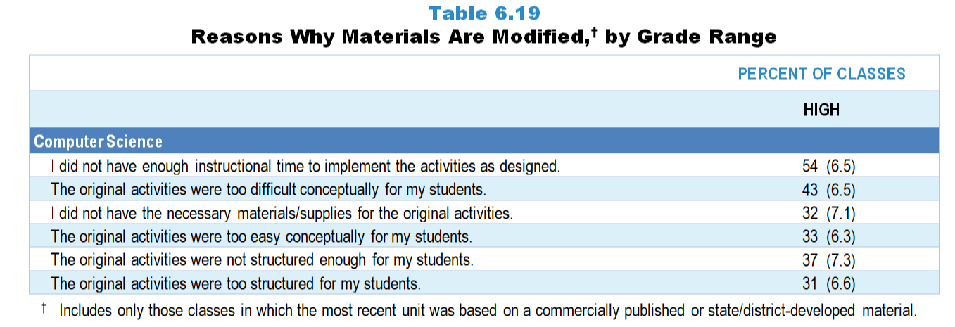
Original Data for Slide 22
(not for presentation)
Notes:
The computer science portion of Table 6.19, p. 147 in Technical Report
This slide shows data from an individual item.
Computer Science Teacher Questionnaire
Q48. [Presented only to teachers who did not select “Not at all” in Q45d]
During this unit, when you modified activities from these materials, how much was each of the following a factor in your decisions? [Select one on each row.] (Response Options: [1] Not a factor, [2] A minor factor, [3] A major factor)
I did not have the necessary materials/supplies for the original activities.
The original activities were too difficult conceptually for my students.
The original activities were too easy conceptually for my students.
I did not have enough instructional time to implement the activities as designed.
The original activities were too structured for my students.
The original activities were not structured enough for my students.
The numbers in parentheses are standard errors.
Findings Highlighted in Technical Report
“Finally, when teachers reported that they modified their published material (which over half did), they rated each of several factors that may have contributed to their decision (see Table 6.19). Two factors stand out: teachers do not have enough time to implement the activities as designed (52–71 percent of classes), and the activities are too difficult for students (43–58 percent of classes). In science, teachers are also likely to cite not having the necessary materials or supplies for the original activities (53–62 percent of classes). Teachers are about equally likely to point to the structure of activities (either too much or too little) across subjects and grade ranges as the reason for modifications.”

Slide 22
Reasons Why Materials Are Modified in High School Computer Science Classes
Notes:
Only high school computer science classes in which (1) the most recent unit was based on commercially published or state/district-developed materials and (2) teachers reported modifying some activities are included in these analyses.

Slide 23
Facilities and Equipment

Slide 24
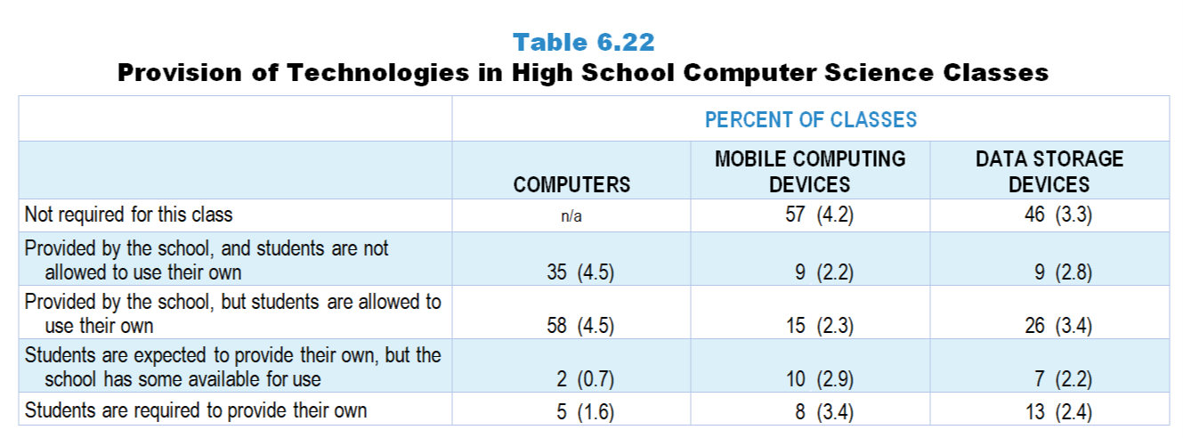
Original Data for Slide 25
(not for presentation)
Notes:
Table 6.22, p. 148 in Technical Report
This slide shows data from an individual item.
Computer Science Teacher Questionnaire
Q32. Which best describes how each of the following devices (if required) is provided for this computer science class? [Select one on each row.] (Response Options: [1] Not required for this class, [2] Provided by the school, and students are not allowed to use their own, [3] Provided by the school, but students are allowed to use their own, [4] Students are expected to provide their own, but the school has some available for use, [5] Students are required to provide their own)
Computers (desktops or laptops)
Mobile computing devices (tablets or smartphones)
Data storage devices
The numbers in parentheses are standard errors.
Findings Highlighted in Technical Report
“Regarding computer science instruction specifically, high school computer science teachers were asked about school policies related to provision of instructional resources in their randomly selected class. Typically, if a particular technology is required, the school provides it for students (see Table 6.22). It is somewhat surprising that any classes require students to provide their own computers or mobile computing devices, but a small percentage do. Even data storage devices (which 13 percent of high school computer science classes require students to provide) can present a financial obstacle to students.”

Slide 25
Provision of Technologies in High School Computer Science Classes

Slide 26
Original Data for Slide 27
(not for presentation)
Notes:
Table 6.24, p. 149 in Technical Report
This slide shows data from an individual item.
Computer Science Teacher Questionnaire
Q33. Please indicate the availability of each of the following for your computer science instruction in this class. [Select one on each row.] (Response Options: [1] Always available in your classroom, [2] Available upon request, [3] Not available)
Probes for collecting data (for example: motion sensors, temperature probes)
Projection devices (for example: Smartboard, document camera, LCD projector)
Robotics equipment
The numbers in parentheses are standard errors.
Findings Highlighted in Technical Report
“Computer science teachers were asked a similar question. Almost all high school computer science classes have access to projection devices (e.g., Smartboard, document camera, LCD projector), and more than half have access to robotics equipment (see Table 6.24). It is particularly interesting that only 40 percent of computer science classes have access to probes for collecting data but 81 percent of high school science classes do. Perhaps these two groups of teachers define the technology differently, or perhaps computer science teachers simply are not aware that the technology exists in the school.”

Slide 27
Availability of Instructional Technologies in High School Computer Science Classes
Notes:
Includes high school computer science teachers indicating the resource is always available in their classroom or available upon request.

Slide 28
Original Data for Slide 29
(not for presentation)
Notes:
Table 6.33, p. 154 in Technical Report
This slide shows data from an individual item.
Computer Science Teacher Questionnaire
Q37. In your opinion, how great a problem is each of the following for your computer science instruction in this class? [Select one on each row.] (Response options: [1] Not a significant problem, [2] Somewhat of a problem, [3] Serious problem
Lack of reliable access to the Internet
Lack of functioning computing devices (for example: desktop computers, laptop computers, tablets, smartphones)
Insufficient power sources for devices (for example: electrical outlets, charging stations)
Lack of support to maintain technology (for example: repair broken devices, install software)
School restrictions on Internet content that is allowed
The numbers in parentheses are standard errors.
Findings Highlighted in Technical Report
“High school computer science teachers were asked how great a problem each of several factors presents in their instruction (see Table 6.33). Given the extent to which high school computer science classes rely on web-based instructional materials, it is perhaps not surprising that one of the most frequently cited problems is school restrictions on Internet content (37 percent of classes). Lack of support to maintain technology is a similarly prominent problem. It is also surprising that teachers in almost 1 in 5 classes rate lack of reliable Internet access as a problem given the ubiquity of Internet in schools.”

Slide 29
Factors Perceived as Problems in High School Computer Science Classes
Notes:
Includes high school computer science teachers indicating “somewhat of a problem” or “serious problem” on a three-point scale from 1 “not a significant problem” to 3 “serious problem.”

