Slide 1
Chapter 6 Instructional Resources

Slide 2
School Computing Resources

Slide 3
Original Data for Slide 4
(not for presentation)
Notes:
Table 6.20, p. 147 in Technical Report
This slide shows data from individual items.
School Coordinator Questionnaire
Q8. Does your school have… [Select one on each row.] (Response options: Yes, No)
One or more computer labs available for teachers to schedule for their classes?
Laptop/tablet carts available for teachers to use with their classes?
A 1-to-1 initiative (every student is provided with a laptop or tablet)?
School-wide Wi-Fi?
The numbers in parentheses are standard errors.
Findings Highlighted in Technical Report
“Given the increased emphasis on computing in instruction across STEM disciplines, the 2018 NSSME+ included several questions about availability of computing resources. As shown in Table 6.20, virtually all schools have school-wide Wi-Fi. Laptop/‌tablet carts and computer labs are also present in a large majority of schools. Perhaps most striking is the percentage of schools (35–44 percent) where every student has a laptop or tablet. Obviously, these initiatives represent a substantial investment.”

Slide 4
Schools With Various Computing Resources

Slide 5
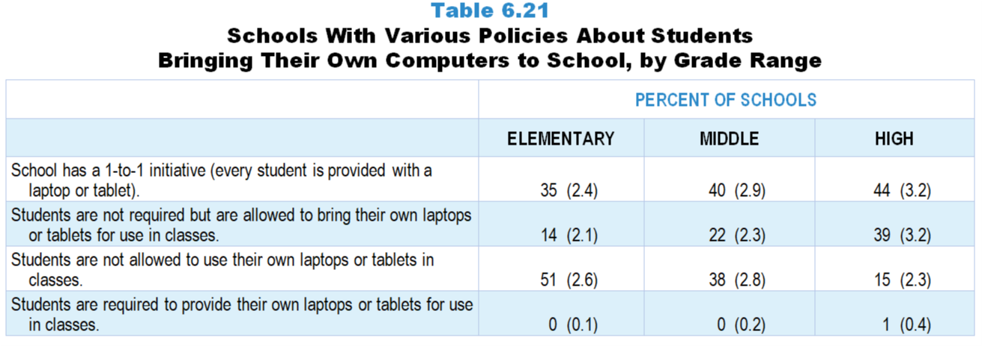
Original Data for Slide 6
(not for presentation)
Notes:
Table 6.21, p. 148 in Technical Report
This slide shows data from individual items.
School Coordinator Questionnaire
Q8. Does your school have… [Select one on each row.] (Response options: Yes, No)
One or more computer labs available for teachers to schedule for their classes?
Laptop/tablet carts available for teachers to use with their classes?
A 1-to-1 initiative (every student is provided with a laptop or tablet)?
School-wide Wi-Fi?
Q9. Which of the following best describes your school’s policy about students using their own computing devices in classes? [Select one.]
Students are required to provide their own laptops or tablets for use in classes.
Students are not required but are allowed to bring their own laptops or tablets for use in classes.
Students are not allowed to use their own laptops or tablets in classes.
The numbers in parentheses are standard errors.
Findings Highlighted in Technical Report
“Because of the potential inequities inherent in students using their own computing devices, policies governing device use are also of interest. Virtually no schools require students to provide their own computers (see Table 6.21). The extent to which students are allowed to bring their laptops and tablets to school and use them in classes increases with grade range. The likelihood that students are not allowed to bring their computers to school follows an opposite trend.”

Slide 6
Schools With Various Policies About Students Bringing Their Own Computers to School

