Slide 1
Chapter 6
Instructional Resources
Mathematics

Slide 2
Use of Textbooks and Other Instructional Resources

Slide 3
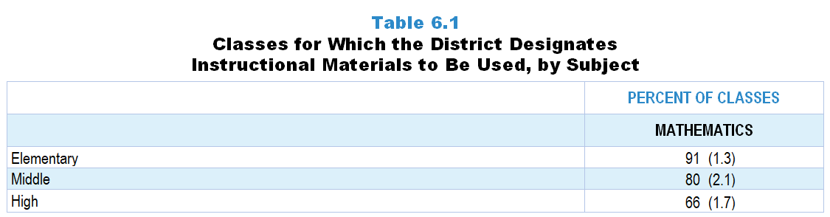
Original Data for Slide 4
(not for presentation)
Notes:
The mathematics portion of Table 6.1, p. 133 in Technical Report
This slide shows data from an individual item.
Mathematics Teacher Questionnaire
Q42. Does your school/district/diocese designate instructional materials (textbooks, units, or lessons) to be used in this class?
Yes
No
The numbers in parentheses are standard errors.
Findings Highlighted in Technical Report
“The 2018 NSSME+ collected data on the use of various instructional resources, including commercially published textbooks or programs, both print and electronic. Of particular interest is how much latitude teachers have in selecting instructional resources. Table 6.1 shows that instructional materials are designated by the district‌ for most science and mathematics classes. The likelihood of having designated materials decreases from elementary school to high school in mathematics. Also, mathematics classes are generally more likely to have designated materials, perhaps due to the greater accountability emphasis in mathematics. High school computer science classes are very unlikely to have designated materials; only about a quarter have materials designated for them.”

Slide 4
Mathematics Classes for Which the District Designates Instructional Materials to Be Used

Slide 5
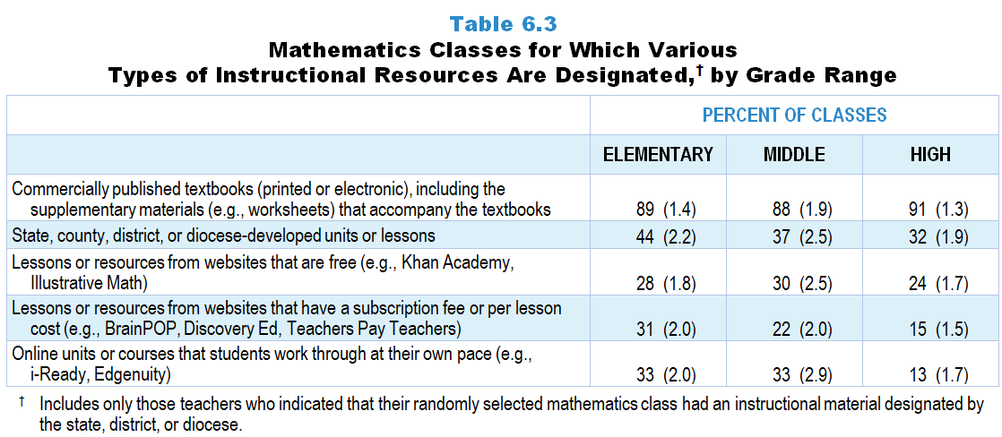
Original Data for Slide 6–8
(not for presentation)
Notes:
Table 6.3, p. 134 in Technical Report
This slide shows data from an individual item.
Mathematics Teacher Questionnaire
Q43. Which of the following types of instructional materials does your school/district/diocese designate to be used in this class? [Select all that apply.]
Commercially published textbooks (printed or electronic), including the supplementary materials (for example: worksheets) that accompany the textbooks
State, county, or district/diocese-developed instructional materials
Online units or courses that students work through at their own pace (for example: i-Ready, Edgenuity)
Lessons or resources from websites that have a subscription fee or per lesson cost (for example: BrainPOP, Discovery Ed, Teachers Pay Teachers)
Lessons or resources from websites that are free (for example: Khan Academy, Illustrative Math)
The numbers in parentheses are standard errors.
Findings Highlighted in Technical Report
“The textbook is just as prominent in mathematics as in science (see Table 6.3). In addition, almost half of elementary classes have a material developed by their education agency as the designated material, and close to one-third have fee-based or free websites as the designated material. One-third of elementary and middle grades mathematics classes have online materials that students work through at their own pace.”

Slide 6
Elementary Mathematics Classes for Which Various Types of Instructional Resources Are Designated
Notes:
Only mathematics classes for which instructional materials are designated by the state, district, or diocese are included in these analyses.
Note: Each grade-level chart is sorted independently; consequently items may appear in different orders.

Slide 7
Middle School Mathematics Classes for Which Various Types of Instructional Resources Are Designated
Notes:
Only mathematics classes for which instructional materials are designated by the state, district, or diocese are included in these analyses.
Note: Each grade-level chart is sorted independently; consequently items may appear in different orders.

Slide 8
High School Mathematics Classes for Which Various Types of Instructional Resources Are Designated
Notes:
Only mathematics classes for which instructional materials are designated by the state, district, or diocese are included in these analyses.
Note: Each grade-level chart is sorted independently; consequently items may appear in different orders.

Slide 9
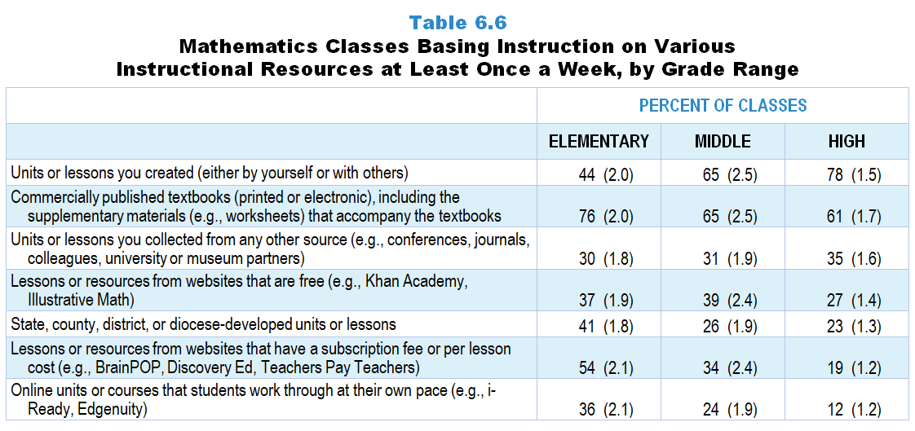
Original Data for Slide 10–12
(not for presentation)
Notes:
The mathematics portion of Table 6.6, p. 136 in Technical Report
This slide shows data derived from:
Mathematics Teacher Questionnaire
Q41. Thinking about your instruction in this class over the entire year, about how often is instruction based on materials from each of the following sources? [Select one on each row.] (Response Options: [1] Never, [2] Rarely (for example: A few times a year), [3] Sometimes (for example: Once or twice a month), [4] Often (for example: Once or twice a week), [5] All or almost all mathematics lessons)
Commercially published textbooks (printed or electronic), including the supplementary materials (for example: worksheets) that accompany the textbooks
State, county, or district/diocese- developed units or lessons
Online units or courses that students work through at their own pace (for example: i-Ready, Edgenuity)
Lessons or resources from websites that have a subscription fee or per lesson cost (for example: BrainPOP, Discovery Ed, Teachers Pay Teachers)
Lessons or resources from websites that are free (for example: Khan Academy, Illustrative Math)
Units or lessons you created (either by yourself or with others)
Units or lessons you collected from any other source (for example: conferences, journals, colleagues, university or museum partners)
The numbers in parentheses are standard errors.
Findings Highlighted in Technical Report
“In mathematics, the influence of teacher-created units and lessons is much more prominent in high school than in elementary school classes (78 and 44 percent, respectively; see Table 6.6). The textbook is especially prominent at the elementary level, where three-fourths of classes are frequently based on this type of instructional resource, considerably more than any other resource. Also, elementary mathematics classes are much more likely than those at other levels to rely on fee-based websites and, to a lesser extent, on online self-paced materials.”

Slide 10
Elementary Mathematics Classes Basing Instruction on Various Instructional Resources at Least Once a Week
Notes:
Note: Each grade-level chart is sorted independently; consequently items may appear in different orders.

Slide 11
Middle School Mathematics Classes Basing Instruction on Various Instructional Resources at Least Once a Week
Notes:
Note: Each grade-level chart is sorted independently; consequently items may appear in different orders.

Slide 12
High School Mathematics Classes Basing Instruction on Various Instructional Resources at Least Once a Week
Notes:
Note: Each grade-level chart is sorted independently; consequently items may appear in different orders.

Slide 13
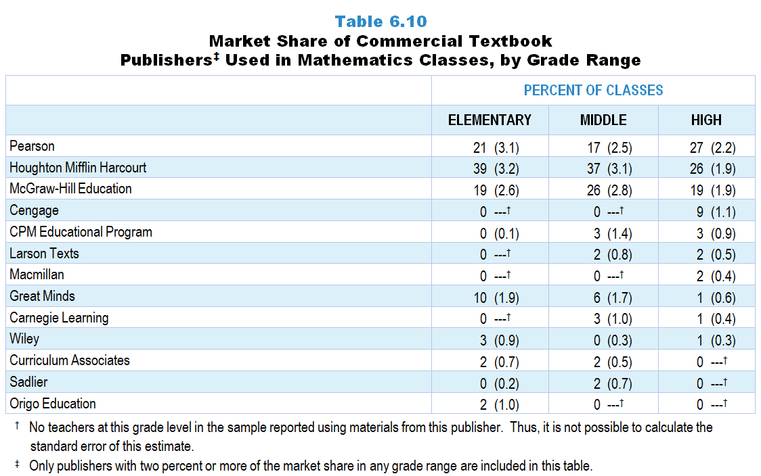
Original Data for Slide 14
(not for presentation)
Notes:
Table 6.10, p. 139 in Technical Report
This slide shows data derived from:
Mathematics Teacher Questionnaire
Q45. [Presented only to teachers who selected ”Sometimes” “Often” or “All” for Q41a or c]
[Version for teachers who indicate using a commercial textbook most often] Please indicate the title, author, most recent copyright year, and ISBN code of the commercially published textbook (printed or electronic) used most often by the students in this class.
The 10- or 13-character ISBN code can be found on the copyright page and/or the back cover of the textbook.
Do not include the dashes when entering the ISBN.
Example ISBN:
Title: ____
First Author: ____
Year: ____
ISBN: ____
URL: [for teachers who indicate using an online program most often]
The numbers in parentheses are standard errors.
Findings Highlighted in Technical Report
“Teachers who indicated that instruction in their randomly selected class was based substantially on a commercially published textbook or module were asked to record the title, author, year, and ISBN of the material used most often in the class. Using this information, the publisher of the material was identified. Tables 6.9–6.11 show the market share held by each of the major science, mathematics, and computer science textbook publishers. It is interesting to note that three publishers—Pearson, McGraw-Hill, and Houghton Mifflin Harcourt—account for instructional materials used in more than 75 percent of middle school and high school science classes and more than 70 percent of all mathematics classes. The only other publishers with a substantial share of the market are Delta Education in elementary science and Great Minds in elementary mathematics. In high school computer science, Pearson again has a considerable market share, followed closely by Cengage.”

Slide 14
Market Share of Commercial Textbook Publishers in Mathematics Classes
Notes:
Note: Only the three most prevalent publishers are included in this figure

Slide 15
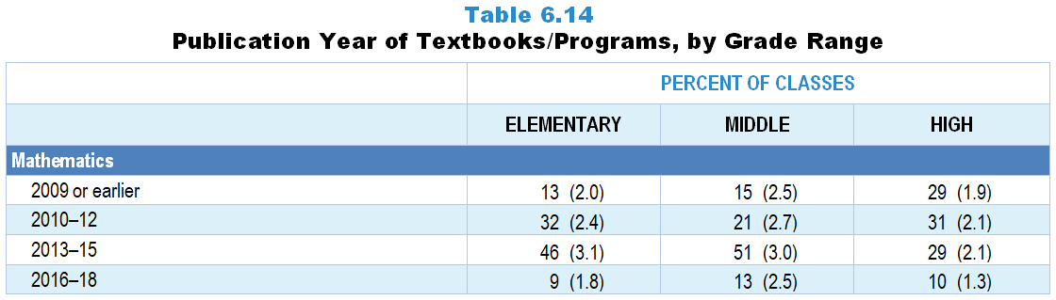
Original Data for Slide 16
(not for presentation)
Notes:
The mathematics portion of Table 6.14, p. 143 in Technical Report
This slide shows data derived from:
Mathematics Teacher Questionnaire
Q45. [Presented only to teachers who selected ”Sometimes” “Often” or “All” for Q41a or c]
[Version for teachers who indicate using a commercial textbook most often] Please indicate the title, author, most recent copyright year, and ISBN code of the commercially published textbook (printed or electronic) used most often by the students in this class.
The 10- or 13-character ISBN code can be found on the copyright page and/or the back cover of the textbook.
Do not include the dashes when entering the ISBN.
Example ISBN:
Title: ____
First Author: ____
Year: ____
ISBN: ____
URL: [for teachers who indicate using an online program most often]
The numbers in parentheses are standard errors.
Findings Highlighted in Technical Report
“Table 6.14 shows the publication year of science, mathematics, and computer science textbooks. In 2018, 43–51 percent of science classes used textbooks published in 2009 or earlier. Science classes are considerably more likely than mathematics classes to use older textbooks. For example, 51 percent of middle grades science classes are using textbooks published in 2009 or earlier, compared to only 15 percent of middle grades mathematics classes. Given the growing presence of computer science classes, it is surprising that a third of them are using textbooks published in 2009 or earlier, but it is important to remember that a relatively small proportion of these classes use published materials at all.”

Slide 16
Publication Year of Mathematics Textbooks/Programs
Notes:
Only classes using commercially published textbooks/programs are included in these analyses.

Slide 17
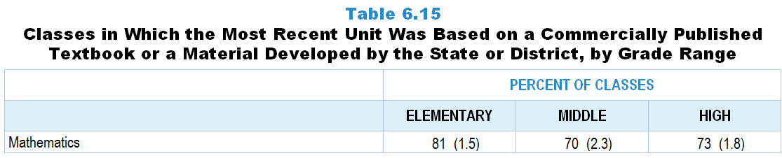
Original Data for Slide 18
(not for presentation)
Notes:
The mathematics portion of Table 6.15, p. 143 in Technical Report
This slide shows data from an individual item.
Mathematics Teacher Questionnaire
Q48. [Presented only to teachers who selected “Sometimes” “Often” or “All” for Q41 a or b]
Was this unit based primarily on a commercially published textbook or state, county, or district/diocese-developed materials?
Yes
No
The numbers in parentheses are standard errors.
Findings Highlighted in Technical Report
“Teachers were also asked whether the most recent unit in their randomly selected class was based primarily on either a commercially published textbook or materials developed by the state or district. (Computer science teachers were asked about commercially published online courses in addition.) As shown in Table 6.15, more than half of classes—mathematics classes in particular—are based on such materials.”

Slide 18
Mathematics Classes in Which the Most Recent Unit Was Based on a Commercially Published Textbook or a Material Developed by the State or District

Slide 19
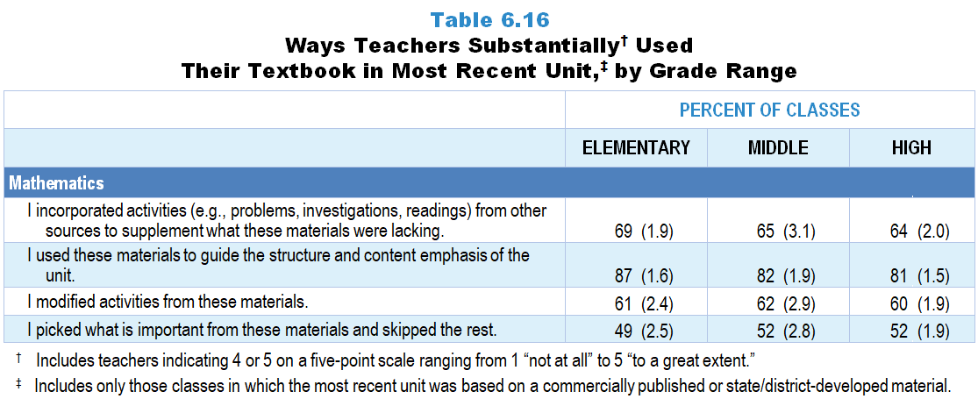
Original Data for Slide 20
(not for presentation)
Notes:
The mathematics portion of Table 6.16, p. 144 in Technical Report
This slide shows data from an individual item.
Mathematics Teacher Questionnaire
Q49. Please indicate the extent to which you did each of the following while teaching this unit. [Select one on each row.] (Response Options: [1] Not at all, [2] 2 of 5, [3] Somewhat, [4] 4 of 5, [5] To a great extent)
I used these materials to guide the structure and content emphasis of the unit.
I picked what is important from these materials and skipped the rest.
I incorporated activities (for example: problems, investigations, readings) from other sources to supplement what these materials were lacking.
I modified activities from these materials.
The numbers in parentheses are standard errors.
Findings Highlighted in Technical Report
“When teachers responded that their most recent unit was based on one of these materials, they were asked how they used the material (see Table 6.16). Two important findings emerge from these data. First, when classes use commercially published and state/‌district-developed materials, the materials heavily influence instruction in all subjects at all grade ranges. Teachers in more than 70 percent of classes in the various subject and grade-level categories use the textbook substantially to guide the overall structure and content emphasis of their units. Second, it is clear that teachers modify their materials substantially when designing instruction. In roughly half or more of classes, teachers incorporate activities from other sources substantially, “pick and choose” from the material, and modify activities from the materials.”

Slide 20
Ways Teachers Substantially Used
Their Textbook in Most Recent Unit
Notes:
Includes classes for which the teacher selected “4 of 5” or “to a great extent” on a 5-point response scale with the options of “not at all,” “2 of 5,” “somewhat,” “4 of 5,” and “to a great extent.”
Only classes in which the most recent unit was based on commercially published or state/‌district-developed materials are included in these analyses.

Slide 21
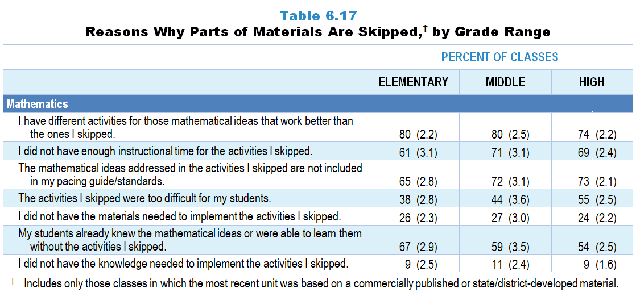
Original Data for Slides 22–24
(not for presentation)
Notes:
The mathematics portion of Table 6.17, p. 145 in Technical Report
This slide shows data from an individual item.
Mathematics Teacher Questionnaire
Q50. [Presented only to teachers who did not select “Not at all” for Q49b] During this unit, when you skipped activities (for example: problems, investigations, readings) in these materials, how much was each of the following a factor in your decisions? [Select one on each row.] (Response Options: [1] Not a factor, [2] A minor factor, [3] A major factor)
The mathematical ideas addressed in the activities I skipped are not included in my pacing guide/standards.
I did not have the materials needed to implement the activities I skipped.
I did not have the knowledge needed to implement the activities I skipped.
The activities I skipped were too difficult for my students.
My students already knew the mathematical ideas or were able to learn them without the activities I skipped.
I have different activities for those mathematical ideas that work better than the ones I skipped.
I did not have enough instructional time for the activities I skipped.
The numbers in parentheses are standard errors.
Findings Highlighted in Technical Report
“Teachers in roughly half of science, mathematics, and computer science classes skip activities in the material substantially. As can be seen in Table 6.17, in all subjects, some of the most frequently selected reasons for skipping parts of the materials are: (1) having another activity that works better than the one skipped, (2) the science ideas addressed not being included in pacing guides or standards, (3) not having enough instructional time, and (4) the activities skipped being too difficult for the students. In more than 40 percent of classes, teachers skip activities that they deem unnecessary (students either already knew the ideas or could learn them without the activities). Differences across grades, however, are also apparent. For example, in mathematics, teachers in 38 percent of elementary classes cite the difficulty of the activity as the reason for skipping it, compared to 55 percent in high school mathematics classes. A similar pattern is evident in science. Also, not having materials for an activity is much more likely to be cited as a reason in science classes (54–62 percent) than in mathematics classes (24–27 percent) or high school computer science classes (28 percent).”

Slide 22
Reasons Why Parts of the Materials Are Skipped in Elementary Mathematics Classes
Notes:
Only mathematics classes in which (1) the most recent unit was based on commercially published or state/district-developed materials and (2) teachers reported skipping some activities are included in these analyses.
Note: Each grade-level chart is sorted independently; consequently items may appear in different orders.

Slide 23
Reasons Why Parts of the Materials Are Skipped in Middle School Mathematics Classes
Notes:
Only mathematics classes in which (1) the most recent unit was based on commercially published or state/district-developed materials and (2) teachers reported skipping some activities are included in these analyses.
Note: Each grade-level chart is sorted independently; consequently items may appear in different orders.

Slide 24
Reasons Why Parts of the Materials Are Skipped in High School Mathematics Classes
Notes:
Only mathematics classes in which (1) the most recent unit was based on commercially published or state/district-developed materials and (2) teachers reported skipping some activities are included in these analyses.
Note: Each grade-level chart is sorted independently; consequently items may appear in different orders.

Slide 25
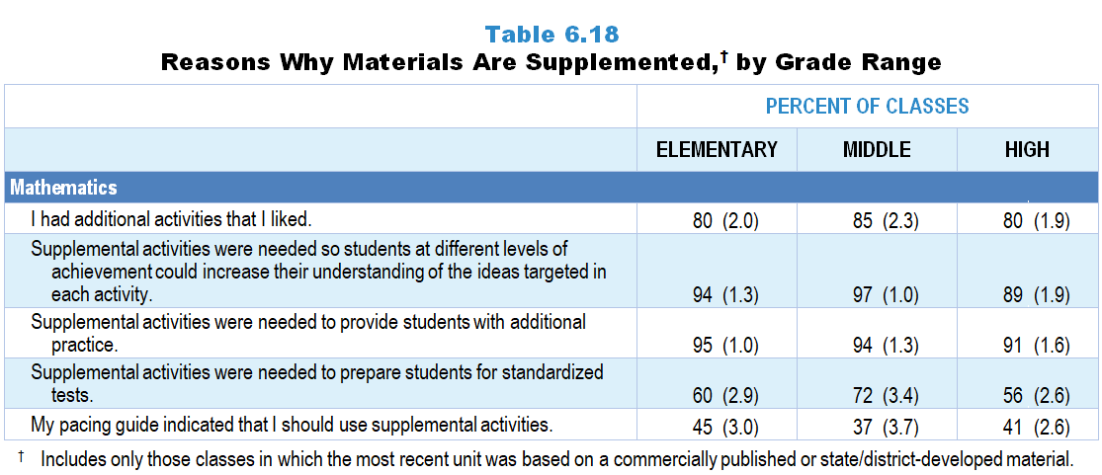
Original Data for Slides 26–28
(not for presentation)
Notes:
The mathematics portion of Table 6.18, p. 146 in Technical Report
This slide shows data from an individual item.
Mathematics Teacher Questionnaire
Q51. [Presented only to teachers who did not select “Not at all” for Q49c] During this unit, when you supplemented these materials with additional activities, how much was each of the following a factor in your decisions? [Select one on each row.] (Response Options: [1] Not a factor, [2] A minor factor, [3] A major factor)
My pacing guide indicated that I should use supplemental activities.
Supplemental activities were needed to prepare students for standardized tests.
Supplemental activities were needed to provide students with additional practice.
Supplemental activities were needed so students at different levels of achievement could increase their understanding of the ideas targeted in each activity.
I had additional activities that I liked.
The numbers in parentheses are standard errors.
Findings Highlighted in Technical Report
“Given that teachers often skip activities in their materials because they know of better ones, it is perhaps not surprising that teachers in well more than half of science, mathematics, and computer science classes supplement their materials. Of the reasons listed on the questionnaire, three stand out above the rest: (1) teachers having additional activities that they like, (2) providing students with additional practice, and (3) differentiating instruction for students at different achievement levels (see Table 6.18). The influence of standardized testing is also evident, with teachers in anywhere from about half to almost three-fourths of classes across subjects supplementing for test-preparation purposes. Finally, in 34–49 percent of classes, depending on subject and grade level, teachers supplement their published material because their pacing guide indicates that they should. This finding both speaks to the prevalence of pacing guides and suggests that supplementing is at least to some extent sanctioned or prescribed by schools and districts.”

Slide 26
Reasons Why Materials Are Supplemented in Elementary Mathematics Classes
Notes:
Only mathematics classes in which (1) the most recent unit was based on commercially published or state/district-developed materials and (2) teachers reported supplementing some activities are included in these analyses.
Note: Each grade-level chart is sorted independently; consequently items may appear in different orders.

Slide 27
Reasons Why Materials Are Supplemented in Middle School Mathematics Classes
Notes:
Only mathematics classes in which (1) the most recent unit was based on commercially published or state/district-developed materials and (2) teachers reported supplementing some activities are included in these analyses.
Note: Each grade-level chart is sorted independently; consequently items may appear in different orders.

Slide 28
Reasons Why Materials Are Supplemented in High School Mathematics Classes
Notes:
Only mathematics classes in which (1) the most recent unit was based on commercially published or state/district-developed materials and (2) teachers reported supplementing some activities are included in these analyses.
Note: Each grade-level chart is sorted independently; consequently items may appear in different orders.

Slide 29
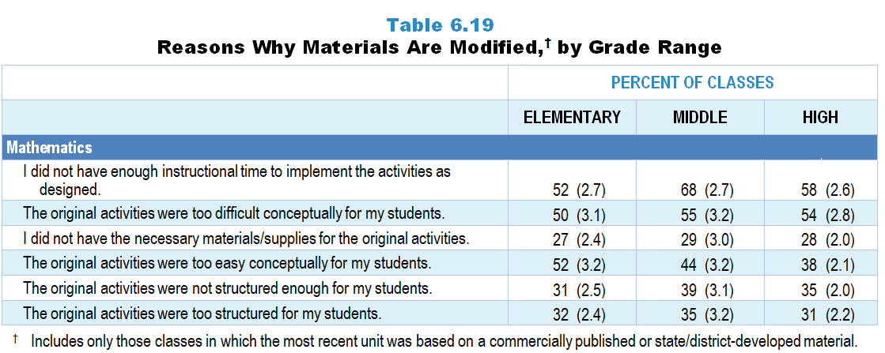
Original Data for Slides 30–32
(not for presentation)
Notes:
The mathematics portion of Table 6.19, p. 147 in Technical Report
This slide shows data from an individual item.
Mathematics Teacher Questionnaire
Q52. [Presented only to teachers who did not select “Not at all” in Q49d] During this unit, when you modified activities from these materials, how much was each of the following a factor in your decisions? [Select one on each row.] (Response Options: [1] Not a factor, [2] A minor factor, [3] A major factor)
I did not have the necessary materials/supplies for the original activities.
The original activities were too difficult conceptually for my students.
The original activities were too easy conceptually for my students.
I did not have enough instructional time to implement the activities as designed.
The original activities were too structured for my students.
The original activities were not structured enough for my students.
The numbers in parentheses are standard errors.
Findings Highlighted in Technical Report
“Finally, when teachers reported that they modified their published material (which over half did), they rated each of several factors that may have contributed to their decision (see Table 6.19). Two factors stand out: teachers do not have enough time to implement the activities as designed (52–71 percent of classes), and the activities are too difficult for students (43–58 percent of classes). In science, teachers are also likely to cite not having the necessary materials or supplies for the original activities (53–62 percent of classes). Teachers are about equally likely to point to the structure of activities (either too much or too little) across subjects and grade ranges as the reason for modifications.”

Slide 30
Reasons Why Materials Are Modified in Elementary Mathematics Classes
Notes:
Only mathematics classes in which (1) the most recent unit was based on commercially published or state/district-developed materials and (2) teachers reported modifying some activities are included in these analyses.
Note: Each grade-level chart is sorted independently; consequently items may appear in different orders.

Slide 31
Reasons Why Materials Are Modified in Middle School Mathematics Classes
Notes:
Only mathematics classes in which (1) the most recent unit was based on commercially published or state/district-developed materials and (2) teachers reported modifying some activities are included in these analyses.
Note: Each grade-level chart is sorted independently; consequently items may appear in different orders.

Slide 32
Reasons Why Materials Are Modified in High School Mathematics Classes
Notes:
Only mathematics classes in which (1) the most recent unit was based on commercially published or state/district-developed materials and (2) teachers reported modifying some activities are included in these analyses.
Note: Each grade-level chart is sorted independently; consequently items may appear in different orders.

Slide 33
Facilities and Equipment

Slide 34
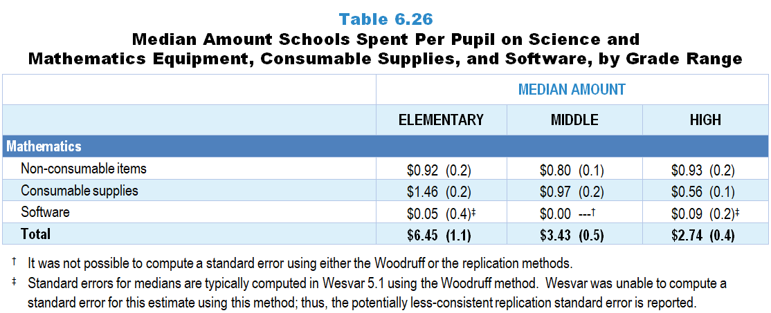
Original Data for Slide 35
(not for presentation)
Notes:
The mathematics portion of Table 6.26, p. 150 in Technical Report
This slide shows data from an individual item.
Mathematics Program Questionnaire
Q17. For this school, how much money was spent on each of the following during the most recently completed budget year? (If you don’t know the exact amounts, please provide your best estimates.)
Consumable supplies for mathematics instruction (for example: graph paper) _____
Non-consumable items for mathematics instruction such as calculators, protractors, manipulatives, etc. (Do not include computers) _____
Software specific to mathematics instruction (for example: dynamic geometry software) _____
The numbers in parentheses are standard errors.
Findings Highlighted in Technical Report
“The 2018 NSSME+ also asked science and mathematics program representatives how much money their schools spent during the most recently completed school year on three kinds of resources: equipment (excluding computers), consumable supplies (e.g., chemicals, graph paper), and software specific to science and mathematics instruction. By dividing these amounts by school enrollment, per-pupil estimates were generated (see Table 6.26). In science, per-pupil spending on equipment and supplies increases sharply from elementary school to high school, as does overall per-pupil spending. In mathematics, total per-pupil spending is substantially higher in elementary schools than in middle and high schools. Clearly, median per-pupil spending for software is the least of the three categories.”

Slide 35
Median Amount Schools Spend Per Pupil on Mathematics Instruction

Slide 36
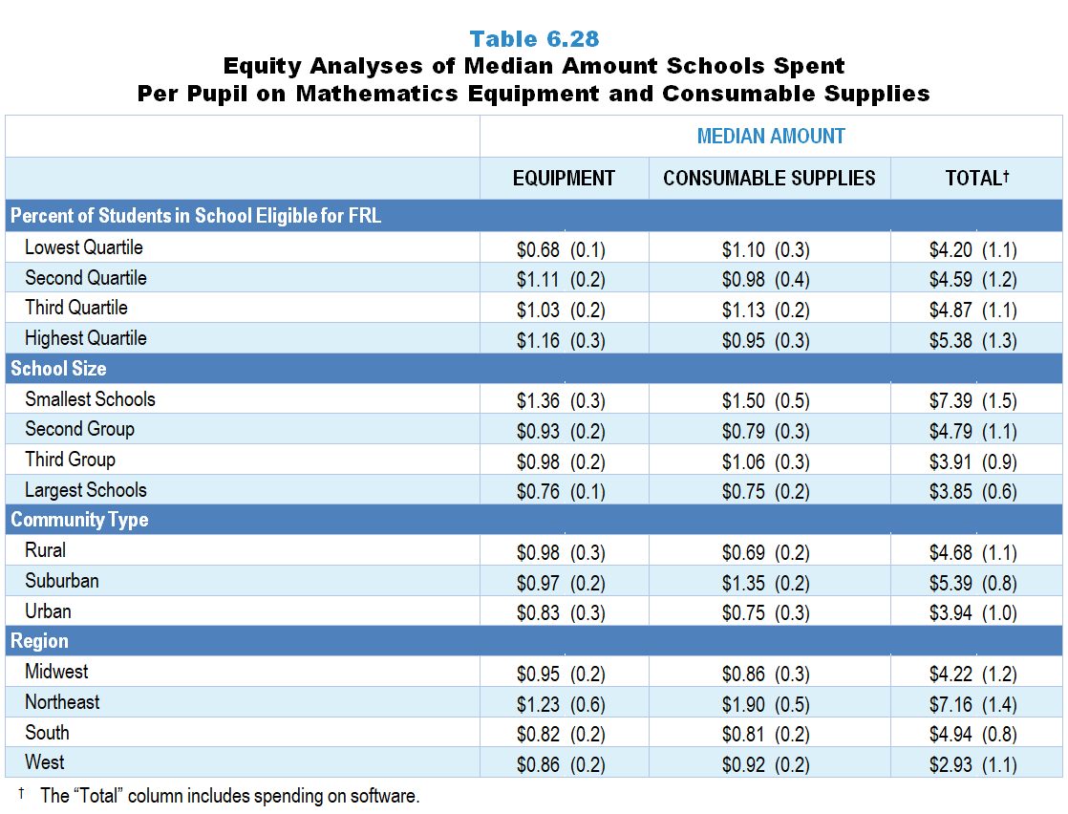
Original Data for Slides 37–38
(not for presentation)
Notes:
Table 6.28, p. 152 in Technical Report
This slide shows data from an individual item.
Mathematics Program Questionnaire
Q17. For this school, how much money was spent on each of the following during the most recently completed budget year? (If you don’t know the exact amounts, please provide your best estimates.)
Consumable supplies for mathematics instruction (for example: graph paper) _____
Non-consumable items for mathematics instruction such as calculators, protractors, manipulatives, etc. (Do not include computers) _____
Software specific to mathematics instruction (for example: dynamic geometry software) _____
Chapters 2–7 in the technical report provide data on several key indicators, disaggregated by one or more equity factors: the prior achievement level of students in the class, the percentage of students from race/ethnicity groups historically underrepresented in STEM in the class, the percentage of students in the school eligible for free/reduced-price lunch (FRL), school size, community type, and region. For FRL, each school was classified into one of four categories (defined as quartiles) based on the proportion of students eligible for FRL. Similarly, each randomly selected class was classified into one of the four categories based on the proportion of students from race/ethnicity groups historically underrepresented in STEM in the class.
The numbers in parentheses are standard errors.
Findings Highlighted in Technical Report
“Expenditures for science and mathematics are not distributed equally across all schools. For example, in science, schools with the lowest percentage of students who are eligible for free/‌reduced-price lunch spend considerably more per pupil on equipment and supplies than those with the highest percentage (see Table 6.27). Schools in the South spend considerably less than schools in the Northeast. In mathematics, the smallest schools spend more overall per pupil than the largest schools (see Table 6.28). Regional differences are also apparent, with schools in the Northeast spending the most overall per pupil. “

Slide 37
Median Amount Schools Spend Per Pupil Overall on Mathematics instruction
Notes:
Median amounts include spending on software.

Slide 38
Median Amount Schools Spend Per Pupil Overall on Mathematics Instruction

Slide 39
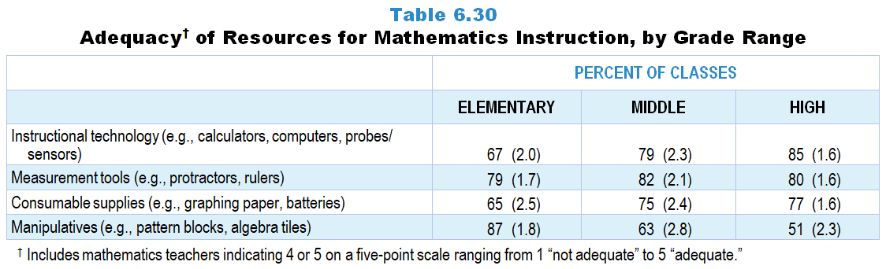
Original Data for Slide 40
(not for presentation)
Notes:
Table 6.30, p. 153 in Technical Report
This slide shows data from an individual item.
Mathematics Teacher Questionnaire
Q40. Mathematics courses may benefit from the availability of particular resources. Considering what you have available, how adequate is each of th0 following for teaching this mathematics class? [Select one on each row.] (Response Options: [1] Not Adequate, [2] 2 of 5, [3] Somewhat Adequate, [4] 4 of 5, [5] Adequate)
Instructional technology (for example: calculators, computers, probes/sensors)
Measurement tools (for example: protractors, rulers)
Manipulatives (for example: pattern blocks, algebra tiles)
Consumable supplies (for example: graphing paper, batteries)
The numbers in parentheses are standard errors.
Findings Highlighted in Technical Report
“In mathematics, the patterns are much more varied (see Table 6.30). Teachers of high school classes are more likely than their elementary counterparts to rate the availability of instructional technology as adequate, but the pattern is reversed for manipulatives. These data suggest that substantial proportions of secondary mathematics teachers want to use manipulative materials but do not have adequate access to them. Ratings of the availability of measurement tools are similar, and high, across grade ranges.”

Slide 40
Mathematics Classes With Adequate Resources for Instruction
Notes:
Includes classes for which the teacher selected “4 of 5” or “adequate” on a 5-point response scale with the options of “not adequate,” “2 of 5,” “somewhat adequate,” “4 of 5,” and “adequate.”

Slide 41
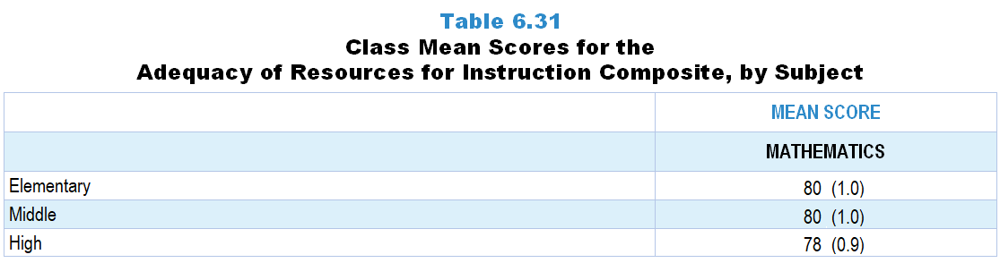
Original Data for Slides 42
(not for presentation)
Notes:
The mathematics portion of Table 6.31, p. 153 in Technical Report
This slide shows data from Composites.
Sets of related questionnaire items were combined to create several composite variables related to key constructs. Composite variables, which are more reliable than individual survey items, were computed to have a minimum possible value of 0 and a maximum possible value of 100. Higher composite scores indicate more of the construct being measure by the composite. Each composite is calculated by summing the responses to the items associated with that composite and then dividing by the total points possible. In order for the composites to be on a 100-point scale, the lowest response option on each scale was set to 0 and the others were adjusted accordingly; so for example, an item with a scale ranging from 1 to 4 was re-coded to have a scale of 0 to 3. By doing this, someone who marks the lowest point on every item in a composite receives a composite score of 0 rather than some positive number. It also assures that 50 is the true mid-point. The denominator for each composite is determined by computing the maximum possible sum of responses for a series of items and dividing by 100; e.g., a 9-item composite where each item is on a scale of 0–3 would have a denominator of 0.27. Composites values were not computed for participants who respond to fewer than two-thirds of the items that form the composite.
Adequacy of Resources for Instruction Composite Items
Q40a. Instructional technology (for example: calculators, computers, probes/sensors)
Q40b. Measurement tools (for example: protractors, rulers)
Q40c. Manipulatives (for example: pattern blocks, algebra tiles)
Q40d. Consumable supplies (for example: graphing paper, batteries)
Mathematics Teacher Questionnaire
Q40. Mathematics courses may benefit from the availability of particular resources. Considering what you have available, how adequate is each of the following for teaching this mathematics class? [Select one on each row.] (Response Options: [1] Not Adequate, [2] 2 of 5, [3] Somewhat Adequate, [4] 4 of 5, [5] Adequate)
Instructional technology (for example: calculators, computers, probes/sensors)
Measurement tools (for example: protractors, rulers)
Manipulatives (for example: pattern blocks, algebra tiles)
Consumable supplies (for example: graphing paper, batteries)
The numbers in parentheses are standard errors.
Findings Highlighted in Technical Report
“These items were combined into a composite variable named Adequacy of Resources for Instruction. As shown in Table 6.31, perceptions of the adequacy of resources vary substantially by content area in elementary and middle school classrooms but are essentially the same in high school classrooms. This aggregate view reflects other findings reported in this section, suggesting that science instruction in the earlier grades is under resourced from teachers’ point of view.”

Slide 42
Adequacy of Resources for Instruction Composite

Slide 43
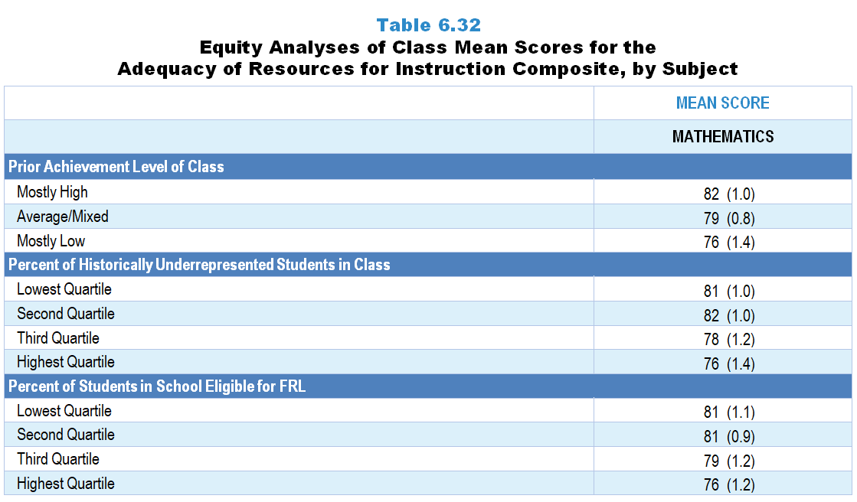
Original Data for Slides 44–46
(not for presentation)
Notes:
The mathematics portion of Table 6.32, p. 154 in Technical Report
This slide shows data from Composites.
Sets of related questionnaire items were combined to create several composite variables related to key constructs. Composite variables, which are more reliable than individual survey items, were computed to have a minimum possible value of 0 and a maximum possible value of 100. Higher composite scores indicate more of the construct being measure by the composite. Each composite is calculated by summing the responses to the items associated with that composite and then dividing by the total points possible. In order for the composites to be on a 100-point scale, the lowest response option on each scale was set to 0 and the others were adjusted accordingly; so for example, an item with a scale ranging from 1 to 4 was re-coded to have a scale of 0 to 3. By doing this, someone who marks the lowest point on every item in a composite receives a composite score of 0 rather than some positive number. It also assures that 50 is the true mid-point. The denominator for each composite is determined by computing the maximum possible sum of responses for a series of items and dividing by 100; e.g., a 9-item composite where each item is on a scale of 0–3 would have a denominator of 0.27. Composites values were not computed for participants who respond to fewer than two-thirds of the items that form the composite.
Adequacy of Resources for Instruction Composite Items
Q40a. Instructional technology (for example: calculators, computers, probes/sensors)
Q40b. Measurement tools (for example: protractors, rulers)
Q40c. Manipulatives (for example: pattern blocks, algebra tiles)
Q40d. Consumable supplies (for example: graphing paper, batteries)
Mathematics Teacher Questionnaire
Q30. For the number of students in this class, indicate the number of males and females in each of the following categories of race/ethnicity.
American Indian or Alaskan Native _____ _____
Asian _____ _____
Black or African American _____ _____
Hispanic or Latino _____ _____
Native Hawaiian or Other Pacific Islander _____ _____
White _____ _____
Two or more races _____ _____
Q31. Which of the following best describes the prior mathematics achievement levels of the students in this class relative to other students in this school?
Mostly low achievers
Mostly average achievers
Mostly high achievers
A mixture of levels
Q40. Mathematics courses may benefit from the availability of particular resources. Considering what you have available, how adequate is each of the following for teaching this mathematics class? [Select one on each row.] (Response Options: [1] Not Adequate, [2] 2 of 5, [3] Somewhat Adequate, [4] 4 of 5, [5] Adequate)
Instructional technology (for example: calculators, computers, probes/sensors)
Measurement tools (for example: protractors, rulers)
Manipulatives (for example: pattern blocks, algebra tiles)
Consumable supplies (for example: graphing paper, batteries)
The numbers in parentheses are standard errors.
Chapters 2–7 in the technical report provide data on several key indicators, disaggregated by one or more equity factors: the prior achievement level of students in the class, the percentage of students from race/ethnicity groups historically underrepresented in STEM in the class, the percentage of students in the school eligible for free/reduced-price lunch (FRL), school size, community type, and region. For FRL, each school was classified into one of four categories (defined as quartiles) based on the proportion of students eligible for FRL. Similarly, each randomly selected class was classified into one of the four categories based on the proportion of students from race/ethnicity groups historically underrepresented in STEM in the class.
Findings Highlighted in Technical Report
“In science, teachers of classes with mostly high-achieving students have the most positive views about their resources, compared to classes with average/‌mixed prior achievers and those with mostly low-achieving students (see Table 6.32). Similarly, teachers of classes with the lowest percentage of students from race/‌ethnicity groups historically underrepresented in STEM have more positive views than those with the highest percentage, as do teachers of classes with the lowest percentage of students eligible for free/‌reduced-price lunch, compared to those with the highest percentage. Mathematics teachers’ views of the adequacy of their resources do not tend to differ substantially by various equity factors.”

Slide 44
Adequacy of Resources for Instruction Composite

Slide 45
Adequacy of Resources for Instruction Composite
Notes:
Historically Underrepresented Students includes American Indian or Alaskan Native, Black or African American, Hispanic or Latino, or Native Hawaiian or Other Pacific Islander students.
Slide shows the composite scores by quartile of percent historically underrepresented students in the randomly selected class.

Slide 46
Adequacy of Resources for Instruction Composite
Notes:
Slide shows the composite scores by quartile of percent of students eligible for free or reduced-price lunch in the school.

