Slide 1
Chapter 6 Instructional Resources
Science

Slide 2
Use of Textbooks and Other Instructional Resources

Slide 3
Original Data for Slide 4
(not for presentation)
Notes:
The science portion of Table 6.1, p. 133 in Technical Report
This slide shows data from an individual item.
Science Teacher Questionnaire
Q56. Does your school/district/diocese designate instructional materials (textbooks, kits, modules, units, or lessons) to be used in this class?
Yes
No
The numbers in parentheses are standard errors.
Findings Highlighted in Technical Report
“The 2018 NSSME+ collected data on the use of various instructional resources, including commercially published textbooks or programs, both print and electronic. Of particular interest is how much latitude teachers have in selecting instructional resources. Table 6.1 shows that instructional materials are designated by the district‌ for most science and mathematics classes. The likelihood of having designated materials decreases from elementary school to high school in mathematics. Also, mathematics classes are generally more likely to have designated materials, perhaps due to the greater accountability emphasis in mathematics. High school computer science classes are very unlikely to have designated materials; only about a quarter have materials designated for them.”

Slide 4
Science Classes for Which the District Designates Instructional Materials to Be Used

Slide 5
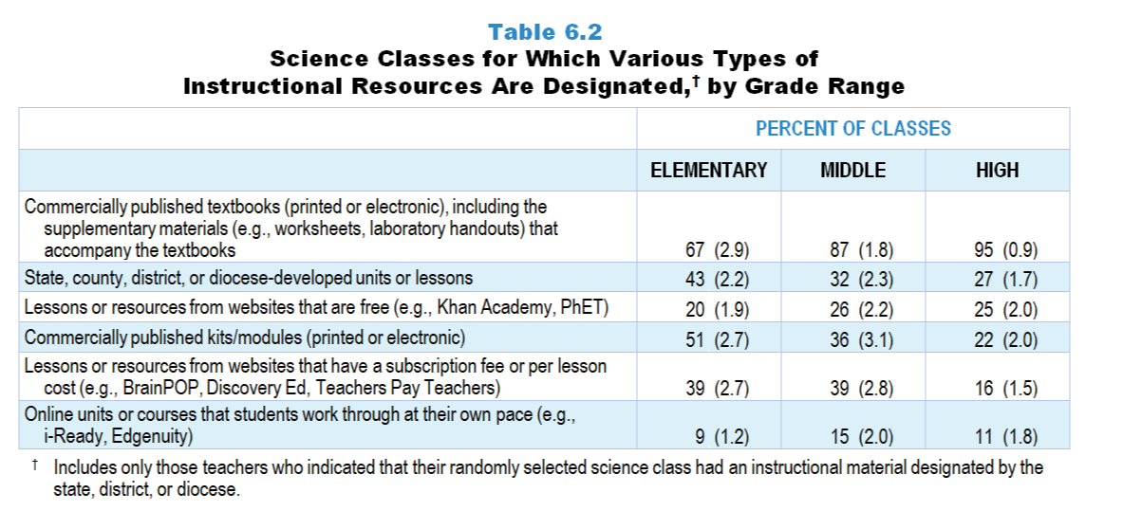
Original Data for Slides 6–8
(not for presentation)
Notes:
Table 6.2, p. 134 in Technical Report
This slide shows data from an individual item.
Science Teacher Questionnaire
Q57. Which of the following types of instructional materials does your school/district/diocese designate to be used in this class? [Select all that apply.]
Commercially published textbooks (printed or electronic), including the supplementary materials (for example: worksheets, laboratory handouts) that accompany the textbooks
Commercially published kits/modules (printed or online)
State, county, or district/diocese-developed instructional materials
Online units or courses that students work through at their own pace (for example: i-Ready, Edgenuity)
Lessons or resources from websites that have a subscription fee or per lesson cost (for example: BrainPOP, Discovery Ed, Teachers Pay Teachers)
Lessons or resources from websites that are free (for example: Khan Academy, PhET)
The numbers in parentheses are standard errors.
Findings Highlighted in Technical Report
“When teachers responded that their randomly selected class had a designated instructional material, the survey presented them with a list of possible types of materials. Despite the increasing variety of instructional materials, it is clear that in science, the textbook still dominates, with the most commonly designated materials being commercially published textbooks and modules (see Table 6.2). The percentage of elementary and middle grades classes (39 percent each) that have fee-based websites as the designated material is considerably larger than in high school (16 percent). State- and district-developed resources are also relatively common in elementary grades. The data also indicate that for many classes, multiple types of materials are designated by the district.”

Slide 6
Elementary Science Classes for Which Various Types of Instructional Resources Are Designated
Notes:
Only science classes for which instructional materials are designated by the state, district, or diocese are included in these analyses.
Note: Each grade-level chart is sorted independently; consequently items may appear in different orders.

Slide 7
Middle School Science Classes for Which Various Types of Instructional Resources Are Designated
Notes:
Only science classes for which instructional materials are designated by the state, district, or diocese are included in these analyses.
Note: Each grade-level chart is sorted independently; consequently items may appear in different orders.

Slide 8
High School Science Classes for Which Various Types of Instructional Resources Are Designated
Notes:
Only science classes for which instructional materials are designated by the state, district, or diocese are included in these analyses.
Note: Each grade-level chart is sorted independently; consequently items may appear in different orders.

Slide 9
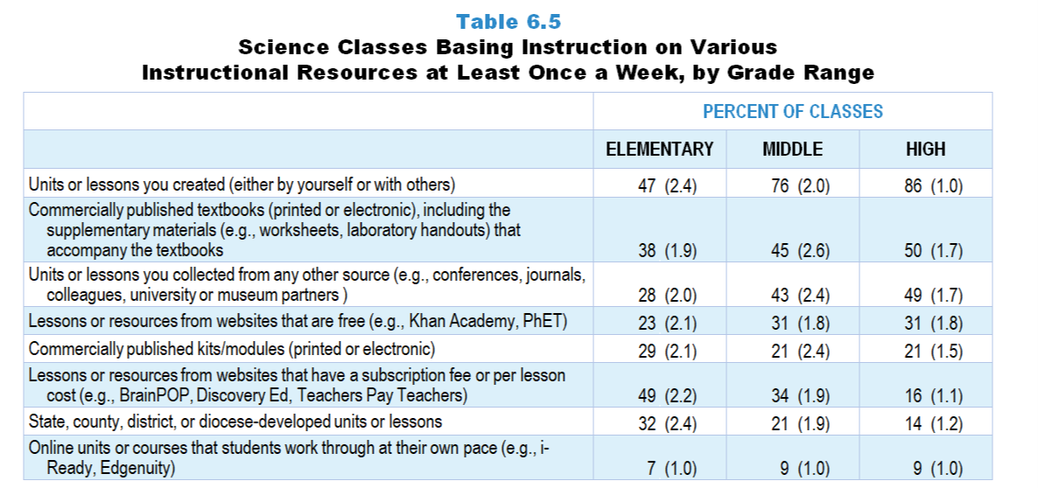
Original Data for Slides 10–12
(not for presentation)
Notes:
Table 6.5, p. 135 in Technical Report
This slide shows data from an individual item.
Science Teacher Questionnaire
Q55. Thinking about your instruction in this class over the entire year, about how often is instruction based on materials from each of the following sources? [Select one on each row.] (Response Options: [1] Never, [2] Rarely (for example: A few times a year), [3] Sometimes (for example: Once or twice a month), [4] Often (for example: Once or twice a week), [5] All or almost all science lessons)
Commercially published textbooks (printed or electronic), including the supplementary materials (for example: worksheets, laboratory handouts) that accompany the textbooks
Commercially published kits/modules (printed or electronic)
State, county, or district/diocese-developed units or lessons
Online units or courses that students work through at their own pace (for example: i-Ready, Edgenuity)
Lessons or resources from websites that have a subscription fee or per lesson cost (for example: BrainPOP, Discovery Ed, Teachers Pay Teachers)
Lessons or resources from websites that are free (for example: Khan Academy, PhET)
Units or lessons you created (either by yourself or with others)
Units or lessons you collected from any other source (for example: conferences, journals, colleagues, university or museum partners )
The numbers in parentheses are standard errors.
Findings Highlighted in Technical Report
“Regardless of whether instructional materials had been designated for their class, teachers were asked how often instruction was based on various types of materials. As can be seen in Table 6.5, teacher-created units or lessons are very likely to be used on a weekly basis in science, and their prominence increases considerably with grade range, from 47 percent of elementary science classes to 86 percent of high school classes. In high school, after teacher-created lessons, commercially published textbooks and units or lessons from any other source are a distant second, with all the rest being relatively uncommon. In middle school science classes, the pattern is similar but less pronounced. In elementary science classes, fee-based websites and teacher-created units and lessons share roughly equal influence, followed by the textbook.”

Slide 10
Elementary Science Classes Basing Instruction on Various Instructional Resources at Least Once a Week
Notes:
Note: Each grade-level chart is sorted independently; consequently items may appear in different orders.

Slide 11
Middle School Science Classes Basing Instruction on Various Instructional Resources at Least Once a Week
Notes:
Note: Each grade-level chart is sorted independently; consequently items may appear in different orders.

Slide 12
High School Science Classes Basing Instruction on Various Instructional Resources at Least Once a Week
Notes:
Note: Each grade-level chart is sorted independently; consequently items may appear in different orders.

Slide 13
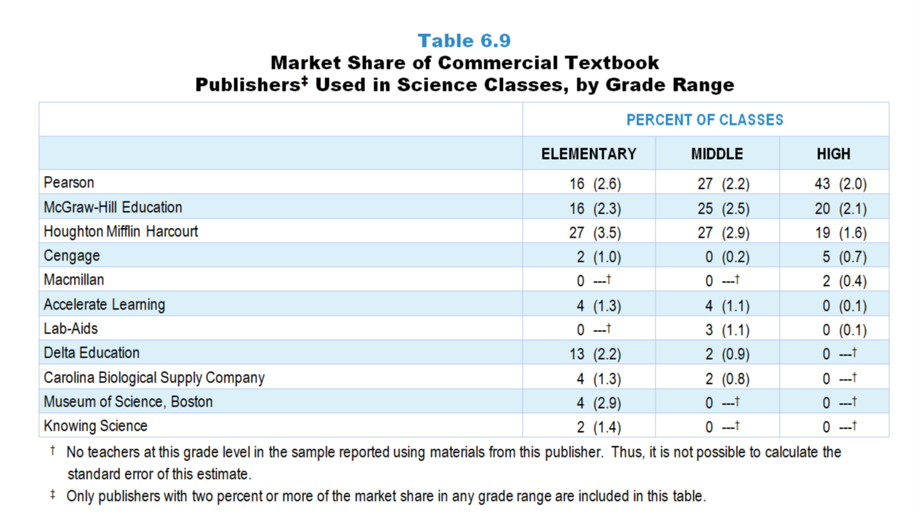
Original Data for Slide 14
(not for presentation)
Notes:
Table 6.9, p. 138 in Technical Report
This slide shows data derived from:
Science Teacher Questionnaire
Q55. [Presented only to teachers who selected “Sometimes” “Often” or “All” for Q55a, b, or d]
[Version for teachers who indicate using a commercial textbook most often]
Please indicate the title, author, most recent copyright year, and ISBN code of the commercially published textbook or kits/modules (printed or electronic) used most often by the students in this class.
If you use multiple kits/modules, select one to enter the information for.
The 10- or 13-character ISBN code can be found on the copyright page and/or the back cover of the textbook/module.
Do not include the dashes when entering the ISBN.
An example of the location of the ISBN is shown to the right.
Title: ____
First Author: ____
Year: ____
ISBN: ____
URL: [for teachers who indicate using an online program most often]
The numbers in parentheses are standard errors.
Findings Highlighted in Technical Report
“Teachers who indicated that instruction in their randomly selected class was based substantially on a commercially published textbook or module were asked to record the title, author, year, and ISBN of the material used most often in the class. Using this information, the publisher of the material was identified. Tables 6.9–6.11 show the market share held by each of the major science, mathematics, and computer science textbook publishers. It is interesting to note that three publishers—Pearson, McGraw-Hill, and Houghton Mifflin Harcourt—account for instructional materials used in more than 75 percent of middle school and high school science classes and more than 70 percent of all mathematics classes. The only other publishers with a substantial share of the market are Delta Education in elementary science and Great Minds in elementary mathematics. In high school computer science, Pearson again has a considerable market share, followed closely by Cengage.”

Slide 14
Market Share of Commercial Textbook Publishers in Science Classes

Slide 15
Original Data for Slide 16
(not for presentation)
Notes:
The science portion of Table 6.14, p. 143 in Technical Report
This slide shows data from an individual item.
Science Teacher Questionnaire
Q55. [Presented only to teachers who selected “Sometimes” “Often” or “All” for Q55a, b, or d]
[Version for teachers who indicate using a commercial textbook most often]
Please indicate the title, author, most recent copyright year, and ISBN code of the commercially published textbook or kits/modules (printed or electronic) used most often by the students in this class.
If you use multiple kits/modules, select one to enter the information for.
The 10- or 13-character ISBN code can be found on the copyright page and/or the back cover of the textbook/module.
Do not include the dashes when entering the ISBN.
An example of the location of the ISBN is shown to the right.
Title: ____
First Author: ____
Year: ____
ISBN: ____
URL: [for teachers who indicate using an online program most often]
The numbers in parentheses are standard errors.
Findings Highlighted in Technical Report
“Table 6.14 shows the publication year of science, mathematics, and computer science textbooks. In 2018, 43–51 percent of science classes used textbooks published in 2009 or earlier. Science classes are considerably more likely than mathematics classes to use older textbooks. For example, 51 percent of middle grades science classes are using textbooks published in 2009 or earlier, compared to only 15 percent of middle grades mathematics classes. Given the growing presence of computer science classes, it is surprising that a third of them are using textbooks published in 2009 or earlier, but it is important to remember that a relatively small proportion of these classes use published materials at all.”

Slide 16
Publication Year of Science Textbooks/Programs
Notes:
Only science classes using commercially published textbooks/modules are included in these analyses.

Slide 17
Original Data for Slide 18
(not for presentation)
Notes:
The science portion of Table 6.15, p. 143 in Technical Report
This slide shows data from an individual item.
Science Teacher Questionnaire
Q62. [Presented only to teachers who selected “Sometimes” “Often” or “All” for Q55a, b, or c]
Was this unit based primarily on a commercially published textbook/kit/module or state, county, or district/diocese-developed materials?
Yes
No
The numbers in parentheses are standard errors.
Findings Highlighted in Technical Report
“Teachers were also asked whether the most recent unit in their randomly selected class was based primarily on either a commercially published textbook or materials developed by the state or district. (Computer science teachers were asked about commercially published online courses in addition.) As shown in Table 6.15, more than half of classes—mathematics classes in particular—are based on such materials.”

Slide 18
Science Classes in Which the Most Recent Unit Was Based on a Commercially Published Textbook or a Material Developed by the State or District

Slide 19
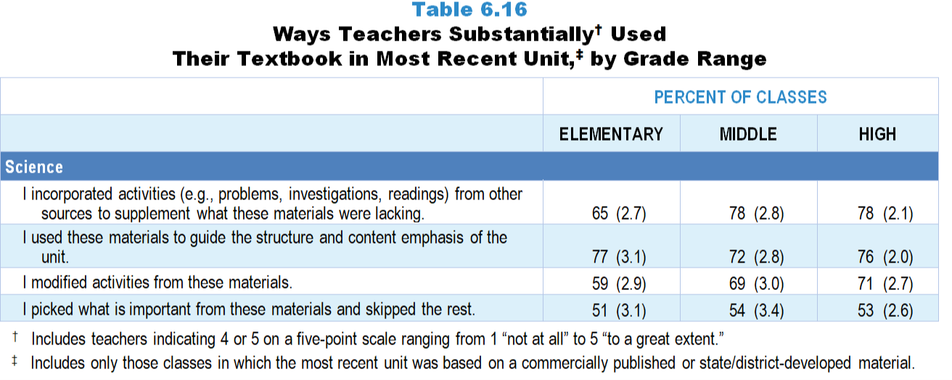
Original Data for Slide 20
(not for presentation)
Notes:
The science portion of the Table 6.16, p. 144 in Technical Report
This slide shows data from an individual item.
Science Teacher Questionnaire
Q63. Please indicate the extent to which you did each of the following while teaching this unit. [Select one on each row.] (Response Options: [1] Not at all, [2] 2 of 5, [3] Somewhat, [4] 4 of 5, [5] To a great extent)
I used these materials to guide the structure and content emphasis of the unit.
I picked what is important from these materials and skipped the rest.
I incorporated activities (for example: problems, investigations, readings) from other sources to supplement what these materials were lacking.
I modified activities from these materials.
The numbers in parentheses are standard errors.
Findings Highlighted in Technical Report
“When teachers responded that their most recent unit was based on one of these materials, they were asked how they used the material (see Table 6.16). Two important findings emerge from these data. First, when classes use commercially published and state/‌district-developed materials, the materials heavily influence instruction in all subjects at all grade ranges. Teachers in more than 70 percent of classes in the various subject and grade-level categories use the textbook substantially to guide the overall structure and content emphasis of their units. Second, it is clear that teachers modify their materials substantially when designing instruction. In roughly half or more of classes, teachers incorporate activities from other sources substantially, “pick and choose” from the material, and modify activities from the materials. “

Slide 20
Ways Science Teachers Substantially Used Their Textbook in the Most Recent Unit
Notes:
Includes classes in which teachers indicated 4 or 5 on a five-point scale ranging from 1 “not at all” to 5 “to a great extent.”
Only science classes in which the most recent unit was based on commercially published or state/‌district-developed materials are included in these analyses.

Slide 21
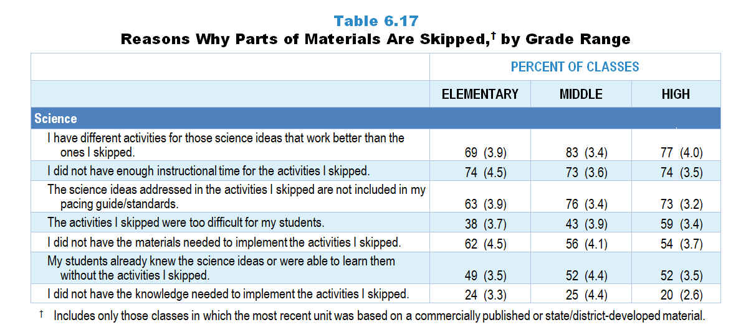
Original Data for Slides 22–24
(not for presentation)
Notes:
The science portion of Table 6.17, p. 145 in Technical Report
This slide shows data from an individual item.
Science Teacher Questionnaire
Q64. [Presented only to teachers who did not select “Not at all” for Q63b]
During this unit, when you skipped activities (for example: problems, investigations, readings) in these materials, how much was each of the following a factor in your decisions? [Select one on each row.] (Response Options: [1] Not a factor, [2] A minor factor, [3] A major factor)
The science ideas addressed in the activities I skipped are not included in my pacing guide/standards.
I did not have the materials needed to implement the activities I skipped.
I did not have the knowledge needed to implement the activities I skipped
The activities I skipped were too difficult for my students.
My students already knew the science ideas or were able to learn them without the activities I skipped.
I have different activities for those science ideas that work better than the ones I skipped.
I did not have enough instructional time for the activities I skipped.
The numbers in parentheses are standard errors.
Findings Highlighted in Technical Report
“Teachers in roughly half of science, mathematics, and computer science classes skip activities in the material substantially. As can be seen in Table 6.17, in all subjects, some of the most frequently selected reasons for skipping parts of the materials are: (1) having another activity that works better than the one skipped, (2) the science ideas addressed not being included in pacing guides or standards, (3) not having enough instructional time, and (4) the activities skipped being too difficult for the students. In more than 40 percent of classes, teachers skip activities that they deem unnecessary (students either already knew the ideas or could learn them without the activities). Differences across grades, however, are also apparent. For example, in mathematics, teachers in 38 percent of elementary classes cite the difficulty of the activity as the reason for skipping it, compared to 55 percent in high school mathematics classes. A similar pattern is evident in science. Also, not having materials for an activity is much more likely to be cited as a reason in science classes (54–62 percent) than in mathematics classes (24–27 percent) or high school computer science classes (28 percent).”

Slide 22
Reasons Why Parts of Materials Are Skipped in Elementary Science Classes
Notes:
Only science classes in which (1) the most recent unit was based on commercially published or state/district-developed materials and (2) teachers reported skipping some activities are included in these analyses.
Note: Each grade-level chart is sorted independently; consequently items may appear in different orders.

Slide 23
Reasons Why Parts of Materials Are Skipped in Middle School Science Classes
Notes:
Only science classes in which (1) the most recent unit was based on commercially published or state/district-developed materials and (2) teachers reported skipping some activities are included in these analyses.
Note: Each grade-level chart is sorted independently; consequently items may appear in different orders.

Slide 24
Reasons Why Parts of Materials Are Skipped in High School Science Classes
Notes:
Only science classes in which (1) the most recent unit was based on commercially published or state/district-developed materials and (2) teachers reported skipping some activities are included in these analyses.
Note: Each grade-level chart is sorted independently; consequently items may appear in different orders.

Slide 25
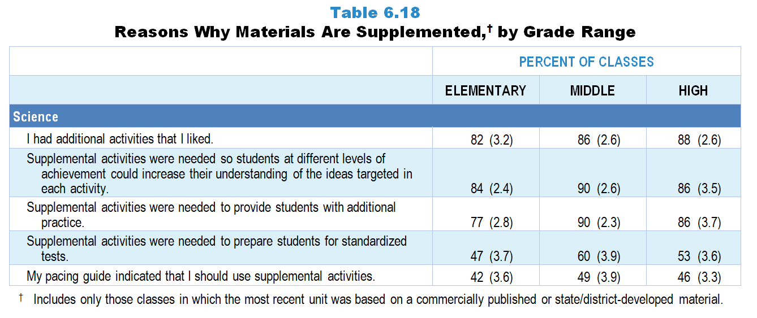
Original Data for Slides 26–28
(not for presentation)
Notes:
The science portion of Table 6.18, p. 146 in Technical Report
This slide shows data from an individual item.
Science Teacher Questionnaire
Q72. [Presented only to teachers who did not select “Not at all” for Q63c]
During this unit, when you supplemented these materials with additional activities, how much was each of the following a factor in your decisions? [Select one on each row.] (Response Options: [1] Not a factor, [2] A minor factor, [3] A major factor)
My pacing guide indicated that I should use supplemental activities.
Supplemental activities were needed to prepare students for standardized tests.
Supplemental activities were needed to provide students with additional practice.
Supplemental activities were needed so students at different levels of achievement could increase their understanding of the ideas targeted in each activity.
I had additional activities that I liked.
The numbers in parentheses are standard errors.
Findings Highlighted in Technical Report
“Given that teachers often skip activities in their materials because they know of better ones, it is perhaps not surprising that teachers in well more than half of science, mathematics, and computer science classes supplement their materials. Of the reasons listed on the questionnaire, three stand out above the rest: (1) teachers having additional activities that they like, (2) providing students with additional practice, and (3) differentiating instruction for students at different achievement levels (see Table 6.18). The influence of standardized testing is also evident, with teachers in anywhere from about half to almost three-fourths of classes across subjects supplementing for test-preparation purposes. Finally, in 34–49 percent of classes, depending on subject and grade level, teachers supplement their published material because their pacing guide indicates that they should. This finding both speaks to the prevalence of pacing guides and suggests that supplementing is at least to some extent sanctioned or prescribed by schools and districts.”

Slide 26
Reasons Why Materials Are Supplemented in Elementary Science Classes
Notes:
Only science classes in which (1) the most recent unit was based on commercially published or state/district-developed materials and (2) teachers reported supplementing some activities are included in these analyses.
Note: Each grade-level chart is sorted independently; consequently items may appear in different orders.

Slide 27
Reasons Why Materials Are Supplemented in Middle School Science Classes
Notes:
Only science classes in which (1) the most recent unit was based on commercially published or state/district-developed materials and (2) teachers reported supplementing some activities are included in these analyses.
Note: Each grade-level chart is sorted independently; consequently items may appear in different orders.

Slide 28
Reasons Why Materials Are Supplemented in High School Science Classes
Notes:
Only science classes in which (1) the most recent unit was based on commercially published or state/district-developed materials and (2) teachers reported supplementing some activities are included in these analyses.
Note: Each grade-level chart is sorted independently; consequently items may appear in different orders.

Slide 29
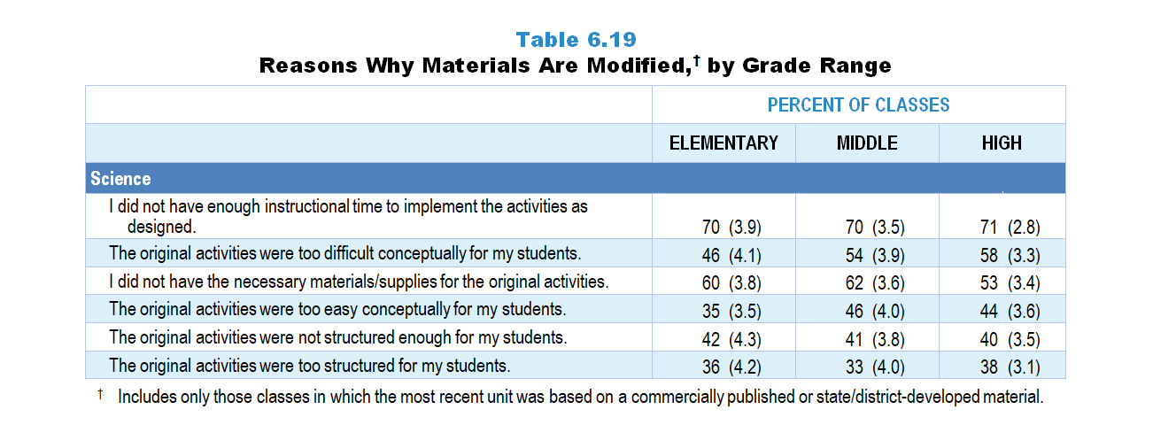
Original Data for Slides 30–32
(not for presentation)
Notes:
The science portion of Table 6.19, p. 147 in Technical Report
This slide shows data from an individual item.
Science Teacher Questionnaire
Q66. [Presented only to teachers who did not select “Not at all” in Q63d]
During this unit, when you modified activities from these materials, how much was each of the following a factor in your decisions? [Select one on each row.] (Response Options: [1] Not a factor, [2] A minor factor, [3] A major factor)
I did not have the necessary materials/supplies for the original activities.
The original activities were too difficult conceptually for my students.
The original activities were too easy conceptually for my students.
I did not have enough instructional time to implement the activities as designed.
The original activities were too structured for my students.
The original activities were not structured enough for my students.
The numbers in parentheses are standard errors.
Findings Highlighted in Technical Report
“Finally, when teachers reported that they modified their published material (which over half did), they rated each of several factors that may have contributed to their decision (see Table 6.19). Two factors stand out: teachers do not have enough time to implement the activities as designed (52–71 percent of classes), and the activities are too difficult for students (43–58 percent of classes). In science, teachers are also likely to cite not having the necessary materials or supplies for the original activities (53–62 percent of classes). Teachers are about equally likely to point to the structure of activities (either too much or too little) across subjects and grade ranges as the reason for modifications.”

Slide 30
Reasons Why Materials Are Modified in Elementary Science Classes
Notes:
Only science classes in which (1) the most recent unit was based on commercially published or state/district-developed materials and (2) teachers reported modifying some activities are included in these analyses.
Note: Each grade-level chart is sorted independently; consequently items may appear in different orders.

Slide 31
Reasons Why Materials Are Modified in Middle School Science Classes
Notes:
Only science classes in which (1) the most recent unit was based on commercially published or state/district-developed materials and (2) teachers reported modifying some activities are included in these analyses.
Note: Each grade-level chart is sorted independently; consequently items may appear in different orders.

Slide 32
Reasons Why Materials Are Modified in High School Science Classes
Notes:
Only science classes in which (1) the most recent unit was based on commercially published or state/district-developed materials and (2) teachers reported modifying some activities are included in these analyses.
Note: Each grade-level chart is sorted independently; consequently items may appear in different orders.

Slide 33
Facilities and Equipment

Slide 34
Original Data for Slide 35
(not for presentation)
Notes:
Table 6.23, p. 149 in Technical Report
This slide shows data from an individual item.
Science Teacher Questionnaire
Q53. Please indicate the availability of each of the following for your science instruction in this class. [Select one on each row.] (Response Options: [1] Always available in your classroom, [2] Available upon request, [3] Not available)
Probes for collecting data (for example: motion sensors, temperature probes)
Microscopes
Balances (for example: pan, triple beam, digital scale)
Projection devices (for example: Smartboard, document camera, LCD projector)
The numbers in parentheses are standard errors.
Findings Highlighted in Technical Report
“The percentages of science classes with at least some availability of these resources (either in the classroom or upon request) are shown in Table 6.23. More than 80 percent of classes at all levels have access to balances. The availability of probes for collecting data increases with grade range, and microscopes are much more available in middle and high school classes than in elementary classes."

Slide 35
Availability of Instructional Technologies in Science Classes
Notes:
Includes only those teachers indicating the resource is always available in their classroom or available upon request.

Slide 36
Original Data for Slide 37
(not for presentation)
Notes:
Table 6.25, p. 150 in Technical Report
This slide shows data from an individual item.
Science Teacher Questionnaire
Q47. Please indicate the availability of each of the following for your science instruction in this class. [Select one on each row.] (Response Options: [1] Located in your classroom, [2] Available in another room, [3] Not available)
Lab tables
Electric outlets
Faucets and sinks
Gas for burners [Grades 9-12 only]
Fume hoods [Grades 9‒12 only]
The numbers in parentheses are standard errors.
Findings Highlighted in Technical Report
“Science teachers were also asked about the availability of laboratory facilities, using the same response options they used for instructional technologies. Electrical outlets and running water are widely available in all grade ranges (see Table 6.25). Fewer than a third of elementary classes have access to lab tables, but they are widespread in middle school and especially high school classrooms. “

Slide 37
Availability of Laboratory Facilities in Science Classes
Notes:
Includes only those science teachers indicating the resource is either located in the classroom or available in another room.

Slide 38
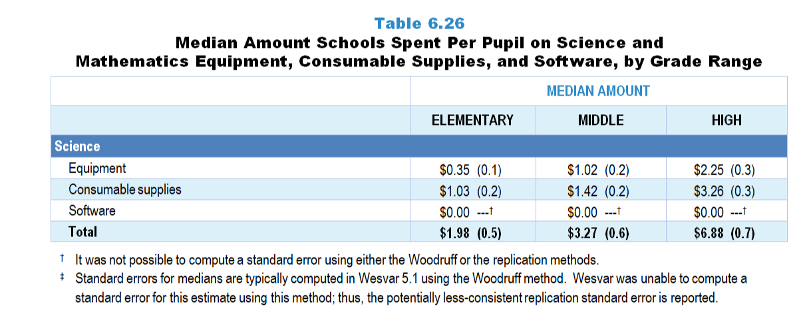
Original Data for Slide 39
(not for presentation)
Notes:
The science portion of Table 6.26, p. 150 in Technical Report
This slide shows data from an individual item.
Science Program Questionnaire
Q14. For this school, how much money was spent on each of the following during the most recently completed budget year? (If you don’t know the exact amounts, please provide your best estimates.)
Consumable supplies for science instruction (for example: chemicals, living organisms, batteries) _____
Science equipment (non-consumable, non-perishable items such as microscopes, scales, etc., but not computers) _____
Software for science instruction _____
The numbers in parentheses are standard errors.
Findings Highlighted in Technical Report
“The 2018 NSSME+ also asked science and mathematics program representatives how much money their schools spent during the most recently completed school year on three kinds of resources: equipment (excluding computers), consumable supplies (e.g., chemicals, graph paper), and software specific to science and mathematics instruction. By dividing these amounts by school enrollment, per-pupil estimates were generated (see Table 6.26). In science, per-pupil spending on equipment and supplies increases sharply from elementary school to high school, as does overall per-pupil spending. In mathematics, total per-pupil spending is substantially higher in elementary schools than in middle and high schools. Clearly, median per-pupil spending for software is the least of the three categories.”

Slide 39
Median Amount Schools Spend Per Pupil on Science Equipment and Consumable Supplies
Notes:
The survey asked about spending on software in addition to equipment and supplies. The median per pupil spending on software in each subject/grade-range combination is $0.00.
The total includes spending on software.

Slide 40
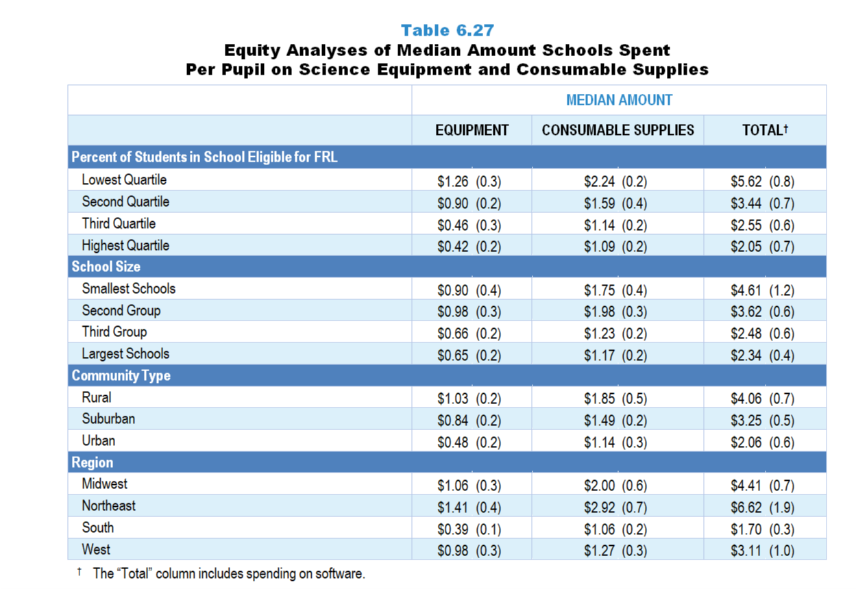
Original Data for Slides 41–44
(not for presentation)
Notes:
Table 6.27, p. 151 in Technical Report
This slide shows data from an individual item.
Science Program Questionnaire
Q14. For this school, how much money was spent on each of the following during the most recently completed budget year? (If you don’t know the exact amounts, please provide your best estimates.)
Consumable supplies for science instruction (for example: chemicals, living organisms, batteries) _____
Science equipment (non-consumable, non-perishable items such as microscopes, scales, etc., but not computers) _____
Software for science instruction _____
The numbers in parentheses are standard errors.
Chapters 2–7 in the technical report provide data on several key indicators, disaggregated by one or more equity factors: the prior achievement level of students in the class, the percentage of students from race/ethnicity groups historically underrepresented in STEM in the class, the percentage of students in the school eligible for free/reduced-price lunch (FRL), school size, community type, and region. For FRL, each school was classified into one of four categories (defined as quartiles) based on the proportion of students eligible for FRL. Similarly, each randomly selected class was classified into one of the four categories based on the proportion of students from race/ethnicity groups historically underrepresented in STEM in the class.
Findings Highlighted in Technical Report
“Expenditures for science and mathematics are not distributed equally across all schools. For example, in science, schools with the lowest percentage of students who are eligible for free/‌reduced-price lunch spend considerably more per pupil on equipment and supplies than those with the highest percentage (see Table 6.27). Schools in the South spend considerably less than schools in the Northeast. In mathematics, the smallest schools spend more overall per pupil than the largest schools (see Table 6.28). Regional differences are also apparent, with schools in the Northeast spending the most overall per pupil.”

Slide 41
Median Amount Schools Spend Per Pupil on Science Equipment and Consumable Supplies
Notes:
Median amounts include spending on software.

Slide 42
Median Amount Schools Spend Per Pupil on Science Equipment and Consumable Supplies
Notes:
Median amounts include spending on software.

Slide 43
Median Amount Schools Spend Per Pupil on Science Equipment and Consumable Supplies
Notes:
Median amounts include spending on software.

Slide 44
Median Amount Schools Spend Per Pupil on Science Equipment and Consumable Supplies
Notes:
Median amounts include spending on software.

Slide 45
Original Data for Slide 46
(not for presentation)
Notes:
Table 6.29, p. 152 in Technical Report
This slide shows data from individual items.
Science Teacher Questionnaire
Q54. Science courses may benefit from the availability of particular resources. Considering what you have available, how adequate is each of the following for teaching this science class? [Select one on each row.] (Response Options: [1] Not adequate, [2] 2 of 5, [3] Somewhat adequate, [4] 4 of 5, [5] Adequate)
Instructional technology (for example: calculators, computers, probes/sensors)
Consumable supplies (for example: chemicals, living organisms, batteries)
Equipment (for example: thermometers, magnifying glasses, microscopes, beakers, photogate timers, Bunsen burners)
Facilities (for example: lab tables, electric outlets, faucets and sinks)
The numbers in parentheses are standard errors.
Findings Highlighted in Technical Report
“Expenditures for science instruction seem to be reflected in teachers’ ratings of the adequacy of resources they have on hand. As can be seen in Table 6.29, the overall pattern is that teachers of classes in the higher grade ranges are generally more likely than those in lower ones to rate the availability of resources as adequate. In elementary grades, teachers of fewer than half of classes rate the availability of resources as adequate, compared to two-thirds or more at the high school level. “

Slide 46
Adequacy of Resources for Science Instruction
Notes:
Includes science teachers indicating 4 or 5 on a five-point scale ranging from 1 “not adequate” to 5 “adequate.”

Slide 47
Original Data for Slide 48
(not for presentation)
Notes:
The science portion of Table 6.31, p. 153 in Technical Report
This slide shows data from composites.
Sets of related questionnaire items were combined to create several composite variables related to key constructs. Composite variables, which are more reliable than individual survey items, were computed to have a minimum possible value of 0 and a maximum possible value of 100. Higher composite scores indicate more of the construct being measured by the composite. Each composite is calculated by summing the responses to the items associated with that composite and then dividing by the total points possible. In order for the composites to be on a 100-point scale, the lowest response option on each scale was set to 0 and the others were adjusted accordingly; so for example, an item with a scale ranging from 1 to 4 was re-coded to have a scale of 0 to 3. By doing this, someone who marks the lowest point on every item in a composite receives a composite score of 0 rather than some positive number. It also assures that 50 is the true mid-point. The denominator for each composite is determined by computing the maximum possible sum of responses for a series of items and dividing by 100; e.g., a 9-item composite where each item is on a scale of 0–3 would have a denominator of 0.27. Composite values were not computed for participants who responded to fewer than two-thirds of the items that form the composite.
Adequacy of Resources for Instruction Composite Items
Q54a. Instructional technology (for example: calculators, computers, probes/sensors)
Q54b. Consumable supplies (for example: chemicals, living organisms, batteries)
Q54c. Equipment (for example: thermometers, magnifying glasses, microscopes, beakers, photogate timers, Bunsen burners)
Q54d. Facilities (for example: lab tables, electric outlets, faucets and sinks)
Science Teacher Questionnaire
Q54. Science courses may benefit from the availability of particular resources. Considering what you have available, how adequate is each of the following for teaching this science class? [Select one on each row.] (Response Options: [1] Not adequate, [2] 2 of 5, [3] Somewhat adequate, [4] 4 of 5, [5] Adequate)
Instructional technology (for example: calculators, computers, probes/sensors)
Consumable supplies (for example: chemicals, living organisms, batteries)
Equipment (for example: thermometers, magnifying glasses, microscopes, beakers, photogate timers, Bunsen burners)
Facilities (for example: lab tables, electric outlets, faucets and sinks)
The numbers in parentheses are standard errors.
Findings Highlighted in Technical Report
“These items were combined into a composite variable named Adequacy of Resources for Instruction. As shown in Table 6.31, perceptions of the adequacy of resources vary substantially by content area in elementary and middle school classrooms but are essentially the same in high school classrooms. This aggregate view reflects other findings reported in this section, suggesting that science instruction in the earlier grades is under resourced from teachers’ point of view.”

Slide 48
Adequacy of Resources for Instruction Composite

Slide 49
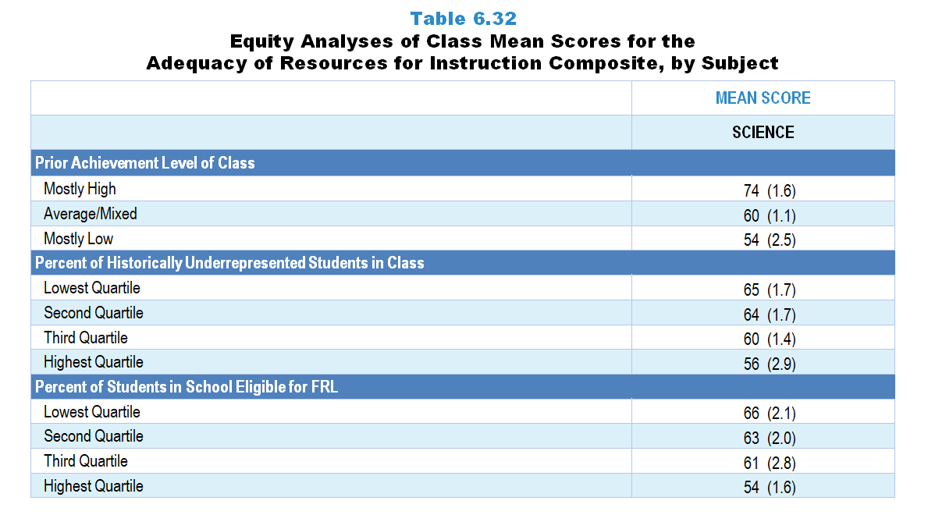
Original Data for Slides 50–52
(not for presentation)
Notes:
The science portion of Table 6.32, p. 154 in Technical Report
This slide shows data from Composites.
Sets of related questionnaire items were combined to create several composite variables related to key constructs. Composite variables, which are more reliable than individual survey items, were computed to have a minimum possible value of 0 and a maximum possible value of 100. Higher composite scores indicate more of the construct being measured by the composite. Each composite is calculated by summing the responses to the items associated with that composite and then dividing by the total points possible. In order for the composites to be on a 100-point scale, the lowest response option on each scale was set to 0 and the others were adjusted accordingly; so for example, an item with a scale ranging from 1 to 4 was re-coded to have a scale of 0 to 3. By doing this, someone who marks the lowest point on every item in a composite receives a composite score of 0 rather than some positive number. It also assures that 50 is the true mid-point. The denominator for each composite is determined by computing the maximum possible sum of responses for a series of items and dividing by 100; e.g., a 9-item composite where each item is on a scale of 0–3 would have a denominator of 0.27. Composite values were not computed for participants who responded to fewer than two-thirds of the items that form the composite.
Adequacy of Resources for Instruction Composite Items
Q54a. Instructional technology (for example: calculators, computers, probes/sensors)
Q54b. Consumable supplies (for example: chemicals, living organisms, batteries)
Q54c. Equipment (for example: thermometers, magnifying glasses, microscopes, beakers, photogate timers, Bunsen burners)
Q54d. Facilities (for example: lab tables, electric outlets, faucets and sinks)
Science Teacher Questionnaire
Q42. For the students in this class, indicate the number of males and females in this class in each of the following categories of race/ethnicity.
American Indian or Alaskan Native _____ _____
Asian _____ _____
Black or African American _____ _____
Hispanic/Latino _____ _____
Native Hawaiian or Other Pacific Islander _____ _____
White _____ _____
Two or more races _____ _____
Q43. Which of the following best describes the prior science achievement levels of the students in this class relative to other students in this school?
Mostly low achievers
Mostly average achievers
Mostly high achievers
A mixture of levels
Q54. Science courses may benefit from the availability of particular resources. Considering what you have available, how adequate is each of the following for teaching this science class? [Select one on each row.] (Response Options: [1] Not adequate, [2] 2 of 5, [3] Somewhat adequate, [4] 4 of 5, [5] Adequate)
Instructional technology (for example: calculators, computers, probes/sensors)
Consumable supplies (for example: chemicals, living organisms, batteries)
Equipment (for example: thermometers, magnifying glasses, microscopes, beakers, photogate timers, Bunsen burners)
Facilities (for example: lab tables, electric outlets, faucets and sinks)
The numbers in parentheses are standard errors.
Chapters 2–7 in the technical report provide data on several key indicators, disaggregated by one or more equity factors: the prior achievement level of students in the class, the percentage of students from race/ethnicity groups historically underrepresented in STEM in the class, the percentage of students in the school eligible for free/reduced-price lunch (FRL), school size, community type, and region. For FRL, each school was classified into one of four categories (defined as quartiles) based on the proportion of students eligible for FRL. Similarly, each randomly selected class was classified into one of the four categories based on the proportion of students from race/ethnicity groups historically underrepresented in STEM in the class.
Findings Highlighted in Technical Report
“In science, teachers of classes with mostly high-achieving students have the most positive views about their resources, compared to classes with average/‌mixed prior achievers and those with mostly low-achieving students (see Table 6.32). Similarly, teachers of classes with the lowest percentage of students from race/‌ethnicity groups historically underrepresented in STEM have more positive views than those with the highest percentage, as do teachers of classes with the lowest percentage of students eligible for free/‌reduced-price lunch, compared to those with the highest percentage. Mathematics teachers’ views of the adequacy of their resources do not tend to differ substantially by various equity factors.”

Slide 50
Adequacy of Resources for Instruction Composite

Slide 51
Adequacy of Resources for Instruction Composite
Notes:
Historically Underrepresented Students includes American Indian or Alaskan Native, Black or African American, Hispanic or Latino, or Native Hawaiian or Other Pacific Islander students.

Slide 52
Adequacy of Resources for Instruction Composite

