Slide 1
Chapter 7
Factors Affecting Resources
Computer Science

Slide 2
School Programs and Practices

Slide 3
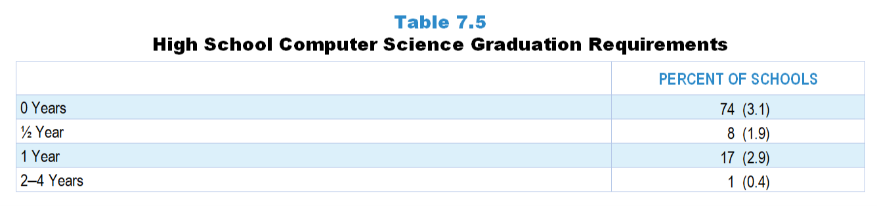
Original Data for Slide 4
(not for presentation)
Notes:
Table 7.5, p. 159 in Technical Report
This slide shows original and derived data from an individual item.
School Coordinator Questionnaire
Q28. [Presented only to schools that include grade 12] In order to graduate from this high school, how many years of computer science are students grades 9–12 required to take?
0 year
1/2 year
1 year
2 years
3 years
4 years
The numbers in parentheses are standard errors.
Findings Highlighted in Technical Report
“In contrast, nearly three-quarters of schools do not require any computer science in order to graduate; almost all that do require one year or less (see Table 7.5). Additionally, program representatives were asked if computer science counts toward graduation requirements in any other subjects. As can be seen in Table 7.6, only a small percentage of high schools allow computer science to count toward graduation requirements in mathematics, science, or foreign language.”

Slide 4
High School Computer Science Graduation Requirements

Slide 5
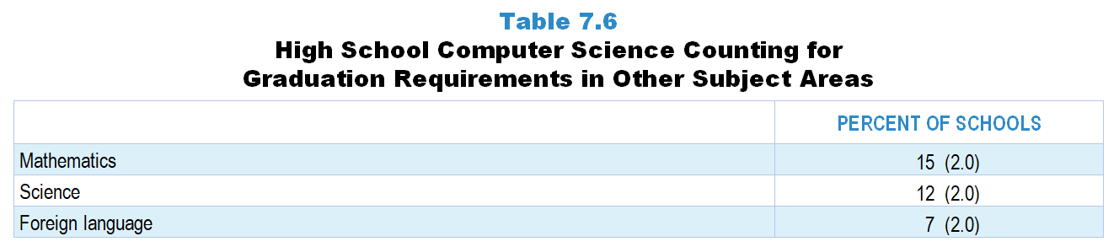
Original Data for Slide 6
(not for presentation)
Notes:
Table 7.6, p. 160 in Technical Report
This slide shows original and derived data from an individual item.
School Coordinator Questionnaire
Q29. [Presented only to schools that include grade 12] Can computer science courses count towards students’ high school graduation requirements in each of the following subject areas? [Select one on each row.] (Response options: Yes, No)
Mathematics
Science
Foreign language
The numbers in parentheses are standard errors.
Findings Highlighted in Technical Report
“In contrast, nearly three-quarters of schools do not require any computer science in order to graduate; almost all that do require one year or less (see Table 7.5). Additionally, program representatives were asked if computer science counts toward graduation requirements in any other subjects. As can be seen in Table 7.6, only a small percentage of high schools allow computer science to count toward graduation requirements in mathematics, science, or foreign language.”

Slide 6
High School Computer Science Counting for Graduation Requirements in Other Subject Areas

Slide 7
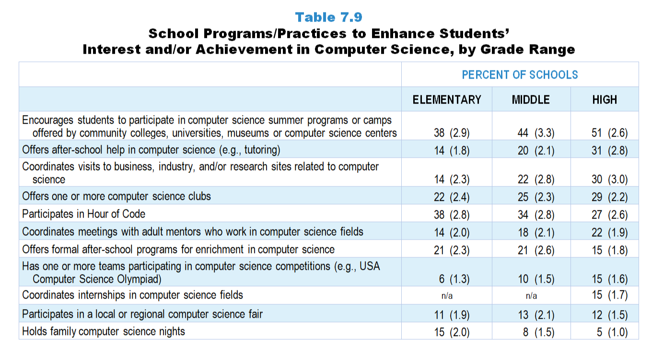
Original Data for Slides 8–13
(not for presentation)
Notes:
Table 7.9, p. 161 in Technical Report
This slide shows data from an individual item.
School Coordinator Questionnaire
Q17. Indicate whether your school does each of the following to enhance students’ interest and/or achievement in computer science. [Select one on each row.] (Response Options: Yes, No)
Holds family computer science nights
Offers after-school help in computer science (for example: tutoring)
Offers formal after-school programs for enrichment in computer science
Offers one or more computer science clubs
Participates in Hour of Code
Participates in a local or regional computer science fair
Has one or more teams participating in computer science competitions (for example: USA Computer Science Olympiad)
Encourages students to participate in computer science summer programs or camps offered by community colleges, universities, museums or computer science centers
Coordinates visits to business, industry, and/or research sites related to computer science
Coordinates meetings with adult mentors who work in computer science fields
Coordinates internships in computer science fields [High schools only]
The numbers in parentheses are standard errors.
Findings Highlighted in Technical Report
“Finally, program representatives were asked to indicate which of several practices their school employs to enhance student interest and/‌or achievement in science, mathematics, and computer science. The results are shown in Tables 7.7‒7.9. Especially in science, such programs tend to be more prevalent as grade range increases. For example, more than three-quarters of high schools offer after-school help in science and engineering, compared to about a third of elementary schools. Similarly, 47 percent of high schools have one or more teams participating in engineering competitions, whereas only 24 percent of elementary schools do. In mathematics, the percentage of schools offering school-based programs to enhance interest and achievement (apart from tutoring) is strikingly low. For example, only about one-third of high schools have mathematics clubs, and fewer than 20 percent of all schools participate in local or regional math fairs. Computer science enhancement programs are rare at all grade levels. With the exception of encouraging students to participate in computer science-based summer programs, the majority of all schools do not provide opportunities intended to promote interest and achievement in computer science. For example, 15 percent or fewer of all schools have teams participating in computer science competitions, coordinate internships in computer science, and participate in local or regional computer science fairs.”

Slide 8
Elementary School Programs/Practices to Enhance Students’ Interest/Achievement in Computer Science
Notes:
Note: Each grade-level chart is sorted independently; consequently items may appear in different orders.

Slide 9
Elementary School Programs/Practices to Enhance Students’ Interest/Achievement in Computer Science
Notes:
Note: Each grade-level chart is sorted independently; consequently items may appear in different orders.

Slide 10
Middle School Programs/Practices to Enhance Students’ Interest/Achievement in Computer Science
Notes:
Note: Each grade-level chart is sorted independently; consequently items may appear in different orders.

Slide 11
Middle School Programs/Practices to Enhance Students’ Interest/Achievement in Computer Science
Notes:
Note: Each grade-level chart is sorted independently; consequently items may appear in different orders.

Slide 12
High School Programs/Practices to Enhance Students’ Interest/Achievement in Computer Science
Notes:
Note: Each grade-level chart is sorted independently; consequently items may appear in different orders.

Slide 13
High School Programs/Practices to Enhance Students’ Interest/Achievement in Computer Science
Notes:
Note: Each grade-level chart is sorted independently; consequently items may appear in different orders.

Slide 14
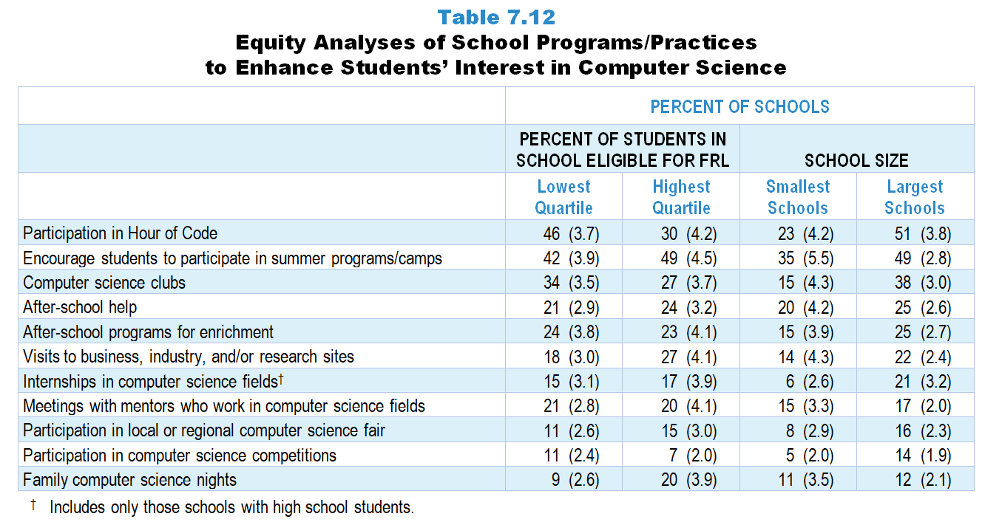
Original Data for Slides 15–18
(not for presentation)
Notes:
Table 7.12, p. 163 in Technical Report
This slide shows data from an individual item.
School Coordinator Questionnaire
Q17. Indicate whether your school does each of the following to enhance students’ interest and/or achievement in computer science. [Select one on each row.] (Response Options: Yes, No)
Holds family computer science nights
Offers after-school help in computer science (for example: tutoring)
Offers formal after-school programs for enrichment in computer science
Offers one or more computer science clubs
Participates in Hour of Code
Participates in a local or regional computer science fair
Has one or more teams participating in computer science competitions (for example: USA Computer Science Olympiad)
Encourages students to participate in computer science summer programs or camps offered by community colleges, universities, museums or computer science centers
Coordinates visits to business, industry, and/or research sites related to computer science
Coordinates meetings with adult mentors who work in computer science fields
Coordinates internships in computer science fields [High schools only]
The numbers in parentheses are standard errors.
Chapters 2–7 in the technical report provide data on several key indicators, disaggregated by one or more equity factors: the prior achievement level of students in the class, the percentage of students from race/ethnicity groups historically underrepresented in STEM in the class, the percentage of students in the school eligible for free/reduced-price lunch (FRL), school size, community type, and region. For FRL, each school was classified into one of four categories (defined as quartiles) based on the proportion of students eligible for FRL. Similarly, each randomly selected class was classified into one of the four categories based on the proportion of students from race/ethnicity groups historically underrepresented in STEM in the class.
Findings Highlighted in Technical Report
“Interestingly, these programs are not distributed equally across all types of schools. Some differences are particularly evident by percentage of students eligible for free/‌reduced-price lunch and school size. Large schools are more likely than small schools to offer many of these programs (see Table 7.10). For example, 45 percent of the largest schools offer opportunities for students to participate in engineering clubs, compared to only 19 percent of the smallest schools, and 53 percent of the largest schools have science clubs, compared to 27 percent of the smallest schools. Results are more varied when looking at these programs by the percentage of students in the school eligible for free/‌reduced-price lunch. Schools with the fewest students eligible for free/reduced-price lunch are more likely to offer enrichment programs (for example, 39 percent of schools in the lowest quartile have students participating in engineering clubs, compared to 26 percent of schools in the highest quartile). In contrast, 55 percent of schools in the highest quartile offer after-school help in science and/‌or engineering, compared to 39 percent of schools in the lowest quartile. Similar patterns exist to a lesser degree for schools’ mathematics programs and practices (see Table 7.11) and computer science programs and practices (see Table 7.12).”

Slide 15
School Programs/Practices to Enhance Students’ Interest in Computer Science, by Percent of Students in School Eligible for FRL
Notes:
Note: Each equity analysis chart is sorted independently; consequently items may appear in different orders.

Slide 16
School Programs/Practices to Enhance Students’ Interest in Computer Science, by Percent of Students in School Eligible for FRL
Notes:
Note: Each equity analysis chart is sorted independently; consequently items may appear in different orders.

Slide 17
School Programs/Practices to Enhance Students’ Interest in Computer Science, by School Size
Notes:
Note: Each equity analysis chart is sorted independently; consequently items may appear in different orders.

Slide 18
School Programs/Practices to Enhance Students’ Interest in Computer Science, by School Size
Notes:
Note: Each equity analysis chart is sorted independently; consequently items may appear in different orders.

Slide 19
Factors That Promote and Inhibit Effective Instruction

Slide 20
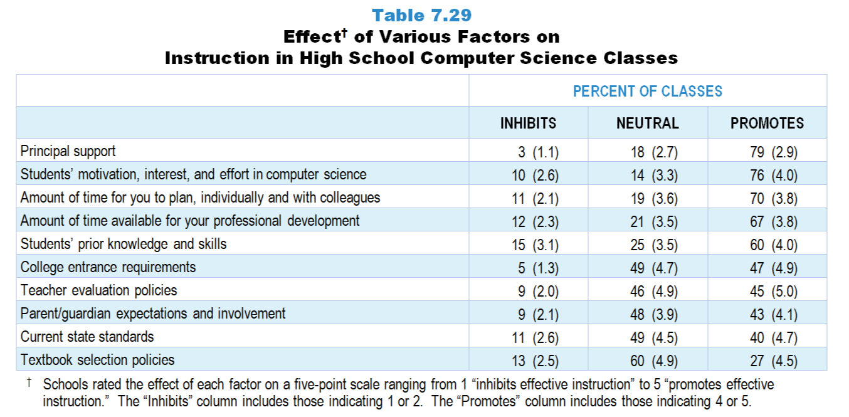
Original Data for Slides 21–22
(not for presentation)
Notes:
Table 7.29, p. 174 in Technical Report
This slide shows data from an individual item.
Computer Science Teacher Questionnaire
Q41. Please rate how each of the following affects your computer science instruction in this class. [Select one on each row.] (Response Options: [1] Inhibits effective instruction, [2] 2 of 5, [3] Neutral or Mixed, [4] 4 of 5, [5] Promotes effective instruction, [6] N/A)
Current state standards
Textbook selection policies
Teacher evaluation policies
College entrance requirements
Students’ prior knowledge and skills
Students’ motivation, interest, and effort in computer science
Parent/guardian expectations and involvement
Principal support
Amount of time for you to plan, individually and with colleagues
Amount of time available for your professional development
The numbers in parentheses are standard errors.
Findings Highlighted in Technical Report
“Table 7.29 displays the results for high school computer science. Unlike high school science and mathematics, students’ motivation, interest, and effort in computer science are seen by teachers in the large majority of classes as promoting effective instruction. Principal support, time to plan, and the amount of time for professional development are also seen as promoters of effective instruction in two-thirds or more of classes. Current state standards and textbook selection policies have a neutral or mixed effect on computer science instruction in approximately half of the classes, likely because these standards and policies are absent from most schools. “

Slide 21
Factors Promoting Effective Instruction in High School Computer Science Classes
Notes:
Schools rated the effect of each factor on a five-point scale ranging from 1 “inhibits effective instruction” to 5 “promotes effective instruction.” The “Inhibits” column includes those indicating 1 or 2. The “Promotes” column includes those indicating 4 or 5.

Slide 22
Factors Inhibiting Effective Instruction in High School Computer Science Classes
Notes:
Schools rated the effect of each factor on a five-point scale ranging from 1 “inhibits effective instruction” to 5 “promotes effective instruction.” The “Inhibits” column includes those indicating 1 or 2. The “Promotes” column includes those indicating 4 or 5.

Slide 23
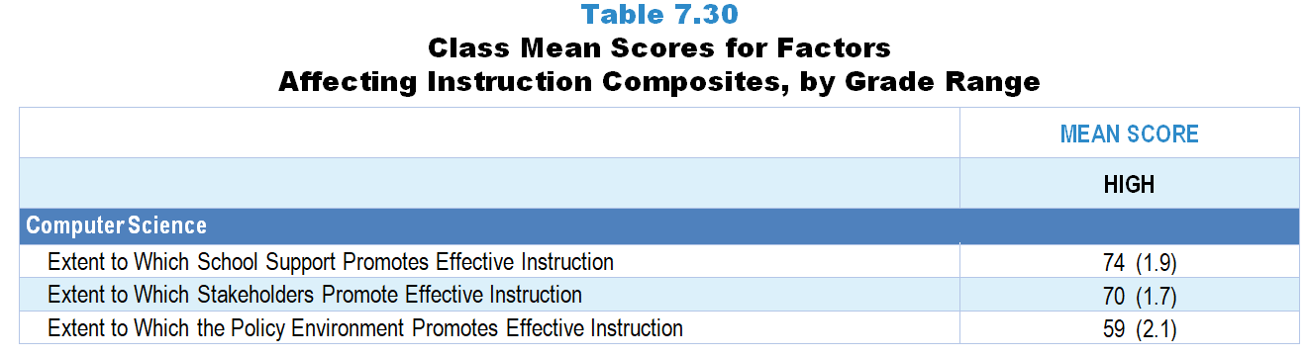
Original Data for Slide 24
(not for presentation)
Notes:
The computer science portion of Table 7.30, p. 174 in Technical Report
This slide shows data from composites.
Sets of related questionnaire items were combined to create several composite variables related to key constructs. Composite variables, which are more reliable than individual survey items, were computed to have a minimum possible value of 0 and a maximum possible value of 100. Higher composite scores indicate more of the construct being measure by the composite. Each composite is calculated by summing the responses to the items associated with that composite and then dividing by the total points possible. In order for the composites to be on a 100-point scale, the lowest response option on each scale was set to 0 and the others were adjusted accordingly; so for example, an item with a scale ranging from 1 to 4 was re-coded to have a scale of 0 to 3. By doing this, someone who marks the lowest point on every item in a composite receives a composite score of 0 rather than some positive number. It also assures that 50 is the true mid-point. The denominator for each composite is determined by computing the maximum possible sum of responses for a series of items and dividing by 100; e.g., a 9-item composite where each item is on a scale of 0–3 would have a denominator of 0.27. Composites values were not computed for participants who respond to fewer than two-thirds of the items that form the composite.
Extent to Which the Policy Environment Promotes Effective Instruction Composite Items
Q41a. Current state standards
Q41b. Textbook selection policies
Q41c. Teacher evaluation policies
Extent to Which Stakeholders Promote Effective Instruction Composite Items
Q41e. Students’ prior knowledge and skills
Q41f. Students’ motivation, interest, and effort in computer science
Q41g. Parent/guardian expectations and involvement
Extent to Which School Support Promotes Effective Instruction Composite Items
Q41i. Amount of time for you to plan, individually and with colleagues
Q41j. Amount of time available for your professional development
Computer Science Teacher Questionnaire
Q41. Please rate how each of the following affects your computer science instruction in this class. [Select one on each row.] (Response Options: [1] Inhibits effective instruction, [2] 2 of 5, [3] Neutral or Mixed, [4] 4 of 5, [5] Promotes effective instruction, [6] N/A)
Current state standards
Textbook selection policies
Teacher evaluation policies
College entrance requirements
Students’ prior knowledge and skills
Students’ motivation, interest, and effort in computer science
Parent/guardian expectations and involvement
Principal support
Amount of time for you to plan, individually and with colleagues
Amount of time available for your professional development
The numbers in parentheses are standard errors.
Findings Highlighted in Technical Report
“Composites from these teacher questionnaire items were created to summarize the extent to which various factors support effective science and mathematics instruction. The means for each subject and grade range are shown in Table 7.30. Several patterns are apparent in the results. The extent to which the policy environment promotes effective instruction is about the same across grade levels in science. Similarly, the extent to which school support promotes effective instruction varies little across grade levels in mathematics. In addition, stakeholders are seen to be the most supportive in the elementary grades for both science and mathematics. Finally, in high school computer science, school and stakeholder support is generally high (mean scores of 74 and 70, respectively) compared with the policy environment (mean score of 59).”

Slide 24
Factors Promoting Effective Instruction Composites

Slide 25
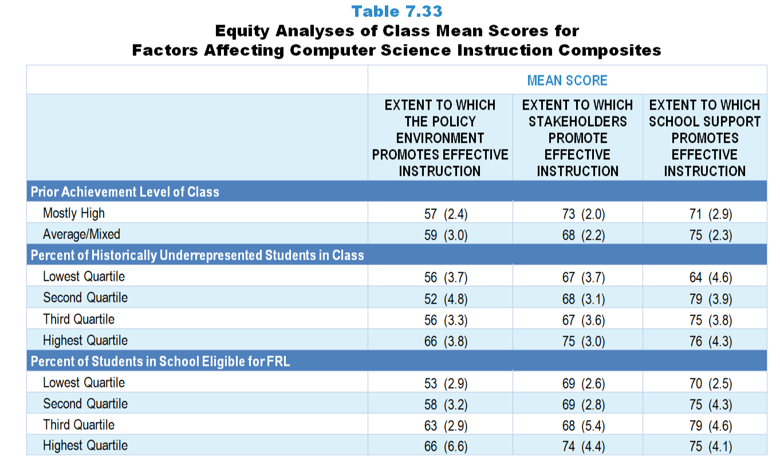
Original Data for Slides 26–28
(not for presentation)
Notes:
Table 7.33, p. 176 in Technical Report
This slide shows data from composites.
Sets of related questionnaire items were combined to create several composite variables related to key constructs. Composite variables, which are more reliable than individual survey items, were computed to have a minimum possible value of 0 and a maximum possible value of 100. Higher composite scores indicate more of the construct being measure by the composite. Each composite is calculated by summing the responses to the items associated with that composite and then dividing by the total points possible. In order for the composites to be on a 100-point scale, the lowest response option on each scale was set to 0 and the others were adjusted accordingly; so for example, an item with a scale ranging from 1 to 4 was re-coded to have a scale of 0 to 3. By doing this, someone who marks the lowest point on every item in a composite receives a composite score of 0 rather than some positive number. It also assures that 50 is the true mid-point. The denominator for each composite is determined by computing the maximum possible sum of responses for a series of items and dividing by 100; e.g., a 9-item composite where each item is on a scale of 0–3 would have a denominator of 0.27. Composites values were not computed for participants who respond to fewer than two-thirds of the items that form the composite.
Extent to Which the Policy Environment Promotes Effective Instruction Composite Items
Q41a. Current state standards
Q41b. Textbook selection policies
Q41c. Teacher evaluation policies
Extent to Which Stakeholders Promote Effective Instruction Composite Items
Q41e. Students’ prior knowledge and skills
Q41f. Students’ motivation, interest, and effort in computer science
Q41g. Parent/guardian expectations and involvement
Extent to Which School Support Promotes Effective Instruction Composite Items
Q41i. Amount of time for you to plan, individually and with colleagues
Q41j. Amount of time available for your professional development
Computer Science Teacher Questionnaire
Q26. For the students in this class, indicate the number of males and females in this class in each of the following categories of race/ethnicity.
American Indian or Alaskan Native _____ _____
Asian _____ _____
Black or African American _____ _____
Hispanic/Latino _____ _____
Native Hawaiian or Other Pacific Islander _____ _____
White _____ _____
Two or more races _____ _____
Q27. Which of the following best describes the prior achievement levels of the students in this class relative to other students in this school?
Mostly low achievers
Mostly average achievers
Mostly high achievers
A mixture of levels
Q41. Please rate how each of the following affects your computer science instruction in this class. [Select one on each row.] (Response Options: [1] Inhibits effective instruction, [2] 2 of 5, [3] Neutral or Mixed, [4] 4 of 5, [5] Promotes effective instruction, [6] N/A)
Current state standards
Textbook selection policies
Teacher evaluation policies
College entrance requirements
Students’ prior knowledge and skills
Students’ motivation, interest, and effort in computer science
Parent/guardian expectations and involvement
Principal support
Amount of time for you to plan, individually and with colleagues
Amount of time available for your professional development
The numbers in parentheses are standard errors.
Chapters 2–7 in the technical report provide data on several key indicators, disaggregated by one or more equity factors: the prior achievement level of students in the class, the percentage of students from race/ethnicity groups historically underrepresented in STEM in the class, the percentage of students in the school eligible for free/reduced-price lunch (FRL), school size, community type, and region. For FRL, each school was classified into one of four categories (defined as quartiles) based on the proportion of students eligible for FRL. Similarly, each randomly selected class was classified into one of the four categories based on the proportion of students from race/ethnicity groups historically underrepresented in STEM in the class.
Findings Highlighted in Technical Report
“The means for some of these factors vary substantially by equity factors. As can be seen in Tables 7.31‒7.33, the mean for the stakeholder composite is substantially higher when classes are composed of mostly high-achieving students, compared to classes with mostly low-achieving students in both science and mathematics. There is also a large gap for this variable in both subjects with regard to poverty—classes in schools with a high percentage of students eligible for free/‌reduced-price lunch have lower scores than classes in schools with the lowest percentage of these students. These patterns do not tend to exist in computer science, perhaps because far fewer schools offer computer science programs.”

Slide 26
Factors Promoting Effective Instruction Composites, by Prior Achievement Level
Notes:
In contrast to science and mathematics, almost no computer science classes are composed of mostly low prior achievers.

Slide 27
Factors Promoting Effective Instruction Composites, by Percentage of Historically Underrepresented Students in Class
Notes:
Historically Underrepresented Students includes American Indian or Alaskan Native, Black or African American, Hispanic or Latino, or Native Hawaiian or Other Pacific Islander students.
Slide shows the composite scores by quartile of percentage of historically underrepresented students in the randomly selected class.

Slide 28
Factors Promoting Effective Instruction Composites, by Percentage of Students Eligible for FRL
Notes:
Slide shows the composite scores by quartile of percentage of students in school eligible for free and reduced lunch.

