Slide 1
Chapter 7 Factors Affecting Instruction
Science

Slide 2
School Programs and Practices

Slide 3
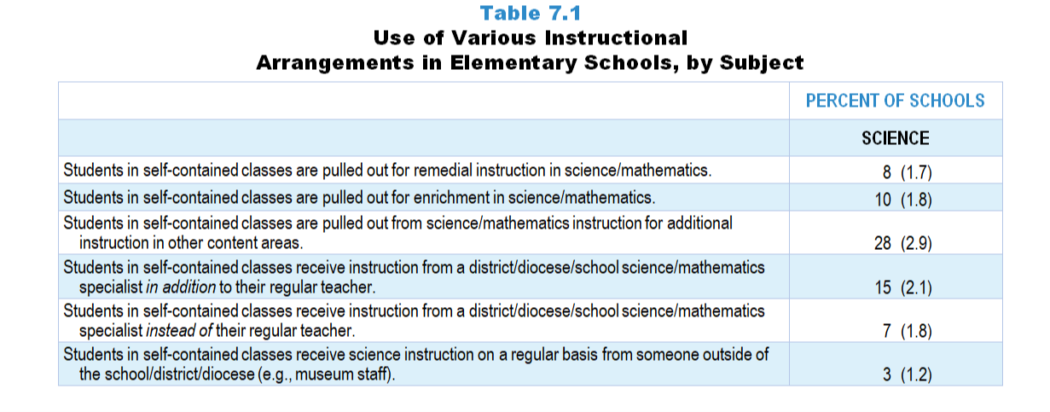
Original Data for Slide 4
(not for presentation)
Notes:
The science portion of Table 7.1, p. 157 in Technical Report
This slide shows data from an individual item.
Science Program Questionnaire
Q2. [Presented only to schools that include self-contained teachers]
Indicate whether each of the following programs and/or practices is currently being implemented in your school. [Select one on each row.] (Response Options: Yes, No)
Students in self-contained classes receive science instruction from a district/diocese/school science specialist instead of their regular teacher.
Students in self-contained classes receive science instruction from a district/diocese/school science specialist in addition to their regular teacher.
Students in self-contained classes receive science instruction on a regular basis from someone outside of the school district/diocese (for example: museum staff).
Students in self-contained classes pulled out for remedial instruction in science.
Students in self-contained classes pulled out for enrichment in science.
Students in self-contained classes pulled out from science instruction for additional instruction in other content areas.
The numbers in parentheses are standard errors.
Findings Highlighted in Technical Report
“The designated school program representatives were given a list of programs and practices and asked to indicate whether each was being implemented in the school. These individuals were also asked about several instructional arrangements for students in elementary self-contained classrooms, such as whether they were pulled out for remediation or enrichment in science and mathematics and whether they received science and mathematics instruction from specialists instead of, or in addition to, their regular teacher. Table 7.1 shows the percentage of elementary schools indicating that each program or practice is in place.
The use of elementary science specialists, either in place of, or in addition to, the regular classroom teacher, is uncommon (7–15 percent of schools). Pull-out science instruction, whether for remediation or enrichment, is also quite rare (8–10 percent of schools). The picture is quite different in elementary school mathematics instruction. Students are pulled out for mathematics remediation in more than 60 percent of schools, and in just over one-third of schools, students are pulled out for mathematics enrichment. The prevalence of these practices may be due in part to the fact that mathematics is much more likely than science to be tested for accountability purposes. In addition, Title 1 funds are more likely to be targeted for remediation in mathematics and reading than in science.”

Slide 4
Use of Various Instructional Arrangements in Elementary Schools

Slide 5
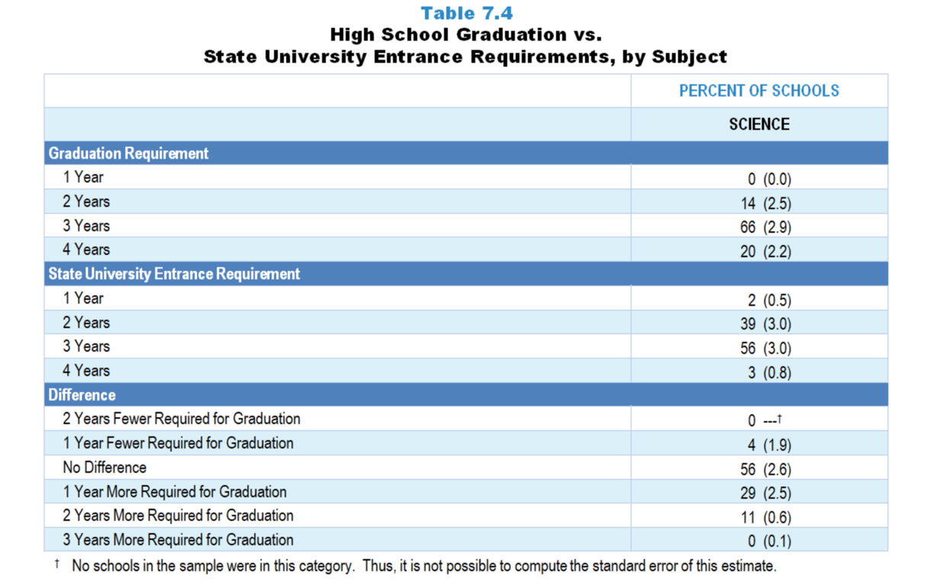
Original Data for Slides 6–7
(not for presentation)
Notes:
The science portion of Table 7.4, p. 159 in Technical Report
This slide shows original and derived data from an individual item.
Science Program Questionnaire
Q12. [Presented only to schools that include grade 12] In order to graduate from this high school, how many years of grades 9–12 science are students required to take?
1 year
2 years
3 years
4 years
The numbers in parentheses are standard errors.
Findings Highlighted in Technical Report
“High school program representatives were asked how many years of science, mathematics, and computer science students are required to take in order to graduate. As can be seen in Table 7.4, the vast majority of high schools require at least three years of science and mathematics; more than half require four years of mathematics. For most schools, graduation requirements are just as demanding as state university entrance requirements. However, when there is a difference, graduation requirements tend to be more rigorous; 40 percent of high schools require more science and 32 percent require more mathematics courses for graduation than state universities do for entrance. State (public) university entrance requirements were mined from the Internet. When state university systems included multiple tiers, the lowest four-year university tier requirements were used.”

Slide 6
High School Graduation vs. State University Entrance Science Requirements

Slide 7
Difference Between High School Graduation and State University Entrance Science Requirements

Slide 8
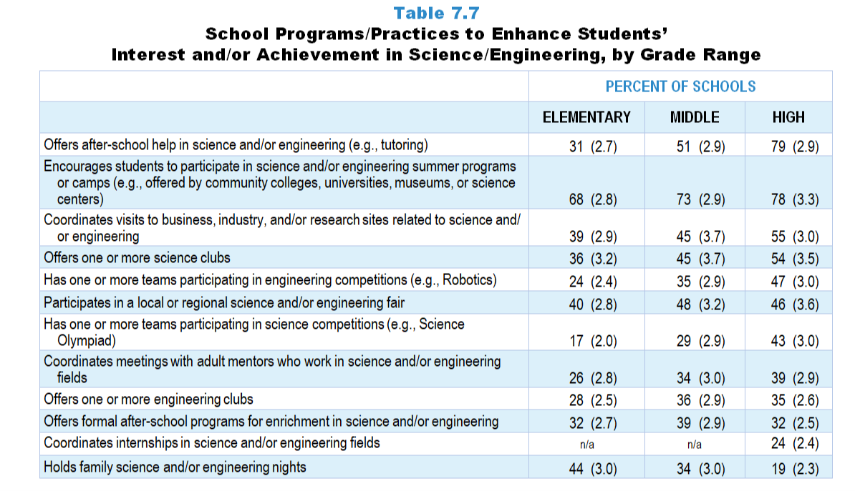
Original Data for Slides 9–14
(not for presentation)
Notes:
Table 7.7, p. 160 in Technical Report
This slide shows data from an individual item.
Science Program Questionnaire
Q4. Indicate whether your school does each of the following to enhance students’ interest and/or achievement in science and/or engineering. [Select one on each row.] (Response Options: Yes, No)
Holds family science and/or engineering nights
Offers after-school help in science and/or engineering (for example: tutoring)
Offers formal after-school programs for enrichment in science and/or engineering
Offers one or more science clubs
Offers one or more engineering clubs
Participates in a local or regional science and/or engineering fair
Has one or more teams participating in science competitions (for example: Science Olympiad)
Has one or more teams participating in engineering competitions (for example: Robotics)
Encourages students to participate in science and/or engineering summer programs or camps (for example: offered by community colleges, universities, museums, or science centers)
Coordinates visits to business, industry, and/or research sites related to science and/or engineering
Coordinates meetings with adult mentors who work in science and/or engineering fields
Coordinates internships in science and/or engineering fields
The numbers in parentheses are standard errors.
Findings Highlighted in Technical Report
“Finally, program representatives were asked to indicate which of several practices their school employs to enhance student interest and/‌or achievement in science, mathematics, and computer science. The results are shown in Tables 7.7‒7.9. Especially in science, such programs tend to be more prevalent as grade range increases. For example, more than three-quarters of high schools offer after-school help in science and engineering, compared to about a third of elementary schools. Similarly, 47 percent of high schools have one or more teams participating in engineering competitions, whereas only 24 percent of elementary schools do. In mathematics, the percentage of schools offering school-based programs to enhance interest and achievement (apart from tutoring) is strikingly low. For example, only about one-third of high schools have mathematics clubs, and fewer than 20 percent of all schools participate in local or regional math fairs. Computer science enhancement programs are rare at all grade levels. With the exception of encouraging students to participate in computer science-based summer programs, the majority of all schools do not provide opportunities intended to promote interest and achievement in computer science. For example, 15 percent or fewer of all schools have teams participating in computer science competitions, coordinate internships in computer science, and participate in local or regional computer science fairs.”

Slide 9
Elementary School Programs/Practices to Enhance Students’ Interest/Achievement in Science/Engineering
Notes:
Note: Each grade-level chart is sorted independently; consequently items may appear in different orders.

Slide 10
Elementary School Programs/Practices to Enhance Students’ Interest/Achievement in Science/Engineering
Notes:
Note: Each grade-level chart is sorted independently; consequently items may appear in different orders.

Slide 11
Middle School Programs/Practices to Enhance Students’ Interest/Achievement in Science/Engineering
Notes:
Note: Each grade-level chart is sorted independently; consequently items may appear in different orders.

Slide 12
Middle School Programs/Practices to Enhance Students’ Interest/Achievement in Science/Engineering
Notes:
Note: Each grade-level chart is sorted independently; consequently items may appear in different orders.

Slide 13
High School Programs/Practices to Enhance Students’ Interest/Achievement in Science/Engineering
Notes:
Note: Each grade-level chart is sorted independently; consequently items may appear in different orders.

Slide 14
High School Programs/Practices to Enhance Students’ Interest/Achievement in Science/Engineering
Notes:
Note: Each grade-level chart is sorted independently; consequently items may appear in different orders.

Slide 15
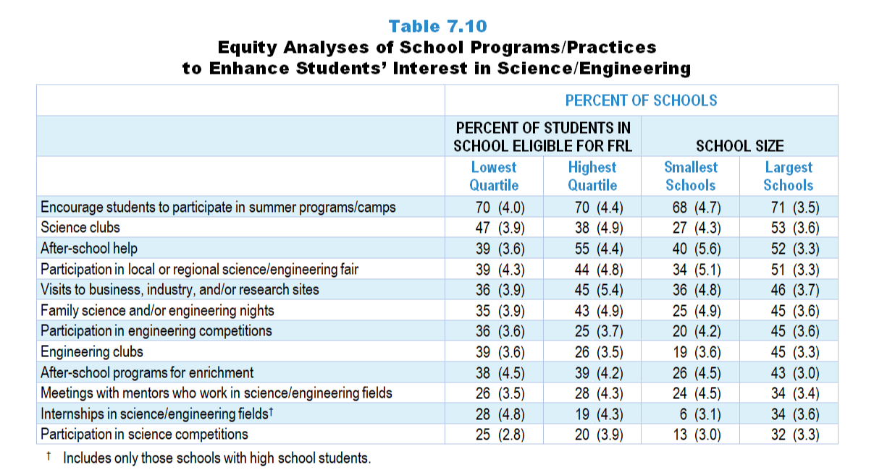
Original Data for Slides 16–19
(not for presentation)
Notes:
Table 7.10, p. 162 in Technical Report
This slide shows data from an individual item.
Science Program Questionnaire
Q4. Indicate whether your school does each of the following to enhance students’ interest and/or achievement in science and/or engineering. [Select one on each row.] (Response Options: Yes, No)
Holds family science and/or engineering nights
Offers after-school help in science and/or engineering (for example: tutoring)
Offers formal after-school programs for enrichment in science and/or engineering
Offers one or more science clubs
Offers one or more engineering clubs
Participates in a local or regional science and/or engineering fair
Has one or more teams participating in science competitions (for example: Science Olympiad)
Has one or more teams participating in engineering competitions (for example: Robotics)
Encourages students to participate in science and/or engineering summer programs or camps (for example: offered by community colleges, universities, museums, or science centers)
Coordinates visits to business, industry, and/or research sites related to science and/or engineering
Coordinates meetings with adult mentors who work in science and/or engineering fields
Coordinates internships in science and/or engineering fields
The numbers in parentheses are standard errors.
Chapters 2–7 in the technical report provide data on several key indicators, disaggregated by one or more equity factors: the prior achievement level of students in the class, the percentage of students from race/ethnicity groups historically underrepresented in STEM in the class, the percentage of students in the school eligible for free/reduced-price lunch (FRL), school size, community type, and region. For FRL, each school was classified into one of four categories (defined as quartiles) based on the proportion of students eligible for FRL. Similarly, each randomly selected class was classified into one of the four categories based on the proportion of students from race/ethnicity groups historically underrepresented in STEM in the class.
Findings Highlighted in Technical Report
“Interestingly, these programs are not distributed equally across all types of schools. Some differences are particularly evident by percentage of students eligible for free/‌reduced-price lunch and school size. Large schools are more likely than small schools to offer many of these programs (see Table 7.10). For example, 45 percent of the largest schools offer opportunities for students to participate in engineering clubs, compared to only 19 percent of the smallest schools, and 53 percent of the largest schools have science clubs, compared to 27 percent of the smallest schools. Results are more varied when looking at these programs by the percentage of students in the school eligible for free/‌reduced-price lunch. Schools with the fewest students eligible for free/reduced-price lunch are more likely to offer enrichment programs (for example, 39 percent of schools in the lowest quartile have students participating in engineering clubs, compared to 26 percent of schools in the highest quartile). In contrast, 55 percent of schools in the highest quartile offer after-school help in science and/‌or engineering, compared to 39 percent of schools in the lowest quartile. Similar patterns exist to a lesser degree for schools’ mathematics programs and practices (see Table 7.11) and computer science programs and practices (see Table 7.12).”

Slide 16
School Programs/Practices to Enhance Students’ Interest in Science/Engineering, by Percent of Students in School Eligible for FRL
Notes:
Note: Each equity analysis chart is sorted independently; consequently items may appear in different orders.
Slide shows the composite scores by quartile of percentage of students in school eligible for free and reduced lunch.

Slide 17
School Programs/Practices to Enhance Students’ Interest in Science/Engineering, by Percent of Students in School Eligible for FRL
Notes:
Note: Each equity analysis chart is sorted independently; consequently items may appear in different orders.

Slide 18
School Programs/Practices to Enhance Students’ Interest in Science/Engineering, by School Size
Notes:
Note: Each equity analysis chart is sorted independently; consequently items may appear in different orders.

Slide 19
School Programs/Practices to Enhance Students’ Interest in Science/Engineering, by School Size
Notes:
Note: Each equity analysis chart is sorted independently; consequently items may appear in different orders.

Slide 20
Extent of Influence of State Standards

Slide 21
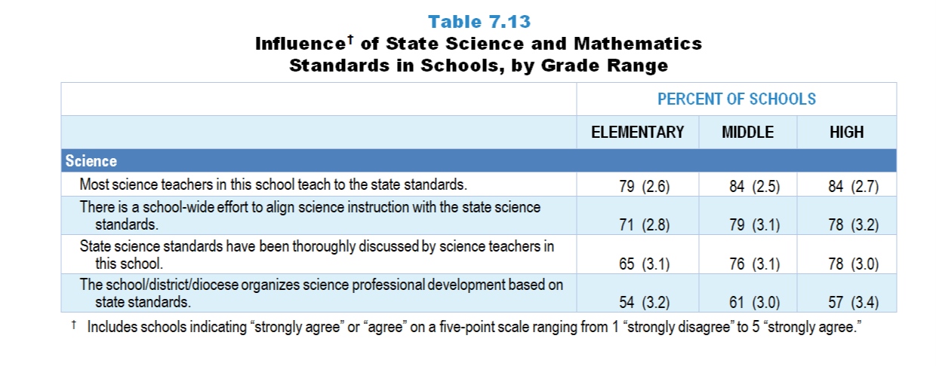
Original Data for Slides 22–24
(not for presentation)
Notes:
The science portion of Table 7.13, p. 164 in Technical Report
This slide shows data from an individual item.
Science Program Questionnaire
Q5. Please provide your opinion about each of the following statements in regard to your current state standards for science. [Select one on each row.] (Response Options: [1] Strongly Disagree, [2] Disagree, [3] No Opinion, [4] Agree, [5] Strongly Agree)
State science standards have been thoroughly discussed by science teachers in this school.
There is a school-wide effort to align science instruction with the state science standards.
Most science teachers in this school teach to the state standards.
This school/district/diocese organizes science professional development based on state standards.
The numbers in parentheses are standard errors.
Findings Highlighted in Technical Report
“School science and mathematics program representatives were given a series of statements about the influence of state standards in their school and district, and asked about the extent to which they agreed with each. A summary of responses is shown in Table 7.13. It is clear that state standards have a major influence at the school level. For example, 79 percent or more of program representatives agree that teachers in the school teach to science and mathematics standards. Similarly, a large majority of representatives agree that science and mathematics standards have been thoroughly discussed by teachers in the school and that there is a school-wide effort to align instruction to standards. Both practices are especially prevalent in mathematics, with 83–90 percent of representatives agreeing across the grade levels. It is somewhat surprising that only about half of high schools are in districts that organize professional development based on science and mathematics standards.”

Slide 22
Elementary Schools Agreeing With Various Statements Regarding State Science Standards
Notes:
Includes schools for which the respondent selected “strongly agree” or “agree” on a 5-point response scale with the options “strongly disagree,” “disagree,” “no opinion,” “agree,” and “strongly agree.”
Note: Each grade-level chart is sorted independently; consequently items may appear in different orders.

Slide 23
Middle Schools Agreeing With Various Statements Regarding State Science Standards
Notes:
Includes schools for which the respondent selected “strongly agree” or “agree” on a 5-point response scale with the options “strongly disagree,” “disagree,” “no opinion,” “agree,” and “strongly agree.”
Note: Each grade-level chart is sorted independently; consequently items may appear in different orders.

Slide 24
High Schools Agreeing With Various Statements Regarding State Science Standards
Notes:
Includes schools for which the respondent selected “strongly agree” or “agree” on a 5-point response scale with the options “strongly disagree,” “disagree,” “no opinion,” “agree,” and “strongly agree.”
Note: Each grade-level chart is sorted independently; consequently items may appear in different orders.

Slide 25
Original Data for Slide 26
(not for presentation)
Notes:
The science portion of Table 7.14, p. 164 in Technical Report
This slide shows data from composites.
Sets of related questionnaire items were combined to create several composite variables related to key constructs. Composite variables, which are more reliable than individual survey items, were computed to have a minimum possible value of 0 and a maximum possible value of 100. Higher composite scores indicate more of the construct being measure by the composite. Each composite is calculated by summing the responses to the items associated with that composite and then dividing by the total points possible. In order for the composites to be on a 100-point scale, the lowest response option on each scale was set to 0 and the others were adjusted accordingly; so for example, an item with a scale ranging from 1 to 4 was re-coded to have a scale of 0 to 3. By doing this, someone who marks the lowest point on every item in a composite receives a composite score of 0 rather than some positive number. It also assures that 50 is the true mid-point. The denominator for each composite is determined by computing the maximum possible sum of responses for a series of items and dividing by 100; e.g., a 9-item composite where each item is on a scale of 0–3 would have a denominator of 0.27. Composites values were not computed for participants who respond to fewer than two-thirds of the items that form the composite.
Focus on State Standards Composite Items
Q5a. State science standards have been thoroughly discussed by science teachers in this school.
Q5b. There is a school-wide effort to align science instruction with the state science standards.
Q5c. Most science teachers in this school teach to the state standards.
Q5d. This school/district/diocese organizes science professional development based on state standards.
Science Program Questionnaire
Q5. Please provide your opinion about each of the following statements in regard to your current state standards for science. [Select one on each row.] (Response Options: [1] Strongly Disagree, [2] Disagree, [3] No Opinion, [4] Agree, [5] Strongly Agree)
State science standards have been thoroughly discussed by science teachers in this school.
There is a school-wide effort to align science instruction with the state science standards.
Most science teachers in this school teach to the state standards.
This school/district/diocese organizes science professional development based on state standards.
The numbers in parentheses are standard errors.
Findings Highlighted in Technical Report
By combining these items in a composite variable, an overview of the influence of standards is possible. As can be seen in Table 7.14, attention to standards is generally greater in mathematics than in science, particularly in elementary and middle schools. The greater weight given to mathematics in school accountability probably contributes to these results. In addition, high schools’ attention to state mathematics standards may be lower than elementary and middle schools’ because they are only held accountable in a few mathematics subjects.”

Slide 26
Focus on Science State Standards Composite

Slide 27
Factors That Promote and Inhibit Effective Instruction

Slide 28
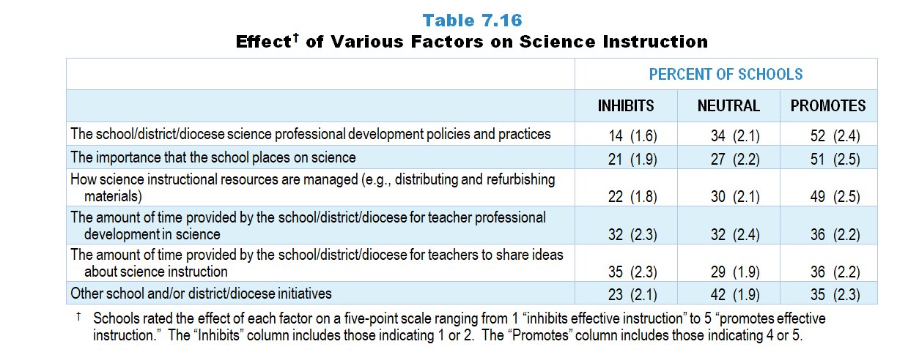
Original Data for Slides 29–30
(not for presentation)
Notes:
Table 7.16, p. 165 in Technical Report
This slide shows data from an individual item.
Science Program Questionnaire
Q16. Please rate the effect of each of the following on the quality of science instruction in your school. [Select one on each row.] (Response Options: [1] Inhibits effective instruction, [2] 2 of 5, [3] Neutral or mixed, [4] 4 of 5, [5] Promotes effective instruction)
The school/district/diocese science professional development policies and practices
The amount of time provided by the school/district/diocese for teacher professional development in science
The importance that the school places on science
Other school and/or district/diocese initiatives
The amount of time provided by the school/district/diocese for teachers to share ideas about science instruction
How science instructional resources are managed (for example: distributing and refurbishing materials)
The numbers in parentheses are standard errors.
Findings Highlighted in Technical Report
“Program representatives were also given a list of factors and asked to indicate their influence on science and mathematics instruction. Results for science instruction are presented in Table 7.16, and those for mathematics instruction are in Table 7.17. As there is little variation by grade range, the results are presented for schools overall. Two factors are perceived by a majority of schools as promoting effective science instruction: school/‌district science professional development policies and practices and the importance that the school places on science. Additionally, fewer than one-fourth of schools see either of these factors as inhibiting science instruction.”

Slide 29
Schools Viewing Various Factors as Promoting Effective Science Instruction
Notes:
Includes schools for which the respondent selected “4 of 5” or “promotes effective instruction” on a 5-point response scale with the options of “inhibits effective instruction,” “2 of 5,” “neutral or mixed,” “4 of 5,” and “promotes effective instruction.”
PD is short for professional development.

Slide 30
Schools Viewing Various Factors as Inhibiting Effective Science Instruction
Notes:
Includes schools for which the respondent selected “inhibits effective instruction” or “2 of 5” on a 5-point response scale with the options of “inhibits effective instruction,” “2 of 5,” “neutral or mixed,” “4 of 5,” and “promotes effective instruction.”
PD is short for professional development.

Slide 31
Original Data for Slide 32
(not for presentation)
Notes:
The science portion of Table 7.18, p. 166 in Technical Report
This slide shows data from composites.
Sets of related questionnaire items were combined to create several composite variables related to key constructs. Composite variables, which are more reliable than individual survey items, were computed to have a minimum possible value of 0 and a maximum possible value of 100. Higher composite scores indicate more of the construct being measure by the composite. Each composite is calculated by summing the responses to the items associated with that composite and then dividing by the total points possible. In order for the composites to be on a 100-point scale, the lowest response option on each scale was set to 0 and the others were adjusted accordingly; so for example, an item with a scale ranging from 1 to 4 was re-coded to have a scale of 0 to 3. By doing this, someone who marks the lowest point on every item in a composite receives a composite score of 0 rather than some positive number. It also assures that 50 is the true mid-point. The denominator for each composite is determined by computing the maximum possible sum of responses for a series of items and dividing by 100; e.g., a 9-item composite where each item is on a scale of 0–3 would have a denominator of 0.27. Composites values were not computed for participants who respond to fewer than two-thirds of the items that form the composite.
Supportive Context for Science Instruction Composite Items
Q16a. The school/district/diocese science professional development policies and practices
Q16b. The amount of time provided by the school/district/diocese for teacher professional development in science
Q16c. The importance that the school places on science
Q16d. Other school and/or district/diocese initiatives
Q16e. The amount of time provided by the school/district/diocese for teachers to share ideas about science instruction
Q16f. How science instructional resources are managed (for example: distributing and refurbishing materials)
Science Program Questionnaire
Q16. Please rate the effect of each of the following on the quality of science instruction in your school. [Select one on each row.] (Response Options: [1] Inhibits effective instruction, [2] 2 of 5, [3] Neutral or mixed, [4] 4 of 5, [5] Promotes effective instruction)
The school/district/diocese science professional development policies and practices
The amount of time provided by the school/district/diocese for teacher professional development in science
The importance that the school places on science
Other school and/or district/diocese initiatives
The amount of time provided by the school/district/diocese for teachers to share ideas about science instruction
How science instructional resources are managed (for example: distributing and refurbishing materials)
The numbers in parentheses are standard errors.
Findings Highlighted in Technical Report
“These items were combined into a composite variable in order to look at the effects of the factors on science and mathematics instruction more holistically. As Table 7.18 displays, elementary schools generally provide a less supportive context for science instruction than middle or high schools. In addition, elementary and middle schools tend to be more supportive for mathematics teaching than science teaching.”

Slide 32
Supportive Context for Science Instruction Composite

Slide 33
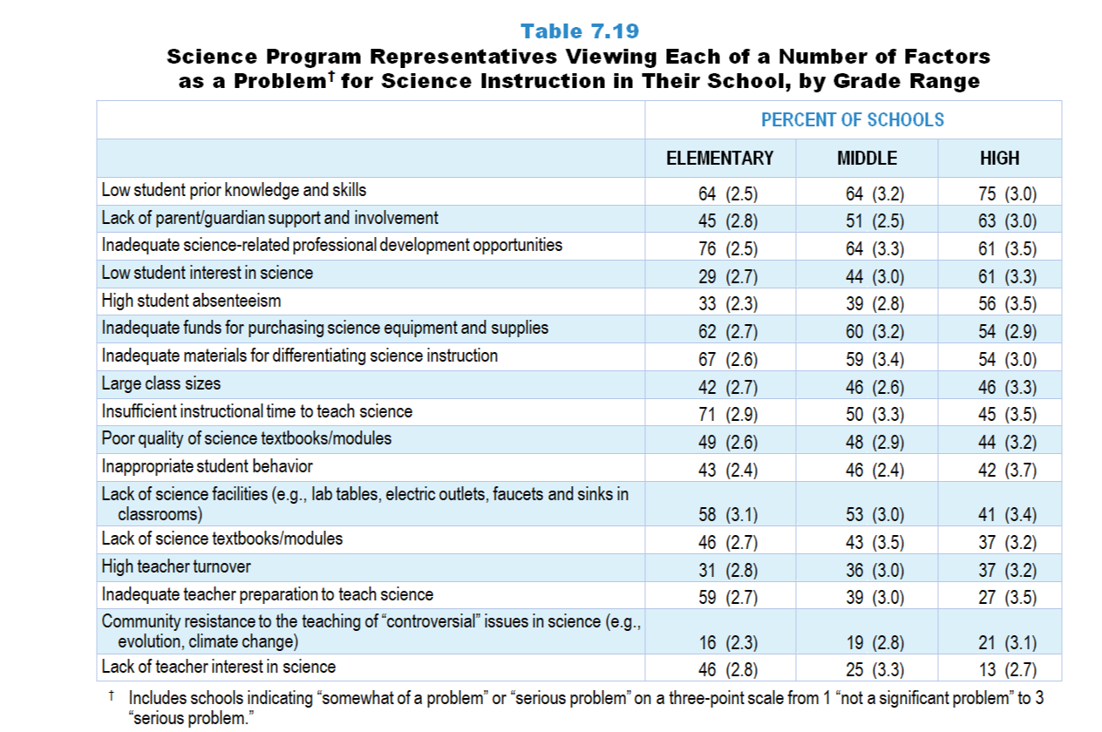
Original Data for Slides 34–39
(not for presentation)
Notes:
Table 7.19, p. 167 in Technical Report
This slide shows data from an individual item.
Science Program Questionnaire
Q17. In your opinion, how great a problem is each of the following for science instruction in your school as a whole? [Select one on each row.] (Response Options: [1] Not a significant problem, [2] Somewhat of a problem, [3] Serious problem)
Lack of science facilities (for example: lab tables, electric outlets, faucets and sinks in classrooms)
Inadequate funds for purchasing science equipment and supplies
Lack of science textbooks/modules
Poor quality science textbooks/modules
Inadequate materials for differentiating science instruction
Low student interest in science
Low student prior knowledge and skills
Lack of teacher interest in science
Inadequate teacher preparation to teach science
High teacher turnover
Insufficient instructional time to teach science
Inadequate science-related professional development opportunities
Large class sizes
High student absenteeism
Inappropriate student behavior
Lack of parent/guardian support and involvement
Community resistance to the teaching of “controversial” issues in science (for example: evolution, climate change)
The numbers in parentheses are standard errors.
Findings Highlighted in Technical Report
“Program representatives were also asked to rate whether each of several factors is a problem for instruction in their school. In science, low student prior knowledge and skills is perceived as a problem across grade levels (64–75 percent of schools), particularly high school, as can be seen in Table 7.19. Inadequate science-related professional development opportunities is perceived as a problem by 61–76 percent of the schools, inadequate materials for differentiating instruction by 54–67 percent, and inadequate funds for purchasing science equipment and supplies by 54–62 percent. In high schools, low student interest is seen as a problem by 61 percent of schools, compared to 44 percent of middle schools and 29 percent of elementary schools. Lack of teacher interest in science is more likely to be seen as a problem in elementary schools (46 percent) than in high schools (13 percent).”

Slide 34
Elementary Schools Viewing Each of a Number of Factors as a Serious Problem for Science Instruction
Notes:
Includes schools indicating “somewhat of a problem” or “serious problem” on a three-point scale from 1 “not a significant problem” to 3 “serious problem.”
Note: Each grade-level chart is sorted independently; consequently items may appear in different orders.

Slide 35
Elementary Schools Viewing Each of a Number of Factors as a Serious Problem for Science Instruction
Notes:
Includes schools indicating “somewhat of a problem” or “serious problem” on a three-point scale from 1 “not a significant problem” to 3 “serious problem.”
Note: Each grade-level chart is sorted independently; consequently items may appear in different orders.

Slide 36
Middle Schools Viewing Each of a Number of Factors as a Serious Problem for Science Instruction
Notes:
Includes schools indicating “somewhat of a problem” or “serious problem” on a three-point scale from 1 “not a significant problem” to 3 “serious problem.”
Note: Each grade-level chart is sorted independently; consequently items may appear in different orders.

Slide 37
Middle Schools Viewing Each of a Number of Factors as a Serious Problem for Science Instruction
Notes:
Includes schools indicating “somewhat of a problem” or “serious problem” on a three-point scale from 1 “not a significant problem” to 3 “serious problem.”
Note: Each grade-level chart is sorted independently; consequently items may appear in different orders.

Slide 38
High Schools Viewing Each of a Number of Factors as a Serious Problem for Science Instruction
Notes:
Includes schools indicating “somewhat of a problem” or “serious problem” on a three-point scale from 1 “not a significant problem” to 3 “serious problem.”
Note: Each grade-level chart is sorted independently; consequently items may appear in different orders.

Slide 39
High Schools Viewing Each of a Number of Factors as a Serious Problem for Science Instruction
Notes:
Includes schools indicating “somewhat of a problem” or “serious problem” on a three-point scale from 1 “not a significant problem” to 3 “serious problem.”
Note: Each grade-level chart is sorted independently; consequently items may appear in different orders.

Slide 40
Original Data for Slide 41
(not for presentation)
Notes:
The science portion of Table 7.21, p. 168 in Technical Report
This slide shows data from composites.
Sets of related questionnaire items were combined to create several composite variables related to key constructs. Composite variables, which are more reliable than individual survey items, were computed to have a minimum possible value of 0 and a maximum possible value of 100. Higher composite scores indicate more of the construct being measure by the composite. Each composite is calculated by summing the responses to the items associated with that composite and then dividing by the total points possible. In order for the composites to be on a 100-point scale, the lowest response option on each scale was set to 0 and the others were adjusted accordingly; so for example, an item with a scale ranging from 1 to 4 was re-coded to have a scale of 0 to 3. By doing this, someone who marks the lowest point on every item in a composite receives a composite score of 0 rather than some positive number. It also assures that 50 is the true mid-point. The denominator for each composite is determined by computing the maximum possible sum of responses for a series of items and dividing by 100; e.g., a 9-item composite where each item is on a scale of 0–3 would have a denominator of 0.27. Composites values were not computed for participants who respond to fewer than two-thirds of the items that form the composite.
Extent to Which a Lack of Resources is Problematic Composite Items
Q17a. Lack of science facilities (for example: lab tables, electric outlets, faucets and sinks in classrooms)
Q17b. Inadequate funds for purchasing science equipment and supplies
Q17c. Lack of science textbooks/modules
Q17d. Poor quality science textbooks/modules
Q17e. Inadequate materials for differentiating science instruction
Extent to Which Student Issues are Problematic Composite Items
Q17f. Low student interest in science
Q17g. Low student prior knowledge and skills
Q17n. High student absenteeism
Q17o. Inappropriate student behavior
Q17p. Lack of parent/guardian support and involvement
Q17q. Community resistance to the teaching of “controversial” issues in science (for example: evolution, climate change)
Extent to Which Teacher Issues are Problematic Composite Items
Q17h. Lack of teacher interest in science
Q17i. Inadequate teacher preparation to teach science
Q17k. Insufficient instructional time to teach science
Q17l. Inadequate science-related professional development opportunities
Science Program Questionnaire
Q17. In your opinion, how great a problem is each of the following for science instruction in your school as a whole? [Select one on each row.] (Response Options: [1] Not a significant problem, [2] Somewhat of a problem, [3] Serious problem)
Lack of science facilities (for example: lab tables, electric outlets, faucets and sinks in classrooms)
Inadequate funds for purchasing science equipment and supplies
Lack of science textbooks/modules
Poor quality science textbooks/modules
Inadequate materials for differentiating science instruction
Low student interest in science
Low student prior knowledge and skills
Lack of teacher interest in science
Inadequate teacher preparation to teach science
High teacher turnover
Insufficient instructional time to teach science
Inadequate science-related professional development opportunities
Large class sizes
High student absenteeism
Inappropriate student behavior
Lack of parent/guardian support and involvement
Community resistance to the teaching of “controversial” issues in science (for example: evolution, climate change)
The numbers in parentheses are standard errors.
Findings Highlighted in Technical Report
“Composite variables created from these items allow for a summary of the factors affecting science and mathematics instruction. One striking difference is that the extent to which student issues are seen as problematic is more pronounced in mathematics instruction compared to science instruction (see Table 7.21). Some differences across grade ranges are also apparent, particularly in science. Specifically, lack of resources and teacher-related issues are more notable at the elementary level than at the high school level.”

Slide 41
Extent Various Factors Are Problematic for Instruction Composites

Slide 42
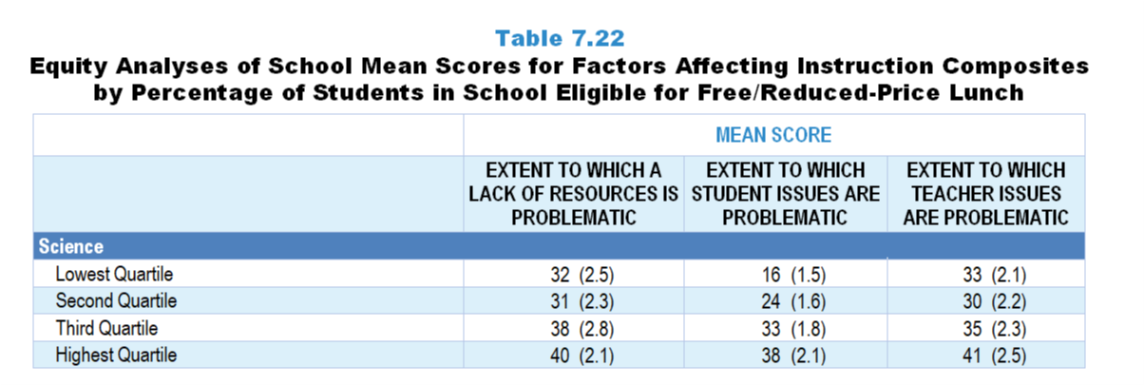
Original Data for Slide 43
(not for presentation)
Notes:
The science portion of Table 7.22, p. 169 in Technical Report
This slide shows data from composites.
Sets of related questionnaire items were combined to create several composite variables related to key constructs. Composite variables, which are more reliable than individual survey items, were computed to have a minimum possible value of 0 and a maximum possible value of 100. Higher composite scores indicate more of the construct being measure by the composite. Each composite is calculated by summing the responses to the items associated with that composite and then dividing by the total points possible. In order for the composites to be on a 100-point scale, the lowest response option on each scale was set to 0 and the others were adjusted accordingly; so for example, an item with a scale ranging from 1 to 4 was re-coded to have a scale of 0 to 3. By doing this, someone who marks the lowest point on every item in a composite receives a composite score of 0 rather than some positive number. It also assures that 50 is the true mid-point. The denominator for each composite is determined by computing the maximum possible sum of responses for a series of items and dividing by 100; e.g., a 9-item composite where each item is on a scale of 0–3 would have a denominator of 0.27. Composites values were not computed for participants who respond to fewer than two-thirds of the items that form the composite.
Extent to Which a Lack of Resources is Problematic Composite Items
Q17a. Lack of science facilities (for example: lab tables, electric outlets, faucets and sinks in classrooms)
Q17b. Inadequate funds for purchasing science equipment and supplies
Q17c. Lack of science textbooks/modules
Q17d. Poor quality science textbooks/modules
Q17e. Inadequate materials for differentiating science instruction
Extent to Which Student Issues are Problematic Composite Items
Q17f. Low student interest in science
Q17g. Low student prior knowledge and skills
Q17n. High student absenteeism
Q17o. Inappropriate student behavior
Q17p. Lack of parent/guardian support and involvement
Q17q. Community resistance to the teaching of “controversial” issues in science (for example: evolution, climate change)
Extent to Which Teacher Issues are Problematic Composite Items
Q17h. Lack of teacher interest in science
Q17i. Inadequate teacher preparation to teach science
Q17k. Insufficient instructional time to teach science
Q17l. Inadequate science-related professional development opportunities
Science Program Questionnaire
Q17. In your opinion, how great a problem is each of the following for science instruction in your school as a whole? [Select one on each row.] (Response Options: [1] Not a significant problem, [2] Somewhat of a problem, [3] Serious problem)
Lack of science facilities (for example: lab tables, electric outlets, faucets and sinks in classrooms)
Inadequate funds for purchasing science equipment and supplies
Lack of science textbooks/modules
Poor quality science textbooks/modules
Inadequate materials for differentiating science instruction
Low student interest in science
Low student prior knowledge and skills
Lack of teacher interest in science
Inadequate teacher preparation to teach science
High teacher turnover
Insufficient instructional time to teach science
Inadequate science-related professional development opportunities
Large class sizes
High student absenteeism
Inappropriate student behavior
Lack of parent/guardian support and involvement
Community resistance to the teaching of “controversial” issues in science (for example: evolution, climate change)
The numbers in parentheses are standard errors.
Chapters 2–7 in the technical report provide data on several key indicators, disaggregated by one or more equity factors: the prior achievement level of students in the class, the percentage of students from race/ethnicity groups historically underrepresented in STEM in the class, the percentage of students in the school eligible for free/reduced-price lunch (FRL), school size, community type, and region. For FRL, each school was classified into one of four categories (defined as quartiles) based on the proportion of students eligible for FRL. Similarly, each randomly selected class was classified into one of the four categories based on the proportion of students from race/ethnicity groups historically underrepresented in STEM in the class.
Findings Highlighted in Technical Report
“When disaggregated by the percentage of students eligible for free/‌reduced-price lunch, some differences in composite means emerge (see Table 7.22). The mean score for the Extent to Which Student Issues are Problematic composite, which includes items such as low student interest, high absenteeism, and inappropriate behavior, varies considerably in both science and mathematics by the percentage of students eligible for free/‌reduced-price lunch (ranging from 16 for the lowest quartile to 38 for the highest in science, and from 23 to 48 in mathematics). Though not as pronounced, similar gaps are seen in science for the Extent to Which a Lack of Resources is Problematic composite, which includes items about a lack of equipment and textbooks, and the Extent to Which Teacher Issues are Problematic composite, which includes items about teacher interest in the subject and teacher preparation to teach the subject.”

Slide 43
School Mean Scores for Factors
Affecting Instruction Composites, by Percentage of Students in School Eligible for FRL
Notes:
Slide shows the composite scores by quartile of percentage of students in school eligible for free and reduced lunch.

Slide 44
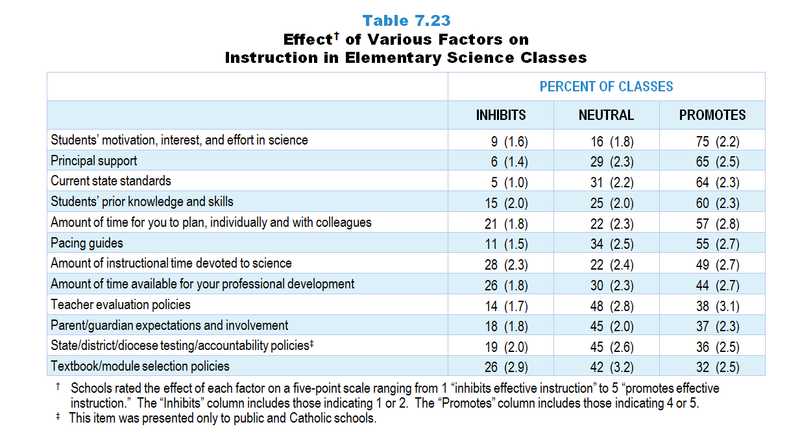
Original Data for Slides 45–46
(not for presentation)
Notes:
Table 7.23, p. 170 in Technical Report
This slide shows data from an individual item.
Science Teacher Questionnaire
Q60. Please rate how each of the following affects your science instruction in this class. [Select one on each row.] (Response Options: [1] Inhibits effective instruction, [2] 2 of 5, [3] Neutral or Mixed, [4] 4 of 5, [5] Promotes effective instruction, [6] N/A)
Current state standards
District/diocese and/or school pacing guides
State/district/diocese testing/accountability policies [Not presented to non-Catholic private schools]
Textbook/module selection policies
Teacher evaluation policies
College entrance requirements [Presented to grades 9–12 teachers only]
Students’ prior knowledge and skills
Students’ motivation, interest, and effort in science
Parent/guardian expectations and involvement
Principal support
Amount of time for you to plan, individually and with colleagues
Amount of time available for your professional development
Amount of instructional time devoted to science [Presented to grades K–5 teachers only]
The numbers in parentheses are standard errors.
Findings Highlighted in Technical Report
“Teachers were asked about factors that affect instruction in their randomly selected class. Elementary science teacher results are shown in Table 7.23. Similar to findings from the program questionnaires, teachers indicate that students’ motivation, interest, and effort in science tend to promote science instruction in elementary classes (75 percent). However, instructional time available for science instruction is seen as one of the biggest inhibitors of science instruction (28 percent).”

Slide 45
Factors Promoting Effective Instruction in Elementary Science Classes
Notes:
Schools rated the effect of each factor on a five-point scale ranging from 1 “inhibits effective instruction” to 5 “promotes effective instruction.” The “Inhibits” column includes those indicating 1 or 2. The “Promotes” column includes those indicating 4 or 5.

Slide 46
Factors Inhibiting Effective Instruction in Elementary Science Classes
Notes:
Schools rated the effect of each factor on a five-point scale ranging from 1 “inhibits effective instruction” to 5 “promotes effective instruction.” The “Inhibits” column includes those indicating 1 or 2. The “Promotes” column includes those indicating 4 or 5.

Slide 47
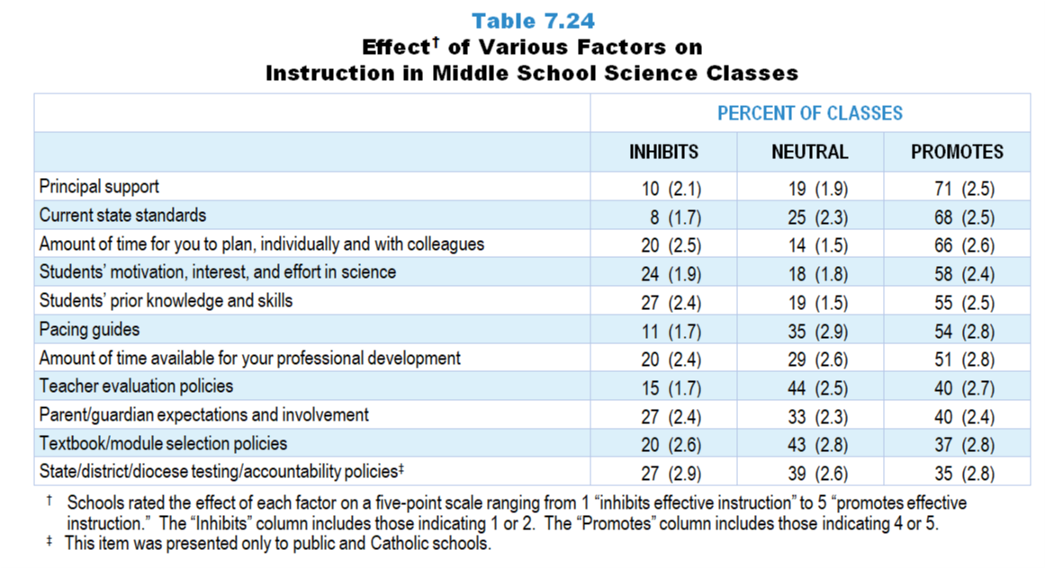
Original Data for Slides 48–49
(not for presentation)
Notes:
Table 7.24, p. 170 in Technical Report
This slide shows data from an individual item.
Science Teacher Questionnaire
Q60. Please rate how each of the following affects your science instruction in this class. [Select one on each row.] (Response Options: [1] Inhibits effective instruction, [2] 2 of 5, [3] Neutral or Mixed, [4] 4 of 5, [5] Promotes effective instruction, [6] N/A)
Current state standards
District/diocese and/or school pacing guides
State/district/diocese testing/accountability policies [Not presented to non-Catholic private schools]
Textbook/module selection policies
Teacher evaluation policies
College entrance requirements [Presented to grades 9–12 teachers only]
Students’ prior knowledge and skills
Students’ motivation, interest, and effort in science
Parent/guardian expectations and involvement
Principal support
Amount of time for you to plan, individually and with colleagues
Amount of time available for your professional development
Amount of instructional time devoted to science [Presented to grades K–5 teachers only]
The numbers in parentheses are standard errors.
Findings Highlighted in Technical Report
“In middle school science classes, principal support, current state standards, and the amount of time provided to plan individually and with colleagues are seen as promoting effective instruction in two-thirds or more of classes (see Table 7.24). Conversely, teachers of about a quarter of middle school science classes see students’ prior knowledge and skills, parent/‌guardian expectations and involvement, and state/‌district testing/‌accountability policies as inhibiting science instruction.”

Slide 48
Factors Promoting Effective Instruction in Middle School Science Classes
Notes:
Schools rated the effect of each factor on a five-point scale ranging from 1 “inhibits effective instruction” to 5 “promotes effective instruction.” The “Inhibits” column includes those indicating 1 or 2. The “Promotes” column includes those indicating 4 or 5.

Slide 49
Factors Inhibiting Effective Instruction in Middle School Science Classes
Notes:
Schools rated the effect of each factor on a five-point scale ranging from 1 “inhibits effective instruction” to 5 “promotes effective instruction.” The “Inhibits” column includes those indicating 1 or 2. The “Promotes” column includes those indicating 4 or 5.

Slide 50
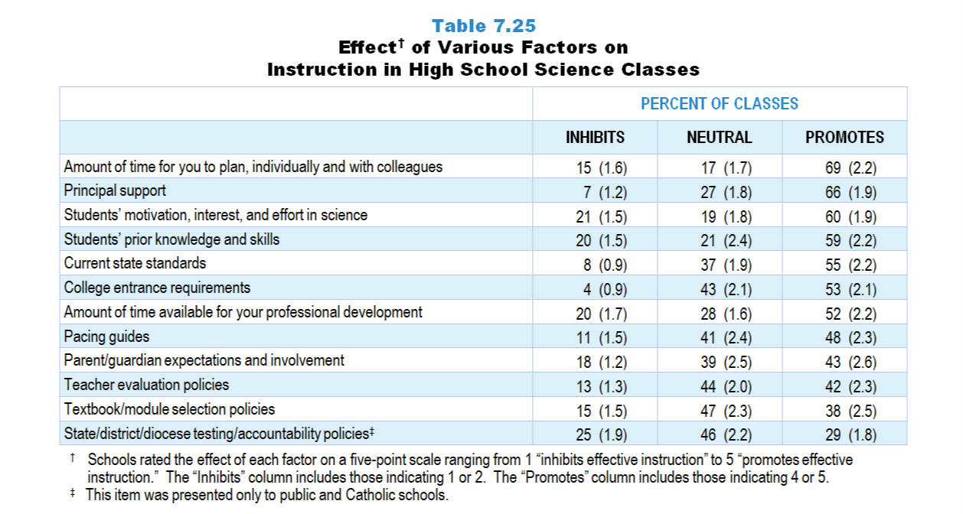
Original Data for Slides 51–52
(not for presentation)
Notes:
Table 7.25, p. 171 in Technical Report
This slide shows data from an individual item.
Science Teacher Questionnaire
Q60. Please rate how each of the following affects your science instruction in this class. [Select one on each row.] (Response Options: [1] Inhibits effective instruction, [2] 2 of 5, [3] Neutral or Mixed, [4] 4 of 5, [5] Promotes effective instruction, [6] N/A)
Current state standards
District/diocese and/or school pacing guides
State/district/diocese testing/accountability policies [Not presented to non-Catholic private schools]
Textbook/module selection policies
Teacher evaluation policies
College entrance requirements [Presented to grades 9–12 teachers only]
Students’ prior knowledge and skills
Students’ motivation, interest, and effort in science
Parent/guardian expectations and involvement
Principal support
Amount of time for you to plan, individually and with colleagues
Amount of time available for your professional development
Amount of instructional time devoted to science [Presented to grades K–5 teachers only]
The numbers in parentheses are standard errors.
Findings Highlighted in Technical Report
“Similar to middle school classes, the amount of time for teachers to plan individually and with colleagues, as well as principal support, are both seen as promoting science instruction in two-thirds or more of high school science classes (see Table 7.25). State testing/‌accountability policies are seen as inhibiting science instruction in one-fourth of high school science classes. In addition, high school teachers were asked how college entrance requirements affect science instruction. In about half of classes, teachers see these requirements as promoting effective instruction; in only 4 percent of high school science classes do teachers consider them as inhibiting instruction.”

Slide 51
Factors Promoting Effective Instruction in High School Science Classes
Notes:
Schools rated the effect of each factor on a five-point scale ranging from 1 “inhibits effective instruction” to 5 “promotes effective instruction.” The “Inhibits” column includes those indicating 1 or 2. The “Promotes” column includes those indicating 4 or 5.

Slide 52
Factors Inhibiting Effective Instruction in High School Science Classes
Notes:
Schools rated the effect of each factor on a five-point scale ranging from 1 “inhibits effective instruction” to 5 “promotes effective instruction.” The “Inhibits” column includes those indicating 1 or 2. The “Promotes” column includes those indicating 4 or 5.

Slide 53
Original Data for Slide 54
(not for presentation)
Notes:
The science portion of Table 7.30, p. 174 in Technical Report
This slide shows data from composites.
Sets of related questionnaire items were combined to create several composite variables related to key constructs. Composite variables, which are more reliable than individual survey items, were computed to have a minimum possible value of 0 and a maximum possible value of 100. Higher composite scores indicate more of the construct being measure by the composite. Each composite is calculated by summing the responses to the items associated with that composite and then dividing by the total points possible. In order for the composites to be on a 100-point scale, the lowest response option on each scale was set to 0 and the others were adjusted accordingly; so for example, an item with a scale ranging from 1 to 4 was re-coded to have a scale of 0 to 3. By doing this, someone who marks the lowest point on every item in a composite receives a composite score of 0 rather than some positive number. It also assures that 50 is the true mid-point. The denominator for each composite is determined by computing the maximum possible sum of responses for a series of items and dividing by 100; e.g., a 9-item composite where each item is on a scale of 0–3 would have a denominator of 0.27. Composites values were not computed for participants who respond to fewer than two-thirds of the items that form the composite.
Extent to Which the Policy Environment Promotes Effective Instruction Composite Items
Q60a. Current state standards
Q60b. District/diocese and/or school pacing guides
Q60c. State/district/diocese testing/accountability policies [Not presented to non-Catholic private schools]
Q60d. Textbook/module selection policies
Q60e. Teacher evaluation policies
Extent to Which Stakeholders Promote Effective Instruction Composite Items
Q60g. Students’ prior knowledge and skills
Q60h. Students’ motivation, interest, and effort in science
Q60i. Parent/guardian expectations and involvement
Extent to Which School Support Promotes Effective Instruction Composite Items
Q60k. Amount of time for you to plan, individually and with colleagues
Q60l. Amount of time available for your professional development
Science Teacher Questionnaire
Q60. Please rate how each of the following affects your science instruction in this class. [Select one on each row.] (Response Options: [1] Inhibits effective instruction, [2] 2 of 5, [3] Neutral or Mixed, [4] 4 of 5, [5] Promotes effective instruction, [6] N/A)
Current state standards
District/diocese and/or school pacing guides
State/district/diocese testing/accountability policies [Not presented to non-Catholic private schools]
Textbook/module selection policies
Teacher evaluation policies
College entrance requirements [Presented to grades 9–12 teachers only]
Students’ prior knowledge and skills
Students’ motivation, interest, and effort in science
Parent/guardian expectations and involvement
Principal support
Amount of time for you to plan, individually and with colleagues
Amount of time available for your professional development
Amount of instructional time devoted to science [Presented to grades K–5 teachers only]
The numbers in parentheses are standard errors.
Findings Highlighted in Technical Report
“Composites from these teacher questionnaire items were created to summarize the extent to which various factors support effective science and mathematics instruction. The means for each subject and grade range are shown in Table 7.30. Several patterns are apparent in the results. The extent to which the policy environment promotes effective instruction is about the same across grade levels in science. Similarly, the extent to which school support promotes effective instruction varies little across grade levels in mathematics. In addition, stakeholders are seen to be the most supportive in the elementary grades for both science and mathematics. Finally, in high school computer science, school and stakeholder support is generally high (mean scores of 74 and 70, respectively) compared with the policy environment (mean score of 59).”

Slide 54
Factors Promoting Effective Instruction Composites

Slide 55
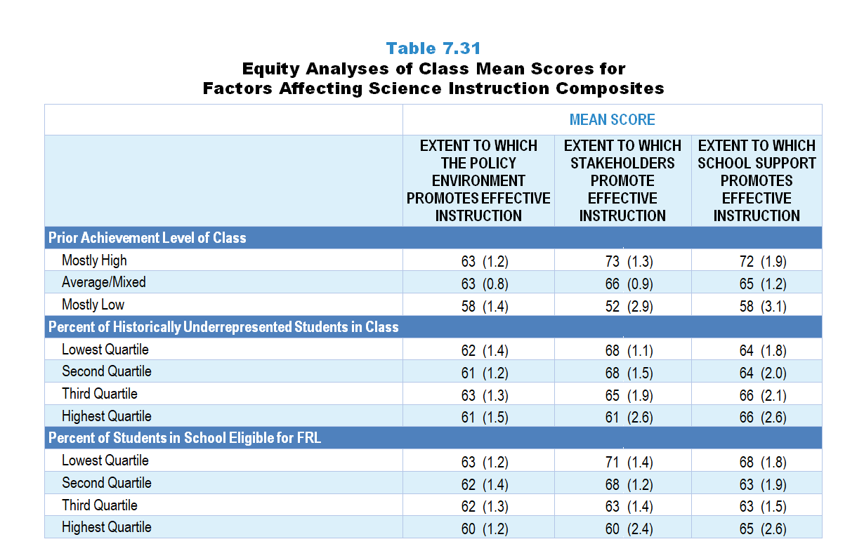
Original Data for Slides 56–58
(not for presentation)
Notes:
Table 7.31, p. 174 in Technical Report
This slide shows data from composites.
Sets of related questionnaire items were combined to create several composite variables related to key constructs. Composite variables, which are more reliable than individual survey items, were computed to have a minimum possible value of 0 and a maximum possible value of 100. Higher composite scores indicate more of the construct being measure by the composite. Each composite is calculated by summing the responses to the items associated with that composite and then dividing by the total points possible. In order for the composites to be on a 100-point scale, the lowest response option on each scale was set to 0 and the others were adjusted accordingly; so for example, an item with a scale ranging from 1 to 4 was re-coded to have a scale of 0 to 3. By doing this, someone who marks the lowest point on every item in a composite receives a composite score of 0 rather than some positive number. It also assures that 50 is the true mid-point. The denominator for each composite is determined by computing the maximum possible sum of responses for a series of items and dividing by 100; e.g., a 9-item composite where each item is on a scale of 0–3 would have a denominator of 0.27. Composites values were not computed for participants who respond to fewer than two-thirds of the items that form the composite.
Extent to Which the Policy Environment Promotes Effective Instruction Composite Items
Q60a. Current state standards
Q60b. District/diocese and/or school pacing guides
Q60c. State/district/diocese testing/accountability policies [Not presented to non-Catholic private schools]
Q60d. Textbook/module selection policies
Q60e. Teacher evaluation policies
Extent to Which Stakeholders Promote Effective Instruction Composite Items
Q60g. Students’ prior knowledge and skills
Q60h. Students’ motivation, interest, and effort in science
Q60i. Parent/guardian expectations and involvement
Extent to Which School Support Promotes Effective Instruction Composite Items
Q60k. Amount of time for you to plan, individually and with colleagues
Q60l. Amount of time available for your professional development
Science Teacher Questionnaire
Q42. For the students in this class, indicate the number of males and females in this class in each of the following categories of race/ethnicity.
American Indian or Alaskan Native _____ _____
Asian _____ _____
Black or African American _____ _____
Hispanic/Latino _____ _____
Native Hawaiian or Other Pacific Islander _____ _____
White _____ _____
Two or more races _____ _____
Q43. Which of the following best describes the prior science achievement levels of the students in this class relative to other students in this school?
Mostly low achievers
Mostly average achievers
Mostly high achievers
A mixture of levels
Q60. Please rate how each of the following affects your science instruction in this class. [Select one on each row.] (Response Options: [1] Inhibits effective instruction, [2] 2 of 5, [3] Neutral or Mixed, [4] 4 of 5, [5] Promotes effective instruction, [6] N/A)
Current state standards
District/diocese and/or school pacing guides
State/district/diocese testing/accountability policies [Not presented to non-Catholic private schools]
Textbook/module selection policies
Teacher evaluation policies
College entrance requirements [Presented to grades 9–12 teachers only]
Students’ prior knowledge and skills
Students’ motivation, interest, and effort in science
Parent/guardian expectations and involvement
Principal support
Amount of time for you to plan, individually and with colleagues
Amount of time available for your professional development
Amount of instructional time devoted to science [Presented to grades K–5 teachers only]
The numbers in parentheses are standard errors.
Chapters 2–7 in the technical report provide data on several key indicators, disaggregated by one or more equity factors: the prior achievement level of students in the class, the percentage of students from race/ethnicity groups historically underrepresented in STEM in the class, the percentage of students in the school eligible for free/reduced-price lunch (FRL), school size, community type, and region. For FRL, each school was classified into one of four categories (defined as quartiles) based on the proportion of students eligible for FRL. Similarly, each randomly selected class was classified into one of the four categories based on the proportion of students from race/ethnicity groups historically underrepresented in STEM in the class.
Findings Highlighted in Technical Report
“The means for some of these factors vary substantially by equity factors. As can be seen in Tables 7.31‒7.33, the mean for the stakeholder composite is substantially higher when classes are composed of mostly high-achieving students, compared to classes with mostly low-achieving students in both science and mathematics. There is also a large gap for this variable in both subjects with regard to poverty—classes in schools with a high percentage of students eligible for free/‌reduced-price lunch have lower scores than classes in schools with the lowest percentage of these students. These patterns do not tend to exist in computer science, perhaps because far fewer schools offer computer science programs.”

Slide 56
Factors Promoting Effective Science Instruction Composites, by Prior Achievement Level

Slide 57
Factors Promoting Effective Science Instruction Composites, by Percentage of Students from Historically Underrepresented Groups
Notes:
Slide shows the composite scores by quartile of percentage of historically underrepresented students in the randomly selected class

Slide 58
Factors Promoting Effective Science Instruction Composites, by Percentage of Students in School Eligible for FRL
Notes:
Slide shows the composite scores by quartile of percentage of students in school eligible for free and reduced lunch.

